Slide 1
Introduction to NoSQL
Your database options in the new non-relational world

Slide 2
What’s NoSQL
Also known as not only SQL or non-relational databases
Not adhering to RDBMS, no SQL as querying language
Horizontally Scalable, High Availability, High Throughput
No fixed schema, can store unstructured data
No Joins operation
Compliments RDBMS instead of replacement

Slide 3
Why NoSQL
To support large numbers of concurrent accesses
To deliver a higher responsive experience to a distributed base of users
To provide high availability, minimize or root out downtime
To be flexible to handle semi and unstructured data
To be swift to adapt to frequent changes for new features

Slide 4
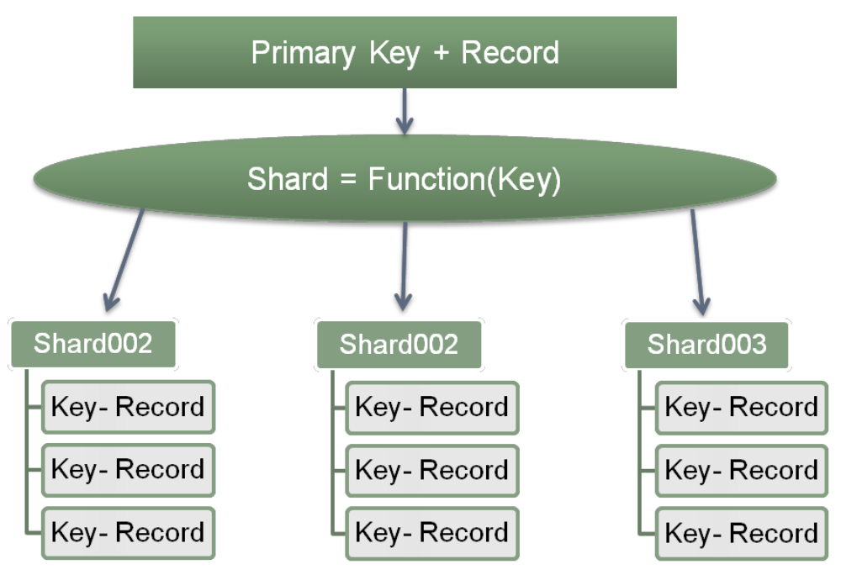
Horizontal Scaling
Sharding means NoSQL system can scale in horizontal crossing numbers of servers
Sharding enable date to be stored in different physical partitions and each isolated instance has its own data set on local disk
Sharding makes replication across different servers easy
Sharding alleviates search load by splitting it across multiple servers

Slide 5
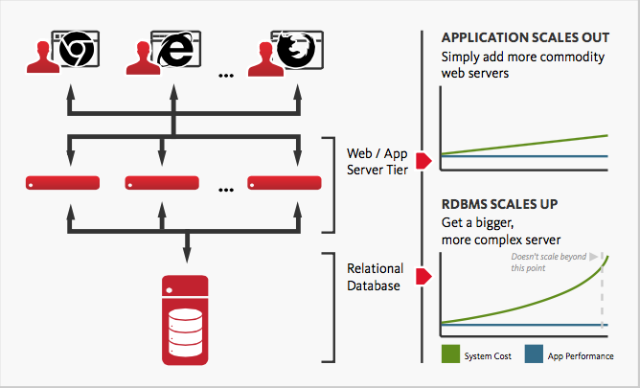
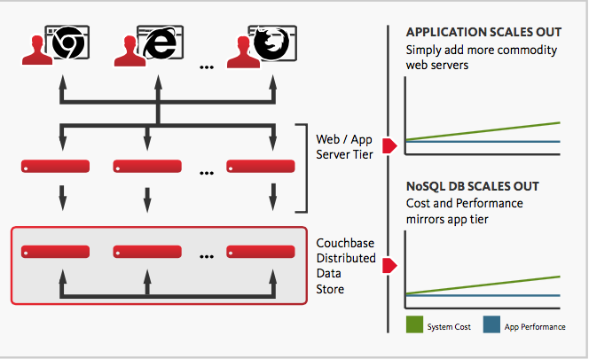
RDBMS vs NoSQL in Scaling
With relational databases, to support more users or store more data, you need a bigger server with more CPUs, more memory, and more disk storage
NoSQL databases provide a more linear, scalable approach to scaling than do relational databases

Slide 6
Types of NoSQL
Key-value stores: pairing keys to values, like hash table in computer programming
Graph stores: excel at dealing with interconnected data.
Column stores: store all of the data in a particular table’s row together
Document stores: store records as documents in XML or JSON format

Slide 7

Where NoSQL is Used?
Google : BigTable, LevelDB
LinkedIn : Espresso
Facebook : Cassandra
Twitter : Hadoop/Hbase, Cassandra
Netflix : SimpleDB, Hadoop/HBase
Amazon: Dynamo
GitHub: ElasticSearch

Slide 8
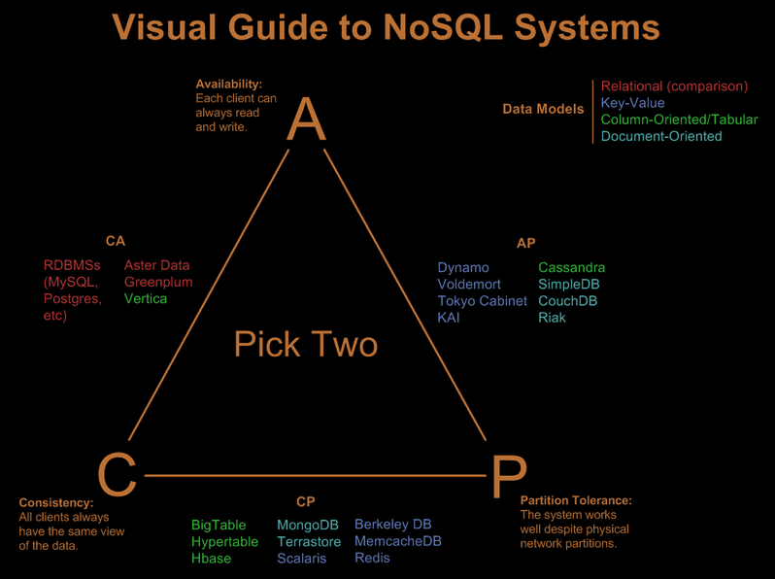
CAP Theorem there is no free lunch with distributed data
Only two of three features can be guaranteed according to CAP theorem
Consistency: the same view of the data always shown
Availability: database always can be read and written
Partition Tolerance: database works well across physical partitions

Slide 9
CAP Theorem in RDBMS & NoSQL
RDBMS: not support Partition
NoSQL: if we want Partition
Select either Consistency or Availability
Drop A-> need to wait until data is consistent
Drop C-> accept inconsistent data sometimes

Slide 10
RDBMS vs NoSQL choose the right tool for the right job
RDBMS
NoSQL
Pros | Cons
Rich Features | Hard Horizontal Scaling
Real-time Data Integrity | Not Flexible, Schema
Full Transaction | Low Throughput
SQL Complex Query | Not OO* Friendly
Good Documentation | Single Point of Failure
Pros | Cons
Easy Horizontal Scaling | Limited Features
Flexible, Schema-less | Late Data Integrity
High Throughput | Lack of Transaction
OO* Friendly | Simple Query(No Joins)
High Availability | Poor Documentation
OO: Object-Oriented

Slide 11
Reference
Brewer's CAP Theorem,By Julian Browne on January 11, 2009.
Why NoSQL, Counchbase
Why_NoSQL_IBM_Cloudant
Oracle NoSQL and SQL Introspective
NoSQL-Intro

