Slide 1
F.6 SP ENGLISH • 2013 DSE PART A
English SP
Terra-Cotta Warriors
in Color
a magazine feature article
TODAY’S lesson
10 Vocabulary items
9 Open-ended questions
(12 marks)
Open-ended questions
DSE 2013 Part A • Reading for marks
Notes:
Lesson 4. Title: DSE 2013 Paper 1 Part A — open-ended questions. Passage: Terra-Cotta Warriors in Color (Text 1).

Slide 2
WARM-UP • PAIR WORK
Key vocabulary: match the meanings
C
1. spectacle
____
A. a king who rules a large country (an empire)
E
2. buried
____
B. small broken pieces of something
A
3. emperor
____
C. an exciting show or scene that you watch
J
4. archaeologists
____
D. digging in the ground to find old things
B
5. fragments
____
E. put underground; covered with earth
I
6. warriors
____
F. small parts that are left over; remains
H
7. grandiose
____
G. good luck; finding something good by chance
G
8. serendipity
____
H. very grand and impressive; bigger than necessary
D
9. excavation
____
I. soldiers who fight in battles
F
10. remnants
____
J. scientists who study old things found in the ground
Notes:
Key: 1=C 2=E 3=A 4=J 5=B 6=I 7=H 8=G 9=D 10=F. One click reveals each answer letter.

Slide 3
Exam tips
Words that signal a reason — and where to look
Easy to spot
Easy to miss — watch out!
because, since, as, due to, thanks to, so that, to + verb, in order to
given + noun (“given the heat”) • with + noun (“with heavy rain”) • out of + noun (“out of fear”) • prompted by • driven by • in an attempt to • so as to • for fear of • in response to
Punctuation clues — read to the RIGHT of the mark
— / : the reason or explanation follows the mark • “ ” the speaker’s own words • ( ) ; extra information / two linked ideas
Remember: the answer usually sits right NEXT to the signal word.
Notes:
Teach: (1) question pattern, (2) hunt the signal word — easy-to-miss ones are the trap, (3) read to the right of — : ; “ ”.

Slide 4
Exam tips
Finding the purpose — read to the right of the mark
“Every day, Hong Kong restaurants throw away hundreds of tonnes of edible food. To fight this waste, a charity has launched a ‘surprise meal’ scheme: chefs collect leftover ingredients and turn them into three-course dinners sold for a sixth of the normal price — the aim is simple, to keep good food out of the landfill. ‘We are not a soup kitchen,’ says founder Grace Lam. ‘We are a rescue team.’ Customers pay what they can, and anyone who cannot pay eats for free.”
What is the purpose of the ‘surprise meal’ scheme?
• Colon after “scheme:” and dash after “normal price —” both introduce an explanation.
• Read right after the dash: “the aim is simple, to keep good food out of the landfill.”
• The opening phrase “To fight this waste” also tells you the aim — check the beginning of the paragraph too.
Model answer: To keep good food out of the landfill / to reduce the amount of edible food being wasted.
Notes:
Ask students to answer before clicking. Click 1 reveals the model answer. Demo (not from the exam paper): purpose question; colon + dash clues.

Slide 5
Exam tips
Finding the reason — spot the hidden word
“Every summer, the city’s Maritime Museum hosts a model-ship race for children. Families crowd the harbour wall to watch the race, which lasts only ten minutes — the real goal is to draw young visitors into the exhibition halls. Visitors who race a boat usually beg their parents for a second visit; given the museum’s modest entrance fee, few families refuse.”
According to the paragraph, why do few families refuse a second visit to the museum?
• The question asks for a REASON → hunt for a signal word you would normally skip over.
• “given the museum’s modest entrance fee” = “because the entrance fee is low” — an easy-to-miss reason signal.
• The semicolon links two ideas — read the second one for the reason.
Model answer: Because the museum’s entrance fee is low / modest.
Notes:
Ask students to answer before clicking. Click 1 reveals the model answer. Demo (not from the exam paper): reason question; skill = spotting the easily missed “given + noun” signal.

Slide 6
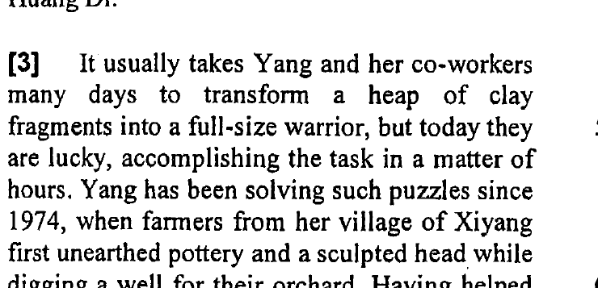
(70%)
QUESTION 1 OF 9
Read the paragraph — then write your answer
What does ‘the task’ (line 23) refer to?
Transforming / rebuilding a heap of clay fragments into a full-size warrior — reassembling an army of terra-cotta warriors.
Paragraph 3 (lines 20–23): “…many days to transform a heap of clay fragments into a full-size warrior, but today they are lucky, accomplishing the task in a matter of hours.” — “the task” looks back at the sentence before it: turning broken clay pieces into a whole warrior.
Notes:
Ask students to answer before clicking. Click 1 reveals the answer and the red circle on the proof. Click 2 reveals the explanation. Expected: rebuilding a full-size warrior from clay fragments. Ask: which words prove it?

Slide 7
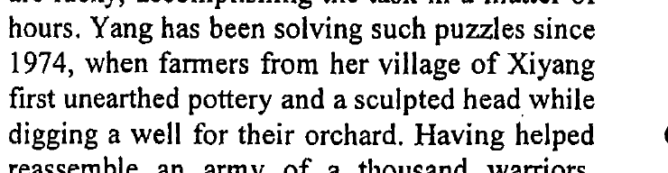
(47%)
QUESTION 2 OF 9
Read the paragraph — then write your answer
According to paragraph 3, what were the farmers doing when they first discovered the terra-cotta warriors?
They were digging a well (for their orchard).
Paragraph 3 (lines 24–27): “…when farmers from her village of Xiyang first unearthed pottery and a sculpted head while digging a well for their orchard.” — they found the warriors by accident while digging the well. “Digging” alone lost the mark.
Notes:
Ask students to answer before clicking. Click 1 reveals the answer and the red circle on the proof. Click 2 reveals the explanation. Expected: digging a well for their orchard. Trap: answer must say “a well”.

Slide 8
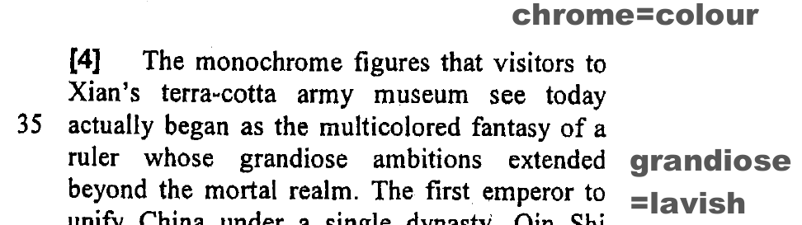
(37%)
QUESTION 3 OF 9
Read the paragraph — then write your answer
Find a word in paragraph 4 that means ‘not colorful’.
monochrome
Paragraph 4 (line 33): “The monochrome figures that visitors to Xian’s terra-cotta army museum see today…” — mono = one, chrome = colour (one colour) → not colorful.
Notes:
Ask students to answer before clicking. Click 1 reveals the answer and the red circle on the proof. Click 2 reveals the explanation. Expected: monochrome. Skill: word-building (mono = one).

Slide 9
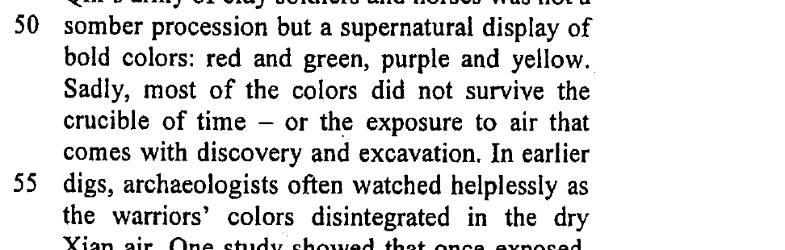
(83%)
QUESTION 4 OF 9
Read the paragraph — then write your answer
According to paragraph 5, why did the colors of the warriors not survive?
Because the colors were exposed to the (dry Xian) air and disintegrated.
Paragraph 5 (lines 51–56): “…most of the colors did not survive the crucible of time — or the exposure to air that comes with discovery and excavation. … the warriors’ colors disintegrated in the dry Xian air.” — exposure to the dry air made the colors flake off. Easiest question this lesson.
Notes:
Ask students to answer before clicking. Click 1 reveals the answer and the red circle on the proof. Click 2 reveals the explanation. Expected: exposed to dry Xian air → disintegrated. Why-question: quote the cause.

Slide 10
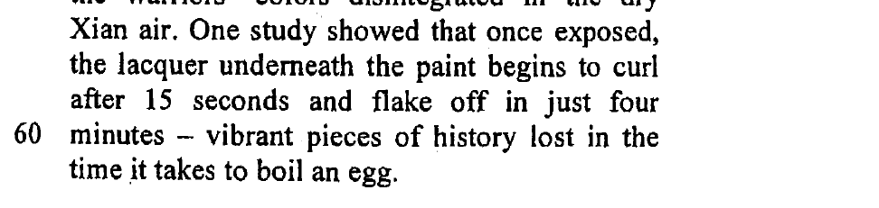
(38%)
QUESTION 5 OF 9
Read the paragraph — then write your answer
In line 61, the writer mentions boiling an egg to show…
…how quickly the paint begins to curl and flake off — vibrant pieces of history are lost in a very short time.
Lines 58–61: “…the lacquer underneath the paint begins to curl after 15 seconds and flake off in just four minutes — vibrant pieces of history lost in the time it takes to boil an egg.” — a boiled egg is ready in minutes; the paint disappears just as fast.
Notes:
Ask students to answer before clicking. Click 1 reveals the answer and the red circle on the proof. Click 2 reveals the explanation. Expected: how fast the paint flakes off. “To show” questions = writer’s intention.

Slide 11
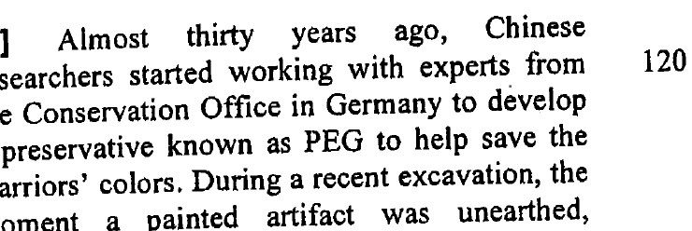
(40%)
QUESTION 6 OF 9
Read the paragraph — then write your answer
Who developed PEG (line 76)?
Chinese researchers (working together) with experts from the Conservation Office in Germany.
Paragraph 7 (lines 74–76): “…Chinese researchers started working with experts from the Conservation Office in Germany to develop a preservative known as PEG…” — BOTH groups developed it; one side only lost the mark.
Notes:
Ask students to answer before clicking. Click 1 reveals the answer and the red circle on the proof. Click 2 reveals the explanation. Expected: Chinese researchers + Conservation Office in Germany. Both sides needed.

Slide 12
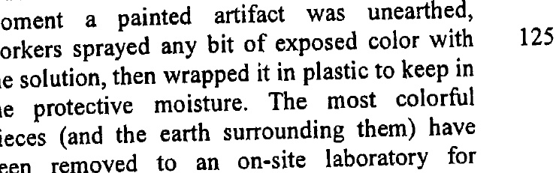
(74%)
QUESTION 7 OF 9
Read the paragraph — then write your answer
What is the purpose of wrapping the artifact in plastic?
To keep in the protective moisture / to keep the artifact wet / to protect it from the dry air.
Paragraph 7 (lines 79–81): “…workers sprayed any bit of exposed color with the solution, then wrapped it in plastic to keep in the protective moisture.” — purpose answers start with “to …” or “so that …”.
Notes:
Ask students to answer before clicking. Click 1 reveals the answer and the red circle on the proof. Click 2 reveals the explanation. Expected: to keep in the protective moisture. Purpose question → “to + verb”.

Slide 13
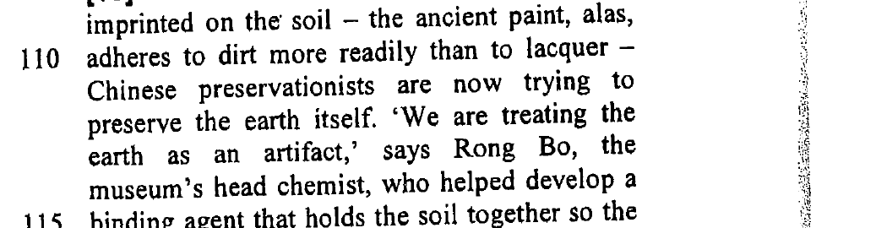
(28%)
QUESTION 8 OF 9
Read the paragraph — then write your answer
According to Rong Bo, why should the earth be treated like an artifact (lines 112–113)?
Because so much color and artistry has been imprinted on the soil — the ancient paint adheres to dirt more readily than to lacquer.
Paragraph 10 (lines 110–113): “…the ancient paint, alas, adheres to dirt more readily than to lacquer — … ‘We are treating the earth as an artifact,’ says Rong Bo…” — the soil itself holds the ancient paint. Hardest question this lesson (28%).
Notes:
Ask students to answer before clicking. Click 1 reveals the answer and the red circle on the proof. Click 2 reveals the explanation. Expected: the paint imprinted on the soil adheres to dirt more readily than to lacquer. Why-question: cause after the dash.

Slide 14
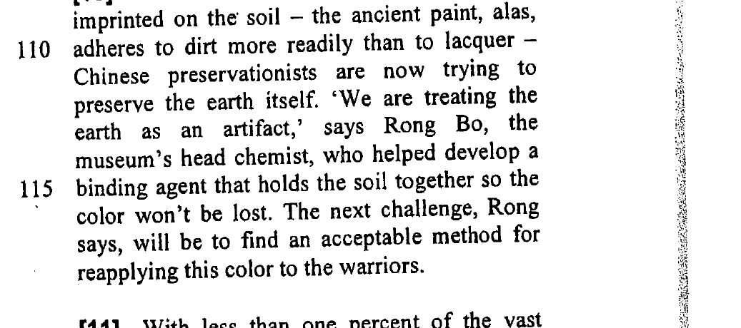
(47/62/63/63%)
QUESTION 9 OF 9
Read the paragraph — then write your answer
Based on the information in paragraph 10, complete the following text by writing ONE word to fill in each blank. You should make sure that your answers are grammatically correct, paying attention to word form, plurals, etc. (4 marks)
The next challenge for (i)________ is to (ii)________ a procedure for (iii)________ color to the warriors now that a (iv)________ has been developed to hold together the soil.
(i) Rong / chemists / researchers / scientists / experts / preservationists (ii) create / find / develop / discover / invent (iii) (re)applying (iv) binding agent
Paragraph 10 (lines 112–118): “…Rong Bo, the museum’s head chemist, who helped develop a binding agent that holds the soil together…. The next challenge, Rong says, will be to find an acceptable method for reapplying this color to the warriors.” — Blank (iv) is a singular noun: binding agent. Correct % per blank: 47 / 62 / 63 / 63.
Notes:
Ask students to answer before clicking. Click 1 reveals the answer and the red circle on the proof. Click 2 reveals the explanation. Expected: (i) Rong/chemists (ii) create/find (iii) reapplying (iv) binding agent. Check word form + plurals.

