Slide 1
F.6 SP ENGLISH • 2013 DSE PART B1
English SP
“Master teaches a much-loved instrument”
“What your updates say about you”
TODAY'S lesson
10 Vocabulary items
11 Open-ended questions
(12 marks)
Focus skill: metaphor & simile
Open-ended questions
DSE 2013 Part B1 • Reading for marks
Notes:
Lesson 5: DSE 2013 Paper 1 Part B1 open-ended questions. Warm-up vocabulary (10 difficult words), tips, 2 demo questions, then 11 open-ended questions (12 marks) in passage order.

Slide 2
WARM-UP • PAIR WORK
Key vocabulary: match the meanings
1 comprise Line 37
____
A. in a way that has the opposite result to the one you intended.
G
2 intake Line 56
____
B. by accident; without realising what you are doing.
E
3 tuition Line 34
____
C. active or happening at night.
I
4 posture Line 40
____
D. the position in which you hold your body when sitting or standing.
D
5 unwittingly Line 6
____
E. a group of people admitted at one time (e.g. a new class of students).
B
6 assumption Line 15
____
F. personal information that you reveal/make known to others.
H
7 disclosures Line 35
____
G. to consist of; to be made up of.
F
8 nocturnal Line 52
____
H. an idea that you accept as true without proof.
C
9 desperation Line 45
____
I. money paid for lessons; (also) teaching itself.
J
10 counterproductively Line 58
____
J. a feeling of hopelessness / a strong need that makes you act without thinking.
A
Match the 10 words to the definitions — write the letter in the blank.
Notes:
Key: 1-G, 2-E, 3-I, 4-D, 5-B, 6-H, 7-F, 8-C, 9-J, 10-A. Click to reveal each answer letter one at a time.

Slide 3
TIPS
Comparison questions — “Why is X compared to Y?”
The answer is the QUALITY the two things share — not the two things themselves.
SIMILE — the signal is written openly
• like · as … as · compared to · similar to
e.g. The pressure before the public exams weighed on her
shoulders like a mountain of lead.
→ the shared quality sits right next to the signal:
heavy — copy the quality, not the object
METAPHOR — the signal is hidden
• X IS Y — no “like” or “as” in the sentence
e.g. Landfills are ticking bombs that future generations
have to deal with.
→ what do the two things share? Both are
dangerous and will cause harm later
How to answer:
• What do the two things SHARE? They are both …
• Write the QUALITY (heavy · dangerous) — never just the object (a mountain · a bomb).
• Never write “because they are similar” — say HOW they are similar.
Let’s try two comparison questions — then the 12-mark exam questions.
Notes:
Comparison questions only: “Why is X compared to Y?” The answer is the shared quality.
Click 1 — SIMILE: the signal is written openly (like / as … as / compared to), so the quality sits next to it (busy).
Click 2 — METAPHOR: X IS Y, no like/as; the quality is often explained after the colon (slot machine → unpredictable rewards → addictive).
Click 3 — how to answer: ask what the two things share; write the QUALITY, not the object; never “because they are similar”.

Slide 4
EXAM TIPS
Simile — demo 1 (easy) · the signal is written openly
(demo — not from the examination paper)
The pressure before the public exams weighed on her shoulders like a mountain of lead.
Question: Why is the pressure compared to a mountain of lead?
Model answer: because the pressure felt very heavy / it weighed her down badly, like a mountain of lead
Notes:
HANDOUT EXAMPLE 1 — simile (the signal is written openly; Helen’s revised handout, Part B).
Ask the class to answer BEFORE clicking. Then click once to reveal the model answer.
Expected: because the pressure felt very heavy / it weighed her down badly, like a mountain of lead.
Teaching move: “like” marks the simile and the shared quality is HEAVY — students copy the quality (heavy), not the object (a mountain of lead).
This question is NOT from the exam paper, so Q10 is still a genuine test later.

Slide 5
EXAM TIPS
Metaphor — demo 2 (difficult) · the signal is hidden
(demo — not from the examination paper)
Landfills are ticking bombs that future generations have to deal with.
Question: Why are landfills compared to ticking bombs?
How to find it: no “like” or “as” — a metaphor says landfills ARE ticking bombs.
Ask what they share: both are dangerous and will cause serious harm later — the harm comes when we do nothing.
Model answer: because both are dangerous — they will cause serious harm later / if nobody deals with them now
Notes:
HANDOUT EXAMPLE 2 — metaphor (the signal is hidden; Helen’s revised handout, Part B).
Ask the class to answer BEFORE clicking. Click 1 reveals the “How to find it” strip; click 2 the model answer.
Expected: because both are dangerous — they will cause serious harm later / if nobody deals with them now.
Teaching move: a metaphor says X IS Y. Copying “ticking bombs” alone earns no mark — write what the two things SHARE.
This question is NOT from the exam paper — the exam’s own comparison (Q10) is kept for the 12-mark practice.

Slide 6
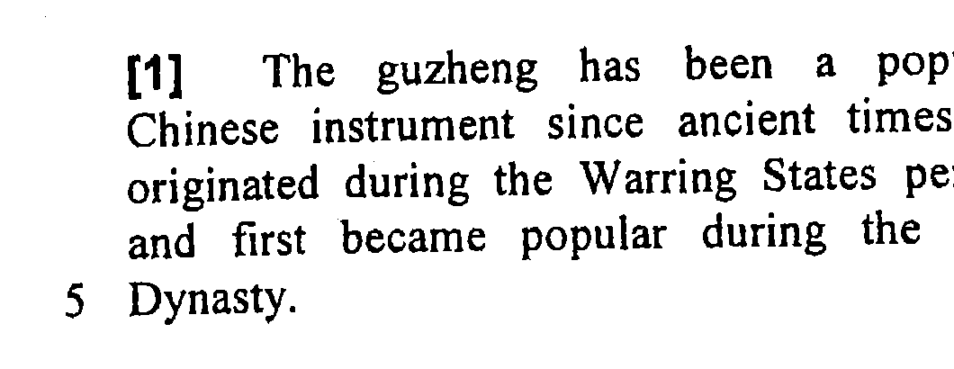
QUESTION 1 OF 11
(82%)
Read the paragraph — then write your answer
1. When did the guzheng become popular?
since ancient times // during the Qin Dynasty
Evidence & explanation
Text 2, ¶1: “a popular Chinese instrument since ancient times… first became popular during the Qin Dynasty.”
the answer is the TIME phrase — either reading is accepted.
(1 mark · 82%)
Notes:
Ask students to answer before clicking. Then click to reveal the answer and evidence.
Expected: since ancient times // during the Qin Dynasty.
Tip: the answer is the TIME phrase — either is accepted.

Slide 7
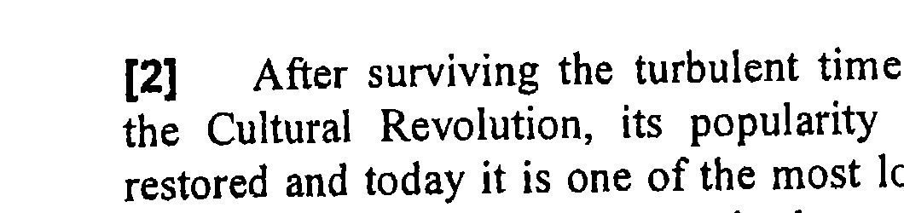
QUESTION 2 OF 11
(43%)
Read the paragraph — then write your answer
2. Find a word in paragraph 2 that means the same as “unstable”.
turbulent
Evidence & explanation
Text 2, ¶2: “After surviving the turbulent times of the Cultural Revolution…”
“turbulent times” = “unstable times” — check the spelling.
(1 mark · 43%)
Notes:
Ask students to answer before clicking. Then click to reveal the answer and evidence.
Expected: turbulent.
Tip: turbulent = unstable — check the spelling.

Slide 8
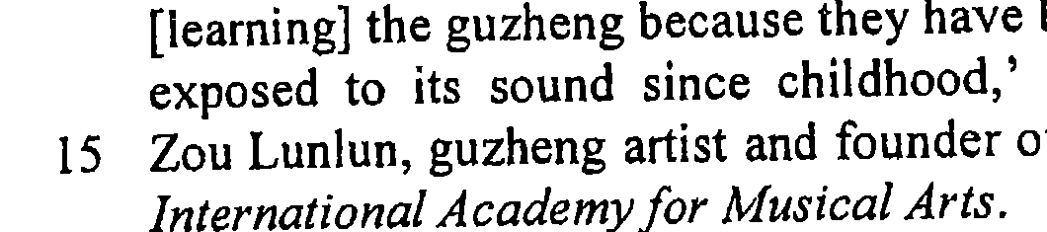
QUESTION 3 OF 11
(85%)
Read the paragraph — then write your answer
3. According to Zou Lunlun, why do Chinese people want to learn the guzheng?
they have been exposed to its sound since childhood
Evidence & explanation
Text 2, ¶3: “Chinese people are attracted to learning the guzheng because they have been exposed to its sound since childhood.”
“because” = reason signal — copy the full clause.
(1 mark · 85%)
Notes:
Ask students to answer before clicking. Then click to reveal the answer and evidence.
Expected: they have been exposed to its sound since childhood.
Tip: “because” = reason signal — copy the full clause.

Slide 9
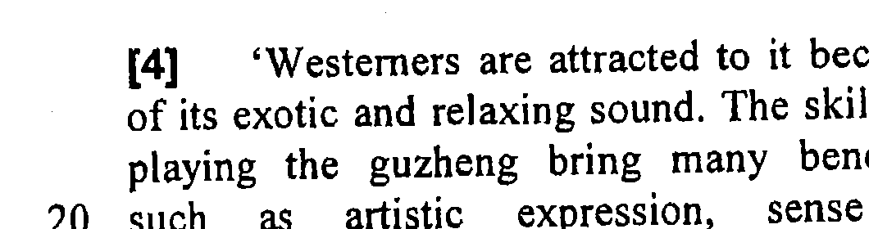
QUESTION 4 OF 11
(59%)
Read the paragraph — then write your answer
4. Use ONE word to complete each blank.
Zou believes Westerners like the guzheng because it sounds ______ and ______.
exotic / relaxing
Evidence & explanation
Text 2, ¶4: “…because of its exotic and relaxing sound.”
two blanks, one mark — BOTH words must be right.
(1 mark · 59%)
Notes:
Ask students to answer before clicking. Then click to reveal the answer and evidence.
Expected: exotic / relaxing.
Tip: two blanks, one mark — BOTH words must be right.

Slide 10
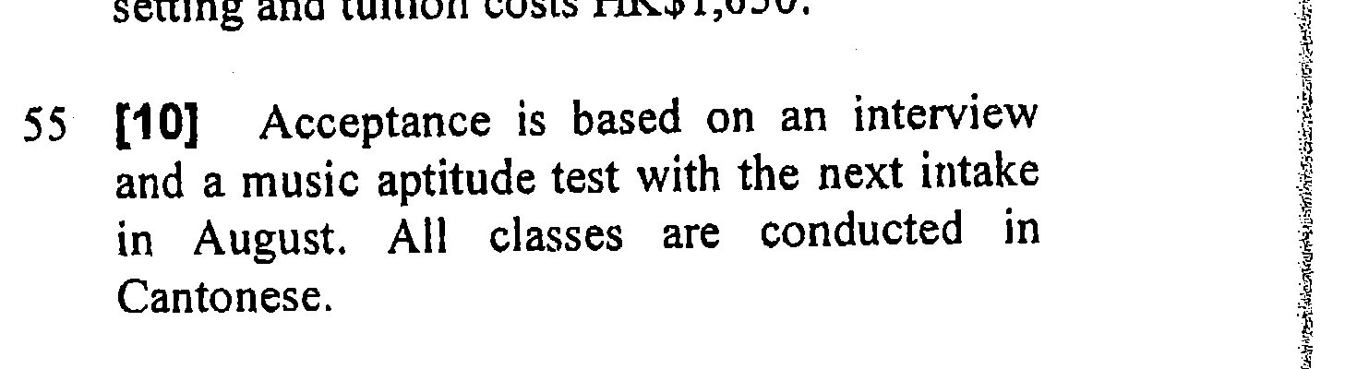
QUESTION 5 OF 11
(34%)
Read the paragraph — then write your answer
5. How does the Leisure and Cultural Services Department select students for their guzheng courses?
(passing an) interview and (taking a music aptitude) test
Evidence & explanation
Text 2, ¶10: “Acceptance is based on an interview and a music aptitude test with the next intake in August.”
TWO points — an interview AND a test — write both or lose the mark.
(1 mark · 34%)
Notes:
Ask students to answer before clicking. Then click to reveal the answer and evidence.
Expected: (passing an) interview and (taking a music aptitude) test.
Tip: TWO points — an interview AND a test — write both or lose the mark.

Slide 11
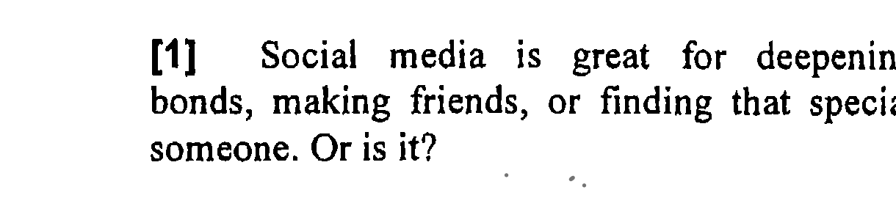
QUESTION 6 OF 11
(3%)
Read the paragraph — then write your answer
6. What does the first paragraph suggest about social media?
it questions whether social media is good // it isn’t always as good as we think
Evidence & explanation
Text 3, ¶1: “Social media is great for deepening bonds… Or is it?”
the rhetorical “Or is it?” flips the positive claim — the doubt IS the answer.
(1 mark · 3%)
Notes:
Ask students to answer before clicking. Then click to reveal the answer and evidence.
Expected: it questions whether social media is good // it isn’t always as good as we think.
Tip: the rhetorical “Or is it?” flips the positive claim — the doubt IS the answer.

Slide 12
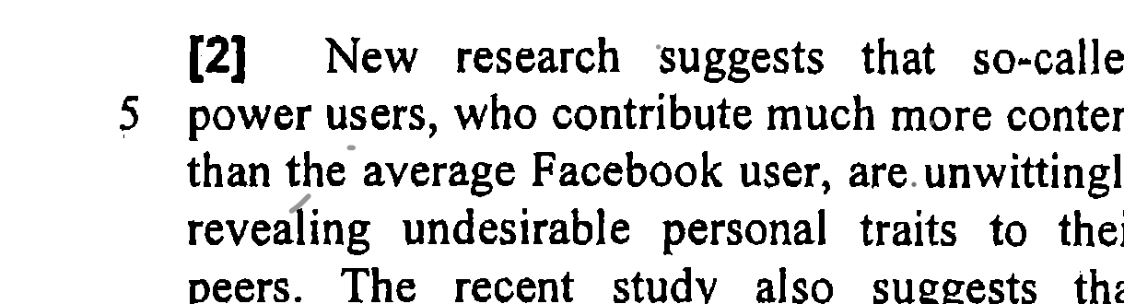
QUESTION 7 OF 11
(56%)
Read the paragraph — then write your answer
7. According to paragraph 2, what are some users doing by accident?
revealing undesirable personal traits (to their peers)
Evidence & explanation
Text 3, ¶2: “…power users… are unwittingly revealing undesirable personal traits to their peers.”
“by accident” = unwittingly — copy the phrase after it.
(1 mark · 56%)
Notes:
Ask students to answer before clicking. Then click to reveal the answer and evidence.
Expected: revealing undesirable personal traits (to their peers).
Tip: “by accident” = unwittingly — copy the phrase after it.

Slide 13
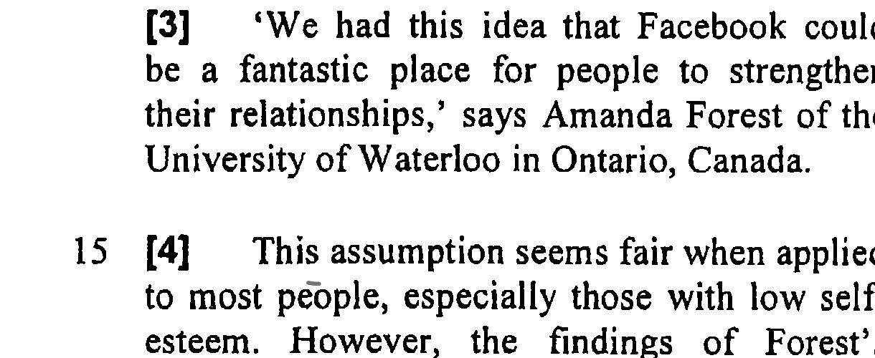
QUESTION 8 OF 11
(33%)
Read the paragraph — then write your answer
8. In line 15, “This assumption” refers to…
(the idea) that Facebook could be a fantastic place for people to strengthen their relationships
Evidence & explanation
“This assumption” points BACK to ¶3: “…Facebook could be a fantastic place for people to strengthen their relationships.”
reference words read backwards — copy the earlier idea.
(1 mark · 33%)
Notes:
Ask students to answer before clicking. Then click to reveal the answer and evidence.
Expected: (the idea) that Facebook could be a fantastic place for people to strengthen their relationships.
Tip: reference words (this / it / that) point backwards — copy the earlier idea.

Slide 14
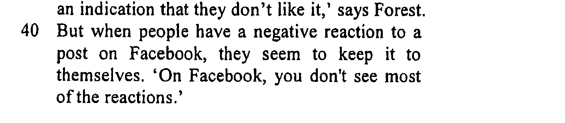
QUESTION 9 OF 11
(53%)
Read the paragraph — then write your answer
9. What does “it” (line 41) refer to?
a negative reaction
Evidence & explanation
Text 3, ¶8: “…a negative reaction to a post on Facebook, they seem to keep it to themselves.”
“it” points back to the noun before it: a negative reaction.
(1 mark · 53%)
Notes:
Ask students to answer before clicking. Then click to reveal the answer and evidence.
Expected: a negative reaction.
Tip: “it” points back to the noun before it: a negative reaction.

Slide 15
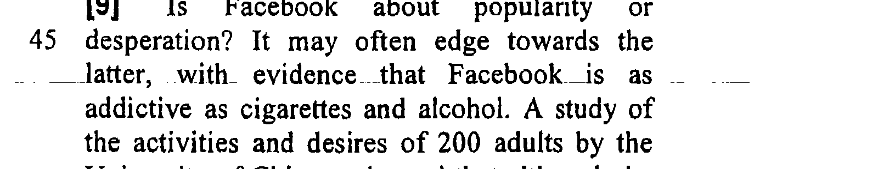
QUESTION 10 OF 11
(28%)
Read the paragraph — then write your answer
10. Why is Facebook compared to cigarettes and alcohol?
because it is (as) addictive as cigarettes and alcohol // it is an addiction
Evidence & explanation
Text 3, ¶9: “…evidence that Facebook is as addictive as cigarettes and alcohol.”
comparison question (see demos 1–2): the shared quality is the answer — addictive.
(1 mark · 28%)
Notes:
Ask students to answer before clicking. Then click to reveal the answer and evidence.
Expected: because it is (as) addictive as cigarettes and alcohol // it is an addiction.
Tip: metaphor & simile — the answer is the SHARED QUALITY (addictiveness), not the objects.

Slide 16
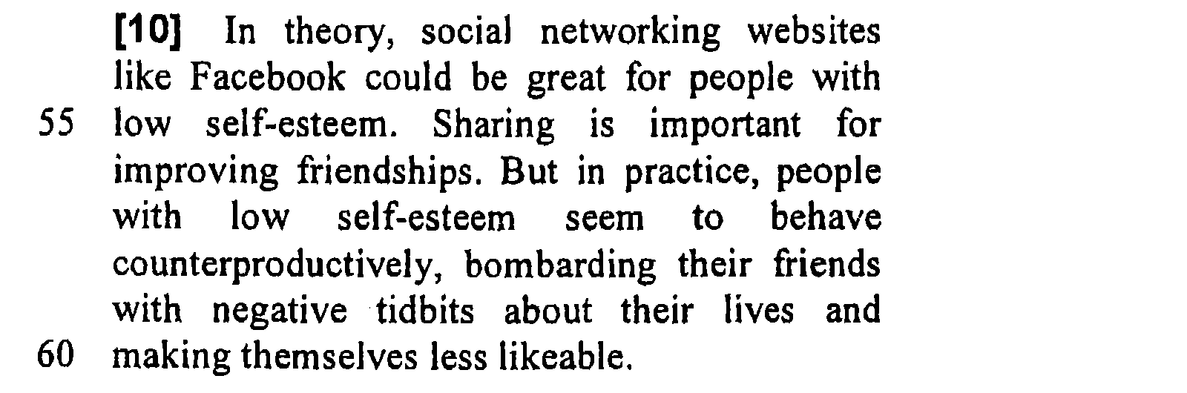
QUESTION 11 OF 11
(48% / 46%)
Read the paragraph — then write your answer
11. i) In what way could social networking websites help people with low self-esteem? ii) In what way can social networking websites be harmful to people with low self-esteem?
i) share things on Facebook // improve their friendships // build self-esteem
Evidence & explanation
Text 3, ¶10: “In theory… sharing… But in practice… bombarding their friends with negative tidbits… becoming less likeable.”
two parts = two marks — give the “In theory” idea AND the “But in practice” idea.
(2 marks · 48% / 46%)
ii) bombard friends with negative tidbits // become less likeable
Notes:
Ask students to answer before clicking. Then click to reveal the answer and evidence.
Expected: i) share things / strengthen friendships ii) bombard friends with negative tidbits / become less likeable.
Tip: two parts = two marks — give the “In theory” idea AND the “But in practice” idea.

