Slide 1
F.6 SP ENGLISH • 2013 DSE PART B2
English SP
The Triumph of Dystopian Literature
What’s behind the boom in dystopian fiction for young readers?
TODAY’S lesson
10 Vocabulary items
1 Exam tip — cloze questions
4 Demo questions
6 Exam questions (15 marks)
Cloze / gap-fill questions
DSE 2013 Part B2 • Text 4 “The Triumph of Dystopian Literature” • Reading for marks
Notes:
F.6 SP — Lesson 6: DSE 2013 Paper 1 Part B2 (Text 4, dystopian fiction).
This lesson focuses on CLOZE / gap-fill questions: 10 vocabulary items, one exam tip, 4 demos, then 6 real exam questions (15 marks).

Slide 2
WARM-UP • PAIR WORK
Key vocabulary: match the meanings
1 authoritarian Line 4
____
A. an imagined perfect world, in which everything is good.
I
2 oppressive Line 5
____
B. a set of three connected books, films or plays.
G
3 conform Line 45
____
C. making something more likely to happen; helpful for.
H
4 conducive Line 22
____
D. written to teach a moral lesson.
C
5 trilogy Line 25
____
E. the state of no longer existing; being completely destroyed.
B
6 cliff-hanger Line 52
____
F. an exciting ending that leaves readers unsure what happens next.
F
7 façade Line 93
____
G. treating people in a harsh and controlling way.
J
8 utopia Line 93
____
H. to behave in the same way as everyone else; to follow a fixed standard.
A
9 didactic Line 140
____
I. demanding total obedience; allowing no personal choice.
D
10 extinction Line 117
____
J. an outward appearance that hides the truth.
E
Match the 10 words to the definitions — write the letter in the blank.
Notes:
Vocabulary warm-up. Students match 1–10 to A–J in pairs, then click one letter at a time to confirm.
Answers: 1-I, 2-G, 3-H, 4-C, 5-B, 6-F, 7-J, 8-A, 9-D, 10-E.

Slide 3
TIPS
What helps you gain the mark?
Reminders for CLOZE (gap-fill) questions
1 Read the whole summary carefully
The summary is a PARAPHRASE of the text — the words around the blank are usually different.
The question tells you where to look: “Based on paragraph 3 …”.
2 Use the words around the blank to find the word class
a / an + ______ = noun a higher ______ = comparative + noun
more ______ = adjective was ______ by = past participle
shown ______ = adverb or preposition phrase
3 Hunt for the matching idea in the paragraph
warn us about the dangers of some current trend ↔ warn readers about today’s problems
quaint, outdated problems ↔ old-fashioned problems
4 Copy the EXACT word from the text — then check the form
ONE word per blank — if the text prints a fixed pair, the pair counts as one answer.
Keep the text’s form: -s, -ed, -ing, -er — and check the spelling.
Then read your completed sentence again — does it make sense, and is it grammatical?
Notes:
Teach the 4-step routine one card at a time (one click per card).
Then the check line: read the completed sentence again — sense + grammar.

Slide 4
EXAM TIPS
Cloze questions — 4 quick demos
(demo — taken from other paragraphs, NOT from the 6 questions you will do)
EASIER 1 · paragraph 6 (line 84)
EASIER 2 · paragraph 5 (lines 57–58)
At the start of a dystopian story, the fictional world may seem (i) ______ enough.
Dystopian novels for young-adult readers have been around for (i) ______.
(i) pleasant 1 mark
(i) decades — watch the plural -s! 1 mark
HARDER 1 · paragraph 9 (lines 141–143)
HARDER 2 · paragraph 7 (lines 110–117)
The Hunger Games could be taken as an (i) ______ of reality TV, but it is not an (ii) ______.
Sambell argues that the protagonist’s final defeat is (i) ______ to the admonitory nature of the classic adult dystopia, and that children’s authors are (ii) ______ to depict the extinction of hope.
(i) indictment (ii) argument 2 marks
(i) crucial (ii) reluctant 2 marks
1 word class → 2 find the paragraph → 3 copy the exact word → 4 check the form
Notes:
Do the two EASIER demos together, then the two HARDER ones. One click each to reveal the answer.
Demo 1: “may seem pleasant enough” → pleasant (straight lift).
Demo 2: “have been around for decades” → decades (the -s matters).
Demo 3: “an indictment of reality TV, but it is not an argument” → the words around the blanks fix the word class (an + noun).
Demo 4: “absolutely crucial to…” and “reluctant to depict…” — the two words sit far apart; scan the whole paragraph.

Slide 5
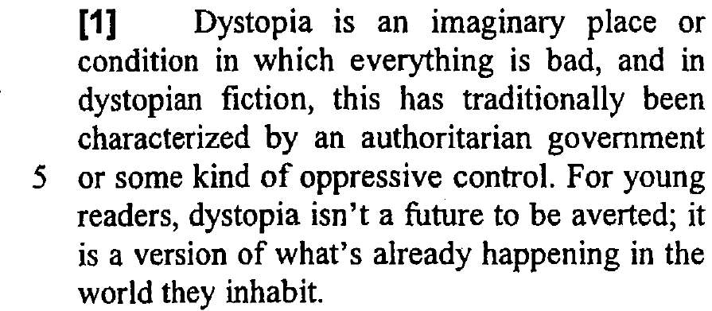
QUESTION 1 OF 6
(88%)
Read the paragraph — then write your answer
1. What does “it” (line 6) refer to?
dystopia
Evidence & explanation
Read backwards — find the noun before “it”
(1 mark · 88%)
Notes:
Ask students to answer before clicking. Then click once to reveal the answer and evidence.
Expected: dystopia. Tip: “it” refers back to the noun before it — “Dystopia is an imaginary place …”.

Slide 6
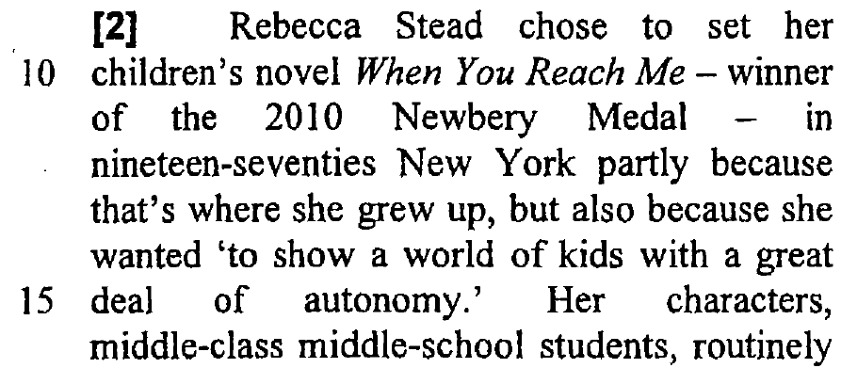
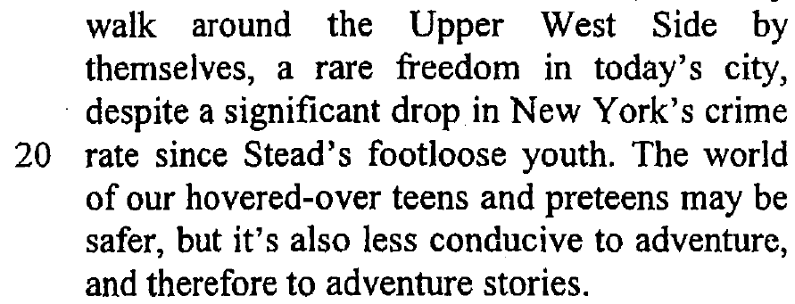
QUESTION 2 OF 6
(91 / 78 / 74 / 59 / 45%)
Read the paragraph — then complete the summary
2. Based on paragraph 2, complete the text with ONE word in each blank. (5 marks)
Check the grammar — word form, plurals etc.
The novel When You Reach Me takes place in New York City (NYC) where (i) ______ grew up. In the 1970s, NYC had a higher (ii) ______ , but children back then had more (iii) ______ . In contrast, NYC today is (iv) ______ yet children are more (v) ______ by their parents. As a result, children don’t walk the streets alone.
Evidence & explanation
Watch the FORM, not just the word: comparative -er · past participle -ed
(5 marks · 91 / 78 / 74 / 59 / 45%)
(i) Rebecca Stead
(ii) crime rate
(iii) freedom // autonomy // adventure
(iv) safer
(v) protected // controlled
Notes:
One blank at a time — ask the class for the word before each click. The proof oval appears with its answer.
Answers: (i) Rebecca Stead · (ii) crime rate · (iii) freedom // autonomy // adventure · (iv) safer · (v) protected // controlled.
Item %: 91 / 78 / 74 / 59 / 45. (iii) comes from “a great deal of autonomy” / “a rare freedom”; (v) from “hovered-over teens”.

Slide 7
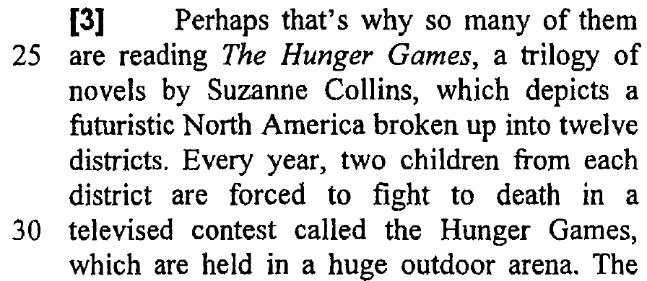
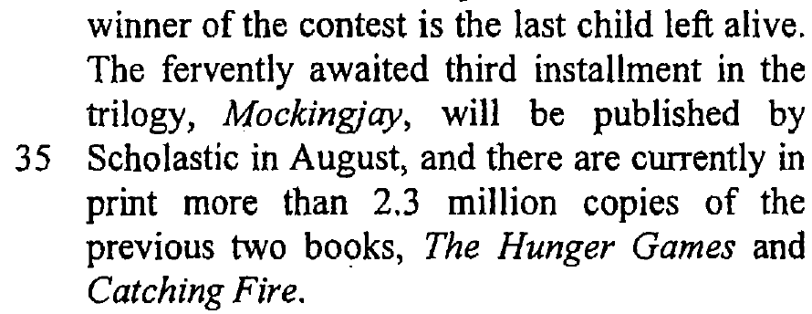
QUESTION 3 OF 6
(24 / 21 / 68 / 88 / 38 / 46%)
Read the paragraph — then complete the synopsis
3. Based on paragraph 3, complete the book synopsis with ONE word in each blank. (6 marks)
Check the grammar — word form, plurals etc.
The Hunger Games is the (i) ______ book in a trilogy of novels written by Suzanne Collins. The story takes place some time in the (ii) ______ . Two children from (iii) ______ district are forced to compete in the Hunger Games. The contest is held in an (iv) ______ and shown (v) ______ . The sole survivor (vi) ______ .
Evidence & explanation
The third book is Mockingjay — so this one is …?
(6 marks · 24 / 21 / 68 / 88 / 38 / 46%)
(i) first
(ii) future
(iii) each
(iv) outdoor arena
(v) on television // TV
(vi) wins // lives
Notes:
One blank at a time. Reveal the answer with its proof oval.
Answers: (i) first · (ii) future · (iii) each · (iv) outdoor arena · (v) on television / TV · (vi) wins // lives.
(i) is the hardest (24%): the text calls Mockingjay “the third installment”, so The Hunger Games is the first book. (ii) “futuristic North America”. (v) “televised contest”. (vi) “the last child left alive”.

Slide 8
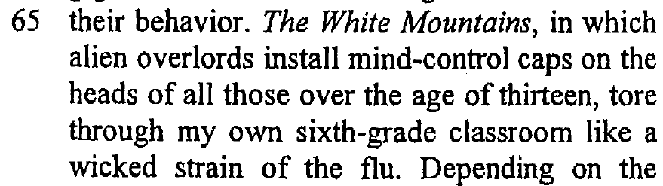
QUESTION 4 OF 6
(23%)
Read the paragraph — then write your answer
4. What does the simile “like a wicked strain of the flu” (lines 68–69) suggest about the book The White Mountains?
the interest in dystopian novels for young-adult readers spread very quickly // the book was infectious // it was popular / a big hit (among teens, among her classmates)
Evidence & explanation
What did the book do to her whole class?
(1 mark · 23%)
Notes:
Ask for the shared quality first: a flu spreads fast and hits everyone — so did the book.
Expected: the interest in dystopian novels for young-adult readers spread very quickly // the book was infectious // it was popular / a big hit.

Slide 9
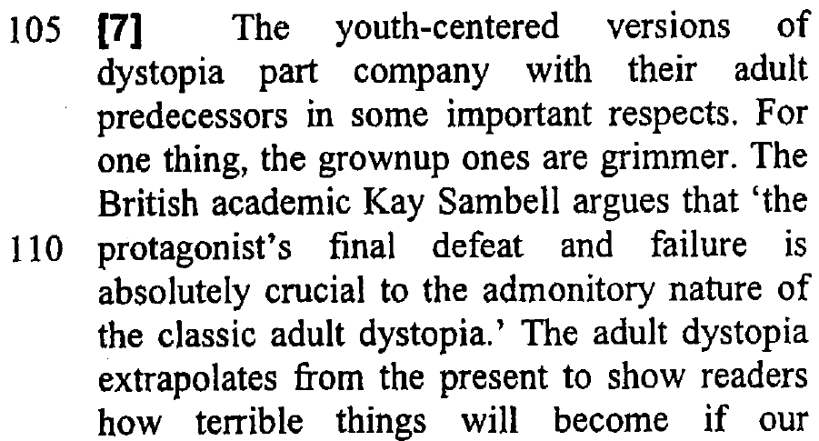
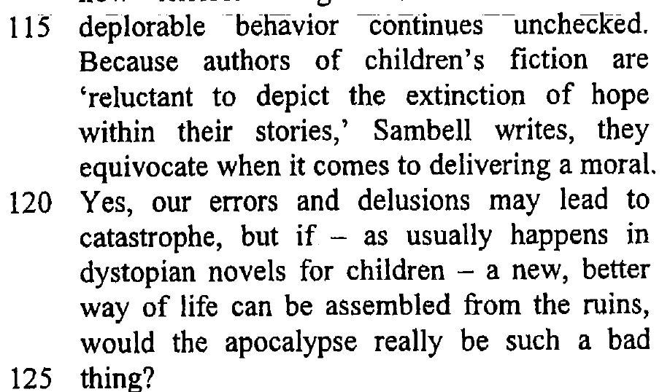
QUESTION 5 OF 6
(69%)
Read the paragraph — then write your answer
5. In paragraph 7, find a word which means “a major disaster”.
catastrophe // apocalypse
Evidence & explanation
Look for a NOUN — and do not write “disaster”
(1 mark · 69%)
Notes:
Word-finding question: the answer must be the word printed in paragraph 7 — “catastrophe” (line 121) or “apocalypse” (line 124).
Both are accepted; click to reveal the answer and circle the two words.

Slide 10
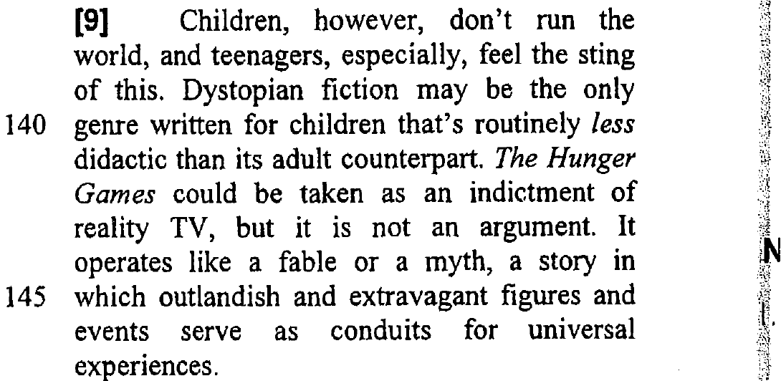
QUESTION 6 OF 6
(18%)
Read the paragraph — then write your answer
6. What does “this” (line 139) refer to?
children not having control in the world // (children) don’t run the world
Evidence & explanation
Read back to the subject of the paragraph
(1 mark · 18%)
Notes:
Reference question — the hardest item (18%). “feel the sting of this” points back to “Children, however, don’t run the world”.
Expected: children not having control in the world // (children) don’t run the world.

