Slide 1
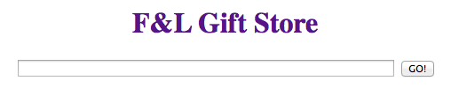
F&L Gift Store Show
By Feiyu Shi and Libby Ferland
11/25/2013

Slide 2
Features
Customer and employee registration and login
Name, email, password validation upon registration
Multiple keywords search engine; Browse items by category
Hide “add to basket” button on item pages when customer is not logged in
Featured item’s page with ratings and reviews
Manage an address book. add, edit, or delete an address

Slide 3
Features
Keep a record of payment methods. add, edit, or delete a card
Edit item quantity in the basket; remove the item from basket
Shipping address, payment method, and shipping method are prompted to be selected in order to complete an order
Live time on employee’s pages
Manager can set a promotion, or remove it
Automatically start a promotion when the period starts

Slide 4
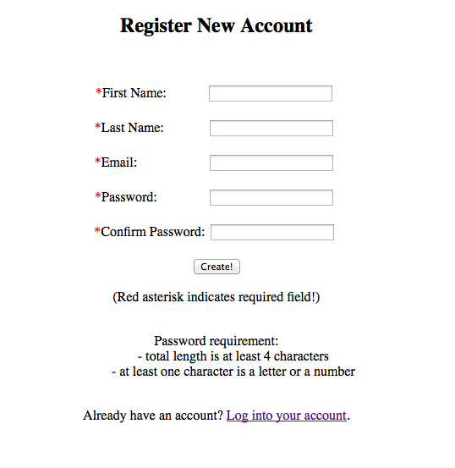
Customer Registration
Name, email, password validation

Slide 5
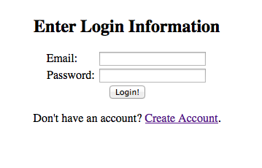
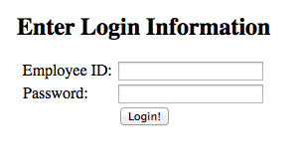
Login
Customer
Employee

Slide 6
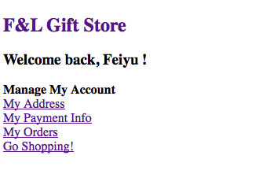
Customer Account Home
Address book, Payment info, Order history

Slide 7
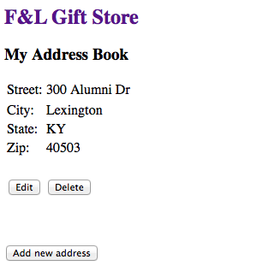
Address Book
Edit, Delete, Add

Slide 8
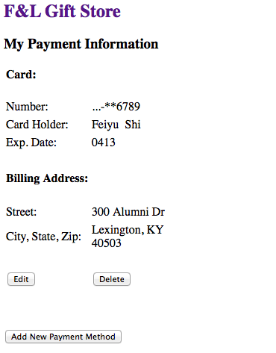
Payment Information
Edit, Delete, Add

Slide 9
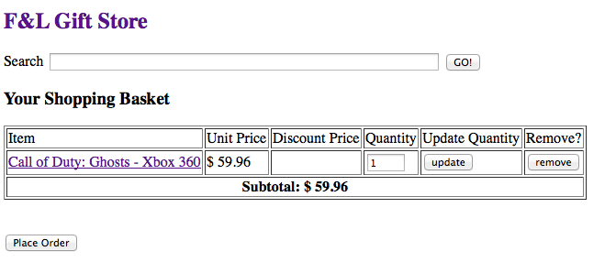
Basket
Item hyperlink, update quantity, remove button
Place order button

Slide 10
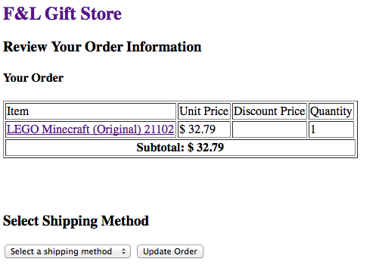
Order Review: Shipping Method
Regular, Two-Day Express, One-Day Overnight

Slide 11
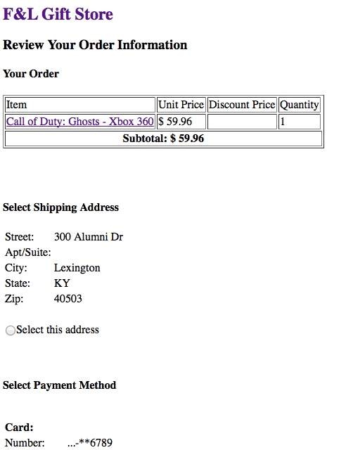
Order Review: Shipping Address, Payment
Select shipping address from address book; Select payment method;
Order now button

Slide 12
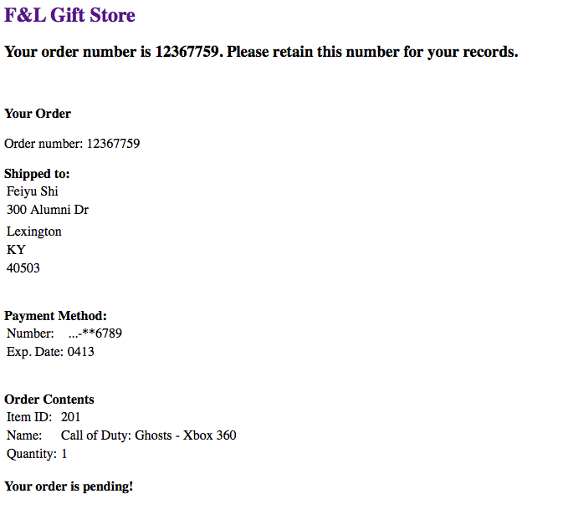
Order Confirmation
Pending orders

Slide 13
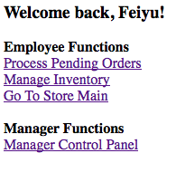
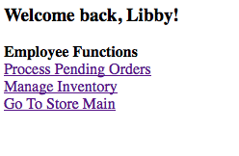
Employee Home
Staff View
Manager View

Slide 14
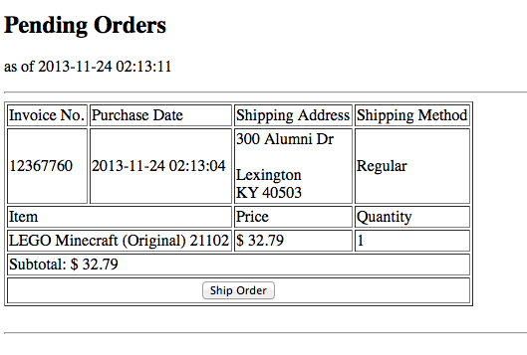
Pending Orders Processing
Ship button

Slide 15
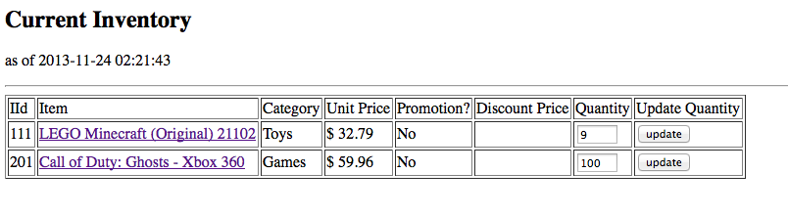
Manage Inventory
Update quantity

Slide 16
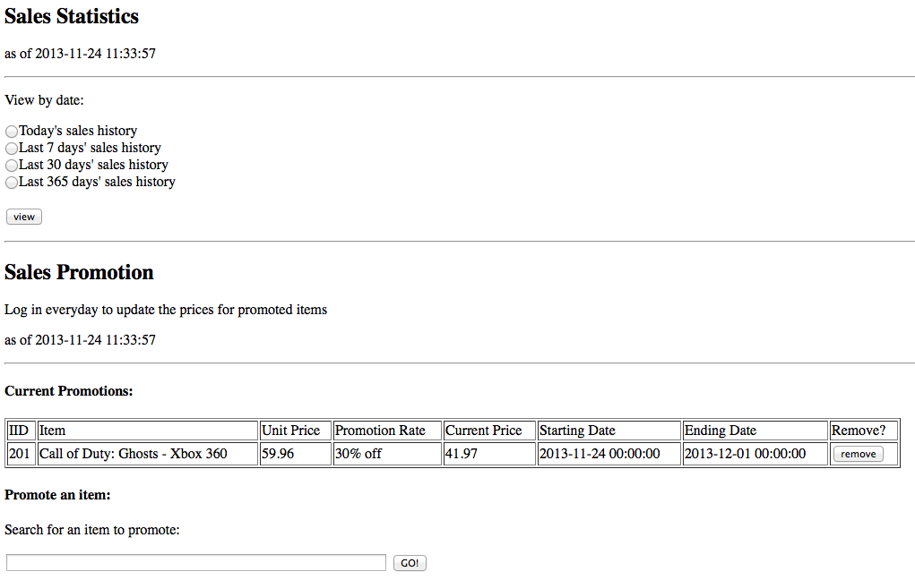
Manager Panel
Sales statistics, sales promotion

Slide 17
DEMO

