Slide 1
Advanced Battle
Trent Faris and Jeremy Hamilton

Slide 2
Requirements
Overall Description
Essential Requirements
Stretch Goals
UMLs

Slide 3
Overall Description
Goals of the game
A turn-based strategy game
Command an army that fights to take over the area of the opposing side.
Review the type of pieces
How players will play a game
AndEngine
based on GLES2

Slide 4
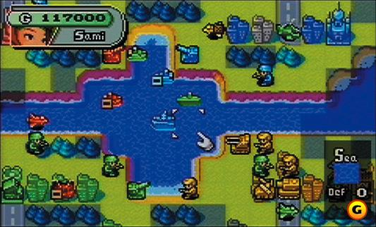
Overall Description

Slide 5
Essential Requirements
Traversable Map
Being able to interact with the game by using touch
Being able to go from start to finish on a local game.

Slide 6
Stretch Goals
Additional Pieces
Neo Tanks
Carrier Vehicles etc.
Media
Music
Action Scenes
Records and Battle History
Game Features
Special Army powers
Fog of War
Multiplayer over the internet

Slide 7
Diagrams
User Activities
Class Diagram
Scene Diagram

Slide 8
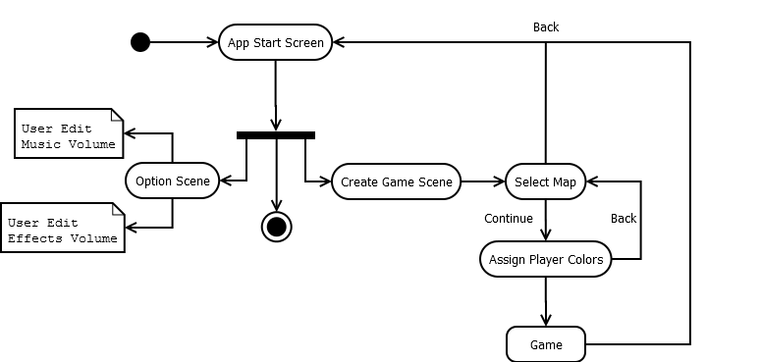
User Activities

Slide 9
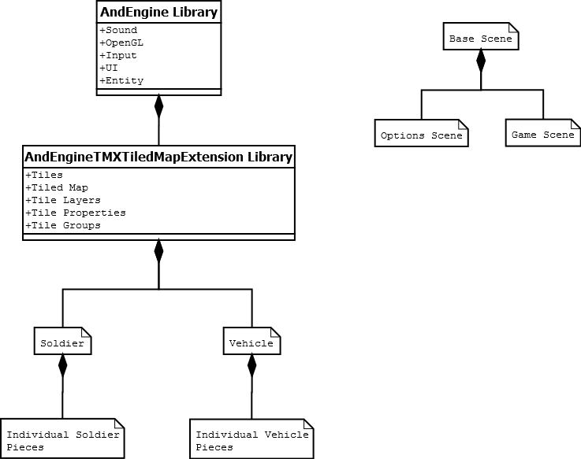
Class and Scene Diagram

Slide 10
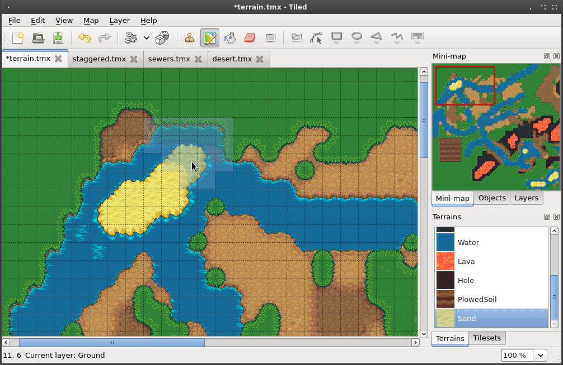
Tiled

Slide 11
Advanced Battle
Trent Faris and Jeremy Hamilton

