Slide 1
QRCode detection
黄文睿、张长贵、程立智

Slide 2
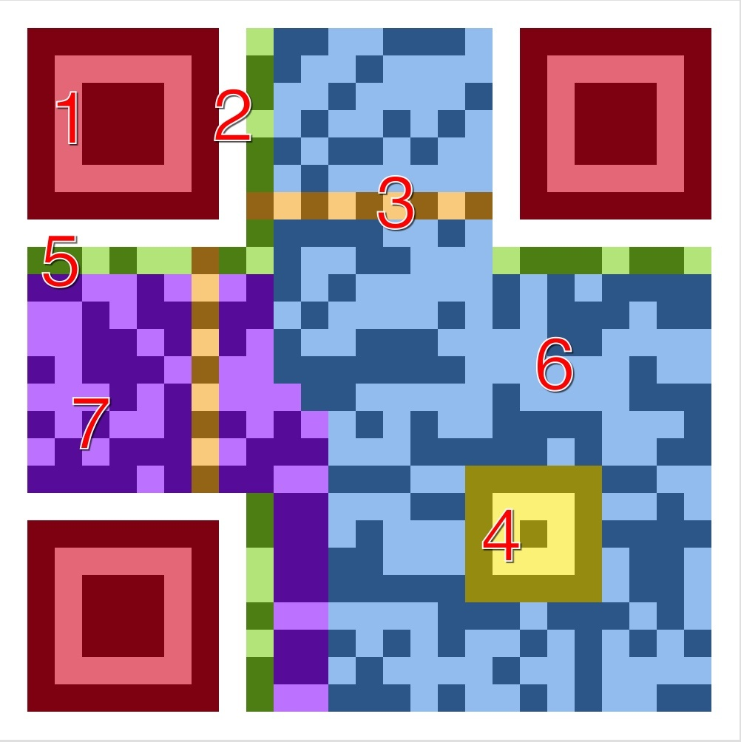
QRCode format
1 - Position Detection Pattern
2 – Separators
3 - Timing Pattern
4 - Alignment Patterns
5 - Format Information
6 - Data
7 - Error Correction

Slide 3
QRCode locating – find contour
bool VideoCapture::read(Mat& image)
Read images
void cvtColor(InputArray src, OutputArray dst,
int code, int dstCn=0 )
void GaussianBlur(InputArray src, OutputArray dst,
Size ksize, double sigmaX, double sigmaY=0,
int borderType=BORDER_DEFAULT )
Remove details
void Canny(InputArray image, OutputArray edges,
double threshold1, double threshold2,
int apertureSize=3, bool L2gradient=false )
void findContours(InputOutputArray image,
OutputArrayOfArrays contours,
OutputArray hierarchy,
int mode, int method, Point offset=Point())
Act!

Slide 4
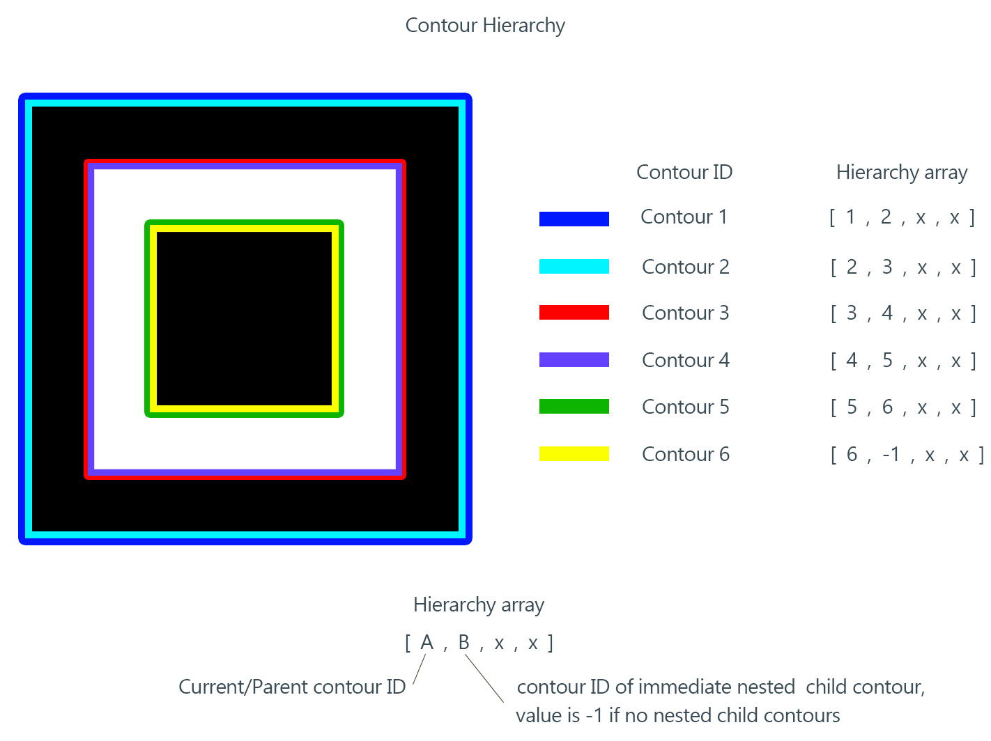
QRCode locating – find contour
Only level >= 5 needed!

Slide 5
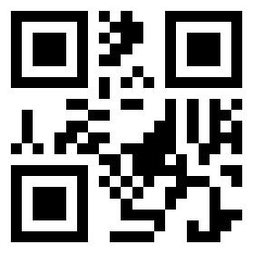
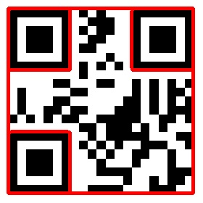
QRCode locating – looks nice

Slide 6

QRCode locating – problem
How?

Slide 7
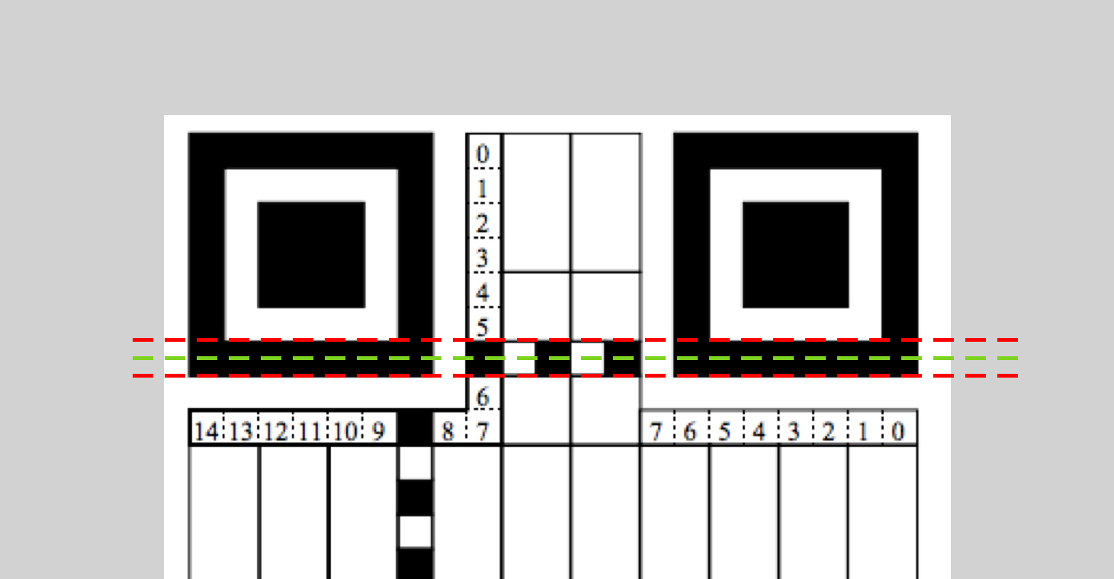
QRCode locating – timing pattern

Slide 8
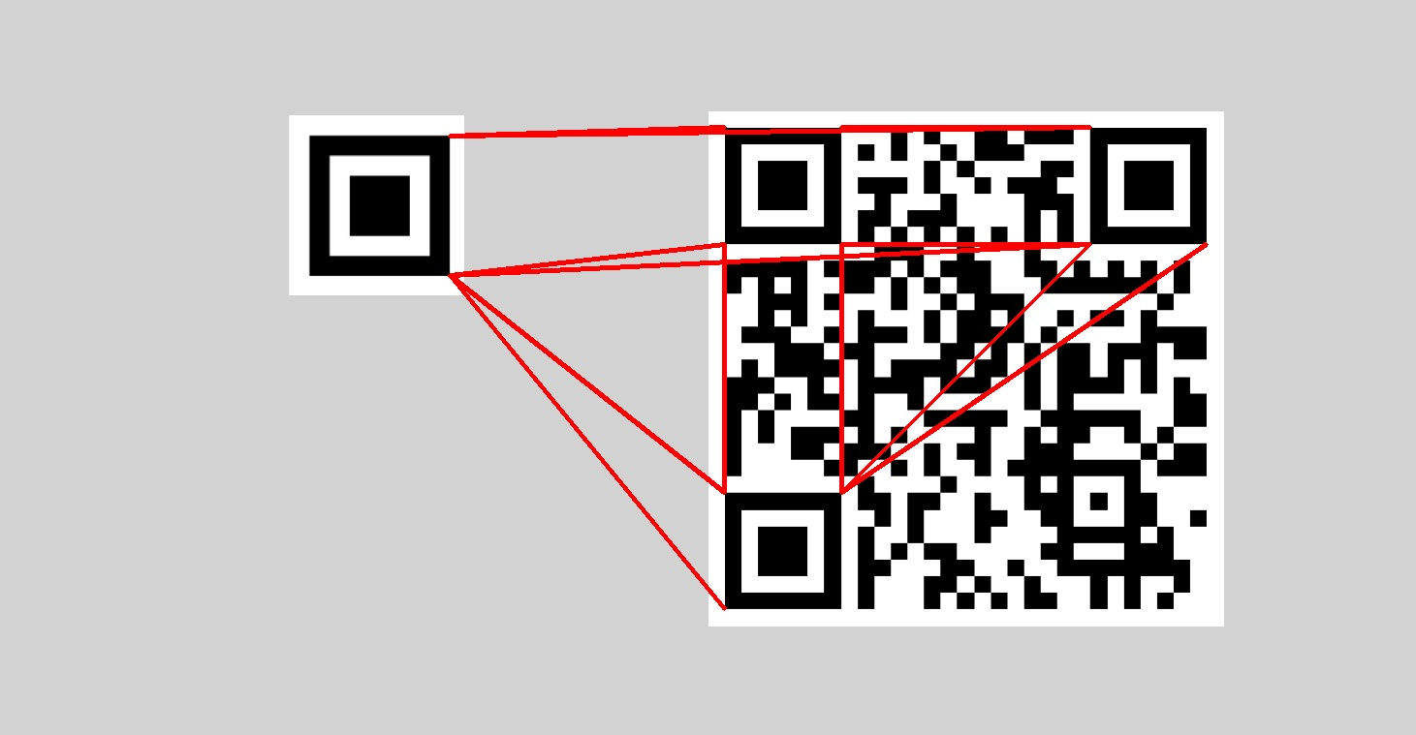
QRCode locating – timing pattern
All connections

Slide 9
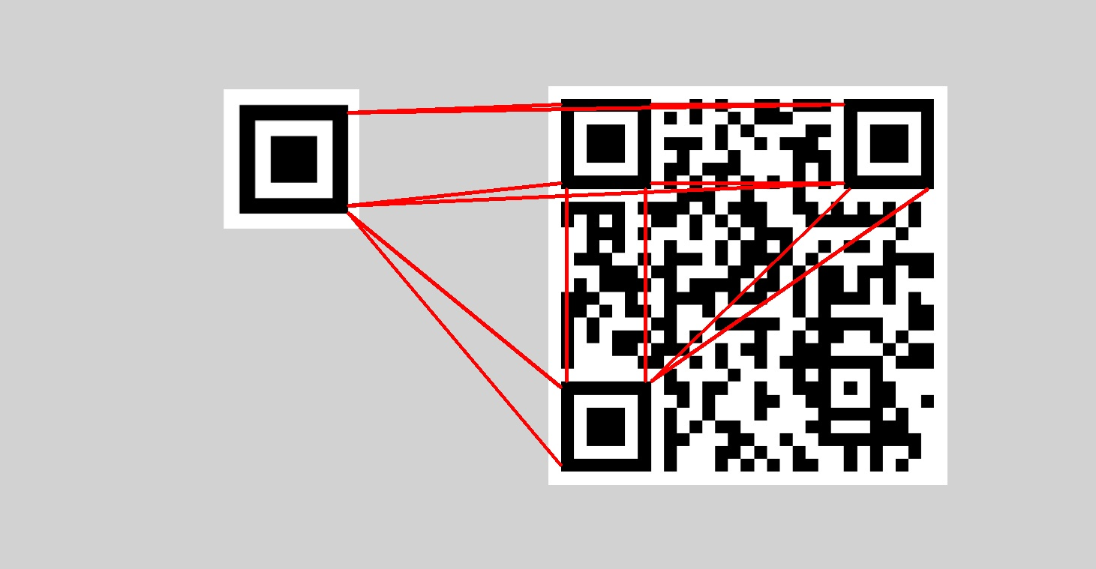
QRCode locating – timing pattern
Getting closer…

Slide 10
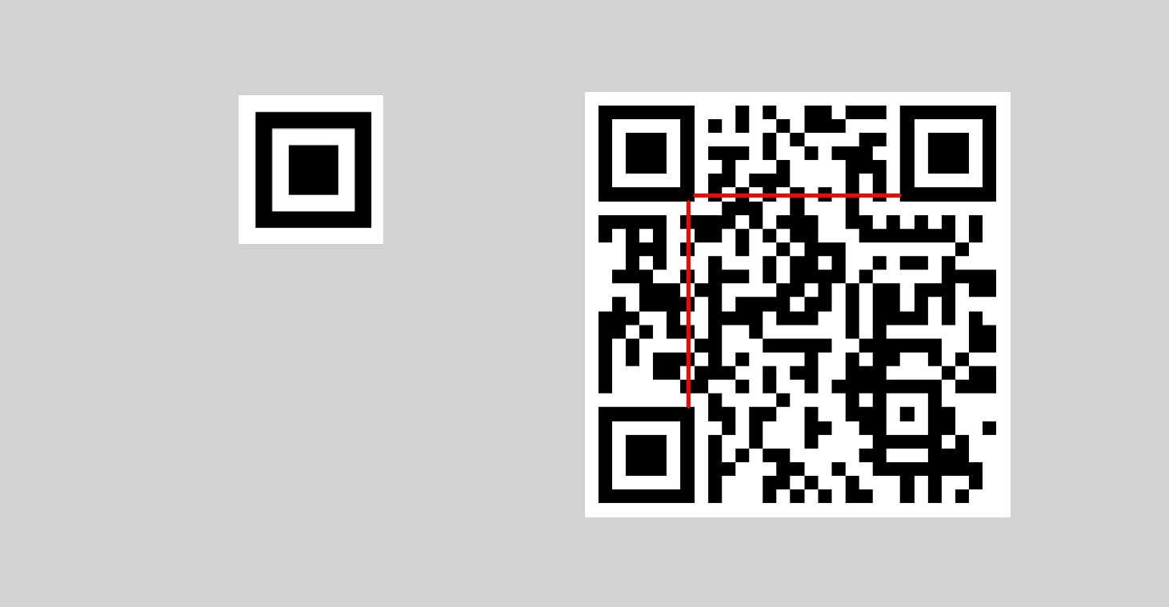
QRCode locating – timing pattern
Filtered

