Slide 1
A330
KneeBoard
VER. 25.1.15
☝️ Click for Update
by Flyingdeuk
Domestic
Japan
China
S.E Asia(GUM)
Supplement
FUEL Consumption
LP Aircon/ HP StartUnit
Cold Temp Correction
Cold Wx Operation
ENG ON Deicing | ENG OFFDeicing
Notes:
Kneeboard

Slide 2
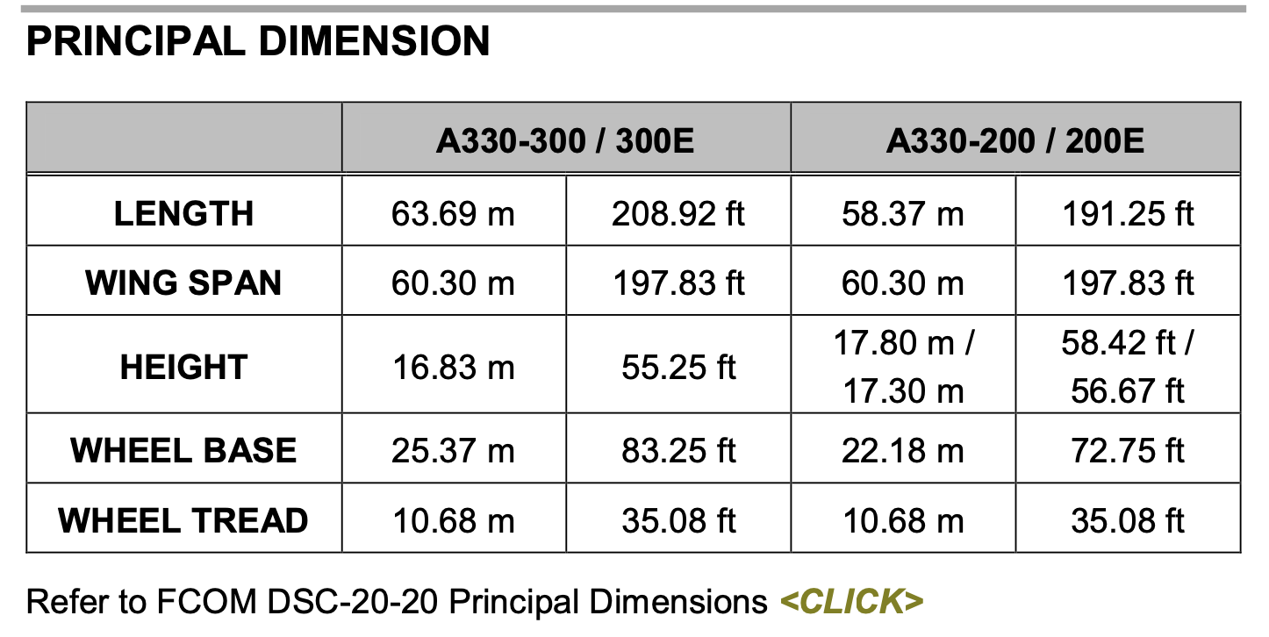
Differences (ATS A333)
A322(5) HL7524-7551 | APMS | EY 252 (151) EY 260 (156) | Total PAX 200 NOR CHK OFP PAX No HL 8026, 8027 PAX AUTO
A323(11) HL7553-7720
A223E(3) HL82xx | APMS -2.5 | EY 188 (112)
A323E(6) HL80xx | APMS -1.5 | EY 248 (148) HL8001 RNP AR X
ENG START |  | HL7xxx 43-48% | HL8xxx 52-54%
WINGSPAN : ICAO E, FAA V
Weight CAT : Heavy
180 Back 72도 48m/(157ft)
MTOW
238T | 524,700 lbs | 230T | 507,063 lbs
217T | 468,402 lbs | 198T | 436,515 lbs
192T | 423,287 lbs
Home

Slide 3
Domestic
GMP | CJU
GMP | PUS
CJU | PUS
ICN | PUS
Welcome PA
Next Page
Home
Notes:
Dometic

Slide 4
WELCOME PA
손님 여러분, 안녕하십니까? 저는 여러분을 모시고 가는 기장 ___입니다. 저희 대한항공을 이용해 주셔서 대단히 고맙습니다. ___ (국제)공항까지 비행시간은 ___시간 ___분 으로 예상됩니다. 비행 중에는 항공기가 갑자기 흔들릴 수도 있으니, 자리에 않아 계실 때에는 항상 좌석벨트를 매주시기 바랍니다. (저희 승무원 모두는) 저는 여러분을 안전하게 모시기 위해 최선을 다하겠습니다. 고맙습니다.
Good morning (afternoon /evening), ladies and gentlemen. This is captain last name speaking. Welcome aboard Korean Air. This flight is bound for ___(international) airport and our flight time is ___ hours(s) and minutes. For your safety, keep your seatbelts fastened while you are seated. Thank you for choosing Koreanair. Please enjoy your flight.
Domestic
GMP | 서울/김포국제
ICN | 서울/인천국제
CJU | 제주국제
PUS | 부산/김해국제
Home
Domestic
도착 방송 Next Page
Notes:
Domestic PA

Slide 5
도착 방송 (5시간이상, 40분전) 출발지 기준 2200-0800 Quiet Hour
손님 여러분, 저는 기장입니다. 우리 비행기는 앞으로 약 (40)분 후에 ___국제공항에 착륙 예정입니다. 현재 공항의 날씨는 ◐___, 기온은 섭씨 __도 입니다.
◐ 맑으며 ◐ (다소)흐리며 ◐ (이슬)비가 내리며/소나기가 내리며 ◐ 바람이 불고 있으며 |  | ◐ 눈이 오고 있으며 ◐ 안개가 끼어 있으며 ◐ 황사가 있으며
지금 이곳의 시각은 __월 __일 __요일, 오전(오후) __시 __분 입니다. 고맙습니다.
Ladies and gentlemen, this is the captain speaking. We expect to land at __ international airport in about (40) minutes. The current temperature at ___ is __ degrees Celsius, or __ degrees Fahrenheit (NAVBLUE 참조) and it is ◐___.
◐ (mostly) clear ◐ (partly) cloudy ◐ drizzling / raining ◐ windy | ◐ snowing ◐ foggy ◐ hazy or smoggy
The current time is __ : __ a.m(p.m), on (day-of-the-week), (month)(date). Thank you for flying with us today.
Domestic

Slide 6
Japan
GMP | KIX
ICN | KIX
ICN | NRT
ICN | CTS
ICN | HND
ICN | NGO
ICN | FUK
ICN | AOJ
ICN | KIJ
CJU | NRT
Home

Slide 7
WELCOME PA
손님 여러분, 안녕하십니까? 저는 여러분을 모시고 가는 기장 ___입니다. 저희 대한항공을 이용해 주셔서 대단히 고맙습니다. ___ (국제)공항까지 비행시간은 ___시간 ___분 으로 예상됩니다. 비행 중에는 항공기가 갑자기 흔들릴 수도 있으니, 자리에 않아 계실 때에는 항상 좌석벨트를 매주시기 바랍니다. (저희 승무원 모두는) 저는 여러분을 안전하게 모시기 위해 최선을 다하겠습니다. 고맙습니다.
Good morning (afternoon /evening), ladies and gentlemen. This is captain last name speaking. Welcome aboard Korean Air. This flight is bound for ___(international) airport and our flight time is ___ hours(s) and minutes. For your safety, keep your seatbelts fastened while you are seated. Thank you for choosing Koreanair. Please enjoy your flight.
Japan
KIX | 오사카/간사이
HND | 도쿄/하네다
NRT | 도쿄/나리타
CTS | 삿포로/신(New) 치토세
NGO | 나고야/주부(Chubu Centrair)
FUK | 후쿠오카
AOJ | 아오모리
KIJ | 니가타
Japan

Slide 8
China
GMP | SHA
GMP | PEK
CJU | PEK
PUS | PVG
ICN | NKG
ICN | TAO
ICN | PEK
ICN | SHE
ICN | PVG
ICN | YNJ
ICN | HGH
ICN | WHE
ICN | XIY
ICN | CSX
ICN | HKG
ICN | TSN
ICN | CGO
ICN | DYG
ICN | DLC
ICN | HFE
ICN | KMG
ICN | MFM
H
O
M
E

Slide 9
WELCOME PA
손님 여러분, 안녕하십니까? 저는 여러분을 모시고 가는 기장 ___입니다. 저희 대한항공을 이용해 주셔서 대단히 고맙습니다. ___ (국제)공항까지 비행시간은 ___시간 ___분 으로 예상됩니다. 비행 중에는 항공기가 갑자기 흔들릴 수도 있으니, 자리에 않아 계실 때에는 항상 좌석벨트를 매주시기 바랍니다. (저희 승무원 모두는) 저는 여러분을 안전하게 모시기 위해 최선을 다하겠습니다. 고맙습니다.
Good morning (afternoon /evening), ladies and gentlemen. This is captain last name speaking. Welcome aboard Korean Air. This flight is bound for ___(international) airport and our flight time is ___ hours(s) and minutes. For your safety, keep your seatbelts fastened while you are seated. Thank you for choosing Koreanair. Please enjoy your flight.
China | China
SHA | 상하이/홍차오
NKG | 난징/루커우
TAO | 칭다오/자오동
PEK | 베이징/소우뚜(Capital)
SHE | 선양/탸오쎈
PVG | 상하이/푸동
YNJ | 옌지
HGH | 황저우/샤오산
WHE | 웨이하이/따쉐이푸오
XIY | 시안/시엔양
CSX | 창사/후앙후아
HKG | 홍콩
TSN | 톈진/빈하이
CGO | 정저우
DYG | 장자제/허화
DLC | 다롄/쪼우쑤이쯔
HFE | 허페이/신치아오
KMG | 쿤밍/창쉐이
MFM | 마카오
C
H
I
N
A

Slide 10
S.E Asia
ICN | CXR
ICN | SGN
ICN | PNH
ICN | MNL
ICN | RMQ
ICN | TPE
PUS | TPE
ICN | GUM
PUS | BKK
Welcome PA
Next Page
Home

Slide 11
WELCOME PA
손님 여러분, 안녕하십니까? 저는 여러분을 모시고 가는 기장 ___입니다. 저희 대한항공을 이용해 주셔서 대단히 고맙습니다. ___ (국제)공항까지 비행시간은 ___시간 ___분 으로 예상됩니다. 비행 중에는 항공기가 갑자기 흔들릴 수도 있으니, 자리에 않아 계실 때에는 항상 좌석벨트를 매주시기 바랍니다. (저희 승무원 모두는) 저는 여러분을 안전하게 모시기 위해 최선을 다하겠습니다. 고맙습니다.
Good morning (afternoon /evening), ladies and gentlemen. This is captain last name speaking. Welcome aboard Korean Air. This flight is bound for ___(international) airport and our flight time is ___ hours(s) and minutes. For your safety, keep your seatbelts fastened while you are seated. Thank you for choosing Koreanair. Please enjoy your flight.
S.E Asia | 상하이/홍차오
CXR | 베트남 나짱(Nha Trang)/깜라인
SGN | 베트남 호찌민/탄소넛
PNH | 캄보디아 프놈펜
MNL | 필리핀 마닐라/니노이 아키노
TPE | 타이완/타이페이 타오유엔
RMQ | 타이완/타이중 칭찬강
PGUM | 괌
BKK | 방콕/수완나폼
SE Asia
도착 방송 Next Page

Slide 12
도착 방송 (5시간이상, 40분전) 출발지 기준 2200-0800 Quiet Hour
손님 여러분, 저는 기장입니다. 우리 비행기는 앞으로 약 (40)분 후에 ___국제공항에 착륙 예정입니다. 현재 공항의 날씨는 ◐___, 기온은 섭씨 __도 입니다.
◐ 맑으며 ◐ (다소)흐리며 ◐ (이슬)비가 내리며/소나기가 내리며 ◐ 바람이 불고 있으며 |  | ◐ 눈이 오고 있으며 ◐ 안개가 끼어 있으며 ◐ 황사가 있으며
지금 이곳의 시각은 __월 __일 __요일, 오전(오후) __시 __분 입니다. 고맙습니다.
Ladies and gentlemen, this is the captain speaking. We expect to land at __ international airport in about (40) minutes. The current temperature at ___ is __ degrees Celsius, or __ degrees Fahrenheit (OPT 참고) and it is ◐___.
◐ (mostly) clear ◐ (partly) cloudy ◐ drizzling / raining ◐ windy | ◐ snowing ◐ foggy ◐ hazy or smoggy
The current time is __ : __ a.m(p.m), on (day-of-the-week), (month)(date). Thank you for flying with us today.
SE Asia

Slide 13

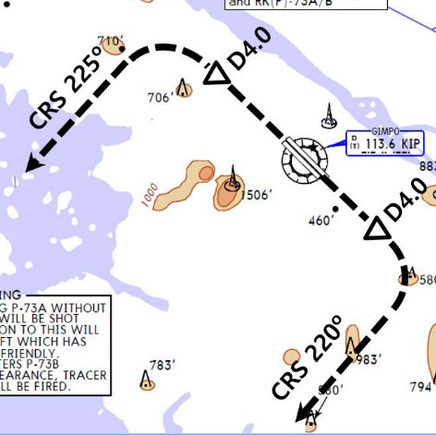
RKSS(GMP) 59ft | RKPC(CJU) 119ft
KE GMP 131.15 DCL -15분 가능 TOBT 5분 차이시 CTC Comm | KE CJU 129.4
PA
Rwy 32R Takeoff
(06:00L~0900L / 12:00L~15:00L /18:00L~21:00L)
GMP : NADP FX-10도, CLB, CONF 1+F, Acc 4000ft
32L/R | BULTI xT | 324 | 5000 |  | Modify NADP
 | (BULTI xQ)
14L/R | BULTI xU | 144 | 6000
 | (BULTI xZ)
KIP 113.6 | 32L IKMO 108.3 | 32R ISKP 110.7 | 14L ISEL 109.9 | 14R IOFR 108.7
FIX | 32L/R : EO32L/R, R225, YJU R271 | 14L/R : EO14L/R, R220, P73 /2
Domestic
CJU : STAR AFT Merge PT(220kts) DCT IAF(210kts), FAF (160kts)
ILS Z 07 | DOTOL xP |  | YUMIN | DOTOL 160
RNP Y 07 (No LPV), RNP Z 07 AR (RNP 0.11)
ILS Z 25 | DOTOL xT(xM) |  | DUKAL | DOTOL/-10 160
FIX |  | RWxx /8
07 : P6(5176’), P5(5882’), P4(6840’-ATC HIRO) 25 : P7(5219’), P8(5882’), P10(7524’-ATC HIRO)
Entering Rapid TWY CTC GND 121.675 (STOP x) HST 40KTS

Slide 14

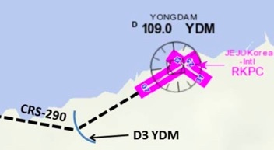
RKPC(CJU) 119ft | RKSS(GMP) 59ft
KE CJU 129.4 DCL -10분 | KE GMP 131.15
PA
Rwy 32L Landing
(06:00L~0900L / 12:00L~15:00L /18:00L~21:00L)
CJU : SID (NADP 1)
07 | KAMIT xE |  |  | 066 10000
25 | KAMIT xW |  |  |  | (246) |  |  | 10000
YDM 109.0 |  |  | 07 109.9 |  |  |  | 25 111.3
HUD |  | 07 : NONE |  |  |  | 25 : YDM246/3, R290
07 : Passing G4 CTC TWR 25 : 31 Holding PSN on P, E1,2,3 CTC TWR
Domestic
GMP : STAR
ILS 32L/R | OLMEN xT | OLMEN xT | BUMSI | OLMEN 160
ILS 14R | OLMEN xU | OLMEN xU | DOKDO | OLMEN 160
FIX | KIP /8(RWY 32), YJU R271, P73 /2
32L : D3(6532’), E2(9117’), 32R(No CL L/T) : E1(6614’) 14R : C1(6578’)
32L/R : 8 KIP L/G, 14R : LOC CAPT L/G FAF : Final Flap TWR -> GND -> APRON (All by ATC) Except RWY14R Landing (Until R)

Slide 15
RKSS(GMP) 59ft | RKPK(PUS) 13ft
KE GMP 131.15 DCL -15분 가능 TOBT 5분 차이시 CTC Comm | KE Gimhae 129.2
PA
Rwy 32R Takeoff
(06:00L~0900L / 12:00L~15:00L /18:00L~21:00L)
GMP : NADP FX-10도, CLB, CONF 1+F, Acc 4000ft
32L/R | OSPOT xT |  |  | (324) |  |  | 5000
 | (OSPOT xQ) |  |  | (324) |  |  | 5000
14L/R | OSPOT xU |  |  | (144) |  |  | 6000
 | (OSPOT xZ) |  |  | (144) |  |  | 6000
KIP 113.6 |  | 32L 108.3 | 32R 110.7 |  |  | 14L 109.9 |  | 14R 108.7
HUD |  | 32L/R : EO32L/R, R225, YJU R271 |  |  | 14L/R : EO14L/R, R220, P73 /2
APRON(130.875) -> GND(121.9) -> TWR (All by ATC)
Domestic
PUS : STAR (T/W 10tks, 36R, 360000lbs 제한)
ILS 36 | KEVOX x | MASTA | 9DME LG, 8DME FLAP
VOR 18 | GAYHA x | MASTA | 18 Circling Click!!
FIX | 36 : IKMA/IKHE /9, /8 |  | 18 : KMH R284, R280
36L : C4 (6299’), C2(7795’) 36R : E3(5866’), E2(7339’) 18R(DIS):C6(5770’),C7(6824’) 18L:E4(5882’),E5(8792’)
Vacate C3,C4 by ATC only. Max Taxi SPD 20KTS C2 HOLD SHORT 가까움(Vacate TaxiSPD)

Slide 16
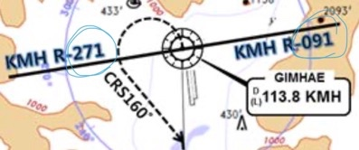
RKPK(PUS) 13ft | RKSS(GMP) 59ft
KE Gimhae 129.2 DCL -5분 | KE GMP 131.15
PA
Rwy 32L Landing
(06:00L~0900L / 12:00L~15:00L /18:00L~21:00L)
PUS : NADP CLB 1500, 360000lbs MAX, CONF 1+F
36 | SOORO x KALOD tx |  |  |  |  | 280 | ATC
18 | GIMHAE x |  |  |  |  | (182) | 5000
KMH 113.8 |  |  | PSN 114.0 |  | 36L 108.5 |  |  | 36R 109.5
FIX |  | 36 : KMH R091, R271, R185
RWY36 400ft Man L/H turn, Max Taxi SPD 20KTS
Domestic
GMP : STAR
ILS 32L/R |  | GUKDO xT | BUMSI | GUKDO 160
ILS 14R |  | GUKDO xU | DOKDO | GUKDO 160
FIX | KIP /8(RWY 32), YJU R271, P73 /2
32L : D3(6532’), E2(9117’), 32R (No CL L/T) : E1(6614’) 14R : C1(6578’)
32L/R : 8 KIP L/G, 14R : LOC CAPT L/G FAF : Final Flap TWR -> GND -> APRON (All by ATC) Except RWY14R Landing (Until R)

Slide 17

RKPC(CJU) 119ft | RKPK(PUS) 13ft
KE CJU 129.4 DCL -10분 | KE Gimhae 129.2
PA
CJU : SID (NADP 1)
07 | AKPON xE |  |  |  | (066) |  |  | 9000
25 | AKPON xW |  |  |  | (246) |  |  | ATC
YDM 109.0 |  |  | 07 109.9 |  |  |  | 25 111.3
FIX |  | 07 : NONE |  |  |  | 25 : YDM246/3, R290
07 : Passing G4 CTC TWR 25 : 31 Holding PSN on P, E1,2,3 CTC TWR
Domestic
PUS : STAR (T/W 10tks, 36R, 360000lbs 제한)
ILS 36 | KEVOX x | ANROD | 9DME LG, 8DME FLAP
VOR 18 | GAYHA x | ANROD | 18 Circling Click!!
FIX | 36 : IKMA/IKHE /9, /8 |  | 18 : KMH R284, R280
36L : C4 (6299’), C2(7795’) / 36R : E3(5866’), E2(7339’) 18R(DIS):C6(5770’),C7(6824’) 18L:E4(5882’),E5(8792’)
Vacate C3,C4 by ATC only. Max Taxi SPD 20KTS C2 HOLD SHORT 가까움(Vacate TaxiSPD)

Slide 18
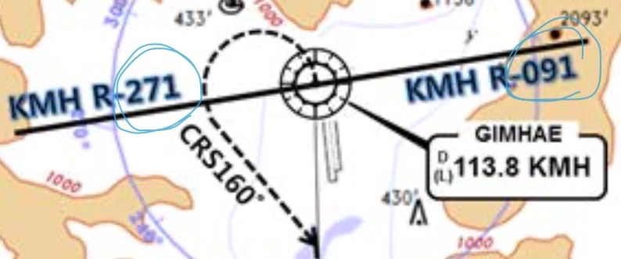
RKPK(PUS) 13ft | RKPC(CJU) 119ft
KE Gimhae 129.2 DCL -5분 | KE CJU 129.4
PA
PUS : NADP CLB 1500, 360000lbs MAX, CONF 1+F
36 | SOORO x TOPAX tx |  |  |  |  | 280 | ATC
18 | BULIM x ENGOT tx |  |  |  |  | (182) | 5000
KMH 113.8 |  |  | PSN 114.0 |  | 36L 108.5 |  |  | 36R 109.5
FIX |  | 36 : KMH R091, R271, R185
RWY36 400ft Man L/H turn, Max Taxi SPD 20KTS
Domestic
CJU : STAR AFT Merge PT(220kts) DCT IAF(210kts), FAF (160kts)
ILS Z 07 | UPGOS xP | YUMIN
RNP Y 07 (No LPV), RNP Z 07 AR (RNP 0.11)
ILS Z 25 | UPGOS xT(xM) | DUKAL
FIX | RWxx /8
07 : P6(5176’), P5(5882’), P4(6840’-ATC HIRO) 25 : P7(5219’), P8(5882’), P10(7524’-ATC HIRO)
Entering Rapid TWY CTC GND 121.675, STOP X HST 40KTS

Slide 19
RKSI(ICN) 23ft | RKPK(PUS) 13ft
KE ICN 131.5 DCL -10분 TOBT 5분 차이시 CTC Comm | KE Gimhae 129.2
PA
ICN : SID (33/34 NADP 1, 15/16 NADP 2)
33L/R | OSPOT xE/A |  |  |  | (333) |  | 5500/ATC
34L/R | OSPOT xY |  |  |  | (333) |  | ATC
15L/R | OSPOT xC |  |  |  | (153) |  | 5000
16L/R | OSPOT xH |  |  |  | (153) |  | 5000
NCN 113.8 |  | 33L 109.3 |  | 33R 108.9 |  |  | 15L 111.9 | 15R 109.1
WNG 112.9 |  | 34L 109.95 |  | 34R 108.1 |  |  | 16L 110.35 | 16R 108.55
FIX | 33L/R : NC05L/R, R242 YJU R271 |  |  |  |  | 34L/R : EO34L/R, R242 YJU R271
Parallel TWY 10KTS 이상(R17 MAX 15kts)
Domestic
PUS : STAR (T/W 10tks, 36R, 360000lbs 제한)
ILS 36 | KEVOX x | MASTA | 9DME LG, 8DME FLAP
VOR 18 | GAYHA x | MASTA | 18 Circling Click!!
FIX | 36 : IKMA/IKHE /9, /8 |  | 18 : KMH R284, R280
36L : C4 (6299’), C2(7795’) / 36R : E3(5866’), E2(7339’) 18R(DIS): C6(5770’),C7(6824’) 18L:E4(5882’),E5(8792’)
Vacate C3,C4 by ATC only, Max Taxi SPD 20KTS C2 HOLD SHORT 가까움(Vacate TaxiSPD)

Slide 20
RKPK(PUS) 13ft | RKSI(ICN) 23ft
KE Gimhae 129.2 DCL -5분 | KE ICN 131.5
PA
PUS : NADP CLB 1500, 360000lbs MAX, CONF 1+F
36 | SOORO x KALOD tx |  |  | 306 |  | 280 | ATC |  | 342
18 | GIMHAE x |  |  | 182 |  | 182 | 5000 |  | 182
KMH 113.8 |  |  | PSN 114.0 |  | 36L 108.5 |  |  | 36R 109.5
FIX |  | 36 : KMH R091, R271, R185
RWY 36 400ft Man L/H turn, Max Taxi SPD 20KTS
Domestic
ICN : STAR
ILS 33/34 | GUKDO xE | ENPIL | GUKDO 180
ILS 15/16 | GUKDO xH | MUNAN | GUKDO 180
FIX | RWY /8(180kts), /5(160kts) , YJU R271
33R : C4(7529’), C5(8513’), 33L : B4(7463’), B5(8513‘) 15L : C2(7522’), C1(8536’), 15R : B3(7454‘), B2(8641‘)
34L : P7(5600’), P8(6578’), 34R : N4(6876’), N5(8507‘) 16R : P6(5597’), P5(6574’), 16L : N3(7043‘), N2(8444‘)
8NM 180kts, 5NM 160kts, Parr TAXI 10kts이상, HIRO

Slide 21
RKSI(ICN) 23ft | RJBB(KIX) 17ft
KE ICN 131.5 DCL -10분 TOBT 5분 차이시 CTC Comm | KE KIX 130.95
PA
ICN : SID (33/34 NADP 1, 15/16 NADP 2)
33L/R | OSPOT xE/A |  |  |  | (333) |  | 5500/ATC
34L/R | OSPOT xY |  |  |  | (333) |  | ATC
15L/R | OSPOT xC |  |  |  | (153) |  | 5000
16L/R | OSPOT xH |  |  |  | (153) |  | 5000
NCN 113.8 |  | 33L 109.3 |  | 33R 108.9 |  |  | 15L 111.9 | 15R 109.1
WNG 112.9 |  | 34L 109.95 |  | 34R 108.1 |  |  | 16L 110.35 | 16R 108.55
FIX | 33L/R : NC05L/R, R242 YJU R271 |  |  |  |  | 34L/R : EO34L/R, R242 YJU R271
Parallel TWY 10KTS 이상(R17 MAX 15kts)
DEP 125.15 – TGU 134.17 – FUK 124.15
TKO 133.8
KIX RDR 120.85
KIX APP 120.25
Japan
KIX : STAR (SAEKI 170, RANDY 150)
06L | ALISA B | BERRY | ILS Y 06L
06R | ALISA A | ALLAN | ILS Y 06R
24L/R | ALISA C | MAYAH | ILS Z 24L/R
FIX | RWxx /8
06L : B8(5160’), B6(6751’), 24R : B7(5318’), B9(6751’) 06R : A7(5137’), A6(6938’), 24L : A8(5269’), A9(6976’)
RWY06 : After 2500ft L/G DN, After 1500ft L/D FLAP TAXI RTE 1(via J4), 2(via J3)

Slide 22
RJBB(KIX) 17ft | RKSI(ICN) 23ft
KE KIX 130.95 DCL -15분 | KE ICN 131.5
PA
KIX : SID – SOUJA tx (NADP 1)
06L/R | HELEN x - SOUJA tx |  |  |  | (059) | ATC (9000)
24L/R |  |  |  |  | (239) | ATC (9000)
KIE 111.6 |  | 06L 108.7 |  | 06R 108.1 |  | 24L 110.7 | 24R 108.5
APU Start, TAXI RTE 1(via J4), 2(via J3)
DEP 119.2
TKO 132.7 – 133.8
FUK 124.15
TGU 120.57
APP 119.75
Japan
ICN : STAR
ILS 33/34 | GUKDO xE | ENPIL | GUKDO 180
ILS 15/16 | GUKDO xH | MUNAN | GUKDO 180
FIX | RWY /8(180kts), /5(160kts) , YJU R271
33R : C4(7529’), C5(8513’), 33L : B4(7563’), B5(8513‘) 15L : C2(7522’), C1(8536’), 15R : B3(7454‘), B2(8641‘)
34L : P7(5600’), P8(6578’), 34R : N4(6876’), N5(8507‘) 16R : P6(5597’), P5(6574’), 16L : N3(7043‘), N2(8444‘)
8NM 180kts, 5NM 160kts, Parr TAXI 10kts이상, HIRO

Slide 23
RKSI(ICN) 23ft | RJAA(NRT) 135ft
KE ICN 131.5 DCL -10분 TOBT 5분 차이시 CTC Comm | KE Tokyo 131.70
PA
ICN : SID (33/34 NADP 1, 15/16 NADP 2)
33L/R | EGOBA xE/A |  |  |  | (333) |  |  | 5500/ATC
34L/R | EGOBA xY |  |  |  | (333) |  |  | ATC
15L/R | EGOBA xC |  |  |  | (153) |  |  | 5000
16L/R | EGOBA xH |  |  |  | (153) |  |  | 5000
NCN 113.8 |  | 33L 109.3 |  | 33R 108.9 |  |  | 15L 111.9 |  | 15R 109.1
WNG 112.9 |  | 34L 109.95 |  | 34R 108.1 |  |  | 16L 110.35 |  | 16R 108.55
FIX | 33L/R : NC05L/R, R242, YJU R271 |  |  |  |  | 34L/R : EO34L/R, R242, YJU R271
Parallel TWY 10KTS 이상(R17 MAX 15kts)
DEP 125.15 – TGU 134.17
TKO 124.15 – 132.02 - 124.1- 128.2
TKO APP 124.4 - 120.2
Japan
NRT : HAKKA 330,YAGAN 240,LIVET 210,SWAMP 150
34L/R | SWAMP E (SWAMP T) | ELGAR (TYLER) | ILS 34L/R(Z)
16L/R | SWAMP G (SWAMP N) | GEMIN (NORMA) | ILS Z 16L/R
FIX | 16L : ITM 4 / 34R : ITJ 14, 4 (DME) 16R : IKF 4 / 34L : IYQ 12, 4 (DME)
16L : B6(6433’), B7(7017’), 34R : B4(5849’), B2(6778’) 16R : A6(6076’), A7(7624’), 34L : A5(6167’), A4(7641’)
L/D DOWN before 14/12 DME, L/D FLAP 4 DME Arrival Taxi RTE in Jeppesen (No Numbering)

Slide 24
RJAA(NRT) 135ft | RKSI(ICN) 23ft
KE Tokyo 131.70 DCL -15분 | KE ICN 131.5
PA
NRT : SID – ENPAR tx (NADP 1)
16L/R | TETRA x ENPAR tx |  | 157 |  | 157 | ATC |  | 157
34L/R |  |  | 337 |  | 337 | 7000/ATC |  | 337
NRE 117.9 |  | 16L 110.7 |  | 16R 111.5 |  | 34L 111.9 | 34R 110.9
34R : CLB 220/10000, A4R21/22/23 220KTS 확인 Verity ENPAR tx TETRA 12000A APU Start, TAXI RTE 1, 2, 3, 4 RWY 별 DEP RTE
DEP 124.2
TKO 120.5 – 133.45 – 133.02 – 133.8
TGU 120.57
APP 119.75
Japan
ICN : STAR
ILS 33/34 | GUKDO xE | ENPIL | GUKDO 180
ILS 15/16 | GUKDO xH | MUNAN | GUKDO 180
FIX | RWY /8(180kts), /5(160kts) , YJU R271
33R : C4(7529’), C5(8513’), 33L : B4(7563’), B5(8513‘) 15L : C2(7522’), C1(8536’), 15R : B3(7454‘), B2(8641‘)
34L : P7(5600’), P8(6578’), 34R : N4(6876’), N5(8507‘) 16R : P6(5597’), P5(6574’), 16L : N3(7043‘), N2(8444‘)
8NM 180kts, 5NM 160kts, Parr TAXI 10kts이상, HIRO

Slide 25
RKSI(ICN) 23ft | RJCC(CTS) 70ft
KE ICN 131.5 DCL -10분 TOBT 5분 차이시 CTC Comm | Chitose Oper 132.05
PA
ICN : SID (33/34 NADP 1, 15/16 NADP 2)
33L/R | EGOBA xE/A |  | 333 |  | 333 |  | 5500/ATC |  | 333
34L/R | EGOBA xY |  | 333 |  | 333 |  | ATC |  | 333
15L/R | EGOBA xC |  | 153 |  | 153 |  | 5000 |  | 153
16L/R | EGOBA xH |  | 153 |  | 153 |  | 5000 |  | 153
NCN 113.8 |  | 33L 109.3 |  | 33R 108.9 |  | 15L 111.9 |  | 15R 109.1
WNG 112.9 |  | 34L 109.95 |  | 34R 108.1 |  | 16L 110.35 |  | 16R 108.55
33L/R : NC05L/R, R242 YJU R271 |  |  |  | 34L/R : EO34L/R, R242 YJU R271
HUD | 33L/R 34L(23’) |  |  | 12303’ |  | 15L/R 16R(23’)
 | 34R (23’) |  |  | 13123’ |  | 16L (23’)
Parallel TWY 10KTS 이상(R17 MAX 15kts)
DEP 125.15 – TGU 134.17 - FUK 124.15 – 133.02
TKO 132.3 - SPR 133.3 -119.3
CTS APP 120.1
Japan
CTS : STAR (01R : IDEMI FL150, 19L : NAVER FL170)
01R | YOTEI SOUTH (YUKII WEST) | YOTEI not YOSEI | ILS Y/Z 01R 3000/2000
19L 19R CAT III | NAVER(170) YUNEY SOUTH (KAORY A) | KAORY YUNEY (KAORY) | ILS Z 19L
HUD | 01R(57’) 01L(62’) | 9843’ | 19L(77’) 19R(82’)
01R : B4(5278’), B3(7047’), 19L : B8(5177’), B9(7119’) 01L : A5(5538’), A4(6961’), 19R : A7(5390’), A8(6873’)
Do not Cross 01L/19R After L/D (No TWY) TAXI to Gate Via D(J) or G

Slide 26
RJCC(CTS) 70ft | RKSI(ICN) 23ft
Chitose Oper 132.05 NO DCL -5분 | KE ICN 131.5
PA
CTS : SID (NADP 1)
ALL | DALBI x SUVIT x SOSHU x |  | 002 |  | 002 | ATC |  | 002
 |  |  | 182 |  | 182 | ATC |  | 182
CHE 116.9 |  | 01R 110.75 |  | 19L 109.35 |  | 01L 110.9 | 19R 111.5
HUD | 01R(57’) 01L(62’) |  | 9843’ |  |  | 19L(77’) 19R(82’)
APU, Deicing at the Gate R/H turn DCT to HWE -> Confirm R/H Turn ND
DEP 124.7
SPR 119.3 – TKO 124.5 - 132.3
FUK 133.02 – 124.15
TGU 120.57
APP 119.75
Japan
ICN : STAR
ILS 33/34 | GUKDO xE | ENPIL | GUKDO 180
ILS 15/16 | GUKDO xH | MUNAN | GUKDO 180
HUD | 33L/R 34L(23’) | 12303’ | 15L/R 16R(23’)
 | 34R(23’) | 13123’ | 16L(23’)
FIX | RWY /8, /5 , YJU R271
33R : C4(7529’), C5(8513’), 33L : B4(7563’), B5(8513‘) 15L : C2(7522’), C1(8536’), 15R : B3(7454‘), B2(8641‘)
34L : P7(5600’), P8(6578’), 34R : N4(6876’), N5(8507‘) 16R : P6(5597’), P5(6574’), 16L : N3(7043‘), N2(8444‘)
8NM 180kts, 5NM 160kts, Parr TAXI 10kts이상, HIRO

Slide 27
RKSI(ICN) 23ft | RJTT(HND) 21ft
KE ICN 131.5 DCL -10분 TOBT 5분 차이시 CTC Comm | Delta Oper 132.075
PA
ICN : SID (33/34 NADP 1, 15/16 NADP 2)
33L/R | EGOBA xE/A |  | 333 |  | 333 |  | 5500/ATC |  | 333
34L/R | EGOBA xY |  | 333 |  | 333 |  | ATC |  | 333
15L/R | EGOBA xC |  | 153 |  | 153 |  | 5000 |  | 153
16L/R | EGOBA xH |  | 153 |  | 153 |  | 5000 |  | 153
NCN 113.8 |  | 33L 109.3 |  | 33R 108.9 |  | 15L 111.9 |  | 15R 109.1
WNG 112.9 |  | 34L 109.95 |  | 34R 108.1 |  | 16L 110.35 |  | 16R 108.55
33L/R : NC05L/R, R242 YJU R271 |  |  |  | 34L/R : EO34L/R, R242 YJU R271
HUD | 33L/R 34L(23’) |  |  | 12303’ |  | 15L/R 16R(23’)
 | 34R (23’) |  |  | 13123’ |  | 16L (23’)
Parallel TWY 10KTS 이상(R17 MAX 15kts)
DEP 125.15 – TGU 134.17 – FUK 133.02 – TKO 120.5
TKO 133.35
TKO APP 119.1 – 119.65
Japan
HND : STAR XAC Night– APP xxx Y 1400z~ SPENS 220
34L/R | XAC xK/H | KAIHO/CACAO | ILS X / VIS
22 | XAC xB | BACON | LDA W(RNVW 22)
16R/L | XAC R | NATTY/SANDY | RNP(R16RT/R16LT)
23 | - | DANON | LDA W(RNVW 23)
HUD | 34L(18’) 9843’ |  | 16R(77’) 8268’ DIS
 | 34R(21’) 9843’ DIS TH |  | 16L(19’) 9744’ DIS
 | 22(35’) 8202’ |  | 23(55’) 8202’
34L : L12(6515’), L13(7165’), 22 : B4(6207’), B3(6830’) 16R : L5(5147’), L3(6361’), 23 : D5(5072’), D3(6391’)
xxx Z : 180kts, 160kts limit APP Chart, xxx Y After 1400z

Slide 28
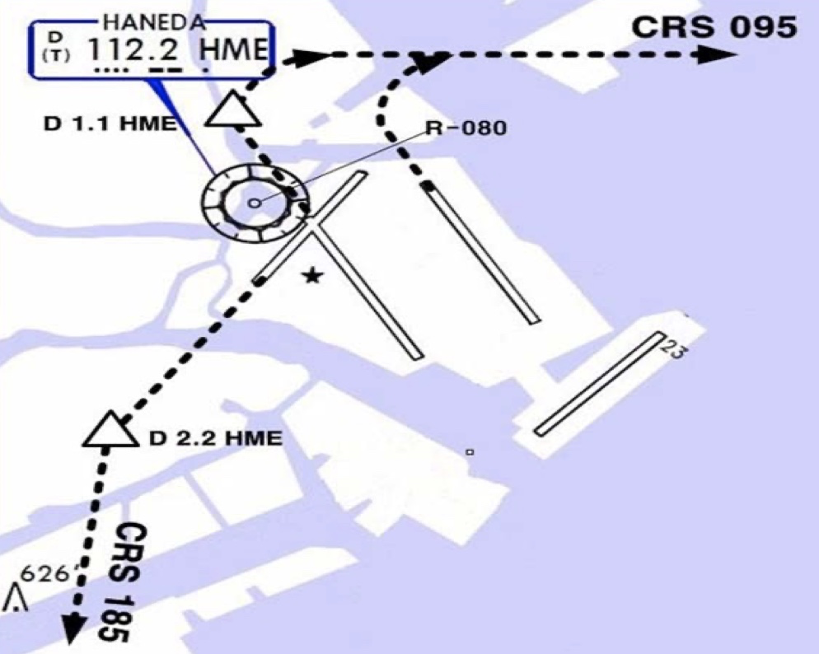
RJTT(HND) 21ft | RKSI(ICN) 23ft
Delta Oper 132.075 DCL -15분 | KE ICN 131.5
PA
HND : SID (xx B/C 2200-0230z 0600-1000z) NADP 1
ALL | BEKLA x OPPAR x |  | RWY H/D | RWY CRS | ATC | RWY H/D
HME 112.2 | 34L 111.7 | 16R 111.55 | 34R 108.9 | 16L 111.95 | 22 108.1 | 23 110.5
HUD |  | 34L(18’) 9843’ 16R(77’)
 |  | 34R(21’) 11024’ 16L(19’)
 |  | 04(19’) 8202’ 05(46’)
34L : HME 351/1.1, R095, 34R : HME R080, R095, 22 : HME /2.2 R185
34R BEKLA : KAIJI 230kts, TORAM Flap5 SPD 16L : BEKLA : PLUTO 230kts RWY05 RTE5 TAXI Chart
DEP ATIS
TKO 120.5 – FUK 133.02
TGU 120.57
APP 119.75
Japan
ICN : STAR
ILS 33/34 | GUKDO xE | ENPIL | GUKDO 180
ILS 15/16 | GUKDO xH | MUNAN | GUKDO 180
HUD | 33L/R 34L(23’) | 12303’ | 15L/R 16R(23’)
 | 34R(23’) | 13123’ | 16L(23’)
FIX | RWY /8, /5 , YJU R271
33R : C4(7529’), C5(8513’), 33L : B4(7563’), B5(8513‘) 15L : C2(7522’), C1(8536’), 15R : B3(7454‘), B2(8641‘)
34L : P7(5600’), P8(6578’), 34R : N4(6876’), N5(8507‘) 16R : P6(5597’), P5(6574’), 16L : N3(7043‘), N2(8444‘)
8NM 180kts, 5NM 160kts, Parr TAXI 10kts이상, HIRO

Slide 29
RKSI(ICN) 23ft | RJGG(NGO) 12ft
KE ICN 131.5 DCL -10분 TOBT 5분 차이시 CTC Comm | SWISSPORT OPERATION 132.05
PA
ICN : SID (33/34 NADP 1, 15/16 NADP 2)
33L/R | EGOBA xE/A |  | 333 |  | 333 |  | 5500/ATC |  | 333
34L/R | EGOBA xY |  | 333 |  | 333 |  | ATC |  | 333
15L/R | EGOBA xC |  | 153 |  | 153 |  | 5000 |  | 153
16L/R | EGOBA xH |  | 153 |  | 153 |  | 5000 |  | 153
NCN 113.8 |  | 33L 109.3 |  | 33R 108.9 |  | 15L 111.9 |  | 15R 109.1
WNG 112.9 |  | 34L 109.95 |  | 34R 108.1 |  | 16L 110.35 |  | 16R 108.55
33L/R : NC05L/R, R242 YJU R271 |  |  |  | 34L/R : EO34L/R, R242 YJU R271
HUD | 33L/R 34L(23’) |  |  | 12303’ |  | 15L/R 16R(23’)
 | 34R (23’) |  |  | 13123’ |  | 16L (23’)
Parallel TWY 10KTS 이상(R17 MAX 15kts)
DEP 125.15
TGU 134.17 – TKO 133.8 – 133.02
센트레아 APP – 121.05
Japan
NGO : STAR (SAMON 290, MARIA 130)
36 | CHESS(CARDS) SOUTH | PROBE | ILS Z 36
18 | CHESS(CARDS) NORTH | QUEST | ILS Z 18
HUD | 36(15’) 11483’ 18(15’)
36 : A6(5213’), A7(6525’), A8(7837’) 18 : A5(5393’), A4(6528’), A3(7841’)
RWY36 : After 1500ft L/D FLAP RWY 18 : After 3000ft L/G DN & L/D FLAP Caution Stop line, Yellow Ramp line, VDGS!!!

Slide 30
RJGG(NGO) 12ft | RKSI(ICN) 23ft
SWISSPORT OPERATION 132.05 DCL -15분 | KE ICN 131.5
PA
NGO : SID – TANGO tx (NADP 1)
36 | OUMI x - TANGO tx |  | 356 | 356 | ATC (7000) | 356
18 |  |  | 176 | 176 | ATC (7000) | 176
CBE 117.8 |  | 18 109.7 |  |  | 36 111.9
HUD | 36(15’) |  | 11483’ |  | 18(15’)
APU Start 30min, Prepare Intersection T/O
DEP 120.0
TKO 133.55 – 133.8 – TGU 120.52
APP – 119.75
Japan
ICN : STAR
ILS 33/34 | GUKDO xE | ENPIL | GUKDO 180
ILS 15/16 | GUKDO xH | MUNAN | GUKDO 180
HUD | 33L/R 34L(23’) | 12303’ | 15L/R 16R(23’)
 | 34R(23’) | 13123’ | 16L(23’)
FIX | RWY /8, /5 , YJU R271
33R : C4(7529’), C5(8513’), 33L : B4(7563’), B5(8513‘) 15L : C2(7522’), C1(8536’), 15R : B3(7454‘), B2(8641‘)
34L : P7(5600’), P8(6578’), 34R : N4(6876’), N5(8507‘) 16R : P6(5597’), P5(6574’), 16L : N3(7043‘), N2(8444‘)
8NM 180kts, 5NM 160kts, Parr TAXI 10kts이상, HIRO

Slide 31
RKSI(ICN) 23ft | RJFF(FUK) 30ft
KE ICN 131.5 DCL -10분 TOBT 5분 차이시 CTC Comm | KE FUK 132.05
PA
ICN : SID (33/34 NADP 1, 15/16 NADP 2)
33L/R | OSPOT xE/A |  | 333 |  | 333 |  | 5500/ATC |  | 333
34L/R | OSPOT xY |  | 333 |  | 333 |  | ATC |  | 333
15L/R | OSPOT xC |  | 153 |  | 153 |  | 5000 |  | 153
16L/R | OSPOT xH |  | 153 |  | 153 |  | 5000 |  | 153
NCN 113.8 |  | 33L 109.3 |  | 33R 108.9 |  | 15L 111.9 |  | 15R 109.1
WNG 112.9 |  | 34L 109.95 |  | 34R 108.1 |  | 16L 110.35 |  | 16R 108.55
33L/R : NC05L/R, R242 YJU R271 |  |  |  | 34L/R : EO34L/R, R242 YJU R271
HUD | 33L/R 34L(23’) |  |  | 12303’ |  | 15L/R 16R(23’)
 | 34R (23’) |  |  | 13123’ |  | 16L (23’)
Parallel TWY 10KTS 이상(R17 MAX 15kts)
TGU 125.37
Kobe 118.9 - FUK APP 119.65
FUK RDR – 121.125
Japan
FUK : RNAV STAR, RDR Vectoring from IKE (PAVGA 13000ft) Hold W of IKE published (Confirm FMS DATA)
16 | SARUP | ENTIX | ILS, RNP, LOC 16
34 | V34 HAWKS WEST | RWY34 HAWKS | VIS 34 ILS, RNP, LOC 34
HUD | 16(15’) 9186’ 34(32’) |  | 24R(305’) 12014’ 24L(293’) 8710’ DIS TH
16 : C6(5505’), C7(6407’), 34 : C4(5193’), C3(6354’)
DGC VOR out of 6NM A/P VIS 34 : After IKE – RDR Vector Downwind – 1800ft – RWY Insight 1500ft – Before L/D CHK Complete before base (Do not Extend Downwind due Terrain)

Slide 32
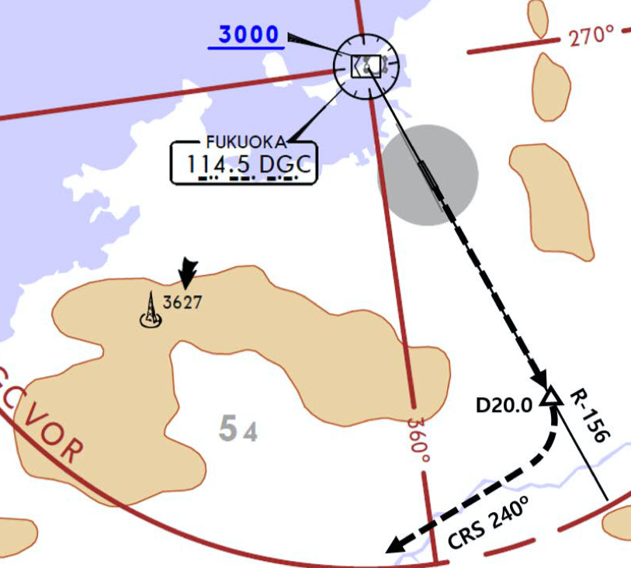
RJFF(FUK) 30ft | RKSI(ICN) 23ft
KE FUK 132.05 DCL -15min, Voice -5min | KE ICN 131.5
PA
FUK : SID (Consider C2, C8 Intersection T/O)
16 | HAKATA xx |  | 158 | 158 | ATC (10000) |  | 158
34 |  |  | 338 | 338 | ATC (10000) |  | 338
DGC 114.5 |  |  |  | 16 111.7 |  | 34 108.9
16 : DGC 156/20 R240 (DGC VOR out of 6NM A/P)
HUD |  | 16(15’) 9186’ 34(32’) |  |  | 24R(305’) 8530’ 24L(293’) 8999’
Caution GP HOLD LINE Initial CTC TWR, “Ready for departure” RWSL(Runway Status Lights) in operation
DEP 127.9
Kobe 135.65
TGU 125.37
Japan
ICN : STAR
ILS 33/34 | GUKDO xE | ENPIL | GUKDO 180
ILS 15/16 | GUKDO xH | MUNAN | GUKDO 180
HUD | 33L/R 34L(23’) | 12303’ | 15L/R 16R(23’)
 | 34R(23’) | 13123’ | 16L(23’)
FIX | RWY /8, /5 , YJU R271
33R : C4(7529’), C5(8513’), 33L : B4(7463’), B5(8513‘) 15L : C2(7522’), C1(8536’), 15R : B3(7454‘), B2(8641‘)
34L : P7(5600’), P8(6578’), 34R : N4(6876’), N5(8507‘) 16R : P6(5597’), P5(6574’), 16L : N3(7043‘), N2(8444‘)
8NM 180kts, 5NM 160kts, Parr TAXI 10kts이상, HIRO

Slide 33
RKSI(ICN) 23ft | RJSA(AOJ) 650ft
KE ICN 131.5 DCL -10분 TOBT 5분 차이시 CTC Comm | JPN AIR AOJ 130.17 NO ATIS
PA
ICN : SID (33/34 NADP 1, 15/16 NADP 2)
33L/R | EGOBA xE/A |  | 333 |  | 333 |  | 5500/ATC |  | 333
34L/R | EGOBA xY |  | 333 |  | 333 |  | ATC |  | 333
15L/R | EGOBA xC |  | 153 |  | 153 |  | 5000 |  | 153
16L/R | EGOBA xH |  | 153 |  | 153 |  | 5000 |  | 153
NCN 113.8 |  | 33L 109.3 |  | 33R 108.9 |  | 15L 111.9 |  | 15R 109.1
WNG 112.9 |  | 34L 109.95 |  | 34R 108.1 |  | 16L 110.35 |  | 16R 108.55
33L/R : NC05L/R, R242 YJU R271 |  |  |  | 34L/R : EO34L/R, R242 YJU R271
HUD | 33L/R 34L(23’) |  |  | 12303’ |  | 15L/R 16R(23’)
 | 34R (23’) |  |  | 13123’ |  | 16L (23’)
Parallel TWY 10KTS 이상(R17 MAX 15kts)
DEP 125.15 – TGU 134.17 - FUK 124.15
FUK 125.15 - 133.02 – 132.3
SPR 133.3 -127.57 - AOJ TWR 118.3
Japan
AOJ : Obstacle Around Airport (High FE, Cold Temp) Hold over MRE, MELOS, YACHI Confirm CRS, EFC CAT II,III Request Before 15min By Com
24 | NONE | MRE YACHI | ILS Y/Z 24 RNP Z 24 (AR)
06 | MELOS SOUTH | YACHI MELOS | RNP Z 06 (AR) VOR Z 06(5도)
HUD | 24(664’) | 9843’ | 06(647’)
24 : T2(5043’),T1(7043’), 06 : T3(5043’), T4(7043’)
ILS Y 24 Turn SPD : Max 200kts, CHK MRE D12 Turn 시작 (선회 반경으로 선회 늦어짐 주의!, SPD Modify) RWY, TWY color Yellow, GND by TWR

Slide 34
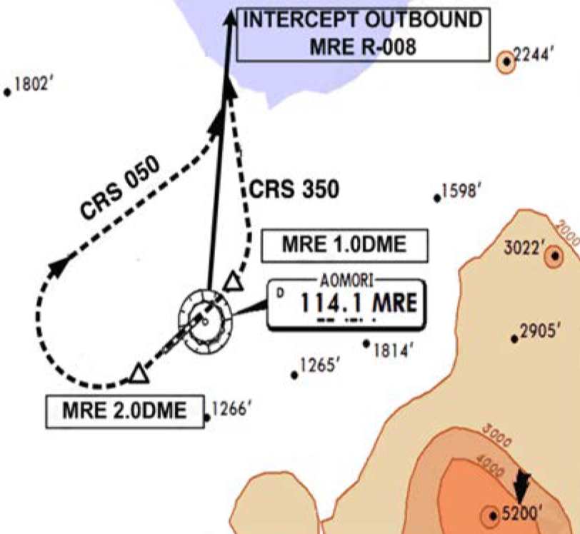
RJSA(AOJ) 650ft | RKSI(ICN) 23ft
JPN AIR AOJ 130.17 NO ATIS, TWR 118.3 Voice | KE ICN 131.5
PA
AOJ : SID (NADP 1)
24 | IWAKI xx | 241 | 241 | ATC | 241
06 |  | 061 | 061 | ATC | 061
MRE 114.1 |  |  | 24 111.9
HUD | 24(664’) | 9843’ |  | 06(647’)
EO | 24 : MRE 241/2, MRE R008 06 : MRE 061/1, R350, MRE R008
ATC 순서 특이함. Deicing at the Gate
TWR 118.3
SPR 127.57 – 133.3
TKO 132.3 – 132.45 – 133.02
TKO 133.8
TGU 120.57
APP 119.75
Japan
ICN : STAR
ILS 33/34 | GUKDO xE | ENPIL | GUKDO 180
ILS 15/16 | GUKDO xH | MUNAN | GUKDO 180
HUD | 33L/R 34L(23’) | 12303’ | 15L/R 16R(23’)
 | 34R(23’) | 13123’ | 16L(23’)
FIX | RWY /8, /5 , YJU R271
33R : C4(7529’), C5(8513’), 33L : B4(7563’), B5(8513‘) 15L : C2(7522’), C1(8536’), 15R : B3(7454‘), B2(8641‘)
34L : P7(5600’), P8(6578’), 34R : N4(6876’), N5(8507‘) 16R : P6(5597’), P5(6574’), 16L : N3(7043‘), N2(8444‘)
8NM 180kts, 5NM 160kts, Parr TAXI 10kts이상, HIRO

Slide 35
RKSI(ICN) 23ft | RJSN(KIJ) 5ft
KE ICN 131.5 DCL -10분 TOBT 5분 차이시 CTC Comm | JPN AIR Niigata 131.85
PA
ICN : SID (33/34 NADP 1, 15/16 NADP 2)
33L/R | EGOBA xE/A |  | 333 |  | 333 |  | 5500/ATC |  | 333
34L/R | EGOBA xY |  | 333 |  | 333 |  | ATC |  | 333
15L/R | EGOBA xC |  | 153 |  | 153 |  | 5000 |  | 153
16L/R | EGOBA xH |  | 153 |  | 153 |  | 5000 |  | 153
NCN 113.8 |  | 33L 109.3 |  | 33R 108.9 |  | 15L 111.9 |  | 15R 109.1
WNG 112.9 |  | 34L 109.95 |  | 34R 108.1 |  | 16L 110.35 |  | 16R 108.55
33L/R : NC05L/R, R242 YJU R271 |  |  |  | 34L/R : EO34L/R, R242 YJU R271
HUD | 33L/R 34L(23’) |  |  | 12303’ |  | 15L/R 16R(23’)
 | 34R (23’) |  |  | 13123’ |  | 16L (23’)
Parallel TWY 10KTS 이상(R17 MAX 15kts)
DEP 125.15 – TGU 134.17 - FUK 124.15
TKO 133.8 - 132.45 – 132.3
KIJ RDR 121.4
Japan
KIJ : GTC-50NM – TERAD (Modify!!) At/Below 3000MSL : 200kts, Above 3000MSL : 250kts
28 | TERAD EAST | KYOGA | ILS Z 28
10 | TERAD WEST (KAETSU) | RYUTO INAHO | RNP Z 10 RNP Y 10 (AR)
HUD | 28(10’) | 8202’ | 10(27’)
28 : B4(6167’),B5(7906’), 10 : P3(6292’), B1(8100’)
LDC Data : RWY28+81ft, RWY10+274ft (Due PAPI PSN) RWY 10 Downslope, Vacate RWY04/22 by ATC Only GND by TWR

Slide 36
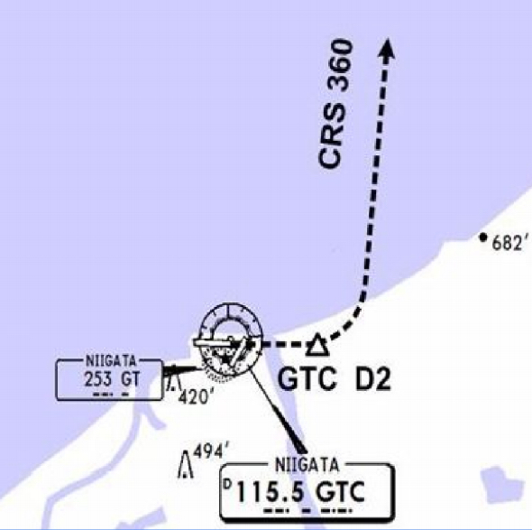
RJSN(KIJ) 5ft | RKSI(ICN) 23ft
JPN AIR KIJ 131.85 TWR Voice -5min | KE ICN 131.5
PA
KIJ : SID (NADP 1)
28 | MOKBA xx | 281 | 281 | ATC | 281
10 |  | 101 | 101 | ATC | 101
GTC 115.5 |  |  | 28 109.3
HUD | 28(10’) | 8202’ |  | 10(27’)
EO | 10 : GTC 101/2, R360
Sometimes Cross 50NM SW GTC FL200
TWR 118.0
TKO 132.3 – 132.45
FUK 133.02 – 124.15
TGU 120.57
APP 119.75
Japan
ICN : STAR
ILS 33/34 | GUKDO xE | ENPIL | GUKDO 180
ILS 15/16 | GUKDO xH | MUNAN | GUKDO 180
HUD | 33L/R 34L(23’) | 12303’ | 15L/R 16R(23’)
 | 34R(23’) | 13123’ | 16L(23’)
FIX | RWY /8, /5 , YJU R271
33R : C4(7529’), C5(8513’), 33L : B4(7563’), B5(8513‘) 15L : C2(7522’), C1(8536’), 15R : B3(7454‘), B2(8641‘)
34L : P7(5600’), P8(6578’), 34R : N4(6876’), N5(8507‘) 16R : P6(5597’), P5(6574’), 16L : N3(7043‘), N2(8444‘)
8NM 180kts, 5NM 160kts, Parr TAXI 10kts이상, HIRO

Slide 37
RKPC(CJU) 119ft | RJAA(NRT) 135ft
KE CJU 129.4 DCL -10분 | KE Tokyo 131.70
PA
CJU : SID (NADP 1)
07 | TAMNA xE |  |  | 066 |  | 066 |  | 9000 | 066
25 | TAMNA xW |  |  | 246 |  | 246 |  | ATC | 246
YDM 109.0 |  |  | 07 109.9 |  |  |  | 25 111.3
07 : NONE |  |  |  |  | 25 : YDM246/3, R290
HUD |  | 07(87’) |  |  | 10433’ |  |  | 25(77’)
07 : Passing G4 CTC TWR 25 : 31 Holding PSN on P, E1,2,3 CTC TWR
DEP 121.2 – ICN 124.52 - KOB 118.9 – FUK 133.15 – 119.35
134.35 - TKO 125.9 - TKO APP 124.4 - 120.2 – ARR 121.27
Japan
NRT : MAMAS 240
34L/R | RUTAS E (RUTAS T) | ELGAR (TYLER) | ILS 34L/R(Z)
16L/R | RUTAS G (RUTAS N) | GEMIN (NORMA) | ILS Z 16L/R
HUD | 16L(135’) | 8202’ | 34R(141’)
 | 16R(130’) | 13123’ | 34L(139’)
FIX | 16L : ITM 4 / 34R : ITJ 14, 4 (DME) 16R : IKF 4 / 34L : IYQ 12, 4 (DME)
16L : B6(6433’), B7(7017’), 34R : B4(5849’), B2(6778’) 16R : A6(6076’), A7(7624’), 34L : A5(6167’), A4(7641’)
L/D DOWN before 14/12 DME, L/D FLAP 4 DME Arrival Taxi RTE in Jeppesen (No Numbering)

Slide 38
RJAA(NRT) 135ft | RKPC(CJU) 119ft
KE Tokyo 131.70 DCL -15분 | KE CJU 129.4
PA
NRT : SID – ENPAR tx (NADP 1)
16L/R | TETRA x ENPAR tx |  | 157 |  | 157 | ATC |  | 157
34L/R |  |  | 337 |  | 337 | 7000/ATC |  | 337
NRE 117.9 |  | 16L 110.7 |  | 16R 111.5 |  | 34L 111.9 | 34R 110.9
HUD | 16L(135’) |  | 8202’ |  |  | 34R(141’)
 | 16R (130’) |  | 13123’ |  |  | 34L (139’)
34R : CLB 220/10000, A4R21/22/23 220KTS 확인 Verity ENPAR tx TETRA 12000A APU Start, TAXI RTE 1, 2, 3, 4 RWY 별 DEP RTE
DEP 124.2
TKO 120.5 – 128.12 – FUK 133.02 – KOB 133.55
132.7 – FUK 133.15 – KOB 118.9
ICN 124.52
APP 121.2
Japan
CJU : STAR AFT Merge PT(220kts) DCT IAF(210kts), FAF (160kts)
ILS Z 07 | TAMNA xP | YUMIN
RNP Y 07 (No LPV), RNP Z 07 AR (No B737-900, RNP 0.11)
ILS Z 25 | TAMNA xT(xM) | DUKAL
HUD | 07(87’) | 10433’ | 25(76’)
07 : P6(5176’), P5(5882’), P4(6840’-ATC HIRO) 25 : P7(5219’), P8(5882’), P10(7524’-ATC HIRO)
Entering Rapid TWY CTC GND 121.675, STOP X HST 40KTS

Slide 39
RKSS(GMP) 59ft | ZSSS(SHA) 10ft
KE GMP 131.15 DCL -15분 가능 TOBT 5분 차이시 CTC Comm | China Eastern 131.5
PA
Rwy 32R Takeoff
(06:00L~0900L / 12:00L~15:00L /18:00L~21:00L)
GMP : SID (NADP 1)
32L/R | BULTI xT |  | 324 |  | 324 |  | 5000 |  | 324
 | (BULTI xQ) |  | 324 |  | 324 |  | 5000 |  | 324
14L/R | BULTI xU |  | 144 |  | 144 |  | 6000 |  | 144
 | (BULTI xZ) |  | 144 |  | 144 |  | 6000 |  | 144
KIP 113.6 |  | 32L 108.3 | 32R 110.7 |  |  | 14L 109.9 |  | 14R 108.7
32L/R : EO32L/R, R225 YJU R271 |  |  |  | 14L/R : EO14L/R, R220 P73 /2
HUD |  | 32L(41’) |  | 10499’ |  |  | 14R(34’)
 |  | 32R(42’) |  | 11811’ |  |  | 14L(38’)
APRON(130.875) -> GND(121.9) -> TWR (All by ATC)
CJU 124.52
SHA 120.95
SHA APP – 125.625 - 125.4 – 126.65
China
SHA : STAR SPD Rest From IAF(210kts), 180kts, 160kts
ILS Z 18L | PUD 61A |  | SS204 |  | above 2960ft PUD QRH Below 2960ft SHA QRH
ILS Z 36R | PUD 71A |  | SS405 |  | Below 2960ft SHA QRH
HUD |  | 18L(6’) |  | 10499’ |  | 36R(9’)
18L: A3(6555’), A4(7578’) 36R: A2(5738’), A1(7089’)
Traffic PTN West of RWY, Landing East RWY Normally Des 550m (1800ft) ”five five zero meters” L08, L09 not available B737 Shall CTC Apron Before Entering

Slide 40
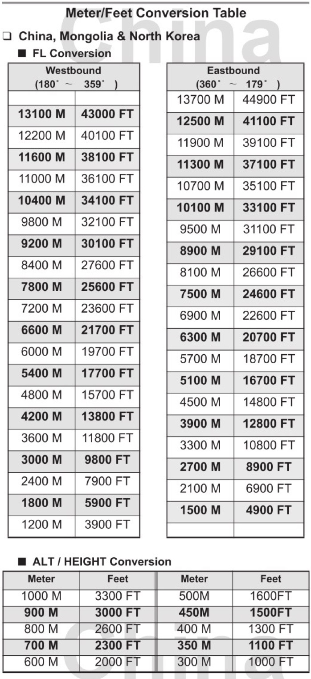
TL
TA
550M 1800ft
China

Slide 41
ZSSS(SHA) 10ft | RKSS(GMP) 59ft
China Eastern 131.5 DCL -20분, No READBACK | KE GMP 131.15
PA
Rwy 32L Landing
(06:00L~0900L / 12:00L~15:00L /18:00L~21:00L)
SHA : SID (NADP 1) N DEP Freq : 126.65 South DEP : 121.10 (넘겨줌)
18R | LAMEN 61D |  |  | 183 |  | 183 | 3000 (900m) | 3000 900m | 183
36L | LAMEN 73D |  |  | 003 |  | 003 | 3000 (900m) | 3000 900m | 003
 | LAMEN 71D |  |  | 003 |  | 003 | 3000 or 4900 | 3000 4900 | 003
SHA 117.2 |  |  | 18L 111.3 |  |  |  | 36R 110.3
HUD |  | 18R (9’) |  |  | 10827’ |  |  | 36L (76’)
RWY 36L LAMEN 71D : L/H Turn Below 200m(660ft) in DCL
DEP 126.65(121.1)
SHA APP 125.4 – 125.625 – SHA 120.95
ICN 125.725 – 124.52
APP – 119.75
China
GMP : STAR
ILS 32L/R | OLMEN xT |  |  | BUMSI | OLMEN 160
ILS 14R | OLMEN xU |  |  | DOKDO | OLMEN 160
HUD |  |  | 32L(41’) | 10499’ | 14R(34’)
 |  |  | 32R(42’) | 11811’ | 14L(38’)
FIX |  | KIP /8(RWY 32), YJU R271, P73 /2
32L : D3(6532’), E2(9117’), 32R : E1(6614’) 14R : C1(6578’)
32L/R : 8 KIP L/G, 14R : LOC CAPT L/G FAF : Final Flap TWR -> GND -> APRON (All by ATC) Except RWY14R Landing (Until R)

Slide 42
RKSS(GMP) 59ft | ZBAA(PEK) 116ft
KE GMP 131.15 DCL -15분 가능 TOBT 5분 차이시 CTC Comm | Air China Beijing 131.5
PA
Rwy 32R Takeoff
(06:00L~0900L / 12:00L~15:00L /18:00L~21:00L)
GMP : SID (NADP 1)
32L/R | NOPIK xT |  | 324 |  | 324 |  | 5000 |  | 324
 | (NOPIK xQ) |  | 324 |  | 324 |  | 5000 |  | 324
14L/R | NOPIK xU |  | 144 |  | 144 |  | 6000 |  | 144
KIP 113.6 |  | 32L 108.3 | 32R 110.7 |  |  | 14L 109.9 |  | 14R 108.7
32L/R : EO32L/R, R225 YJU R271 |  |  |  | 14L/R : EO14L/R, R220 P73 /2
HUD |  | 32L(41’) |  | 10499’ |  |  | 14R(34’)
 |  | 32R(42’) |  | 11811’ |  |  | 14L(38’)
APRON(130.875) -> GND(121.9) -> TWR (All by ATC)
DEP 125.15 – TGU 132.8 – DLC 132.95
TAO 133.72 – 128.15 – PEK 125.6
PEK APP 120.6 – Final 119.0
China
PEK : STAR (RW01/19 main (RW36L/18R))
01(36L) | DUMAP xZA | AA421 | ILS Z 01(Y 36L)
19(18R)) | DUMAP xZA | AA521 | ILS Z 19(Y 18R)
HUD | 01(84’) 12467’ 19(94’) 3.2도
 | 36L(107’) 10499’ 18R(115’)
FIX : RWxx /8(180kts), /6(160kts) TMA Max 280kts
01 : Q5(5223’), Q6(7024’), 19 :Q4(5298’), Q3(7103’) 36L : P6(6276’), P7(7719’), 18R : P3(6223’), P2(7552’)
APU off Procedure (GND Air Cond’ & GPU) Standard TAXI RTE in Jeppesen Chart

Slide 43
TL
TA
550M 1800ft
China

Slide 44
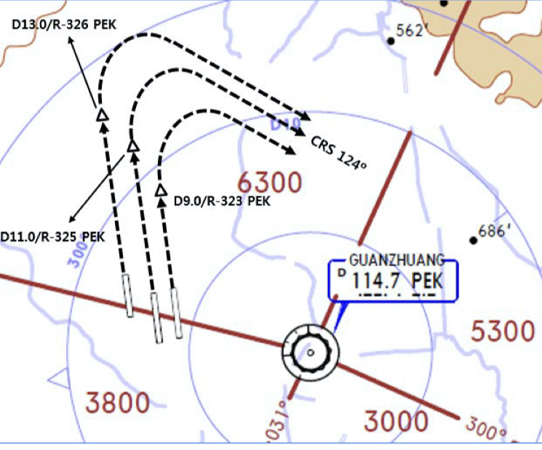
ZBAA(PEK) 116ft | RKSS(GMP) 59ft
Air China Beijing 131.5 DCL -30분, Voice -10분 (COBT/STD 15분 차이 CTC Comm) | KE GMP 131.15
PA
Rwy 32L Landing
(06:00L~0900L / 12:00L~15:00L /18:00L~21:00L)
PEK : SID (NADP 1) RW36R/18L Intersec T/O W2, W7
36R (01) | MUGLO xWD(xYD) |  |  | 359 |  |  | 359 | ATIS/DCL | 3000 900m | 359
18L (19) | MUGLO xZD(xYD) |  |  | 179 |  |  | 179 | ATIS/DCL | 3000 900m | 179
PEK 114.7 |  |  | 36R 111.55 |  | 18L 109.3 |  |  | 01 108.5 |  | 19 108.9
36R : PEK 325/11, 36L : PEK 326/13, 01 : PEK 323/9 R124
HUD |  | 36R(98’) 01(84’) |  |  |  | 12467’ |  |  | 18L(110’) 19(94’)
COBT from ATIS “Enroute”, Bad Wx DOTRA SID
DEP 124.4
PEK APP 120.6 – PEK 125.6
DLC 123.2 – 132.95
ICN 132.8 – APP 119.75
China
GMP : STAR
ILS 32L/R | REBIT xT(xQ) |  |  | BUMSI | REBIT 170
ILS 14R | REBIT xU |  |  | DOKDO
HUD |  |  | 32L(41’) | 10499’ | 14R(34’)
 |  |  | 32R(42’) | 11811’ | 14L(38’)
FIX |  | KIP /8(RWY 32), YJU R271, P73 /2
32L : D3(6532’), E2(9117’), 32R : E1(6614’) 14R : C1(6578’)
32L/R : 8 KIP L/G, 14R : LOC CAPT L/G FAF : Final Flap TWR -> GND -> APRON (All by ATC) Except RWY14R Landing (Until R)

Slide 45
RKSS(GMP) 59ft | RJBB(KIX) 17ft
KE GMP 131.15 DCL -15분 가능 TOBT 5분 차이시 CTC Comm | KE KIX 130.95
PA
Rwy 32R Takeoff
(06:00L~0900L / 12:00L~15:00L /18:00L~21:00L)
GMP : SID (NADP 1)
32L/R | EGOBA xT |  | 324 |  | 324 |  | 5000 |  | 324
 | (EGOBA xQ) |  | 324 |  | 324 |  | 5000 |  | 324
14L/R | EGOBA xU |  | 144 |  | 144 |  | 6000 |  | 144
KIP 113.6 |  | 32L 108.3 | 32R 110.7 |  |  | 14L 109.9 |  | 14R 108.7
32L/R : EO32L/R, R225 YJU R271 |  |  |  | 14L/R : EO14L/R, R220 P73 /2
HUD |  | 32L(41’) |  | 10499’ |  |  | 14R(34’)
 |  | 32R(42’) |  | 11811’ |  |  | 14L(38’)
APRON(130.875) -> GND(121.9) -> TWR (All by ATC)
DEP 125.15 – TGU 134.17 - TKO 133.8
KIX RDR 120.85
KIX APP 120.25
Japan
KIX : STAR (SAEKI 170, RANDY 150)
06L | ALISA B | BERRY | ILS Y 06L
06R | ALISA A | ALLAN | ILS Y 06R
24L/R | ALISA C | MAYAH | ILS Z 24L/R
HUD | 06L(15’) 13123’ 24R(23’)
 | 06R(5’) 11483’ 24L(12’)
06L : B8(5160’), B6(6751’), 24R : B7(5318’), B9(6751’) 06R : A7(5137’), A6(6938’), 24L : A8(5269’), A9(6976’)
RWY06 : After 2500ft L/G DN, After 1500ft L/D FLAP TAXI RTE 1, 2

Slide 46
RJBB(KIX) 17ft | RKSS(GMP) 59ft
KE KIX 130.95 DCL -15분 | KE GMP 131.15
PA
Rwy 32L Landing
(06:00L~0900L / 12:00L~15:00L /18:00L~21:00L)
KIX : SID – SOUJA tx (NADP 1)
06L/R | HELEN x - SOUJA tx |  | 059 |  | 059 | ATC (9000) |  | 059
24L/R |  |  | 239 |  | 239 | ATC (9000) |  | 239
KIE 111.6 |  | 06L 108.7 |  | 06R 108.1 |  | 24L 110.7 | 24R 108.5
HUD | 06L(15’) |  | 13123’ |  |  | 24R(23’)
 | 06R (5’) |  | 13123’ |  |  | 24L (12’)
APU Start, TAXI RTE 1, 2
DEP 119.2
TKO 132.7 – 133.8
TGU 120.57
APP 119.75
Japan
GMP : STAR
ILS 32L/R | GUKDO xT |  |  | BUMSI | OLMEN 160
ILS 14R | GUKDO xU |  |  | DOKDO | OLMEN 160
HUD |  |  | 32L(41’) | 10499’ | 14R(34’)
 |  |  | 32R(42’) | 11811’ | 14L(38’)
FIX |  | KIP /8(RWY 32), YJU R271, P73 /2
32L : D3(6532’), E2(9117’), 32R : E1(6614’) 14R : C1(6578’)
32L/R : 8 KIP L/G, 14R : LOC CAPT L/G FAF : Final Flap TWR -> GND -> APRON (All by ATC) Except RWY14R Landing (Until R)

Slide 47
RKPC(CJU) 119ft | ZBAA(PEK) 116ft
KE CJU 129.4 DCL -10분 | Air China Beijing 132.0
PA
CJU : SID (NADP 1)
07 | LIMDI xE |  |  | 066 |  | 066 |  | 9000 | 066
25 | KAMIT xW |  |  | 246 |  | 246 |  | ATC | 246
YDM 109.0 |  |  | 07 109.9 |  |  |  | 25 111.3
07 : NONE |  |  |  |  | 25 : YDM246/3, R290
HUD |  | 07(87’) |  |  | 10433’ |  |  | 25(76’)
07 : Passing G4 CTC TWR 25 : 31 Holding PSN on P, E1,2,3 CTC TWR
China
DEP 121.2 – TGU 124.52 – 120.72 – 126.17 – 132.8
DLC 132.95 - TAO 133.72 – 128.15 – PEK 125.6
PEK APP 120.6 – Final 119.0
PEK : STAR (RW01/19 main (RW36L/18R))
01(36L) | DUMAP xZA | AA421 | ILS Z 01(Y 36L)
19(18R)) | DUMAP xZA | AA521 | ILS Z 19(Y 18R)
HUD | 01(84’) 12467’ 19(94’) 3.2도
 | 36L(107’) 10499’ 18R(115’)
FIX : RWxx /8(180kts), /6(160kts) TMA Max 280kts
01 : Q5(5223’), Q6(7024’), 19 :Q4(5298’), Q3(7103’) 36L : P6(6276’), P7(7719’), 18R : P3(6223’), P2(7552’)
APU off Procedure (GND Air Cond’ & GPU) Standard TAXI RTE in Jeppesen Chart

Slide 48
TL
TA
550M 1800ft
China

Slide 49
ZBAA(PEK) 116ft | RKPC(CJU) 119ft
Air China Beijing 132.0 DCL 30분전, Voice 10분전 (COBT/STD 15분 차이 CTC Comm) | KE CJU 129.4
PA
PEK : SID (NADP 1) RW36R/18L Intersec T/O W2, W7
36R (01) | MUGLO xWD(xYD) |  |  | 359 |  |  | 359 | ATIS/DCL | 3000 900m | 359
18L (19) | MUGLO xZD(xYD) |  |  | 179 |  |  | 179 | ATIS/DCL | 3000 900m | 179
PEK 114.7 |  |  | 36R 111.55 |  | 18L 109.3 |  |  | 01 108.5 |  | 19 108.9
36R : PEK 325/11, 36L : PEK 326/13, 01 : PEK 323/9 R124
HUD |  | 36R(98’) 01(84’) |  |  |  | 12467’ |  |  | 18L(110’) 19(94’)
COBT from ATIS “Enroute”, Bad Wx DOTRA SID
DEP 124.4
PEK APP 120.6 – PEK 125.6
DLC 123.2 – 132.95
ICN 132.8 – 126.17 – 120.72
124.52 - APP 119.75
China
CJU : STAR AFT Merge PT(220kts) DCT IAF(210kts), FAF (160kts)
ILS Z 07 | LIMDI xP |  | YUMIN
RNP Y 07 (No LPV), RNP Z 07 AR (No B737-900, RNP 0.11)
ILS Z 25 | LIMDI xT(xM) |  | DUKAL
HUD |  | 07(87’) |  | 10433’ |  | 25(76’)
07 : P6(5176’), P5(5882’), P4(6840’-ATC HIRO) 25 : P7(5219’), P8(5882’), P10(7524’-ATC HIRO)
Entering Rapid TWY CTC GND 121.675 (STOP x) HST 40KTS

Slide 50
RKPK(PUS) 13ft | ZSPD(PVG) 13ft
KE Gimhae 129.2 DCL -5분 | China Eastern 130.5
PA
PUS : SID (Mod NADP CLB2 1000, 14000 MAX)
36 | SOORO x TOPAX tx |  |  | 306 |  | 280 |  | ATC |  | 279
18 | BULIM x ENGOT tx |  |  | 182 |  | 182 |  | 5000 |  | 182
KMH 113.8 |  |  | PSN 114.0 |  | 36L 108.5 |  |  |  | 36R 109.5
36 : KMH R091, R271, R185
HUD |  | 36L(13’) 10499’ 36R(8’) 8999’ |  |  |  |  | 18R(13’) 8530’ 18L(13’) 8999’
RWY36 400ft Man L/H turn, Max Taxi SPD 20KTS
DEP 125.5 – TGU 128.17 – 124.52(125.72)
SHA 120.95
SHA APP 125.62(119.975) – 125.4
China
PVG : STAR (North of ‘PVGNB’, R-276 Prohibited)
34R(L)/35L(R) | DUM 91A/92A | MP2 | ILS Z xx
16L(R)/17R(L) | DUM 81A/82A | MP1 | ILS Z xx
HUD | 34R/L(11’/12’) 12467’ 16L/R(12’/11’)
 | 35R(10’) 13123’ 17L10’)
 | 35L(12’) 11155’ 17R(12’)
34R : G4(5603’), G5(6896’), 16L : G3(5577’), G2(6909’) 35L : D4(5636’), D5(6932’), 17R : D3(5626’), D2(6942’)
Normally DUMET 6000m, ILS Ident /6 160kts Follow Me Car Insight – TAXI L/T off,APU off Procedure

Slide 51
TL
TA
550M 1800ft
China

Slide 52
ZSPD(PVG) 13ft | RKPK(PUS) 13ft
China Eastern 130.5 DCL 10분전, No READ BACK! | KE Gimhae 129.2
PA
PVG : SID (NADP 1) (ATC Hold Expected Fuel Add!!)
34L/R 35R/L | LAM 92D (LAM 91D) |  |  | 348 |  |  | 348 | ATC (900m) | 348
16R/L 17L/R | LAM 82D (LAM 81D) |  |  | 168 |  |  | 168 | ATC (900m) | 168
PUD 116.9 |  |  | 34R 108.9 |  | 35L 108.1 |  |  | 34L 108.3 | 35R 111.9
 |  |  | 16L 111.5 |  | 17R 111.1 |  |  | 16R 108.7 | 17L 110.7
HUD |  | 34R/L(11’/12’) 35R(10’) 35L(12’) |  |  |  | 12467’ 13123’ 11155’ |  | 16L/R(12’/11’) 17L(10’) 17R(12’)
APU Start, TUG Connect After Beacon L/T ON Ready for Intersection T/O
SHA APP 125.4 (Without Instruction)
SHA APP 125.62(119.975)
SHA 120.95
ICN 125.725(124.52) – 128.17
APP – 125.5
China
PUS : STAR (Tail Wind 36R 136000lbs F40)
ILS 36 | KEVOX x | ANROD | 9DME LG, 8DME FLAP
VOR 18 | GAYHA x | ANROD | 18 Circling Click!!
HUD | 36L(13’) 10499’ 36R(8’) 8999’ |  | 18R(13’) 8530’ 18L(13’) 8999’
FIX | 36 : IKMA/IKHE /9, /8 |  | 18 : KMH R284, R280
36L : C4 (6299’), C2(7795’) / 36R : E3(5866’), E2(7339’) 18R : C6(5770’), C7 (6824’) / 18L : E4(5882’), E5(8792’)
Vacate C3,C4 by ATC only. Max Taxi SPD 20KTS C2 HOLD SHORT 가까움(Vacate TaxiSPD)

Slide 53
RKSI(ICN) 23ft | ZSNJ(NKG) 49ft
KE ICN 131.5 DCL -10분 TOBT 5분 차이시 CTC Comm | None
PA
ICN : SID (33/34 NADP 1, 15/16 NADP 2)
33L/R | BOPTA xA |  | 333 |  | 333 |  | ATC |  | 333
34L/R | BOPTA xY |  | 333 |  | 333 |  | ATC |  | 333
15L/R | BOPTA xC |  | 153 |  | 153 |  | 5000 |  | 153
16L/R | BOPTA xH |  | 153 |  | 153 |  | 5000 |  | 153
NCN 113.8 |  | 33L 109.3 |  | 33R 108.9 |  | 15L 111.9 |  | 15R 109.1
WNG 112.9 |  | 34L 109.95 |  | 34R 108.1 |  | 16L 110.35 |  | 16R 108.55
33L/R : NC05L/R, R242 YJU R271 |  |  |  | 34L/R : EO34L/R, R242 YJU R271
HUD | 33L/R 34L(23’) |  |  | 12303’ |  | 15L/R 16R(23’)
 | 34R (23’) |  |  | 13123’ |  | 16L (23’)
Parallel TWY 10KTS 이상(R17 MAX 15kts)
DEP 125.15 – TGU 126.17 – 120.72 – 124.52(125.72)
SHA 120.95 – 120.55 – 125.95 – 119.075
NKG APP 126.55 – 119.25
China
NKG : STAR (‘D’ N31 34.0 E118 42.1 – R101, R289)
07 (06) | ESB 71F/21A (ESB 61F/11A) | SNQ | ILS Z 07 (ILS Z 06)
25 (24) | ESB 52F/22A (ESB 42F/12A) | NJ210 | ILS Z 25 (ILS Z 24)
HUD | 07(41’) 11811’ 25(39’)
 | 06(43’) 11811’ 24(38’)
07 : D5(6499’), D6(7582’), 25 : D2(6505’), D1(7582’) 06 : A5(6614’), A6(7860’), 24 : A3(6637’), A9(7864’)
IAF, Missed App SPD APP : 210kts or 205kts Follow Me Car on C 13, APU off Procedure

Slide 54
TL
TA
550M 1800ft
China

Slide 55
ZSNJ(NKG) 49ft | RKSI(ICN) 23ft
None DCL 가능, READ BACK! | KE ICN 131.5
PA
NKG : SID (NADP 1) (ATC Hold Expected Fuel Add!!)
06 (07) | ESB 61X/11D (ESB 71X/21D) |  |  | 064 |  |  | 064 | 3000 (900m) | 3000 900m | 064
24 (25) | ESB 42X/12D (ESB 52X/22D) |  |  | 244 |  |  | 244 | 3000 (900m) | 3000 900m | 244
NJL 113.6 |  |  | 07 108.7 |  | 25 111.3 |  |  | 06 110.3 |  | 24 110.9
HUD |  | 06(43’) 07(41’) |  |  |  | 11811’ |  |  | 24(38’) 25(39’)
APU Start, TUG Connect After Beacon L/T ON
DEP 119.25
NKG APP 126.55
SHA 119.075 – 125.95 - 120.55 - 120.95
ICN 125.725(124.52) – 120.72 – 126.17
APP – 119.75
China
ICN : STAR
ILS 33/34 | OLMEN xE | ENPIL | OLMEN 180
ILS 15/16 | OLMEN xH | MUNAN | OLMEN 180
HUD | 33L/R 34L(23’) | 12303’ | 15L/R 16R(23’)
 | 34R(23’) | 13123’ | 16L(23’)
FIX | RWY /8, /5 , YJU R271
33R : C4(7529’), C5(8513’), 33L : B4(7563’), B5(8513‘) 15L : C2(7522’), C1(8536’), 15R : B3(7454‘), B2(8641‘)
34L : P7(5600’), P8(6578’), 34R : N4(6876’), N5(8507‘) 16R : P6(5597’), P5(6574’), 16L : N3(7043‘), N2(8444‘)
8NM 180kts, 5NM 160kts, Parr TAXI 10kts이상, HIRO

Slide 56
RKSI(ICN) 23ft | ZSQD(TAO) 30ft
KE ICN 131.5 DCL -10분 TOBT 5분 차이시 CTC Comm | None
PA
ICN : SID (33/34 NADP 1, 15/16 NADP 2)
33L/R | NOPIK xA |  | 333 |  | 333 |  | ATC |  | 333
34L/R | NOPIK xY |  | 333 |  | 333 |  | ATC |  | 333
15L/R | BINIL xC |  | 153 |  | 153 |  | 5000 |  | 153
16L/R | BINIL xH |  | 153 |  | 153 |  | 5000 |  | 153
NCN 113.8 |  | 33L 109.3 |  | 33R 108.9 |  | 15L 111.9 |  | 15R 109.1
WNG 112.9 |  | 34L 109.95 |  | 34R 108.1 |  | 16L 110.35 |  | 16R 108.55
33L/R : NC05L/R, R242 P518 R068, R278 |  |  |  | 34L/R : EO34L/R, R242 P518 R068, R278
HUD | 33L/R 34L(23’) |  |  | 12303’ |  | 15L/R 16R(23’)
 | 34R (23’) |  |  | 13123’ |  | 16L (23’)
Parallel TWY 10KTS 이상(R17 MAX 15kts)
DEP 125.15 – TGU 128.7 – DLC 132.95
TAO 128.55 – 134.85
TAO APP 119.77 – 119.4
China
TAO : STAR (After AGAVO Direct IKEKA then LATUX)
35(34) | LAT 91A/01A | JD405 | ILS Z 35(34)
17(16) | LAT 81A/11A | JD305 | ILS Z 17(16)
HUD | 35(27’) 11811’ 17(29’)
 | 34(27’) 11811’ 16(27’)
FIX : AVBIK R014, LAROP R159, R183 (두점 연결 )
35 : S2(5255’), S4(6624’), 17 : S1(5282’), S3(6604’) 34 : R2(5278’), R4(6650’), 16 : R1(5318’), R3(6706’)
위의 Point 불가시 TWR 보고, Apron CTC 주의 Follow Me Car on Lxx APU off Procedure

Slide 57
TL
TA
550M 1800ft
China

Slide 58
ZSQD(TAO) 30ft | RKSI(ICN) 23ft
None DCL 가능, No READ BACK! (Voice 10분전 부터) | KE ICN 131.5
PA
TAO : SID (NADP 1) Walk Around Ramp Pass & PW
34 (35) | LAT 91D/01D |  |  | 350 |  |  | 350 | ATC 3000 (900m) | 3000 900m | 350
16 (17) | LAT 81D/11D |  |  | 170 |  |  | 170 | ATC 3000 (900m) | 3000 900m | 170
JDG 114.45 |  |  | 17 110.15 |  | 35 109.75 |  |  | 16 111.9 |  | 34 108.55
HUD |  | 34(27’) 35(27’) |  |  |  | 11811’ |  |  | 16(27’) 17(29’)
FIX : AVBIK R014, LAROP R159, R183 (두점 연결)
Heading 190, Join W209 -> DCT LATUX CRS 148
TAO APP 119.4
TAO 119.73
TAO 134.85 – DLC 132.95
ICN 128.7 – APP 119.75
China
ICN : STAR
ILS 33/34 | REBIT xA | PAMBI | REBIT 170
ILS 15/16 | REBIT xH | MUNAN | REBIT 170
HUD | 33L/R 34L(23’) | 12303’ | 15L/R 16R(23’)
 | 34R(23’) | 13123’ | 16L(23’)
FIX | RWY /8, /5 , P518 R068, R278
33R : C4(7529’), C5(8513’), 33L : B4(7563’), B5(8513‘) 15L : C2(7522’), C1(8536’), 15R : B3(7454‘), B2(8641‘)
34L : P7(5600’), P8(6578’), 34R : N4(6876’), N5(8507‘) 16R : P6(5597’), P5(6574’), 16L : N3(7043‘), N2(8444‘)
8NM 180kts, 5NM 160kts, Parr TAXI 10kts이상, HIRO

Slide 59
RKSI(ICN) 23ft | ZBAA(PEK) 116ft
KE ICN 131.5 DCL -10분 TOBT 5분 차이시 CTC Comm | Air China Beijing 132.0
PA
ICN : SID (33/34 NADP 1, 15/16 NADP 2)
33L/R | NOPIK xA |  | 333 |  | 333 |  | ATC |  | 333
34L/R | NOPIK xY |  | 333 |  | 333 |  | ATC |  | 333
15L/R | BINIL xC |  | 153 |  | 153 |  | 5000 |  | 153
16L/R | BINIL xH |  | 153 |  | 153 |  | 5000 |  | 153
NCN 113.8 |  | 33L 109.3 |  | 33R 108.9 |  | 15L 111.9 |  | 15R 109.1
WNG 112.9 |  | 34L 109.95 |  | 34R 108.1 |  | 16L 110.35 |  | 16R 108.55
33L/R : NC05L/R, R242 P518 R068, R278 |  |  |  | 34L/R : EO34L/R, R242 P518 R068, R278
HUD | 33L/R 34L(23’) |  |  | 12303’ |  | 15L/R 16R(23’)
 | 34R (23’) |  |  | 13123’ |  | 16L (23’)
Parallel TWY 10KTS 이상(R17 MAX 15kts)
DEP 125.15 – TGU 132.8 – DLC 132.95
TAO 133.72 – 128.15 – PEK 125.6
PEK APP 120.6 – Final 119.0
China
PEK : STAR (RW01/19 main (RW36L/18R))
01(36L) | DUMAP xZA | AA421 | ILS Z 01(Y 36L)
19(18R)) | DUMAP xZA | AA521 | ILS Z 19(Y 18R)
HUD | 01(84’) 12467’ 19(94’) 3.2도
 | 36L(107’) 10499’ 18R(115’)
FIX : RWxx /8(180kts), /6(160kts) TMA Max 280kts
01 : Q5(5223’), Q6(7024’), 19 :Q4(5298’), Q3(7103’) 36L : P6(6276’), P7(7719’), 18R : P3(6223’), P2(7552’)
APU off Procedure (GND Air Cond’ & GPU) Standard TAXI RTE in Jeppesen Chart

Slide 60
TL
TA
550M 1800ft
China

Slide 61
ZBAA(PEK) 116ft | RKSI(ICN) 23ft
Air China Beijing 132.0 DCL 30분전, Voice 10분전 (COBT/STD 15분 차이 CTC Comm) | KE ICN 131.5
PA
PEK : SID (NADP 1) RW36R/18L Intersec T/O W2, W7
36R (01) | MUGLO xWD(xYD) |  |  | 359 |  |  | 359 | ATIS/DCL | 3000 900m | 359
18L (19) | MUGLO xZD(xYD) |  |  | 179 |  |  | 179 | ATIS/DCL | 3000 900m | 179
PEK 114.7 |  |  | 36R 111.55 |  | 18L 109.3 |  |  | 01 108.5 |  | 19 108.9
36R : PEK 325/11, 36L : PEK 326/13, 01 : PEK 323/9 R124
HUD |  | 36R(98’) 01(84’) |  |  |  | 12467’ |  |  | 18L(110’) 19(94’)
COBT from ATIS “Enroute”, Bad Wx DOTRA SID
DEP 124.4
PEK APP 120.6 – PEK 125.6
DLC 123.2 – 132.95
ICN 132.8 – APP 119.75
China
ICN : STAR
ILS 33/34 | REBIT xA | PAMBI | REBIT 170
ILS 15/16 | REBIT xH | MUNAN | REBIT 170
HUD | 33L/R 34L(23’) | 12303’ | 15L/R 16R(23’)
 | 34R(23’) | 13123’ | 16L(23’)
FIX | RWY /8, /5 , P518 R068, R278
33R : C4(7529’), C5(8513’), 33L : B4(7563’), B5(8513‘) 15L : C2(7522’), C1(8536’), 15R : B3(7454‘), B2(8641‘)
34L : P7(5600’), P8(6578’), 34R : N4(6876’), N5(8507‘) 16R : P6(5597’), P5(6574’), 16L : N3(7043‘), N2(8444‘)
8NM 180kts, 5NM 160kts, Parr TAXI 10kts이상, HIRO

Slide 62
RKSI(ICN) 23ft | ZYTX(SHE) 198ft
KE ICN 131.5 DCL -10분 TOBT 5분 차이시 CTC Comm | China Southern Dispatch 131.5
PA
ICN : SID (33/34 NADP 1, 15/16 NADP 2)
33L/R | NOPIK xA |  | 333 |  | 333 |  | ATC |  | 333
34L/R | NOPIK xY |  | 333 |  | 333 |  | ATC |  | 333
15L/R | BINIL xC |  | 153 |  | 153 |  | 5000 |  | 153
16L/R | BINIL xH |  | 153 |  | 153 |  | 5000 |  | 153
NCN 113.8 |  | 33L 109.3 |  | 33R 108.9 |  | 15L 111.9 |  | 15R 109.1
WNG 112.9 |  | 34L 109.95 |  | 34R 108.1 |  | 16L 110.35 |  | 16R 108.55
33L/R : NC05L/R, R242 P518 R068, R278 |  |  |  | 34L/R : EO34L/R, R242 P518 R068, R278
HUD | 33L/R 34L(23’) |  |  | 12303’ |  | 15L/R 16R(23’)
 | 34R (23’) |  |  | 13123’ |  | 16L (23’)
Parallel TWY 10KTS 이상(R17 MAX 15kts)
DEP 125.15 – TGU 132.8 – DLC 132.95 – 135.65
DLC 134.325(128.775)
SHE APP 125.55 – 119.825
TWR 118.1
China
SHE : STAR (CLR Limit TOSID Late Handoff to SHE)
06 | TOSID 62A, 61A | TX504 | ILS Z 06
24 | TOSID 72A, 11A | TX662 | ILS Z 24
HUD | 06(170’) 10499’ 24(198’)
Around TOSID – Present TRK or HDG – CTC SHE CTL
06 : D(6210’), C(7854’), 24 : J(6227’), K(7864’) - ATC
06 : HP06(03), 24 : HP06(03) Follow Me Car Normally Remain Parking Brake SET!! APU off Procedure (GND Air Cond’ & GPU)

Slide 63
TL
TA
550M 1800ft
China

Slide 64
ZYTX(SHE) 198ft | RKSI(ICN) 23ft
China Southern Dispatch 131.5 DCL 가능, 5분전 READ BACK! (Voice 10분전) | KE ICN 131.5
PA
SHE : SID (NADP 1) A2, A8 Intersec T/O by ATC
06 | TOSID 61,62D |  |  | 056 |  | 056 | ATIS/DCL | 3000 900m | 056
24 | TOSID 71,72D |  |  | 236 |  | 236 | ATIS/DCL | 3000 900m | 236
SEY 114.1 |  |  | 06 110.5 |  |  |  | 24 110.3 |  | 19 108.9
HUD |  | 06(170’) |  |  | 10499’ |  |  | 24(198’)
ADT = CTOT See Eroute ATIS Follow FollowMe Car Until HPxx Be Careful “Hold short CAT I Hold line” Maintain Present TRK/HDG Join A588(CRS 217) Offset R3 → Active Fix DCT and EXE again!!
CTC APP without TWR Instruction
APP 119.825 – 125.55
DLC 134.325 – 135.65
DLC 132.95
ICN 132.8 – APP 119.75
China
ICN : STAR
ILS 33/34 | REBIT xA | PAMBI | REBIT 170
ILS 15/16 | REBIT xH | MUNAN | REBIT 170
HUD | 33L/R 34L(23’) | 12303’ | 15L/R 16R(23’)
 | 34R(23’) | 13123’ | 16L(23’)
FIX | RWY /8, /5 , P518 R068, R278
33R : C4(7529’), C5(8513’), 33L : B4(7563’), B5(8513‘) 15L : C2(7522’), C1(8536’), 15R : B3(7454‘), B2(8641‘)
34L : P7(5600’), P8(6578’), 34R : N4(6876’), N5(8507‘) 16R : P6(5597’), P5(6574’), 16L : N3(7043‘), N2(8444‘)
8NM 180kts, 5NM 160kts, Parr TAXI 10kts이상, HIRO

Slide 65
RKSI(ICN) 23ft | ZSPD(PVG) 13ft
KE ICN 131.5 DCL -10분 TOBT 5분 차이시 CTC Comm | China Eastern 130.5
PA
ICN : SID (33/34 NADP 1, 15/16 NADP 2)
33L/R | BOPTA xA |  | 333 |  | 333 |  | ATC |  | 333
34L/R | BOPTA xY |  | 333 |  | 333 |  | ATC |  | 333
15L/R | BOPTA xC |  | 153 |  | 153 |  | 5000 |  | 153
16L/R | BOPTA xH |  | 153 |  | 153 |  | 5000 |  | 153
NCN 113.8 |  | 33L 109.3 |  | 33R 108.9 |  | 15L 111.9 |  | 15R 109.1
WNG 112.9 |  | 34L 109.95 |  | 34R 108.1 |  | 16L 110.35 |  | 16R 108.55
33L/R : NC05L/R, R242 YJU R271 |  |  |  | 34L/R : EO34L/R, R242 YJU R271
HUD | 33L/R 34L(23’) |  |  | 12303’ |  | 15L/R 16R(23’)
 | 34R (23’) |  |  | 13123’ |  | 16L (23’)
Parallel TWY 10KTS 이상(R17 MAX 15kts)
DEP 125.15 – TGU 126.17 – 120.72 – 124.52(125.72)
SHA 120.95
SHA APP 125.62(119.975) – 125.4
China
PVG : STAR (North of ‘PVGNB’, R-276 Prohibited)
34R(L)/35L(R) | DUM 91A/92A | MP2 | ILS Z xx
16L(R)/17R(L) | DUM 81A/82A | MP1 | ILS Z xx
HUD | 34R/L(11’/12’) 12467’ 16L/R(12’/11’)
 | 35R(10’) 13123’ 17L(10’)
 | 35L(12’) 11155’ 17R(12’)
34R : G4(5603’), G5(6896’), 16L : G3(5577’), G2(6909’) 35L : D4(5636’), D5(6932’), 17R : D3(5626’), D2(6942’)
Normally DUMET 6000m, ILS Ident /6 160kts Follow Me Car Insight – TAXI L/T off,APU off Procedure

Slide 66
TL
TA
550M 1800ft
China

Slide 67
ZSPD(PVG) 13ft | RKSI(ICN) 23ft
China Eastern 130.5 DCL 10분전, No READ BACK! | KE ICN 131.5
PA
PVG : SID (NADP 1) (ATC Hold Expected Fuel Add!!)
34L/R 35R/L | LAM 92D (LAM 91D) |  |  | 348 |  |  | 348 | ATC (900m) | 348
16R/L 17L/R | LAM 82D (LAM 81D) |  |  | 168 |  |  | 168 | ATC (900m) | 168
PUD 116.9 |  |  | 34R 108.9 |  | 35L 108.1 |  |  | 34L 108.3 | 35R 111.9
 |  |  | 16L 111.5 |  | 17R 111.1 |  |  | 16R 108.7 | 17L 110.7
HUD |  | 34R/L(11’/12’) 35R(10’) 35L(12’) |  |  |  | 12467’ 13123’ 11155’ |  | 16L/R(12’/11’) 17L(10’) 17R(12’)
APU Start, TUG Connect After Beacon L/T ON Ready for Intersection T/O
SHA APP 125.4 (Without Instruction)
SHA APP 125.62(119.975)
SHA 120.95
ICN 125.725(124.52) – 120.72 – 126.17
APP – 119.75
China
ICN : STAR
ILS 33/34 | OLMEN xE | ENPIL | OLMEN 180
ILS 15/16 | OLMEN xH | MUNAN | OLMEN 180
HUD | 33L/R 34L(23’) | 12303’ | 15L/R 16R(23’)
 | 34R(23’) | 13123’ | 16L(23’)
FIX | RWY /8, /5 , YJU R271
33R : C4(7529’), C5(8513’), 33L : B4(7563’), B5(8513‘) 15L : C2(7522’), C1(8536’), 15R : B3(7454‘), B2(8641‘)
34L : P7(5600’), P8(6578’), 34R : N4(6876’), N5(8507‘) 16R : P6(5597’), P5(6574’), 16L : N3(7043‘), N2(8444‘)
8NM 180kts, 5NM 160kts, Parr TAXI 10kts이상, HIRO

Slide 68
RKSI(ICN) 23ft | ZYYJ(YNJ) 624ft
KE ICN 131.5 DCL -10분 TOBT 5분 차이시 CTC Comm | None No D-ATIS
PA
ICN : SID (33/34 NADP 1, 15/16 NADP 2)
33L/R | NOPIK xA |  | 333 |  | 333 |  | ATC |  | 333
34L/R | NOPIK xY |  | 333 |  | 333 |  | ATC |  | 333
15L/R | BINIL xC |  | 153 |  | 153 |  | 5000 |  | 153
16L/R | BINIL xH |  | 153 |  | 153 |  | 5000 |  | 153
NCN 113.8 |  | 33L 109.3 |  | 33R 108.9 |  | 15L 111.9 |  | 15R 109.1
WNG 112.9 |  | 34L 109.95 |  | 34R 108.1 |  | 16L 110.35 |  | 16R 108.55
33L/R : NC05L/R, R242 P518 R068, R278 |  |  |  | 34L/R : EO34L/R, R242 P518 R068, R278
HUD | 33L/R 34L(23’) |  |  | 12303’ |  | 15L/R 16R(23’)
 | 34R (23’) |  |  | 13123’ |  | 16L (23’)
Parallel TWY 10KTS 이상(R17 MAX 15kts)
DEP 125.15 – TGU 132.8 – DLC 132.95 – 135.65
128.77 – SHE 119.3 – 118.9
YNJ TWR 118.75
China
YNJ : RNP STAR (RW09 main for L/D) CHK NAV DATA for Holding Area(Expect Hold Mil Train)
09 | KAN/OMB 09A (KAN/OMB 04(02)A) | YJ504 (D267T) | ILS Z 09 (VOR 4도 off)
27 | KAN/OMB 19(18)A (KAN/OMB 11(12)A) | YJ604 (D341N) | ILS Z 27 (VOR 4도 off)
HUD | 09(621’) 8530’ 27(597’) 3.3도
FIX | DPRKK(N43 01.6/E129 52.0) R100, R200 RWY27 /12 (Do not overshoot 12DME ARC)
09 : C(5330’),180 BACK(8530’), 27 : B(7400’),A (8350’)
Expect Hold Due to MIL Train(ADD FUEL 30min) PAX Window must closed Between APP and DEP. Parking Brake Remain SET (Winter)

Slide 69
TL
TA
550M 1800ft
QFE Next Page
China

Slide 70
YNJ Altitude / Height Conversion Table
xxxx meters on STD 이후 적용 xxxx meters on QFE xxxx -> REQ QNH -> QNH xxx SET후 Conversion Table 사용 YNJ A/P Elevation : 623ft = 22.5hPa
Height based on QFE (instructed by ATC) | Altitude base on QNH (Set Altitude : QFE + Elev SET)
xxx m on QFE | xxx m plus Elevation Set
3000 m | 10500 ft
2700 m | 9500 ft
2400 m | 8500 ft
2100 m | 7500 ft
1800 m | 6500 ft
1500 m | 5600 ft
1200 m | 4600 ft
1100 m | 4200 ft
1000 m | 3900 ft
850 m | 3400 ft
800 m | 3200 ft
750 m | 3100 ft
550 m | 2400 ft
515 m | 2300 ft
500 m | 2300 ft
425 m | 2000 ft
355 m | 1800 ft
200 m | 1300 ft
100 m | 1000 ft
0 m | 623 ft

Slide 71
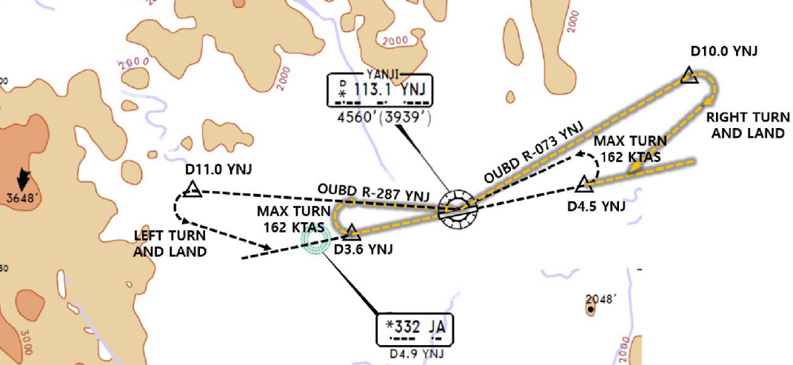
ZYYJ(YNJ) 624ft | RKSI(ICN) 23ft
None TWR 118.75 By Voice | KE ICN 131.5
PA
YNJ : RNP SID (NADP 1) RW27 Main CTOT from GND Staff due to Mil Train (ADD Fuel) Consider Improve C/B & NO Bleed T/O (in Summer)
27 | KANVU 19D (11D) |  |  | 271 |  | 271 | ATC/6500ft (1800mQFE) | 3000 900m | 271
09 | KANVU 09D (01D) |  |  | 091 |  | 091 | ATC/6500ft SPD 200kts | 3000 900m | 091
YNJ 113.1 |  |  | 09 108.7 |  |  |  | 27 109.3 |  | 19 108.9
FIX |  | 27 : YNJ 271/3.6, YNJ 073/10 (MAX 162kts) 09 : YNJ 091/4.5, YNJ 287/11 (MAX 162kts)
HUD |  | 27(597’) 3.3도 |  |  | 8530’ |  |  | 09(621’)
Must Check MTOW RWY 27 180 Back(Clockwise)
YNJ 118.75
SHE 132.35 – 119.3
DLC 128.77 – 135.65
132.95 - ICN 132.8
China
ICN : STAR
ILS 33/34 | REBIT xA | PAMBI | REBIT 170
ILS 15/16 | REBIT xH | MUNAN | REBIT 170
HUD | 33L/R 34L(23’) | 12303’ | 15L/R 16R(23’)
 | 34R(23’) | 13123’ | 16L(23’)
FIX | RWY /8, /5 , P518 R068, R278
33R : C4(7529’), C5(8513’), 33L : B4(7563’), B5(8513‘) 15L : C2(7522’), C1(8536’), 15R : B3(7454‘), B2(8641‘)
34L : P7(5600’), P8(6578’), 34R : N4(6876’), N5(8507‘) 16R : P6(5597’), P5(6574’), 16L : N3(7043‘), N2(8444‘)
8NM 180kts, 5NM 160kts, Parr TAXI 10kts이상, HIRO

Slide 72
RKSI(ICN) 23ft | ZSHC(HGH) 22ft
KE ICN 131.5 DCL -10분 TOBT 5분 차이시 CTC Comm | Hangzhou Reporting Office 130.65
PA
ICN : SID (33/34 NADP 1, 15/16 NADP 2)
33L/R | BOPTA xA |  | 333 |  | 333 |  | ATC |  | 333
34L/R | BOPTA xY |  | 333 |  | 333 |  | ATC |  | 333
15L/R | BOPTA xC |  | 153 |  | 153 |  | 5000 |  | 153
16L/R | BOPTA xH |  | 153 |  | 153 |  | 5000 |  | 153
NCN 113.8 |  | 33L 109.3 |  | 33R 108.9 |  | 15L 111.9 |  | 15R 109.1
WNG 112.9 |  | 34L 109.95 |  | 34R 108.1 |  | 16L 110.35 |  | 16R 108.55
33L/R : NC05L/R, R242 YJU R271 |  |  |  | 34L/R : EO34L/R, R242 YJU R271
HUD | 33L/R 34L(23’) |  |  | 12303’ |  | 15L/R 16R(23’)
 | 34R (23’) |  |  | 13123’ |  | 16L (23’)
Parallel TWY 10KTS 이상(R17 MAX 15kts)
DEP 125.15 – TGU 126.17 – 120.72 – 124.52(125.72)
SHA 120.95 – 120.55 - SHA APP 125.62 – 119.7
HGH APP 119.82 – 120.4 – 125.55
China
HGH : STAR - STAR, APP, Missed APP Keep Track Cauton Military Traffic (Missed APP ALT In ATIS)
07/06 | OKT, SUP 91A | HC410 | ILS Z xx
25/24 | OKT, SUP 81A | HC305 | ILS Z xx
HUD | 06(22’) 11155’ 24(22’)
 | 07(22’) 11811’ 25(22’)
FIX | APP SPD REST in APP Chart
06 : C5(5613’), C6(6899’), 24 : C4(5613’), C3(6981’) 07 : A5(6266’), A6(7565’), 25 : A4(6250’), A3(7555’) TWR Permisson Report RWY Vacated
TAXI RTE In Jeppesen Chart, Follow Me Car, APU off

Slide 73
TL
TA
550M 1800ft
China

Slide 74
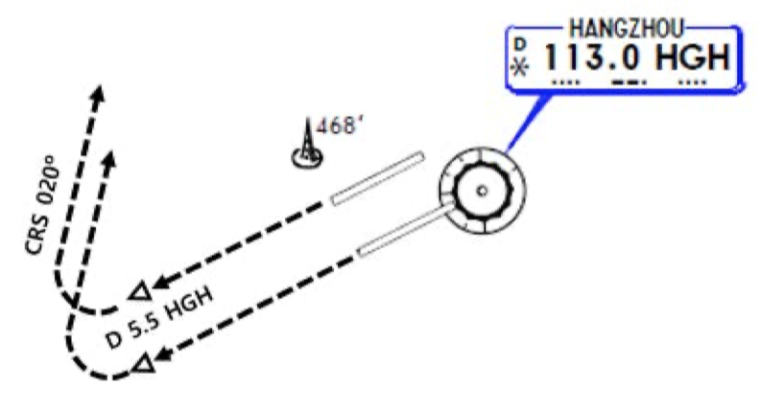
ZSHC(HGH) 22ft | RKSI(ICN) 23ft
Hangzhou Reporting Office 130.65 DCL(NO Readback) Voice 10min전 | KE ICN 131.5
PA
HGH: SID (NADP 1)
07/06 | OKT, SUP 91D |  |  | 069 |  | 069 | 3000 (900m) | 069
25/24 | SUP 81D |  |  | 249 |  | 249 | 3000 (900m) | 249
HGH 113.0 |  |  | 06 110.5 |  | 07 110.35 |  | 24 111.5 | 25 108.5
FIX |  | 24/25 : HGH 249/5.5, R020
HUD |  | 06(22’) 11155’ 24(22’) |  |  |  |  | 16L/R(12’/11’) 17L(10’)
 |  | 07(22’) 11811’ 25(22’)
APU Start, TUG Connect After Beacon L/T ON Red/Blue PushBack, Verify RWY & Direction After T/O, Report T/O RWY
HGH APP 120.4 – 119.82
SHA APP 119.975
SHA 120.55 - 120.95
ICN 125.725(124.52) – 120.72 – 126.17
APP – 119.75
China
ICN : STAR
ILS 33/34 | OLMEN xE | ENPIL | OLMEN 180
ILS 15/16 | OLMEN xH | MUNAN | OLMEN 180
HUD | 33L/R 34L(23’) | 12303’ | 15L/R 16R(23’)
 | 34R(23’) | 13123’ | 16L(23’)
FIX | RWY /8, /5 , YJU R271
33R : C4(7529’), C5(8513’), 33L : B4(7563’), B5(8513‘) 15L : C2(7522’), C1(8536’), 15R : B3(7454‘), B2(8641‘)
34L : P7(5600’), P8(6578’), 34R : N4(6876’), N5(8507‘) 16R : P6(5597’), P5(6574’), 16L : N3(7043‘), N2(8444‘)
8NM 180kts, 5NM 160kts, Parr TAXI 10kts이상, HIRO

Slide 75
RKSI(ICN) 23ft | ZSWH(WEH)146ft
KE ICN 131.5 DCL -10분 TOBT 5분 차이시 CTC Comm | None No D-ATIS
PA
ICN : SID (33/34 NADP 1, 15/16 NADP 2)
33L/R | NOPIK xA |  | 333 |  | 333 |  | ATC |  | 333
34L/R | NOPIK xY |  | 333 |  | 333 |  | ATC |  | 333
15L/R | BINIL xC |  | 153 |  | 153 |  | 5000 |  | 153
16L/R | BINIL xH |  | 153 |  | 153 |  | 5000 |  | 153
NCN 113.8 |  | 33L 109.3 |  | 33R 108.9 |  | 15L 111.9 |  | 15R 109.1
WNG 112.9 |  | 34L 109.95 |  | 34R 108.1 |  | 16L 110.35 |  | 16R 108.55
33L/R : NC05L/R, R242 P518 R068, R278 |  |  |  | 34L/R : EO34L/R, R242 P518 R068, R278
HUD | 33L/R 34L(23’) |  |  | 12303’ |  | 15L/R 16R(23’)
 | 34R (23’) |  |  | 13123’ |  | 16L (23’)
Parallel TWY 10KTS 이상(R17 MAX 15kts)
DEP 125.15 – TGU 132.8 – DLC 132.95
TAO 133.725
WHE TWR 118.65 (130.0)
China
WEH (TL 69) : RNAV STAR (QFE but QNH Operation) Around AGAVO ATIS 126.25 get RWY, APP info
03 | IKE xx F | WH106 | RNP ILS Z 03
21 | IKE xx F | WH206 | RNP ILS Z 21
HUD | 03(113’) 8530’ 21(146’)
03 : B(6500’), C(5300’), 21 : D(7300’) 90 Turn Vacate 180 Back No Terminal Side Turn
RWY 21 Short Track Miles -> Req one Orbit WH113 Watch MLDW Due to RWY 21 ShortCut Descend Published Report Published = CLR APP PAX Window must closed Between APP and DEP

Slide 76
TL
TA
550M 1800ft
QFE Next Page
China

Slide 77
WEH Altitude / Height Conversion Table
xxxx meters on STD 이후 적용 xxxx meters on QFE xxxx -> REQ QNH -> QNH xxx SET후 Conversion Table 사용 03 Elev : 113ft = 4.0hPa, 21 Elev : 146ft = 5.2hPa
Height based on QFE (instructed by ATC) | Altitude base on QNH (Set Altitude : QFE + Elev SET)
xxx m on QFE | xxx m plus Elevation Set
2400 m | 8000 ft
2100 m | 7000 ft
1800 m | 6000 ft
1500 m | 5100 ft
1200 m | 4100 ft
1100 m | 3700 ft
1000 m | 3400 ft
900 m | 3100 ft
800 m | 2700 ft
700 m | 2400 ft
600 m | 2100 ft
550 m | 1900 ft
500 m | 1800 ft
400 m | 1400 ft
350 m | 1300 ft
300 m | 1100 ft
280 m | 1000 ft
200 m | 800 ft
100 m | 400 ft
0 m | 03 : 113 ft | 21 : 146 ft

Slide 78
ZSWH(WEH)146ft | RKSI(ICN) 23ft
None -5 Min, TWR 118.65 By Voice | KE ICN 131.5
PA
WEH (TA 4930’) : RNP SID (NADP 1)
03 | IKE xx X |  |  | 026 |  | 026 | ATC 4500m(14800’) | 3000 900m | 026
21 | IKE xx X |  |  | 206 |  | 206 | ATC 4500m(14800’) | 3000 900m | 206
WHE 115.8 |  |  | 03 110.1 |  |  |  | 21 110.7 |  | 19 108.9
HUD |  | 03(113’) |  |  | 8530’ |  |  | 21(146’)
RWY03/21 Expect C – Taxi down on RWY – 180 Back Taxi to RWY21 via B -> Confirm 180 Back!!! 180 Back No Terminal Side Turn PAX Window must closed Between APP and DEP
TWR 118.65
TAO 133.725
DLC 132.95
TGU 132.8
China
ICN : STAR
ILS 33/34 | REBIT xA | PAMBI | REBIT 170
ILS 15/16 | REBIT xH | MUNAN | REBIT 170
HUD | 33L/R 34L(23’) | 12303’ | 15L/R 16R(23’)
 | 34R(23’) | 13123’ | 16L(23’)
FIX | RWY /8, /5 , P518 R068, R278
33R : C4(7529’), C5(8513’), 33L : B4(7563’), B5(8513‘) 15L : C2(7522’), C1(8536’), 15R : B3(7454‘), B2(8641‘)
34L : P7(5600’), P8(6578’), 34R : N4(6876’), N5(8507‘) 16R : P6(5597’), P5(6574’), 16L : N3(7043‘), N2(8444‘)
8NM 180kts, 5NM 160kts, Parr TAXI 10kts이상, HIRO

Slide 79
RKSI(ICN) 23ft | ZLXY(XIY)1572ft
KE ICN 131.5 DCL -10분 TOBT 5분 차이시 CTC Comm | Airport Operation Center 132.0
PA
ICN : SID (33/34 NADP 1, 15/16 NADP 2)
33L/R | NOPIK xA |  | 333 |  | 333 |  | ATC |  | 333
34L/R | NOPIK xY |  | 333 |  | 333 |  | ATC |  | 333
15L/R | BINIL xC |  | 153 |  | 153 |  | 5000 |  | 153
16L/R | BINIL xH |  | 153 |  | 153 |  | 5000 |  | 153
NCN 113.8 |  | 33L 109.3 |  | 33R 108.9 |  | 15L 111.9 |  | 15R 109.1
WNG 112.9 |  | 34L 109.95 |  | 34R 108.1 |  | 16L 110.35 |  | 16R 108.55
33L/R : NC05L/R, R242 P518 R068, R278 |  |  |  | 34L/R : EO34L/R, R242 P518 R068, R278
HUD | 33L/R 34L(23’) |  |  | 12303’ |  | 15L/R 16R(23’)
 | 34R (23’) |  |  | 13123’ |  | 16L (23’)
Parallel TWY 10KTS 이상(R17 MAX 15kts)
DEP 125.15 – TGU 132.8 – DLC 132.95
TAO 133.725 – 128.15
PEK 125.6 – 120.35 – 133.65 – 134.15 - 126.7
XIY 125.3 – 120.95
XIY APP 119.05 – 120.2 – 125.1
China
XIY (TL 118) : RNAV STAR (Spd Restriction at REF Page) Req ILS APP instead of Visual APP
05L/R | LOVRA xx W | XY906 | RNAV ILS Z 05L/R
23R/L | LOVRA xx Y | XY801 | RNAV ILS Z 23R/L
HUD | 05L(1562’) 9843’ 23R(1569’)
 | 05R(1556’) 12467’ 23L(1538’)
05L : A3(6778’), A2(9032’), 23R : A6(5544’), A7(6512’) 05R : D4(5613’), D3(7322’), 23L : D5(5646’), D6(7408’)
Follow Me Car, CTC Apron before Gate in “Closing to xx TWY, apply to change to xx Freq” Taxi RTE in Jeppesen Chart.

Slide 80
TL
TA
550M 1800ft
China

Slide 81
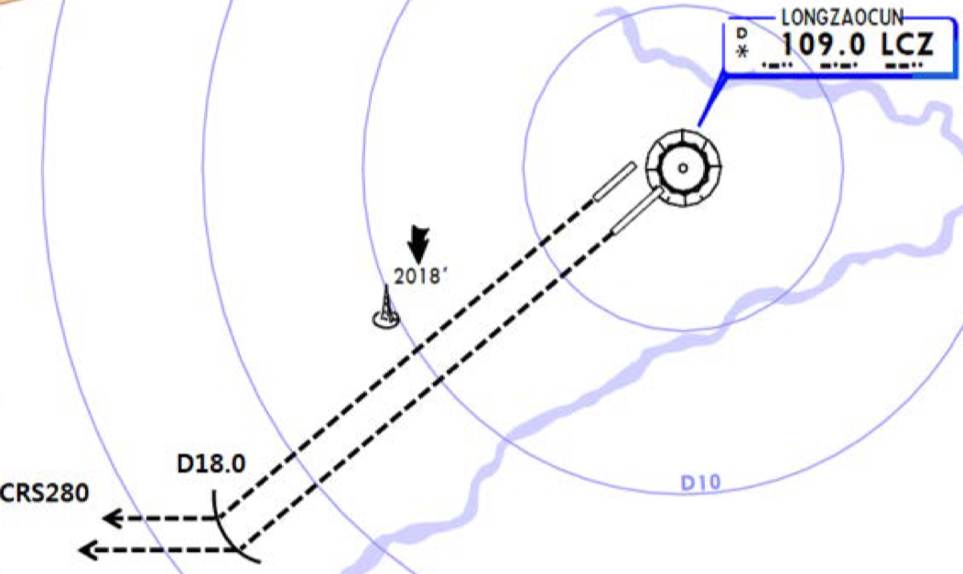
ZLXY(XIY)1572ft | RKSI(ICN) 23ft
Airport Operation Center 132.0 DCL -30~10 Min, Read Back | KE ICN 131.5
PA
XIY (TA 9850’) : RNAV SID (NADP 1)
05L/R | WJC xx W/Z |  |  | 052 |  | 052 | ATC 1500m(4900’) |  |  | 052
23R/L | WJC xx X/Y |  |  | 232 |  | 232 | ATC 1500m(4900’) |  |  | 232
LCZ 109.0 |  |  | 05L 109.9 |  | 23R 110.3 |  | 21 110.7 | 05R 109.3 | 23L 111.1 | 19 108.9
FIX |  | 23R/L : LCZ /18
HUD |  | 05L(1562’) 9843’ 23R(1569’)
 |  | 05R(1556’) 12467’ 23L(1538’)
NOTAM TO Perf, ADT = CTOT
DEP 119.9- XIY 120.95 – 124.1
PEK 126.7 – 134.15 – 128.3 – 120.35
DLC 123.2 - 132.95
TAE 132.8
China
ICN : STAR
ILS 33/34 | REBIT xA | PAMBI | REBIT 170
ILS 15/16 | REBIT xH | MUNAN | REBIT 170
HUD | 33L/R 34L(23’) | 12303’ | 15L/R 16R(23’)
 | 34R(23’) | 13123’ | 16L(23’)
FIX | RWY /8, /5 , P518 R068, R278
33R : C4(7529’), C5(8513’), 33L : B4(7563’), B5(8513‘) 15L : C2(7522’), C1(8536’), 15R : B3(7454‘), B2(8641‘)
34L : P7(5600’), P8(6578’), 34R : N4(6876’), N5(8507‘) 16R : P6(5597’), P5(6574’), 16L : N3(7043‘), N2(8444‘)
8NM 180kts, 5NM 160kts, Parr TAXI 10kts이상, HIRO

Slide 82
RKSI(ICN) 23ft | ZGHA(CSX)220ft
KE ICN 131.5 DCL -10분 TOBT 5분 차이시 CTC Comm | Changsha Reporting Office 131.15
PA
ICN : SID (33/34 NADP 1, 15/16 NADP 2)
33L/R | NOPIK xA |  | 333 |  | 333 |  | ATC |  | 333
34L/R | NOPIK xY |  | 333 |  | 333 |  | ATC |  | 333
15L/R | BINIL xC |  | 153 |  | 153 |  | 5000 |  | 153
16L/R | BINIL xH |  | 153 |  | 153 |  | 5000 |  | 153
NCN 113.8 |  | 33L 109.3 |  | 33R 108.9 |  | 15L 111.9 |  | 15R 109.1
WNG 112.9 |  | 34L 109.95 |  | 34R 108.1 |  | 16L 110.35 |  | 16R 108.55
33L/R : NC05L/R, R242 P518 R068, R278 |  |  |  | 34L/R : EO34L/R, R242 P518 R068, R278
HUD | 33L/R 34L(23’) |  |  | 12303’ |  | 15L/R 16R(23’)
 | 34R (23’) |  |  | 13123’ |  | 16L (23’)
Parallel TWY 10KTS 이상(R17 MAX 15kts)
DEP 125.15 – TGU 132.8 – DLC 132.95
TAO 133.725 – 128.15 – PEK 127.35 – 127.5
PEK 132.2 – SHA 118.9 – WUH 119.7 - 134.35
CSX 132.55 – 125.6 – 119.65
HUH TWR 118.55(118.175)
China
CSX (TL 118) : RNAV STAR After OLMIB 6600M, STAR or RDR Vec before GUSIV
18L/R | PEX xx W | HA366 | RNAV ILS Z 18L/R
36R/L | PEX xx X | HA383 | RNAV ILS Z 36R/L
HUD | 18L(212’) 12467’ 36R(188’)
 | 18R(219’) 10499’ 36L(198’)
18L : C9(5629’),C7(6948’),36R : C11(5675’),C13(6961’) 18R : B4(5167’), B3(6427’), 36L : B5(5206’), B6(6443’)
Position Report to GND first CTC TWY T9 less 29.2m , Follow Me Car APU Procedure but APU available cabin 26도 이하시

Slide 83
TL
TA
550M 1800ft
China

Slide 84
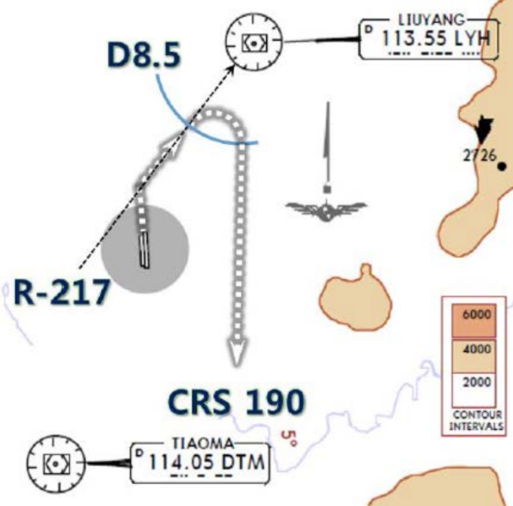
ZGHA(CSX)220ft | RKSI(ICN) 23ft
Changsha Reporting Office 132.0 DCL -20m, Read Back | KE ICN 131.15
PA
XIY (TA 9850’) : RNAV SID (NADP 1)
18R/L | OPO xx W | OPO xx W |  | 181 |  | 181 | ATC(900m) |  | 181
36L/R | OPO xx X | OPO xx X |  | 001 |  | 001 | ATC(900m) |  | 001
18R 110.3 |  |  | 36L 109.9 | 18R 110.3 | 18L 109.3 | 36L 109.9 | 18L 109.3 | 36R 111.1 | 19 108.9
FIX | 36L/R : LYH217/8.5, R190 (LYH 113.55 for EO)
HUD | 18R(219’) 10499’ 36L(198’)
 | 18L(212’) 12467’ 36R(188’)
CTC DEP 119.65 without TWR Instruction
DEP 119.65- CSX 132.55
WUH 134.35 – 120.975 – 135.65
125.775
SHA 132.4 - 125.325 - 120.55
120.95
China
ICN : STAR
ILS 33/34 | REBIT xA | PAMBI | REBIT 170
ILS 15/16 | REBIT xH | MUNAN | REBIT 170
HUD | 33L/R 34L(23’) | 12303’ | 15L/R 16R(23’)
 | 34R(23’) | 13123’ | 16L(23’)
FIX | RWY /8, /5 , P518 R068, R278
33R : C4(7529’), C5(8513’), 33L : B4(7563’), B5(8513‘) 15L : C2(7522’), C1(8536’), 15R : B3(7454‘), B2(8641‘)
34L : P7(5600’), P8(6578’), 34R : N4(6876’), N5(8507‘) 16R : P6(5597’), P5(6574’), 16L : N3(7043‘), N2(8444‘)
8NM 180kts, 5NM 160kts, Parr TAXI 10kts이상, HIRO

Slide 85
RKSI(ICN) 23ft | VHHH(HKG) 28ft
KE ICN 131.5 DCL -10분 TOBT 5분 차이시 CTC Comm | HAS FLT Dispatch 131.6
PA
ICN : SID (33/34 NADP 1, 15/16 NADP 2)
33L/R | BOPTA xA |  | 333 |  | 333 |  | ATC |  | 333
34L/R | BOPTA xY |  | 333 |  | 333 |  | ATC |  | 333
15L/R | BOPTA xC |  | 153 |  | 153 |  | 5000 |  | 153
16L/R | BOPTA xH |  | 153 |  | 153 |  | 5000 |  | 153
NCN 113.8 |  | 33L 109.3 |  | 33R 108.9 |  | 15L 111.9 |  | 15R 109.1
WNG 112.9 |  | 34L 109.95 |  | 34R 108.1 |  | 16L 110.35 |  | 16R 108.55
33L/R : NC05L/R, R242 YJU R271 |  |  |  | 34L/R : EO34L/R, R242 YJU R271
HUD | 33L/R 34L(23’) |  |  | 12303’ |  | 15L/R 16R(23’)
 | 34R (23’) |  |  | 13123’ |  | 16L (23’)
Parallel TWY 10KTS 이상(R17 MAX 15kts)
ICN 124.52(125.72) - FUK 127.5 - TPE 125.5 – 126.7
129.1 - HKG RDR 121.3 – 126.5
DEP 122.0 – Final 119.1 – 119.35
China
HKG : Terminal Tx RTE + STAR Chart (TL110) ENPET FL260, RWY25R After TOPUN - APP Mode
07L(R) | ABBEY xxA SIERA xxA/C | LIMES |  | ILS 07L(R)
25R(L) | ABBEY xxB SIERA xxB/D | TD |  | RNAV tx ILS 25R ILS 25L
HUD | 07L(23’) 11896’ DIS TH 25R (23’)
 | 07R(27’) 11942’ DIS TH |  | 12467’ 25L(27’)
07L : C7(5882’), C8(7194’), 25R : C6(5882’), C5(7211’) 07R : J7(6916’), J8(7998’), 25L : J5(6916’), J4(8192’)
Confirm Chart SPD vs ATC SPD (ATC First) xxR Dash Line for B737, APU BAN off Procedure

Slide 86
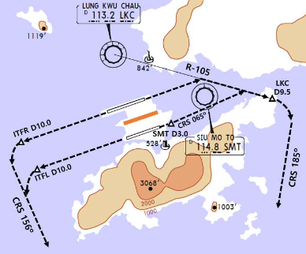
VHHH(HKG) 28ft | RKSI(ICN) 23ft
HAS FLT Disp 131.6 DCL 20분전 5분 차이시 CTC Comm | KE ICN 131.5
PA
HKG : SID + Terminal Tx RTE Chart TA 9000 NADP2 : 1000 SPD INTV (Vzf+10~20kts), 1500 CLB TH (NADP 1/2 for 07L/R)
07L(R) | OCEAN xxE(A) (RASSE xxZ/X) |  |  | 074 |  |  | 074 | 5000 | 074
25R(L) | OCEAN xxB/F |  |  | 254 |  |  | 254 | 5000 | 254
SMT 114.8 |  |  | 07L 111.5 |  | 25R 108.75 |  |  | 07R 110.9 | 25L 110.9
HUD |  | 07R/L(27’/23’) |  |  |  | 12467’ |  | 25L/R(27’/23’)
E. O |  | 07L(R) : LKC R105(SMT /3), LKC105/9.5 R185 25R(L) : ITFR(ITFL)254/10, R156
SID – Tx RTE Chart Many SPD Restriction
HKG DEP 123.8 – RDR 118.925
TPE 129.1 – 126.7 – 123.6 – 125.5
FUK 127.5 - ICN 125.725(124.52)
ICN - 120.72 – 126.17
APP – 119.75
China
ICN : STAR
ILS 33/34 | OLMEN xE | ENPIL | OLMEN 180
ILS 15/16 | OLMEN xH | MUNAN | OLMEN 180
HUD | 33L/R 34L(23’) | 12303’ | 15L/R 16R(23’)
 | 34R(23’) | 13123’ | 16L(23’)
FIX | RWY /8, /5 , YJU R271
33R : C4(7529’), C5(8513’), 33L : B4(7563’), B5(8513‘) 15L : C2(7522’), C1(8536’), 15R : B3(7454‘), B2(8641‘)
34L : P7(5600’), P8(6578’), 34R : N4(6876’), N5(8507‘) 16R : P6(5597’), P5(6574’), 16L : N3(7043‘), N2(8444‘)
8NM 180kts, 5NM 160kts, Parr TAXI 10kts이상, HIRO

Slide 87
RKSI(ICN) 23ft | ZBTJ(TSN) 6ft
KE ICN 131.5 DCL -10분 TOBT 5분 차이시 CTC Comm | Air China Tianjin 132.0
PA
ICN : SID (33/34 NADP 1, 15/16 NADP 2)
33L/R | NOPIK xA |  | 333 |  | 333 |  | ATC |  | 333
34L/R | NOPIK xY |  | 333 |  | 333 |  | ATC |  | 333
15L/R | BINIL xC |  | 153 |  | 153 |  | 5000 |  | 153
16L/R | BINIL xH |  | 153 |  | 153 |  | 5000 |  | 153
NCN 113.8 |  | 33L 109.3 |  | 33R 108.9 |  | 15L 111.9 |  | 15R 109.1
WNG 112.9 |  | 34L 109.95 |  | 34R 108.1 |  | 16L 110.35 |  | 16R 108.55
33L/R : NC05L/R, R242 P518 R068, R278 |  |  |  | 34L/R : EO34L/R, R242 P518 R068, R278
HUD | 33L/R 34L(23’) |  |  | 12303’ |  | 15L/R 16R(23’)
 | 34R (23’) |  |  | 13123’ |  | 16L (23’)
Parallel TWY 10KTS 이상(R17 MAX 15kts)
DEP 125.15 – TGU 132.8 – DLC 132.95
TAO 133.72 – 128.15 – PEK 125.6
TSN APP 119.27 – TWR 118.425(130.0)
China
TSN : STAR (Missed App 1970’ Initially)
16L/16R | DUMAP xK/R/H | TJ960 TJ919 | ILS 16L/16R
34R/34L | DUMAP xQ | TJ841 | ILS 34R/34L
HUD | 16L(4’) 10 499’ 34R(5’)
 | DIS TH 16R(5’) 10499’/11811’ 34L(6’)
FIX : RWxx /8, RWxx /6 160kts(JEPP REF)
16L :W3(6269’),W2(9809’), 34R :W7(6443’),W8(7591’) 16R :B4(5177’),B3(7191’), 34L :B5(5183’),B6(7201’)
Follow me car on D, TAXI SPD Max 27kts

Slide 88
TL
TA
550M 1800ft
China

Slide 89
ZBTJ(TSN) 6ft | RKSI(ICN) 23ft
Air China Tianjin 132.0 DCL 30분전, Voice 10분전 (Read Back!) | KE ICN 131.5
PA
TSN : SID (NADP 1) Caution 600m Level Off – SPD Inc
16R /16L | MUGLO xT |  | 161 | 161 | 161 | 600m ATC | 3000 900m | 161
34L /34R | MUGLO xW/R |  | 341 | 341 | 341 | 600m ATC | 3000 900m | 341
TAJ 112.1 |  | 16L 109.7 | 34R 111.5 | 18L 109.3 |  | 16R 110.9 |  | 34L 110.5
HUD | 16R(5’) 16L(4’) |  |  | 11811’ 10499 |  |  | 34L(6’) 34R(5’)
16R : Do not pass A11 Confirm Parking Brake Release before Push back
DEP 119.27
PEK 125.6
DLC 123.2 – 132.95
ICN 128.7 – APP 119.75
China
ICN : STAR
ILS 33/34 | REBIT xA | PAMBI | REBIT 170
ILS 15/16 | REBIT xH | MUNAN | REBIT 170
HUD | 33L/R 34L(23’) | 12303’ | 15L/R 16R(23’)
 | 34R(23’) | 13123’ | 16L(23’)
FIX | RWY /8, /5 , P518 R068, R278
33R : C4(7529’), C5(8513’), 33L : B4(7563’), B5(8513‘) 15L : C2(7522’), C1(8536’), 15R : B3(7454‘), B2(8641‘)
34L : P7(5600’), P8(6578’), 34R : N4(6876’), N5(8507‘) 16R : P6(5597’), P5(6574’), 16L : N3(7043‘), N2(8444‘)
8NM 180kts, 5NM 160kts, Parr TAXI 10kts이상, HIRO

Slide 90
RKSI(ICN) 23ft | ZHCC(CGO) 496ft
KE ICN 131.5 DCL -10분 TOBT 5분 차이시 CTC Comm | Zhengzhou AOC 132.0
PA
ICN : SID (33/34 NADP 1, 15/16 NADP 2)
33L/R | NOPIK xA |  | 333 |  | 333 |  | ATC |  | 333
34L/R | NOPIK xY |  | 333 |  | 333 |  | ATC |  | 333
15L/R | BINIL xC |  | 153 |  | 153 |  | 5000 |  | 153
16L/R | BINIL xH |  | 153 |  | 153 |  | 5000 |  | 153
NCN 113.8 |  | 33L 109.3 |  | 33R 108.9 |  | 15L 111.9 |  | 15R 109.1
WNG 112.9 |  | 34L 109.95 |  | 34R 108.1 |  | 16L 110.35 |  | 16R 108.55
33L/R : NC05L/R, R242 P518 R068, R278 |  |  |  | 34L/R : EO34L/R, R242 P518 R068, R278
HUD | 33L/R 34L(23’) |  |  | 12303’ |  | 15L/R 16R(23’)
 | 34R (23’) |  |  | 13123’ |  | 16L (23’)
Parallel TWY 10KTS 이상(R17 MAX 15kts)
DEP 125.15 – TGU 128.7 – DLC 132.95- TAO 133.05
128.55 - 128.15 – PEK 127.35 – TAO 128.35
CGO 119.35 – 120.72 - APP 126.35
China
CGO : STAR xxL/R L/D RWY Freq CHG ATIS (Caution 12R/30L LOC false Capture, Fluctuation)
12L/12R | NOP xxU RNAV | DZY | ILS Z 12L/12R
30L/30R | NOP xxV RNAV | CC527 | ILS Z 30L/30R
HUD | 12L(496’) 11811’ 30R(484’)
 | 12R(494’). 11155’ 30L(484’)
FIX : ILS Ident /8 (180kts) /6 (160kts) APP SPD in JEPP
12L : D7(5853’),D8(6955’), 30R :D6(5833’),D5(6935’) 12R :H7(5702’),H8(6883’), 30L :H5(5672’),H4(6932’)
Follow me car, APU Off But 26도 이하 사용가능

Slide 91
TL
TA
550M 1800ft
China

Slide 92
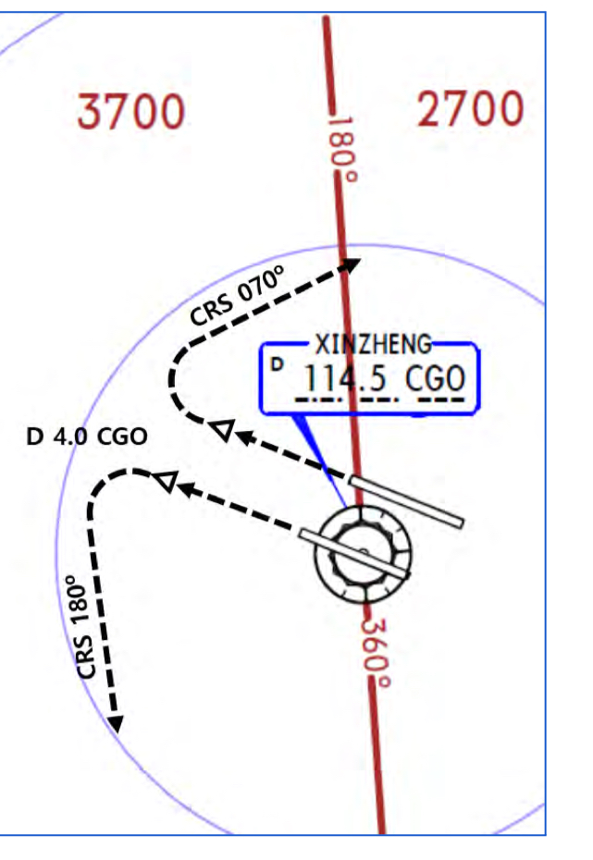
ZHCC(CGO) 496ft | RKSI(ICN) 23ft
Zhengzhou AOC 132.0 DCL (Read Back!) | KE ICN 131.5
PA
CGO : SID (NADP 1) Lower ALT – Consider Add Fuel
12R /12L | OKT xX RNAV |  | 116 | 161 | 116 |  | 1200m ATC | 3000 900m | 116
30R /30L | OKT xY RNAV |  | 296 | 341 | 296 |  | 1200m ATC | 3000 900m | 296
CGO 114.5 |  | 12L 108.5 | 30R 110.7 | 18L 109.3 |  |  | 12R 110.3 |  | 30L 109.3
HUD | 12R(494’) 12L(496’) |  |  | 11155’ 11811’ |  |  |  | 30L(484’) 30R(484’)
EO | 30L : CGO 296/4, R180 |  |  |  |  | 30R : CGO /4, CRS 070
Req Pushback to Apron 121.7
DEP 126.35(AUTO or NOT)
CGO 124.2 – 119.35
TAO 128.35 – PEK 127.35 – 128.15
DLC 132.95 - ICN 128.7
China
ICN : STAR
ILS 33/34 | REBIT xA | PAMBI | REBIT 170
ILS 15/16 | REBIT xH | MUNAN | REBIT 170
HUD | 33L/R 34L(23’) | 12303’ | 15L/R 16R(23’)
 | 34R(23’) | 13123’ | 16L(23’)
FIX | RWY /8, /5 , P518 R068, R278
33R : C4(7529’), C5(8513’), 33L : B4(7563’), B5(8513‘) 15L : C2(7522’), C1(8536’), 15R : B3(7454‘), B2(8641‘)
34L : P7(5600’), P8(6578’), 34R : N4(6876’), N5(8507‘) 16R : P6(5597’), P5(6574’), 16L : N3(7043‘), N2(8444‘)
8NM 180kts, 5NM 160kts, Parr TAXI 10kts이상, HIRO

Slide 93
RKSI(ICN) 23ft | ZGDY(DYG) 713ft
KE ICN 131.5 DCL -10분 TOBT 5분 차이시 CTC Comm | None
PA
ICN : SID (33/34 NADP 1, 15/16 NADP 2)
33L/R | BOPTA xA |  | 333 |  | 333 |  | ATC |  | 333
34L/R | BOPTA xY |  | 333 |  | 333 |  | ATC |  | 333
15L/R | BOPTA xC |  | 153 |  | 153 |  | 5000 |  | 153
16L/R | BOPTA xH |  | 153 |  | 153 |  | 5000 |  | 153
NCN 113.8 |  | 33L 109.3 |  | 33R 108.9 |  | 15L 111.9 |  | 15R 109.1
WNG 112.9 |  | 34L 109.95 |  | 34R 108.1 |  | 16L 110.35 |  | 16R 108.55
33L/R : NC05L/R, R242 YJU R271 |  |  |  | 34L/R : EO34L/R, R242 YJU R271
HUD | 33L/R 34L(23’) |  |  | 12303’ |  | 15L/R 16R(23’)
 | 34R (23’) |  |  | 13123’ |  | 16L (23’)
Parallel TWY 10KTS 이상(R17 MAX 15kts)
DEP 125.15 – TGU 126.17 – 120.72 – 124.52(125.72)
SHA 120.95 – 120.55 – 125.32 – 132.32 - 120.1
GZU 124.9 – 133.5 - WUH 134.35
119.3 - CHS 123.9
DYG TWR 118.45
China
DYG : STAR High Terr, ATIS within 100NM DYG TWR no RDR Service KEEP FLT PLAN RTE
08 | LIN xxA RNP | JX001 | ILS X 08
26 | LIN xxA RNP | DG944 | ILS X 26
HUD | 08(713’) 3.2도 8530’ 26(665’) 3.2도
08 : J(6530’), DownSlope 0.65% 26 : B(6530’)
Do not Intercept RWY08 inside DYG 11NM(FIX) RWY Grooved (AIP), Follow Me Car on A

Slide 94
TL
TA
550M 1800ft
China

Slide 95
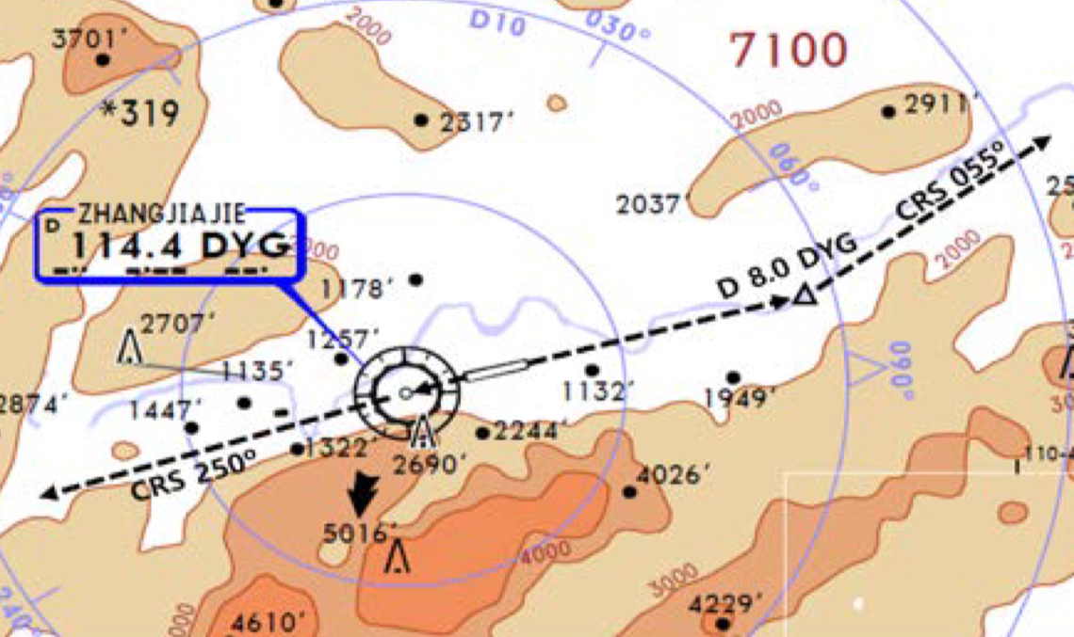
ZGDY(DYG) 713ft | RKSI(ICN) 23ft
None Voice TWR | KE ICN 131.5
PA
DYG : SID (NADP 1) (RWY Grooved AIP)
08 | LIN xxD |  |  | 079 |  | 079 |  | ATC (2400m) |  | 3000 900m | 079
26 | LIN xxD |  |  | 259 |  | 259 |  | ATC (2400m) |  | 3000 900m | 259
DYG 114.4 |  |  | 08 109.7 |  |  |  |  |  | 26 108.9
HUD |  | 08(713’) |  |  | 8530’ |  |  |  |  | 24(665’)
EO |  | 08 : DYG 079/8, R055 |  |  |  |  | 26 : DYG, R250
TWR 118.45
CHS 123.9
GZU 124.9 – 133.5 - 133.25 – SHA 120.1 – 132.32
128.12 – 125.32 – 126.17 – 120.55 – 120.95
ICN 125.725(124.52) – 120.72 – 126.17
APP – 119.75
China
ICN : STAR
ILS 33/34 | OLMEN xE | ENPIL | OLMEN 180
ILS 15/16 | OLMEN xH | MUNAN | OLMEN 180
HUD | 33L/R 34L(23’) | 12303’ | 15L/R 16R(23’)
 | 34R(23’) | 13123’ | 16L(23’)
FIX | RWY /8, /5 , YJU R271
33R : C4(7529’), C5(8513’), 33L : B4(7563’), B5(8513‘) 15L : C2(7522’), C1(8536’), 15R : B3(7454‘), B2(8641‘)
34L : P7(5600’), P8(6578’), 34R : N4(6876’), N5(8507‘) 16R : P6(5597’), P5(6574’), 16L : N3(7043‘), N2(8444‘)
8NM 180kts, 5NM 160kts, Parr TAXI 10kts이상, HIRO

Slide 96
RKSI(ICN) 23ft | ZYTL(DLC) 107ft
KE ICN 131.5 DCL -10분 TOBT 5분 차이시 CTC Comm | None
PA
ICN : SID (33/34 NADP 1, 15/16 NADP 2)
33L/R | NOPIK xA |  | 333 |  | 333 |  | ATC |  | 333
34L/R | NOPIK xY |  | 333 |  | 333 |  | ATC |  | 333
15L/R | BINIL xC |  | 153 |  | 153 |  | 5000 |  | 153
16L/R | BINIL xH |  | 153 |  | 153 |  | 5000 |  | 153
NCN 113.8 |  | 33L 109.3 |  | 33R 108.9 |  | 15L 111.9 |  | 15R 109.1
WNG 112.9 |  | 34L 109.95 |  | 34R 108.1 |  | 16L 110.35 |  | 16R 108.55
33L/R : NC05L/R, R242 P518 R068, R278 |  |  |  | 34L/R : EO34L/R, R242 P518 R068, R278
HUD | 33L/R 34L(23’) |  |  | 12303’ |  | 15L/R 16R(23’)
 | 34R (23’) |  |  | 13123’ |  | 16L (23’)
Parallel TWY 10KTS 이상(R17 MAX 15kts)
DEP 125.15 – TGU 132.8 – DLC 132.95
APP 123.85 – 119.6
TWR 118.25
China
DLC : RNAV(PMS) STAR CHK RWY 10 TL107 CAT C/D If Over MLDW, Report DLC -32NM for Holding or Missed APP
10 | RUPID xx A | TL107(PMS) CHK ALT TL106 | RNAV ILS Z 10 OFF SET LOC
28 | RUPID xx A | TL307(PMS) TL304 | RNAV ILS Z 28
HUD | 10(106’) 10171’ DIS TH 28(89’) 9843’
10(3.3/3.5) : E(5469’),D(6535’), 28 : F(5393’),G(6555’)
RWY 10 Align After DA Due Terrain (NO AUTO L/D) Align by Visual Follow GS Parking Brake Remain SET (After All Offload then REQ Release) TAXI SPD Max 16kts, APU off Procedure

Slide 97
TL
TA
550M 1800ft
China

Slide 98
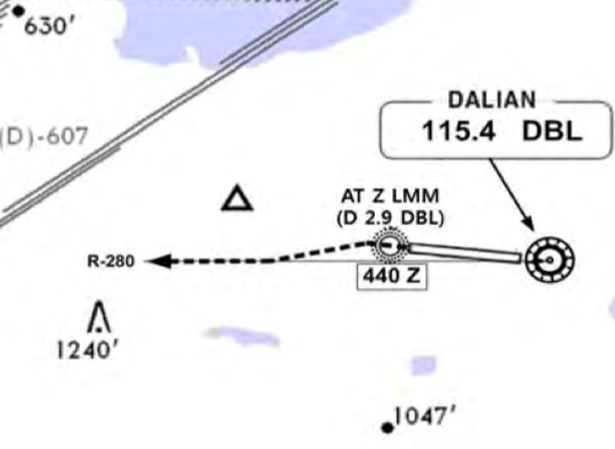
ZYTL(DLC)107ft | RKSI(ICN) 23ft
None DCL 20min(ReadBack to GND) Voice 10min(GND) | KE ICN 131.5
PA
DLC : RNP SID (NADP 1)
10 | SANKO xx D |  |  | 103 |  | 103 | ATC 900m(3000’) | 3000 900m | 103
28 | SANKO xx D |  |  | 283 |  | 283 | ATC 900m(3000’) | 3000 900m | 283
DBL 115.4 |  |  | 10 109.1 |  |  |  | 28 111.1 |  | 19 108.9
HUD |  | 10(106’) |  |  | 10827’ |  |  | 28(89’)
E.O |  | 28 : DBL 283/2.9, DBL 280
PushBack Facing West (RWY28 180Back) TAXI SPD 16kts RWY28 Hold Short C/B – HP3/HP3
TWR 118.25
APP 123.85
DLC 132.95
TGU 132.8
China
ICN : STAR
ILS 33/34 | REBIT xA | PAMBI | REBIT 170
ILS 15/16 | REBIT xH | MUNAN | REBIT 170
HUD | 33L/R 34L(23’) | 12303’ | 15L/R 16R(23’)
 | 34R(23’) | 13123’ | 16L(23’)
FIX | RWY /8, /5 , P518 R068, R278
33R : C4(7529’), C5(8513’), 33L : B4(7563’), B5(8513‘) 15L : C2(7522’), C1(8536’), 15R : B3(7454‘), B2(8641‘)
34L : P7(5600’), P8(6578’), 34R : N4(6876’), N5(8507‘) 16R : P6(5597’), P5(6574’), 16L : N3(7043‘), N2(8444‘)
8NM 180kts, 5NM 160kts, Parr TAXI 10kts이상, HIRO

Slide 99
RKSI(ICN) 23ft | ZSOF(HFE) 207ft
KE ICN 131.5 DCL -10분 TOBT 5분 차이시 CTC Comm | None
PA
ICN : SID (33/34 NADP 1, 15/16 NADP 2)
33L/R | BOPTA xA |  | 333 |  | 333 |  | ATC |  | 333
34L/R | BOPTA xY |  | 333 |  | 333 |  | ATC |  | 333
15L/R | BOPTA xC |  | 153 |  | 153 |  | 5000 |  | 153
16L/R | BOPTA xH |  | 153 |  | 153 |  | 5000 |  | 153
NCN 113.8 |  | 33L 109.3 |  | 33R 108.9 |  | 15L 111.9 |  | 15R 109.1
WNG 112.9 |  | 34L 109.95 |  | 34R 108.1 |  | 16L 110.35 |  | 16R 108.55
33L/R : NC05L/R, R242 YJU R271 |  |  |  | 34L/R : EO34L/R, R242 YJU R271
HUD | 33L/R 34L(23’) |  |  | 12303’ |  | 15L/R 16R(23’)
 | 34R (23’) |  |  | 13123’ |  | 16L (23’)
Parallel TWY 10KTS 이상(R17 MAX 15kts)
DEP 125.15 – TGU 126.17 – 120.72 – 124.52(125.72)
SHA 120.95 – 120.55 - 125.32
NKG 126.55
HFE APP 124.45 – 119.85
China
HFE : STAR SA CAT I not Approved RVR 550 Wx Min (with HUD or AP or FD) DCT “VEMEX”
15 | MAD 01A | OF205 | ILS Z 15
33 | MAD 02A, RDR Vec | OF108 | ILS Z 33
HUD | 15(200’) 11155’ 33(208’)
15 : A5(5500’), A6(6500’), 33 : A4(5500’), A3(6500’) No AMM TWR CLR Report Vacating RWY, TWY to TWR
Follow Me Car H(F/G), Report Marshaller Insight

Slide 100
TL
TA
550M 1800ft
China

Slide 101
ZSOF(HFE) 207ft | RKSI(ICN) 23ft
None DCL(NO Readback) | KE ICN 131.5
PA
HFE: SID (NADP 1)
15 | MAD 01/03D |  |  | 154 | 154 | 3000 (900m) | 154
33 | MAD 02/04D |  |  | 334 | 334 | 3000 (900m) | 334
XQH 109.8 |  |  | 15 109.3 |  |  | 33 108.5
HUD |  | 15(200’) 11155’ 33(208’) |  |  |  | 16L/R(12’/11’) 17L(10’)
Confirm Pushback Direction & RWY
HFE APP 119.85 - 124.45
NKG APP 126.55
SHA 132.4 - 120.55 - 120.95
ICN 125.725(124.52) – 120.72 – 126.17
APP – 119.75
China
ICN : STAR
ILS 33/34 | OLMEN xE | ENPIL | OLMEN 180
ILS 15/16 | OLMEN xH | MUNAN | OLMEN 180
HUD | 33L/R 34L(23’) | 12303’ | 15L/R 16R(23’)
 | 34R(23’) | 13123’ | 16L(23’)
FIX | RWY /8, /5 , YJU R271
33R : C4(7529’), C5(8513’), 33L : B4(7563’), B5(8513‘) 15L : C2(7522’), C1(8536’), 15R : B3(7454‘), B2(8641‘)
34L : P7(5600’), P8(6578’), 34R : N4(6876’), N5(8507‘) 16R : P6(5597’), P5(6574’), 16L : N3(7043‘), N2(8444‘)
8NM 180kts, 5NM 160kts, Parr TAXI 10kts이상, HIRO

Slide 102
RKSI(ICN) 23ft | ZPPP(KMG) CHK below
KE ICN 131.5 DCL -10분 TOBT 5분 차이시 CTC Comm | KE KMG 133.35 LD ALT 6000ft for T/O
PA
ICN : SID (33/34 NADP 1, 15/16 NADP 2)
33L/R | NOPIK xA |  | 333 |  | 333 |  | ATC |  | 333
34L/R | NOPIK xY |  | 333 |  | 333 |  | ATC |  | 333
15L/R | BINIL xC |  | 153 |  | 153 |  | 5000 |  | 153
16L/R | BINIL xH |  | 153 |  | 153 |  | 5000 |  | 153
NCN 113.8 |  | 33L 109.3 |  | 33R 108.9 |  | 15L 111.9 |  | 15R 109.1
WNG 112.9 |  | 34L 109.95 |  | 34R 108.1 |  | 16L 110.35 |  | 16R 108.55
33L/R : NC05L/R, R242 P518 R068, R278 |  |  |  | 34L/R : EO34L/R, R242 P518 R068, R278
HUD | 33L/R 34L(23’) |  |  | 12303’ |  | 15L/R 16R(23’)
 | 34R (23’) |  |  | 13123’ |  | 16L (23’)
Parallel TWY 10KTS 이상(R17 MAX 15kts)
DEP 125.15 – TGU 128.7 – DLC 132.95 – TAO 128.55
PEK 127.35 – 127.5 - 132.2 – CAN 18.9 – 133.5
CAN 135.35 – 132.35 – 128.72 – CHD 132.25 – 133.65
KMG 134.35 - APP 120.35 – 119.0
China
KMG : STAR no VOR at A/P LD ALT 6900 ini DES CHK LD Limit NO ENG BLEED L/D, FLAP 15 L/D
03/04 | XIS 2J (1,3J) | MP3 (XSJ) |  | ILS Z
21/22 | XIS 2L (1,3L) | MP1 (MP2) |  | ILS Z
HUD | 03(6896’) 11352’ 04(6885’) 14764’ |  | 11352’ 21(6887’) 13123’ 22(6879’)
FIX | RWY21/22 /8 170kts, /6 160kts
03 : F4(5994’), F3(7227’), 21 : F7(5892’), F8(7204’) 04 : C5(6482’), C4(716’), 22 : C6(6509’), C7(7726’)
Follow Me Car D7, R East only, Q West Only

Slide 103
TL
TA
550M 1800ft
China

Slide 104
ZPPP(KMG) 6901ft | RKSI(ICN) 23ft
KE KMG 133.35 DCL 10-30min TOBT | KE ICN 131.5
PA
KMG: SID (NADP 1) Check T/O Perf Report SID to TWR Initial CTC
03/04 | NOD x W/X |  |  | 040 |  | 040 | ATC (3000m) |  | 040
21/22 | NOD x Y/Z |  |  | 220 |  | 220 | ATC (3000m) |  | 220
03 111.3 |  |  | 04 109.3 |  | 21 110.1 |  |  | 22 108.5
HUD |  | 03(6896’) 13123’ 21(6887’) 04(6885’) 14764’ 22(6879’) |  |  |  |  | 16L/R(12’/11’) 17L(10’)
Pushback After 5min, Eng Start After Pushback Watch STOPBAR L/T, Don’t Confuse J, C1, C2
KMG APP 124.25 – KMG 125.75
China
ICN : STAR
ILS 33/34 | REBIT xA | PAMBI | REBIT 170
ILS 15/16 | REBIT xH | MUNAN | REBIT 170
HUD | 33L/R 34L(23’) | 12303’ | 15L/R 16R(23’)
 | 34R(23’) | 13123’ | 16L(23’)
FIX | RWY /8, /5 , P518 R068, R278
33R : C4(7529’), C5(8513’), 33L : B4(7563’), B5(8513‘) 15L : C2(7522’), C1(8536’), 15R : B3(7454‘), B2(8641‘)
34L : P7(5600’), P8(6578’), 34R : N4(6876’), N5(8507‘) 16R : P6(5597’), P5(6574’), 16L : N3(7043‘), N2(8444‘)
8NM 180kts, 5NM 160kts, Parr TAXI 10kts이상, HIRO

Slide 105
RKSI(ICN) 23ft | VMMC(MFM) 20ft
KE ICN 131.5 DCL -10분 TOBT 5분 차이시 CTC Comm | Menzies OCD 130.55
PA
ICN : SID (33/34 NADP 1, 15/16 NADP 2)
33L/R | BOPTA xA |  | 333 |  | 333 |  | ATC |  | 333
34L/R | BOPTA xY |  | 333 |  | 333 |  | ATC |  | 333
15L/R | BOPTA xC |  | 153 |  | 153 |  | 5000 |  | 153
16L/R | BOPTA xH |  | 153 |  | 153 |  | 5000 |  | 153
NCN 113.8 |  | 33L 109.3 |  | 33R 108.9 |  | 15L 111.9 |  | 15R 109.1
WNG 112.9 |  | 34L 109.95 |  | 34R 108.1 |  | 16L 110.35 |  | 16R 108.55
33L/R : NC05L/R, R242 YJU R271 |  |  |  | 34L/R : EO34L/R, R242 YJU R271
HUD | 33L/R 34L(23’) |  |  | 12303’ |  | 15L/R 16R(23’)
 | 34R (23’) |  |  | 13123’ |  | 16L (23’)
Parallel TWY 10KTS 이상(R17 MAX 15kts)
ICN 124.52(125.72) - FUK 127.5 - TPE 125.5 – 126.7
129.1 - HKG RDR 121.3 – 126.3
ZUI APP 123.85 – MFM TWR 118.0
China
MFM : STAR (TL ATC) Missed APP See Meter Table ZAO R231 North X, FL110 250kts, App 190kts
34 | SMT xx A | HAZEL | ILS Z 34
16 | SMT xx B | ZUM | Offset 54 LOC Z 16 1000ft Turn Final NAV CHG (GS Warn)
HUD | 34(20’) 9613’ DIS TH |  | 9400’ DIS TH 16(20’)
FIX | ZAO R231, RWxx /8
34 : G(9074’) 16 : E(7020’), D(8989’)
In Apron, Caution Wingtip & Jet Blast Advanced VDGS

Slide 106
TL
TA
550M 1800ft
China

Slide 107
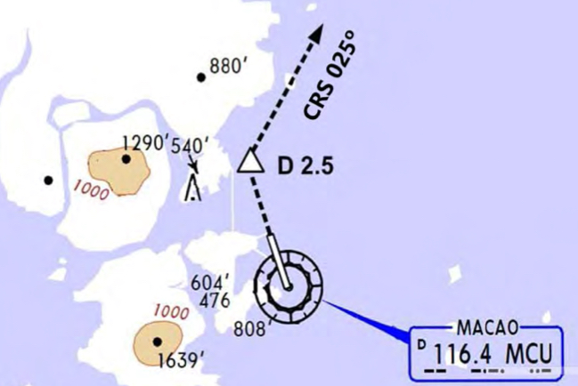
VMMC(MFM) 20ft | RKSI(ICN) 23ft
Menzies OCD 130.55 GND/TWR 5분전 Voice | KE ICN 131.5
PA
MFM : RW34 Modified NADP (TA 9000) Climb Offset 15도(359) to 400ft (B737 No LNAV, 400ft R/T 359, DCT LATOP then LNAV)
34 | CONGA xx T/U |  |  | 359 |  | 359 | FL160/ATC | 359
16 | CONGA xx P |  |  | 164 |  | 164 | 5000 | 164
MCU 116.4 |  |  | 34 109.7 |  |  |  | 16 111.7
HUD |  | 34 (20’) |  |  | 11024’ |  | 16 (20’)
FIX |  | ZAO R231 , RW34 E.O : MCU 344/2.5, R025
A1-15, A17, B1-6, B8 Confirm PushBack BLUE After TWY Protection, Eng Start
ZUI DEP 123.85
HKG RDR 123.8 - 118.25
TPE 125.5 - FUK 127.5
ICN 125.725(124.52) - 120.72
126.17
China
ICN : STAR
ILS 33/34 | OLMEN xE | ENPIL | OLMEN 180
ILS 15/16 | OLMEN xH | MUNAN | OLMEN 180
HUD | 33L/R 34L(23’) | 12303’ | 15L/R 16R(23’)
 | 34R(23’) | 13123’ | 16L(23’)
FIX | RWY /8, /5 , YJU R271
33R : C4(7529’), C5(8513’), 33L : B4(7563’), B5(8513‘) 15L : C2(7522’), C1(8536’), 15R : B3(7454‘), B2(8641‘)
34L : P7(5600’), P8(6578’), 34R : N4(6876’), N5(8507‘) 16R : P6(5597’), P5(6574’), 16L : N3(7043‘), N2(8444‘)
8NM 180kts, 5NM 160kts, Parr TAXI 10kts이상, HIRO

Slide 108
RKSI(ICN) 23ft | VVCR(CXR) 46ft
KE ICN 131.5 DCL -10분 TOBT 5분 차이시 CTC Comm | None No D-ATIS
PA
ICN : SID (33/34 NADP 1, 15/16 NADP 2)
33L/R | BOPTA xA |  | 333 |  | 333 |  | ATC |  | 333
34L/R | BOPTA xY |  | 333 |  | 333 |  | ATC |  | 333
15L/R | BOPTA xC |  | 153 |  | 153 |  | 5000 |  | 153
16L/R | BOPTA xH |  | 153 |  | 153 |  | 5000 |  | 153
NCN 113.8 |  | 33L 109.3 |  | 33R 108.9 |  | 15L 111.9 |  | 15R 109.1
WNG 112.9 |  | 34L 109.95 |  | 34R 108.1 |  | 16L 110.35 |  | 16R 108.55
33L/R : NC05L/R, R242 YJU R271 |  |  |  | 34L/R : EO34L/R, R242 YJU R271
HUD | 33L/R 34L(23’) |  |  | 12303’ |  | 15L/R 16R(23’)
 | 34R (23’) |  |  | 13123’ |  | 16L (23’)
Parallel TWY 10KTS 이상(R17 MAX 15kts)
FUK 127.5 – TPE 125.5 – 127.9 – 129.1 – MNL 119.3
MNL RDO 8942(5655) – HCM 120.7
132.35 – 134.05 – CXR APP 127.9
SE Asia
CXR : STAR (Wx, Using RWY from HoChiMinh CTL) RWY20 Max Tail Wind 15kts, chk condition CAAV STAR, APP not Authorized
20L/R | COTUN, BANKE, HUNTA, NHATA xx | CR xxx AFT IAF STEEP DES(3.8) | ILS Y 20L RNP 20R
02R/L |  |  | ILS X/Z 02L/R
HUD | 02R(15’) 3.5도 | 10000’ |  | 20L(34’)
 | 02L(20’) 3.5도 | 10010’ |  | 20R(46’)
20L : G3(6735’), G1(9603’), 02R : G5(6528’), G7(9662’) 20R : W4(5971’), W3(7680’),02L : W5(5606’), W6(7345’)
FollowMe Car Service, Sensitie VDGS Caution!!

Slide 109
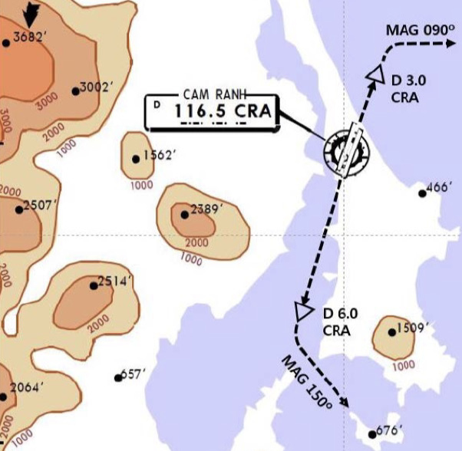
VVCR(CXR) 46ft | RKSI(ICN) 23ft
None TWR 118.2 By Voice | KE ICN 131.5
PA
CNX : RNP SID (NADP 1) Follow Restrictions due to Military Traffic
02L/R | NIHOA xxA |  | 020 |  | 020 | ATC/FL100 | 3000 900m | 020
20R/L | NIHOA xxB |  | 200 |  | 200 | ATC/FL100 | 3000 900m | 200
CRA 116.5 |  | 02R 111.9 |  | 02L 110.7 |  |  | 20L 110.3 | 19 108.9
02 : CRA 020/2, R090 20 : CRA 200/6, R150
HUD | 02L(20’) 3.5도 |  |  | 10010’ |  |  | 20R(46’)
 | 02R(15’) 3.5도 |  |  | 10000’ |  |  | 20L(34’)
TWY Y5 only below wingspan 36m/118ft
DEP 127.9 – HCM 134.05
DAD 123.3 – SNY 122.6(-5min)
HKG 132.15 – 127.1 – TPE 129.1
125.5 – FUK 127.5(SENKA /20)
SE Asia
ICN : STAR
ILS 33/34 | OLMEN xE | ENPIL | OLMEN 180
ILS 15/16 | OLMEN xH | MUNAN | OLMEN 180
HUD | 33L/R 34L(23’) | 12303’ | 15L/R 16R(23’)
 | 34R(23’) | 13123’ | 16L(23’)
FIX | RWY /8, /5 , YJU R271
33R : C4(7529’), C5(8513’), 33L : B4(7563’), B5(8513‘) 15L : C2(7522’), C1(8536’), 15R : B3(7454‘), B2(8641‘)
34L : P7(5600’), P8(6578’), 34R : N4(6876’), N5(8507‘) 16R : P6(5597’), P5(6574’), 16L : N3(7043‘), N2(8444‘)
8NM 180kts, 5NM 160kts, Parr TAXI 10kts이상, HIRO

Slide 110
RKSI(ICN) 23ft | VVTS(SGN) 33ft
KE ICN 131.5 DCL -10분 TOBT 5분 차이시 CTC Comm | None No D-ATIS
PA
ICN : SID (33/34 NADP 1, 15/16 NADP 2)
33L/R | BOPTA xA |  | 333 |  | 333 |  | ATC |  | 333
34L/R | BOPTA xY |  | 333 |  | 333 |  | ATC |  | 333
15L/R | BOPTA xC |  | 153 |  | 153 |  | 5000 |  | 153
16L/R | BOPTA xH |  | 153 |  | 153 |  | 5000 |  | 153
NCN 113.8 |  | 33L 109.3 |  | 33R 108.9 |  | 15L 111.9 |  | 15R 109.1
WNG 112.9 |  | 34L 109.95 |  | 34R 108.1 |  | 16L 110.35 |  | 16R 108.55
33L/R : NC05L/R, R242 YJU R271 |  |  |  | 34L/R : EO34L/R, R242 YJU R271
HUD | 33L/R 34L(23’) |  |  | 12303’ |  | 15L/R 16R(23’)
 | 34R (23’) |  |  | 13123’ |  | 16L (23’)
Parallel TWY 10KTS 이상(R17 MAX 15kts)
FUK 127.5(SENKA /20) – TPE 125.5 – 127.9 – 129.1
MNL 119.3 - MNL RDO 8942(5655) – HCM 120.7
132.35 – SGN APP 125.5
SE Asia
SGN : STAR (CPDLC : VVHM) TL 190
25R(L) | DALAP xxH | SOKAN | SOKAN | ILS W 25R/L
07R(L) | DALAP xxG | SAMDU | SAMDU | ILS W 07R, VOR 07L
HUD | 25R(33’) 10007’ 07L(20’) |  | 10007’
 | 25L(32’) 12559’ |  | 10036’ (DISP TH) 07R(24’)
25R:P4(6158’), P5(6991’),07R:S6(4412’),S5(6574’,110도) B737 P4, P5, S6, S5 Unable Tell ATC 25L : S7(6824’), S8(9671’), 07L : P3(6266’), P2(8907’)
FollowMe Car Service in Ramp (Caution STOPBAR L/T) Sensitie VDGS!!! (0.5m이내, 2m STOP시 바로 정지)

Slide 111
VVTS(SGN) 33ft | RKSI(ICN) 23ft
None -15min, DEL 121.8 By Voice | KE ICN 131.5
PA
SGN : RNP SID (NADP 1) TA 18000’ Request RWY due to Performance
25L(R) | KADUM xxD |  | 250 |  | 250 | 11000 | 3000 900m | 250
07L(R) | KADUM xxE/A |  | 070 |  | 070 | ATC | 3000 900m | 070
TSH 116.8 |  | 25R 110.5 |  | 07R 111.7 |  |  | 25L 108.3 | 19 108.9
HUD | 25R(33’) 10007’ 07L(20’) |  |  | 10010’ |  |  | 20R(46’)
 | 25L(32’) 12559’ 07R(24’) |  |  | 10000’ |  |  | 20L(34’)
Caution TSAT +- 5min ATC CLR, RWY CHG After TAXI Caution STOPBAR L/T, Follow Car Service
APP 125.5 – HCM 120.1 - 134.05
HNI 123.3 – SNY 122.6(-5min)
HKG 132.15 – 127.1 – TPE 129.1 – 127.9
126.7 – 123.6 - FUK 127.5(SENKA /20)
SE Asia
ICN : STAR
ILS 33/34 | OLMEN xE | ENPIL | OLMEN 180
ILS 15/16 | OLMEN xH | MUNAN | OLMEN 180
HUD | 33L/R 34L(23’) | 12303’ | 15L/R 16R(23’)
 | 34R(23’) | 13123’ | 16L(23’)
FIX | RWY /8, /5 , YJU R271
33R : C4(7529’), C5(8513’), 33L : B4(7563’), B5(8513‘) 15L : C2(7522’), C1(8536’), 15R : B3(7454‘), B2(8641‘)
34L : P7(5600’), P8(6578’), 34R : N4(6876’), N5(8507‘) 16R : P6(5597’), P5(6574’), 16L : N3(7043‘), N2(8444‘)
8NM 180kts, 5NM 160kts, Parr TAXI 10kts이상, HIRO

Slide 112
RKSI(ICN) 23ft | VDPP(PNH) 40ft
KE ICN 131.5 DCL -10분 TOBT 5분 차이시 CTC Comm | PNH DIS 129.0
PA
ICN : SID (33/34 NADP 1, 15/16 NADP 2)
33L/R | BOPTA xA |  | 333 |  | 333 |  | ATC |  | 333
34L/R | BOPTA xY |  | 333 |  | 333 |  | ATC |  | 333
15L/R | BOPTA xC |  | 153 |  | 153 |  | 5000 |  | 153
16L/R | BOPTA xH |  | 153 |  | 153 |  | 5000 |  | 153
NCN 113.8 |  | 33L 109.3 |  | 33R 108.9 |  | 15L 111.9 |  | 15R 109.1
WNG 112.9 |  | 34L 109.95 |  | 34R 108.1 |  | 16L 110.35 |  | 16R 108.55
33L/R : NC05L/R, R242 YJU R271 |  |  |  | 34L/R : EO34L/R, R242 YJU R271
HUD | 33L/R 34L(23’) |  |  | 12303’ |  | 15L/R 16R(23’)
 | 34R (23’) |  |  | 13123’ |  | 16L (23’)
Parallel TWY 10KTS 이상(R17 MAX 15kts)
FUK 127.5(SENKA /20) – TPE 125.5 – 127.9 – 129.1
MNL 119.3 - MNL RDO 8942(5655)
HCM 120.7(MIGUG) - PNH 127.5
APP 123.8
SE Asia
PNH : RNAV STAR (TL ATC, ATIS) Caution CLR Limit GONLY, Do not Confuse ANAT, ANAB
05 | NANXY xxB | BOSET | SOKAN | RNP 05
23 | DETMA xxA | KOSDA Del Holding Data | SAMDU | ILS 23
HUD | 05(40’) 9843’ |  | 9350’ (DISP TH) 23(37’)
05 : E(6240’), H(7148’), 23 : C(7004’), 180 Back No Centerline L/T, No Vacate Lead L/T(Only Edge L/T)
APU Off after 5min after parking Stand xx Yellow Lead-in Marking(xx A,B Blue Line!!)

Slide 113
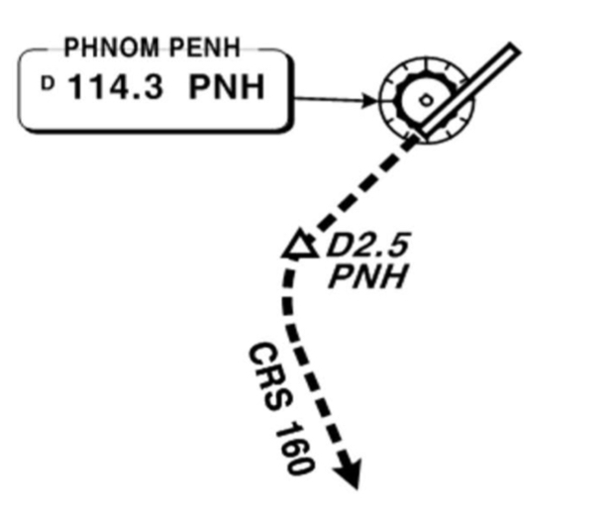
VDPP(PNH) 40ft | RKSI(ICN) 23ft
PNH DIS 129.0 READY! TWR 118.0 By Voice | KE ICN 131.5
PA
PNH : RNAV SID (NADP 1) TA 10000’ RWY 23 SEYHA Watch Over Bank
05 | NANXY xx (SEYHA xx) | 046 |  | 046 | ATC (5000) | 046
23 | KADUM xxE/A | 226 |  | 226 | ATC | 226
PNH 114.3 |  |  | 23 109.7 |  |  | 19 108.9
HUD | 05(40’) 9843’ 23(37’) |  | 10010’
E.O | PNH 226/2.5, R160
APU Start 10min Before DEP Line up 180 Back follow Yellow Guide Line
APP 123.8 – PNH 127.5
HCM 134.05 – 120.7
MNL RDO 8942/5655(ARESI)
MNL 119.3(AKOTA)
TPE 127.9 – 125.5
FUK 127.5(SENKA /20)
SE Asia
ICN : STAR
ILS 33/34 | OLMEN xE | ENPIL | OLMEN 180
ILS 15/16 | OLMEN xH | MUNAN | OLMEN 180
HUD | 33L/R 34L(23’) | 12303’ | 15L/R 16R(23’)
 | 34R(23’) | 13123’ | 16L(23’)
FIX | RWY /8, /5 , YJU R271
33R : C4(7529’), C5(8513’), 33L : B4(7563’), B5(8513‘) 15L : C2(7522’), C1(8536’), 15R : B3(7454‘), B2(8641‘)
34L : P7(5600’), P8(6578’), 34R : N4(6876’), N5(8507‘) 16R : P6(5597’), P5(6574’), 16L : N3(7043‘), N2(8444‘)
8NM 180kts, 5NM 160kts, Parr TAXI 10kts이상, HIRO

Slide 114
RKSI(ICN) 23ft | RPLL(MNL) 75ft
KE ICN 131.5 DCL -10분 TOBT 5분 차이시 CTC Comm | PAGSS Oper 131.0 No D-ATIS
PA
ICN : SID (33/34 NADP 1, 15/16 NADP 2)
33L/R | BOPTA xA |  | 333 |  | 333 |  | ATC |  | 333
34L/R | BOPTA xY |  | 333 |  | 333 |  | ATC |  | 333
15L/R | BOPTA xC |  | 153 |  | 153 |  | 5000 |  | 153
16L/R | BOPTA xH |  | 153 |  | 153 |  | 5000 |  | 153
NCN 113.8 |  | 33L 109.3 |  | 33R 108.9 |  | 15L 111.9 |  | 15R 109.1
WNG 112.9 |  | 34L 109.95 |  | 34R 108.1 |  | 16L 110.35 |  | 16R 108.55
33L/R : NC05L/R, R242 YJU R271 |  |  |  | 34L/R : EO34L/R, R242 YJU R271
HUD | 33L/R 34L(23’) |  |  | 12303’ |  | 15L/R 16R(23’)
 | 34R (23’) |  |  | 13123’ |  | 16L (23’)
Parallel TWY 10KTS 이상(R17 MAX 15kts)
FUK 133.6 – 127.5 – 123.2 – 123.9(BISIG ETA)
MNL RDO 8903(13300)
MNL 128.7(BEDIP) – APP 124.4
SE Asia
MNL : RNP STAR with RNP APP (CPDLC : RPHI) TL 130 3 STAR Difference Track Mile & IAF
06 | POLIO, NABAL (7,5,3)R/P DCT MIA RDR Vec (TMA 250, 20NM 210) | GONDO (DAGAT) | RNP 06 ILS 06
24 | DALAP xxG | MUTAN (MEDAM) | RNP 24 ILS 24
HUD | 06 (16’) 11188’ 24 (75’)
06 : R2(6223’), R1(8221’), 24 : R4(6095’), R5(7746’) Unable advise ATC, Do not confuse R2, E2, RWY31
CTC Ramp before Entering apron, Report Chockin Time Caution HotSpot RWY31

Slide 115
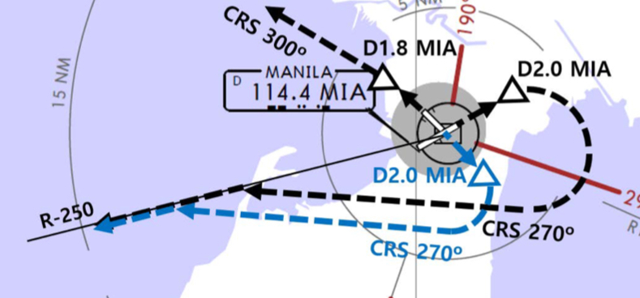
RPLL(MNL) 75ft | RKSI(ICN) 23ft
PAGSS Oper 131.0 -5min, CLR 125.1 By Voice Aircraft Type, Proposing ALT | KE ICN 131.5
PA
MNL : RDR Vector to CAB (NADP 1) TA 11000’ Main RWY H/D Climb 7000ft, CLR for T/O
06 | CAB xx R/A (Cabanatuan) |  | 061 | 061 | 12000ATC | 061
24 | CAB xx P/B (Cabanatuan) |  | 241 | 241 | 9000 ATC | 241
MIA 114.4 |  | 06 109.1 |  |  | 24 109.9 | 19 108.9
E.O | 06 : MIA /2, R250
HUD | 06(16’) 11188’ 24(75’)
Req ENG Startup to GND -> Req Pushback to Ramp
DEP 124.4(121.1)
MNL 128.7 – 119.3(LEBIX ETA)
TPE 127.9 – 125.5
FUK 127.5 - 133.6
ICN 125.72 - 124.52
SE Asia
ICN : STAR
ILS 33/34 | OLMEN xE | ENPIL | OLMEN 180
ILS 15/16 | OLMEN xH | MUNAN | OLMEN 180
HUD | 33L/R 34L(23’) | 12303’ | 15L/R 16R(23’)
 | 34R(23’) | 13123’ | 16L(23’)
FIX | RWY /8, /5 , YJU R271
33R : C4(7529’), C5(8513’), 33L : B4(7563’), B5(8513‘) 15L : C2(7522’), C1(8536’), 15R : B3(7454‘), B2(8641‘)
34L : P7(5600’), P8(6578’), 34R : N4(6876’), N5(8507‘) 16R : P6(5597’), P5(6574’), 16L : N3(7043‘), N2(8444‘)
8NM 180kts, 5NM 160kts, Parr TAXI 10kts이상, HIRO

Slide 116
RKSI(ICN) 23ft | RCMQ(RMQ)665ft
KE ICN 131.5 DCL -10분 TOBT 5분 차이시 CTC Comm | Mandarin Operation 131.85/95
PA
ICN : SID (33/34 NADP 1, 15/16 NADP 2)
33L/R | BOPTA xA |  | 333 |  | 333 |  | ATC |  | 333
34L/R | BOPTA xY |  | 333 |  | 333 |  | ATC |  | 333
15L/R | BOPTA xC |  | 153 |  | 153 |  | 5000 |  | 153
16L/R | BOPTA xH |  | 153 |  | 153 |  | 5000 |  | 153
NCN 113.8 |  | 33L 109.3 |  | 33R 108.9 |  | 15L 111.9 |  | 15R 109.1
WNG 112.9 |  | 34L 109.95 |  | 34R 108.1 |  | 16L 110.35 |  | 16R 108.55
33L/R : NC05L/R, R242 YJU R271 |  |  |  | 34L/R : EO34L/R, R242 YJU R271
HUD | 33L/R 34L(23’) |  |  | 12303’ |  | 15L/R 16R(23’)
 | 34R (23’) |  |  | 13123’ |  | 16L (23’)
Parallel TWY 10KTS 이상(R17 MAX 15kts)
FUK 127.5(SENKA /20)
TPE 125.5
APP 128.5 – 119.7 – 130.1
SE Asia
RMQ : No STAR TL130 COPRA FL220 ILS Z 36 : HLG31 SPD Modify
18 | RDR Vector | HLG | ILS 18
36 |  | FATAN (ARROZ) | ILS Z 36 (ILS Y 36)
HUD | 18(653’) | 12005’ |  | 36(663’)
FIX | RWxx /8
18 : EOR(12005’), 36 : W5(8500’)
E1~4, W1 for Military Follow Me Car on W, Report W3 Intersection

Slide 117
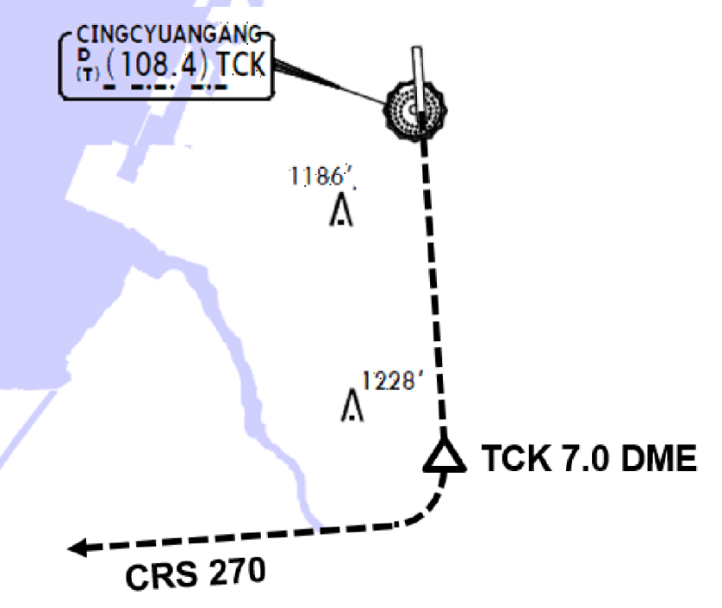
RCMQ(RMQ)665ft | RKSI(ICN) 23ft
Madarin Operation 131.85/95 Voice to GND | KE ICN 131.5
PA
RMQ : SID (NADP 1) TA 11000
18 | HLG xA (SPRAY xS) | 181 | 181 | ATC 7000 | 181
36 | HLG xB (SPRAY xT) | 001 | 001 |  | 001
18 111.7 |  | 36 111.5 |  |  | 19 108.9
HUD | 18(653’) | 12005’ |  | 36(663’)
EO | 18 : TCK 181/7, R270
ATC CLR after PushBack, Report W3 Intersection
TWR 118.75
TPE APP 130.1 – 119.7
TPE 125.5
FUK 127.5 (SENKA /20)
SE Asia
ICN : STAR
ILS 33/34 | OLMEN xE | ENPIL | OLMEN 180
ILS 15/16 | OLMEN xH | MUNAN | OLMEN 180
HUD | 33L/R 34L(23’) | 12303’ | 15L/R 16R(23’)
 | 34R(23’) | 13123’ | 16L(23’)
FIX | RWY /8, /5 , YJU R271
33R : C4(7529’), C5(8513’), 33L : B4(7563’), B5(8513‘) 15L : C2(7522’), C1(8536’), 15R : B3(7454‘), B2(8641‘)
34L : P7(5600’), P8(6578’), 34R : N4(6876’), N5(8507‘) 16R : P6(5597’), P5(6574’), 16L : N3(7043‘), N2(8444‘)
8NM 180kts, 5NM 160kts, Parr TAXI 10kts이상, HIRO

Slide 118
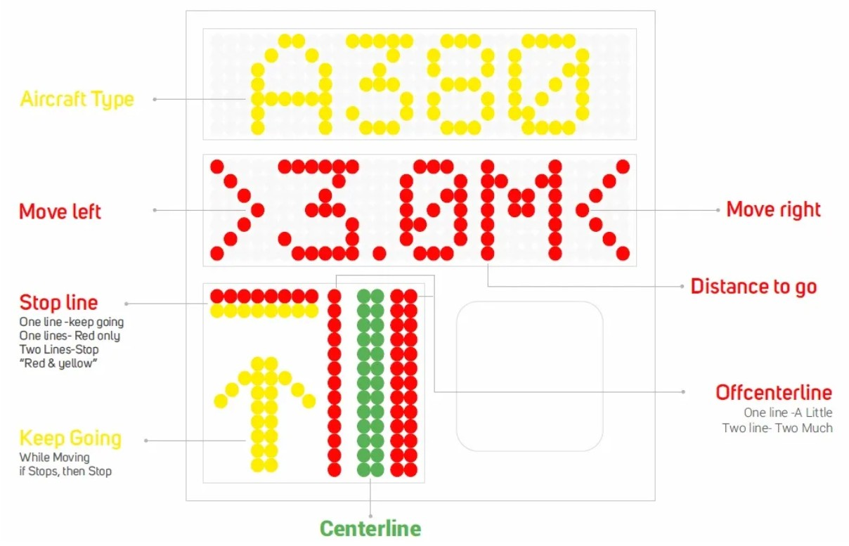
RKSI(ICN) 23ft | RCTP(TPE)108ft
KE ICN 131.5 DCL -10분 TOBT 5분 차이시 CTC Comm | Dynasty Operation 131.3
PA
ICN : SID (33/34 NADP 1, 15/16 NADP 2)
33L/R | BOPTA xA |  | 333 |  | 333 |  | ATC |  | 333
34L/R | BOPTA xY |  | 333 |  | 333 |  | ATC |  | 333
15L/R | BOPTA xC |  | 153 |  | 153 |  | 5000 |  | 153
16L/R | BOPTA xH |  | 153 |  | 153 |  | 5000 |  | 153
NCN 113.8 |  | 33L 109.3 |  | 33R 108.9 |  | 15L 111.9 |  | 15R 109.1
WNG 112.9 |  | 34L 109.95 |  | 34R 108.1 |  | 16L 110.35 |  | 16R 108.55
33L/R : NC05L/R, R242 YJU R271 |  |  |  | 34L/R : EO34L/R, R242 YJU R271
HUD | 33L/R 34L(23’) |  |  | 12303’ |  | 15L/R 16R(23’)
 | 34R (23’) |  |  | 13123’ |  | 16L (23’)
Parallel TWY 10KTS 이상(R17 MAX 15kts)
FUK 127.5(SENKA /20)
TPE 125.5
APP 128.5
125.6
SE Asia
TPE : STAR TL130 COPRA FL200 (FL250-130 : 280kts, FL130-10000ft : Max 280kts, APP Chart Text)
05L/R | BAKER xx A | JAMMY |  | ILS 05L/R
23R/L | BAKER xx B | AUGUR |  | ILS 23R/L
HUD | 05L(74’) | 12008’ |  |  | 23R(63’)
 | 05R(107’) DIS 12139’ | 12467’ | 23L(96’) DIS 11319’ |  | 23L(96’)
05L : N7(5787’), N6(6738’), 23R : N6(4468’), N4(6656’) 05R : S6(5419’), S7(7244’), 23L : S5(5442’), S4(7470’)
No VOR at TPE, A-VDGS see above

Slide 119
RCTP(TPE)108ft | RKSI(ICN) 23ft
Dynasty Operation 131.3 DCL, Voice -5min | KE ICN 131.5
PA
TPE : RNAV SID (NADP 1) TA 11000 Be Ready Intersection T/O, A030 -> 3000ft
05R/L | PIANO xxA/C |  | 054 | 054 | ATC | 054
23L/R | PIANO xxD/B |  | 234 | 234 | ATC | 234
05L 111.1 |  | 23R 109.3 | 05R 110.7 |  | 23L 111.9 | 19 108.9
HUD | 05L(74’) |  | 12008’ |  | 23R(63’)
 | 05R(107’) |  | 12467’ |  | 23L(96’)
“DCT PIANO then L3 RNAV Transition”
DEP 128.5
TPE 125.5
FUK 127.5 (SENKA /20)
SE Asia
ICN : STAR
ILS 33/34 | OLMEN xE | ENPIL | OLMEN 180
ILS 15/16 | OLMEN xH | MUNAN | OLMEN 180
HUD | 33L/R 34L(23’) | 12303’ | 15L/R 16R(23’)
 | 34R(23’) | 13123’ | 16L(23’)
FIX | RWY /8, /5 , YJU R271
33R : C4(7529’), C5(8513’), 33L : B4(7563’), B5(8513‘) 15L : C2(7522’), C1(8536’), 15R : B3(7454‘), B2(8641‘)
34L : P7(5600’), P8(6578’), 34R : N4(6876’), N5(8507‘) 16R : P6(5597’), P5(6574’), 16L : N3(7043‘), N2(8444‘)
8NM 180kts, 5NM 160kts, Parr TAXI 10kts이상, HIRO

Slide 120
RKSI(ICN) 23ft | PGUM(GUM) 305ft
KE ICN 131.5 DCL -10분 TOBT 5분 차이시 CTC Comm | Menzies Operations 129.4 No DATIS
PA
ICN : SID (33/34 NADP 1, 15/16 NADP 2)
33L/R | OSPOT xE/A |  | 333 |  | 333 |  | 5500/ATC |  | 333
34L/R | OSPOT xY |  | 333 |  | 333 |  | ATC |  | 333
15L/R | OSPOT xC |  | 153 |  | 153 |  | 5000 |  | 153
16L/R | OSPOT xH |  | 153 |  | 153 |  | 5000 |  | 153
NCN 113.8 |  | 33L 109.3 |  | 33R 108.9 |  | 15L 111.9 |  | 15R 109.1
WNG 112.9 |  | 34L 109.95 |  | 34R 108.1 |  | 16L 110.35 |  | 16R 108.55
33L/R : NC05L/R, R242 YJU R271 |  |  |  | 34L/R : EO34L/R, R242 YJU R271
HUD | 33L/R 34L(23’) |  |  | 12303’ |  | 15L/R 16R(23’)
 | 34R (23’) |  |  | 13123’ |  | 16L (23’)
Parallel TWY 10KTS 이상(R17 MAX 15kts)
FUK 133.15 – 135.3 – 132.3
TKO RDO (BIXAK) 17904/8870
SFO RDO (PAKDO) 4666/8903
GUM (NATSS) 118.7
SE Asia
GUM : no STAR (UTC + 10, TL 180) CPDLC BIXAK to NATSS : RJJJ to KZAK CTC GUM CERAP 118.7 (SQ2100) Before 250NM
06L/R | UNZ/-15,OBALE(MEMKE) | ILS 6L/R (Upslope)
24L/R | UNZ/-15,CIBOL(WABOX) | RNAV Y 24L/R (Downslope)
HUD | 6L(256’) 11014’ DIS TH 6R(258’) 10014’ | 24R(305’) 12014’ 24L(293’) 8710’ DIS TH | 24R(305’) 12014’ 24L(293’) 8710’ DIS TH
FIX | UNZ /250 (UNZ VOR out of 3.3NM A/P) | 18 : KMH R283, R280
06L : E(6473’), F(6975’), 24R : D(6282’), C(8264’) 06R : E(6502’), G(7808’) , 24L : B(8254’)
Prepare GS OUT, Vacate RWY CTC Ramp CTL

Slide 121
EDTO Procedure APU Remain ON
PREFLIGHT Apply Alternate Airport IFR Wx Minima for Planning (Ops Pecs C055) -> EDTO ERA Only(ERA no Wx) RVSM CHK : CAPT/FO 50ft, PILOT/FE 75ft FUEL CROSS FEED V/V CHK : On -> Off, V/V L/T CHK NAV DATA Input : EEP, ETP1, ETP2, EXP HF SELCAL CHK : Jeppesen - ENT DATA Pacific SEOUL RADIO : 8903(3004,6532,13300,13303,17904)
AFTER START APU Remain ON Until Passing EXP
AFTER LEVEL OFF (CRZ CHK) RVSM CHK : CAPT/FO 200ft
BEFORE EEP (Entry Point, ERA 기준) 60min 기준 : B737-900 398NM, Others 408NM (winthin MAX 120min 750NM) 1 ELEC SRC Fail Before EEP : Reroute, Divert FIX 1 : EEP, FIX 2 : ETP1 FMS ALT A/P SET : ALTN Page EDTO C/L : Fuel, A/C, MSA, ALT Wx & NOTAM Review Contingency Procedure - Drift Down 30도이상, 5NM, FL290이하, +-500ft - Wx Dev 5NM 이상, +-300ft
EDTO Segment 1 ELEC SRC Fail After EEP : Continue Apply Actual Wx for Actual Divert
ETP (Equal Time Point, EDTO ERA기준) FIX, ALTN Page SET EDTO C/L : Fuel, A/C, MSA, ALT Wx & NOTAM Last ETP(Critical Point) Fuel less then PLAN – Continue by PIC
EXP (Exit Point) APU - OFF
1 HR Before TOD FUEL CROSS FEED V/V CHK : On -> Off, V/V L/T CHK

Slide 122
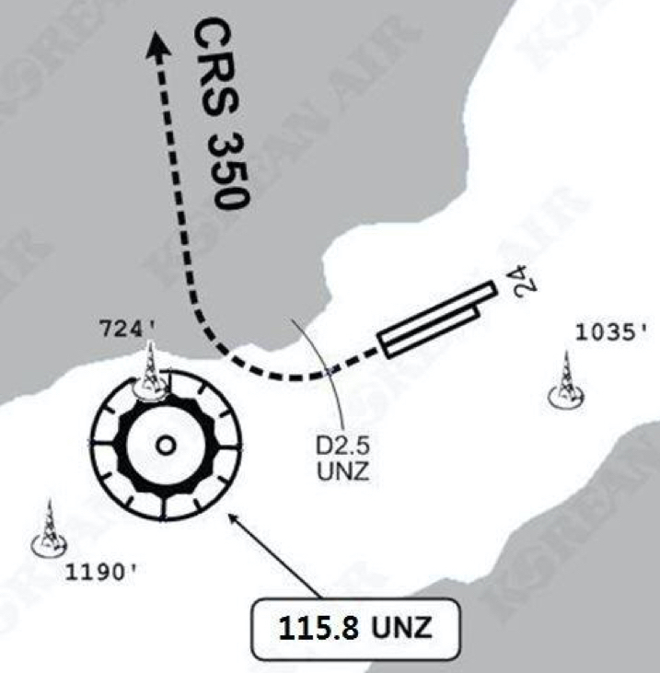
PGUM(GUM) 305ft | RKSI(ICN) 23ft
Menzies Operations 129.4 By Voice, No DATIS | KE ICN 131.5
PA
PUS : no SID (RWY 06 LNAV not Arming on GND)
06L/R | RWY H/D |  | 063 | 063 | ATC (9000) |  | 063
24L/R | RWY H/D |  | 243 | 243 | ATC (9000) |  | 243
UNZ 115.8 |  |  |  | 06L 110.3 |  | 06R 110.9
24 : UNZ /2.5 (UNZ VOR out of 3.3NM A/P)
HUD |  | 06L(256’) 12014’ 24R(305’) 06R(258’) 10014’ 24L(293’) |  |  | 24R(305’) 8530’ 24L(293’) 8999’
RWY, Ramp Area have lots of Slope, Be Caution 06 Upslope, 24 Downslope
DEP 118.7
SFO RDO (NATSS) 8870/6532
TKO RDO (PAKDO) 3455/8903
FUK 132.3 (HIDEK)
KOB 133.85 – 118.9
TAE 125.37
SE Asia
ICN : STAR
ILS 33/34 | GUKDO xE | ENPIL | GUKDO 180
ILS 15/16 | GUKDO xH | MUNAN | GUKDO 180
HUD | 33L/R 34L(23’) | 12303’ | 15L/R 16R(23’)
 | 34R(23’) | 13123’ | 16L(23’)
FIX | RWY /8, /5 , YJU R271
33R : C4(7529’), C5(8513’), 33L : B4(7463’), B5(8513‘) 15L : C2(7522’), C1(8536’), 15R : B3(7454‘), B2(8641‘)
34L : P7(5600’), P8(6578’), 34R : N4(6876’), N5(8507‘) 16R : P6(5597’), P5(6574’), 16L : N3(7043‘), N2(8444‘)
8NM 180kts, 5NM 160kts, Parr TAXI 10kts이상, HIRO

Slide 123
RKPK(PUS) 13ft | RCTP(TPE)108ft
KE Gimhae 129.2 DCL -5분 | Dynasty Operation 131.3
PA
PUS : SID (Mod NADP CLB2 1000, 14000 MAX)
36 | SOORO x TOPAX tx |  |  | 306 |  | 280 |  | ATC |  | 279
18 | BULIM x ENGOT tx |  |  | 182 |  | 182 |  | 5000 |  | 182
KMH 113.8 |  |  | PSN 114.0 |  | 36L 108.5 |  |  |  | 36R 109.5
36 : KMH R091, R271, R185
HUD |  | 36L(13’) 10499’ 36R(8’) 8999’ |  |  |  |  | 18R(13’) 8530’ 18L(13’) 8999’
RWY36 400ft Man L/H turn, Max Taxi SPD 20KTS
DEP 125.5 – TGU 128.17 – 124.52(125.72)
FUK 127.5(SENKA /20)
TPE 125.5
APP 128.5
125.6
SE Asia
TPE : STAR TL130 COPRA FL200 (FL250-130 : 280kts, FL130-10000ft : Max 280kts, APP Chart Text)
05L/R | BAKER xx A | JAMMY |  | ILS 05L/R
23R/L | BAKER xx B | AUGUR |  | ILS 23R/L
HUD | 05L(74’) | 12008’ |  |  | 23R(63’)
 | 05R(107’) DIS 12139’ | 12467’ | 23L(96’) DIS 11319’ |  | 23L(96’)
05L : N7(5787’), N6(6738’), 23R : N6(4468’), N4(6656’) 05R : S6(5419’), S7(7244’), 23L : S5(5442’), S4(7470’)
No VOR at TPE, A-VDGS see above

Slide 124
RCTP(TPE)108ft | RKPK(PUS) 13ft
Dynasty Operation 131.3 DCL, Voice -5min | KE Gimhae 129.2
PA
TPE : RNAV SID (NADP 1) TA 11000 Be Ready Intersection T/O, A030 -> 3000ft
05R/L | PIANO xxA/C |  | 054 | 054 | ATC | 054
23L/R | PIANO xxD/B |  | 234 | 234 | ATC | 234
05L 111.1 |  | 23R 109.3 | 05R 110.7 |  | 23L 111.9 | 19 108.9
HUD | 05L(74’) |  | 12008’ |  | 23R(63’)
 | 05R(107’) |  | 12467’ |  | 23L(96’)
“DCT PIANO then L3 RNAV Transition”
DEP 128.5
TPE 125.5
FUK 127.5 (SENKA /20)
ICN 125.725(124.52) – 128.17
APP – 125.5
SE Asia
PUS : STAR (Tail Wind 36R 136000lbs F40)
ILS 36 | KEVOX x | ANROD | 9DME LG, 8DME FLAP
VOR 18 | GAYHA x | ANROD | 18 Circling Click!!
HUD | 36L(13’) 10499’ 36R(8’) 8999’ |  | 18R(13’) 8530’ 18L(13’) 8999’
FIX | 36 : IKMA/IKHE /9, /8 |  | 18 : KMH R283, R280
36L : C4 (6299’), C2(7795’) / 36R : E3(5866’), E2(7339’) 18R : C6(5770’), C7 (6824’) / 18L : E4(5882’), E5(8792’)
Vacate C3,C4 by ATC only. Max Taxi SPD 20KTS C2 HOLD SHORT 가까움(Vacate TaxiSPD)

Slide 125
RKPK(PUS) 13ft | VTBS(BKK) 4ft
KE Gimhae 129.2 DCL -5분 | KE Bangkok 131.25
PA
PUS : SID (Mod NADP CLB2 1000, 14000 MAX)
36 | SOORO x TOPAX tx |  |  | 306 |  | 280 |  | ATC |  | 279
18 | BULIM x ENGOT tx |  |  | 182 |  | 182 |  | 5000 |  | 182
KMH 113.8 |  |  | PSN 114.0 |  | 36L 108.5 |  |  |  | 36R 109.5
36 : KMH R091, R271, R185
HUD |  | 36L(13’) 10499’ 36R(8’) 8999’ |  |  |  |  | 18R(13’) 8530’ 18L(13’) 8999’
RWY36 400ft Man L/H turn, Max Taxi SPD 20KTS
DEP 125.5 – TGU 128.17 – 124.52(125.72)
FUK 127.5(SENKA /20)
TPE 125.5 – 129.1 – HKG 132.15 - 127.1
SNY 122.6 – HNI 123.3 – VTN 128.3
BKK 132.1 – 133.1 - APP 119.1
SE Asia
BKK : STAR TL130 UTC+7 (SPD CTL via STAR Chart)
19L/R | EASTE xxC | Select Tx | ILS Z 19L/R
01L/R | EASTE xxD | Select Tx | ILS Z 01L/R
HUD | 19L(4’) | 13123’ No Groov |  | 01R(4’)
 | 19R(4’) | 12139’ |  | 01L(4’)
FIX | RWxx /8 (180tks), /5 (160-150kts)
19L : B8(5567’), B10(6965’), 01R : B7(5964’), B5(7962’) 19R : E9(5052’), E13(7139’), 01L : E12(4872’), E7(6958’)
HIRO, Standard Taxi Route, APU Off Procedure

Slide 126
VTBS(BKK) 4ft | RKPK(PUS) 13ft
KE Bangkok 131.25 DCL -20min, Voice 133.8 | KE Gimhae 129.2
PA
BKK : RNAV SID (NADP 1) TA 11000 A-CDM REQ Pushback +-5min of TSAT TSAT/CTOT Inform to GND CTL
19R/L | UPKUP xxG/J |  |  | 195 | 195 |  | 6000 |  | 195
01R/L | UPKUP xxK/H |  |  | 015 | 015 |  | 6000 |  | 015
SVB 111.4 |  | 19L 110.5 | 01L 109.1 | 05R 110.7 |  | 19R 109.5 | 23L 111.9 | 01R 110.1 | 19 108.9
HUD | 19R(4’) |  |  | 12139’ |  |  | 01L(4’)
 | 19L (4’) 13123’ No Groov 01R(4’) |  |  | 13123’ |  |  | 01R(4’)
APU Start within 10min, Standard TAXI Route 19R Do not Pass E1, D2
DEP 119.25 (AUTO) – BKK 133.1 – VIE 128.3
HNI 123.3 - SNY 122.6 – HKG 127.1 – 125.35
TPE 129.1(126.7, 127.9) – 125.5
FUK 127.5 (SENKA /20)
ICN 125.725(124.52) – 128.17
APP 125.5
SE Asia
PUS : STAR (Tail Wind 36R 136000lbs F40)
ILS 36 | KEVOX x | ANROD | 9DME LG, 8DME FLAP
VOR 18 | GAYHA x | ANROD | 18 Circling Click!!
HUD | 36L(13’) 10499’ 36R(8’) 8999’ |  | 18R(13’) 8530’ 18L(13’) 8999’
FIX | 36 : IKMA/IKHE /9, /8 |  | 18 : KMH R283, R280
36L : C4 (6299’), C2(7795’) / 36R : E3(5866’), E2(7339’) 18R : C6(5770’), C7 (6824’) / 18L : E4(5882’), E5(8792’)
Vacate C3,C4 by ATC only. Max Taxi SPD 20KTS C2 HOLD SHORT 가까움(Vacate TaxiSPD)

Slide 127
CRZ FUEL Penalty (Approximation)
A330 4000ft below OPT ALT : 5% increase trip fuel 8000ft below OPT ALT : 10% increase trip fuel Above OPT ALT : 3% increase trip fuel
FUEL Consumption
APU GND : 438 LBS/hr (BLOCK FUEL산정) IN FLT : 286 LBS/hr
TAXI 2 ENG, no APU : 3300 LBS/hr (55 LBS/hr)
CRZ - Reserved
Holding 분당 200LBS (Actual F/F 참조) Missed App & Landing 3000 LBS (과거 EDTO자료 1회 Missed App + L/D)
FUEL Loading
Center Tank 80000LBS 이상시 Tail Tank Load FUEL Overfill : 1000LBS 기준
Home

Slide 128
PACKS USE WITH LP AIR CONDITION UNIT
공항 요구로 APU OFF후 기내 온도 조절을 위한 방법 Low Press Unit을 연결하며 APU와 동시사용 금지
The flight crew must not use conditioned air from the packs and from the LP Air Conditioning Unit at the same time, to prevent any adverse effect on the Air Conditioning system.
절차 POM, FCOM에 없음
APU BLEED USE WITH HP AIR START UNIT
APU 부작동시 AIR START UNIT으로 시동을 위해 사용 외부 BLEED AIR의 역할을 함. APU BLEED 동시사용 금지
The flight crew must not use bleed air from the APU BLEED and from the HP Air Start Unit at the same time, to prevent any adverse effect on the Bleed Air System.
절차 POM, FCOM에 없음
Home
ENG START
Next Page

Slide 129
STARTING with AIR START UNIT
통상 ENG 1 먼저 (EXT PWR Start 2 ENG) “Req Engine Start up Present Positon~~~”
● Before connecting the air start unit: PACK 1 & 2 ................................... OFF F/O prevent any possible contamination of the packs by the air start unit. APU BLEED .................................. OFF F/O ENG 1 & 2 BLEED ....................... OFF F/O X BLEED .................................... OPEN F/O AIR START UNIT CONNECT ... REQ CAP Two ground air start units may be used in parallel if the pressure/flow relation is expected to be marginal.
● When cleared to start: Note: The AIR ABNORM BLEED CONFIG alert is triggered after the first engine start. It can be disregarded. ENG 1 ..................................... START CAP Note: As necessary, engine 2 can be started first. In this case, check the brake ACCU pressure prior to engine start. Note: The minimum recommended starter air supply pressure is 25 PSI when the start valve is open.
● After engine 1 is started: ■ If the air start unit is used to start engine 2: ENG 2 .............................. START CAP ● When engine 2 is started: AIR START UNIT DISC . . . . REQ CAP X BLEED ............................ AUTO F/O ENG 1 & 2 BLEED ................. ON F/O PACK 1 & 2 ............................. ON F/O
■ If the crossbleed engine start procedure is used to start engine 2: AIR START UNIT DISC ....... REQ CAP ENG 1 BLEED ........................ ON F/O PACK 1 & 2 ............................. ON F/O CRSBLD ENG START PROC.APPLY
EXT PWR ...................... CHK AVAIL CAP EXT PWR DISCONNECT ........ REQ CAP FCOM : In order to ensure that the entire network remains electrically supplied, it is recommended to start both engines before the disconnection of the external electrical power. NOR PROC - AFTER START .......RESUME
Home
Home

Slide 130
ENG CROSSBLEED START
#1 ENGBLEED 로 #2 ENG START, EXT PWR 필요
PushBack 완료(Parking Brake set), Suppy eng Area CLR One engine must be running in order to supply air for other engine start. ● Before second engine start : APU BLEED ................................. OFF F/O The BLEED valve of the supplying engine reopens and the cross bleed valve closes. ENG BLEED (supply engine) ....... ON F/O ENG BLEED (receive engine) ..... OFF F/O The bleed valves of receiving engines are closed to avoid reverse flow leakage. X BLEED..................................... OPEN F/O
● When cleared to start : AREA CLEAR OF OBS ........... CONF CAP Ensure increased power jet wake does not constitute any hazard to people or installations behind the aircraft. THR LVR (sup eng) . ADJ BLD PRES CAP Adjust thrust of supplying engine to obtain an engine bleed pressure of 30 PSI. If the thrust required to obtain the appropriate engine bleed pressure exceeds 40 % N1, pay particular attention to the surrounding area. RECEIVING ENGINE .............. START ALL Apply the normal engine start procedure.
● After start : THR LVR (supply engine) ......... IDLE CAP X BLEED.................................... AUTO F/O ENG BLEED (receive engine) ...... ON F/O PACK 1 &2 .................................... ON F/O
Home

Slide 131
COLD TEMP CORRECTION General 5도 간격은 보수적으로 보간법 적용됨
Min 제외한 모든 고도 수정은 ATC 인가 필요 Mandatory, Missed App 고도 ATC 사전 인가 없이 금지
반드시 고도 – FE 후의 고도를 보정해야함. Ex) FE 200ft 공항 : 5000ft는 4800ft만 보정해야함.
Height Above FE (Feet) 200-800ft
TEMP | 200 | 300 | 400 | 500 | 600 | 700 | 800
0 | 20 | 20 | 30 | 30 | 40 | 40 | 50
-5 | 20 | 30 | 40 | 40 | 50 | 60 | 70
-10 | 20 | 30 | 40 | 50 | 60 | 70 | 80
-15 | 30 | 40 | 50 | 60 | 80 | 90 | 100
-20 | 30 | 50 | 60 | 70 | 90 | 100 | 120
Height Above FE (Feet) 900-5000ft
TEMP | 900 | 1000 | 1500 | 2000 | 3000 | 4000 | 5000
0 | 50 | 60 | 90 | 120 | 170 | 230 | 280
-5 | 70 | 80 | 120 | 160 | 230 | 310 | 390
-10 | 90 | 100 | 150 | 200 | 290 | 390 | 490
-15 | 110 | 120 | 180 | 240 | 360 | 480 | 600
-20 | 130 | 140 | 210 | 280 | 420 | 570 | 710
Domestic
Japan
China
GMP, CJU, PUS next page
Home

Slide 132
COLD TEMP CORRECTION (Domestic)
Min 은 반드시 수정 (중간 고도 CORRECTION은 PIC 결정) Missed App 고도는 ATC 협조 필요
GMP 32L (261’) / 32R (262’) / 14R (254’)
32L/R | 8000 | 5500 | 5300 | 4000 | 2800 | 2300 | 2000
0 | 8450 | 5810 | 5600 | 4230 | 2970 | 2440 | 2120
-5 | 8620 | 5930 | 5710 | 4310 | 3030 | 2490 | 2160
-10 | 8780 | 6040 | 5820 | 4390 | 3080 | 2530 | 2200
R14 | 4000 | 2800 | 1400 |  | 4000
0 | 4230 | 2970 | 1490 |  | 4230
-5 | 4310 | 3030 | 1520 |  | 4310
-10 | 4390 | 3080 | 1540 |  | 4390
CJU 07 (307’) / 25 (296’)
 | 4000 | 2900 | 1800 | 07 | 8000 | 25 | 6000
0 | 4220 | 3070 | 1900 |  | 8450 |  | 6340
-5 | 4300 | 3130 | 1940 |  | 8620 |  | 6460
-10 | 4380 | 3180 | 1970 |  | 8780 |  | 6590
PUS 36L(233’),36R(228’) / 18L/R (see below)
36L/R | 6000 | 5000 | 3300 | 2100 |  | 6000
0 | 6340 | 5290 | 3490 | 2210 |  | 6340
-5 | 6460 | 5390 | 3560 | 2250 |  | 6460
-10 | 6580 | 5490 | 3620 | 2290 |  | 6580
18L/R | 6000 | 5000 | 4000 | 2600 | 1700 |  | 6000
0 | 6340 | 5290 | 4230 | 2760 | 1800 |  | 6340
-5 | 6460 | 5390 | 4310 | 2810 | 1830 |  | 6460
-10 | 6580 | 5490 | 4390 | 2860 | 1870 |  | 6580
Home

Slide 133
COLD Wx Operation
OAT (GND) / TAT (TAT) is 10°C (50°F) or below : • visible moisture (clouds, fog with VIS 1SM (1600 m) or rain, snow, sleet, ice crystals...) • ice, snow, slush and standing water is present on the ramps, taxiways, or runways.
PRELIMINARY (OAT 3°C 이하) LOGBOOK -------------------------------------- CHECK MAX TIME TO NEXT ENG ACC ---- DETERMINE TAXI IN TIME – NEXT ENG ACC TIME 15분 이내인지 확인
TAXI-OUT(OAT 3°C 이하) TAXI TIME ------------------------------------ MONITOR 15분 초과 또는 Eng Vibrations시 절차 수행 SOP SURFACE COND & AREA ---------- CHECK ATC ------------------------------------------------ NOTIFY PARKING BRAKE ------------------------------- ON the aircraft starts to move, immediately retard the thrust levers to IDLE. THR LEVERS ----------- 50% N1 (NO HOLD TIME) THR LEVERS --------------------- RETARD TO IDLE Repeat this procedure at intervals not longer than 15 min, or if the engine vibrations increase. SOP TAXI -------------------------------------- RESUME
BEFORE TAKEOFF FLAPS lever ------------------ SET FOR TAKEOFF FLAPS ------------------------------------- CHECK PSN T/O CONFIG pb ---------------------------------- TEST T/O MEMO ------------------------ CHECK NO BLUE AFTER START checklist ------------- COMPLETE BEFORE TAKEOFF checklist --- ACCOMPLISH
TAKEOFF(OAT 3°C 이하) A final engine acceleration must be performed before takeoff to entirely clean the engine from ice accretion. ATC ------------------------------------------------ NOTIFY PARKING BRK(OR BRK PEDALS) ------ APPLY THR LEVERS ----------- 50% N1 (NO HOLD TIME) THR LEVERS --------------------- RETARD TO IDLE SOP TAKEOFF ------------------------------- RESUME
AFTER L/D, PARKING DO NOT RETRACT FLAPS Ice Shedding 절차 반복
Home

Slide 134
ENG ON Deicing in ICN TOBT- 40min CTC KE ICN (사전신청, 결과확인)
ICN Deicing ”Deicing Required ENG On Deicing” ICN Apron “Req Pushback Deicing Zone xx” SQ2000 Pad Control Arrange Deicing Pad No. Ice Man Manage Deicing Process
Gate 시동후 (FLAP UP, FLT CTL CHK 없이) PARKING BRAKE -------------------------- SET Report Parking Brake SET - > Ice Man BROADBAND XMT sw ------------------- OFF COMMUNICATION with GND ------ ESTAB DE/ANTI-ICING FLUID TYPE ------ CHECK CABIN PRESS MODE SEL ---- CHK AUTO ENG 1 & 2 BLEED ------------------------- OFF Note : AIR ENG 1+2 BLEED FAULT – Disregard APU BLEED --------------------------------- OFF DITCHING pb -------------------------------- ON Note : CAB PR FWD OFV NOT OPEN, CAB PR AFT OFV NOT OPEN, COND LAV + GAL VENT FALUT –Disregard THRUST LEVERS ----------------- CHK IDLE “A/C PREPARED FOR SPRAYING” Report Ready for Deicing - > Ice Man
START SPRAY REQ DCL(CTC DEL)
UPON COMPLETE SPRAY(TIME CHK 1분) 용액과 마지막 용액 뿌린 시간 받고 적는다. Holdover Time 결정!!! PITOT STATICS (GND Crew) ---------- CHK GND EQUIPMENT ------------------- REMOVE DITCHING pb ------------------------------- OFF OUTFLOW V/V - CHK OPEN(ECAM press)
TIME CHECK 1분후 ENG 1 & 2 BLEED --------------------------- ON BROADBAND XMT sw --------------------- ON 5분후 APU BLEED -------------------------- AS RQRD NORMAL PROCEDURE ----------- RESUME FLT CONTROL CHK, FLAPS UP
DECISION TREE next page
Cold Wx
Home

Slide 135
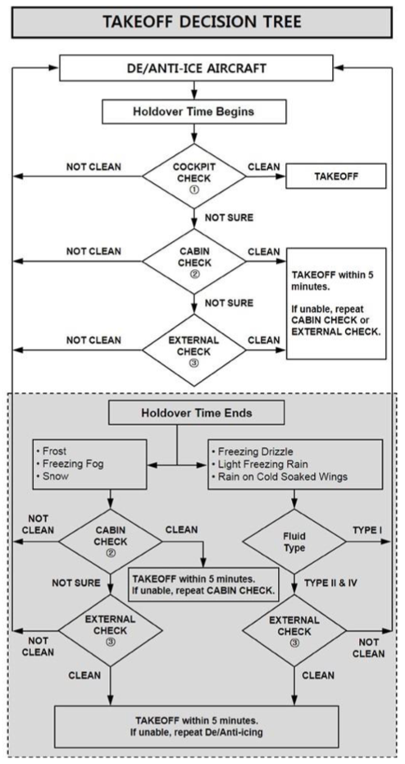
Home

Slide 136
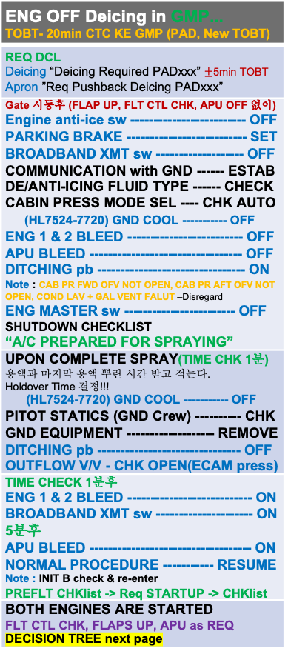
ENG OFF Deicing in GMP... TOBT- 20min CTC KE GMP (PAD, New TOBT)
REQ DCL Deicing “Deicing Required PADxxx” $±$5min TOBT Apron ”Req Pushback Deicing PADxxx”
Gate 시동후 (FLAP UP, FLT CTL CHK, APU OFF 없이) Engine anti-ice sw ------------------------- OFF PARKING BRAKE -------------------------- SET BROADBAND XMT sw ------------------- OFF COMMUNICATION with GND ------ ESTAB DE/ANTI-ICING FLUID TYPE ------ CHECK CABIN PRESS MODE SEL ---- CHK AUTO (HL7524-7720) GND COOL ----------- OFF ENG 1 & 2 BLEED ------------------------- OFF APU BLEED --------------------------------- OFF DITCHING pb -------------------------------- ON Note : CAB PR FWD OFV NOT OPEN, CAB PR AFT OFV NOT OPEN, COND LAV + GAL VENT FALUT –Disregard ENG MASTER sw ------------------------ OFF SHUTDOWN CHECKLIST “A/C PREPARED FOR SPRAYING”
UPON COMPLETE SPRAY(TIME CHK 1분) 용액과 마지막 용액 뿌린 시간 받고 적는다. Holdover Time 결정!!! (HL7524-7720) GND COOL ----------- OFF PITOT STATICS (GND Crew) ---------- CHK GND EQUIPMENT ------------------- REMOVE DITCHING pb ------------------------------- OFF OUTFLOW V/V - CHK OPEN(ECAM press)
TIME CHECK 1분후 ENG 1 & 2 BLEED --------------------------- ON BROADBAND XMT sw --------------------- ON 5분후 APU BLEED ----------------------------------- ON NORMAL PROCEDURE ----------- RESUME Note : INIT B check & re-enter PREFLT CHKlist -> Req STARTUP -> CHKlist
BOTH ENGINES ARE STARTED FLT CTL CHK, FLAPS UP, APU as REQ DECISION TREE next page
Home
Cold Wx

Slide 137
Home

Slide 138
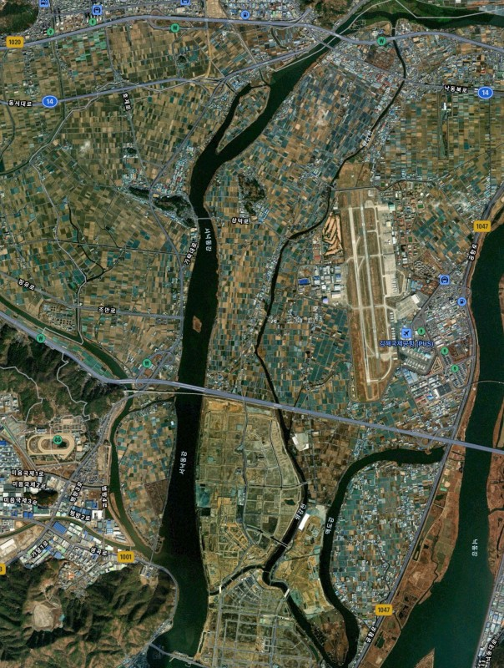
PUS VOR 18L/R
F-PLN APPR VIA STAR VOR18L/R GAYHA GAYHA x TRANS MASTA | SEC F-PLN APPR VIA R18L/R V18L/R (MDA: Blank) (LDG CONF chk)
FIX : KMH 280(Base Turn), 284(Missed App)
KMH32
KMH35
(18L)
KMH34
(18R)
KMH R280
Start Turn
TRK 182
090-1000ft
(900ft)
A/P Off
FD Off -
On
KMH30
TRK110
KMH30-1NM
-3 FPA Des
KMH22
(MA046)
1700ft L/O 6000ft SET
TRK to KMH22
Act SEC F-PLN
DCT KMH22 - NAV
ECAM memo no blue
FAF
(FF046)
Before L/D CHK Complete
NEXT 1700ft
Missed App
Base Turn 이전 : L/H Turn KMH 284 OUTBD (PULL TRK)
Base Turn 이후 : Continue R/H Turn KMH 284 OUTBD (PULL TRK)
Domestic
LOC 36 Circling
Next Page

Slide 139
PUS LOC 36L/R Circling 18L/R
F-PLN APPR VIA STAR LOC36L KEVOX KEVOX x TRANS MASTA | SEC F-PLN APPR VIA R18L/R V18L/R (MDA: Blank) (LDG CONF chk)
CI36L(CF36R) 3500 FI36L(FF36R) 2100
FIX : KMH 280(Base Turn), 310(Missed App)
KMH32
KMH35
(18L)
KMH34
(18R)
KMH R280
Start Turn
TRK 182
090-1000ft
(900ft)
A/P Off
FD Off -
On
KMH30
TRK 110
KMH30-1NM
-3 FPA Des
KMH22
TRK to KMH22
Act SEC F-PLN
DCT KMH22 - NAV
FLAP FULL(LD no blue)
Before L/D CHK
KMH18
Before FAF L/G DN CONF 3
1700ft L/O
6000ft SET
Missed App
Base Turn 이전 : L/H Turn KMH 310 OUTBD (PULL TRK)
Base Turn 이후 : Continue R/H Turn KMH 310 OUTBD (PULL TRK)
Domestic

Slide 140
GS KTS | KM | MILES
300 310 320 330 340 350 | 560 570 590 610 630 650 | 350 360 370 380 390 400
360 370 380 390 400 | 670 690 710 720 740 | 410 430 440 450 460
410 420 430 440 450 | 760 780 800 820 830 | 470 480 500 510 520
460 470 480 490 500 | 850 870 890 910 930 | 530 540 550 560 580
510 520 530 540 550 | 950 960 980 1000 1020 | 590 600 610 620 630
560 570 580 590 600 | 1040 1060 1070 1090 1110 | 650 660 670 680 690
610 620 630 640 650 | 1130 1150 1170 1190 1200 | 700 710 730 740 750
660 670 680 690 700 | 1220 1240 1260 1280 1300 | 760 770 780 800 810
Home

