Slide 1
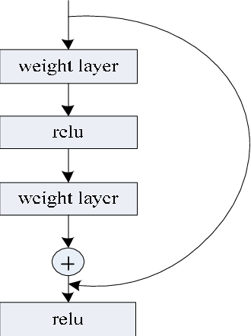
Optical Neural networks with a learnable Residual path: Shallow Unitary Photonic Engine by Residual (SUPER)
Lingling Fan
2022.3.30

Slide 2
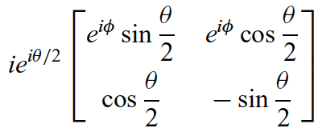
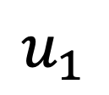
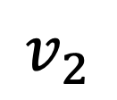
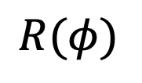
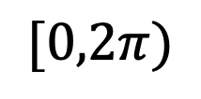
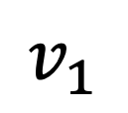

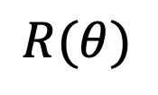

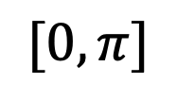
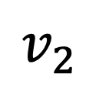

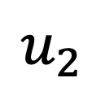
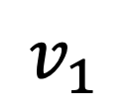
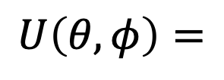

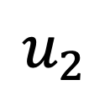
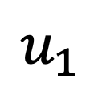
Schematic
$$B$$
$$R(θ)$$
$$B$$
$$R(φ)$$
$$u_{1}$$
$$v_{1}$$
$$U(θ, φ)$$
$$u_{1}$$
$$v_{1}$$
$$[0,π]$$
$$[0,2π)$$
$$=$$
$$u_{2}$$
$$v_{2}$$
$$u_{2}$$
$$v_{2}$$
$$U\left(θ, φ\right)=$$

Slide 3
n

Slide 4
n

Slide 5
n

Slide 6
n

Slide 7
n

Slide 8
n

