Slide 1
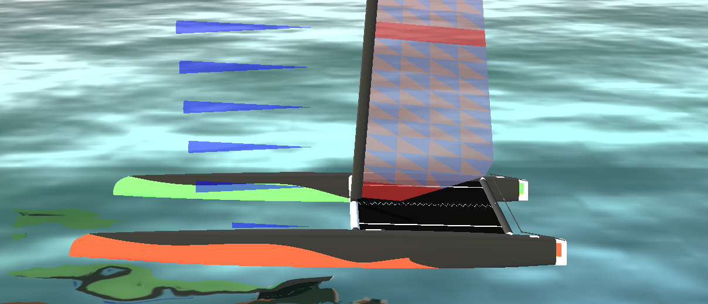

Slide 2
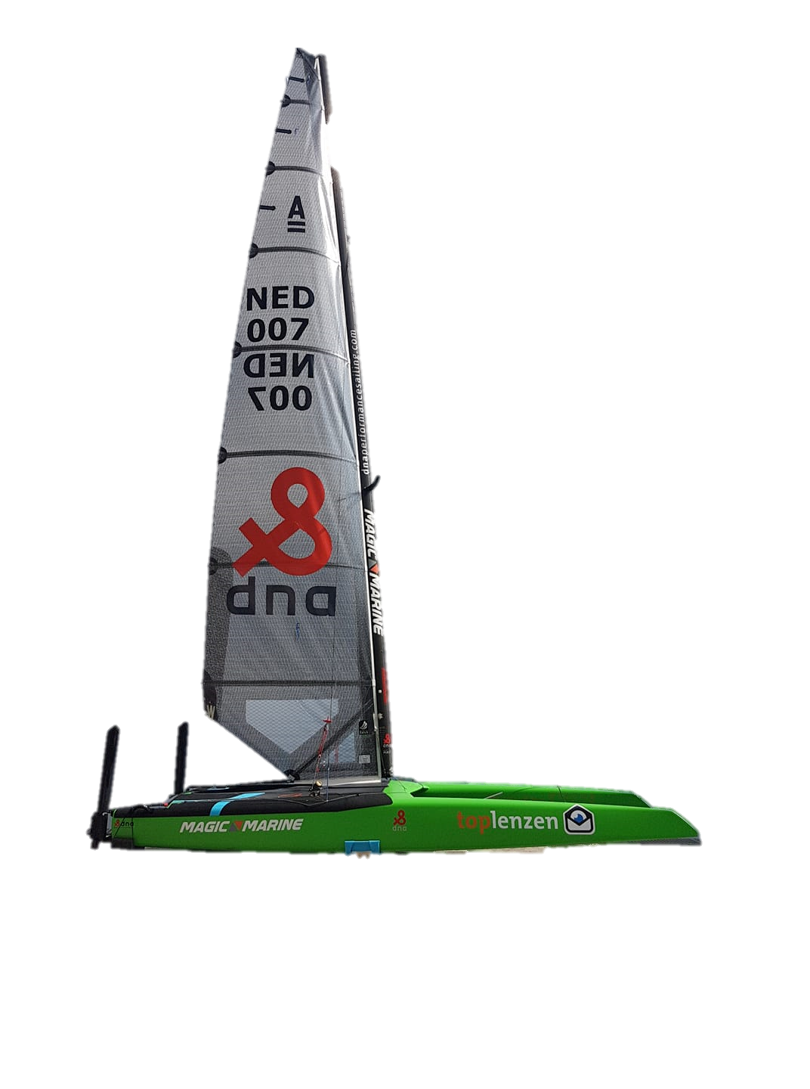
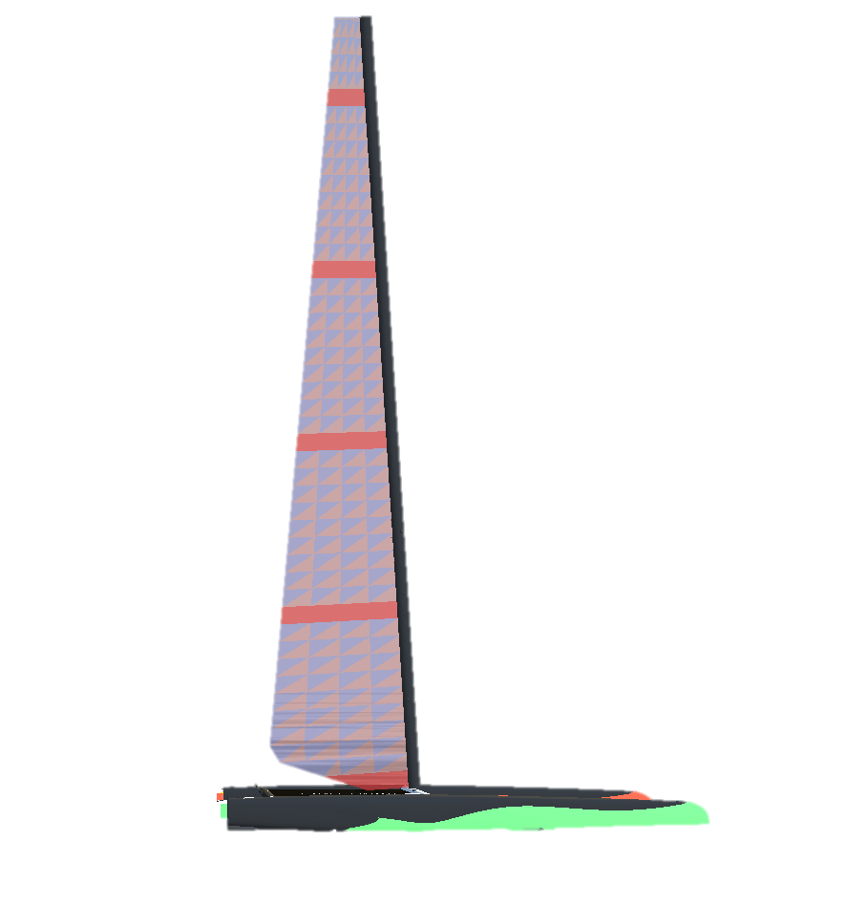
Notes:
A-Class: New DNA F1 'X' preview - Catamaran Racing , News & Design (catsailingnews.com)

Slide 3
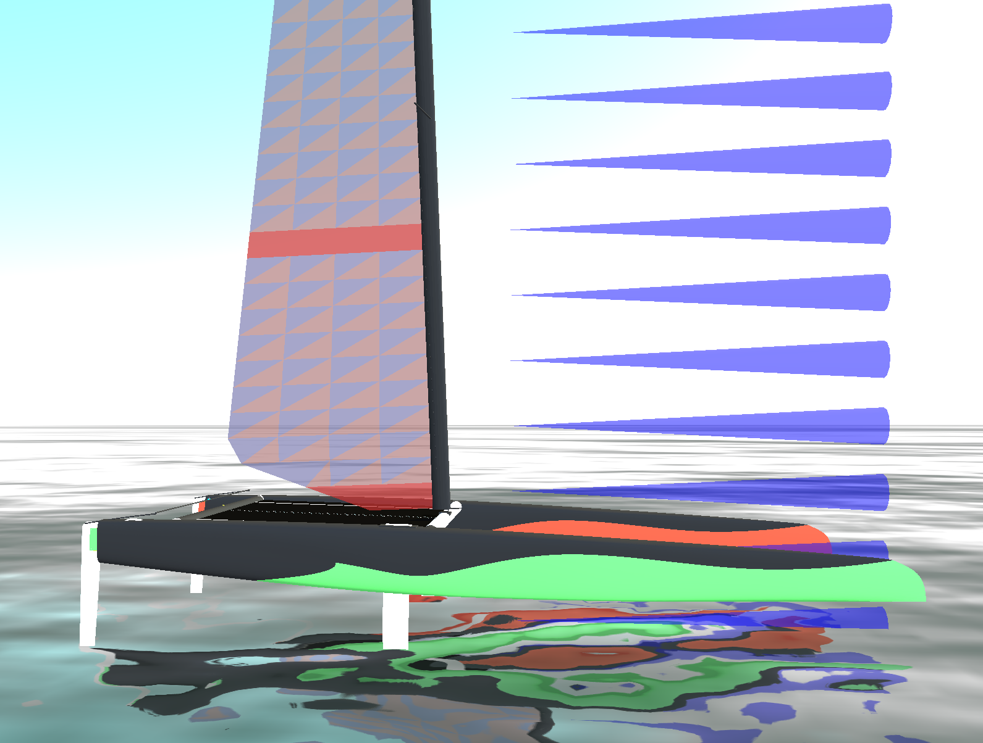
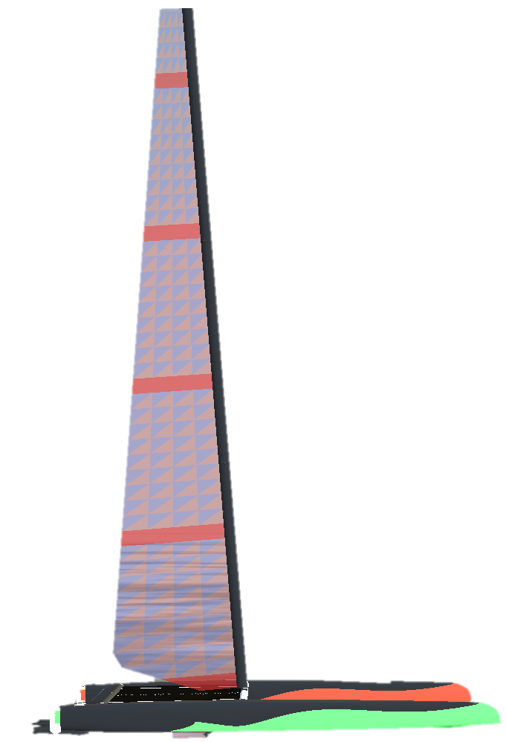
Notes:
A-Class: New DNA F1 'X' preview - Catamaran Racing , News & Design (catsailingnews.com)

Slide 4
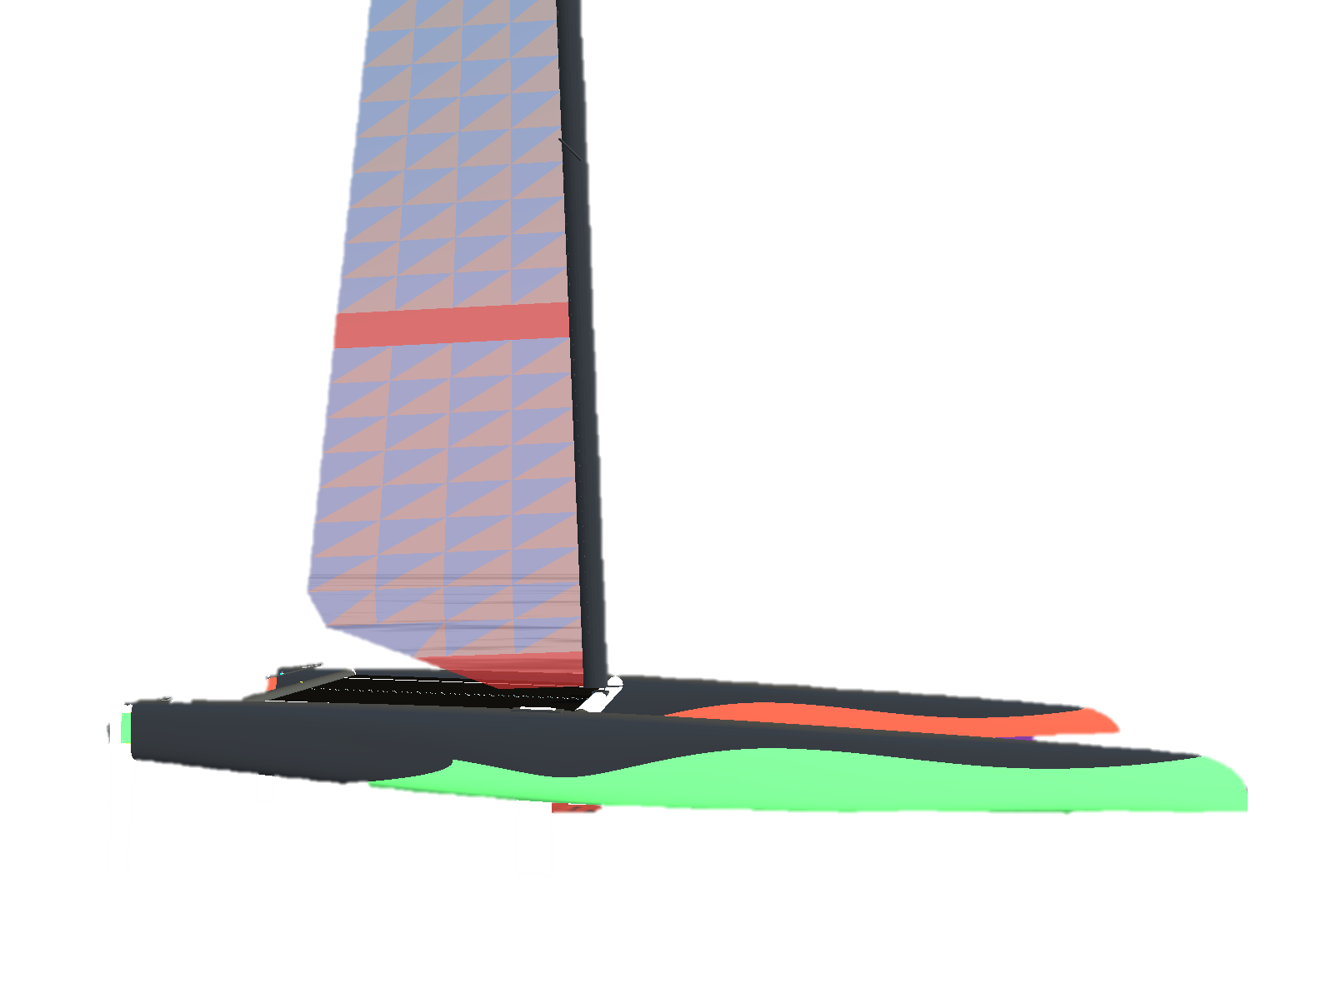
Notes:
A-Class: New DNA F1 'X' preview - Catamaran Racing , News & Design (catsailingnews.com)

Slide 5
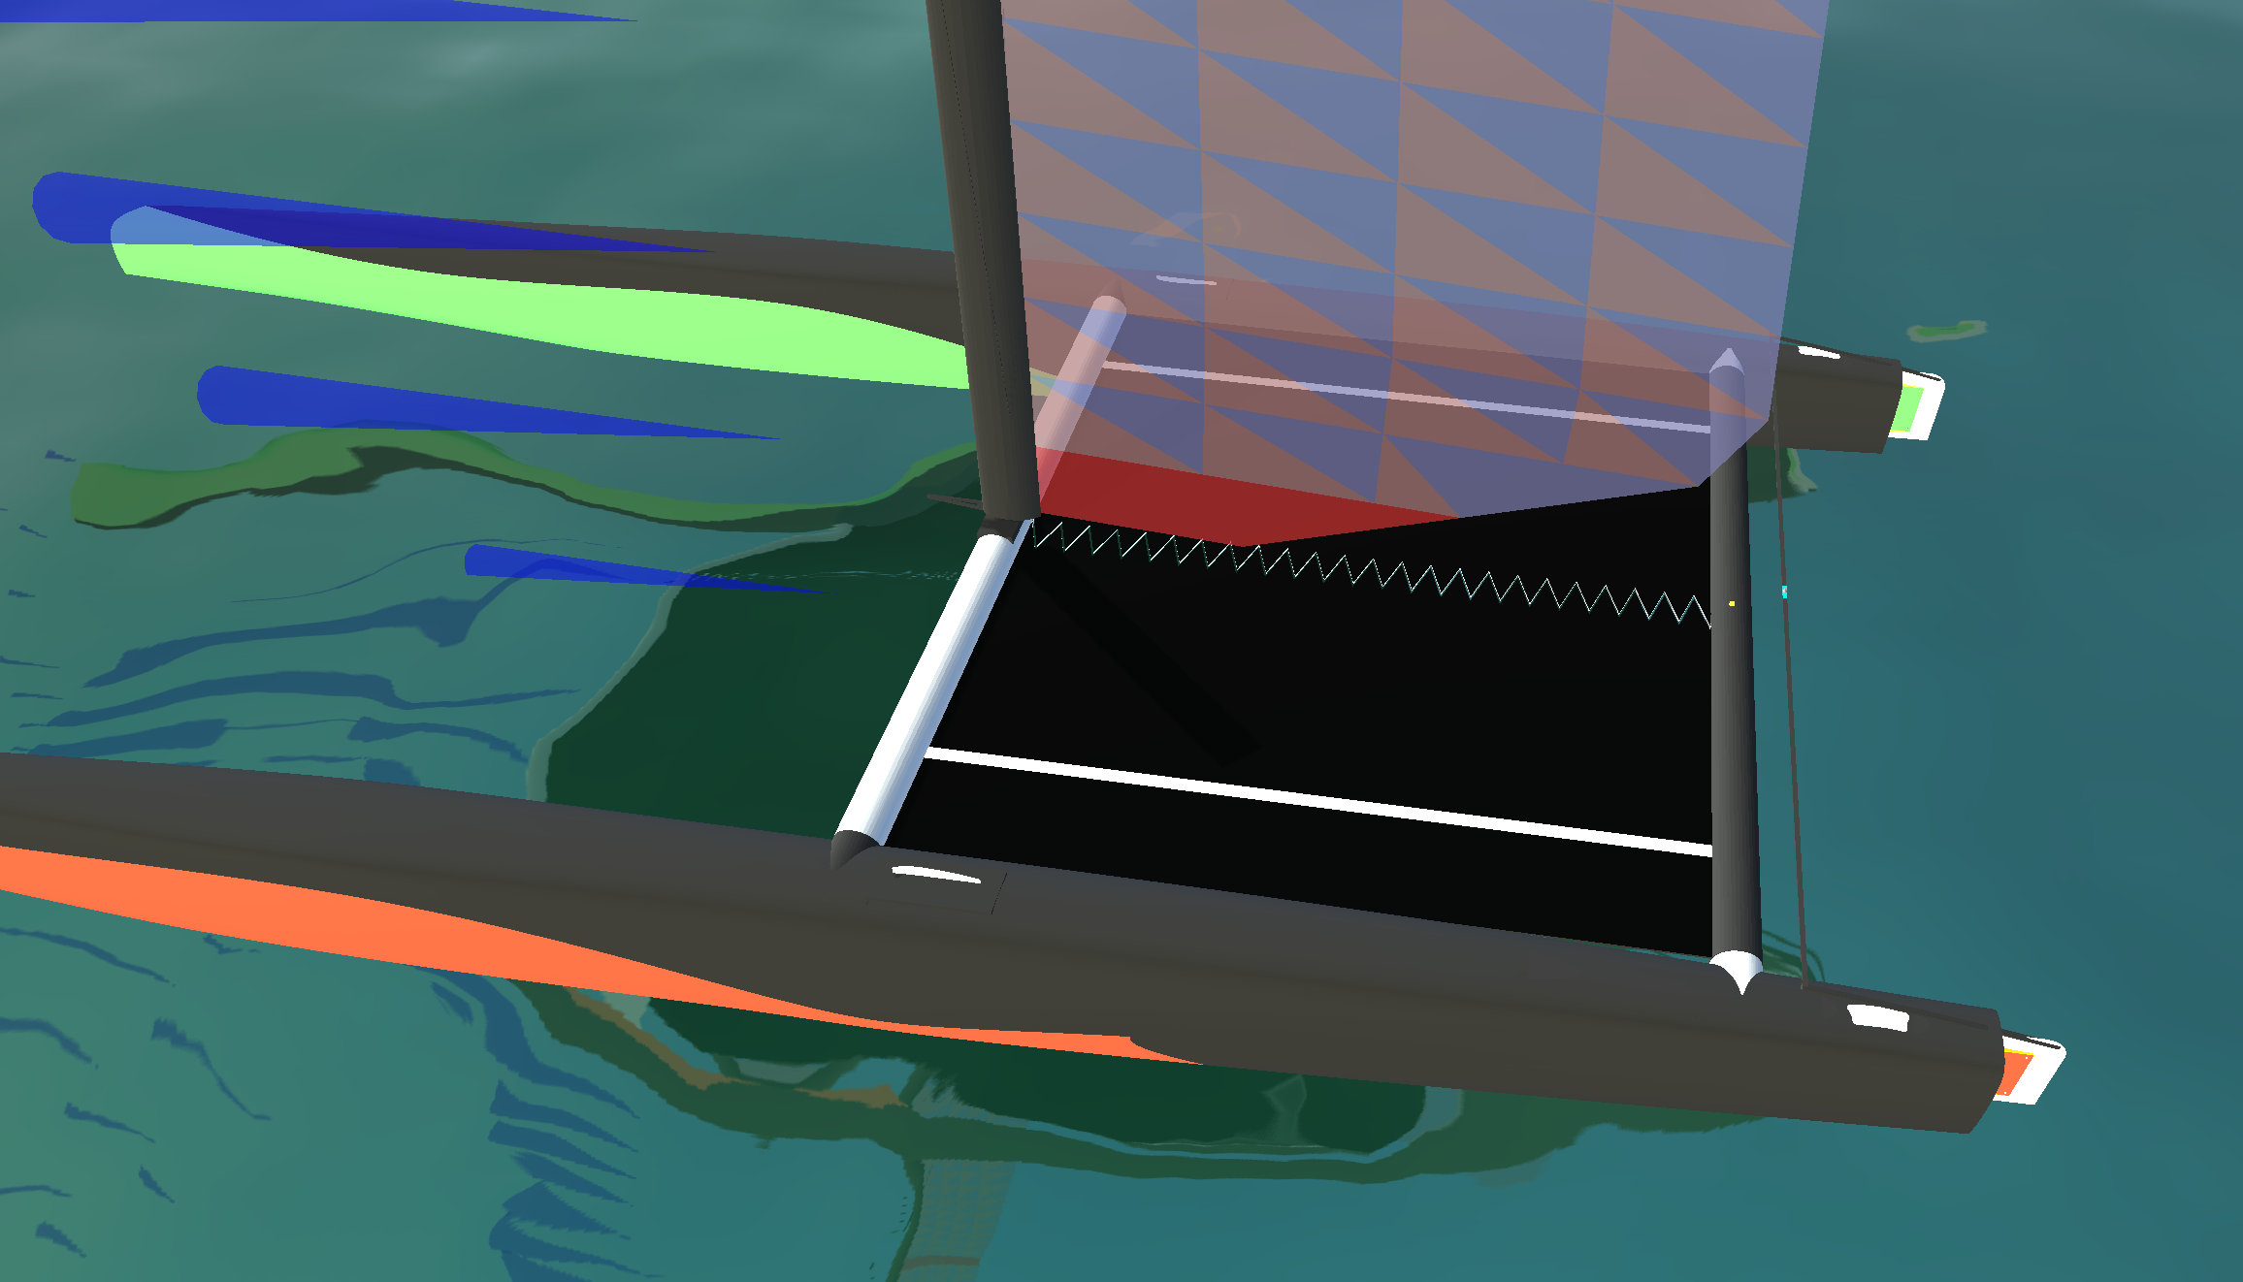
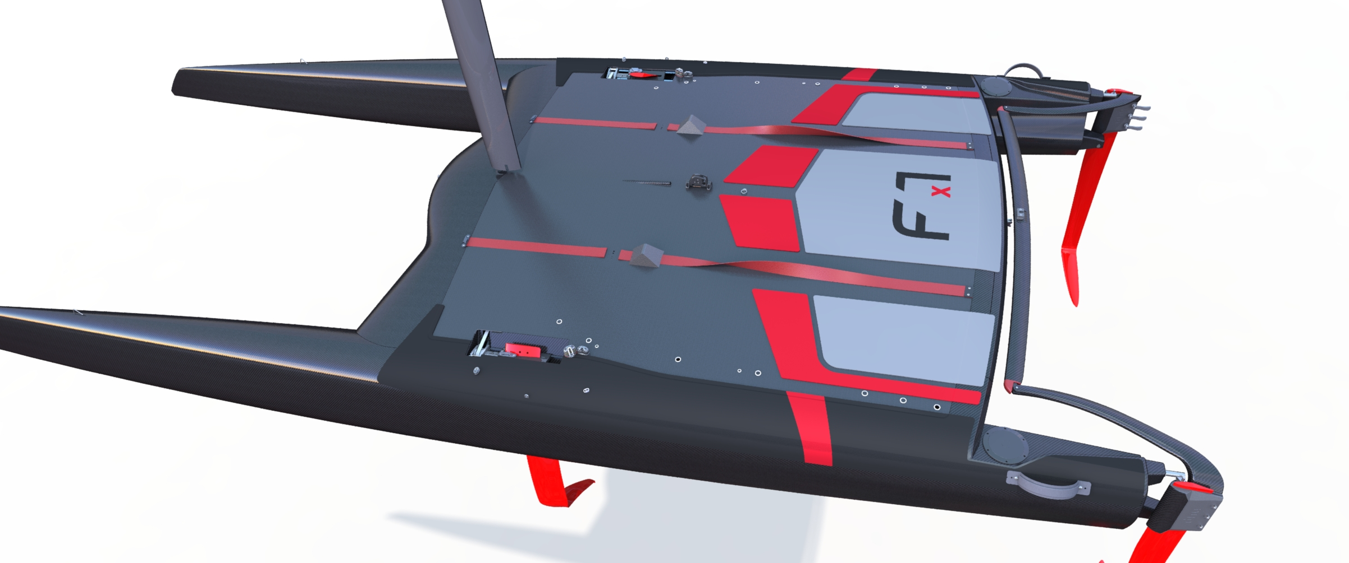
Notes:
The new DNA F1x A-class catamaran is unveiled! | International A-Division Catamaran Association (a-cat.org)

Slide 6
Notes:
The new DNA F1x A-class catamaran is unveiled! | International A-Division Catamaran Association (a-cat.org)

