Slide 1
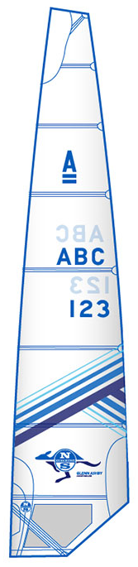
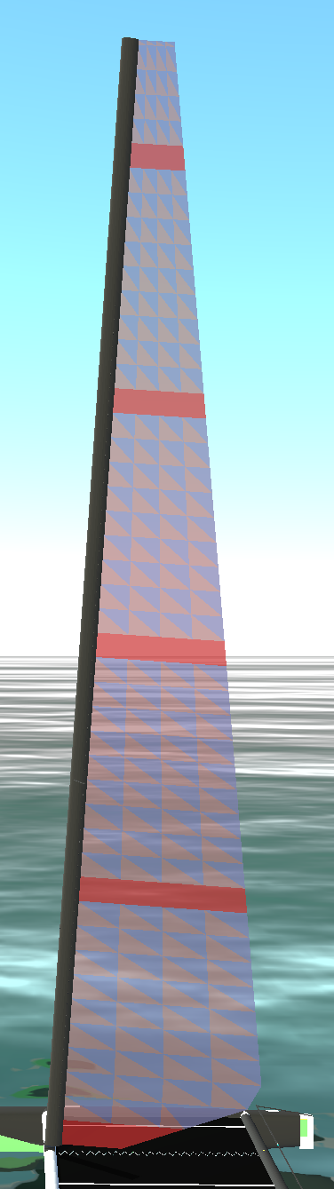
Notes:
A-Class Decksweeper 2 Mainsail | North Sails

