Slide 1
Rotor Speed Estimation from Onboard Audio of Multirotor Drones
Dmitrii Mukhutdinov · Lin Wang
School of Electronic Engineering and Computer Science
Queen Mary University of London, United Kingdom
Quiet Drones 2026 — UAS/UAM Noise Modelling

Slide 2
Why listen to a drone’s rotors?
Unique signature
Rotor harmonics dominate a drone’s ego-noise.
Pitch = speed
Each rotor’s blade-passage frequency is set directly by its rotational speed.
No telemetry
Per-rotor speed read passively from a single onboard microphone.
Enables manoeuvre & fault diagnostics, model-based source separation, and conditioning signals for noise suppression

Slide 3
The task: per-rotor speed from a mixture
The task
Input: one-channel mixture of speech + 4-rotor UAV noise at 16 kHz
Output: four rotor speeds at every STFT frame (~31 fps)
Practically relevant regime: SNR from −30 to 0 dB
Why it’s hard
Four simultaneous, equally prominent, time-varying pitches — all close to each other
The lowest harmonics are masked by strong broadband noise (wind noise)
Single-pitch trackers (YIN, CREPE) assume one fundamental — they don’t apply

Slide 4
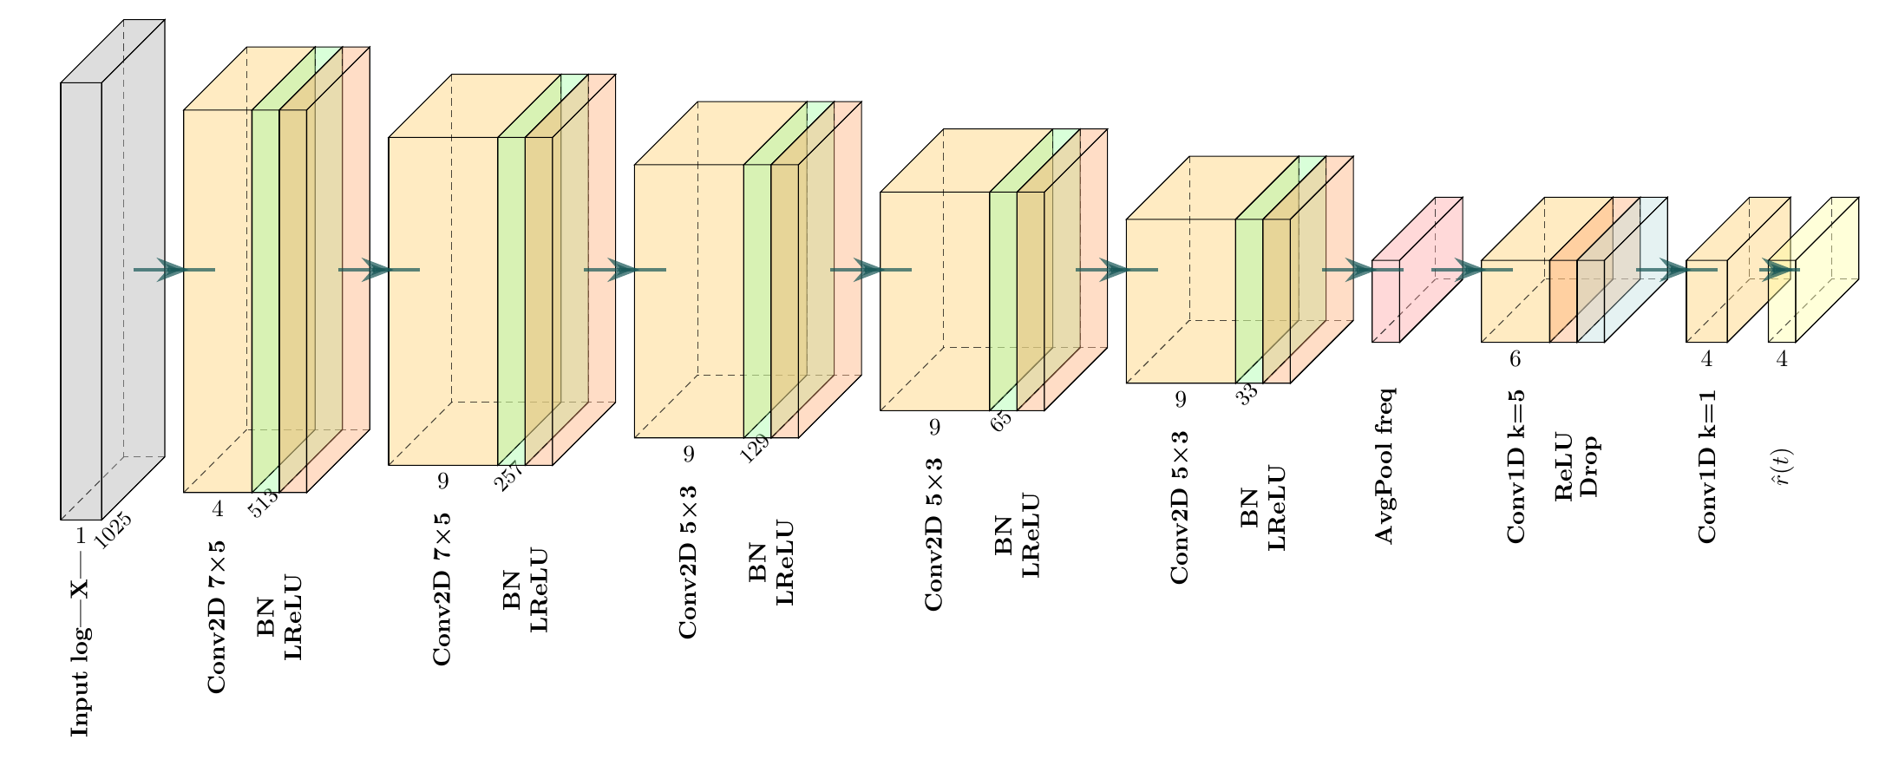
SimpleConv: a lightweight regressor
log-magnitude STFT of the mixture → four per-rotor speeds at every frame
538k parameters · ~15 ms per second of audio · 67× real-time on CPU

Slide 5
Data: DREGON-LM
Speech
LibriSpeech utterances (train-clean-100) – resampled to 16 kHz
Rotor noise
Real in-flight DREGON quadcopter recordings, with synchronised 4-rotor tachometer telemetry – resampled to 16 kHz
Mixture
Mixed at a sampled SNR; targets = motor speeds interpolated to the STFT frame grid
+
→
6000 / 600
train / validation clips
8.2 s
clip length @ 16 kHz
−30 to 0 dB
SNR range

Slide 6
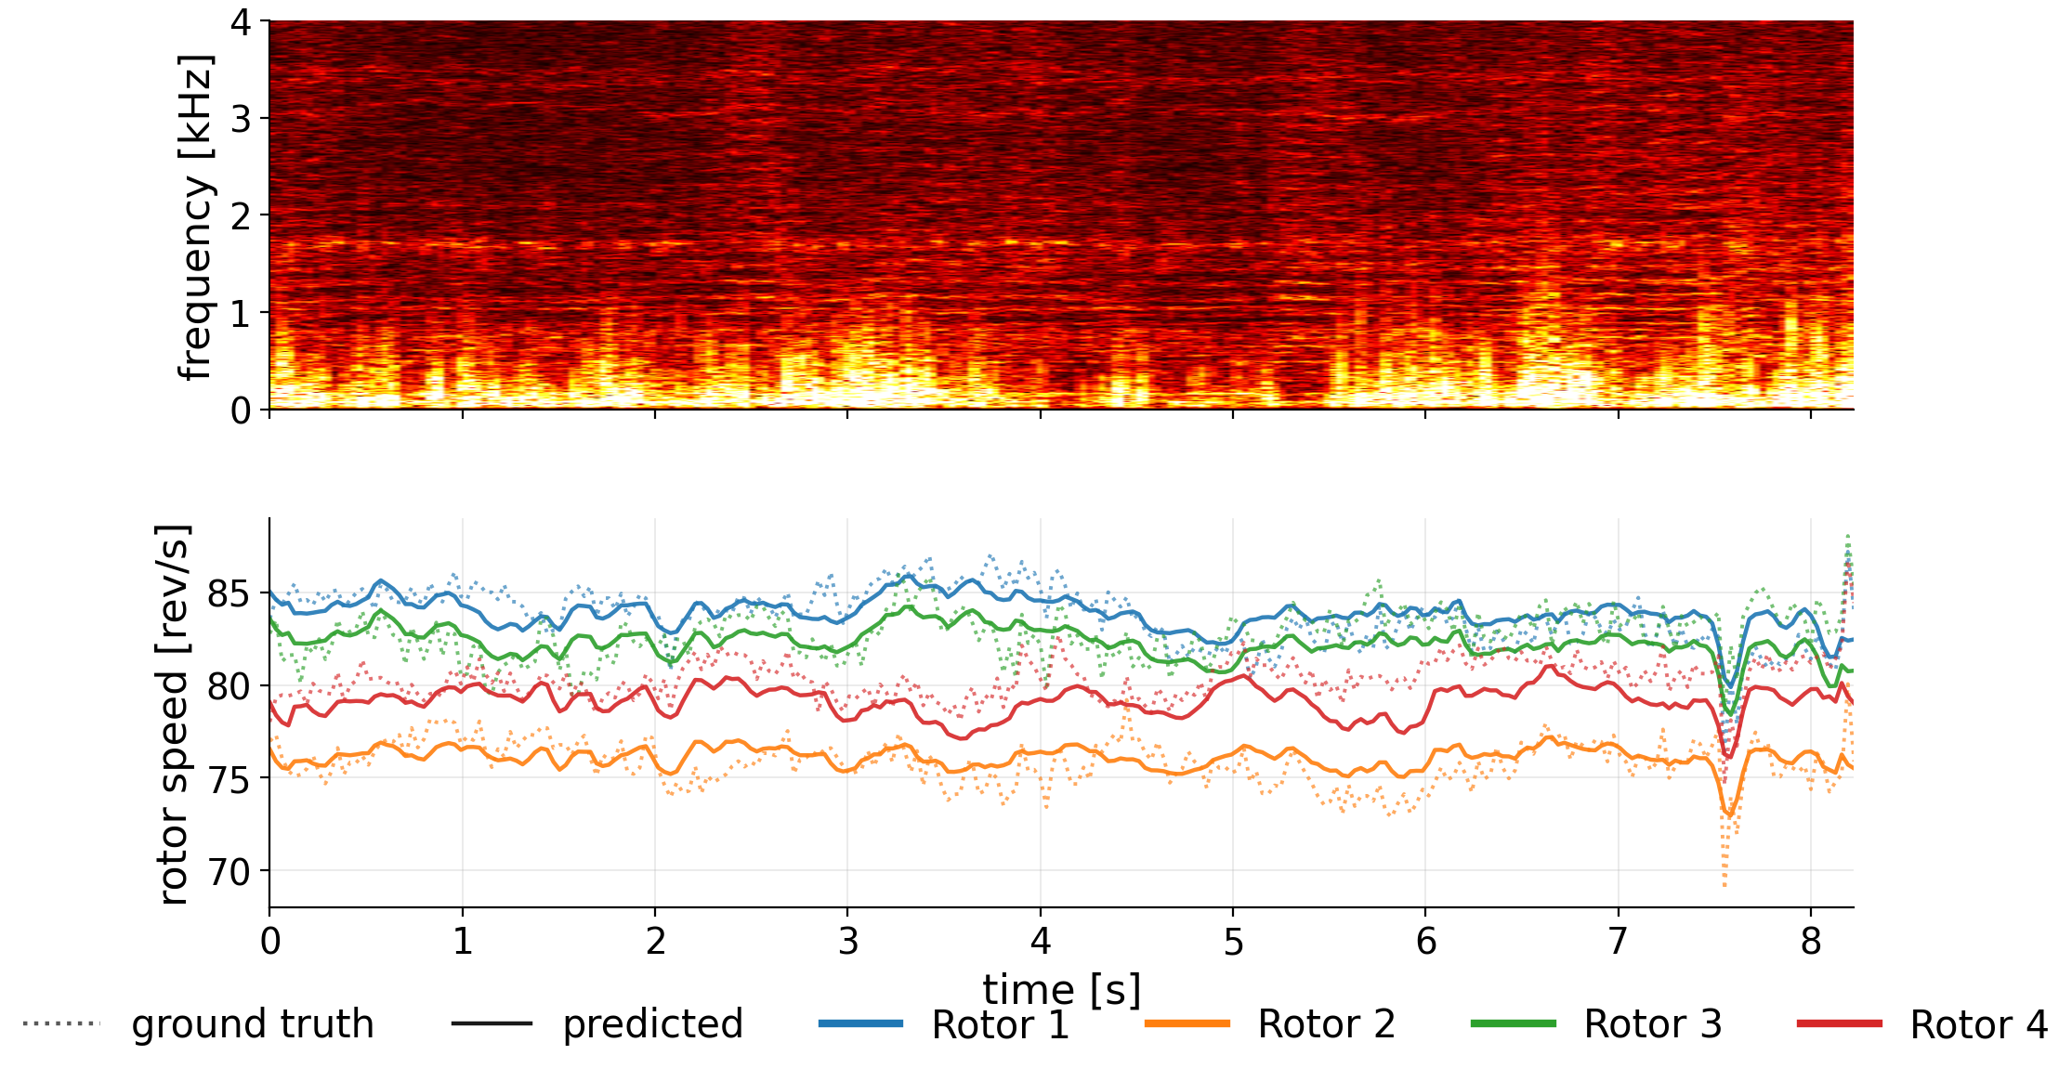
It tracks each rotor individually
Example 1 of 3
Near-hover: four rotors held at slightly different speeds — the model follows each one through the brief throttle dip.

Slide 7
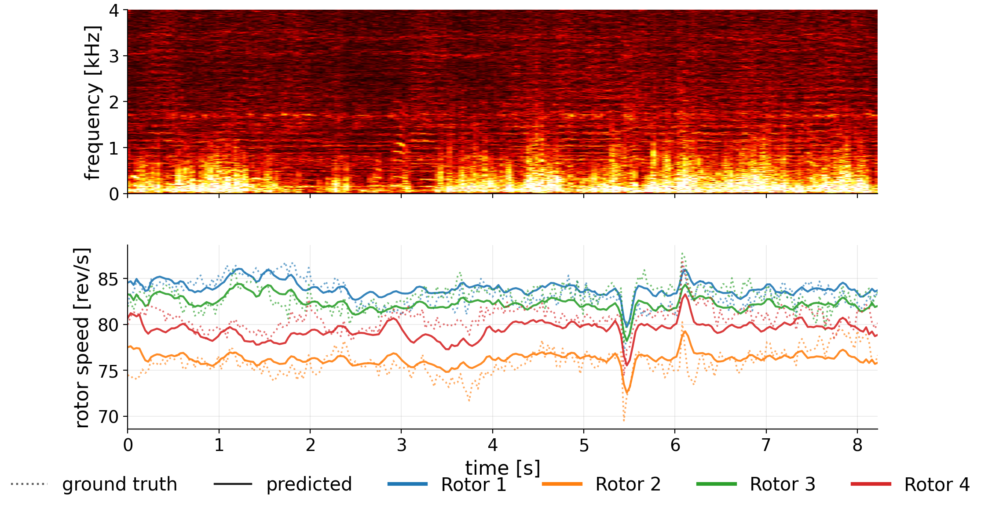
It tracks each rotor individually
Example 2 of 3
A coordinated maneuver — all four speeds dip together near 5.5 s, then overshoot; the tracking stays locked on.

Slide 8
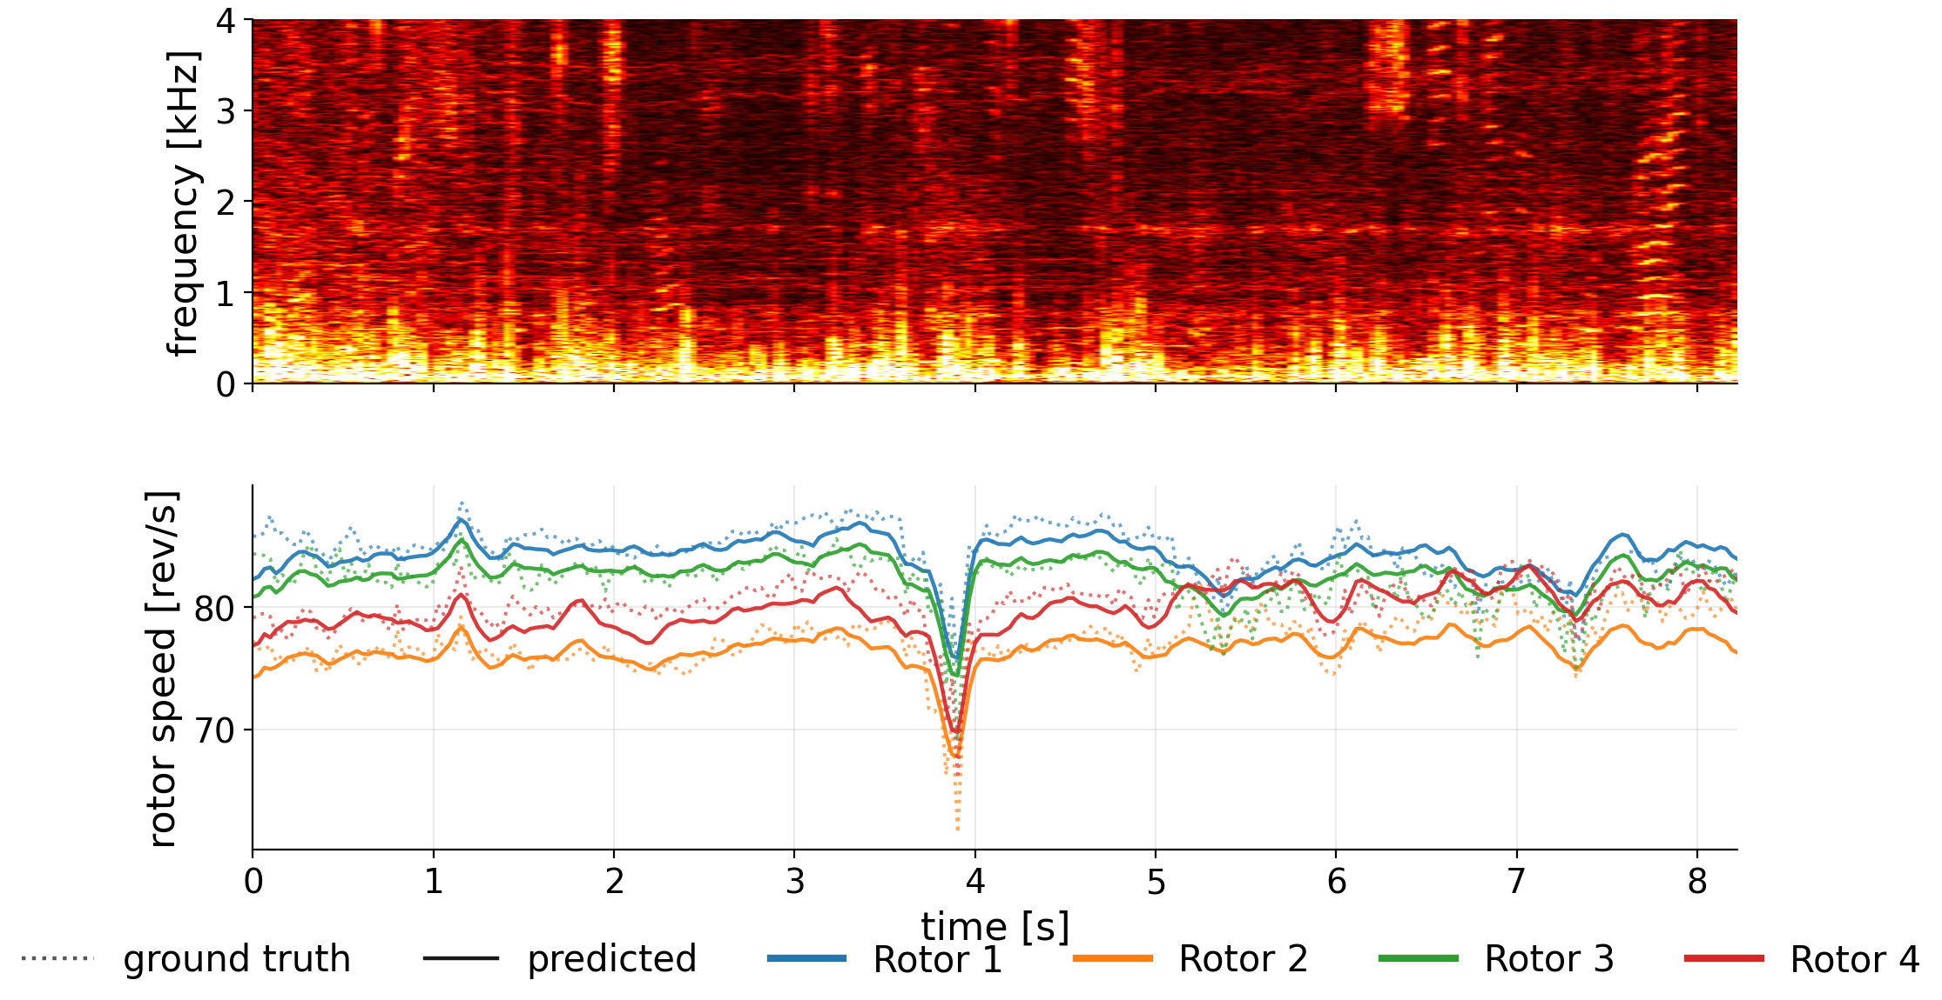
It tracks each rotor individually
Example 3 of 3
A sharp, synchronized throttle cut near 4 s — the predictor captures the dive and recovery on every rotor.

Slide 9
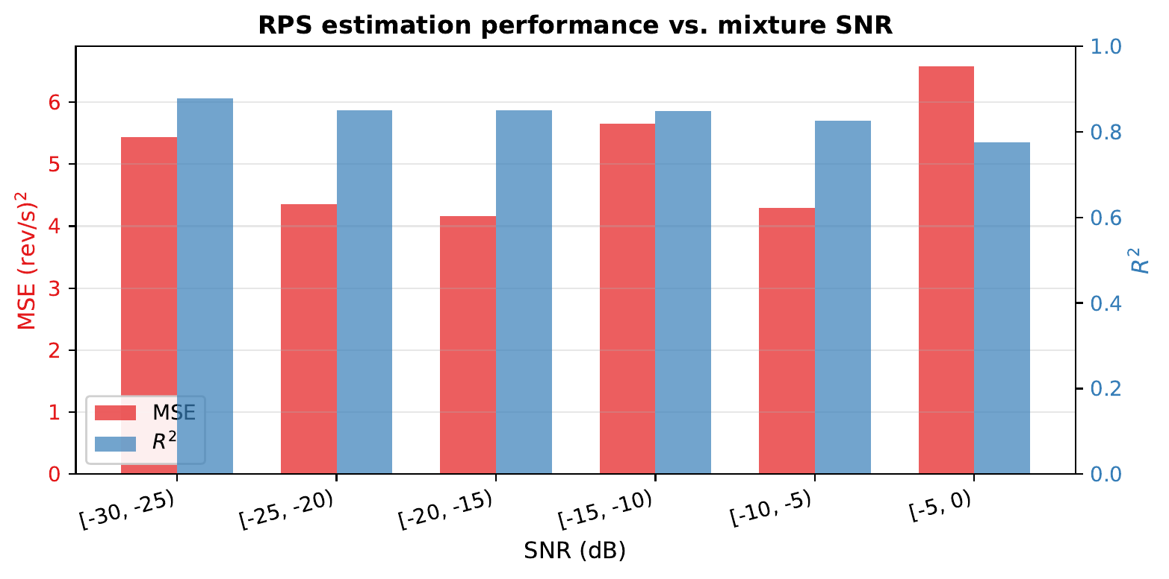
Accurate across the full SNR range
R² = 0.84
tracks the temporal trajectory
MAE = 0.56
rev/s — per-rotor average error
MSE = 5.15
(rev/s)² on held-out mixtures
≈ 100× lower error than a mean-RPS baseline (365 (rev/s)²)
MSE (red) and R² (blue) per 5 dB SNR bin — stable from −30 to 0 dB.

Slide 10
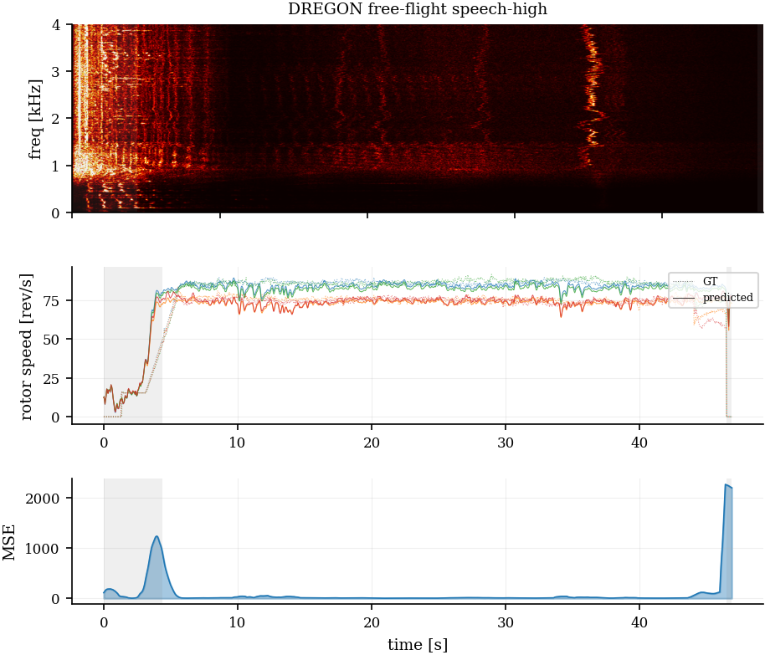
Generalizes to real free flight
Out-of-distribution test
Real DREGON free flight, ~47 s, contains prominent speech source (SNR −3 to −8 dB);
Steady flight: all four rotors tracked, mean MSE 19.9 (rev/s)² — within ~2× of the validation score on synthetic mixtures
Only failure: takeoff & landing
Rotors spin up / down to zero — a regime never seen in training
Distribution shift, not a limit of audio-only estimation
Spectrogram, GT (dotted) vs predicted (solid), and per-frame MSE; grey bands = takeoff / landing.

Slide 11
Conclusions & what’s next
Takeaways
First study of audio-only multi-rotor RPS estimation in strong non-rotor noise
A tiny conv net recovers per-rotor speed from −30 to 0 dB (R² = 0.84)
Passive acoustic drone-state monitoring without telemetry is feasible
What’s next
Cross-airframe and real low-SNR flight recordings
Compare against adapted classical pitch trackers and SOTA multi-pitch tracking methods for music
Use predicted RPS to condition downstream tasks (enhancement, state classification)

Slide 12
Thank you!
Dmitrii Mukhutdinov · Lin Wang
d.mukhutdinov@qmul.ac.uk · lin.wang@qmul.ac.uk
Queen Mary University of London

Slide 13
Backup slides
Recent, after-submission work — for questions
Classical baselines · architecture sweep · mutli-pitch tracking baselines · generalization

Slide 14
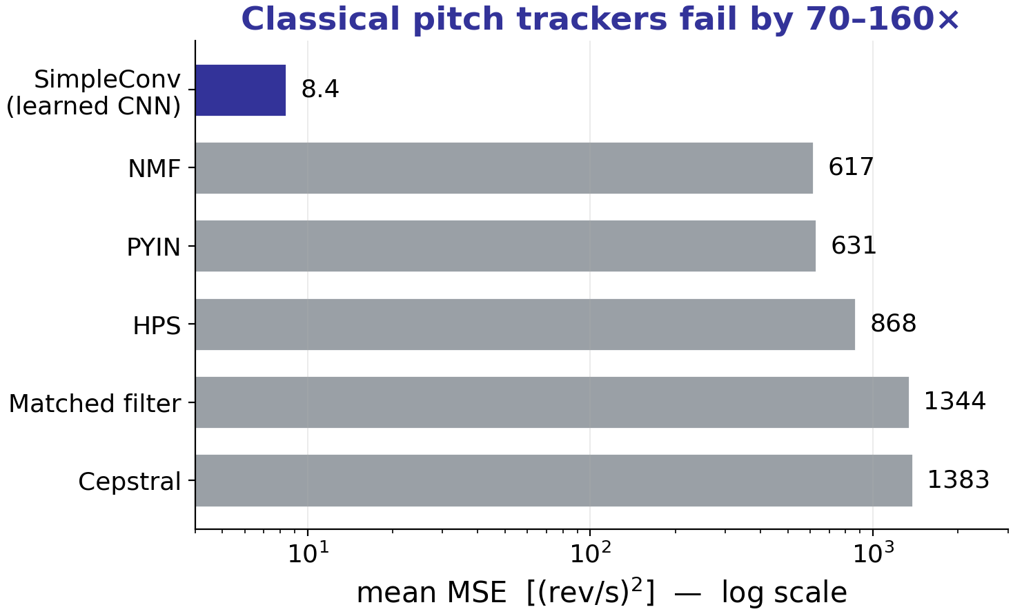
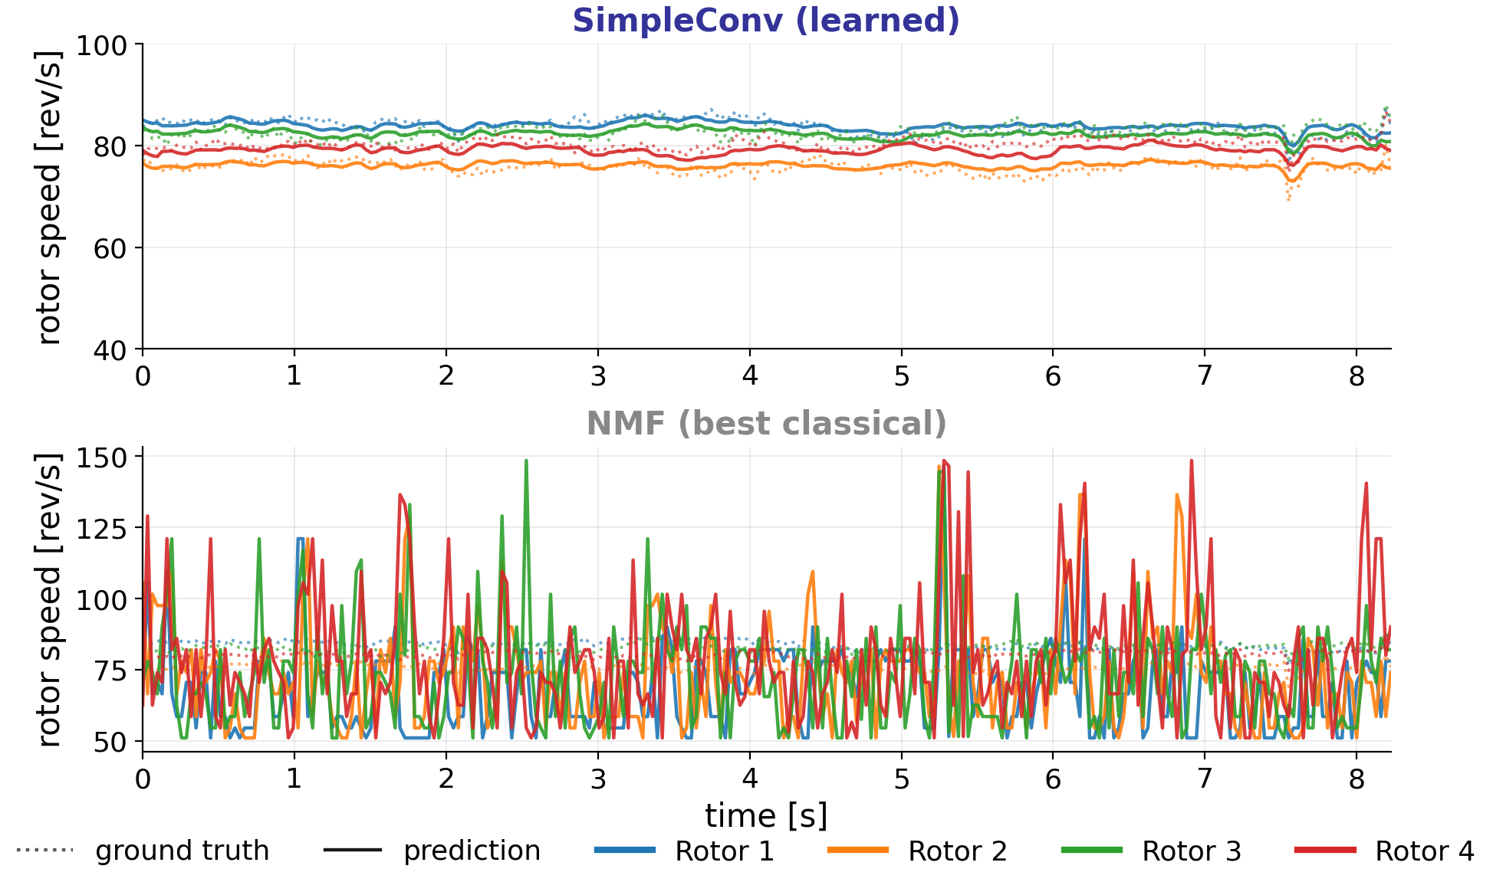
Classical methods don’t work
After-submission work
Five single-/multi-pitch trackers (PYIN, cepstral, HPS, matched filter, NMF), all with R² < 0. Even true multi-pitch NMF is ~70× worse than the CNN; its tracks (bottom right) are essentially noise.

Slide 15
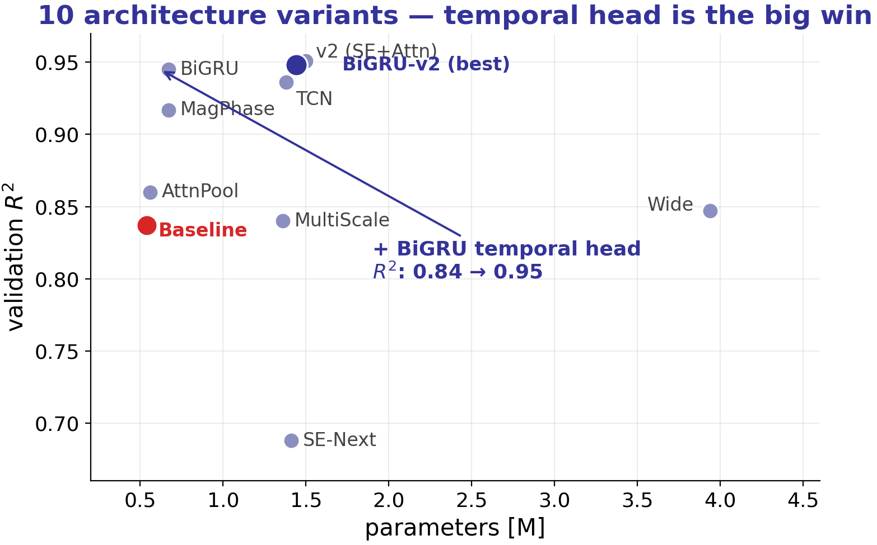
We swept 10 architecture variants
After-submission work
A BiGRU temporal head is the biggest single gain (R² 0.84 → 0.95). Pure width scaling and SE-without-temporal do not help.

Slide 16
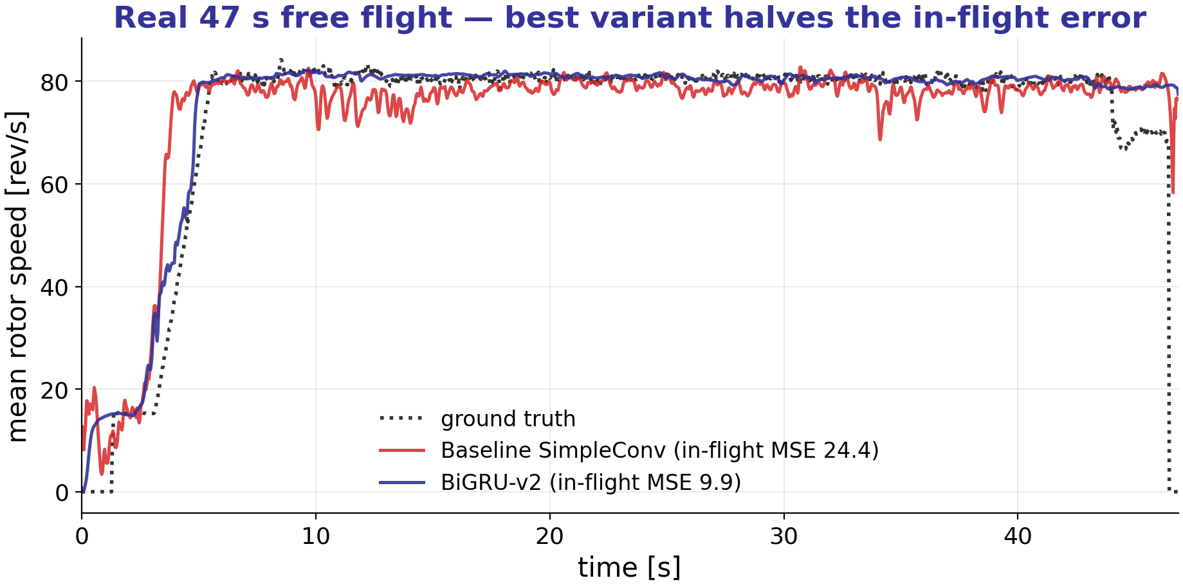
Best variant on a real 47s flight
After-submission work
BiGRU-v2 halves the baseline’s in-flight error (MSE 9.9 vs 24.4) and tracks the take-off and landing transients more tightly.

Slide 17
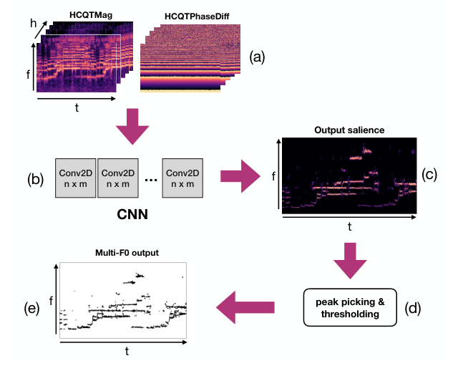
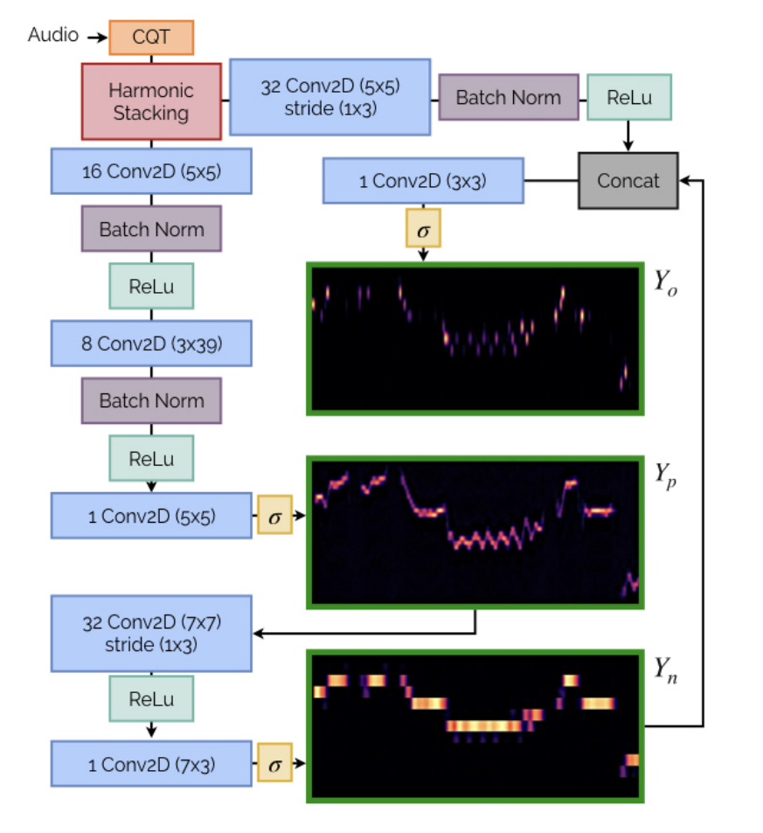
Multi-pitch salience baselines
After-submission work
LateDeep: HCQT → CNN → salience map (~1.2M params)
Basic Pitch (Spotify): CQT note transcriber (~16k params)
Both are off-the-shelf multi-pitch models: they emit a salience map S(t, f) ∈ [0, 1], which we peak-pick and restore the four motor speed trajectories using least-cost assignment (Hungarian algorithm).

Slide 18
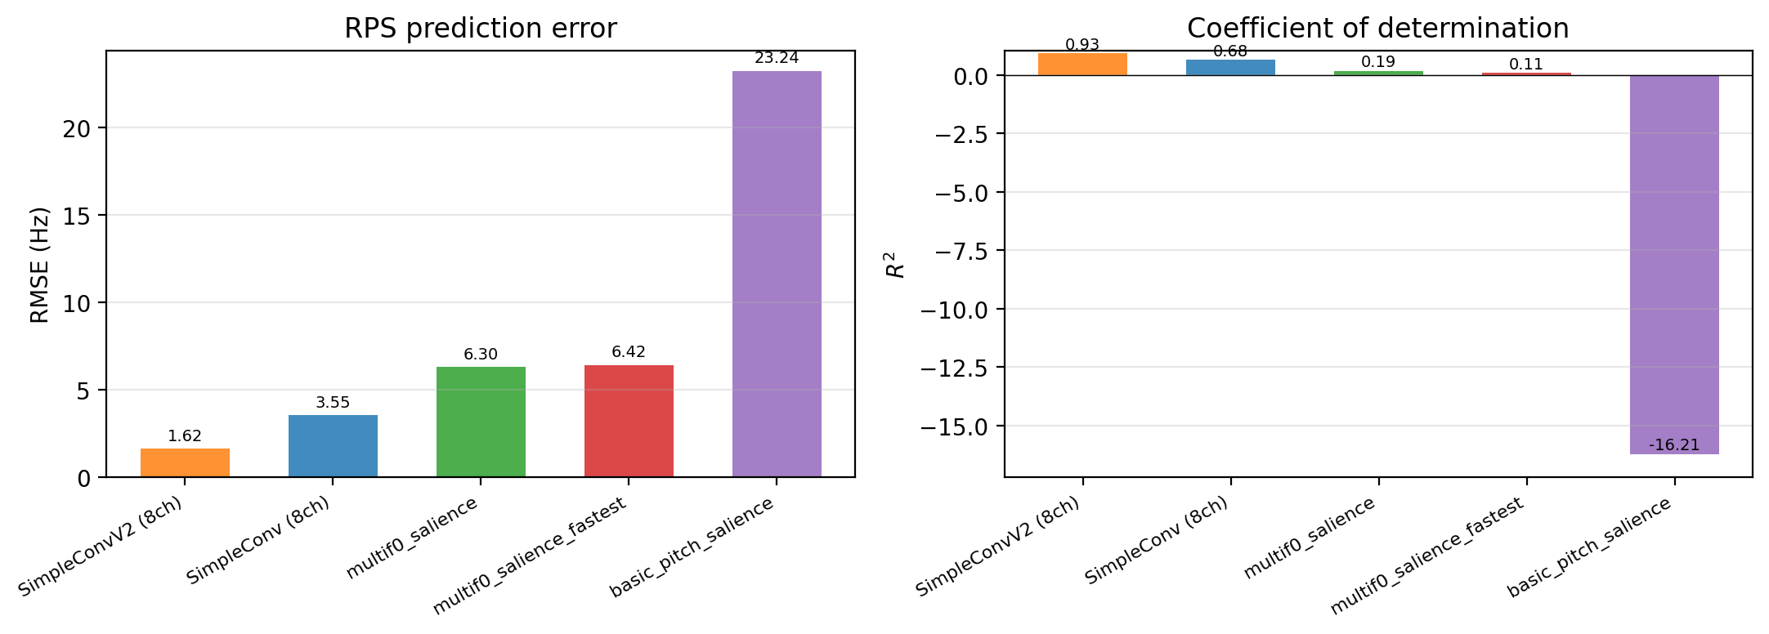
Multi-pitch salience baselines
After-submission work
Salience map → peak-pick → Hungarian tracking lags 4–14×. Rotors cluster in 69–89 Hz; in 55% of frames two are <1 Hz apart — below the ~0.9 Hz grid spacing — so the difference between rotor trajectories cannot be distinguished.
Resolution floor
≥ 2.5–3 Hz (perfect map)
SimpleConvV2 total
1.62 Hz — below the floor

Slide 19
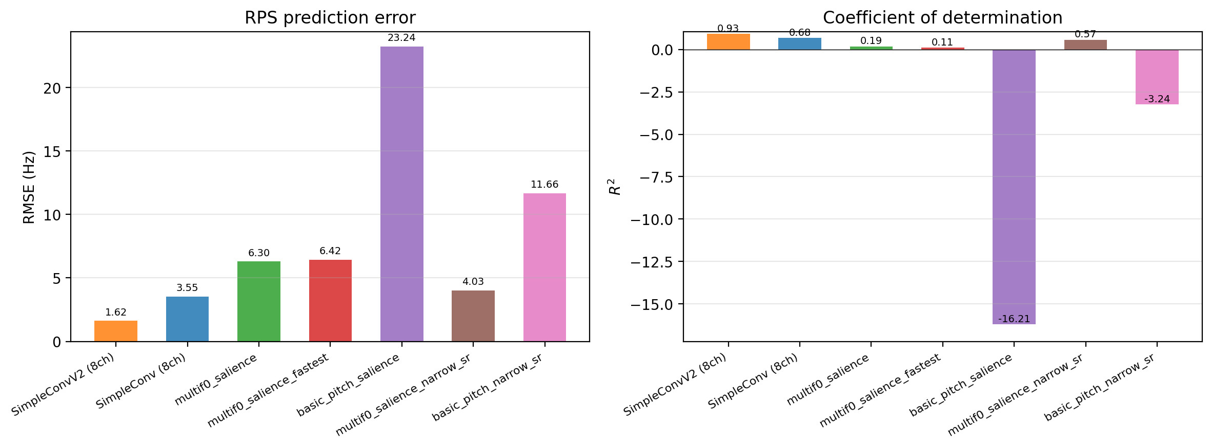
Fixing resolution isn’t enough
After-submission work
A narrow-band front-end (55–110 Hz) + a learned super-resolution grid (~0.15 Hz/bin) avoids RPS tracking from collapsing into the same bins. However, Basic Pitch stays unusable (R² −3.24); multif0 is still worse than our simples convolutional regressor.
Best salience (LateDeep)
RMSE 6.30 → 4.03 · R² 0.19 → 0.57
SimpleConvV2
still 2.5× better (1.62 Hz)

Slide 20
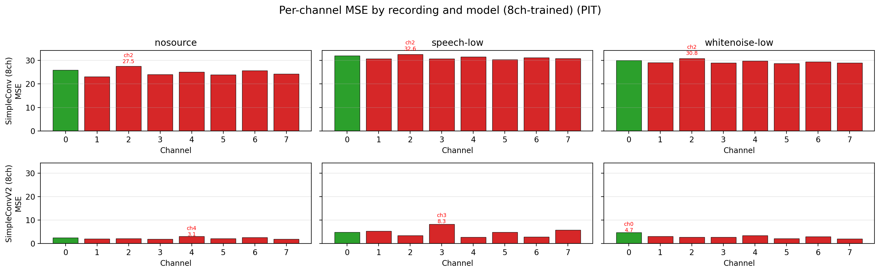
Generalizing across microphones
After-submission work
Trained on all 8 mics, evaluated per-mic with PIT (which rotor is loudest depends on mic position, so rotor identity needs PIT).
Simplest convolutional regressor (SimpleConv) fails to generalize across channels; improved architecture (SimpleConvV2) generalizes well.
Plain SimpleConv
R² = 0.68 — lags
SimpleConvV2
R² = 0.93 — uniform

Slide 21
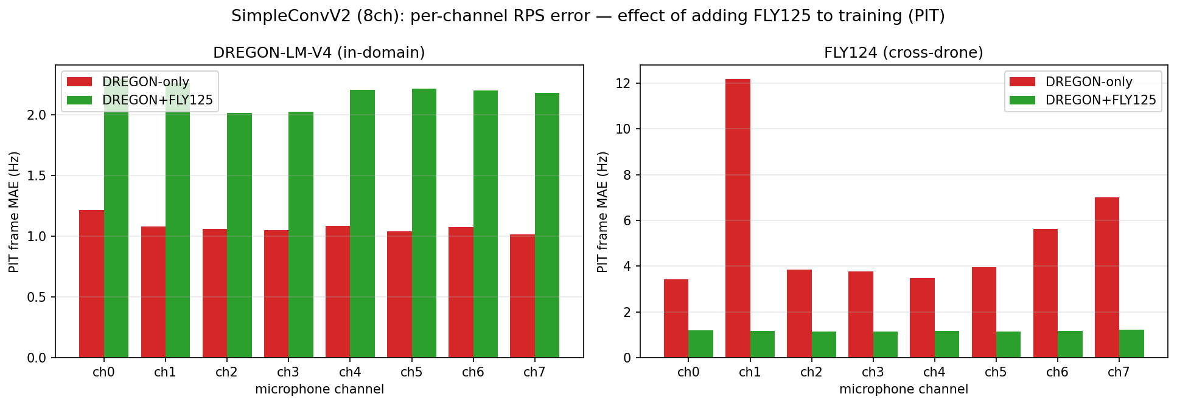
Generalizing to a new drone
After-submission work
SimpleConvV2 trained only on DREGON, tested on an in-house recording of a different drone (coded FLY124). Adding another in-house recording of the same drone to the training set (coded FLY125) makes it uniform (~1.1 Hz) on every mic; but performance on DREGON validation set slightly degrades.
DREGON-only on FLY124
RMSE 7.96 · R² 0.52
+ one FLY125 recording
RMSE 1.63 · R² 0.96

