Slide 1
Radar Measurements
Chris Allen (callen@eecs.ku.edu)
Course website URL
people.eecs.ku.edu/~callen/725/EECS725.htm

Slide 2
Radar measurement accuracy & resolution
Radar systems are used to measure various parameters
  range, velocity, position, RCS, surface roughness, displacement, etc.
Assessing the quality of these measurements depends on the application
Key terminology
  Accuracy – related to measurement error or uncertainty
  Precision – the ability to produce the same measured result repeatedly
  Resolution – the ability to distinguish or discern various targets
  Uncertainty – range likely to contain the true value of the measured parameter
Examples
Range resolution
  ability to resolve two or more targets based on range differences
Range accuracy
  range measurement uncertainty

Slide 3
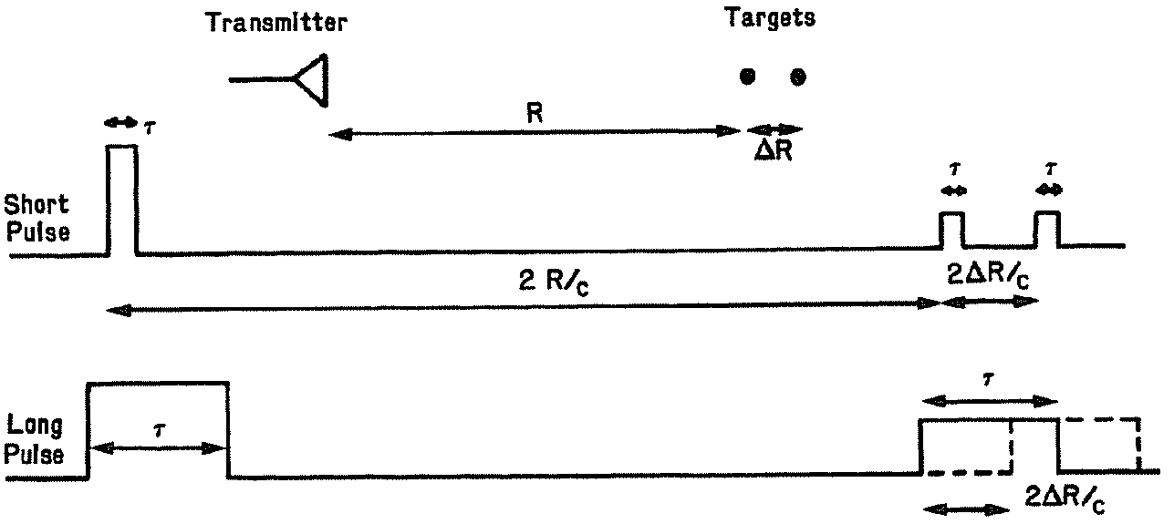
Range resolution and spatial discrimination
Spatial discrimination relates to the ability to resolve signals from targets based on spatial position or velocity.
  angle, range, velocity
Resolution is the measure of the ability to determine whether only one or more than one different targets are observed.
Range resolution, symbolized by ΔR or ρ_{r}, is related to pulse duration, τ, or signal bandwidth, B
Two targets at nearly
the same range
Short pulse → higher bandwidth
Long pulse → lower bandwidth

Slide 4
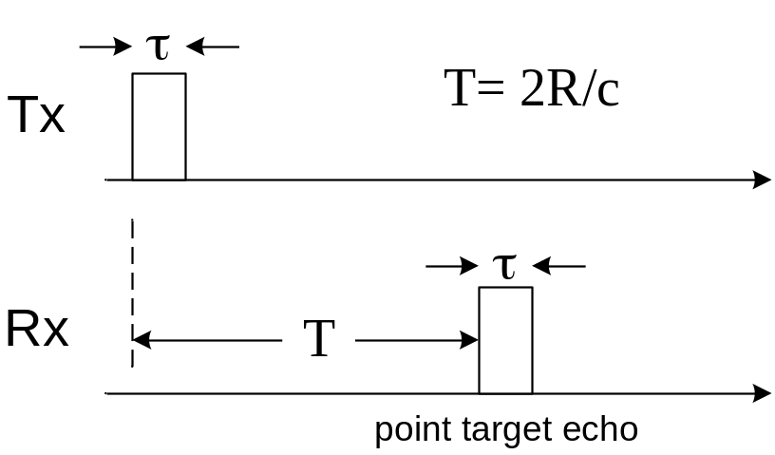
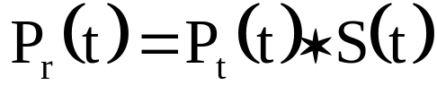
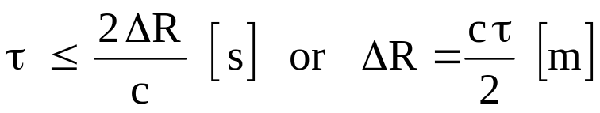
Range resolution
Short pulse radar
The received echo, P_{r}(t) is
where
  P_{t}(t) is the pulse shape
  S(t) is the target impulse response
  ∗ denotes convolution
To resolve two closely spaced targets, ΔR

Slide 5
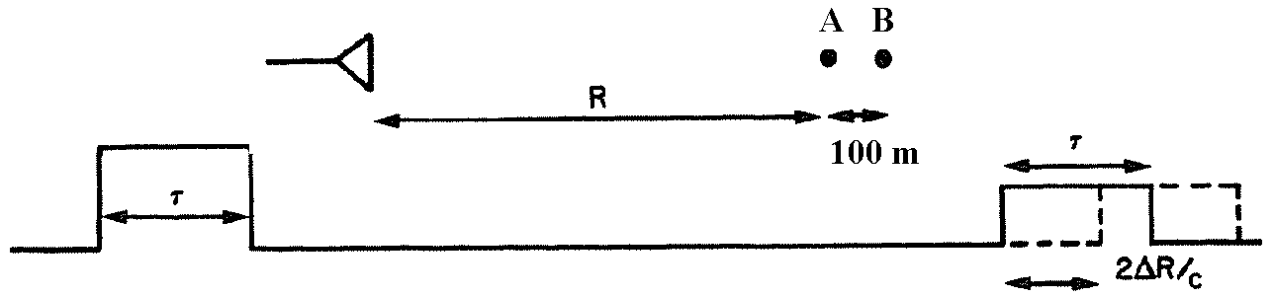
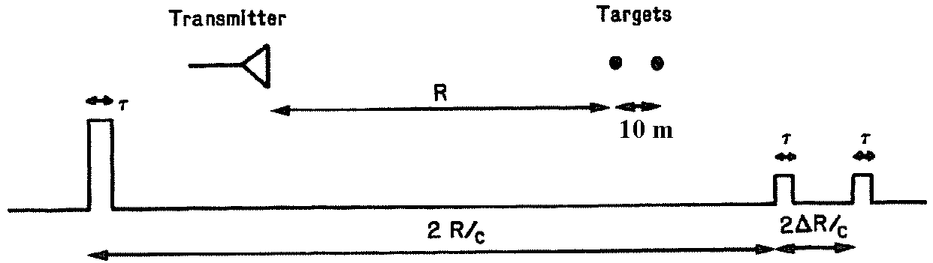
Range resolution
Example
  τ = 1 μs, ΔR = 150 m
  R_{A} = 30 km, R_{B} = 30.1 km
  T_{A} = 2 R_{A}/c = 200 μs
  T_{B} = 2 R_{B}/c = 200.67 μs
  T_{B} – T_{A} = 0.67 μs < 1 μs
  → therefore a 1-μs pulse cannot resolve targets separated by 100 m
  τ = 10 ns, ΔR = 1.5 m
  R_{A} = 30 km, R_{B} = 30.01 km
  T_{A} = 2 R_{A}/c = 200 μs
  T_{B} = 2 R_{B}/c = 200.067 μs
  T_{B} – T_{A} = 67 ns > 10 ns
  → therefore a 10-ns pulse can resolve targets separated by 10 m

Slide 6
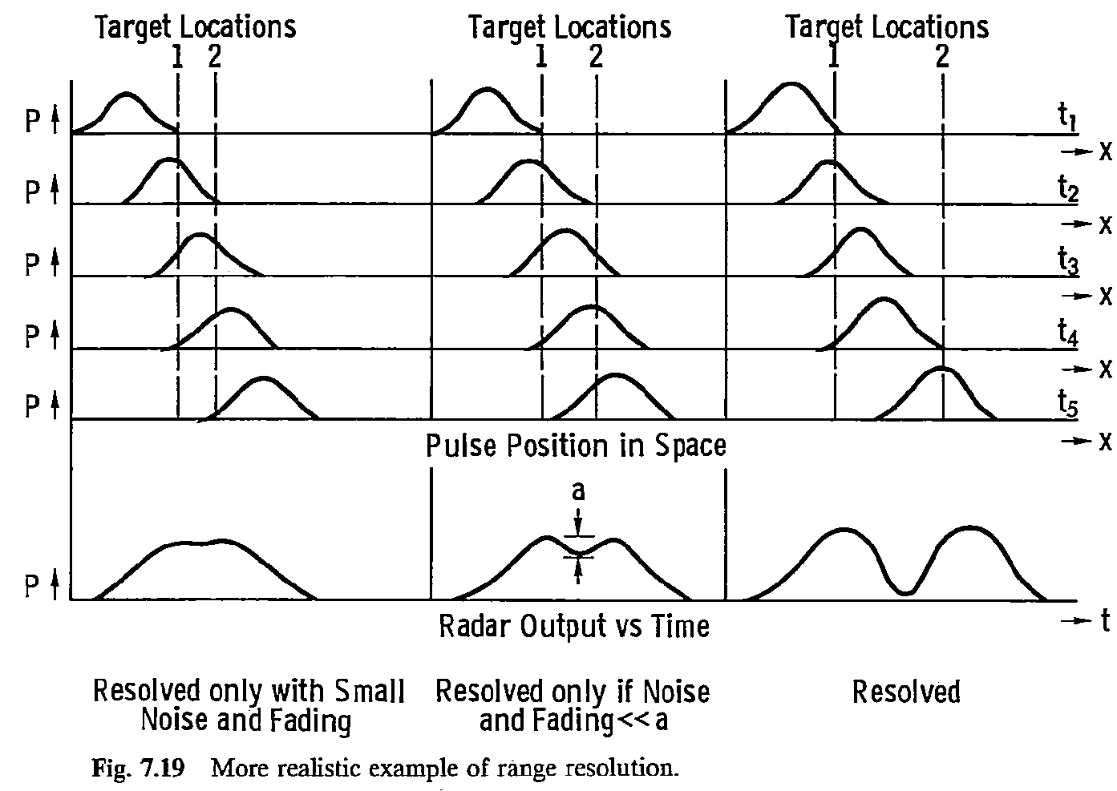
Range resolution

Slide 7
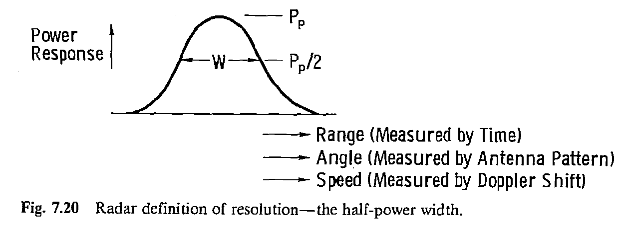
Spatial discrimination and range resolution
The ability to resolve targets is somewhat subjective.
In microwave remote sensing a more objective definition of resolution is: the distance (angle, range, speed) between the half-peak-power response.

Slide 8
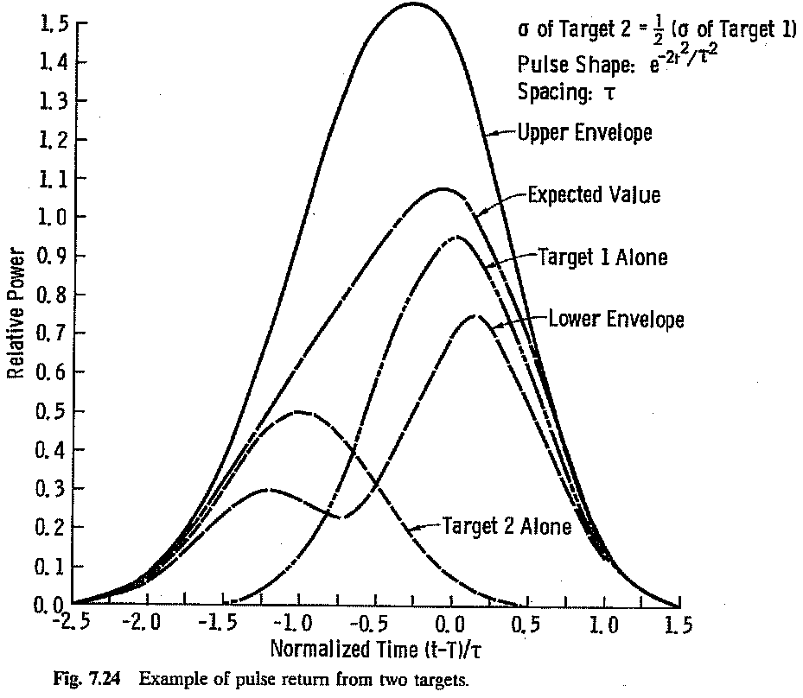
Range resolution
Factors complicating target resolution include differing signal strengths (RCS), phase differences between targets, noise, and fading effects.

Slide 9
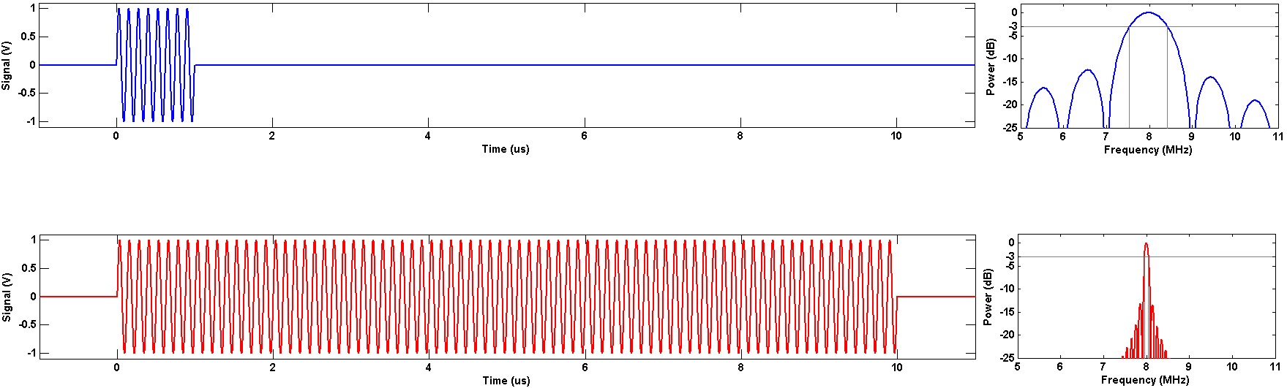
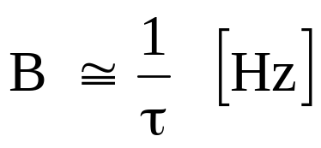
Range resolution
Actually it is not the pulse duration, τ, directly that limits range resolution, rather it is the signal bandwidth, B.
Pulses with short durations have wide bandwidths whereas pulses with long durations have narrow bandwidths.
f = 8 MHz, τ = 1 μs, B = ~ 1 MHz
f = 8 MHz, τ = 10 μs, B = ~ 100 kHz

Slide 10
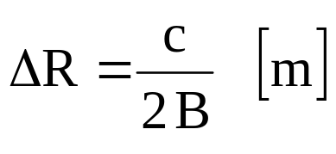
Range resolution
The radar’s ability to discriminate between targets at different ranges, its range resolution, ΔR or ρ_{r}, is inversely related to the signal bandwidth, B.
  where c is the speed of light in the medium.
The bandwidth of the received signal should match the bandwidth of the transmitted signal.
  A receiver bandwidth wider than the incoming signal bandwidth permits additional noise with no additional signal, and SNR is reduced.
  A receiver bandwidth narrower than the incoming signal bandwidth reduces the noise and signal equally, and the radar’s range resolution is degraded (i.e., made more coarse).
Therefore to achieve an ΔR of 1.5 m in free space requires a 100-MHz bandwidth (τ = 10 ns) in both the transmitted waveform and the receiver bandwidth.

Slide 11
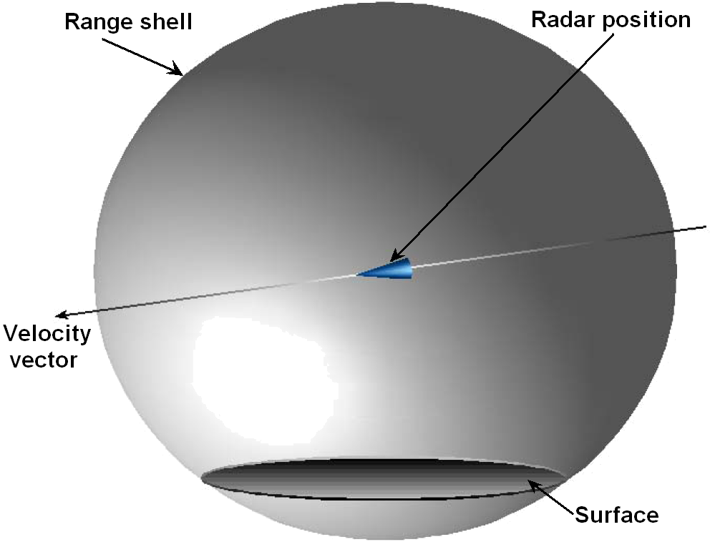
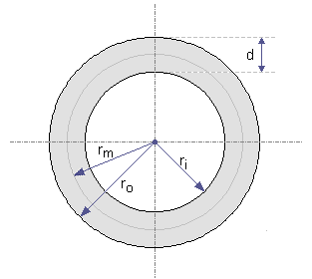
Range resolution
As the pulse propagates away from the radar, it forms an imaginary sphere (centered on the radar’s antenna, radius: R, thickness: ΔR),
sometimes called the range shell, that expands at light speed.
As this shell engages targets, in this case the ground (a planar surface), it maps out a rapidly growing annulus representing those regions contributing to the backscatter at that instant.
Annulus

Slide 12
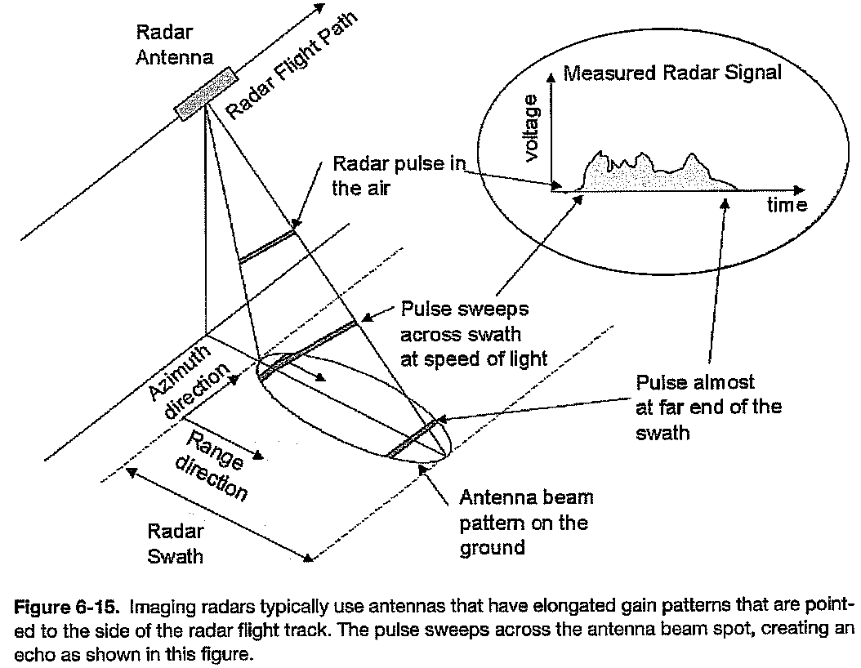
Range resolution

Slide 13
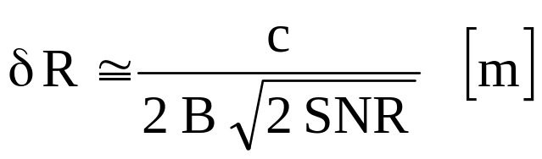
Range accuracy
Accurate range measurement is different (though related) to range resolution.
The ability to accurately extract the round-trip time of flight depends on the range resolution, ΔR, and on the signal-to-noise ratio, SNR.
It can be shown that range accuracy, δR, is related to bandwidth, B, and SNR as
for SNR » 1
Example
  Consider a radar with B = 300 MHz and an SNR of 20 (13 dB)
  The achievable range resolution, ΔR, is 0.5 m and
  the achievable range accuracy, δR is 8 cm

Slide 14
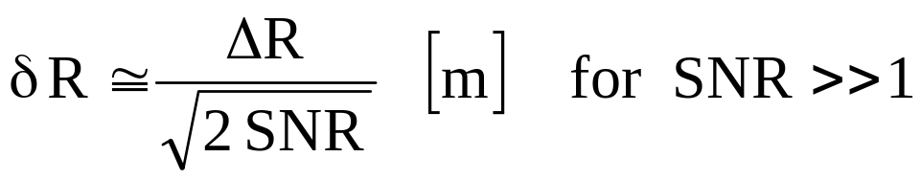
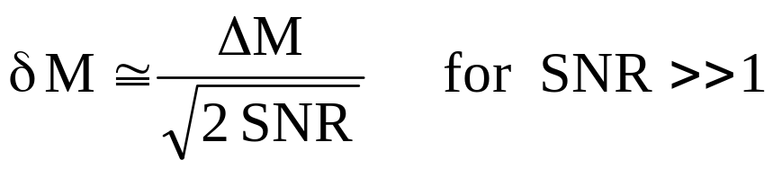
Range accuracy
Range accuracy, δR, is related to range resolution, ΔR, as
In general the uncertainty associated with any measurement is related to the measurement resolution.
For measurement with resolution ΔM, the accuracy, δM, is

Slide 15
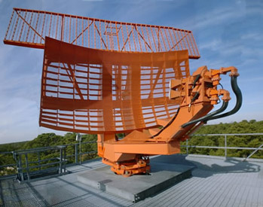
Analysis example
Taken from problems 1.4 and 1.7 in the
original textbook (solutions are found in Appendix V)
Consider the ACR 430 airfield-control radar for close
control during aircraft approach in poor weather conditions.
This radar operates in the X band with f = 9.4 GHz.
The antenna measures 3.4 m horizontally and 0.75 m vertically.
The transmitter has peak output power, P_{t}, of 55 kW and a pulse duration, τ, of 100 ns, (i.e., B = 10 MHz).
Radar system losses (L) total -5 dB and the received noise power, P_{N}, is -131 dBW.
For an aircraft RCS of 10 m², find:
the horizontal position error (range accuracy and az res) at 1 nautical mile
the maximum range for aircraft detection (for SNR ≥ 13 dB)

Slide 16
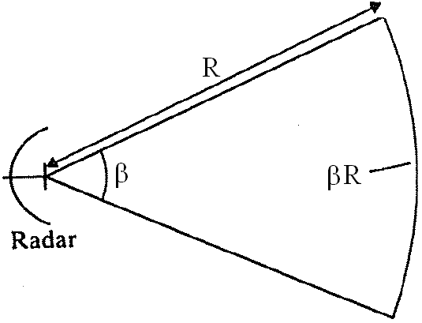
Analysis example
Preliminary calculations
  Wavelength, λ = c/9.4 GHz = 3.2 cm
  Azimuth beamwidth, β_{az} = 0.032/3.4 = 9.4 mrad = 0.54 °
  Elevation beamwidth, β_{el} = 43 mrad = 2.5 °
  Gain, G_{t} = G_{r} = 4π/(β_{az} β_{el}) = 31293 = 45 dBi
  Range resolution, ΔR = c τ / 2 = 15 m
  Range accuracy, δR = ΔR / √(2 SNR)
Azimuth resolution, R·β_{az}
  1 nautical mile = 1852 m
  R β_{az} = 1852 · 0.0094 = 17 m

Slide 17
Analysis example
Range accuracy
  need to find the SNR for R = 1852 m
SNR = P_{t} G_{t} G_{r} σ λ² L / [(4π)³ R⁴ P_{N}]
P_{t} (55 kW) 77 dBm
G_{t}·G_{r} 90 dBi
σ 10 dBsm
λ² -30 dBsm
L -5 dB
(4π)⁻³ -33 dB
R⁻⁴ -131 dB m⁴
P_{N}⁻¹ 101 dBm
SNR 79 dB or 80 × 10⁶
Range accuracy, δR
δR = ΔR / √(2 SNR) = 0.5 / √(2 × 80 × 10⁶) = 1 mm
The realizable range accuracy depends on the processing algorithm.

Slide 18
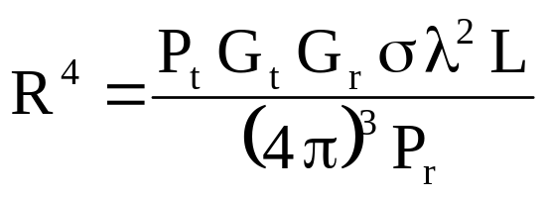
Analysis example
Now find the range, R_{max}, that results in a 13-dB SNR
  Solving the radar range equation for R⁴ in terms of P_{r} yields
The received signal power required for a 13-dB SNR is
P_{r}(dB) = 13 + P_{N}(dB) = -88 dBm
Therefore R_{max} (dBm⁴) = 197
and R_{max} = 84.1 km or 45 nautical miles

Slide 19
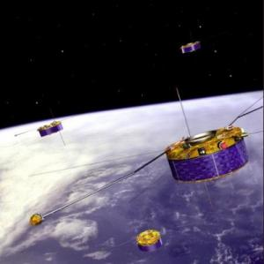
Design example
Formation flying satellites
System requirements
position knowledge to within 3 mm (uncertainty)
range resolution of 15 cm (6 in)
Constraints
X-band operation (f = 10 GHz)
σ = 1 m²
maximum range, R = 20 km
antenna size, 1 m ×1 m
receiver noise figure, F = 2
T = 290 K
Loss, L = 0.5
Find
required bandwidth, B
required transmit power, P_{t}

Slide 20
Design example
Find B from ΔR
ΔR = c/(2 B) = 0.15 m
therefore B = 1 GHz and the associated pulse duration, τ = 1 ns
(this is a brute force approach, more elegant approaches will be introduced later)
Now find the required transmit power, P_{t}
Find required SNR from δR
δR = c / [2 B √(2 SNR)] = 0.003 m
the required SNR = 0.5 [c/(2 B δR)]² = 1250 = 31 dB
Find noise power, P_{N}
P_{N} = k T B F = 8 x 10⁻¹² W or -81 dBm
Find required P_{r} from SNR and P_{N}
P_{r} = SNR + P_{N} = 31 dB + -81 dBm = -50 dBm

Slide 21
Design example
Find the gain of the antennas
Beamwidths, β_{az} = β_{el} = 0.03 rad = 1.7 °
G_{t} = G_{r} = 4π/(β_{az} β_{el}) = 14000 = 41 dBi
Find P_{t} using the radar range equation and required P_{r}
G_{t}·G_{r} 82 dBi
σ 0 dBsm
λ² -30 dBsm
L -3 dB
(4π)⁻³ -33 dB
R⁻⁴ -172 dB m⁴
P_{r} /P_{t} -156 dB
P_{r} ≥ P_{t} – 156 dB = -50 dBm
P_{t} ≥ +106 dBm = 40 MW
need to get a 40-MW transmitter with a 1-ns pulse duration (non-trivial)

Slide 22
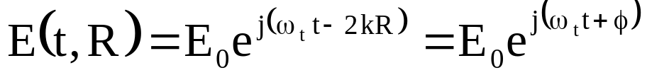
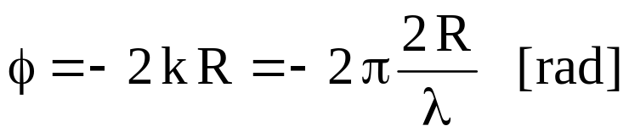
Doppler shift and velocity
Relative motion between the radar’s antenna and the target produces a Doppler shift in the received signal frequency.
A simple derivation
  A target is located at a distance R [m] from a radar.
  The received electric field of the backscattered wave is given as
  where E₀ is the wave’s magnitude [V/m], ω_{t} = 2πf_{t} [rad/s], k = 2π/λ [rad/m], and λ is the wavelength of the transmitted wave [m].
  The phase of the backscattered wave relative to its phase at R = 0 is

Slide 23
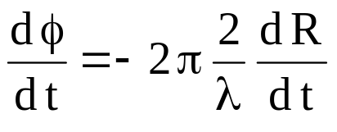
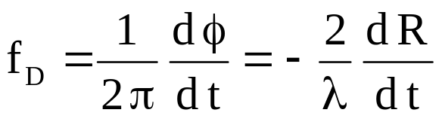
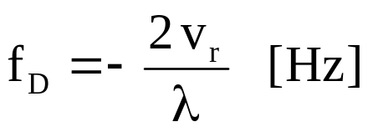
Doppler shift and velocity
  Now assume relative motion between the target and the radar such that the range, R, and phase, φ, change with time
  Since frequency is the time derivative of phase, the received frequency differs from the transmitted frequency by the Doppler frequency shift, f_{D},
  (note: division by 2π to convert angular frequency to standard frequency)
  or
  where v_{r} is the radial velocity [m/s].

Slide 24
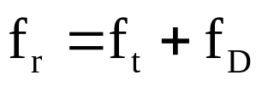
Doppler shift and velocity
The Doppler frequency shift can be positive or negative with a positive f_{D} corresponding to the target moving toward the radar.
  f_{D} > 0 for v_{r} < 0 (i.e., decreasing range) and
  f_{D} < 0 for v_{r} > 0 (i.e., increasing range).
Consequently for a transmitted frequency f_{t} the received signal frequency, f_{r}, is
Example
Consider a police radar with a frequency, f_{t}, of 10 GHz (λ = 0.03 m)
An approaching car is traveling at 70 mph (v_{r} = 31.3 m/s)
The frequency of the received signal will be 10,000,002,086 Hz
This Doppler shift of +2.086 kHz can easily be detected and measured to provide an accurate radial velocity measurement.

Slide 25
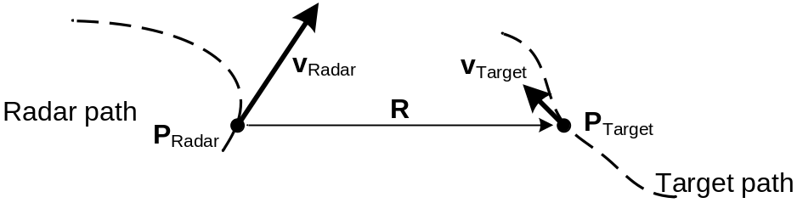
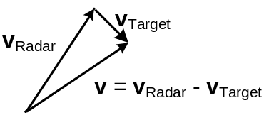
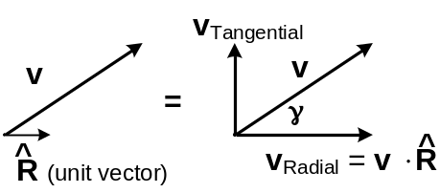
Doppler shift and velocity
Now let’s focus on the radial velocity term.
Given the position, P, and velocity, v, both the radar and the target, the radial velocity and resulting Doppler frequency can be determined.
Therefore the Doppler frequency shift depends on
  relative velocity as seen from radar
  radar wavelength
Instantaneous position and velocity
Relative velocity, v
^
v_{r} = v⋅R = v cos(γ) [m/s]
f_{D} = −2 v cos(γ) / λ [Hz]
Radial velocity component

Slide 26
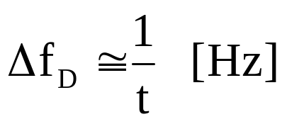
Doppler resolution
Doppler frequency resolution pertains to the ability to resolve two frequency tones.
Frequency resolution is inversely related to the observation time.
  The greater the observation time, the finer the frequency resolution
Therefore to resolve Doppler frequencies separated by
  1 MHz requires an observation time of at least 1 μs
  1 kHz requires an observation time of at least 1 ms
  1 Hz requires an observation time of at least 1 s
Note that the required observation time may greatly exceed the pulse duration. Techniques to meet this will be presented later.

Slide 27
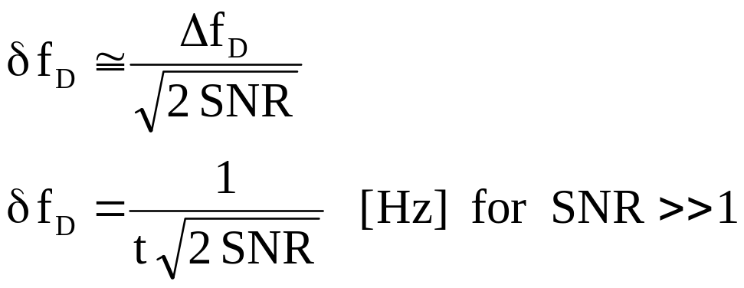
Doppler accuracy
From the previously presented generalization
We can also estimate the Doppler accuracy (or Doppler uncertainty) as

Slide 28
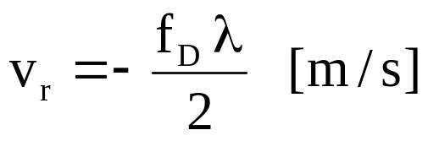
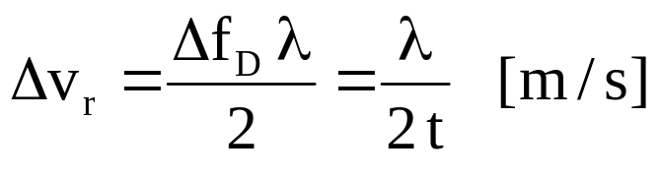
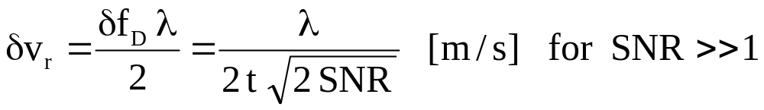
Radial velocity resolution and accuracy
The radial velocity can be estimated from the measured Doppler frequency.
Similarly the radial velocity resolution and accuracy can be related to the Doppler resolution and accuracy.
Radial velocity resolution, Δv_{r}
Radial velocity accuracy, δv_{r}
where t is the observation time

Slide 29
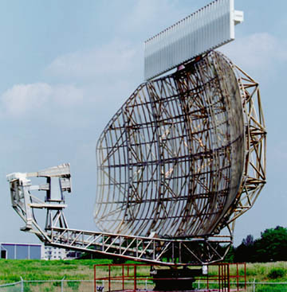
Surveillance radar design
Purpose: to detect and track ‘targets’ in the vicinity
  Relevant to both military and civil applications
This is a ground-based appliction
The search space the entire sky (the upper hemisphere)
Generic system requirements Antenna considerations
All-weather operation L-band or S-band
Good angular position resolution large antenna
High-gain antennas (to reduce P_{t}) large antenna
Furthermore the search period should be dependent on the target dynamics
  For example, for civil aircraft (sub-sonic speeds) a search period measured in 10s of seconds may be appropriate

Slide 30
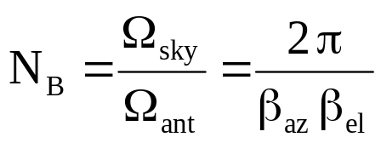
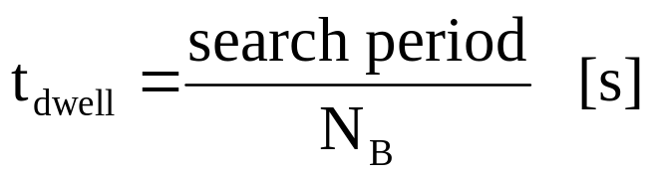
Surveillance radar design
The antenna’s beamwidths (and hence gain) are related to the measurement rate as follows.
  The upper hemisphere of the sky fills 2π sr of solid angle, Ω_{sky}
  The antenna’s beam projects a solid angle Ω_{ant} = β_{az} β_{el}
  Therefore the number of unique beam positions, N_{B}, required to search the sky is
  Notice that N_{B} = G/2. In general an antenna with gain G must probe G directions to survey the 4π solid angle of an entire sphere (think spaceborne application)
Now given the search period, the dwell time, t_{dwell}, (time spent probing each beam position) is

Slide 31
Surveillance radar design
Example
  Consider an application where T = 10 s and G = 36 dBi (4000).
  Therefore the number of beam positions is N_{B} = 2000 and
  the dwell time is t_{dwell} = 10/2000 = 5 ms.
  So in those 5 ms the radar must detect any targets, measure the range to each it finds, and then repeat this process for the remaining 1999 beam positions over the next 9.995 seconds.
  In addition the antenna beam must be essentially stationary, pointing at that piece of sky for those 5 ms and then switch instantly to the next position and so on. For a mechanically-steered antenna this may be quite a challenge, however electronically-steered antennas are available that can readily accomplish this.

Slide 32
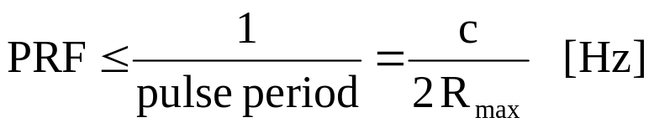
Pulse repetition frequency (PRF)
Continuing with the surveillance radar design, the focus now shifts to the timing of the transmit pulses and received echoes.
  Issues include unambiguous range and velocity measurements
Assumptions
  Pulsed radar with periodic waveform transmission
  No transmissions permitted during receive intervals (i.e., blind ranges)
  Only one pulse in the air at a time (i.e., no pulses in the air during a Tx event)
Given the range to the most distant target of interest, R_{max}, also known as the unambiguous range
We know that the minimum pulse period is 2R_{max}/c
Therefore the maximum PRF is

Slide 33
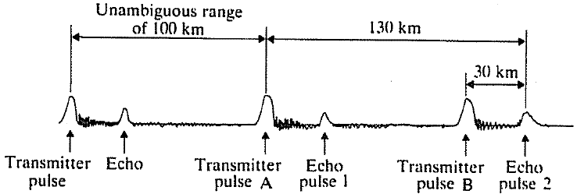
Pulse repetition frequency (PRF)
Consider the case where a target at range 130 km is surveyed with a radar configured with a 100-km unambiguous range.
R_{max} = 100 km, PRF = 1.5 kHz, 666-μs pulse period
Round-trip travel time for 130-km target range
2R/c = 866 μs
Ambiguous because unable to tell if echo pulse 2 results from Tx pulse A or B.
If echo 1 is from Tx A,
then range is 30 km.
If echo 1 is from Tx B,
the range is 130 km.
Therefore the radar has a 100-km range ambiguity.
Possible solutions – discriminate between Tx pulses based on frequency, phase, polarization, pulse shape, etc.

Slide 34
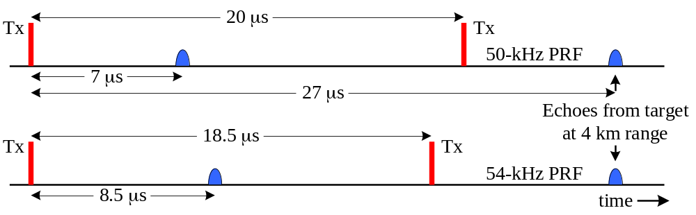
Pulse repetition frequency (PRF)
Another approach to resolving range ambiguities is to vary the PRF. (called PRF jitter or staggered PRF)
Example
  Target range, R = 4050 m (2R/c = 27 μs)
  PRF₁ = 50 kHz (PRI₁ = 20 μs)
  PRF₂ = 54 kHz (PRI₂ = 18.5 μs)
  PRI (pulse repetition interval) = 1/PRF [s]
  Also known as pulse repetition period (PRP), pulse repetition time (PRT), or
  inter-pulse period (IPP).

Slide 35
Pulse repetition frequency (PRF)
PRF and spatial sampling
  Consider the case of an imaging radar where a moving radar illuminates a static scene
  Most image formation algorithms require periodic radar samples to exploit efficient processing (e.g., fast-Fourier transforms, FFTs)
  Non-periodic sampling significantly complicates this processing and is therefore discouraged.
  Even the effects of a variable radar velocity can create problems leading some to slave the PRF to the radar’s ground speed to force a constant distance between samples, e.g., PRF = α v_{ground}
Why don’t we simply use a lower PRF to avoid the range ambiguity problem entirely?
  A lower PRF:
  reduces the number of observations within the dwell time
  affects the SNR if we are combining signals from multiple pulses
  creates Doppler measurement ambiguities

Slide 36
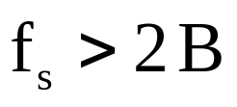
Pulse repetition frequency (PRF)
Doppler ambiguities
  The relative radial velocity produces a Doppler frequency shift.
  For modest pulse durations (ns to μs) the observation time is too short to resolve and accurately measure f_{D}.
    For a 1-μs pulse duration, τ, (and a 1-μs echo duration from a point target) the frequency resolution, Δf = 1/τ = 1 MHz
    Doppler frequencies of interest may be 10 to 1000 Hz, typically not MHz
    Cannot arbitrarily increase pulse duration since the transmitter blinds the receiver creating a blind range, R_{blind} = cτ/2 [m] (R_{blind} = 150 m for τ = 1 μs)
  To overcome this limitation, signal phase information from successive pulses can be used for f_{D} discrimination.
  However to adequately sample f_{D}, we must satisfy the Nyquist-Shannon criterion which says that the sampling frequency, f_{s}, must exceed twice the signal’s bandwidth.

Slide 37
Doppler ambiguities
To unambiguously reconstruct a waveform, the Nyquist-Shannon sampling theorem (developed and refined from the 1920s to 1950s at Bell Labs) states that exact reconstruction of a continuous-time baseband signal from its samples is possible if the signal is bandlimited and the sampling frequency is greater than twice the signal bandwidth.
Application to radar means that the pulse-repetition frequency (PRF) must be at least twice the Doppler bandwidth.
  For the case where the Doppler frequency shift will be ± 250 Hz (a 500-Hz Doppler bandwidth), the PRF must be at least 500 Hz.
    Under this sampling plan we can only resolve signals with 250-Hz bandwidth and are hence unable to resolve + from – Doppler frequencies. However due to the predictable Doppler characteristics we are able to resolve + from – frequencies.
The lower PRF limit is determined by Doppler ambiguities

Slide 38
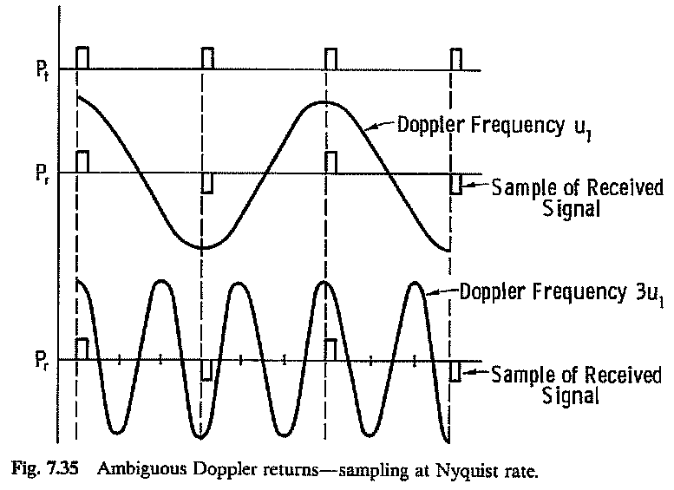
PRF & Doppler ambiguities

Slide 39
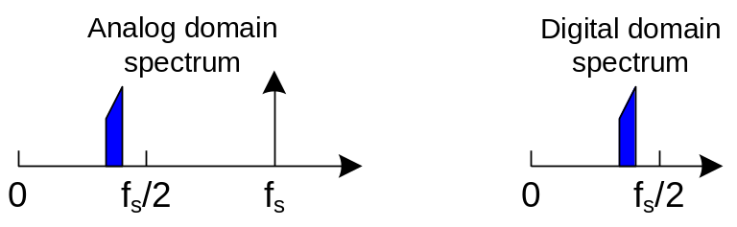
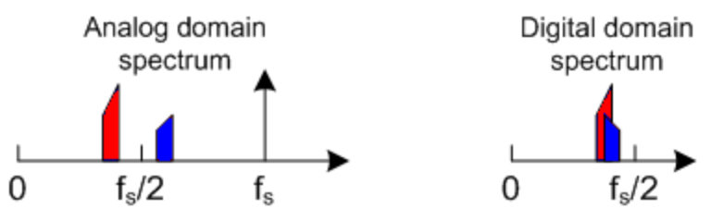
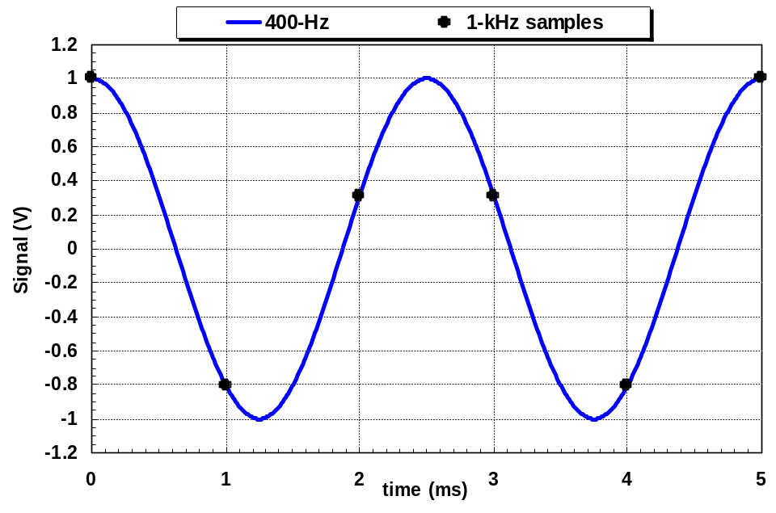
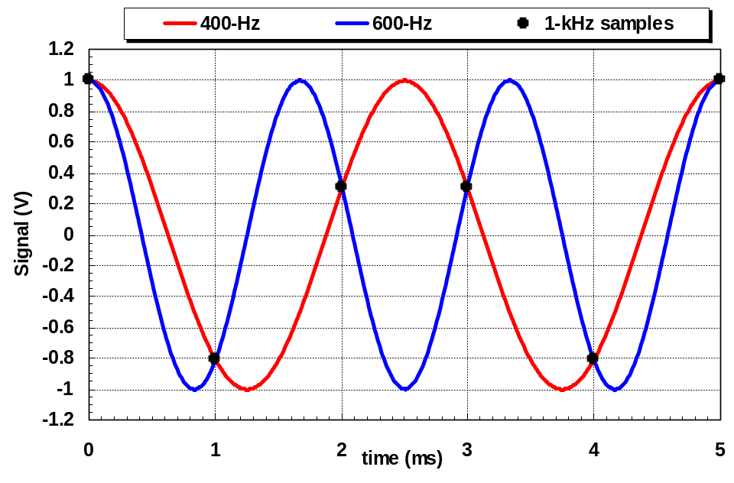
PRF & Doppler ambiguities
Failure to satisfy the Nyquist-Shannon requirement can lead to aliasing of undesired signals into the band of interest.

Slide 40

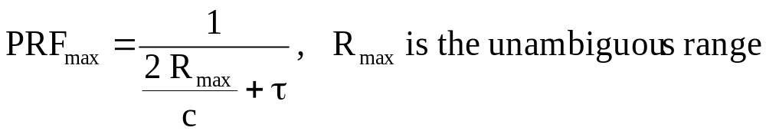
PRF constraints
Recapping what we’ve seen—
  The lower PRF limit is determined by Doppler ambiguities
  The upper PRF limit is determined by the range ambiguities
The upper PRF limit is further reduced due to the non-zero Tx pulse duration.
  Since the echo duration at least as long as the pulse duration (τ), an additional delay is required before the next Tx pulse.
  Therefore the upper PRF limit now becomes

Slide 41
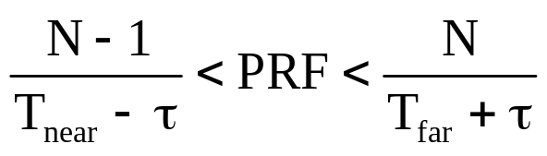

PRF constraints
Eclipsing (an issue if more than one pulse in the air at one time)
  Furthermore, for systems with more than one pulse in the air at one time and that do not support receiving while transmitting, various forbidden PRFs will exist that will eclipse the receive intervals with transmission pulses, which leads to
  where T_{near} and T_{far} refer to signal arrival times for near and far targets, τ is the transmit pulse duration, and N represents whole numbers (1, 2, 3, …) corresponding to pulse number.
  Since the PRF period must also accommodate another Tx pulse during the receive interval, the PRF_{max} is further reduced as

Slide 42


PRF constraints
Tx and Rx timing for airborne radar systems
  Consider the case of an airborne radar system on a straight and level flight trajectory and an altitude h above a flat Earth.
  Its antenna is oriented such that it illuminates a spot on the ground broadside to the aircraft effectively mapping a swath over time.
  Given the altitude (h), the incidence angle (θ), and the elevation beamwidth (β_{el}), we can find the time of arrival for echo signals from the swath.
where T₁ = 2R₁/c
echo from swath due to Tx₁

Slide 43


PRF constraints
Tx and Rx timing for airborne radar systems
  Given the altitude, h = 10 km, the incidence angle θ = 25°, and the elevation beamwidth, β_{el} = 10°, we can find the distance from the ground track to the near and far swath edges (x₁, x₂), the range to the near and far swath edges (R₁, R₂) and the round-trip time of flight for echoes from the near and far swath edges (T₁, T₂), the swath width, and the echo duration.
Find x₁, R₁, and T₁
x₁ = h tan(θ - β_{el}/2) = 3.64 km
R₁ = h sec(θ - β_{el}/2) = 10.6 km
T₁ = 2 R₁/c = 70.9 μs
Find x₂, R₂, and T₂
x₂ = h tan(θ + β_{el}/2) = 5.77 km
R₂ = h sec(θ + β_{el}/2) = 11.5 km
T₂ = 2 R₂/c = 77 μs
Find the swath width and the echo duration
Swath width = x₂ - x₁ ≈ 2 km
Echo duration = T₂ - T₁ + τ = 6.1 μs + τ
Therefore ignoring any guard time (e.g., for switches)
Minimum period
2τ + 6.1 μs

Slide 44



Spherical Earth calculations
Spherical Earth geometry calculations
  R_{e} Earth’s average radius
  (6378.145 km)
  h orbit altitude above sea level (km)
  α core angle
  R radar range
  γ look angle
  θ_{i} incidence angle

Slide 45



Spherical Earth calculations
Satellite orbital velocity calculations (for circular orbits)
  R_{e} Earth’s average radius
  (6378.145 km)
  h orbit altitude above sea level (km)
  v satellite velocity
  v_{g} satellite ground velocity
  μ standard gravitational parameter
  (398,600 km³/s² for Earth)

Slide 46




Spherical Earth calculations
Swath width geometry calculations
  R_{e} Earth’s average radius
  (6378.145 km)
  R_{n} range to swath’s near edge
  R_{f} range to swath’s far edge
  W_{gr} swath width on ground
  W_{r} slant range swath width
  α_{n} core angle to swath’s near edge
  α_{f} core angle to swath’s far edge
  θ_{i,m} incidence angle at mid-beam

Slide 47

PRF constraints
Tx and Rx timing for spaceborne radar systems
  Given the altitude, h = 500 km, the incidence angle θ = 31°, and the elevation beamwidth, β_{el} = 0.87°, we can find the distance from the ground track to the near and far swath edges (x₁, x₂), the range to the near and far swath edges (R₁, R₂) and the round-trip time of flight for echoes from the near and far swath edges (T₁, T₂), the swath width, and the echo duration.
At the beam center
γ = 28.53°, θ = 31° and α = 2.47°
R = 575.9 km and x = 275.1 km
T = 2 R/c = 3.8417 ms
At the near edge of the swath
γ₁ = 28.09°, θ₁ = 30.53° and α₁ = 2.43°
R₁ = 573.3 km and x₁ = 270.0 km
T₁ = 2 R₁/c = 3.8244 ms
At the far edge of the swath
γ₂ = 28.96°, θ₂ = 31.48° and α₂ = 2.52°
R₂ = 578.5 km and x₂ = 280.2 km
T₂ = 2 R₂/c = 3.8594 ms
Swath width = x₂ - x₁ ≈ 10.172 km
Echo duration = T₂ - T₁ + τ = 35 μs + τ
Therefore ignoring any guard time (e.g., for switches)
Minimum period
2τ + 35 μs

Slide 48

PRF constraints

Slide 49

PRF constraints

Slide 50

PRF constraints

Slide 51





Antenna length, velocity, and PRF
Given an antenna length, ℓ
wavelength, λ
velocity, v
We know
The Doppler bandwidth, B_{Dop}, is
Therefore PRF_{min} is
(small angle approximation)
Aircraft case
v = 200 m/s, ℓ = 1 m
PRF_{min} = 400 Hz
Spacecraft case
v = 7000 m/s, ℓ = 10 m
PRF_{min} = 1.4 kHz
Note that PRF_{min} is independent of λ

Slide 52


Receiver signal sampling
Analog-to-digital conversion
  The analog-to-digital converter (ADC)
  plays a critical role in modern radar systems.
  As was pointed out previously the ADC
  quantizes the analog video into discrete
  digital values
    analog domain → digital domain
  Timing of sample conversion is controlled by ADC clock
  Key parameters of this process include:
    sampling frequency, f_{s}
    ADC’s resolution N_{ADC} (i.e., the number of bits)
  We will explore how each of these
  parameters relate to radar performance.

Slide 53
Sampling criteria
The Nyquist-Shannon sampling theorem also applies to signal digitization in the analog-to-digital converter (ADC) requiring that the ADC sampling frequency be at least twice the waveform bandwidth.
  For a signal with a 1-GHz bandwidth, the ADC’s sample rate must be at least 2 GHz (doable but non-trivial and expensive)
    The data acquisition system (ADC and associated control system and memory elements) will be expensive in terms of component cost, power dissipation, and complexity
    As digital switching speed increases, the power dissipation of the digital components increases
    High-speed ADC operation requires high-speed memory elements (RAM or FIFOs) with write-cycle time periods comparable to the sampling clock period
    Also high-speed data acquisition generally requires more memory depth than low-speed acquisition since the number of samples, N_{s} = f_{s} × echo duration
    Example – a 2-GHz f_{s} and a 10-μs echo duration results in 20,000 samples collected with a 500-ps sample period

Slide 54

Sampling criteria
Often radar receiver systems will use in-phase and quadrature signal processing (I and Q) wherein the received signal is decomposed into the equivalent of its real and imaginary components.
  In these cases two ADCs are required to digitize these two representations of the received signal (bad – twice the complexity) but the sampling rate requirements on each ADC is reduced by half (good – easier)

Slide 55

Sampling criteria
Returning our attention to the Nyquist-Shannon sampling theorem, note that it means that the ADC sampling frequency be at least twice the waveform bandwidth for a bandlimited signal.
  Thus for a baseband signal this requires the maximum signal frequency be less than or equal to 50% of the sampling frequency; hardware realization typically is more conservative due to challenges associated achieving a bandlimited signal.
    Consider a baseband signal with spectral components from DC to 100 MHz. According to the Nyquist-Shannon theorem, a 200-MHz sampling frequency will suffice. To avoid severe requirements on the analog anti-aliasing filter that precedes the ADC (used to ensure a bandlimited signal) an additional margin will be added by requiring the maximum signal frequency to be 40% of f_{s}, thus a 250-MHz sampling frequency might be used.

Slide 56

Sampling criteria
And again returning to the Nyquist-Shannon sampling theorem, note that it means that the ADC sampling frequency be at least twice the waveform bandwidth for a bandlimited signal.
  For an intermediate-frequency (IF) signal (not at baseband) theory requires a sampling frequency of at least twice the signal bandwidth. However aliasing issues may require a higher sampling frequency.
    Consider an IF signal with 30 MHz of bandwidth and a 150-MHz center frequency. Per the Nyquist-Shannon theorem, the sampling frequency must be at least 60 MHz. However a 60-MHz sampling frequency will alias the signal upon itself thus irreparably distorting the signal.
    A higher sampling frequency of 120-MHz avoids this problem.
This technique is called undersampling.

Slide 57





Undersampling

Slide 58


Sampling criteria
Sampling requirements
  Finally, for a simple pulse system, with pulse duration τ, the sampling requirement is
  For systems using more complex signal waveforms with bandwidth B, the sampling requirement is

Slide 59

Sampling criteria
Fast time and slow time
  Radar systems sample the backscattered echo signal over two time scales.
    This echo signal is sampled as it returns from a single transmit pulse
      Sample start time is governed by the round-trip time of flight, speed of light
      Sample frequency is driven by the signal bandwidth
    This echo signal is sampled as the target moves relative to the radar
      Sample start time is governed by the relative velocity, radar or target speed
      Sample frequency is driven by the Doppler bandwidth
  Therefore the radar simultaneously works in two
  time scales
    Fast time – interval when the echo arrives
      sample period typically measured in ns or μs
    Slow time – interval between pulses
      sample period typically measured in ms to s
  Signal processing (e.g., filtering) can be
  performed in either scale or axis.

Slide 60
ADC resolution and dynamic range
The ADC quantizes the analog input signal into a fixed number of bits, N_{ADC}, that is sometimes called the ADC’s resolution.
This parameter is important in radar applications as it is related to the ADC’s dynamic range and thus affects the radar’s instantaneous dynamic range.
Dynamic range – the range of signal powers over which the signal is detectable and linear
  The dynamic range’s lower limit is the minimum detectable signal which is related to the SNR.
  The dynamic range’s upper limit is that power level that causes the receiver’s transfer function to become nonlinear (typically involving saturation).

Slide 61
ADC resolution and dynamic range
The radar’s dynamic range is determined by the dynamic range of several components in the receiver, both analog and digital.
  The analog components (e.g., amplifiers, mixers, filters, switches, etc.) when properly designed will have a tremendous dynamic range (> 100 dB).
  The primary digital component in this analysis is the analog-to-digital converter (ADC) whose dynamic range is set by the number of bits. Quite often the ADC’s dynamic range becomes the limiting factor affecting the radar’s dynamic range.

Slide 62


ADC resolution and dynamic range
Example
  Consider an 8-bit ADC has an analog input
  voltage range of 0 to 2 V.
  Eight bits of resolution provide 2⁸ (or 256)
  possible states.
  The scale of the least significant bit (LSB)
  is 2 V/256 or 8 mV.
bit 0 1 2 3 4 5 6 7
weight 8 mV 16 mV 32 mV 64 mV 128 mV 256 mV 512 mV 1024 mV
  Therefore 00000000₂ = 00_{H} = 0 V
  11111111₂ = FF_{H} = 2 V
  Each next greater bit doubles the available voltage range.
  Doubling (x2) of voltage range quadruples (x4) the power range (6 dB)
  Therefore the ADC’s number of bits (N_{ADC}) sets the ADC’s dynamic range:
  N_{ADC} (bits) 8 12 14 16
  Dynamic range_{ADC} (dB) 48 72 84 96

Slide 63

ADC resolution and dynamic range
Since the ADC’s dynamic range improves with N_{ADC}, a large number of ADC bits is desired. However there is a tradeoff – due to technological challenges, increasing the number of ADC bits requires a reduction in the device’s maximum sample rate.

Slide 64
Dynamic range
Why is a large dynamic range so important?
  Recall the ACR 430 airfield-control radar example
    f = 9.4 GHz, P_{Tx} = 55 kW, τ = 100 ns, G = 45 dBi,
    P_{N} = -101 dBm, R_{max} = 84.1 km, ΔR = 15 m, R_{blind} = 15 m
  For a 10-m² target RCS the received signal power is
    + 2 dBm at a range of 800 m
    – 88 dBm at a range of 84.1 km (given as the minimum detectable signal)
    + 2 dBm – (– 88 dBm) = 90 dB
  Therefore the system requires a 90-dB dynamic range to simultaneously accommodate echo signals from both near and distant targets.
    This assumes all aircraft have a 10-dB RCS (not necessarily true) and
    ignores the possibility of jamming signals that might disrupt operation.
    A more conservative design might have a dynamic range > 95 dB
    To provide a dynamic range greater than 95 dB requires an ADC with
    at least 16 bits of resolution.
    Based on 1999-era data, the fastest 16-bit ADC samples at a 3-MS/s rate but a 100-ns τ requires a 20-MS/s rate.

Slide 65

Dynamic range
One way to overcome this dynamic range problem is to recognize that the strong target echoes come from near targets whereas the weak target echoes come from distant targets and therefore reduce this predictable signal strength variation in the analog domain (before it gets to the ADC).
This technique of varying the receiver gain during the receive interval is known as swept gain or sensitivity time control (STC).
It has the advantage of accommodating a large signal dynamic range with a limited instantaneous dynamic range.
Other techniques for accommodating a large signal dynamic range involve pulse compression and digital signal processing, topics yet to be covered.

Slide 66

Data rates
The rate at which data output from the ADC is another important system parameter, primarily this may represent a significant challenge to the signal processing, data transport, or data storage system.
  The ADC output data flow at an uneven rate – between echoes the system is largely idle while during the echo acquisition time a burst of data flows.
  Typically these data are buffered (e.g., in a FIFO) and read out at a slower pace to produce a steady data rate.
The data rate is determined by several radar system parameters

Slide 67

Data rates
Example
  Consider a radar system with the
  following parameters.
  Pulse duration, τ = 1 μs
  R_{max} = 50 km, PRF = 2 kHz
  Echo duration = 350 μs
  ADC: f_{s} = 1 MHz, N_{ADC} = 14 bits/channel, I & Q sample scheme (i.e., 2 channels)
  The radar data rate, M, is
b: bits, B: bytes, 1 B = 8 b
Radar systems produce large data rates

Slide 68
Radar cross section (RCS)
An object’s RCS depends on the characteristics
of the object (size, materials, geometry) and
of the radar (frequency, polarization, orientation)
Consider the simple sphere
  The RCS of a sphere is complex (although it is independent of orientation due to its symmetry)
  If the circumference is much larger than the wavelength (2πr » λ)
  then RCS ≈ physical cross sectional area (πr²) × reflectivity (ε_{r}, μ_{r})
  [called the optical region]
  If the circumference is comparable to the wavelength (2πr ∼ λ)
  then RCS fluctuates with variations in size or wavelength
  [called the Mie region or resonance region]
  If the circumference is much smaller than a wavelength (2πr « λ)
  then the RCS ∝ (r/λ)⁴
  [called the Rayleigh region]
This explains why radars don’t typically ‘see’ air molecules and why the sky is blue.

Slide 69

RCS of a metal sphere
Γ = 1

Slide 70



Radar cross section (RCS)
The electrical properties of materials determine the reflection properties.
  Electrical properties: ε, μ, σ, η = √(μ/ε)
  For a smooth, planar, boundary between two half spaces with a plane wave incident normal to the surface, the reflection coefficient, R, is
  The reflection coefficient, R, relates to field quantities (V/m).
  Reflectivity, Γ, relates to power (and RCS).

Slide 71


Radar cross section (RCS)
In many cases, μ₁ = μ₂ = μ_{o} (= 4π × 10⁻⁷ H/m)
so that η = η_{o}/√ε_{r} (where η_{o} = 377 Ω) and
Clearly Γ approaches 1 for cases of high dielectric contrast (ε₂/ ε₁) and approaches 0 for cases of low contrast.
Example
Consider the three-layer structure composed of
air (ε_{r} =1), ice (ε_{r} = 3.2), and the bed.
Find the reflectivity at the two boundaries when
the bed is rock (ε_{r} =6) again when the bed is liquid water (ε_{r} = 81)

Slide 72


Radar cross section (RCS)
RCS of some common shapes

Slide 73




Radar cross section (RCS)
Dihedral and trihedral corner reflectors

Slide 74



Radar cross section (RCS)
Dihedral and trihedral corner reflectors

Slide 75

Radar cross section (RCS)
Luneberg lens

Slide 76

Radar cross section (RCS)
Luneberg lens

Slide 77

Radar cross section (RCS)

Slide 78

Radar clutter
Clutter: unwanted echoes from the environment
  terrain, buildings, animals, aircraft, the ocean, rain, etc.
What is considered clutter depends on your application
  Three classes of clutter: point, surface, volume
    Point: point targets
    Surface: 2-D surface (e.g., ocean surface, cornfield)
    Volume: 3-D volume (e.g., forest canopy, rain, snowpack)
  Characterization
    Point clutter: characterized by its RCS, σ [m²]
    Surface clutter: characterized by its backscattering coefficient, σ° [unitless]
      σ° = σ_{c}/A_{c} where σ_{c} is average RCS of area A_{c}
    Volume clutter: characterized by its volumetric backscatter, η [m⁻¹]
      η = σ_{c}/V_{c} where σ_{c} is average RCS within volume V_{c}

Slide 79


Factors affecting backscatter
The backscattering characteristics of a surface are represented by the scattering coefficient, σ°
For surface scattering, several factors affect σ°
  Dielectric contrast
    Large contrast at boundary produces large reflection coefficient
      Air (ε_{r} = 1), Ice (ε_{r} ~ 3.2), (Rock (4 ≤ ε_{r} ≤ 9), Soil (3 ≤ ε_{r} ≤ 10),
      Vegetation (2 ≤ ε_{r} ≤ 15), Water (~ 80), Metal (σ → ∞)
  Surface roughness (measured relative to λ)
    RMS height and correlation length used to characterize roughness
  Incidence angle, σ°(θ)
  Surface slope
    Skews the σ°(θ) relationship
  Polarization
    σ°_{VV} ∼ σ°_{HH} » σ°_{HV} ∼ σ°_{VH}

Slide 80

Surface roughness and backscatter

Slide 81


Surface roughness and backscatter

Slide 82


Backscatter from bare soil
Note: At 1.1 GHz,
λ = 27.3 cm

Slide 83

Radar clutter

Slide 84

Radar clutter

Slide 85
Simple σ° models
For purposes of radar system design, simple models for the backscattering characteristics from terrain can be used.
A variety of models have been developed.
Below are some of the more simple models that may be useful.
σ°(θ) = σ°(0) cos^{n}(θ)
where θ is the incidence angle and n is a roughness-dependent variable.
  n = 0 for a very rough (Lambertian) surface [σ°(θ) = σ°(0)]
  n = 1 for a moderately rough surface [σ°(θ) = σ°(0) cos (θ)]
  n = 2 for a moderately smooth surface [σ°(θ) = σ°(0) cos² (θ)]
σ°(θ) = σ°(0) e^{-θ/ θo}
where θ is the incidence angle and θ_{o} is a roughness-dependent angle.
In both model types σ°(0) depends on the target characteristics

Slide 86


Backscatter application: detecting flooded lands
Combination of water surface and vertical tree trucks forms natural dihedral with enhanced backscatter.

Slide 87

Radar equation for extended targets
The area of illumination to be used in the analysis is dependent on the system characteristics.
Different illumination areas result depending on whether the system is beam limited, pulse (or range) limited, Doppler (or speed) limited, or a combination of these.

Slide 88

Radar equation for extended targets

Slide 89

Radar equation for extended targets
For homogeneous extended area targets (e.g., grass, bare soil, forest, water, sand, snow, etc.) σ° ≅ constant (though still dependent on θ, φ, and polarization).
Substituting this relationship leads to
where ΔA is the system’s spatial resolution (ΔA = Δx⋅ Δy) and
⟨P_{r}⟩ is the mean value of the received signal power.
The scattering coefficient, σ°, contains target information.
  Soil moisture
  Surface wind speed and direction over water
  Ground surface roughness
  Water equivalent content of a snowpack
Therefore the accuracy and precision of σ° measurements are important.

Slide 90



Ground imaging radar
In a real-aperture system images of radar backscattering are mapped into slant range, R, and along-track position.
  The along-track resolution, Δy, is provided solely by the antenna. Consequently the along-track resolution degrades as the distance increases. (Antenna length, ℓ, directly affects along-track resolution.)
  Cross-track ground range resolution, Δx, is incidence angle dependent
where τ_{p} is the compressed pulse duration
slant range
slant range
along-track
direction
Δy
ground range
ground range
cross-track
direction
cross-track
direction
Δx
Δx

