Slide 1
Radar Signal Processing
[material taken from Radar – Principles, Technologies, Applications by B Edde, 1995 Prentice Hall, and
A Technical Tutorial on Digital Signal Synthesis by Analog Devices, 1999]
Chris Allen (callen@eecs.ku.edu)
Course website URL
people.eecs.ku.edu/~callen/725/EECS725.htm

Slide 2
Objectives
Improve signal-to-interference ratio and target detection
  Interference: noise (internal & external), clutter,
  ECM – electronic countermeasures
    intentional jammers
  EMI – electromagnetic interference
    unintentional jamming
  self jamming
Reduce the target-masking effects of clutter
Reduce radar vulnerability to ECM
Extract information on target characteristics and behavior

Slide 3
Basics
Signal processing relies on the characteristic differences between signals from targets and the interfering signals.
  Target signals exhibit orderliness, interferers exhibit randomness
  The rate of change of the phase (dφ/dt) of the orderly signals is deterministic unlike the dφ/dt of the interferer signals
The essential processes for enhancing target signals while suppressing interference signals are
  Signal integration
  summing composite signals within the same bin
  Correlation
  a measure of similarity between two functions or signals
  Filtering and spectrum analysis
  correlation with complex sinusoids to separate signals into spectral components (e.g., Doppler)

Slide 4
Basics
Additional processes that prove useful include
  Windowing
  A time-limited signal operated on by a finite process results in spectral leakage wherein the signal energy spreads into adjacent spectral bins. This leakage can mask weak, nearby signals.
  Windowing reduces the leakage in correlation and spectral processes.
  Convolution
  Convolution in one domain (time or frequency) has the same effect as multiplication in the other domain. Thus convolution offers flexibility in certain signal processes.
  Windowing, for example, involves time-domain multiplication and can be implemented as a convolution in the frequency domain.

Slide 5
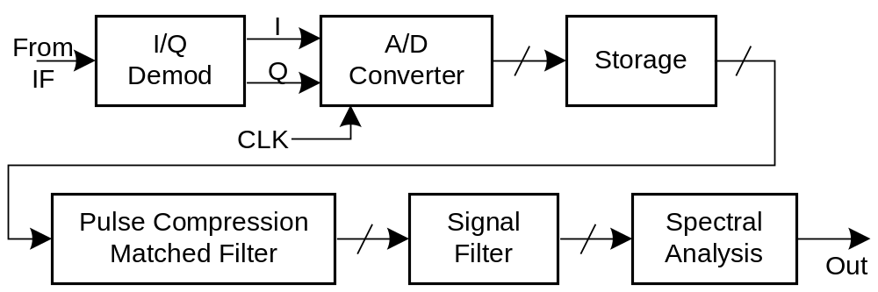
Signal processing block diagram
Typical signal
processor, digital
pulse compression.
  A/D converter
    transforms analog signals into digital words at specific times and rates
  Storage
    temporarily keeps digitized signals while waiting for all signals required for process to be gathered
  Pulse compression matched filter
    correlates the echo signal with delayed copy of the transmitted signal
  Signal filter
    removes portion of the Doppler spectrum (slow time) to reduce clutter
  Spectrum analysis
    segregates signal components by Doppler shift

Slide 6
Fundamental properties
Definitions and distinctions of radar signal processors
Linearity
  If input x_{i}(t) produces output y_{i}(t),
  then inputting x₁(t) + x₂(t) + x₃(t) produces y₁(t) + y₂(t) + y₃(t).
Time invariance
  If input x(t) produces output y(t), then inputting x(t - τ) produces y(t - τ).
Causality
  An input is required to produce an output and the input must occur in time before the output (non-predictive behavior).
System impulse response
  A system has a finite impulse response (FIR) if at some time
  nT > NT (N finite), the contribution to the output of input
  x(mT) (m < n) becomes and remains zero.
  A system has an infinite impulse response (IIR) if the contribution to the output nT > NT of the input x(mT) (m < n) does not remain zero for any finite N.

Slide 7
Signal integration
Signal integration is the process of summing the contents of several samples of the same range bin (in the slow-time domain).
  Coherent integration – uses the signal’s amplitude & phase
  Incoherent integration – uses the signal’s amplitude only
Coherent integration
  after N integrations, (S/I)_{out} = N (S/I)_{in}
  where S is signal and I is random interference (e.g., noise)
  [note that clutter may not be random]
Incoherent integration
  after N integrations, (S/I)_{out} = N_{eff} (S/I)_{in}
  where N_{eff} is effective number of integrations
  N_{eff} ~ N for small N (N < 5), N_{eff} ~ √N for large N (N > 10)
  [does not improve signal-to-clutter ratio]

Slide 8
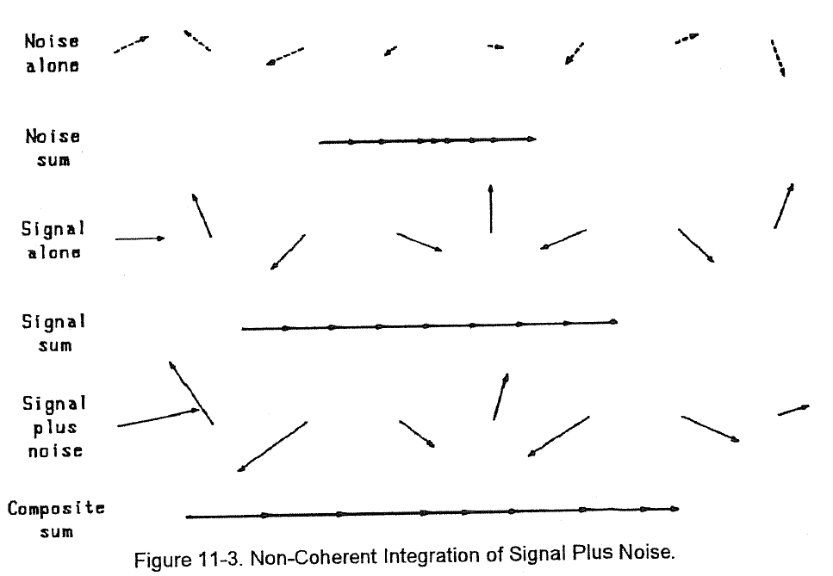
Signal integration (incoherent)
Example
  Incoherent integration of a moving target with interfering noise.
  Signal sum is greater than the noise, but not as much greater as it would be if the integration were coherent.
  With incoherent integration, the noise can never sum to zero.

Slide 9
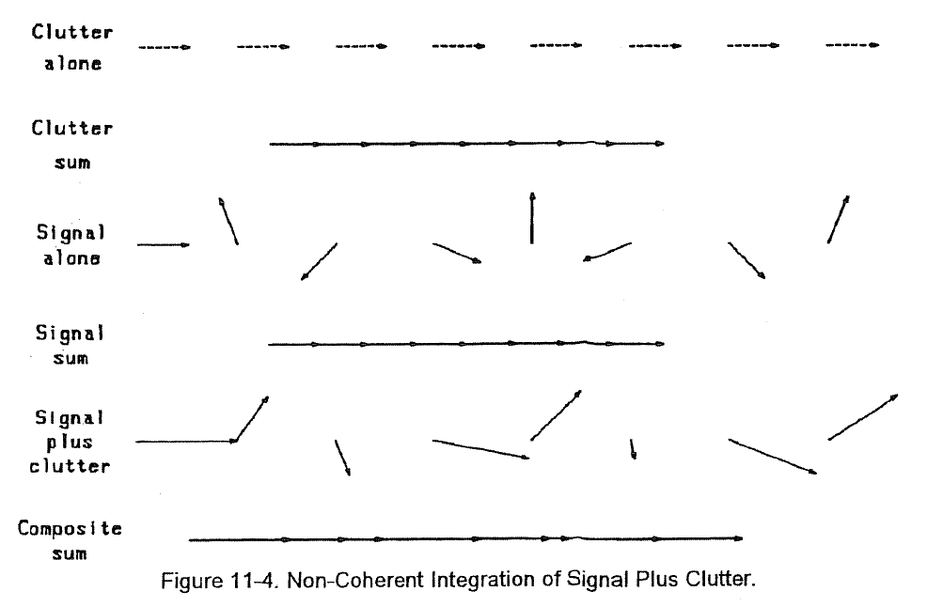
Signal integration (incoherent)
Example
  Incoherent integration of signal-plus-clutter.
  Primarily used in incoherent radars where it is one of the few processes available for improving the signal-to-noise ratio.

Slide 10
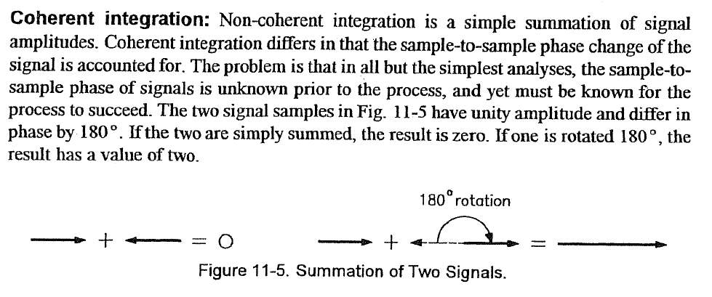
Signal integration (coherent)

Slide 11
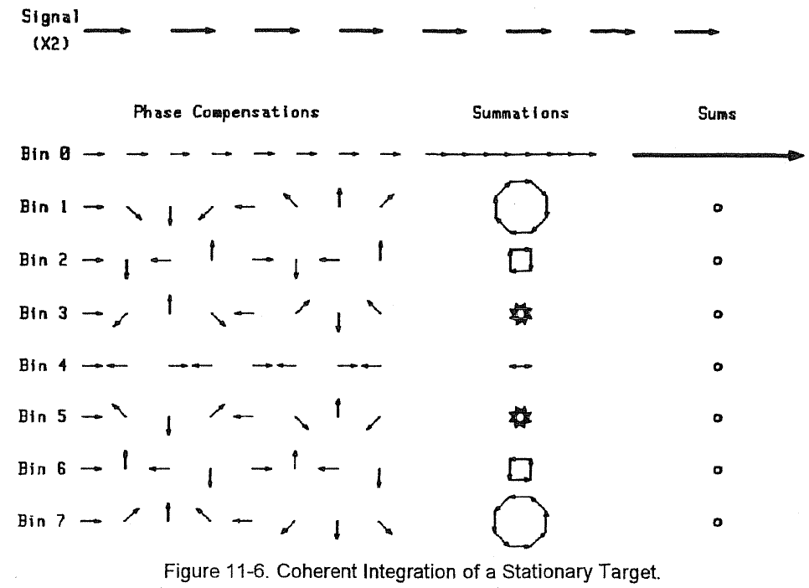
Signal integration (coherent)
Example
  Coherent integration of a stationary target.
  The top row shows the eight consecutive samples of the signal from a single range bin.
  The left column of phasors represents the phase compensation.

Slide 12
Signal integration (coherent)
Example (continued)
  The center column represents the summation after signal phasors are rotated by the angle of the phase compensation.
  The right column shows the final sum.

Slide 13
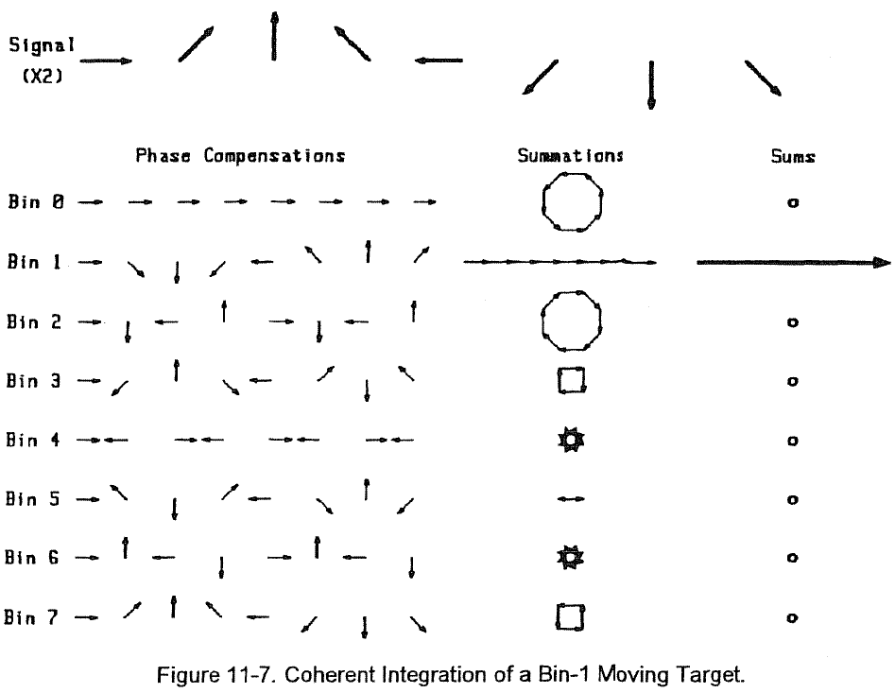
Signal integration (coherent)
Example
  Process applied to signal from a target which matches the bin-1 compensation.
  Phase of echo advances 45° between hits.
  Matched filter is implemented in bin 1; a mismatch results in all other bins.

Slide 14
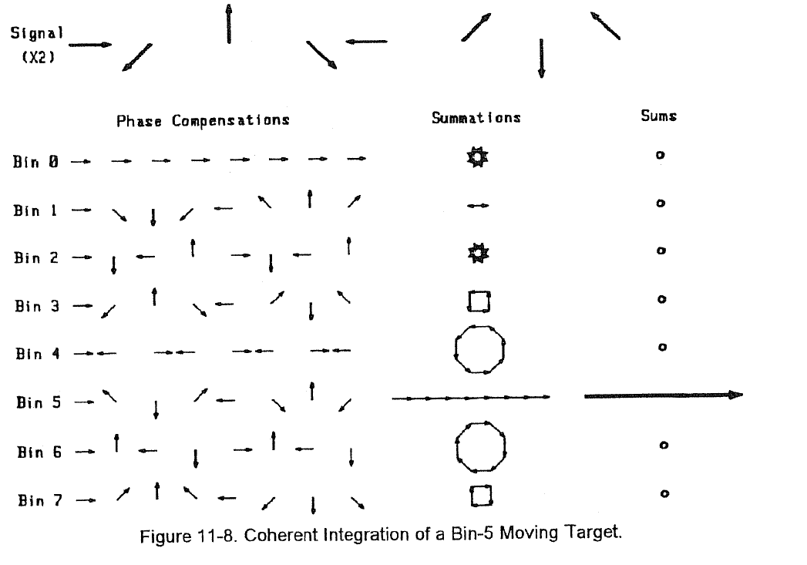
Signal integration (coherent)
Example
  Process applied to signal from a target which matches the bin-5.
  Matched filter is implemented in bin 5; a mismatch results in all other bins.

Slide 15
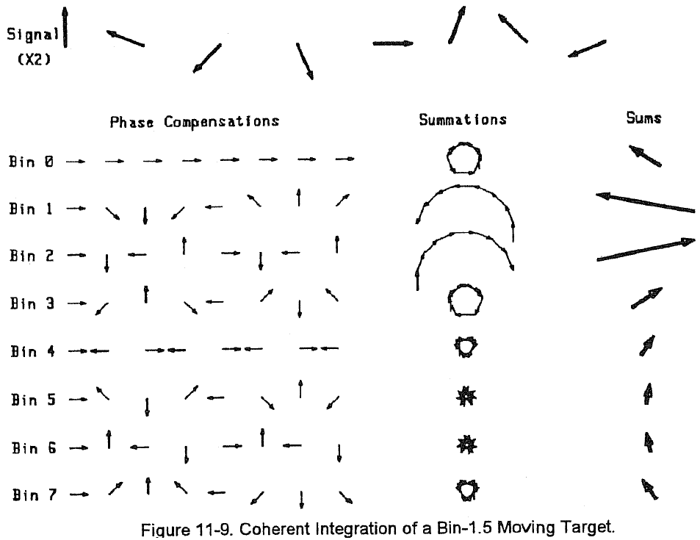
Signal integration (coherent)
Example
  Process applied to target whose phase advances 67.5° between hits.
  This signal falls between bin 1 (45° per hit) and bin 2 (90° per hit) – filter mismatch.
  Signal energy is split between two bins and it leaks into other bins.

Slide 16
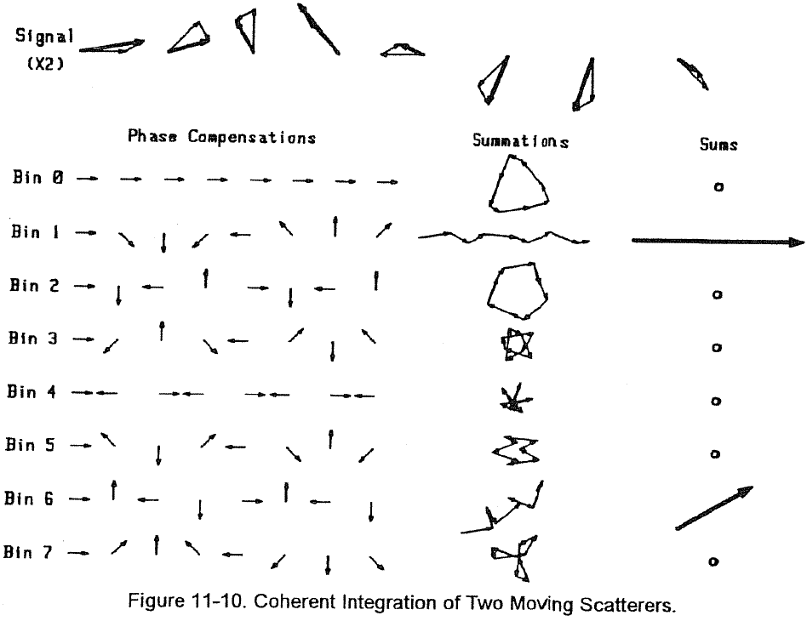
Signal integration (coherent)
Example
  Process applied to signal from two targets in the same range bin.
  Bin-1 target has RCS 4 times the RCS of target in bin 6 (2:1 in voltage).
  Example could be echo from jet aircraft and its engine modulation.

Slide 17
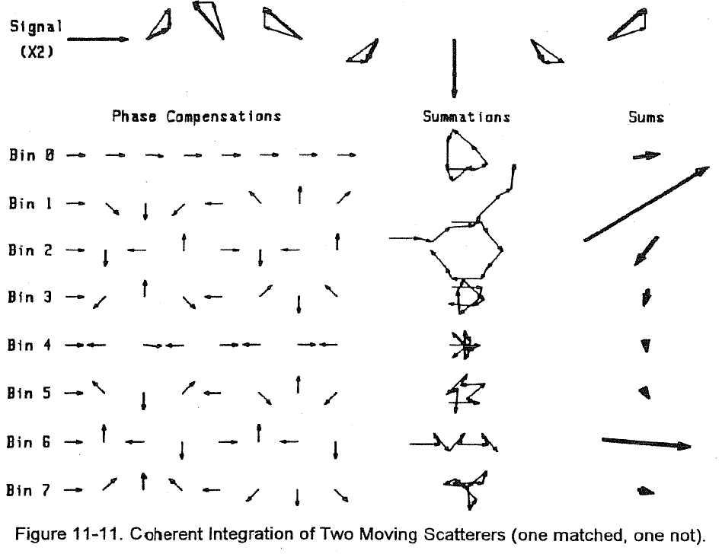
Signal integration (coherent)
Example
  Process applied to signal from two targets in the same range bin.
  First target (bin 1.2) has RCS 4 times the RCS of second target (bin 6).
  Leakage caused by mismatch of first target.

Slide 18
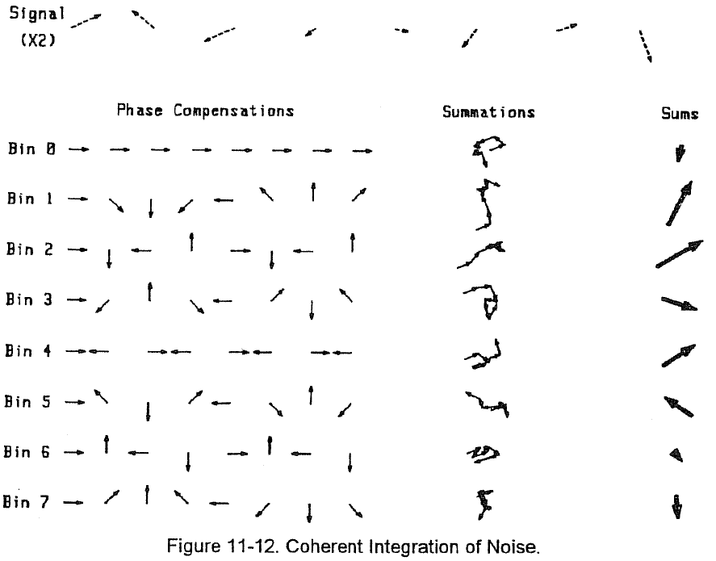
Signal integration (coherent)
Example
  Process applied to noise.
  Randomness results in relatively equal energy among the bins and much smaller summation in each bin than would result from the same amplitude coherent signal.

Slide 19
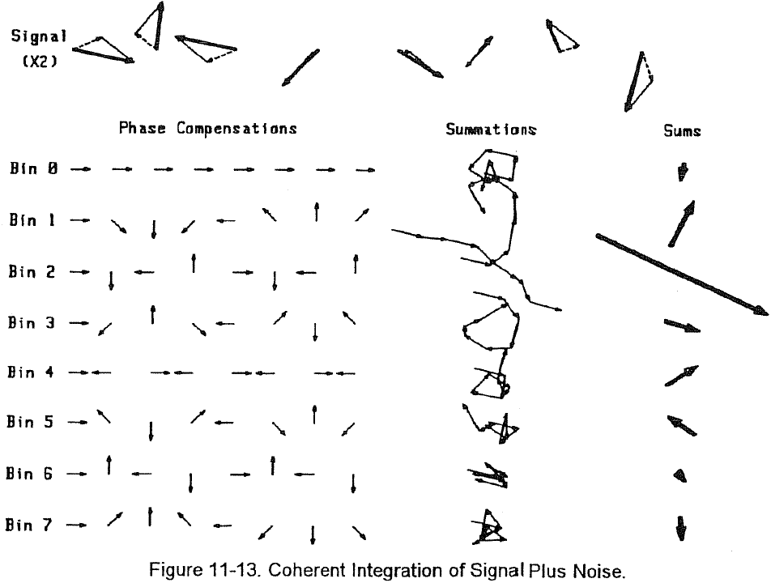
Signal integration (coherent)
Example
  Process applied to noise plus moving target (bin 2).
  Noise energy is spread roughly equally among the bins.
  Signal energy is contained in bin 2.
  If signal were not matched to one bin, leakage would occur.

Slide 20
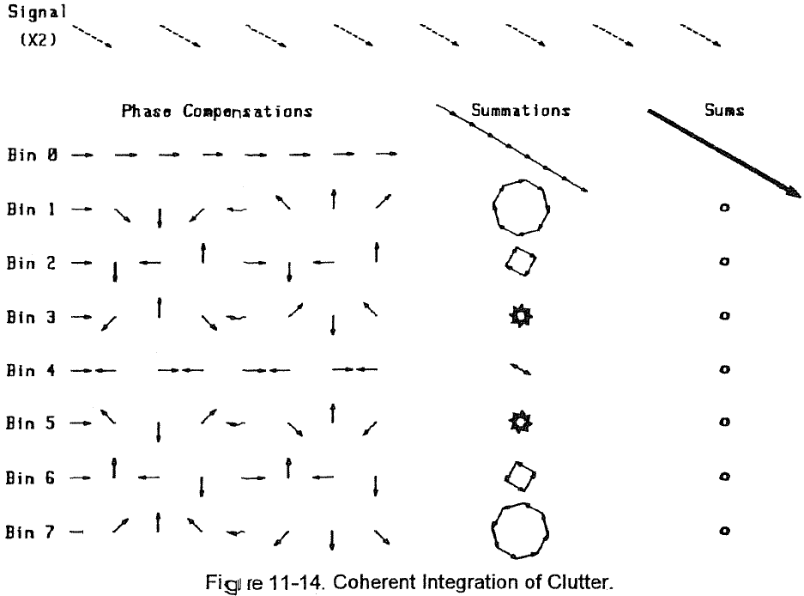
Signal integration (coherent)
Example
  Process applied to clutter only.
  Clutter energy is contained in bin 0.
  Note that the phase does not have to be zero, simply does not change from sample-to-sample.

Slide 21
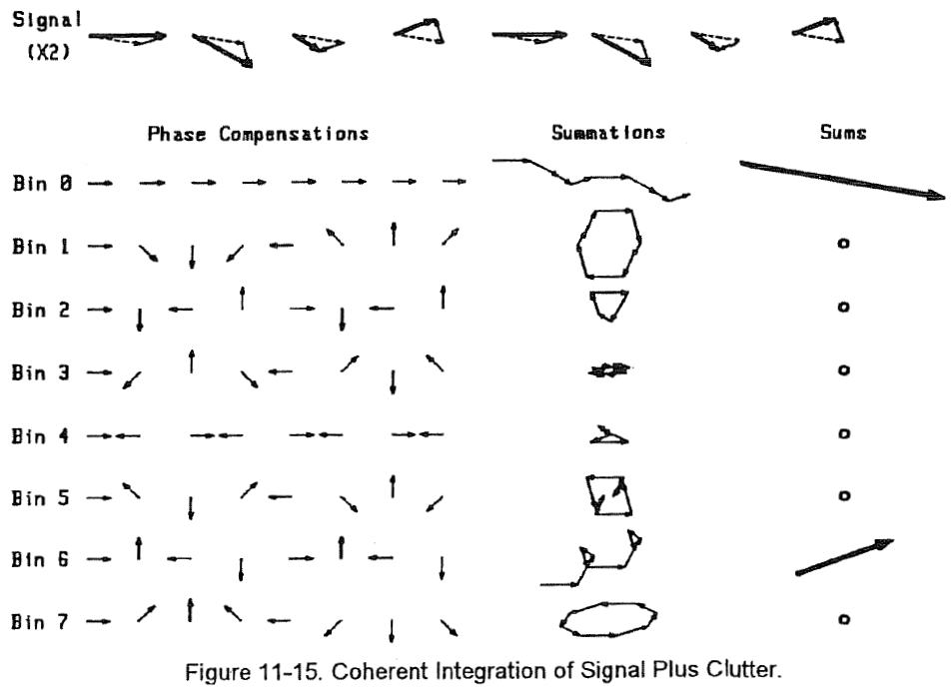
Signal integration (coherent)
Example
  Process applied to signal plus clutter.
  Clutter energy is contained in bin 0; moving target in bin 6.
  Note that if the clutter were not matched to one bin, the leakage could mask the moving target.

Slide 22
Signal integration (coherent)
Compensation for any motion
  These examples show the application of several phase compensation patterns to each signal set.
  If one of the anticipated motions was correct, a large sum resulted.
  If the motion anticipated did not match the target’s actual motion, the sum was small and leakage occurred.
  The process shown is implemented in radars as a discrete Fourier transform (DFT).
  While it is not possible to anticipate all target motions prior to processing, and therefore the DFT must use a selected phase-compensation set.
  The more points used in the DFT the more likely the phase compensation will come close to matching the signal.

Slide 23
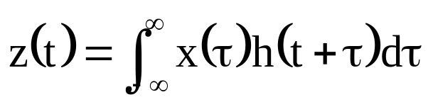
Signal correlation
Correlation is the process of matching two waveforms, usually in the time domain.
Provides a degree of “fit” and the time at which the maximum correlation coefficient (“best fit”) occurs.
Correlation can occur in either the continuous or discrete realms.
continuous form
  z(t) is the correlation function of displacement time t
  x(τ) is one function (of integration time τ)
  h(t + τ) is the other function (of both integration and displacement times)

Slide 24
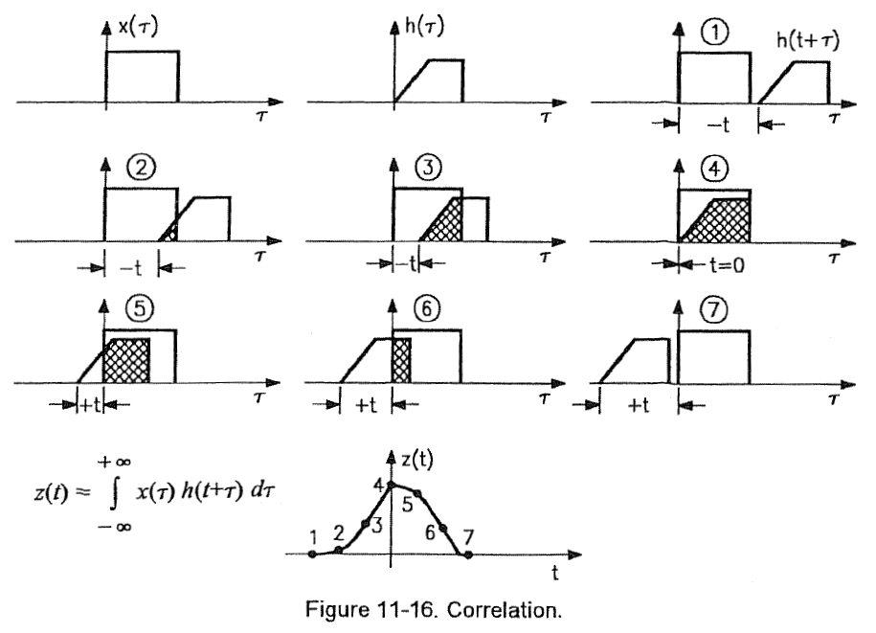
Signal correlation
In the process one signal, x(τ), is held stationary in time and the other, h(t + τ), is displaced in time and “slides” across it.
At each point in the displacement, or sliding, process, the product of x and h is taken and the area under the product is found.
This area is the correlation of x and h at time t.

Slide 25
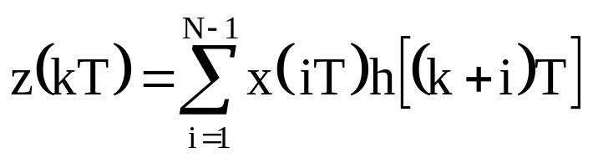
Signal correlation
discrete form
  z(kT) is the discrete correlation of x and h
  N is the total number of samples in one period of the signal (including any zero padding present)
  k is the sample number of displacement time (corresponds to t in continuous realm)
  i is the sample number of the time used to find the area under the product (corresponds to τ in the continuous realm)
  T is the time between samples of the discrete signals and the time granularity of the displacement h
  x(iT) is the first function fixed in time
  h[(k + i)T] is the second function displaced in time

Slide 26
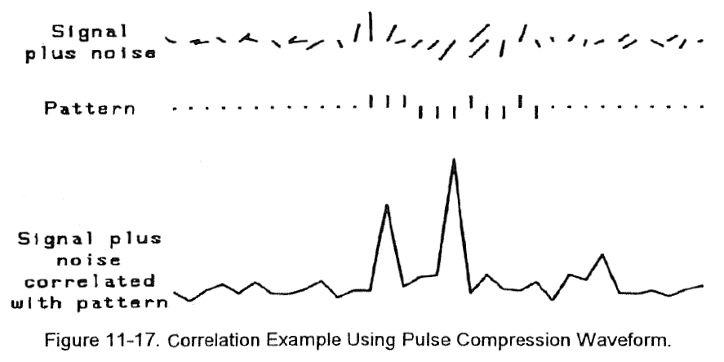
Signal correlation (pulse compression)
Example
  Data stream from an I/Q demodulator containing noise and two embedded targets.
  The correlation function clearly identifies the two targets.

Slide 27
Signal convolution
Convolution is a process by which multiplications are transferred from one domain to the other.
The relationship between multiplication and convolution is
  f(t) is the first signal as a function of time
  w(t) is the second signal as a function of time
  F(f) is the first signal as a function of frequency
  W(f) is the second signal as a function of frequency
  FT[x(t)] is the Fourier transform of x(t) and is X(f)

Slide 28
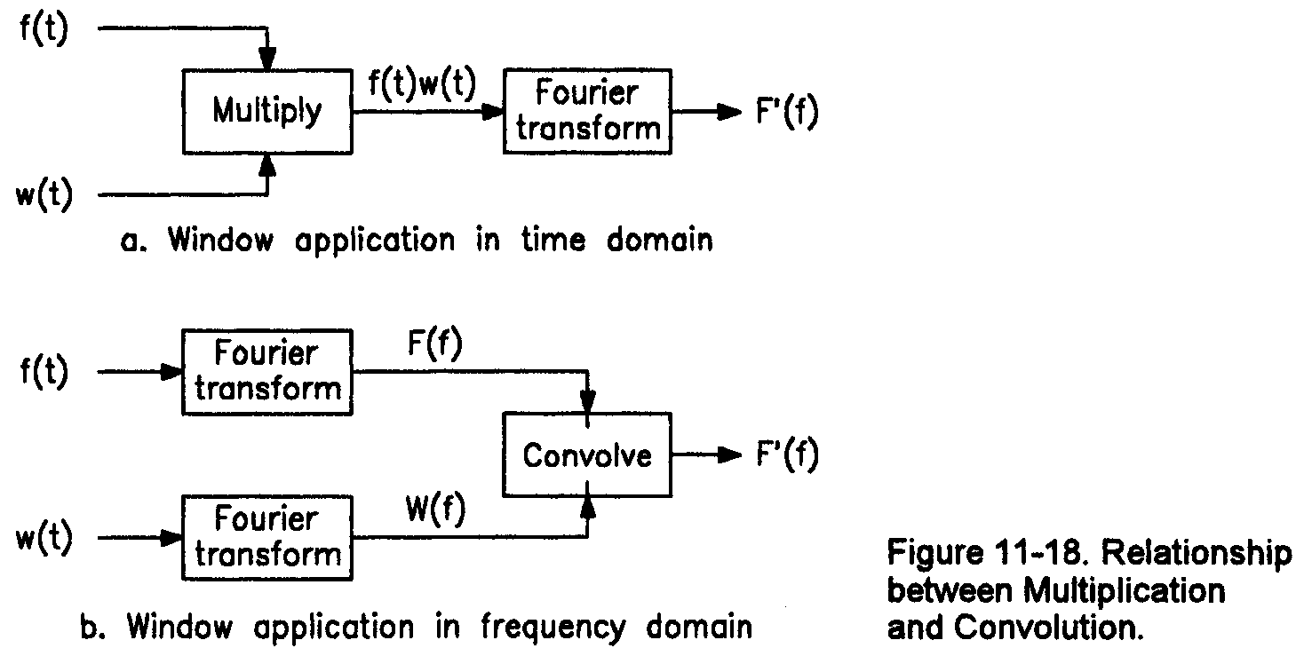
Signal convolution
Convolution is a process by which multiplications are transferred from one domain to the other.
Dual nature between time & frequency domain.

Slide 29
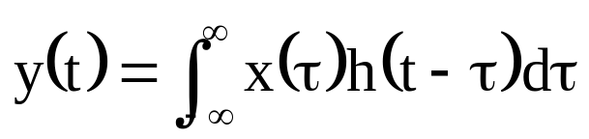
Signal convolution
Convolution can occur in either the continuous or discrete realms.
The process of convolution is almost identical to that of correlation. The only difference is that one of the signals
(it matters not which) is reversed in time.
continuous form
  y(t) is the convolution function of x and h as a function of displacement time t
  x(τ) is one signal as a function of integration time τ
  h(−τ) is the second signal reversed in integration time τ
  h(t − τ) is h(τ) reversed and displaced

Slide 30
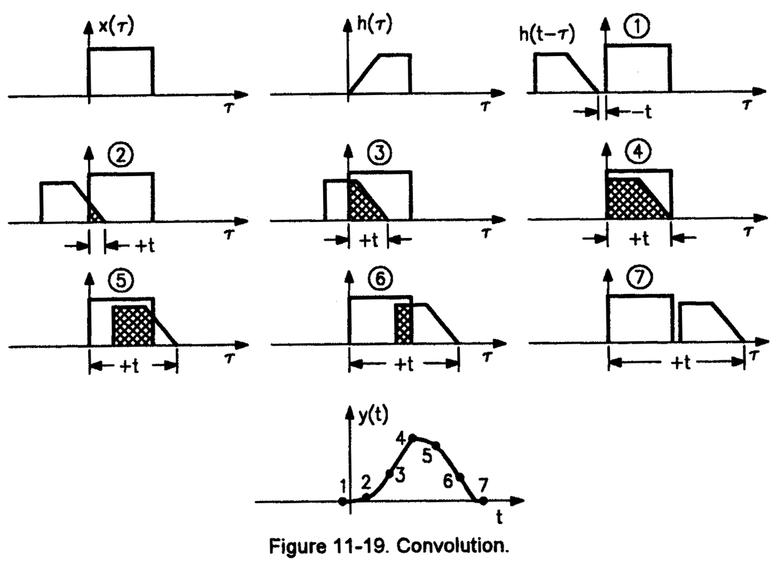
Signal convolution
In the process one signal, x(τ), is held stationary in time and the other, h(t − τ), is reversed and displaced in time and “slides” across it.
Note the similarity to the correlation process.
This area is the correlation of x and h at time t.

Slide 31
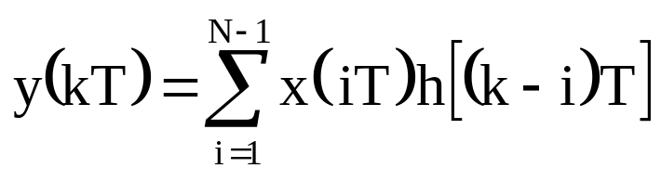
Signal convolution
discrete form
  y(kT) is the discrete convolution of x and h
  N is the total number of samples in one period of the signal (including any zero padding present)
  k is the sample number of displacement time
  (corresponds to t in continuous realm)
  i is the sample number of the time used to find the area under the product
  (corresponds to τ in the continuous realm)
  T is the time between samples of the discrete signals and the time granularity of the displacement h
  x(iT) is the first function fixed in time
  h[(k − i)T] is the second function reversed and displaced in time

Slide 32
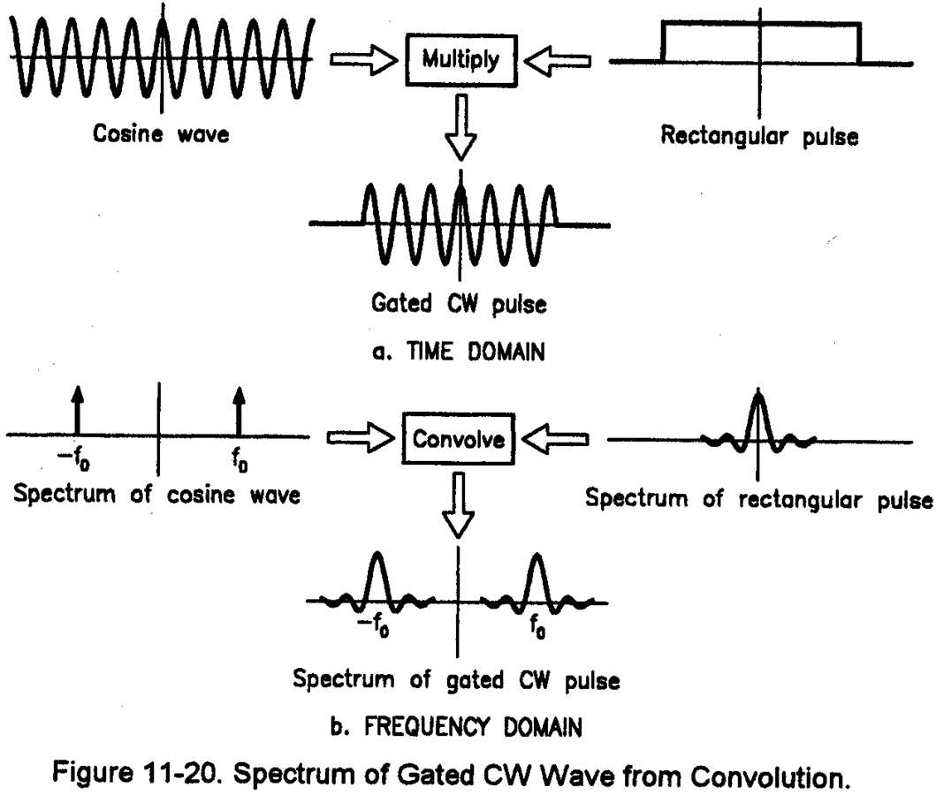
Signal convolution (impulse response)
Example
  Many radar convolution applications involve impulses.
  An impulse in the continuous world is a rectangular pulse, having width of zero, infinite amplitude, and an area of one.
  Continuous convolution with impulses is quite simple.
  The function being convolved with the impulse is copied at the location of each impulse.

Slide 33


Spectrum analysis
Process of dividing functions into their frequency components.
Radar applications include separating moving targets based on Doppler shift as well as separating targets from clutter and other types of interference.
The basic tool for spectrum analysis is the Fourier transform (FT) which transforms functions of time to functions of frequency.
  G(f) is a function of frequency
  g(t) is the corresponding function of time
  FT[ ] is the Fourier transform of a function
The Inverse Fourier transform (IFT) converts functions of frequency to functions of time.
  IFT[ ] is the inverse Fourier transform of a function

Slide 34
Spectrum analysis
There are three varieties of the Fourier transform.
  Continuous Fourier transform (CFT)
    Describes frequency components of a signal which is continuous and aperiodic in time.
    Resulting spectrum is continuous and aperiodic in frequency.
  Fourier series (FS)
    Gives the spectrum of a function which is continuous and periodic in time.
    Resulting spectrum is continuous, but has non-zero values at only discrete frequencies.
    These frequencies are harmonically related to the sample frequency.
    The spectrum is aperiodic.
  Discrete Fourier transform (DFT)
    Gives a spectrum of a function which is discrete (sampled) in time.
    Whether or not the time function is periodic, its spectrum is discrete and periodic as is the spectrum of a periodic time function.

Slide 35
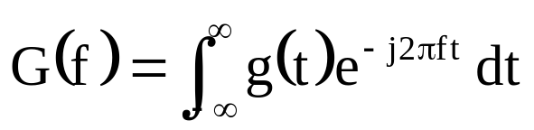
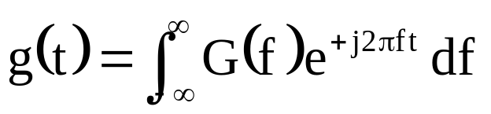
Spectrum analysis (CFT)
Continuous Fourier transform (CFT)
  The CFT is continuous and is performed with integration.
CFT
  G(f) is the spectrum of g(t)
  g(t) is the function in the time domain
  f is frequency
  t is time
Inverse CFT (ICFT)

Slide 36
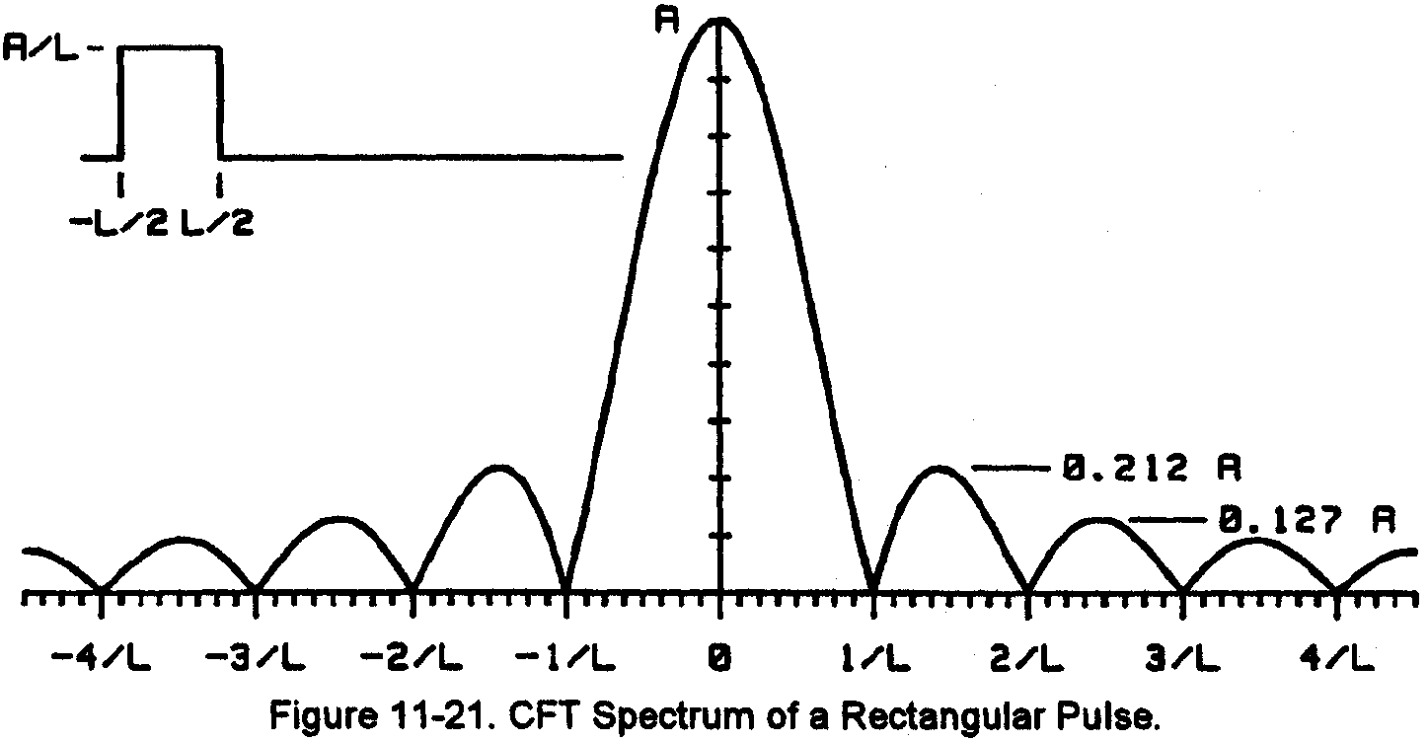
Spectrum analysis (CFT)
The CFT of a rectangular pulse in the time domain is a sinc function [sinc(x) ≡ sin(πx)/(πx)].
The peak value of the spectrum is the area under the pulse.
Nulls occur at n/L where L is the pulse duration and n is any non-zero integer.

Slide 37
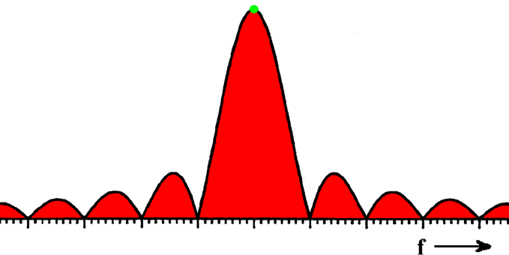
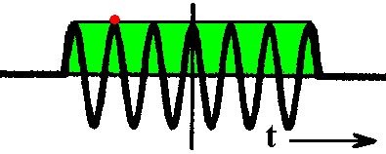
Spectrum analysis (FT properties)
The Fourier transform is linear.
  Signals which are sums of components in the time domain yield spectra which are sums of the spectra of the individual signals.
  Real and imaginary components of complex signals (a_{i} + jb_{i}) can be processed as separate entities.
    G(f) and H(f) are spectra of g(t) and h(t)
Transformation has an area-amplitude relationship.
  Peak amplitude of the spectrum is a linear function of the area under the time envelope.
  The area under the spectrum is a linear function of the time-domain peak amplitude.

Slide 38
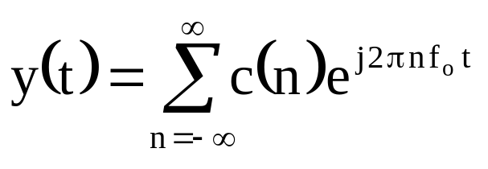
Spectrum analysis (FS)
Fourier series (FS)
  The FS describes continuous periodic functions.
  This periodicity in time causes the formation of a line spectrum, whose components are frequency impulses.
  A frequency impulse represents a complex sinusoid.
  The spectrum of a periodic time function is a summation of sinusoids.
  The i^{th} impulse is at frequency nf_{o} and has amplitude c(n).
FS
    y(t) is a wave composed of an infinite series of complex sinusoids
    c(n) are the coefficients and are complex
    f_{o} is the fundamental frequency of the wave
    n is any integer

Slide 39
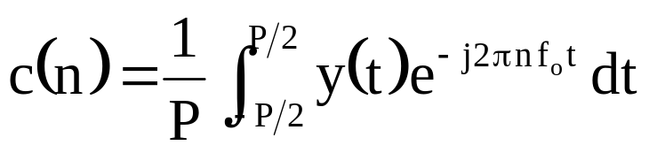
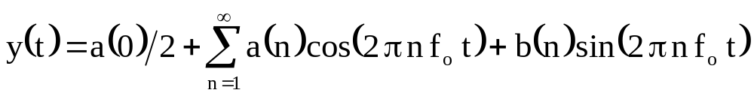
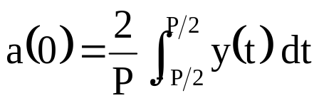
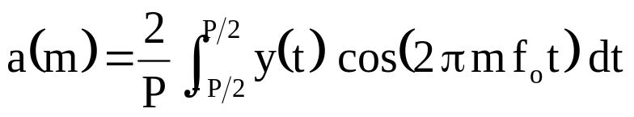
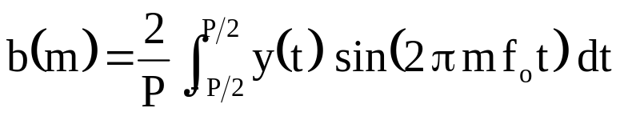
Spectrum analysis (FS)
Fourier series (FS)
  The coefficients c(i) contain the time domain information and are evaluated as
    P is the period of the wave
  The FS is often expressed in trigonometric form as
    m is any integer greater than zero

Slide 40
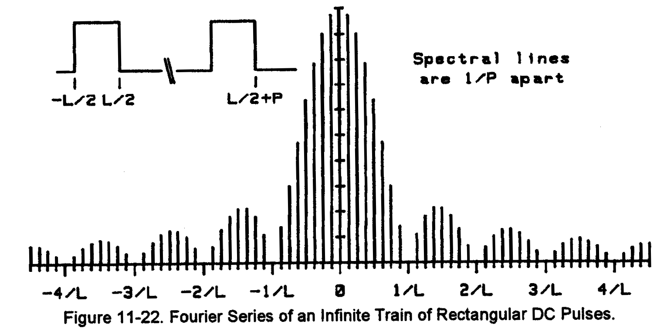
Spectrum analysis (FS)
The FS of an infinite periodic train of continuous DC pulses is shown.
The spectrum of a periodic train of gated CW waves is identical to this spectrum except that its center is as the frequency of the gated CW.
That is, the spectral lines are separated by the PRF.

Slide 41
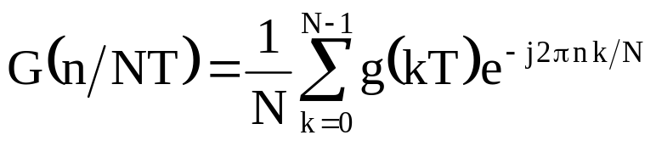
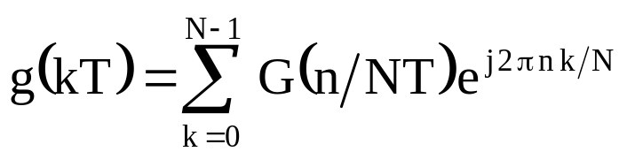
Spectrum analysis (DFT)
Discrete Fourier transform (DFT)
  The DFT changes time to frequency and vice versa for sampled functions.
DFT
    G(n/NT) is the spectrum of the function g(kT) at frequency n
    n is the frequency sample number
    n /NT is the frequency of sample n
    N is the total number of time samples
    T is the time between samples (reciprocal of sample frequency)
    k is the sample number
    kT is the time since the start of the time function
    nk/N is frequency times time
Inverse DFT (IDFT)

Slide 42
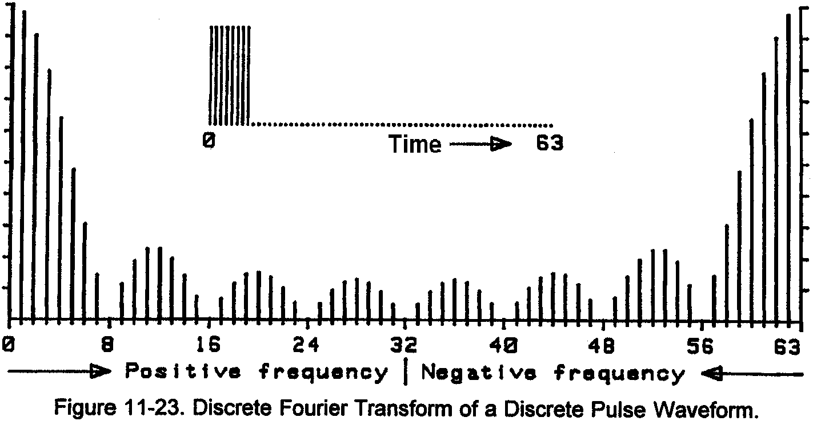
Spectrum analysis (DFT)
The DFT of a rectangular pulse in the time domain is shown.
Positive signal frequencies land in bins 0 through N/2–1, with DC in bin 0 and increasing bin numbers corresponding to increasing frequency.
Bins N-1 through N/2+1 contain the negative frequencies, with the lowest negative frequency in bin N-1 and decreasing bin number corresponding to increasing negative frequency.
If bin N existed, it would be at the sample frequency.

Slide 43
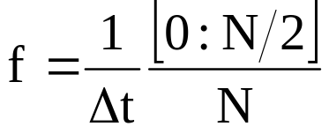
Spectrum analysis (DFT)
Frequency scaling
  The frequency vector corresponding to the positive frequencies can be found using
    Δt is the sample spacing in the time domain, i.e., Δt = 1/f_{s}
    N is the total number of time samples

Slide 44
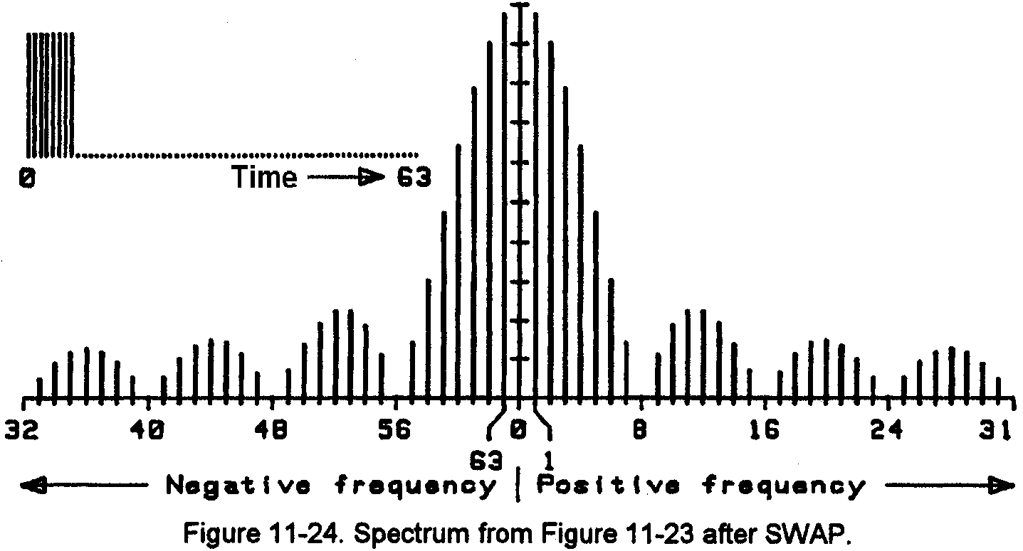
Spectrum analysis (DFT)
DFT spectrum after SWAP operation (fftshift in Matlab) to move frequencies to their natural positions.
Maximum positive and negative frequencies are at the ends with zero frequency in the center.
Note that frequency bin N/2 (32 in this example) is not Nyquist sampled and some information in signals containing this frequency is lost.

Slide 45
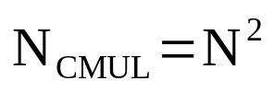
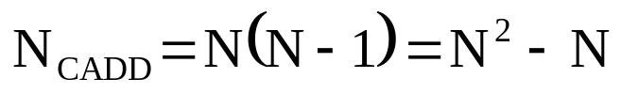

Spectrum analysis (DFT)
The DFT can require vast amount of computation if the number of samples is large.
Assuming the exponentials are found and stored in a table, the remaining operations involve complex multiplications and additions.
The minimum calculation load for a DFT is
    N_{CMUL} is the number of complex multiplies
    N is the number of time data points and the number of frequency samples
    N_{CADD} is the number of complex additions in the transform
There are 4 real multiplications and 2 real additions in a complex multiplication.
There are 2 real additions in a complex addition.

Slide 46
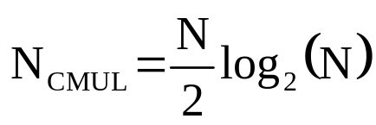
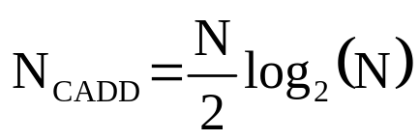
Spectrum analysis (FFT)
Example
DFT processing a signal involving 1024 samples requires:
  1,048,576 complex multiplies or 2,097,152 real adds and 4,194,304 real multiplies
  1,047,552 complex additions or 2,095,104 real adds
  For a total of 4,194,304 real multiplies and 4,192,256 real additions.
The DFT algorithm contains considerable redundancy.
In 1965 Cooley and Tukey identified and removed these redundancies in the Fast Fourier Transform (FFT).
  In the FFT (radix 2), the number of operations is
FFT processing a signal involving 1024 samples requires
  5,120 complex multiplies or 10,240 real adds and 20,480 real multiplies
  5,120 complex additions or 10,240 real adds
  For a total of 20,480 real multiplies and 20,480 real additions.
  This is a savings of 99.5% compared to the number required for DFT processing which translates into faster execution speed enabling FFT spectral analysis with significantly less computational resources.

Slide 47
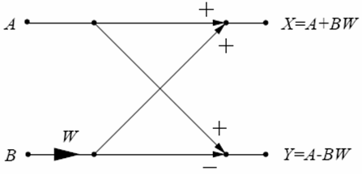
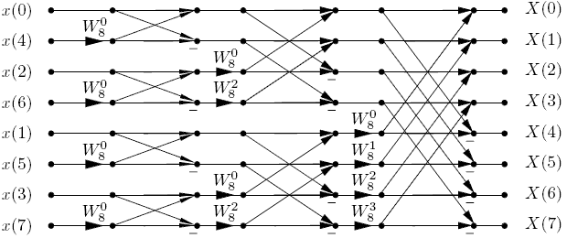

Spectrum analysis (FFT)
The basis of the radix-2 FFT is the 2-point transform called the butterfly because of the form of its signal flow diagram.
The radix-2 decimation-in-time (DIT) FFT with N = 8

Slide 48
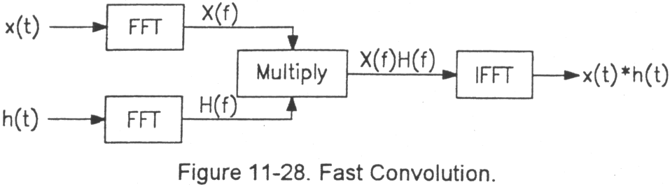
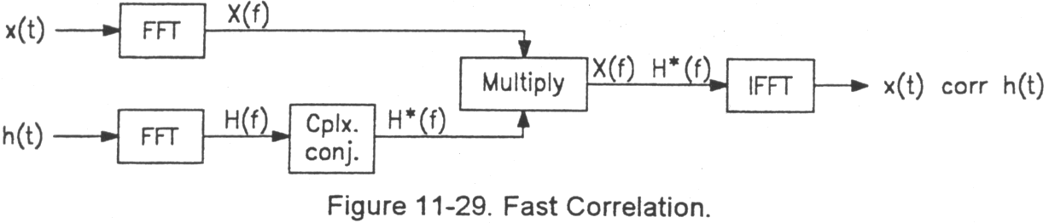
Spectrum analysis (FFT)
The efficiency of the FFT (and its inverse, the IFFT) enables other operations, constructed around the FFT, to be similarly efficient.
Efficient convolution
Efficient correlation

Slide 49
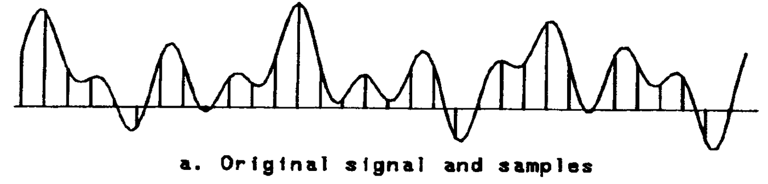
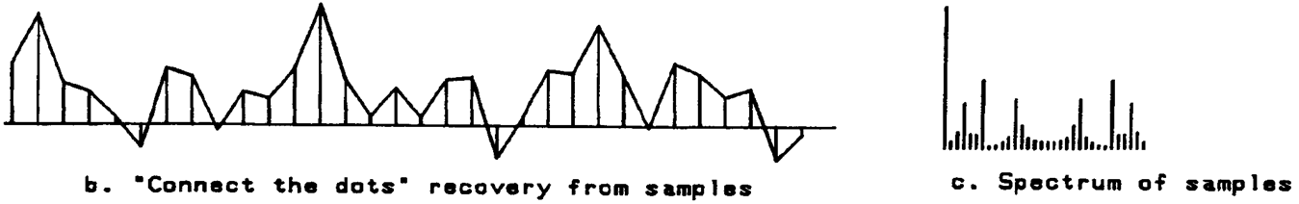


Spectrum analysis (FFT)
Efficient interpolation

Slide 50

Airborne SAR block diagram
New terminology:
SAR (synthetic-aperture radar)
Magnitude images
Magnitude and Phase Images
Phase Histories
Motion compensation (MoComp)
Autofocus
Autofocus
Timing and Control
Inertial measurement unit (IMU)
Gimbal
Chirp (Linear FM waveform)
Digital-Waveform Synthesizer

Slide 51

Image-formation processor
HPF: high-pass filter
CTM: corner-turn memory
Focus: matched-filter parameters
Autofocus: remove phase errors using radar data analysis

Slide 52

Image-formation processor

Slide 53

Image-formation processor
Corner-turn memory operation

Slide 54
Airborne SAR block diagram
New terminology:
SAR (synthetic-aperture radar)
Magnitude images
Magnitude and Phase Images
Phase Histories
Motion compensation (MoComp)
Autofocus
Autofocus
Timing and Control
Inertial measurement unit (IMU)
Gimbal
Chirp (Linear FM waveform)
Digital-Waveform Synthesizer

Slide 55

Digital-waveform synthesis
Digital-waveform generation typically involves one of two methods – an arbitrary waveform generation (AWG) or direct-digital synthesis (DDS).
  Digital waveform generation is
    is very repeatable and digitally controlled
    is immune to aging and temperature drift effects
  Arbitrary waveform generation (AWG) involves reading pre-determined values from a memory directly into a digital-to-analog (D/A) converter.
  Direct digital synthesis (DDS) is a technique for using digital data processing blocks as a means to generate a frequency- and phase-tunable output signal referenced to a fixed-frequency precision clock source.

Slide 56

Arbitrary waveform generation
Arbitrary waveform generation (AWG)
  Pre-determined values stored in a memory having fast access times.
  Values are read out at high speed into a digital-to-analog converter.
  Waveform length (duration) limited by number of locations in memory and read-out rate.
Advantages
  Any arbitrary waveform can be produced.
Disadvantages
  Long-duration waveforms or a large variety of waveforms requires a large capacity, fast read time memory.
  Changing waveforms on the fly requires computing and downloading waveform files into the fast memory during operation.
Block diagram for an arbitrary waveform generator.

Slide 57
Arbitrary waveform generation
Arbitrary waveform generation (AWG)
  Design example
  A waveform is desired with the following characteristics:
  Duration: 10 μs
  Maximum frequency: 250 MHz
  Minimum sample (clock) frequency: 2 x 250 MHz or 500 MHz
  selected clock frequency, 625 MHz (1.6-ns sample period)
  Required memory depth: 10 μs/1.6 ns = 6250 words per waveform
Block diagram for an arbitrary waveform generator.

Slide 58

Direct digital synthesis
Direct digital synthesis (DDS)
  The DDS produces periodic (e.g., sinusoidal) waveforms by computing the signal phase in real time and converting the phase into amplitude via a
  lookup table.
Advantages
  Requires minimal memory capacity.
  Capable of producing long-duration (or even CW) waveforms.
  Micro-Hz frequency precision, sub-degree phase tuning.
  Extremely fast frequency hopping speed, phase continuous.
Disadvantages
  Waveforms limited to periodic patterns.

Slide 59



Direct digital synthesis
Direct digital synthesis (DDS)
  The heart of the DDS is a phase accumulator that is used to produce a phase output that increases linearly in time.
  By varying the tuning word the rate of the phase increase can be adjusted.
  Sometimes referred to as a
  Numerically Controlled Oscillator
  (NCO).
Slope ∝ frequency
Synthesized frequency depends on:
  Reference clock frequency, f_{c}
  Tuning word value, M
  Number of bits in phase accumulator, 2^{N}
N-bit variable-modulus counter and phase register
Sine lookup table contains one cycle of a sine waveform.

Slide 60

Direct digital synthesis
To visualize the basic function, consider the phase accumulator to be a vector rotating around a phase wheel where each designated point on the wheel corresponds to a point on a cycle of a sine waveform.
As the vector rotates around the wheel, visualize that a corresponding output sinewave is being generated.
The phase accumulator is actually a modulus M counter that increments its stored number each time it receives a clock pulse.
The magnitude of the increment is determined by a digital word M.

Slide 61

Direct digital synthesis
The output of the phase accumulator is linear and cannot directly be used to generate a sinewave or any other waveform except a ramp. Therefore, a phase-to-amplitude lookup table is used to convert a truncated version of the phase accumulator’s instantaneous output value into the sinewave amplitude information that is presented to the D/A
converter.

Slide 62
Direct digital synthesis
The sine lookup table typically contains just ¼ of a cycle and exploits the symmetrical nature to synthesize a full sinewave.
The number of address bits into the lookup table determines the phase resolution and ultimately the phase quantization noise.

Slide 63

Direct digital synthesis
The D/A converter transforms the digital values to an analog waveform. The resolution of the D/A converter (number of bits) determines its output amplitude quantization noise level, ultimately setting the maximum signal-to-noise ratio.
The stair-step characteristic of the D/A converter output contains undesired higher-frequency components that are removed by a low-pass filter that serves to interpolate (or smooth) the output waveform.

Slide 64


Direct digital synthesis
Finer D/A resolution
(more bits) produces
less quantization
noise, yielding a
cleaner output
spectrum.

Slide 65


Direct digital synthesis
An anti-alias (low-pass)
filter is used to limit the
output waveform to
include the desired
fundamental waveform
and to exclude the image
or harmonic components.

Slide 66

Direct digital synthesis
The output from the D/A converter suffers from the sin(x)/x amplitude response characteristic of sample-and-hold systems.
Furthermore, due to the sampling nature, image frequency components are produced about harmonics of the sample frequency.
To separate the desired tone from its image, the maximum useful output frequency is limited to about 40% of the sample clock frequency.

Slide 67



Direct digital synthesis
Similar to the undersampling process in data acquisition, the desired output waveform can be an image (and not the fundamental) appearing in a higher-order Nyquist zone, termed super Nyquist.
  The disadvantage of using images as primary output signals is basically the decrease in signal to noise ratio and SFDR (spurious-free dynamic range). The image amplitude as well as the fundamental amplitude are all subject to sin(x)/x amplitude variations with frequency.
  Unfortunately, spurious signals in the DDS/DAC output spectrum seem to get more numerous and larger the further one goes from the Nyquist limit!

Slide 68
Direct digital synthesis
Direct digital synthesis (DDS)
  Design example
  A waveform is desired with the following characteristics:
  Duration: 10 μs
  Maximum frequency: 250 MHz
  Desired frequency resolution, 1 Hz
  Desired output SNR, > 90 dB
  Minimum sample (clock) frequency: 250 MHz/40% or 625 MHz
  Frequency resolution requires N ≥ log2(625 MHz / 1 Hz) = 30 bits
  Output SNR requires DAC with 90 dB/6 dB per bit ≥ 15 bits

Slide 69


Direct digital synthesis
Constant frequency operation requires linear phase variation.
Chirp operation required quadratic phase variation.
Quadratic phase produced using 2nd accumulator (frequency accumulator).
Various registers used to set start frequency, start phase, chirp rate.

Slide 70

Direct digital synthesis
Amplitude modulation possible by modulating signal amplitude following lookup table output.
Thus it is possible to remove the sin(x)/x amplitude variation.
Other amplitude modulations possible as well.

Slide 71

Direct digital synthesis
Example DDS
Analog Devices AD9854
300-MHz internal clock rate
Two-stage accumulators for chirp generation
Dual, 12-bit integrated D/A converters
Integrated input clock frequency multiplier
sin(x)/x amplitude correction
3.3-V single supply
80-dB dynamic range
Max P_{diss} = 4 W
Unit cost: ~$20
Applications
FSK, BPSK, PSK, chirp, AM
Radar and scanning systems
Test equipment
Commercial and amateur RF exciters

Slide 72

Direct digital synthesis
Analog Devices AD9854 (300-MHz DDS)
  48-bit frequency and phase resolution: 1 μHz
  17-bit sine lookup table address: 2.7 milli-degree resolution
  12-bit D/A resolution: 72 dB SNR
  I/Q outputs: single-sideband signal generation
  15 MHz input clock frequency & 20x clock multiplier → 300 MHz internal clock

Slide 73

Direct digital synthesis
Analog Devices AD9858 (1-GHz DDS)
  1 GHz max sample frequency (max useful output frequency 400 MHz)
  32-bit frequency and phase resolution: 0.23 Hz
  15-bit sine lookup table address: 0.01 degree resolution
  10-bit D/A resolution: 55 dB SNR
  Dual accumulator for chirp generation
  No amplitude correction
  P_{diss} = 2 W
  Unit cost ~ $50
Phase offset enables phase manipulation.
Useful for:
  Interpulse 0/π modulation
  Motion compensation

Slide 74

Direct digital synthesis
Oversampling the output waveform has the benefit of spreading the quantization noise across a wider spectrum, thus limiting the in-band quantization noise level.
  The amount of quantization noise power is dependent on the resolution of the DAC.
  It is a fixed quantity and is proportional to the shaded area.
  In the oversampled case, the total amount of quantization noise power is the same as in the Nyquist sampled case.
  Since the noise power is the same in both cases (it’s constant), and the area of the noise rectangle is proportional to the noise power, then the height of the noise rectangle in the oversampled case must be less than the Nyquist sampled case in order to maintain the same area.

Slide 75
Direct digital synthesis
Digital waveform generation enables reliable, predictable, repeatable waveform production without aging or temperature variations.
Direct digital synthesis techniques enable extremely precise frequency control and phase-continuous signal modulation.
Dual accumulator DDS systems produce linear FM (chirp) waveforms with selectable start frequency, start phase, and chirp rates.
Amplitude control mechanisms enable compensation for the sin(x)/x amplitude variation.
Integrated input clock frequency multipliers enable high frequency internal clocking with modest input clock frequencies.

