Slide 1



QNX Vehicle Gateway
State Level Hackathon
[Team name], [City]
Safety-first CAN scheduling with QNX message passing

Slide 2
Problem & Scenario
Design and Execution
  Scenario: a car gateway sits between ECUs; a late or fake safety frame (brake, airbag) is a safety failure
  Threats we model: traffic flood, spoofed safety frames, unknown IDs, impossible values (900 km/h)
  Why deterministic: the worst case matters, not the average
  Key metric: safety frame delay below 500 µs, zero deadline misses under flood and attack

Slide 3
QNX Architectural Approach
Design and Execution
Microkernel + message passing: ECUs, Gateway and Receiver are separate processes using name_attach, name_open, MsgSend, MsgReceive, MsgReply (no sockets)
Priorities (SCHED_FIFO): Safety 50, CAN RX 40, Gateway 40, Diagnostics 20; ECU safety + heartbeat threads 45
Priority inheritance: the Gateway receive thread runs at the sender's priority; mutexes use PTHREAD_PRIO_INHERIT
Isolation: Gateway threads pinned to core 0 (ThreadCtl RUNMASK); cores 1-3 stay free
ECU safety thread
prio 45
MsgSend (blocks)
Gateway RX thread
name_attach gw_ingress
runs at 45 (inherited)
Queues by CAN ID
safety / telemetry / diag
Worker threads
Safety 50 | Gateway 40
Diagnostics 20
Receiver
gw_safety / gw_bulk
MsgReceive + MsgReply
MsgReply unblocks the sender once the frame is queued. Safety frames are served first.

Slide 4
Technical Execution (Implementation)
Design and Execution
// ECU (sender_core.h)
coid = name_open("gw_ingress", 0);
MsgSend(coid, &x, sizeof(x), &reply, sizeof(reply));
sp.sched_priority = 45; /* safety thread */
pthread_setschedparam(pthread_self(), SCHED_FIFO, &sp);
// Gateway (Gateway.c)
at = name_attach(NULL, "gw_ingress", 0);
ThreadCtl(_NTO_TCTL_RUNMASK, (void *)PIN_MASK);
for (;;) {
rcvid = MsgReceive(at->chid, &msg, sizeof(msg), NULL);
if (msg.type == GW_IPC_MSG) {
handle_frame(&msg.ipc.m); /* checks + queue */
MsgReply(rcvid, EOK, NULL, 0);
}
}
pthread_mutexattr_setprotocol(&ma, PTHREAD_PRIO_INHERIT);
Sender: name_open("gw_ingress") once, then MsgSend per frame (blocks until the Gateway replies)
Gateway: its own thread does name_attach + a MsgReceive loop, pinned to core 0
handle_frame(): allowlist, class check, rate limit, plausibility, then queue by CAN ID
Threads (SCHED_FIFO): Safety 50, Gateway 40, Diagnostics 20; mutexes PTHREAD_PRIO_INHERIT
MsgReply unblocks the sender; the receive thread inherits the sender priority
Each ECU: 5 threads + mode controller (Normal, Congestion, Attack, Combined, 10 s each)

Slide 5
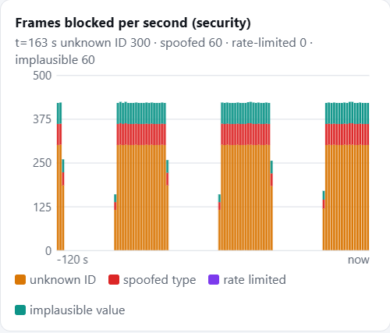
Resilience & "The Hack" Response
Design and Execution
Stress | What we send | Gateway response | Result
Congestion | 10x telemetry + 40x diagnostics per tick, per ECU | Priority queues: safety served first | Safety max 151 µs, 0 misses
Unknown ID | ID 0x666 every 10 ms | Allowlist drops it | About 300 blocked per s, none forwarded
Spoofed safety | Telemetry ID flagged as safety | Class check: ID must match type | About 60 blocked per s
Impossible value | Speed 900 km/h | Plausibility range check | About 60 blocked per s
Silent ECU | Heartbeat stops | Heartbeat monitor (timeout) | Dashboard shows LOST, restored when it returns
Receiver restart | Receiver process stops | Gateway re-opens the link every 1 s | Forwarding resumes by itself
Dashboard: frames blocked per second, by type. Bursts follow the Attack and Combined phases; 0 safety frames dropped.

Slide 6
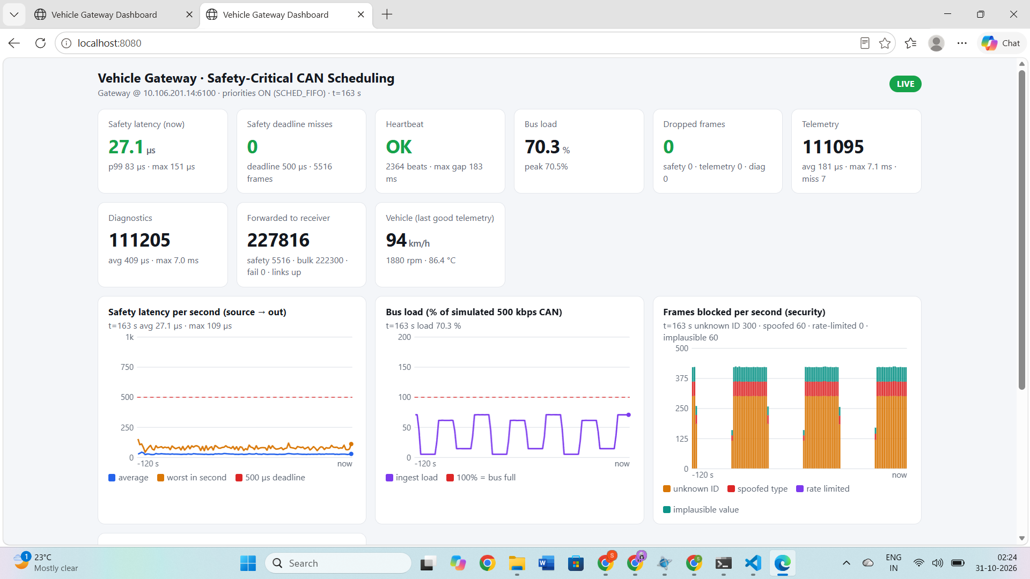
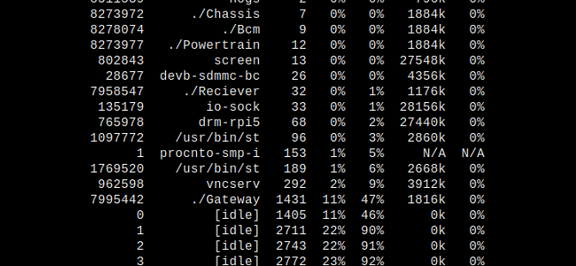
Performance Proof
Demonstration
Safety latency, 3 ECUs flooding + attacking, ~70% bus load:
Deadline misses: 42 of 4081 → 0 of 5516
p99: 583 µs → 83 µs
Max: 3064 µs → 151 µs
CPU (hogs): Gateway ~1-2% of one core normal, ~47% of core 0 in congestion; core 0 still 46% idle, cores 1-3 ~90% idle
Proof: ECU safety priority 45 makes QNX deliver safety before queued telemetry
hogs in congestion mode: Gateway 47% of core 0, cores 1-3 mostly idle

Slide 7
Future Scalability & Conclusion
Demonstration
To automotive grade: real CAN / CAN-FD hardware, HMAC + counter on safety frames, per-ECU CAN IDs, QNX HAM to restart services, adaptive partitioning
Learning: safety latency spikes (max 3 ms) came from message order; fixed with QNX priorities, not more code
"Under flood and attack, the safety message arrives first, every time."

