Slide 1




Vehicle Gateway with Safety-Critical CAN Scheduling
State Level Hackathon
Crazac
Design of a Safety-Critical Vehicle Gateway on QNX

Slide 2
Title & Team Identity
Design and Execution
  Project Name: SafeGate Real-Time Safety-Critical Vehicle Gateway
  Theme Selected: Automotive
  Team Name & City: Crazac & Coimbatore
  Two/Three-Line Value Proposition: Develops a real-time vehicle gateway using QNX to prioritize safety-critical CAN messages over normal traffic. Ensures predictable message delivery under network congestion, improving vehicle communication reliability and safety.

Slide 3
Problem Synthesis & Scenario
Design and Execution
Scenario: Modern vehicles exchange data such as speed, braking status and engine information through the CAN network. During heavy network traffic, important safety messages like emergency braking and collision warnings may get delayed due to congestion. Even a small delay can affect vehicle response and passenger safety. Therefore, a real-time gateway is needed to prioritize critical messages and ensure timely communication.
Criticality: During heavy traffic, low-priority messages may cause delays or starvation. Safety-critical messages must be processed within a fixed time limit. QNX priority-based scheduling ensures predictable and timely task execution.
Success metric:
Safety message latency: Below 10 ms.
Deadline misses: Zero safety-message deadline misses during congestion testing.
Monitor CAN bus utilization and dropped frames.

Slide 4
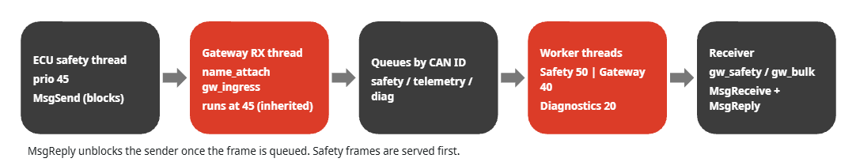
QNX Architectural Approach
Design and Execution
Additional Real-Time Mechanisms
CAN ID-Based Arbitration for safety priority.
Deadline Monitoring for time-bound delivery.
Congestion Monitoring for network load.
Heartbeat Monitoring for fault detection.
Microkernel + message passing: ECUs, Gateway and Receiver are separate processes using name_attach, name_open, MsgSend, MsgReceive, MsgReply (no sockets)
Priorities (SCHED_FIFO): Safety 50, CAN RX 40, Gateway 40, Diagnostics 20; ECU safety + heartbeat threads 45
Priority inheritance: the Gateway receive thread runs at the sender's priority; mutexes use PTHREAD_PRIO_INHERIT
Isolation: Gateway threads pinned to core 0 (ThreadCtl RUNMASK); cores 1-3 stay free

Slide 5
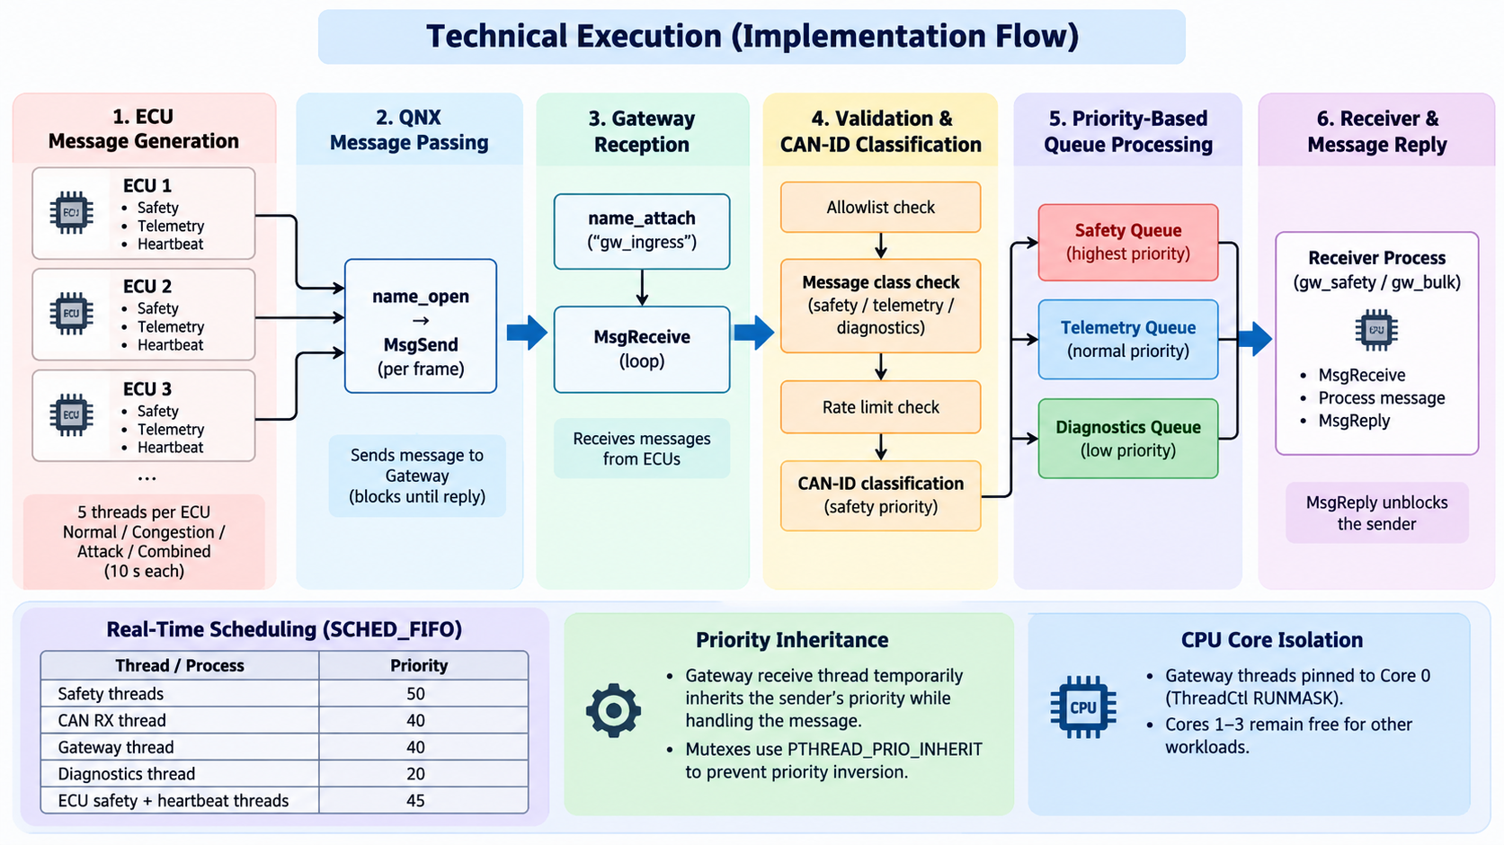
Technical Execution (Hardware & Logic)
Design and Execution

Slide 6
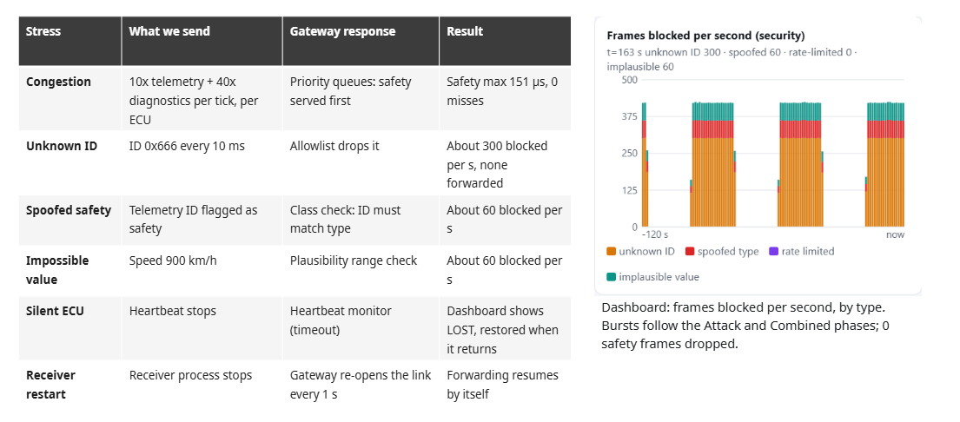
Resilience & "The Hack" Response
Design and Execution

Slide 7
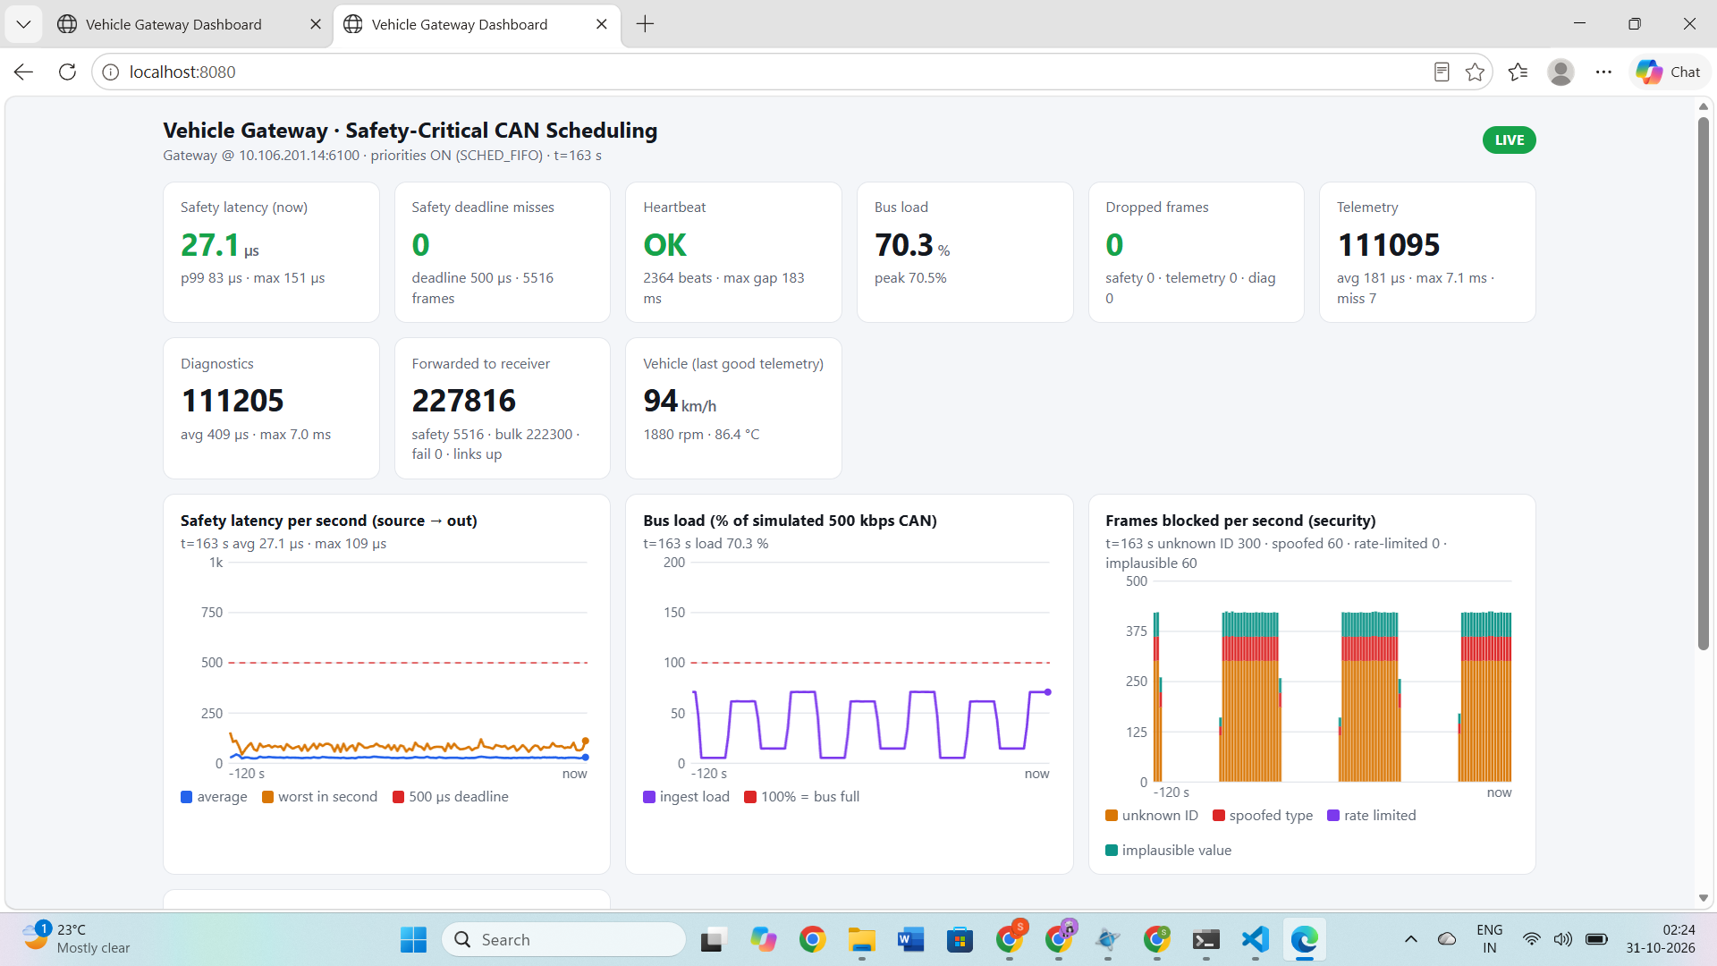
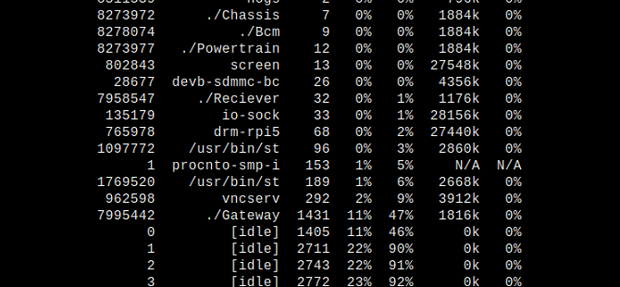
Performance Proof
Demonstration
Safety latency, 3 ECUs flooding + attacking, ~70% bus load:
Deadline misses: 42 of 4081 → 0 of 5516
p99: 583 µs → 83 µs
Max: 3064 µs → 151 µs
CPU (hogs): Gateway ~1-2% of one core normal, ~47% of core 0 in congestion; core 0 still 46% idle, cores 1-3 ~90% idle
Proof: ECU safety priority 45 makes QNX deliver safety before queued telemetry

Slide 8
Future Scalability & Conclusion
Demonstration
Future Scalability
More ECUs: Extend the gateway to support additional vehicle ECUs and communication channels.
Advanced Security: Integrate stronger intrusion detection and authentication mechanisms.
Hardware Integration: Connect real CAN interfaces and test with physical automotive networks.
Performance Optimization: Improve scheduling and resource utilization for higher network loads.
Remote Monitoring: Expand the laptop dashboard with advanced diagnostics and alerts.
Conclusion
Successfully developed a QNX 8.0-based multi-ECU Vehicle Gateway on Raspberry Pi.
Implemented real-time priority scheduling and QNX message passing.
Achieved zero deadline misses across 5,516 safety frames, with 83 µs p99 latency and 151 µs maximum latency.
Demonstrated reliable safety-message handling under simulated congestion and attack conditions.

Slide 9
Thank you

