Slide 1

Project-Based Learning
Phase-II Evaluation
OS User Activity Monitoring & Insider Threat Detection System
KernelGuard | Team ID: OSDBMS-V-2026-T298
OS (TCS 502) and DBMS (TCS 503) | Academic Session 2026–27
Graphic Era (Deemed to be University), Dehradun
Notes:
Team and title: supplied Phase 1 report.

Slide 2
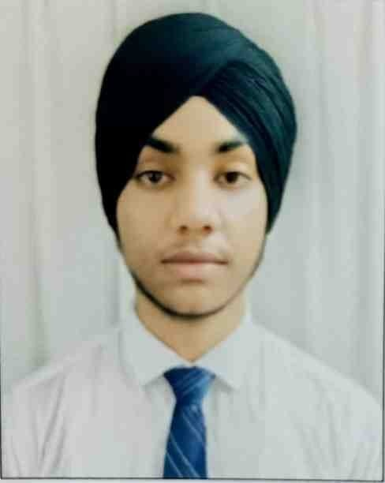
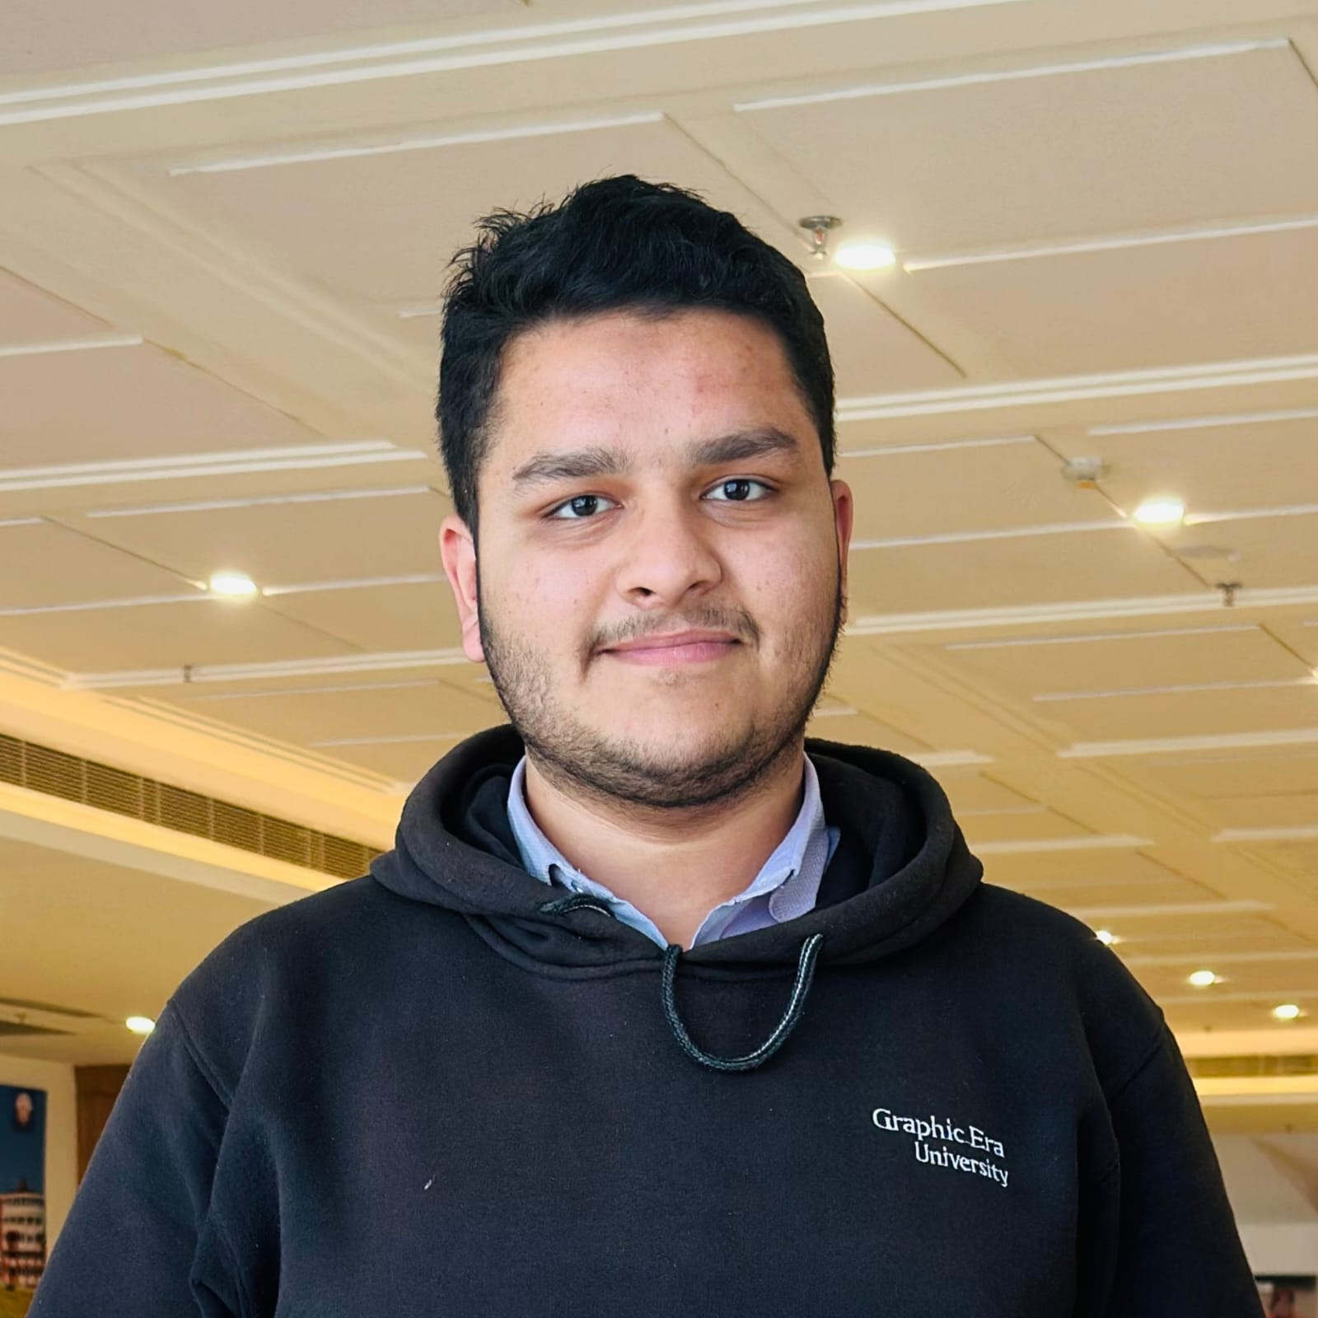
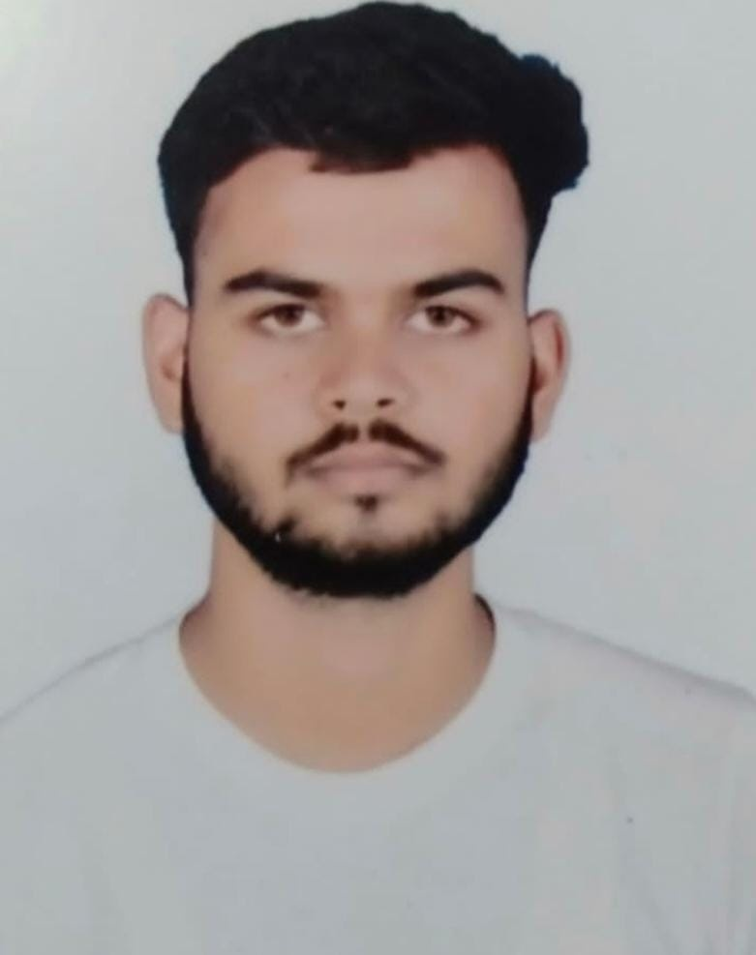
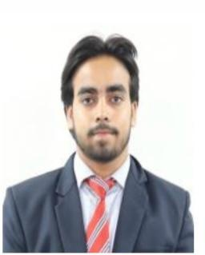
Team & Mentor Details
Team Information
Mentor
Team ID: OSDBMS-V-2026-T298
Domain: OS activity monitoring and DBMS
(Prof.)Dr.Mohammad Wazid
Team Members
Arshpreet Singh
Mohd Ahmed Khan
Ankit
Mohd Shoaib
24021835
24021365
240212134
240211124
Department of Computer Science & Engineering | Graphic Era (Deemed to be University)
2/15
Notes:
Team details and portraits: supplied Phase 1 report.

Slide 3
Phase-I Recap & Feedback Incorporated
Phase I proposal
Recorded Phase II decisions
•
A local Linux monitor for file, login, process and USB activity.
•
The implementation focuses first on Linux Audit and MySQL.
•
Relational records and explainable warnings were the proposed result.
•
Two rules and linked evidence make the prototype testable.
•
No formal mentor feedback text was supplied.
Department of Computer Science & Engineering | Graphic Era (Deemed to be University)
3/15
Notes:
Sources: supplied Phase 1 report; Phase 2 README.md. No separate mentor feedback record was supplied.

Slide 4
Problem Statement & Finalized Objectives
Audit events need a clear route from raw record to stored evidence and a reviewable warning.
•
Group related Linux Audit lines into one normalized event.
•
Store event and policy relationships in MySQL with replay protection.
•
Detect failed-login bursts and after-hours protected reads.
•
Display the evidence behind each alert in a local dashboard.
Department of Computer Science & Engineering | Graphic Era (Deemed to be University)
4/15
Notes:
Source: C:\KernalGuard-Phase2-PBL\README.md and kernelguard/core.py.

Slide 5
Updated System Architecture / Workflow
Linux Audit
ausearch
Parser
normalized events
MySQL
eight tables
Two rules
linked alerts
Dashboard
evidence view
→
→
→
→
Department of Computer Science & Engineering | Graphic Era (Deemed to be University)
5/15
Notes:
Source: C:\KernalGuard-Phase2-PBL\README.md and docs/FILE_GUIDE.md.

Slide 6
Module Design & Functional Requirements
Core modules
Functional requirements
•
Parser groups raw audit records and selects fields.
•
Reject duplicate source IDs.
•
Collector uses a writer lock and transactional checkpoint.
•
Separate demo from live records.
•
Schema stores events, details, alerts and policy history.
•
Show alert reason, evidence and saved settings.
Department of Computer Science & Engineering | Graphic Era (Deemed to be University)
6/15
Notes:
Source: C:\KernalGuard-Phase2-PBL\docs/FILE_GUIDE.md.

Slide 7
Technology Stack & Development Methodology
Technology
Development method
•
Linux auditd and ausearch for source records.
•
Build one audit-to-alert path.
•
Python, SQLAlchemy and PyMySQL for ingestion.
•
Verify parser and schema offline.
•
MySQL 8.4 and Flask for storage and review.
•
Run fixture and controlled Linux checks separately.
Department of Computer Science & Engineering | Graphic Era (Deemed to be University)
7/15
Notes:
Source: C:\KernalGuard-Phase2-PBL\requirements.txt, README.md.

Slide 8
Implementation of PBL Course Concepts
Course | Concept applied | Project module
Operating Systems | Audit records, UID/AUID/EUID, protected path | Rule and parser
DBMS | Keys, foreign keys, joins and transactions | Eight-table MySQL schema
Software Engineering | Config validation and repeatable tests | CLI, fixture and tests
Department of Computer Science & Engineering | Graphic Era (Deemed to be University)
8/15
Notes:
Source: C:\KernalGuard-Phase2-PBL\README.md. Technical context: https://docs.redhat.com/en/documentation/red_hat_enterprise_linux/7/html/security_guide/sec-understanding_audit_log_files ; https://dev.mysql.com/doc/refman/8.4/en/create-table-foreign-keys.html

Slide 9
Development & Implementation Progress
Component | Status | Evidence
Audit parser and collector | Complete | parser.py and app.py
Relational schema | Complete | core.py and schema.mysql.sql
Two policies | Complete | core.py and fixture
Dashboard | Complete | Flask templates and routes
Department of Computer Science & Engineering | Graphic Era (Deemed to be University)
9/15
Notes:
Source: C:\KernalGuard-Phase2-PBL\docs/FILE_GUIDE.md.

Slide 10
Working Prototype / Demonstration
A prepared fixture traces records through storage, rules and the dashboard.
•
Import nine origin=demo audit events.
•
Inspect two alerts and six event-evidence links.
•
For live evidence, read a harmless protected file and find its origin=live row.
Department of Computer Science & Engineering | Graphic Era (Deemed to be University)
10/15
Notes:
Source: C:\KernalGuard-Phase2-PBL\README.md. Fixture counts are synthetic; live check recorded on Kali.

Slide 11
Testing, Results & Validation
Check | Result | Evidence scope
Local automated tests | 3 passed; 1 skipped | MySQL integration opt-in
MySQL 8.4 integration | 4 passed | Recorded Kali run, 2 Oct 2026
Protected file read | Observed | Live audit and DB row on Kali
Fixture | 9 events; 2 alerts | Synthetic, replay safe
Department of Computer Science & Engineering | Graphic Era (Deemed to be University)
11/15
Notes:
Sources: current local pytest run; Phase 2 README.md.

Slide 12
GitHub Repository & Development Activity
Available source record
Evidence boundary
•
Local folder: C:\KernalGuard-Phase2-PBL.
•
No public remote is configured in this copy.
•
Current branch: main.
•
Individual commit counts cannot be derived from it.
•
The standalone folder has no commit history.
•
The completed project has separate history.
Department of Computer Science & Engineering | Graphic Era (Deemed to be University)
12/15
Notes:
Source: local git status and Phase 2 README.md.

Slide 13
Individual Contribution
Member | Presentation area | Source area
Arshpreet Singh | Audit collection | rule, parser, checkpoint
Mohd Ahmed Khan | Database design | schema and SQL analysis
Ankit | Detection and tests | rules and fixture
Mohd Shoaib | Dashboard | views and evidence pages
Department of Computer Science & Engineering | Graphic Era (Deemed to be University)
13/15
Notes:
Source: Phase 2 docs/TEAM.md. Assignment map, not proof of exact file authorship.

Slide 14
Challenges, Remaining Work & Phase-III Roadmap
Phase II challenges
Phase III scope
•
Group multi-line audit records.
•
Add user, process and USB inventory.
•
Avoid duplicate replay after restart.
•
Add bulk-file, privileged-command and USB policies.
•
Distinguish synthetic from live evidence.
•
Add authenticated review history.
Department of Computer Science & Engineering | Graphic Era (Deemed to be University)
14/15
Notes:
Sources: Phase 2 README.md; C:\KernalGuard\docs/ARCHITECTURE.md.

Slide 15
Expected Outcomes & References
Phase II outcome
References
•
Working audit-to-alert prototype.
•
Red Hat Linux Audit documentation.
•
Eight MySQL tables and read-only dashboard.
•
SQLAlchemy 2.0 transaction documentation.
•
Live protected-read check recorded on Kali.
•
MySQL 8.4 foreign-key manual.
Department of Computer Science & Engineering | Graphic Era (Deemed to be University)
15/15
Notes:
References: https://docs.redhat.com/en/documentation/red_hat_enterprise_linux/7/html/security_guide/sec-understanding_audit_log_files ; https://docs.sqlalchemy.org/en/20/core/connections.html ; https://dev.mysql.com/doc/refman/8.4/en/create-table-foreign-keys.html

