Slide 1

Project-Based Learning
Phase-III Evaluation
OS User Activity Monitoring & Insider Threat Detection System
KernelGuard | Team ID: OSDBMS-V-2026-T298
OS (TCS 502) and DBMS (TCS 503) | Academic Session 2026–27
Graphic Era (Deemed to be University), Dehradun
Notes:
Team and title: supplied Phase 1 report.

Slide 2
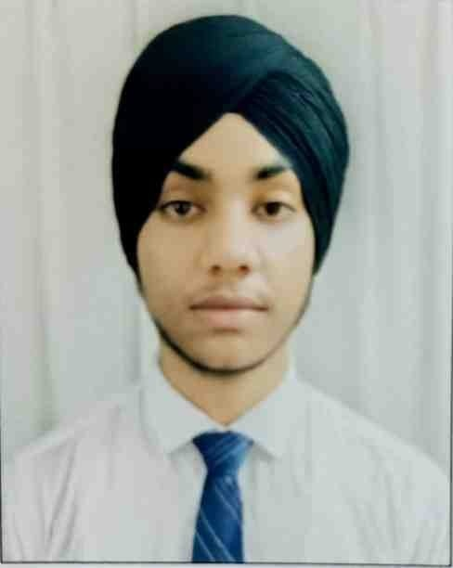
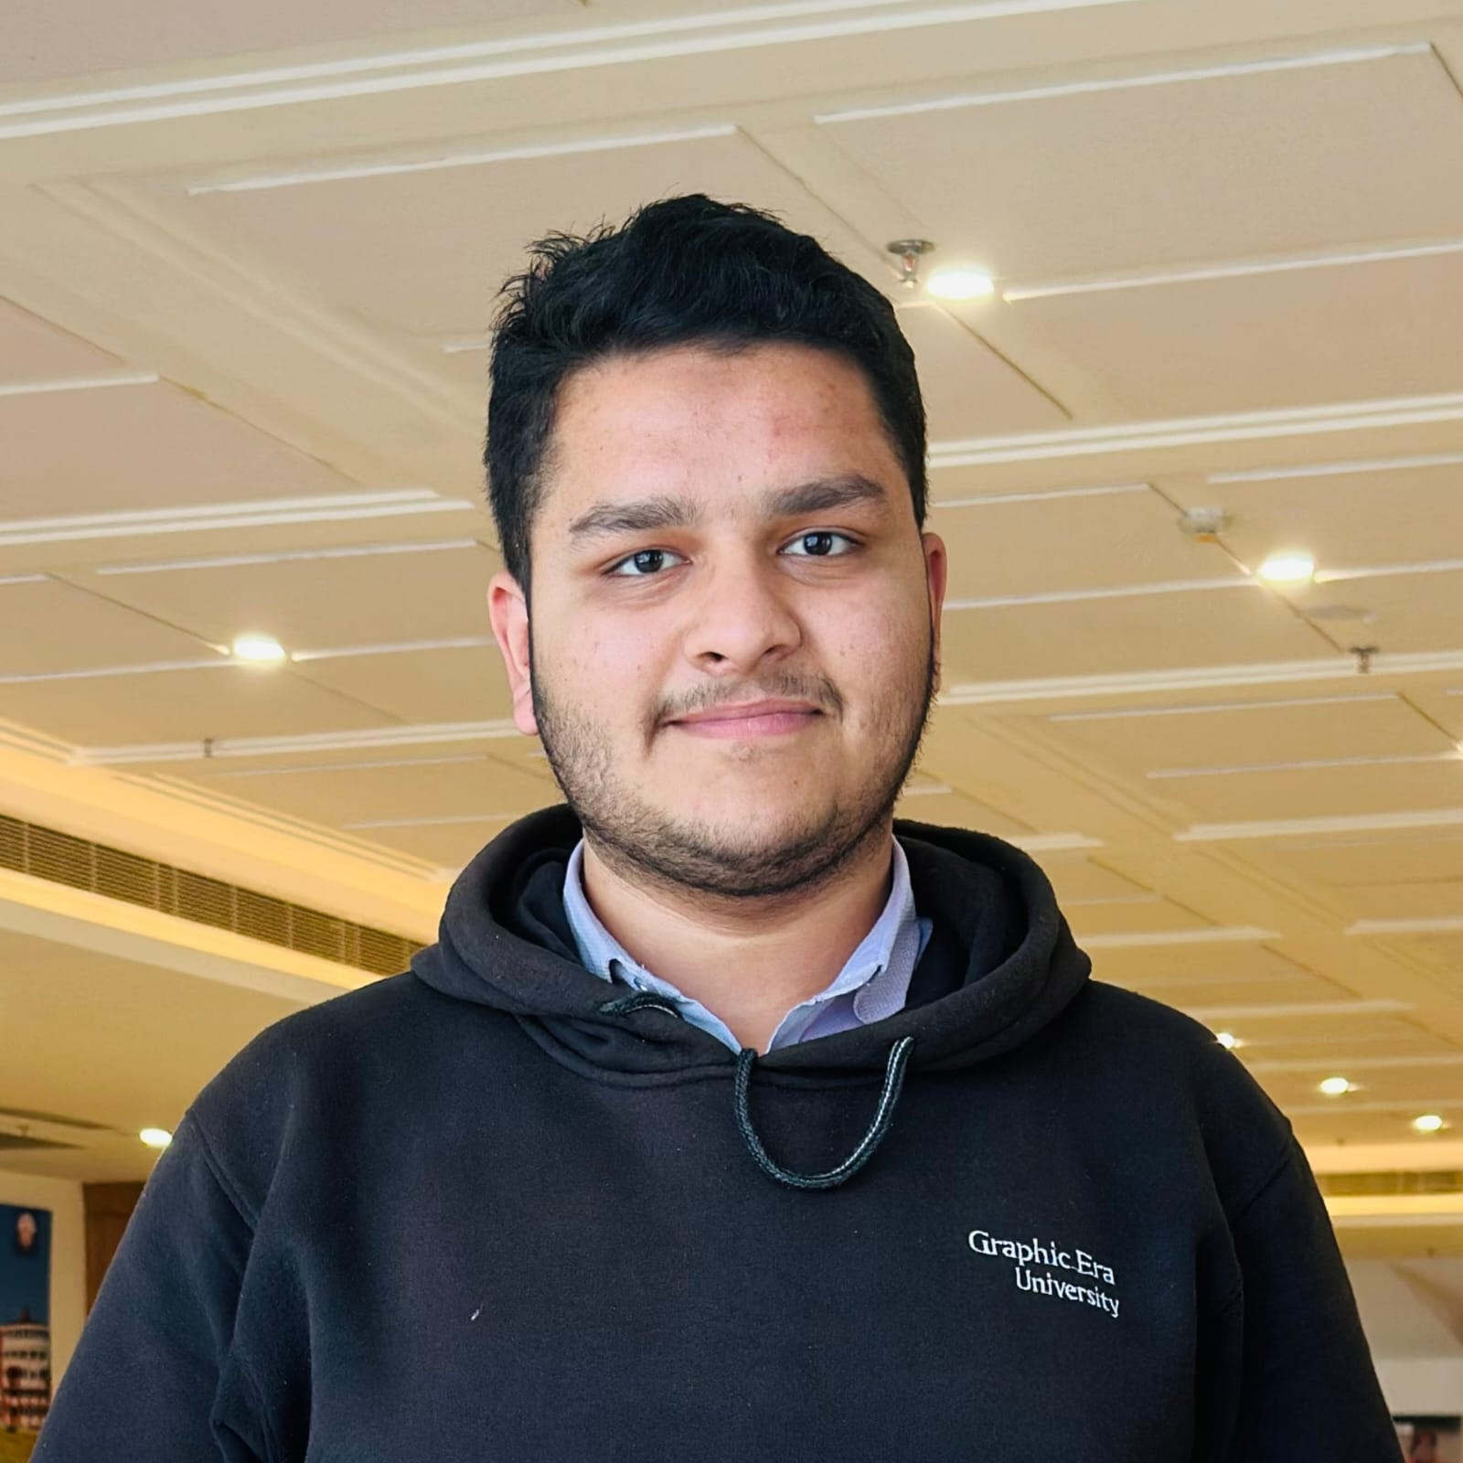
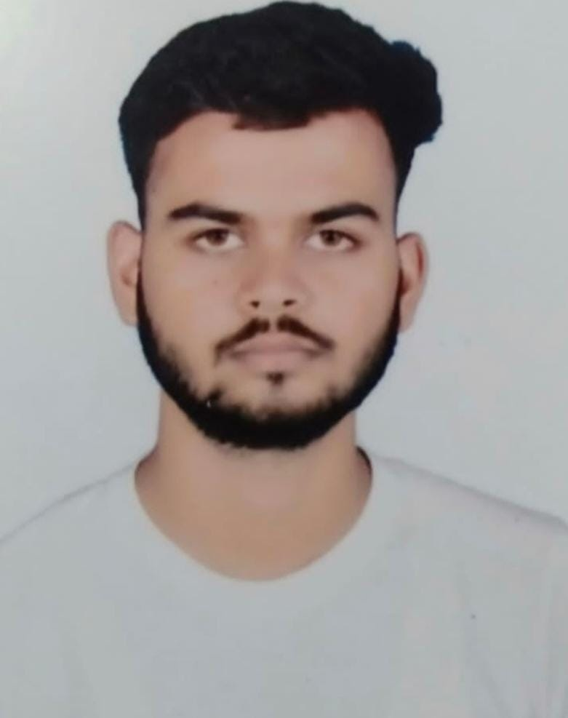
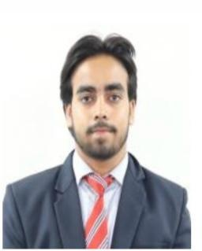
Team & Mentor Details
Team Information
Mentor
Team ID: OSDBMS-V-2026-T298
Domain: OS activity monitoring and DBMS
(Prof.)Dr.Mohammad Wazid
Team Members
Arshpreet Singh
Mohd Ahmed Khan
Ankit
Mohd Shoaib
24021835
24021365
240212134
240211124
Department of Computer Science & Engineering | Graphic Era (Deemed to be University)
2/18
Notes:
Team details and portraits: supplied Phase 1 report.

Slide 3
Project Abstract & Problem Statement
KernelGuard combines local Linux activity evidence, relational storage and administrator review.
•
Audit records and sampled host inventory are difficult to assess in isolation.
•
Five deterministic rules link a policy match to its supporting events.
•
The dashboard preserves review and USB approval history.
Department of Computer Science & Engineering | Graphic Era (Deemed to be University)
3/18
Notes:
Source: C:\KernalGuard\README.md and docs/ARCHITECTURE.md.

Slide 4
Objectives & Final Deliverables
Objectives
Deliverables
•
Collect audit and host inventory with stable identities.
•
Five policy families and evidence-linked alerts.
•
Keep events, alerts and decisions relationally consistent.
•
User, process and USB inventory.
•
Make each alert explainable.
•
Authenticated dashboard, review history and setup guide.
Department of Computer Science & Engineering | Graphic Era (Deemed to be University)
4/18
Notes:
Source: C:\KernalGuard\README.md.

Slide 5
Phase-I & Phase-II Feedback Incorporated
Earlier milestones
Final integration
•
Phase I proposed a local activity monitor.
•
Phase III adds sampled inventory and three policies.
•
Phase II demonstrated audit ingestion, MySQL and two rules.
•
Administrator actions now keep decision history.
•
No separate written mentor feedback was supplied.
Department of Computer Science & Engineering | Graphic Era (Deemed to be University)
5/18
Notes:
Sources: supplied Phase 1 report; Phase 2 README.md; Phase 3 README.md.

Slide 6
Final System Architecture
Audit + host
inputs
Parser +
inventory
Locked DB
transactions
Five policy
checks
Authenticated
review
→
→
→
→
Department of Computer Science & Engineering | Graphic Era (Deemed to be University)
6/18
Notes:
Source: C:\KernalGuard\docs/ARCHITECTURE.md.

Slide 7
Final Technology Stack
Collection and logic
Storage and interface
•
auditd, ausearch, procfs, pwd and pyudev.
•
MySQL/InnoDB deployment; SQLite demo.
•
Python, psutil and Pydantic validation.
•
Flask templates, sessions and CSRF checks.
•
SQLAlchemy transactions and Portalocker.
•
Waitress on localhost.
Department of Computer Science & Engineering | Graphic Era (Deemed to be University)
7/18
Notes:
Sources: C:\KernalGuard\README.md and requirements.txt.

Slide 8
Implementation of PBL Course Concepts
Course | Concept implemented | Project evidence
Operating Systems | Audit, process lifecycle, boot/session identity | Parser and inventory
DBMS | 17 tables, FKs, joins, transactions | Schema and persistence
Security Engineering | Policy checks and review history | Rules and dashboard
Department of Computer Science & Engineering | Graphic Era (Deemed to be University)
8/18
Notes:
Source: C:\KernalGuard\docs/ARCHITECTURE.md.

Slide 9
Module-Wise Final Implementation
Module | Implemented behavior | Source
Audit collection | Grouping, identity and replay control | parser.py, core.py
Inventory | Users, processes, USB state | inventory/
Detection | Five evidence-linked policies | activity_rules.py
Administrator review | Login, CSRF and retained decisions | auth.py, reviews.py
Department of Computer Science & Engineering | Graphic Era (Deemed to be University)
9/18
Notes:
Source: C:\KernalGuard\docs/ARCHITECTURE.md.

Slide 10
Working System / Prototype Demonstration
The demo and Kali deployments show the complete event-to-review path.
•
Trace a controlled protected-file read to an event and alert.
•
Inspect linked evidence and the policy snapshot.
•
Review an alert and inspect retained decision history.
Department of Computer Science & Engineering | Graphic Era (Deemed to be University)
10/18
Notes:
Source: C:\KernalGuard\docs/LIVE_AUDIT_CHECK.md and README.md.

Slide 11
Data / Database / Backend Implementation
Relational evidence
Identity and state
•
17 MySQL tables with InnoDB foreign keys.
•
Process key includes boot, PID and start time.
•
Join tables link alerts to events and policy values.
•
Incomplete scans keep warnings.
•
Transactions keep audit and checkpoint writes together.
•
USB decisions and review history remain stored.
Department of Computer Science & Engineering | Graphic Era (Deemed to be University)
11/18
Notes:
Source: C:\KernalGuard\docs/ARCHITECTURE.md; https://dev.mysql.com/doc/refman/8.4/en/create-table-foreign-keys.html

Slide 12
Testing & Validation
Test area | Result | Boundary
Current Windows suite | 89 passed; 1 skipped | MySQL opt-in
Policy evaluation | 11/11 expected outcomes | Synthetic cases
Live Kali audit/inventory | Controlled checks observed | Recorded lab host
Oracle MySQL 8.4 | Integration test passed | Separate Kali deployment
Department of Computer Science & Engineering | Graphic Era (Deemed to be University)
12/18
Notes:
Sources: current local pytest run; C:\KernalGuard\docs/EVALUATION.md, docs/LIVE_AUDIT_CHECK.md, docs/MYSQL84_DOCKER.md.

Slide 13
Results & Performance Analysis
Saved evaluation: 500 synthetic events produced 100 alerts in 0.4806 seconds.
•
The measured workload used disk-backed SQLite in one transaction.
•
It excludes source collection, inventory polling and web rendering.
•
Two legitimate scenarios also match policy and require human review.
Department of Computer Science & Engineering | Graphic Era (Deemed to be University)
13/18
Notes:
Source: C:\KernalGuard\docs/EVALUATION.md and docs/evaluation.json. Not production throughput or field accuracy.

Slide 14
GitHub Repository & Development Evidence
Visible local history
Evidence boundary
•
Local folder: C:\KernalGuard; branch main.
•
No public remote is configured here.
•
Two commits are visible in this checkout.
•
The allocation record does not prove authorship.
•
Current working-tree edits are uncommitted.
•
Individual commit counts are unavailable.
Department of Computer Science & Engineering | Graphic Era (Deemed to be University)
14/18
Notes:
Source: local git log/status and docs/contributions/README.md.

Slide 15
Individual Contribution
Member | Presentation area | Implementation area
Arshpreet Singh | Linux evidence | audit and host collection
Mohd Ahmed Khan | Relational design | database and integration
Ankit | Rule evaluation | five policies and cases
Mohd Shoaib | Administrator view | dashboard and reviews
Department of Computer Science & Engineering | Graphic Era (Deemed to be University)
15/18
Notes:
Source: C:\KernalGuard\docs/contributions/README.md. Area allocation, not verified individual authorship.

Slide 16
Challenges, Limitations & Lessons Learned
Engineering challenges
Current limits
•
Boot/PID reuse needs stable identities.
•
Physical USB remove/reconnect remains unverified.
•
Audit replay needs source deduplication.
•
Sampling can miss short device cycles.
•
Partial process scans need warnings.
•
A policy match does not prove malicious intent.
Department of Computer Science & Engineering | Graphic Era (Deemed to be University)
16/18
Notes:
Source: C:\KernalGuard\docs/ARCHITECTURE.md and docs/ACCEPTANCE.md.

Slide 17
Final Outcomes, Applications & Future Scope
Final outcome
Next validation
•
Working local monitoring prototype.
•
Physical USB enrollment/reconnect test.
•
Five explainable policies and review history.
•
Live USB-enumeration failure test.
•
MariaDB and Oracle MySQL Kali deployments.
•
Larger labelled field evaluation.
Department of Computer Science & Engineering | Graphic Era (Deemed to be University)
17/18
Notes:
Sources: C:\KernalGuard\README.md, docs/MYSQL84_DOCKER.md and docs/ACCEPTANCE.md.

Slide 18
References & Project Resources
Technical references
Project resources
•
Red Hat Linux Audit documentation.
•
README.md and docs/ARCHITECTURE.md.
•
SQLAlchemy 2.0 transactions.
•
docs/EVALUATION.md and docs/ACCEPTANCE.md.
•
MySQL 8.4 foreign keys; Flask security.
•
AI assistance recorded in project attribution notes.
Department of Computer Science & Engineering | Graphic Era (Deemed to be University)
18/18
Notes:
References: https://docs.redhat.com/en/documentation/red_hat_enterprise_linux/7/html/security_guide/sec-understanding_audit_log_files ; https://docs.sqlalchemy.org/en/20/core/connections.html ; https://dev.mysql.com/doc/refman/8.4/en/create-table-foreign-keys.html ; https://flask.palletsprojects.com/en/stable/web-security/ ; C:\KernalGuard\docs/ORIGINALITY_AND_ATTRIBUTION.md.

