Slide 1

Linux
Notes:
Good morning everyone, My name is Sonu Kumar Kushwaha

Slide 2
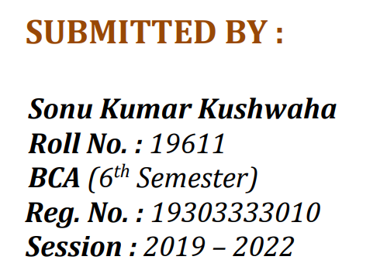
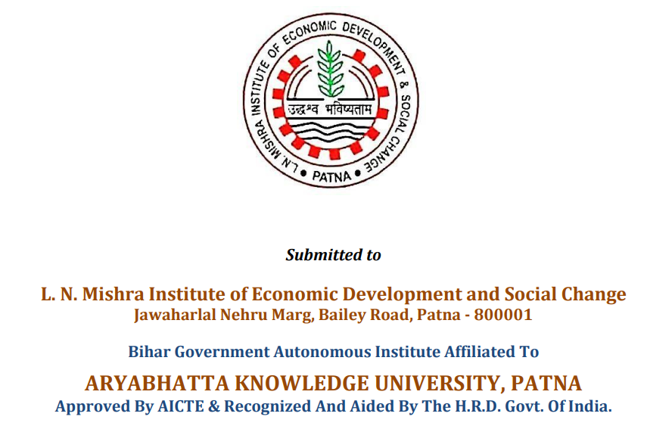

Slide 3
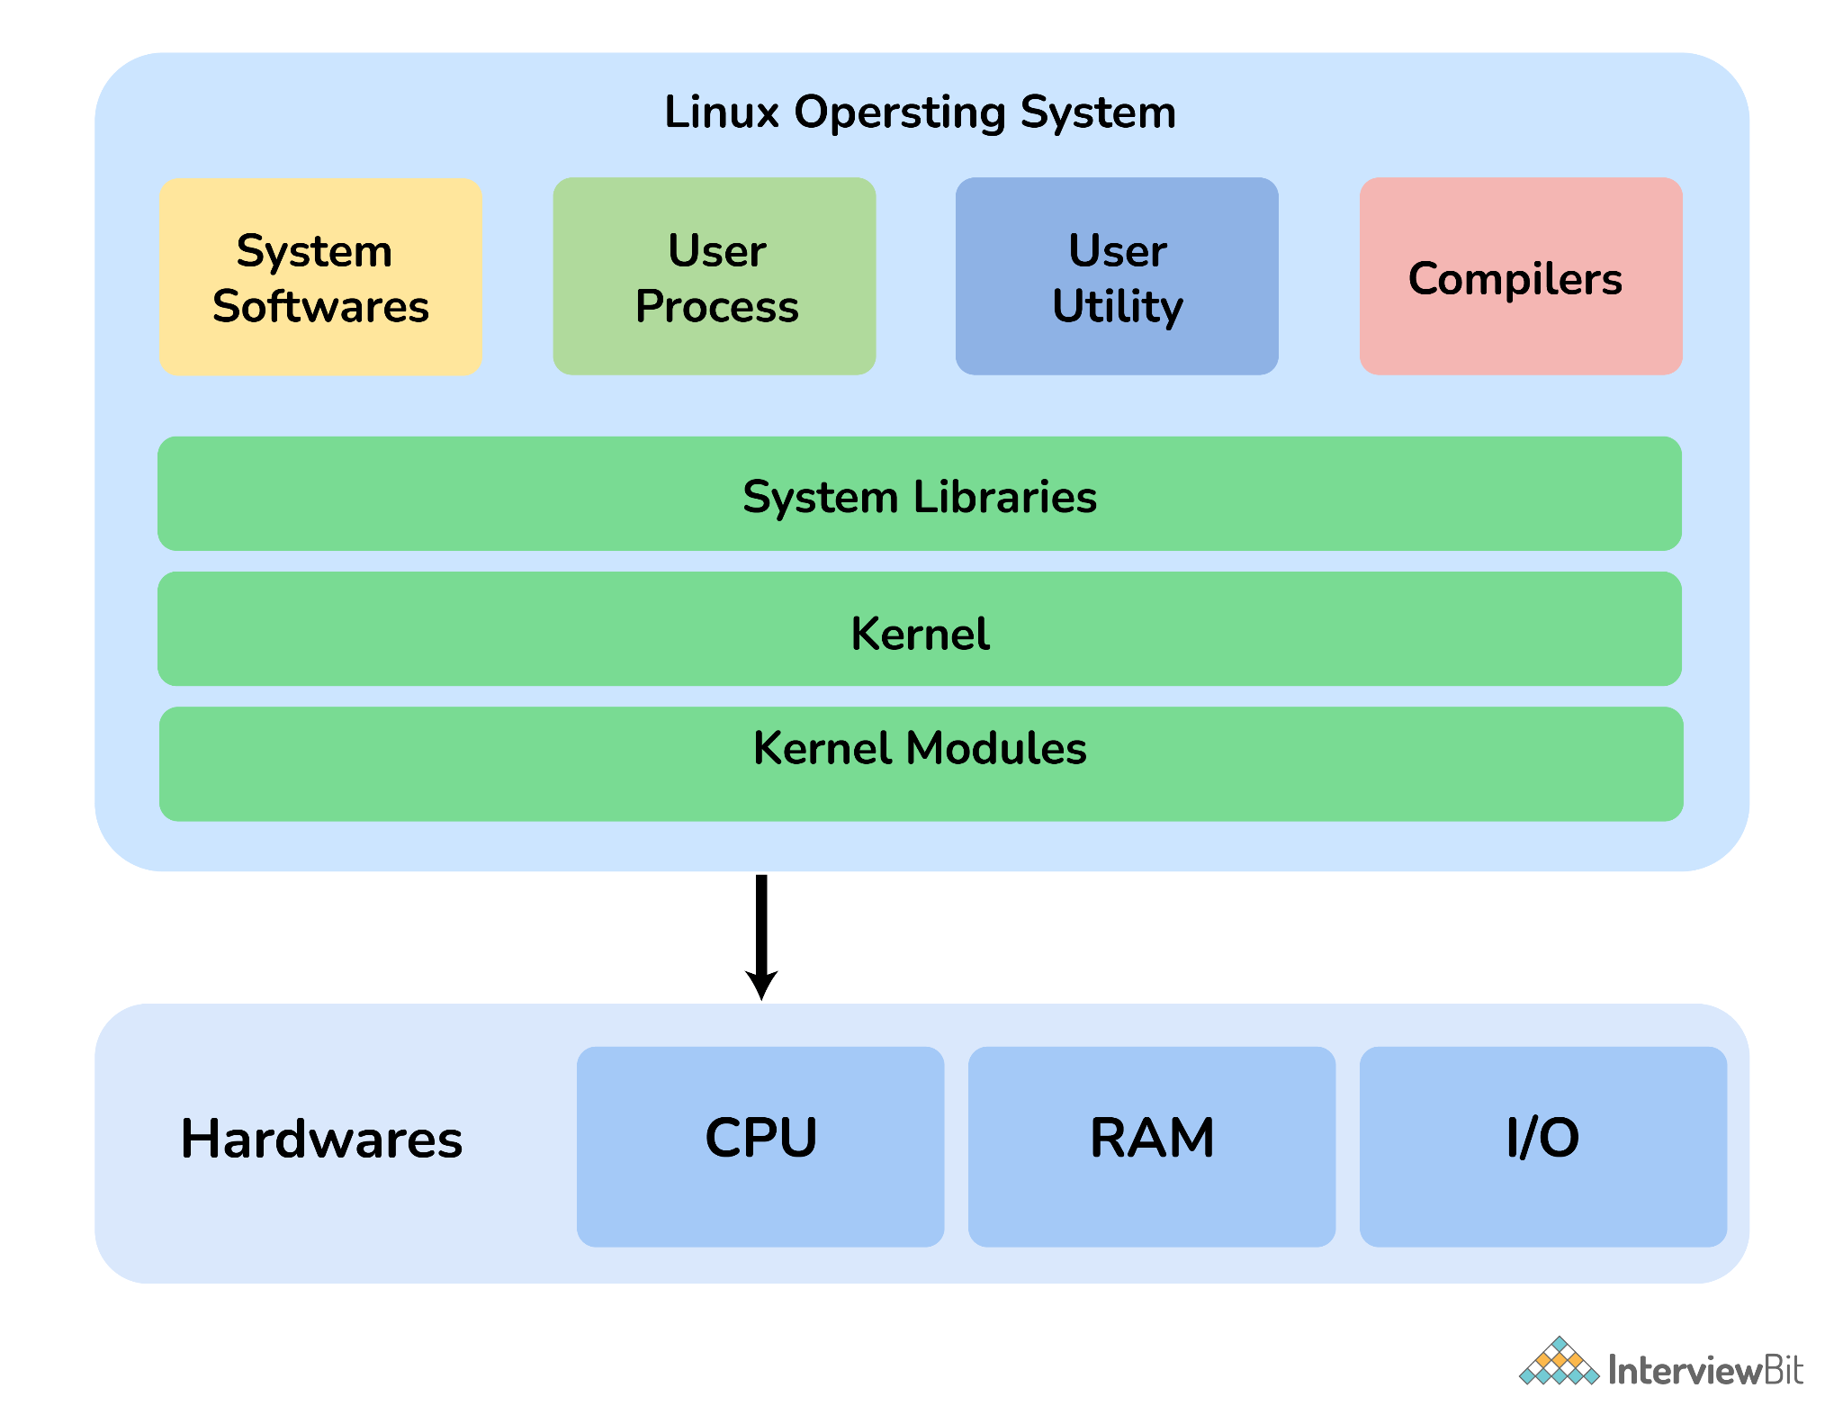
Linux is an open-source computer operating system (OS) that directly manages hardware and resources of a system such as CPU, memory, and storage, and manages the communication between software and hardware.
It was first released on 17 September 1991 by Linus Torvalds and is considered more secure and faster than Windows.
It is freely distributable and is generally built around Linux Kernel (low-level system software that is used to manage hardware resources for users).
It can be installed in mobiles, laptops, computers, notebooks, etc.
Flavors of Linux OS include Ubuntu, Debian, SUSE Linux, Gentoo, etc.

Slide 4
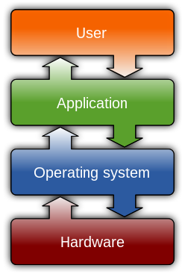
Open-source software (OSS) is computer software that is released under a license in which the copyright holder grants users the rights to use, study, change, and distribute the software and its source code to anyone and for any purpose.
An operating system (OS) is system software that manages computer hardware, software resources, and provides common services for computer programs.

Slide 5
Features of Linux OS
Free and Open Source: It is freely and easily available to anyone.
Robust and Adaptable: Linux can operate for prolonged periods without crashing and considered to have very much immune to security threats.
More secure: It is more secure as it provides security using authentication features like password authentication, security auditing, and file system access control.
Multiprogramming System: More than one can function or an application can run simultaneously.
Application Support: It has its own software repository i.e., place or storage location from where software can be retrieved so that users can download and install applications.
Supports customized keywords: There are many different languages used throughout the world, therefore Linux supports the installation of multiple languages keyboards.
GUI (Graphical User Interface): It provides an interface for users to interact with the system and allows to use of GUI applications such as VLC, Firefox, etc.

Slide 6
Elements or Components of Linux
Kernel: It is considered a core or main part of Linux and is generally responsible for all major activities of OS such as process management, device management, etc.
System Library: These are special functions or programs with the help of which application programs or system utilities can access features of the kernel without any requirement of code. It is simply used to implement the functionality of the OS.
System Utility: These are utility programs that are responsible to perform specialized and individual-level tasks. They are considered more liable and allow users to manage the computer.
Hardware: It is physical hardware that includes items such as a mouse, keyboard, display, CPU, etc.
Shell: It is an environment in which we can run our commands, shell scripts, and programs. It is an interface between user and kernel that hides all complexities of functions of the kernel from the user. It is used to execute commands.

Slide 7
Types of Linux User Mode
CLI (Command Line Interface): It is basically a command-line program that usually accepts text as input to execute or run functions of the operating system. It allows users to type declarative commands simply to give instructions to the computer to perform or execute operations.
GUI (Graphical User Interface): It is basically a human-computer interface that allows users to interact with electronic devices through graphical icons and visual indicators. The use of these graphical elements or icons makes it easier for users to interact with the system.

Slide 8
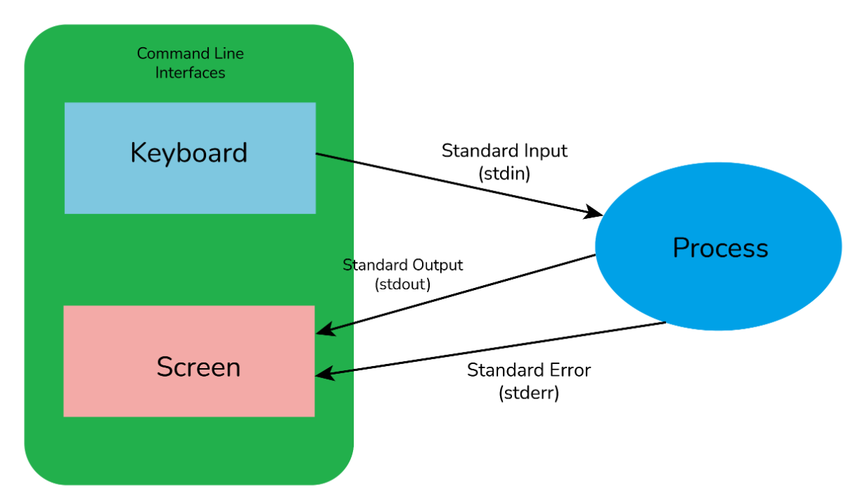
Standard Streams in Linux
Standard Input (stdin)
Standard Output (stdout)
Standard Error (stderr)

Slide 9
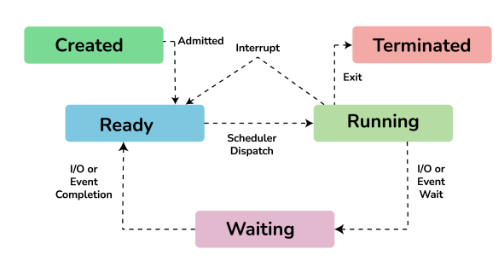
Process States in Linux
New/Ready: In this state, a new process is created and is ready to run.
Running: In this state, the process is being executed.
Blocked/Wait: In this state, the process is waiting for input from the user and if doesn't have resources to run such as memory, file locks, input, then it can remain in a waiting or blocked state.
Terminated/Completed: In this state, the process has completed the execution or terminated by the OS.
Zombie: In this state, the process is terminated but information regarding the process still exists and is available in the process table.

Slide 10
Let us get a "CLUE", a Command Line User Experience, with Linux

Slide 11
Basic Commands
pwd: It stands for “print working directory”. This command is generally used to display the path of the present or current working directory.
cd: It stands for “change directory”. This command is generally used to change the present working directory to the directory that we want to work on.
Is: It stands for “list”. This command is generally used to show the full list of content of files and directories in the present working directory.
mkdir: It stands for “make directory”. This command generally allows users to create directories in Linux.
rmdir: It stands for “remove directory”. This command is used to remove/delete each directory that is specified on the command line.
grep : It stands for “global regular expression print” processes text line by line, and prints any lines which match a specified pattern.

Slide 12
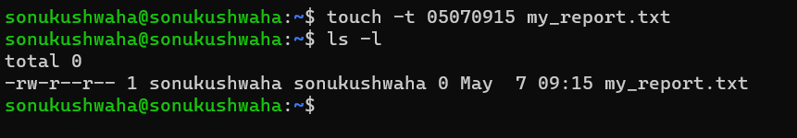
clear: clear the screen OR use ctrl + l
touch: used to change the time and/or date of a file OR create an empty file
date: shows date
cal: shows calendar
who: find out who's working on your system
Notes:
The first four digits stand for May 7 (0507) and the last four (0915) the time, 9:15 in the morning
Cal
Cal 2000
Cal 12 2025

Slide 13
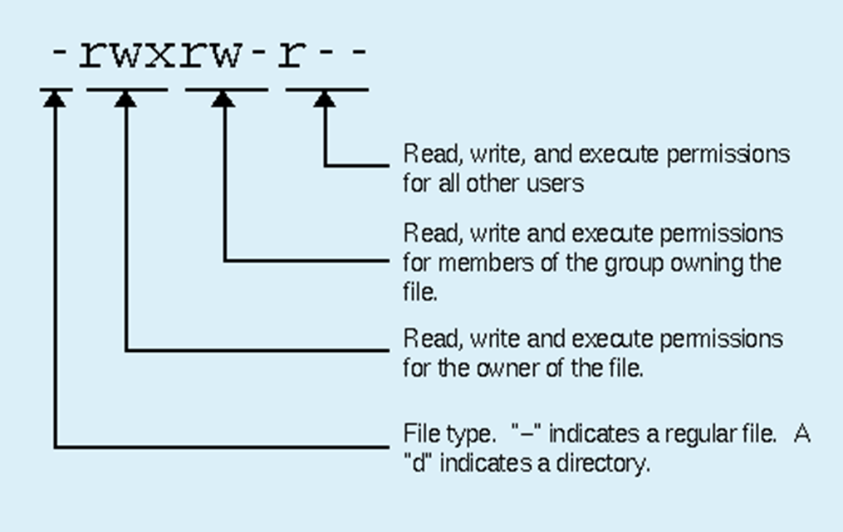
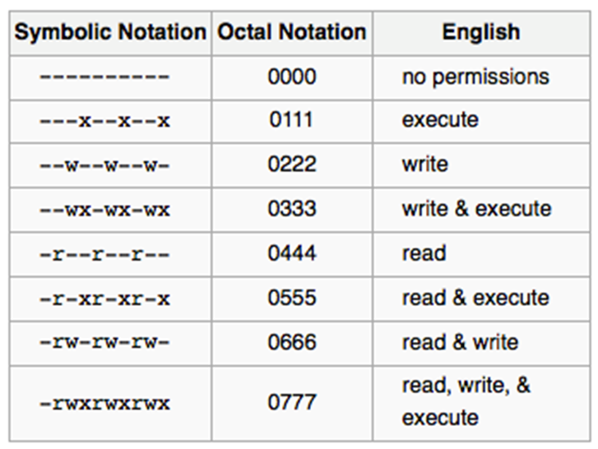
File Permission

Slide 14
Conclusion
Linux, like windows, iOS, and Mac, is an operating system that helps one to use or utilize old and outdated computer systems such as Firewall, router, backup server, etc.
It makes computer systems more secure than Windows and does not require any use of Anti-Virus Programs.
It is becoming increasingly popular as the OS for servers because it comes with the capabilities to heavily encrypt and protect all of a computer's data.
In Linux, everything is a file!
Notes:
Everyone knows what a files is... It's that "photo", "document", or "music" that you use. Programs are made of files, in fact, the whole Linux operating system is just a collection of files... But, now for the weird part. Not only is that digital photo that you uploaded to your computer a file, but your monitor is a file too! You see, in Linux, everything is a file!

Slide 15
Further Reference
https://www.linux.com/
https://tldp.org/LDP/intro-linux/html/index.html
https://www.linux.org/

Slide 16
Thank You

