Slide 1
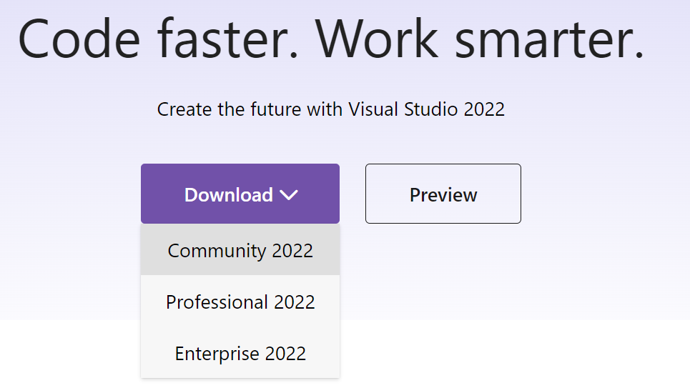
Vs 2022; tensorrt 10; cuda 12.4; opencv 4.9.0
https://visualstudio.microsoft.com/vs/

Slide 2


https://developer.nvidia.com/cuda-toolkit

Slide 3
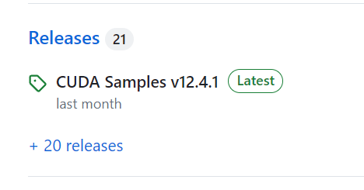
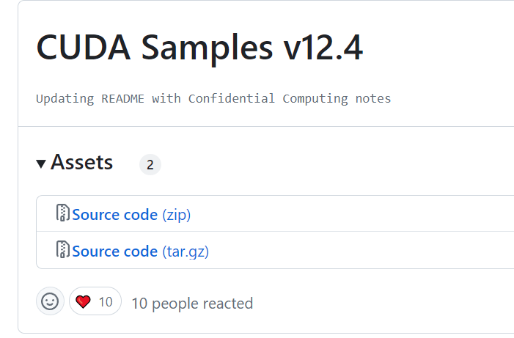
https://github.com/NVIDIA/cuda-samples

Slide 4
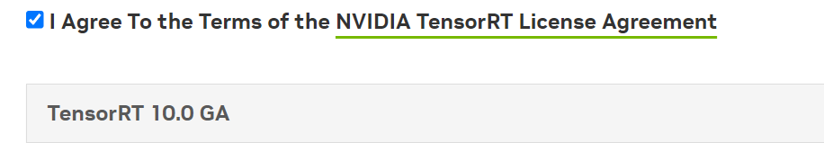
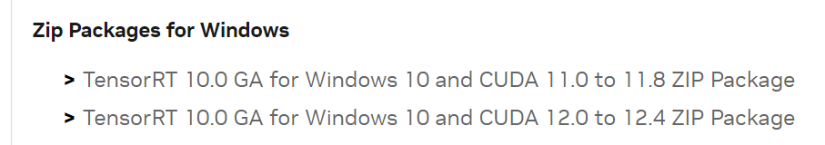
https://developer.nvidia.com/tensorrt

Slide 5
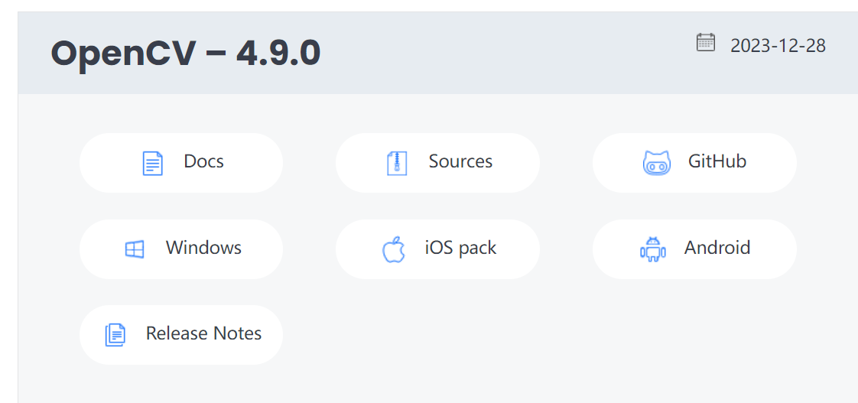
https://opencv.org/releases/

Slide 6
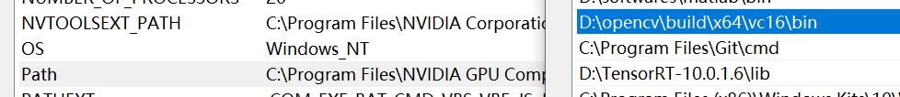
Install here (for example):
D:\opencv
D:\TensorRT-10.0.1.6
D:\cuda-samples-12.4
Path:
D:\opencv\build\x64\vc16\bin
D:\TensorRT-10.0.1.6\lib
Restart computer if dll is not found

Slide 7
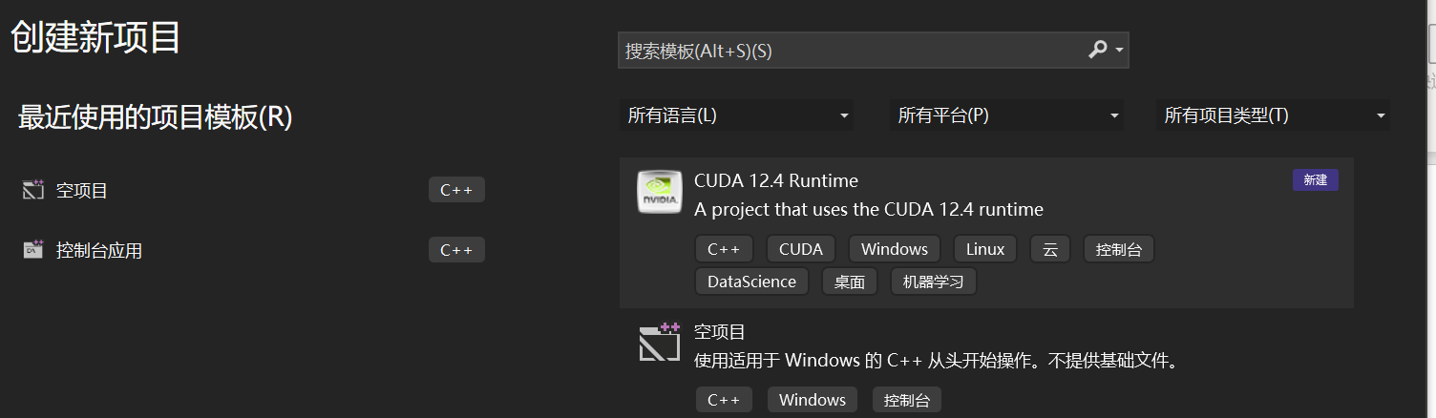

Slide 8
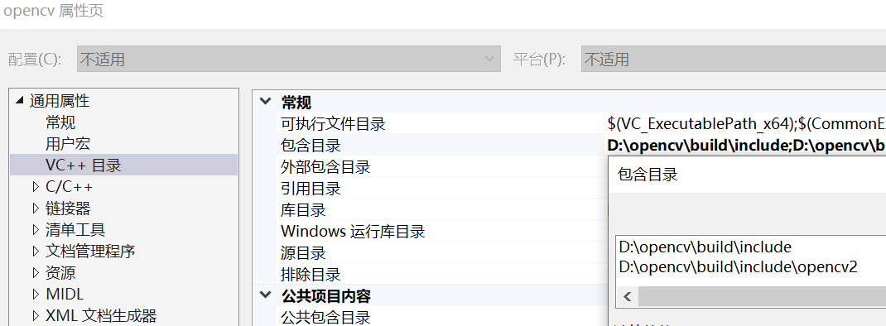
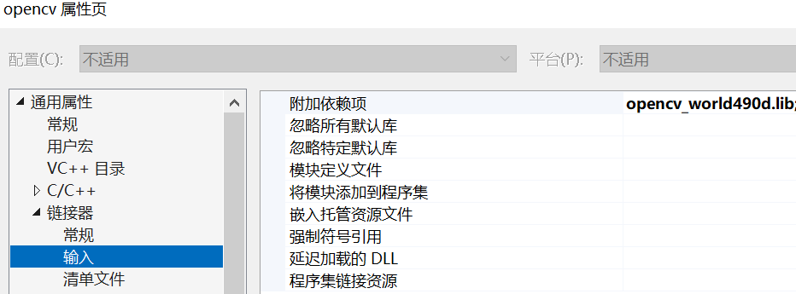
Opencv
包含
D:\opencv\build\include
D:\opencv\build\include\opencv2
库
D:\opencv\build\x64\vc16\lib
输入
opencv_world490d.lib //debug
opencv_world490.lib //release
cuda
包含
D:\cuda-samples-12.4\Common
库
D:\cuda-samples-12.4\Common\lib\x64
freeglut.lib
glew64.lib
Dll at D:\cuda-samples-12.4\bin\win64\Debug
tensorrt
包含
D:\TensorRT-10.0.1.6\include
库
D:\TensorRT-10.0.1.6\lib
输入
nvinfer_10.lib
nvonnxparser_10.lib

Slide 9
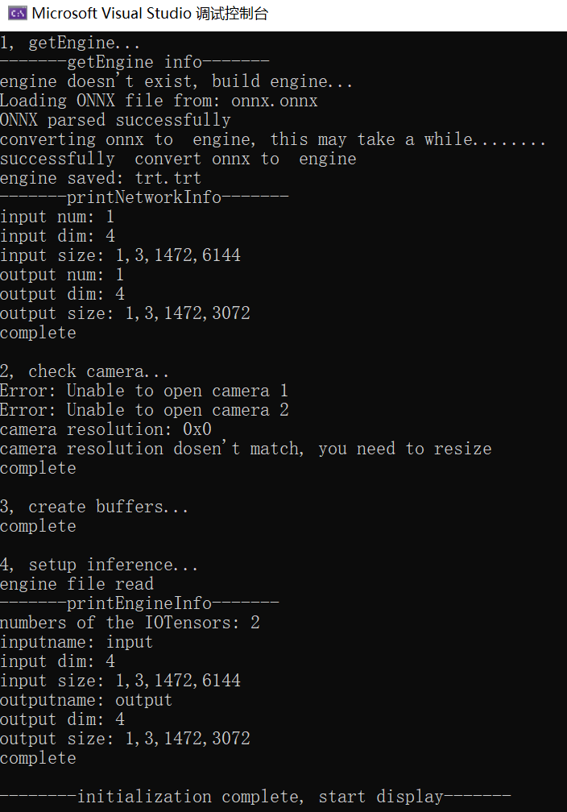
run

