Slide 1

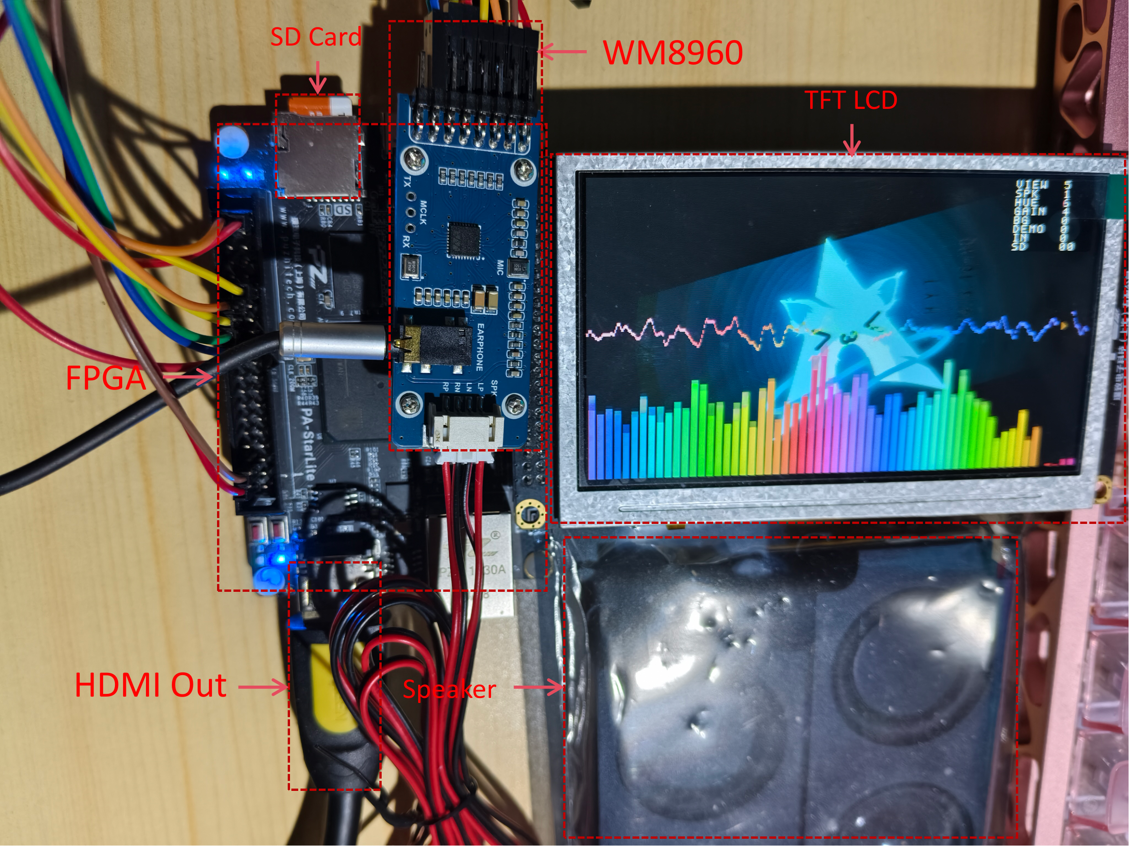
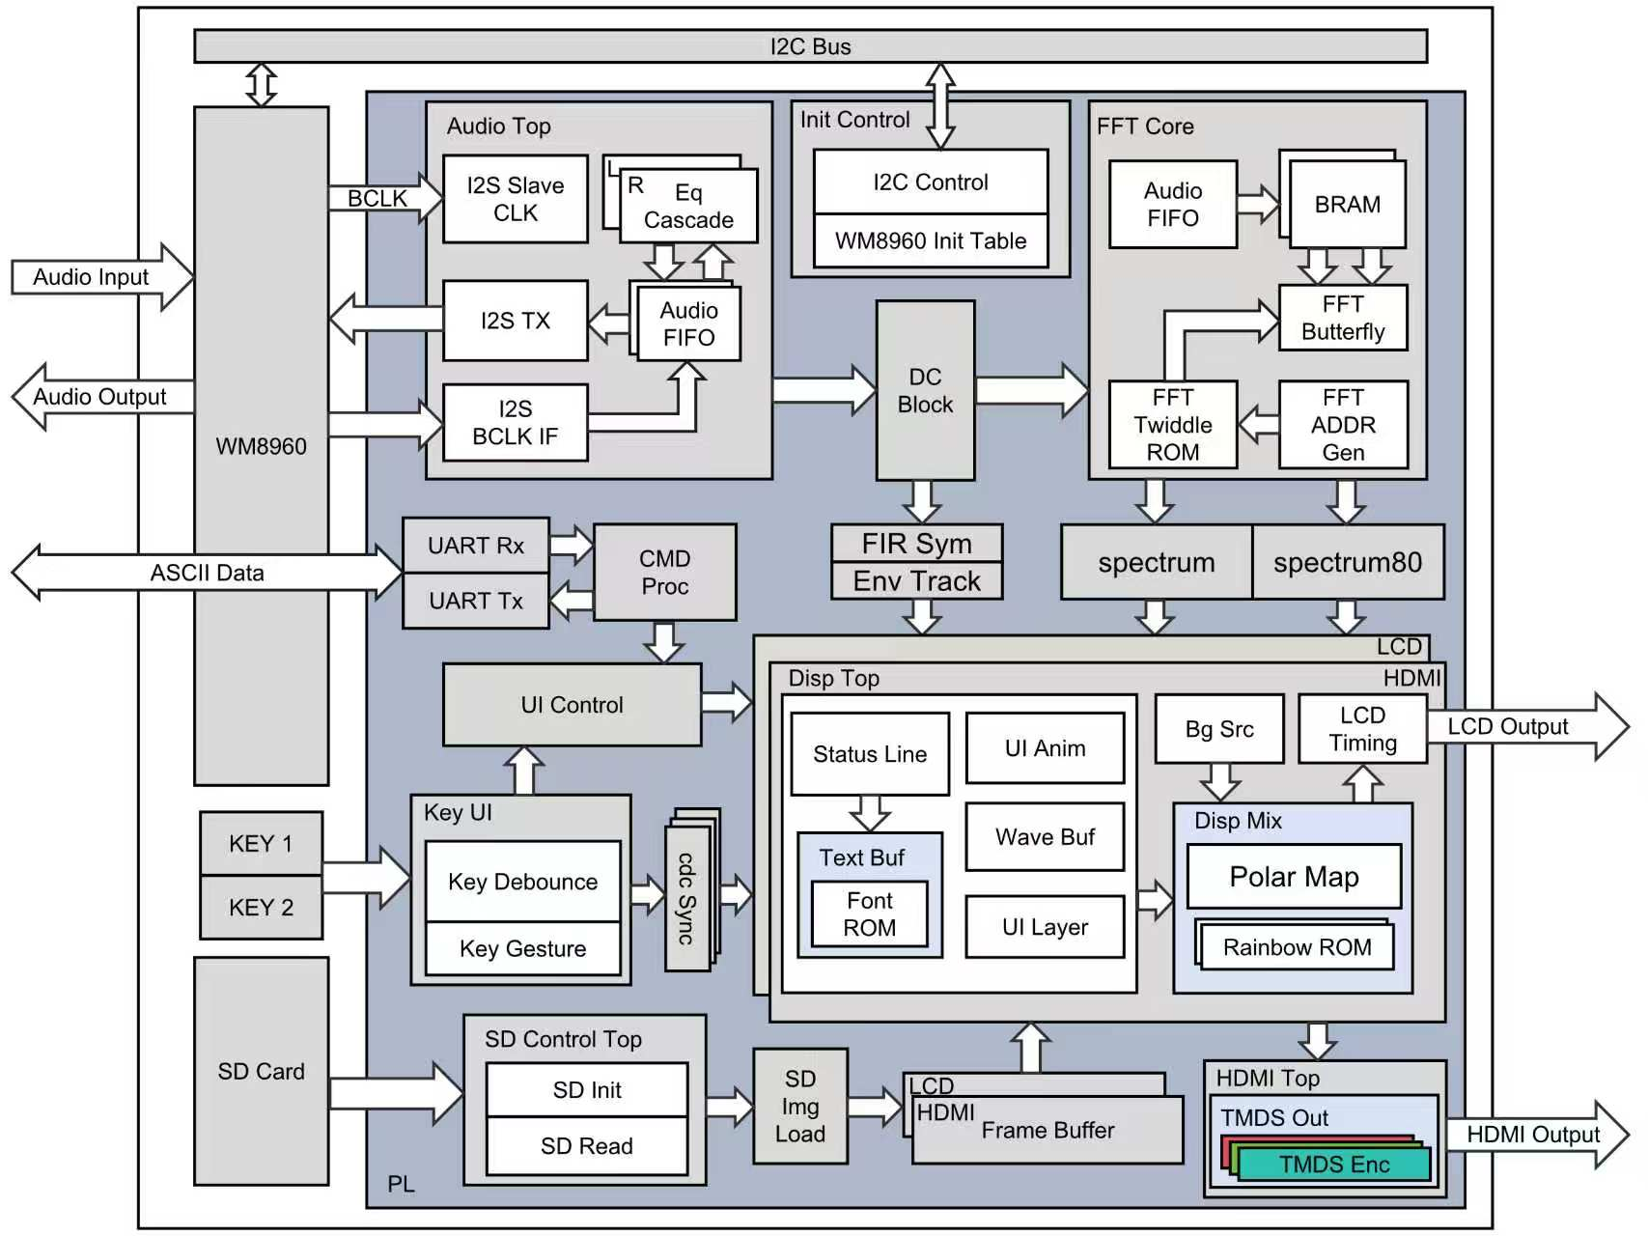

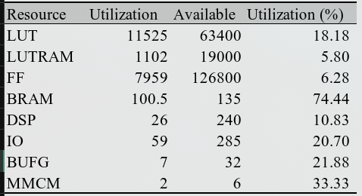
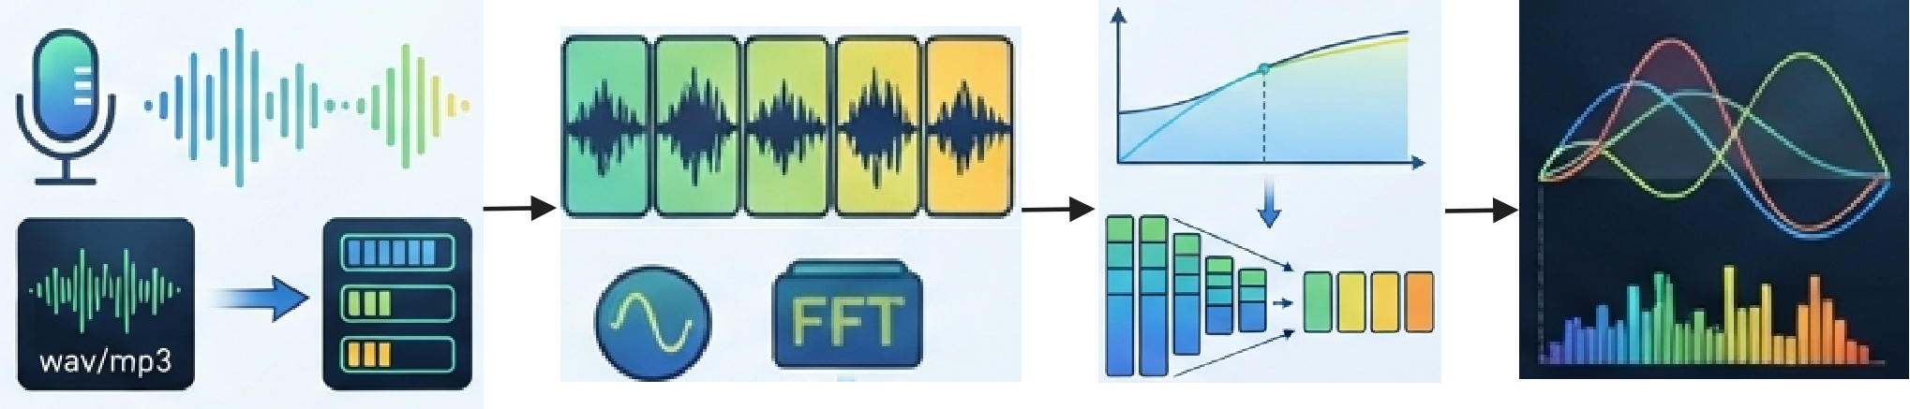
INTRODUCTION
Sonic-Speed Parallelism System
Bingyu Fei, Chenrui Guo, Ziyu Li
Anhui Normal University
Audio visualization systems use real-time audio acquisition, spectrum measurement, and dynamic graphical analysis to transform acoustic signals that are difficult to observe directly into visual spectra and waveforms, extending the ways information is represented in human-computer interaction.
Suitable for embedded applications requiring low-latency, configurable spectrum analysis, such as car audio spectrum displays, live performance mixing visualization, Hi-Fi player interfaces, and mechanical vibration spectrum monitoring.
Key Information Summary:
1. Single-butterfly FFT: Features only one butterfly unit and time-division multiplexing of a dual-port BRAM; full-frame processing accounts for 1.3% of the frame period, and resource usage is 1/512 that of a fully parallel scheme.
2. Scan-based rendering: Directly generates RGB in coordinate mode, eliminating the need for an LCD frame buffer.
3. Dual-Path Homogeneous Display: A single parametric rendering core drives both the LCD and HDMI outputs, ensuring consistency in spectral and waveform data.
4. Dual-Size Image Frame Buffer: The LCD stores the full image, while the HDMI output is cropped to a specific region and then scaled up by a factor of 2, reducing BRAM resource overhead.
On board test by
AMD Artix-7 XC7A100T
C
R
R
E
E
S
A
T
U
I
L
Typical Applications
System Architecture
V
T
Audio Processing and Visualization:
1. Complete the WM8960 configuration and receive the output digital audio data;
2. Simultaneously performs 5-segment IIR parametric equalization and 1,024-point FFT spectral analysis;
3. Perform logarithmic binning, peak hold, and linear attenuation on the spectrum results;
4. Drives the LCD and HDMI to simultaneously display bar spectra, polar spectra, and waveforms.
E
D
Testing revealed that all 39 simulation regression tests passed, with the overall results showing 0 CRITICAL and 0 WARNING. The system occupies approximately 11.5K LUTs, 100.5 BRAMs, and 26 DSP48s. All clock constraints have been met, and power-down auto-startup has been implemented via QSPI Flash programming. These results demonstrate that the system successfully performs real-time audio processing, spectral analysis, and dual-screen display simultaneously within limited hardware resources.
The existing resources still support further expansion. In the future, higher-resolution displays, additional spectrum analysis channels, and new interactive interfaces can be added to the modular RTL architecture, while memory bandwidth and processing latency continue to be optimized to meet the demands of more complex audio visualization applications.
E
S
I
G
N
Acquisition and Interactive Control:
1. Supports parameter configuration via buttons and UART;
2. Read images from the SD card, store them in the frame buffer, and wait for the next frame to be displayed;
3. Implement automatic startup after a power loss via QSPI Flash programming.

Slide 2
引言
音速并行系统
费斌宇, 郭辰睿, 李紫钰
安徽师范大学
板载测试：
AMD Artix-7 XC7A100T
音频可视化系统通过实时音频采集、频谱测量与动态图形分析，将难以直接观察的声音信号转化为可视化的频谱和波形，拓展了人机交互中的信息表达方式。
适用于车载音响频谱显示、演出调音可视化、Hi-Fi 播放器界面，以及机械振动频谱监测等需要低延迟、可配置频谱分析的嵌入式场景。
关键信息摘要:
1. 单蝶形 FFT：仅使用一个蝶形单元和双口 BRAM 时分复用，整帧处理占帧周期的 1.3%，资源约为全并行方案的 1/512。
2. 扫描式渲染：以坐标模式直接生成 RGB，LCD 无需帧缓存。
3. 双路同源显示：一套参数化渲染核心驱动 LCD 与 HDMI，保持频谱和波形数据一致。
4. 双尺寸图像帧缓存：LCD 保存完整 480×272 图像，HDMI 保存裁剪后的 320×180 区域并进行 2 倍整数放大，避免额外 BRAM 开销。
C
R
R
E
E
S
A
T
U
I
L
典型应用
V
T
系统架构
E
音频处理与可视化显示：
1. 完成 WM8960 配置并接收输出的数字音频数据；
2. 同时完成 5 段 IIR 参量均衡和 1024 点 FFT 频谱分析；
3. 对频谱结果进行对数分箱、峰值保持与线性衰减；
4. 驱动 LCD 与 HDMI 同步显示柱状频谱、极坐标频谱和动态波形。
经过测试发现，39 项仿真回归全部通过，综合与实现结果为 0 CRITICAL、0 WARNING。系统约占用 11.5K LUT、100.5 BRAM 和 26 个 DSP48，所有时钟约束均已满足，并已通过 QSPI Flash 固化实现掉电自启动。上述结果表明，系统在有限硬件资源下同时完成了实时音频处理、频谱分析和双屏显示。
现有资源仍然支持进一步扩展。后续可在模块化 RTL 架构上增加更高分辨率显示、更多频谱分析通道及新的交互接口，同时继续优化存储带宽与处理延迟，以满足更复杂的音频可视化应用需求。
D
E
S
I
G
N
交互与存储控制:
1. 支持按键与 UART 进行参数配置；
2. 读取 SD 卡图片并将存入Frame Buffer 等待下一帧显示；
3. 通过 QSPI Flash 固化实现掉电自启动。

