Slide 1
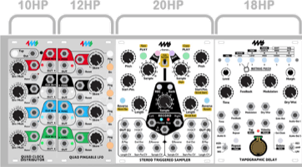
Scrap full-range
80W 6ohm
Scrap surround system
Bass drivers 8ohm
255mm
Volvo C70 scrap midrange dome 8ohm
255mm
172mm
172mm
Ebay 25W dome
Tweeter 8ohm
56mm
56mm
4
2
7
5
6
8
9
10
65mm
TR
110mm
TR
BASS
BASS
40mm
7
116mm
116mm
PASSIVE
RADIATOR
40mm
OPTIONAL
BASS
146mm
1
3
TREBLE
Rail from sliding door
BASS
BASS
BASS
MID
MID
460mm
460mm / 5.08 = 90 HP
460mm
/57
Epoxy rain gutter plate
129.5mm
6mm
7.4mm
22.2mm
26mm
98mm
72 mm
114mm
/18
122mm
146mm

Slide 2
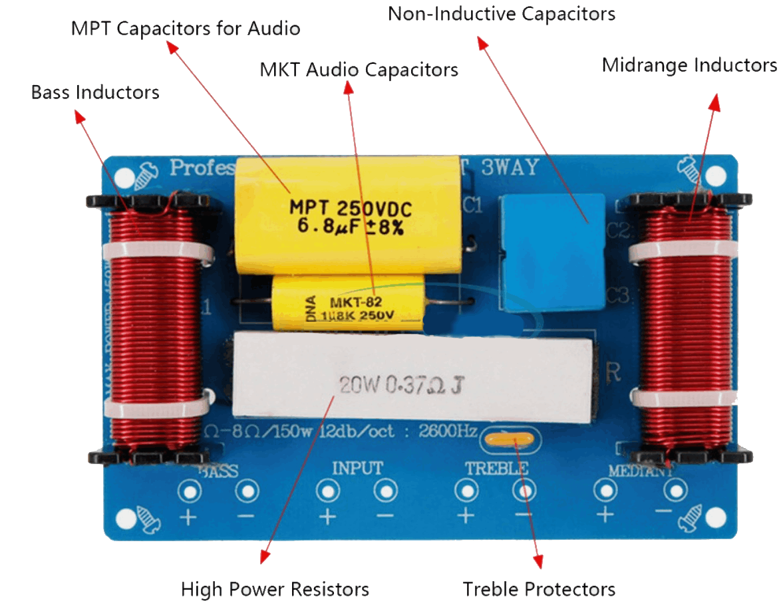
speaker
textile
1380mm
Std. Eurorack frame
460mm
460mm
460mm
26mm
175mm
6mm
98mm
connector hole
137mm
140mm
160mm
/57
12mm
575mm
Rail from sliding door
12mm
Epoxy rain gutter front plate
25mm
50mm
165mm
Passive filter
Circuit design
+
+
8Ω
8Ω
filter
filter
+
+
1
3
2.2Ω
2.2Ω
8Ω
8Ω
283mm
283mm
1
3
8Ω
8Ω
8Ω
8Ω
8Ω
8Ω
8Ω
2
4
6
7
10
8
8Ω
8Ω
9
375mm
375mm
6Ω
2
4
702mm
630mm
5
-
-
Connector HAT
167mm
125mm
283mm
Crossover filter
7
6
5
1
+
2
+
3
+
4
+
9
8
10
jumpers
AMP-
102mm
F
J
J
J
J
J
J
F
/78.7
61mm
H
M
L
L
M
H
AMP+

Slide 3
DRAFT!!!
7
6
5
1
+
2
+
3
+
4
+
9
8
10
AMP-
AMP-
J
J
J
J
J
J
H
M
L
L
M
H

