Slide 1
01 · OFFGRID
Hop
OffGrid
Solo
Your floor, offline.
Open source
github.com/flyme2mars/hop
AKSHAI KRISHNA S
01 / 09

Slide 2
02 · PROBLEM
Hostel floors lose the network.
Dead zones
Hostel floors often have dead zones, or no usable network.
Power cuts
During a power cut, phones cannot help the floor coordinate.
The tower
WhatsApp needs the tower. The floor does not always have it.
AKSHAI KRISHNA S
02 / 09

Slide 3
03 · SOLUTION
A floor board with no internet.
Android app
A local Offer / Ask / Note board on your floor. It works with no internet.
Nearby phones
Phones on the same floor can share posts over Bluetooth when the app is open.
Blackout mode
A full black screen with a timer, and I’m OK / Need help.
AKSHAI KRISHNA S
03 / 09

Slide 4
04 · FEATURES
Board, blackout, and nearby sync.
Setup
Floor board
Set name, room, and floor.
Floor board with filters.
Claim
History
Claim posts on the floor.
History of posts.
Settings
Blackout mode
App settings.
Full black screen with a timer and I’m OK / Need help.
Nearby sync
Offline alone
Bluetooth nearby sync, same floor, when the app is open.
Fully usable offline alone.
AKSHAI KRISHNA S
04 / 09

Slide 5
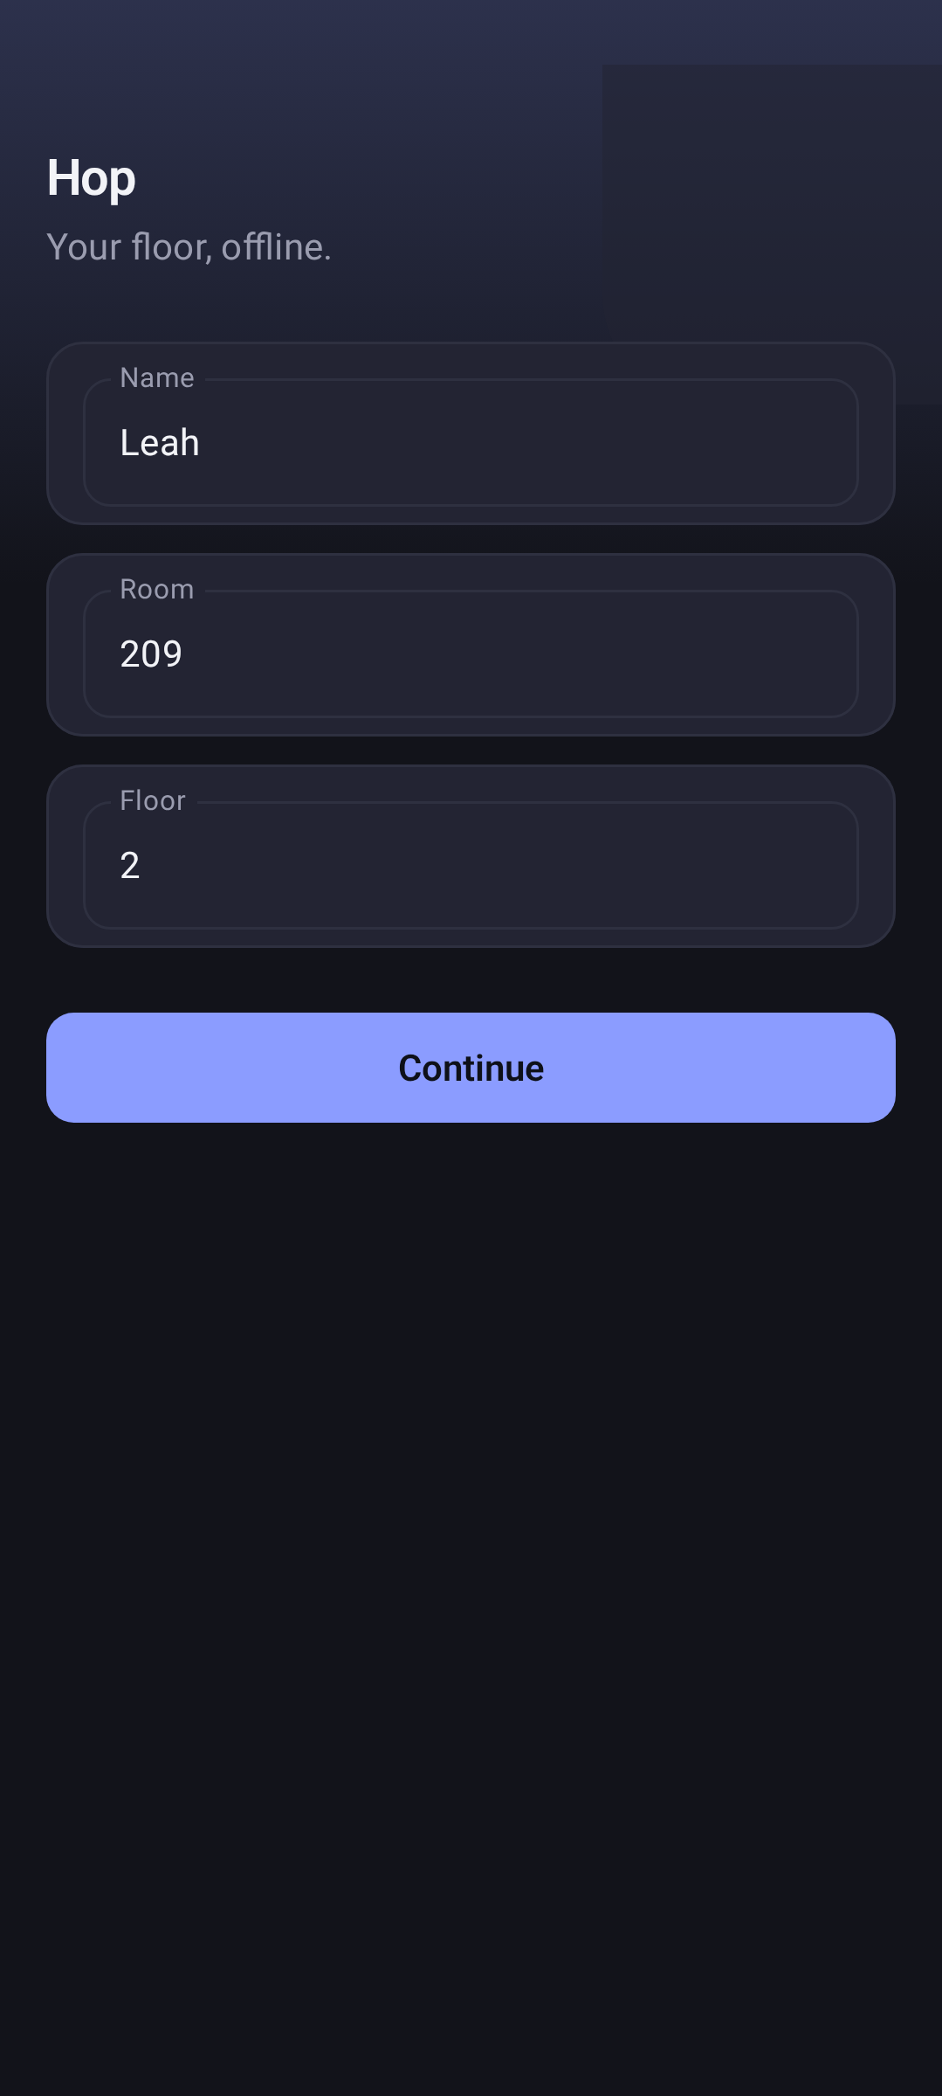
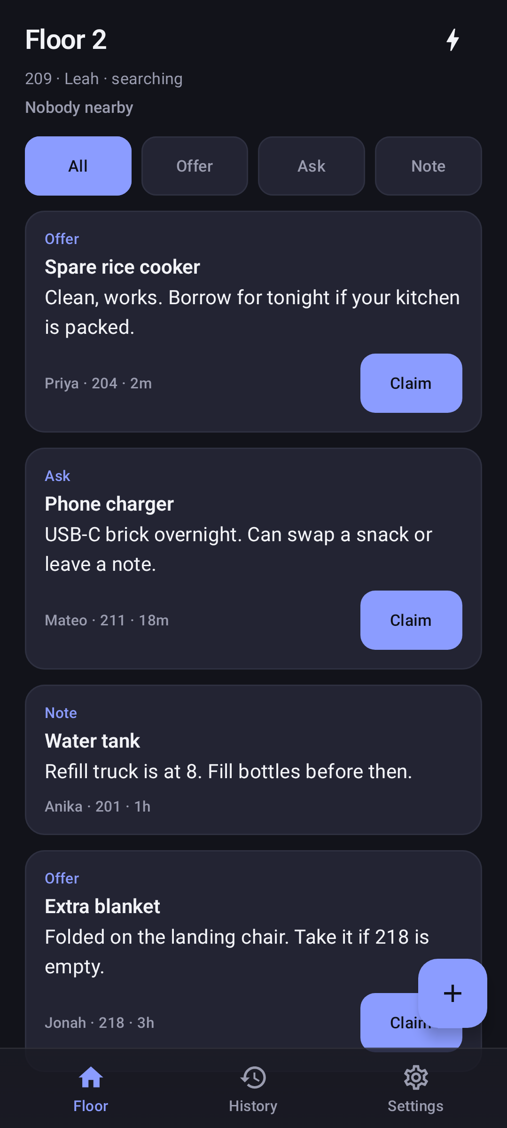
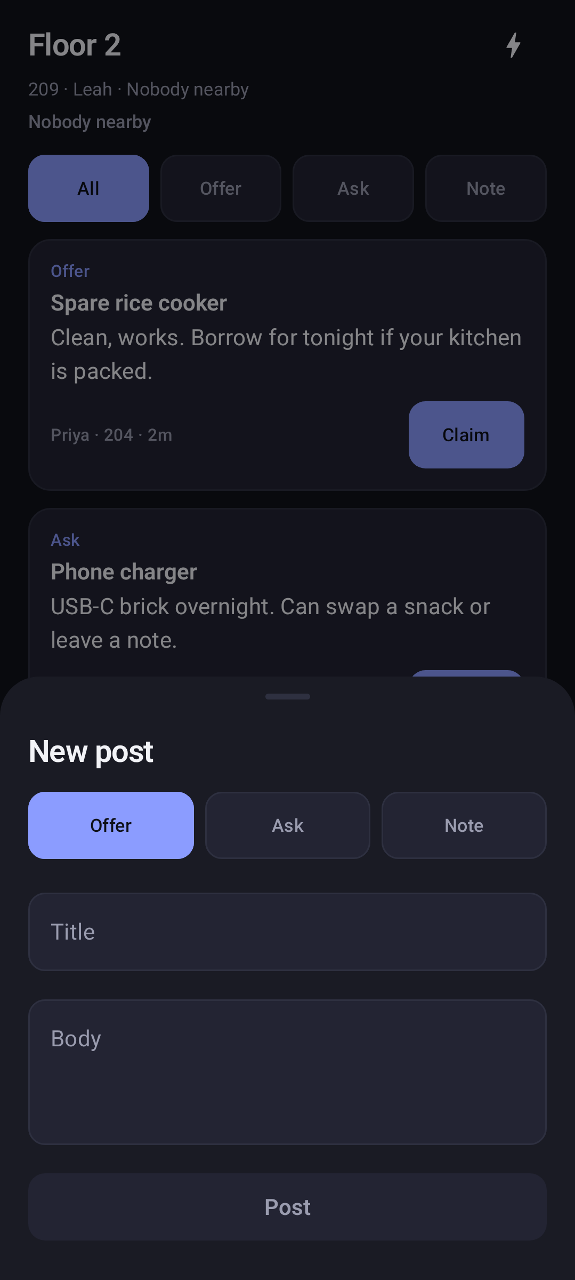
05 · SCREENS
The floor board.
First open
Set name, room, and floor.
Floor
Offer / Ask / Note board, with filters. Claim posts.
New post
Write an Offer, Ask, or Note.
First open
Floor
New post
AKSHAI KRISHNA S
05 / 09

Slide 6
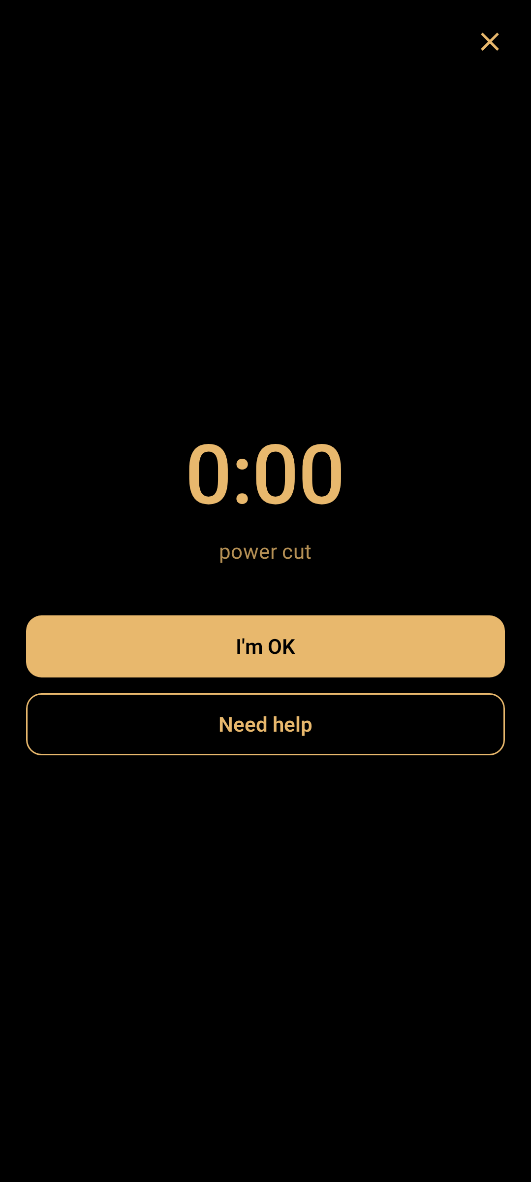

06 · SCREENS
Blackout, and nearby.
Blackout
A full black screen with a timer, and I’m OK / Need help.
Nearby
Bluetooth nearby sync on the same floor, when the app is open. Fully usable offline alone.
Blackout
Nearby
AKSHAI KRISHNA S
06 / 09

Slide 7
07 · STACK
What it is built with.
App
Kotlin, Jetpack Compose, and Material 3.
Local store
Room and DataStore.
Nearby
BLE advertise / scan + GATT sync.
Build
GitHub Actions debug APK.
AKSHAI KRISHNA S
07 / 09

Slide 8
08 · FUTURE
After the first floor.
Mesh
Stronger multi-hop mesh.
Peers
Better peer UX.
Background
Background limits / battery.
iOS
iOS if ever needed.
AKSHAI KRISHNA S
08 / 09

Slide 9
09 · OFFGRID
Hop
github.com/flyme2mars/hop
Solo OffGrid entry
Your floor, offline.
Open source
AKSHAI KRISHNA S
09 / 09

