Slide 1

Technical Report For
android.keystore.cts.KeyChainTest#testIsBoundKeyAlgorithm_RequiredAlgorithmsSupported FAIL
2014/08/24

Slide 2
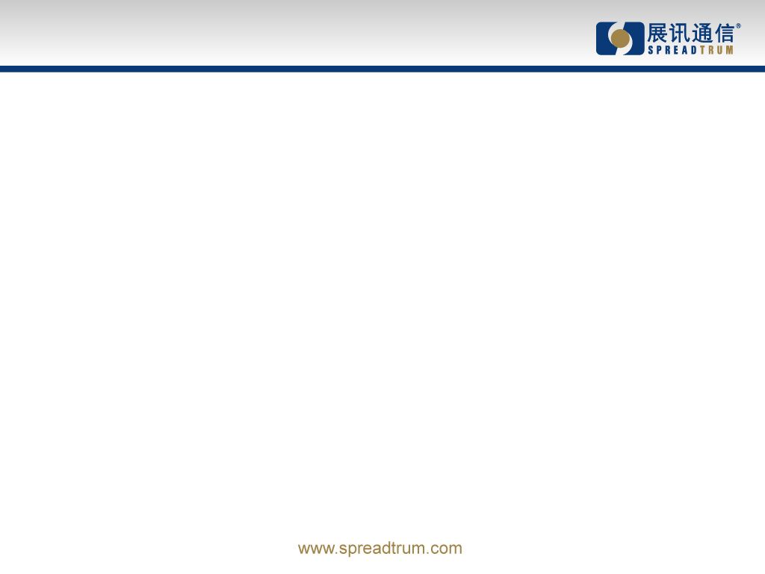
Issue description
cts-tf > run cts -c android.keystore.cts.KeyChainTest -m testIsBoundKeyAlgorithm_RequiredAlgorithmsSupported
08-06 12:46:39 I/TestInvocation: Starting invocation for 'cts' on build '5.1_r2' on device T8861A147030384
08-06 12:46:39 I/T8861A147030384: Created result dir 2015.08.06_12.46.39
08-06 12:46:46 I/T8861A147030384: Collecting device info
08-06 12:46:48 I/T8861A147030384: -----------------------------------------
08-06 12:46:48 I/T8861A147030384: Test package android.keystore started
08-06 12:46:48 I/T8861A147030384: -----------------------------------------
08-06 12:46:51 I/T8861A147030384: android.keystore.cts.KeyChainTest#testIsBoundKeyAlgorithm_RequiredAlgorithmsSupported FAIL
junit.framework.AssertionFailedError: RSA must be hardware-backed by a hardware-specific Keymaster HAL
at android.keystore.cts.KeyChainTest.testIsBoundKeyAlgorithm_RequiredAlgorithmsSupported(KeyChainTest.java:37)
at java.lang.reflect.Method.invokeNative(Native Method)
at android.test.AndroidTestRunner.runTest(AndroidTestRunner.java:191)
at android.test.AndroidTestRunner.runTest(AndroidTestRunner.java:176)
at android.test.InstrumentationTestRunner.onStart(InstrumentationTestRunner.java:554)
at android.app.Instrumentation$InstrumentationThread.run(Instrumentation.java:1756)
. <number>

Slide 3
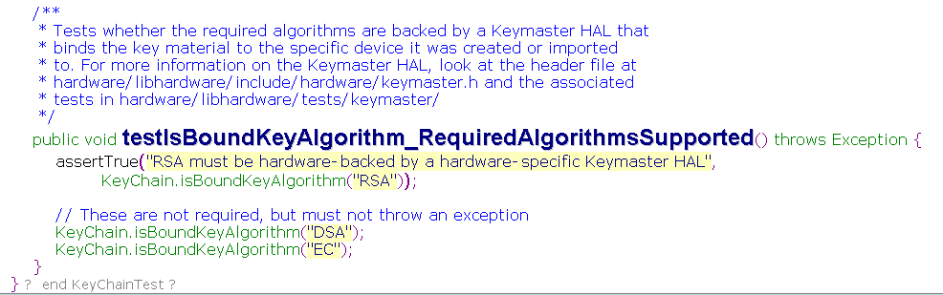
Analysis
Tests whether the required algorithms are backed by a Keymaster HAL that binds the key material to the specific device it was created or imported to:
This test required Phone need implement security chip to store Keys.
. <number>

Slide 4
Analysis
SC7731 reference platform credential storage is KEYMASTER_SOFTWARE_ONLY.
If the finial device based on this platform does not have an additional security chip for handle hardware-based keys, this CTS test case will be found failed.
we get a waiver for this case.
. <number>

Slide 5


