Slide 1


Slide 2
Introduction
A traffic analysis method to detect Tor-based malware network activity.
Challenge: Tor traffic is anonymous and encrypted, how to distinguish benign traffic & malware traffic?
A machine learning mechanism with FPR of 0.7% on 0day-malware is proposed.

Slide 3
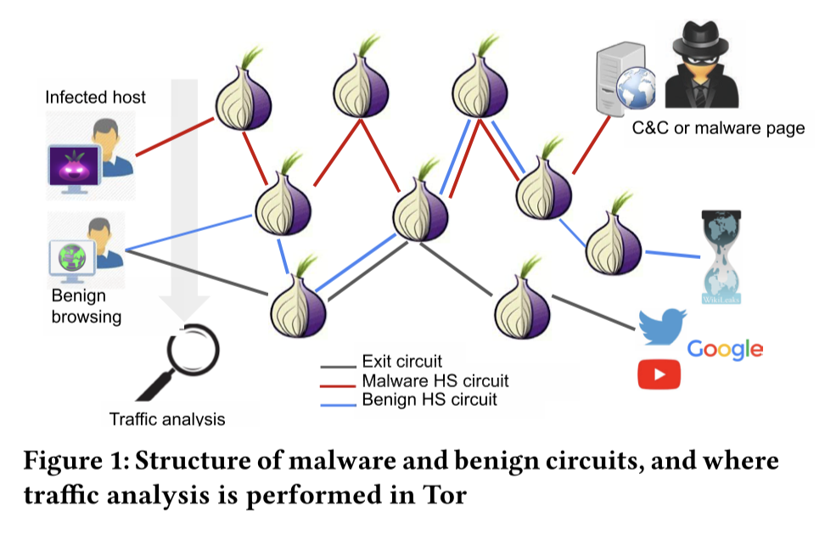
Background
Infected hosts usually need network connection to be controlled by attackers.
Common detect methods (based on IP address, port & DPI) could be useless if malware uses Tor to anonymized its traffic.
Traffic analysis is a way to get information from the patterns of the captured packets.

Slide 4
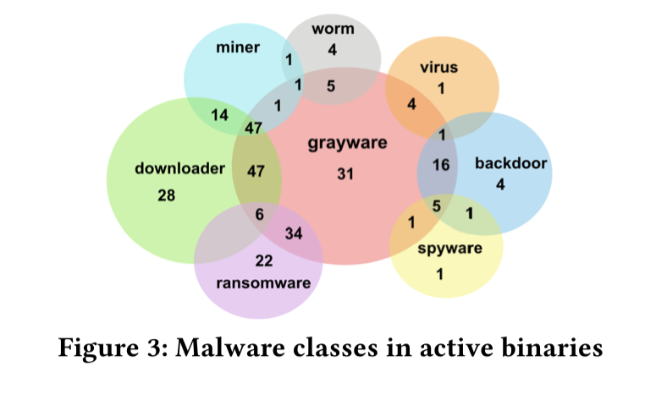
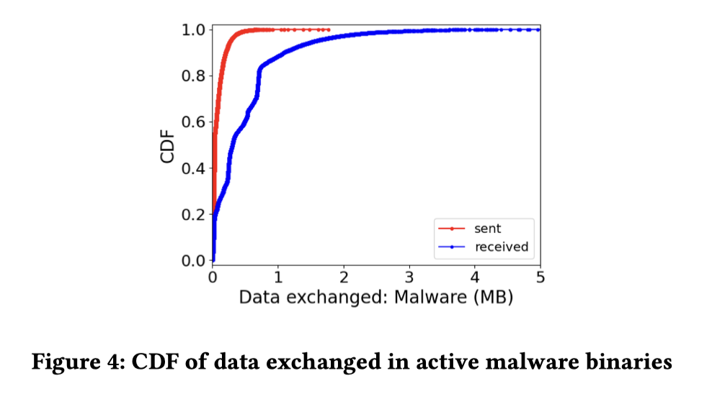
Dataset - Malwares
523 samples (binary files) are filtered and downloaded which can generate 2-direction Tor traffic.
These samples are characterized with category labels.
Traffic are generated when malwares are run in sandbox.

Slide 5
Dataset - Benign traffic
Two sources of benign traffic is used:
Generated browsing traffic.
Collected data.
Streams are extracted and labeled, as part of the dataset used to train machine learning models.

Slide 6
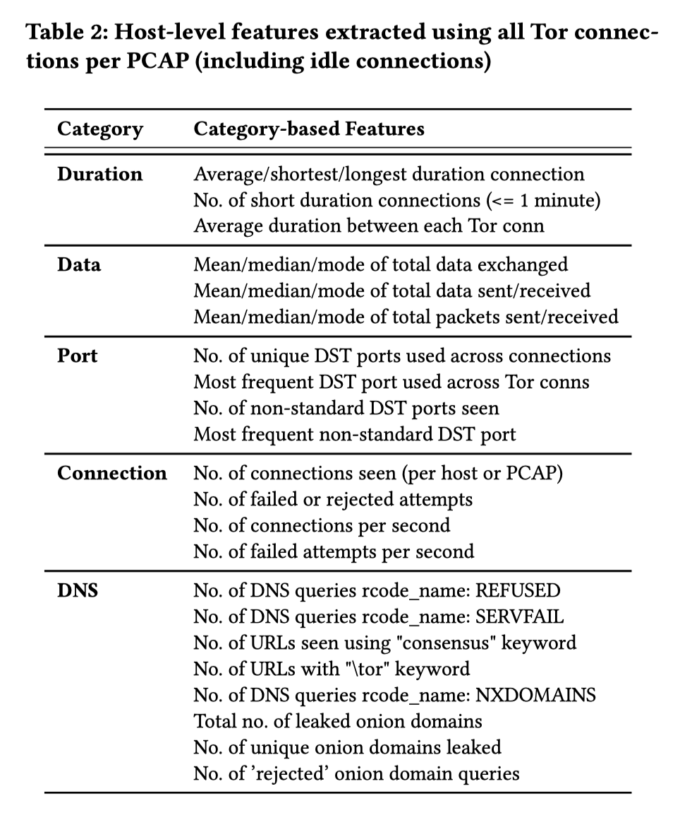
Methodology - Classification Features
Connection-level features
A set consists of 150 WF features proposed by Hayes et al. is used.*
Host-level features
As shown in table, this paper proposed a set of novel features to capture malware behavior that may be exposed by analyzing all Tor connections initiated by a host.
*: Jamie Hayes and George Danezis. 2016. k-fingerprinting: A Robust Scalable Website Fingerprinting Technique. In 25th USENIX Security Symposium ( USENIX Security 16 ). 1187–1203.

Slide 7
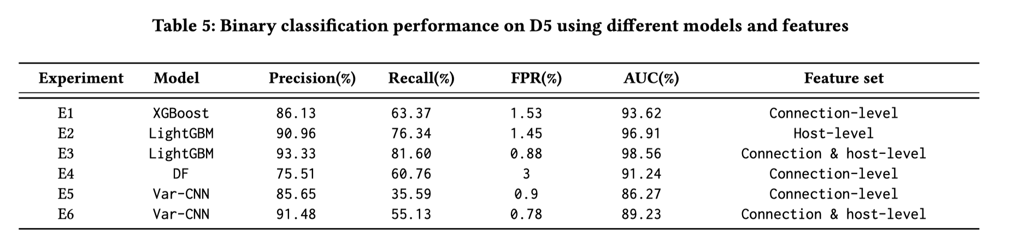
Methodology – Classifier Training
Amazon’s AutoGluon is used to optimized classifier performance during training process.
Algorithms based on decision trees - LightGBM & XGBoost perform better than Deep Learning models, with precision up to 93.33%.
Host-level features perform better than connection-level features.

Slide 8
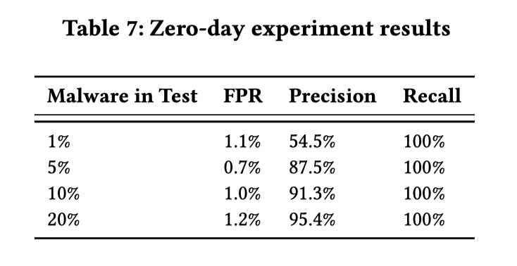
Evaluation
Best performance model (LightGBM + host & connection features) is used in evaluation phase.
When facing 0-day malwares, this classifier can identify all (100% recall) malware network connections no matter what the proportion of malware is.

