Slide 1
TNMSG
Welcome
Lesson 8 Philip’s Journeys
Acts 8:4–40
1

Slide 2
Summary – Philip’s Journeys
Bible Passages
Scattered believers spread the gospel beyond Jerusalem. Philip preaches about Christ in Samaria, where people believe and are baptized. Peter and John pray for them to receive the Holy Spirit, and Peter rebukes Simon’s attempt to buy spiritual authority. God directs Philip to an Ethiopian official. Beginning with Isaiah, Philip explains the good news about Jesus, and the official is baptized.
Study Guide Lesson
Compare the two encounters: who responds, what barriers are crossed, what leads to belief and baptism, and how the apostles participate. Explore God’s guidance, Scripture pointing to Jesus, and the Holy Spirit as God’s gift. Simon’s story challenges us to examine our motives in giving and serving.
2
Notes:
The church has faced terrible opposition, and believers have been scattered. Yet the message travels with them. First, we meet a community in Samaria, then one traveler on a road. Along the way, Simon’s request raises questions about our motives. Through both encounters, Luke keeps our attention on Jesus and on God’s work in bringing people to hear about him. The study guide asks us to compare these stories. [NEXT SLIDE]
[Sources]
Lesson 8 edited Bible Study Planning Document, Current Lesson/Output. Study Guide screenshots dated September 16, 2026. Scripture references use NIV. Notes and answers are paraphrases unless marked otherwise.
Acts 8:4–40; Acts 1:8. Study Guide lesson introduction and Questions 1, 5, and 6; Bible note 8:1–4 (IMG_3197.jpeg).

Slide 3
Point of Clarification
The Philip in Acts Chapter 8 is not “Philip the Apostle”
Two passages help distinguish them:
Acts 8:1, 4–5: The apostles remain in Jerusalem while scattered believers spread the word. Philip goes to Samaria and preaches.
Acts 21:8: Luke explicitly identifies him as “Philip the evangelist, who was one of the seven.”
3
Notes:
Before we go further, let’s clarify which Philip we’re following. The Philip in Acts 8 is not Philip the apostle. He is Philip the evangelist, one of the seven men chosen in Acts 6 to help meet the needs of the growing church.
It’s easy to confuse them, but Acts 21:8 identifies this Philip as “the evangelist” and “one of the seven.” [NEXT SLIDE]

Slide 4
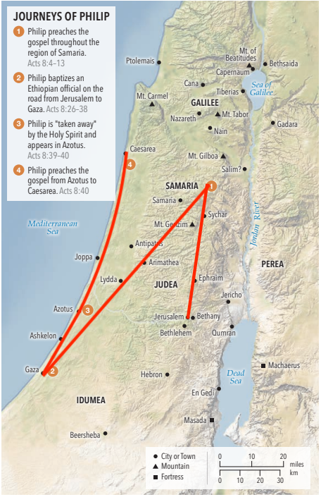
Philip’s travels
Journey | Miles | Days
Jerusalem to Samaria | 40–45 | 3–4
Samaria to Gaza (via Jerusalem) | 90–100 | 6–8
Gaza to Azotus* | 20 | 1–2
Azotus to Caesarea | 60 | 3–5
Approximate walking days, allowing for terrain.
Actual route and duration are unknown.
*Walking comparison only. The Spirit took Philip away
before he appeared at Azotus (Acts 8:39–40).
4
Notes:
Somebody in here loves maps. Was that you, John? Here’s a map to help picture the scale of Philip’s ministry. The hillier stretches could require several days of walking. The actual routes are unknown, and time spent preaching would add to the trip time. Acts places the encounter with the Ethiopian on the road to Gaza, not necessarily in Gaza itself. The Gaza to Azotus row compares the locations only. Scripture says the Spirit took Philip away and he appeared at Azotus. Now on with the questions. [NEXT SLIDE]
[Sources]
Map: user supplied Phillip Travel Map.png, Rose Guide to the Book of Acts, printed page 11. https://files.tyndale.com/thpdata/firstchapters/978-1-64938-020-3.pdf#page=12
Distances: https://wednesdayintheword.com/distances-jerusalem/ and https://www.biblegateway.com/resources/reformation-study-bible/Acts.8.40
Acts 8:26–40. Walking assumptions: roughly 12–15 miles per day on hillier sections and 15–20 on easier sections, with broad allowances for slower travel. These estimates are not a terrain-model calculation. Samaria to Gaza sums the estimated distances via Jerusalem. No total duration is asserted.

Slide 5
Two gospel encounters
Q: 1 and 5. Compare Philip’s ministry to the Samaritans (Acts 8:4–25) with his encounter with the Ethiopian official (Acts 8:26–40). Who responds, what barriers are crossed, what leads them to believe, and what role do the apostles play?
Answer:
The same good news welcomes very different people.
5
Notes:
In Samaria, Philip’s miraculous signs and preaching led people to believe his message; Peter and John then prayed with and laid hands on them. God then directs Philip to a man reading Isaiah, where Philip explains Jesus. The man requests baptism without a reported apostolic visit. His welcome resonates with Psalm 68:31 and Isaiah 56:3–5. Let’s read these passages: [Read Psalm 68:31] [Read Isaiah 56:3–5.]
Let’s compare these two encounters, and then we will loop back and look at the stories of Simon and the Ethiopian. [NEXT SLIDE]
[Sources]
Lesson 8 edited Bible Study Planning Document, Current Lesson/Output. Study Guide screenshots dated September 16, 2026. Scripture references use NIV. Notes and answers are paraphrases unless marked otherwise.
Acts 8:4–17; John 4:9; Acts 1:8. Study Guide Question 1 and notes on Samaria and Peter and John. Bible notes 8:5 (IMG_3197.jpeg), 8:15–17 (IMG_3199.jpeg). Acts 8:26–40; Deuteronomy 23:1; Psalm 68:31; Isaiah 56:3–5; Ephesians 2:11–18. Study Guide Question 5 and eunuch note, footnote [8]; Bible notes 8:27 (IMG_3199.jpeg) and 8:29–35 (IMG_3199.jpeg and IMG_3200.jpeg).
Nonspoken reference: full original wording and context
1. Questions 1 and 5 will help you compare the two episodes in 8:4–25 and 8:26–40.
a. In 8:4–25, who is evangelized, convinced, and baptized?
b. What do the Jews think of these people (see John 4:9)?
c. How is this group’s conversion significant to the progress of the gospel? (Recall who has been converted up to now.)
d. What convinces this group to become believers (see 8:6–8, 12)?
e. What is the apostles’ role in bringing this group into the church (see 8:14–17)?
5. Keep question 1 in mind as you answer these questions.
a. Who accepted the gospel in 8:26–40?
b. What status did this kind of person have with the Jews (see Deuteronomy 23:1)?
c. How was this person’s conversion significant to the progress of the gospel (see Psalm 68:31; Isaiah 56:3–5; Ephesians 2:11–18)?
d. What was the apostles’ role in taking the step to permit such a person into the church? Why is this important?
e. What convinced this person to be baptized (see 8:35)?
Match by topic: 1a with 5a, 1b with 5b, 1c with 5c, 1d with 5e, and 1e with 5d. In the presentation, ask about one topic before revealing its paired answers. Samaritans should not be treated as a generic label for all Gentiles. Philip is one of the Seven, not the apostle Philip (Acts 6:5; 21:8). The guide and Bible note differ about the official’s earlier religious standing; Acts leaves it unsettled. Do not claim Acts records a later national conversion of Ethiopia. Question 5.1 retains its original numbering as a follow-up discussion.

Slide 6
Who responds?
Questions 1a and 5a
Samaria
Ethiopian official
Men and women, including Simon.
A eunuch who managed the queen’s treasury.
Discussion
What point was Luke trying to make with these two examples?
6
Notes:
Philip’s ministry in Samaria and his encounter with the Ethiopian official are commonly placed in the early to mid-30s AD. Luke wrote Acts roughly 30 to 40 years later. Thus, this is more than just storytelling. Luke was inspired to make a point. [Pause for discussion.]
[Sources]
Lesson 8 edited Bible Study Planning Document, Current Lesson/Output. Study Guide screenshots dated September 16, 2026. Scripture references use NIV. Notes and answers are paraphrases unless marked otherwise.
Acts 8:4–17; John 4:9; Acts 1:8. Study Guide Question 1 and notes on Samaria and Peter and John. Bible notes 8:5 (IMG_3197.jpeg), 8:15–17 (IMG_3199.jpeg). Acts 8:26–40; Deuteronomy 23:1; Psalm 68:31; Isaiah 56:3–5; Ephesians 2:11–18. Study Guide Question 5 and eunuch note, footnote [8]; Bible notes 8:27 (IMG_3199.jpeg) and 8:29–35 (IMG_3199.jpeg and IMG_3200.jpeg).
Nonspoken reference: full original wording and context
1. Questions 1 and 5 will help you compare the two episodes in 8:4–25 and 8:26–40.
a. In 8:4–25, who is evangelized, convinced, and baptized?
b. What do the Jews think of these people (see John 4:9)?
c. How is this group’s conversion significant to the progress of the gospel? (Recall who has been converted up to now.)
d. What convinces this group to become believers (see 8:6–8, 12)?
e. What is the apostles’ role in bringing this group into the church (see 8:14–17)?
5. Keep question 1 in mind as you answer these questions.
a. Who accepted the gospel in 8:26–40?
b. What status did this kind of person have with the Jews (see Deuteronomy 23:1)?
c. How was this person’s conversion significant to the progress of the gospel (see Psalm 68:31; Isaiah 56:3–5; Ephesians 2:11–18)?
d. What was the apostles’ role in taking the step to permit such a person into the church? Why is this important?
e. What convinced this person to be baptized (see 8:35)?
Full comparison row: Who responds? | Samaritan men and women, including Simon. | An Ethiopian eunuch responsible for the queen’s treasury.
Match by topic: 1a with 5a, 1b with 5b, 1c with 5c, 1d with 5e, and 1e with 5d. In the presentation, ask about one topic before revealing its paired answers. Samaritans should not be treated as a generic label for all Gentiles. Philip is one of the Seven, not the apostle Philip (Acts 6:5; 21:8). The guide and Bible note differ about the official’s earlier religious standing; Acts leaves it unsettled. Do not claim Acts records a later national conversion of Ethiopia. Question 5.1 retains its original numbering as a follow-up discussion.

Slide 7
What barriers are crossed?
Questions 1b and 5b
Samaria
Ethiopian official
Longstanding religious and social hostility with Jews.
Assembly restriction (Deut. 23:1). His prior religious status is unclear.
Discussion
1. What message was Luke trying to get across?
2. Are there similar barriers today that prevent the gospel from being spread?
7
Notes:
Again, I ask: what point was Luke trying to make? How does this apply today?
[Pause for discussion.]
[Sources]
Lesson 8 edited Bible Study Planning Document, Current Lesson/Output. Study Guide screenshots dated September 16, 2026. Scripture references use NIV. Notes and answers are paraphrases unless marked otherwise.
Acts 8:4–17; John 4:9; Acts 1:8. Study Guide Question 1 and notes on Samaria and Peter and John. Bible notes 8:5 (IMG_3197.jpeg), 8:15–17 (IMG_3199.jpeg). Acts 8:26–40; Deuteronomy 23:1; Psalm 68:31; Isaiah 56:3–5; Ephesians 2:11–18. Study Guide Question 5 and eunuch note, footnote [8]; Bible notes 8:27 (IMG_3199.jpeg) and 8:29–35 (IMG_3199.jpeg and IMG_3200.jpeg).
Nonspoken reference: full original wording and context
1. Questions 1 and 5 will help you compare the two episodes in 8:4–25 and 8:26–40.
a. In 8:4–25, who is evangelized, convinced, and baptized?
b. What do the Jews think of these people (see John 4:9)?
c. How is this group’s conversion significant to the progress of the gospel? (Recall who has been converted up to now.)
d. What convinces this group to become believers (see 8:6–8, 12)?
e. What is the apostles’ role in bringing this group into the church (see 8:14–17)?
5. Keep question 1 in mind as you answer these questions.
a. Who accepted the gospel in 8:26–40?
b. What status did this kind of person have with the Jews (see Deuteronomy 23:1)?
c. How was this person’s conversion significant to the progress of the gospel (see Psalm 68:31; Isaiah 56:3–5; Ephesians 2:11–18)?
d. What was the apostles’ role in taking the step to permit such a person into the church? Why is this important?
e. What convinced this person to be baptized (see 8:35)?
Full comparison row: What barriers exist? | Longstanding hostility between Jews and Samaritans. | His physical condition carried an assembly restriction under Deuteronomy 23:1; Acts leaves his exact religious standing unclear.
Match by topic: 1a with 5a, 1b with 5b, 1c with 5c, 1d with 5e, and 1e with 5d. In the presentation, ask about one topic before revealing its paired answers. Samaritans should not be treated as a generic label for all Gentiles. Philip is one of the Seven, not the apostle Philip (Acts 6:5; 21:8). The guide and Bible note differ about the official’s earlier religious standing; Acts leaves it unsettled. Do not claim Acts records a later national conversion of Ethiopia. Question 5.1 retains its original numbering as a follow-up discussion.

Slide 8
How does the gospel spread?
Questions 1c and 5c
Samaria
Ethiopian official
The gospel crosses an old religious and social divide.
The gospel crosses national and social boundaries.
Discussion
1. What do the crowds in Samaria and the encounter with one traveler teach us about how God’s mission advances?
2. How might these encounters challenge our ideas about what successful ministry looks like?
8
Notes:
How does each encounter advance the spread of the gospel? As we look at these successful encounters, how might they influence our ministry today?
[Pause for discussion.]
[Sources]
Lesson 8 edited Bible Study Planning Document, Current Lesson/Output. Study Guide screenshots dated September 16, 2026. Scripture references use NIV. Notes and answers are paraphrases unless marked otherwise.
Acts 8:4–17; John 4:9; Acts 1:8. Study Guide Question 1 and notes on Samaria and Peter and John. Bible notes 8:5 (IMG_3197.jpeg), 8:15–17 (IMG_3199.jpeg). Acts 8:26–40; Deuteronomy 23:1; Psalm 68:31; Isaiah 56:3–5; Ephesians 2:11–18. Study Guide Question 5 and eunuch note, footnote [8]; Bible notes 8:27 (IMG_3199.jpeg) and 8:29–35 (IMG_3199.jpeg and IMG_3200.jpeg).
Nonspoken reference: full original wording and context
1. Questions 1 and 5 will help you compare the two episodes in 8:4–25 and 8:26–40.
a. In 8:4–25, who is evangelized, convinced, and baptized?
b. What do the Jews think of these people (see John 4:9)?
c. How is this group’s conversion significant to the progress of the gospel? (Recall who has been converted up to now.)
d. What convinces this group to become believers (see 8:6–8, 12)?
e. What is the apostles’ role in bringing this group into the church (see 8:14–17)?
5. Keep question 1 in mind as you answer these questions.
a. Who accepted the gospel in 8:26–40?
b. What status did this kind of person have with the Jews (see Deuteronomy 23:1)?
c. How was this person’s conversion significant to the progress of the gospel (see Psalm 68:31; Isaiah 56:3–5; Ephesians 2:11–18)?
d. What was the apostles’ role in taking the step to permit such a person into the church? Why is this important?
e. What convinced this person to be baptized (see 8:35)?
Full comparison row: What advances in the gospel’s spread? | The gospel reaches beyond the Jerusalem community across an old religious and social divide. | The gospel reaches a traveler from another nation and illustrates welcome across social boundaries.
Match by topic: 1a with 5a, 1b with 5b, 1c with 5c, 1d with 5e, and 1e with 5d. In the presentation, ask about one topic before revealing its paired answers. Samaritans should not be treated as a generic label for all Gentiles. Philip is one of the Seven, not the apostle Philip (Acts 6:5; 21:8). The guide and Bible note differ about the official’s earlier religious standing; Acts leaves it unsettled. Do not claim Acts records a later national conversion of Ethiopia. Question 5.1 retains its original numbering as a follow-up discussion.

Slide 9
What leads to belief and baptism?
Questions 1d and 5e
Samaria
Ethiopian official
Philip’s message about Jesus and miraculous signs.
Philip explains Jesus from Isaiah. The official requests baptism.
Discussion
1. What stays the same in Philip’s message, and what changes in how he communicates it?
2. What does Philip’s conversation with the Ethiopian teach us about listening before explaining?
9
Notes:
As we compare these encounters, what similarity or difference stands out? What leads these people to belief and baptism?
[Pause for discussion.]
[Sources]
Lesson 8 edited Bible Study Planning Document, Current Lesson/Output. Study Guide screenshots dated September 16, 2026. Scripture references use NIV. Notes and answers are paraphrases unless marked otherwise.
Acts 8:4–17; John 4:9; Acts 1:8. Study Guide Question 1 and notes on Samaria and Peter and John. Bible notes 8:5 (IMG_3197.jpeg), 8:15–17 (IMG_3199.jpeg). Acts 8:26–40; Deuteronomy 23:1; Psalm 68:31; Isaiah 56:3–5; Ephesians 2:11–18. Study Guide Question 5 and eunuch note, footnote [8]; Bible notes 8:27 (IMG_3199.jpeg) and 8:29–35 (IMG_3199.jpeg and IMG_3200.jpeg).
Nonspoken reference: full original wording and context
1. Questions 1 and 5 will help you compare the two episodes in 8:4–25 and 8:26–40.
a. In 8:4–25, who is evangelized, convinced, and baptized?
b. What do the Jews think of these people (see John 4:9)?
c. How is this group’s conversion significant to the progress of the gospel? (Recall who has been converted up to now.)
d. What convinces this group to become believers (see 8:6–8, 12)?
e. What is the apostles’ role in bringing this group into the church (see 8:14–17)?
5. Keep question 1 in mind as you answer these questions.
a. Who accepted the gospel in 8:26–40?
b. What status did this kind of person have with the Jews (see Deuteronomy 23:1)?
c. How was this person’s conversion significant to the progress of the gospel (see Psalm 68:31; Isaiah 56:3–5; Ephesians 2:11–18)?
d. What was the apostles’ role in taking the step to permit such a person into the church? Why is this important?
e. What convinced this person to be baptized (see 8:35)?
Full comparison row: What leads to belief and baptism? | People hear Philip’s message about Jesus and see the signs he performs. | Philip explains the good news about Jesus, beginning with Isaiah, and the official requests baptism.
Match by topic: 1a with 5a, 1b with 5b, 1c with 5c, 1d with 5e, and 1e with 5d. In the presentation, ask about one topic before revealing its paired answers. Samaritans should not be treated as a generic label for all Gentiles. Philip is one of the Seven, not the apostle Philip (Acts 6:5; 21:8). The guide and Bible note differ about the official’s earlier religious standing; Acts leaves it unsettled. Do not claim Acts records a later national conversion of Ethiopia. Question 5.1 retains its original numbering as a follow-up discussion.

Slide 10
What role do the apostles play?
Questions 1e and 5d
Samaria
Ethiopian official
Peter and John pray and lay hands. Believers receive the Spirit.
No apostolic visit or consultation is reported. God directs Philip.
Discussion
1. Why was the apostles’ personal involvement significant in their interactions with the Samaritans?
2. What is significant about the absence of a reported apostolic visit in the Ethiopian’s conversion?
10
Notes:
What role do the apostles play in these two encounters? As we look at these two encounters, what similarity or difference stands out—and why?
[Pause for discussion.]
[Sources]
Lesson 8 edited Bible Study Planning Document, Current Lesson/Output. Study Guide screenshots dated September 16, 2026. Scripture references use NIV. Notes and answers are paraphrases unless marked otherwise.
Acts 8:4–17; John 4:9; Acts 1:8. Study Guide Question 1 and notes on Samaria and Peter and John. Bible notes 8:5 (IMG_3197.jpeg), 8:15–17 (IMG_3199.jpeg). Acts 8:26–40; Deuteronomy 23:1; Psalm 68:31; Isaiah 56:3–5; Ephesians 2:11–18. Study Guide Question 5 and eunuch note, footnote [8]; Bible notes 8:27 (IMG_3199.jpeg) and 8:29–35 (IMG_3199.jpeg and IMG_3200.jpeg).
Nonspoken reference: full original wording and context
1. Questions 1 and 5 will help you compare the two episodes in 8:4–25 and 8:26–40.
a. In 8:4–25, who is evangelized, convinced, and baptized?
b. What do the Jews think of these people (see John 4:9)?
c. How is this group’s conversion significant to the progress of the gospel? (Recall who has been converted up to now.)
d. What convinces this group to become believers (see 8:6–8, 12)?
e. What is the apostles’ role in bringing this group into the church (see 8:14–17)?
5. Keep question 1 in mind as you answer these questions.
a. Who accepted the gospel in 8:26–40?
b. What status did this kind of person have with the Jews (see Deuteronomy 23:1)?
c. How was this person’s conversion significant to the progress of the gospel (see Psalm 68:31; Isaiah 56:3–5; Ephesians 2:11–18)?
d. What was the apostles’ role in taking the step to permit such a person into the church? Why is this important?
e. What convinced this person to be baptized (see 8:35)?
Full comparison row: What role do the apostles play? | Peter and John come, pray, and lay hands on the believers, who receive the Holy Spirit. | No apostolic visit or consultation is reported; God directs Philip to the encounter.
Match by topic: 1a with 5a, 1b with 5b, 1c with 5c, 1d with 5e, and 1e with 5d. In the presentation, ask about one topic before revealing its paired answers. Samaritans should not be treated as a generic label for all Gentiles. Philip is one of the Seven, not the apostle Philip (Acts 6:5; 21:8). The guide and Bible note differ about the official’s earlier religious standing; Acts leaves it unsettled. Do not claim Acts records a later national conversion of Ethiopia. Question 5.1 retains its original numbering as a follow-up discussion.

Slide 11
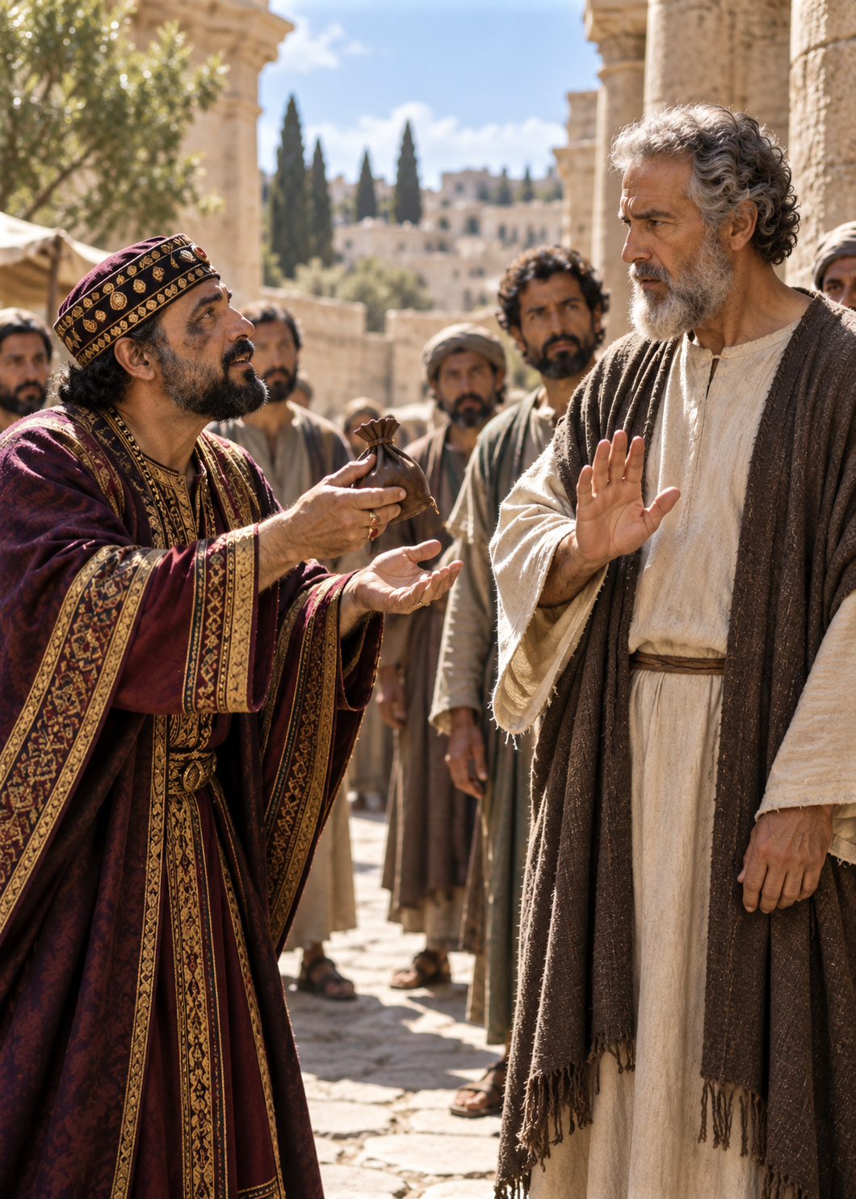
Simon’s request and our motives
Q: 3, 4, and 4.1.
What does Simon’s attempt to buy spiritual authority reveal about his heart, why might Luke include this incident in the story of the gospel’s spread, and how might we seek influence or recognition through our giving or service today? (Acts 8:18–24)
11
Notes:
Questions 3 and 4 are connected, so let’s discuss them at the same time. Simon, the magician, wants to buy the authority to give the Holy Spirit to others through the laying on of his hands. Peter responds strongly. What does this episode add to Luke’s account of the growing church? Finally, turn the question toward our own motives in giving and serving. [Pause for discussion.]
[Sources]
Lesson 8 edited Bible Study Planning Document, Current Lesson/Output. Study Guide screenshots dated September 16, 2026. Scripture references use NIV. Notes and answers are paraphrases unless marked otherwise.
Acts 8:9–24. Study Guide Questions 3 and 4 and Optional Application after Question 4. Bible notes 8:18–23 and 8:24 (IMG_3199.jpeg).
Nonspoken reference: full original wording and context
3. What was so terrible about Simon’s request in 8:18–19?
4. Why do you think Luke recorded the episode with Simon? What does it add to the story of Acts?
Optional Application: Do people ever try to buy spiritual authority today? Think of one example, and examine your own life.
Retain all three movements: Simon’s request, its significance in Acts, and personal application. Luke reports Simon’s belief and baptism, then Peter’s rebuke; do not claim a conclusive verdict on his ultimate salvation. Later traditions cited in Study Guide footnotes [4]–[6] are not events recorded by Luke.

Slide 12
Simon’s request and our motives
Answers:
3. Simon treats God’s gift as something he can buy and control.
4. Peter shows that the church must confront wrong motives and call for repentance.
4.1. Giving or service can become a way to seek influence or recognition.
12
Notes:
Peter exposes a heart that is not right before God and calls him to repent and pray. The episode shows that spreading the gospel includes confronting wrong motives. Giving generously and serving faithfully are good; the problem comes when we treat them as a purchase of influence. A donor who expects control over church decisions illustrates the danger, but the same expectation can hide in any of us.
[Sources]
Lesson 8 edited Bible Study Planning Document, Current Lesson/Output. Study Guide screenshots dated September 16, 2026. Scripture references use NIV. Notes and answers are paraphrases unless marked otherwise.
Acts 8:9–24. Study Guide Questions 3 and 4 and Optional Application after Question 4. Bible notes 8:18–23 and 8:24 (IMG_3199.jpeg).
Nonspoken reference: full original wording and context
3. What was so terrible about Simon’s request in 8:18–19?
4. Why do you think Luke recorded the episode with Simon? What does it add to the story of Acts?
Optional Application: Do people ever try to buy spiritual authority today? Think of one example, and examine your own life.
Retain all three movements: Simon’s request, its significance in Acts, and personal application. Luke reports Simon’s belief and baptism, then Peter’s rebuke; do not claim a conclusive verdict on his ultimate salvation. Later traditions cited in Study Guide footnotes [4]–[6] are not events recorded by Luke.

Slide 13
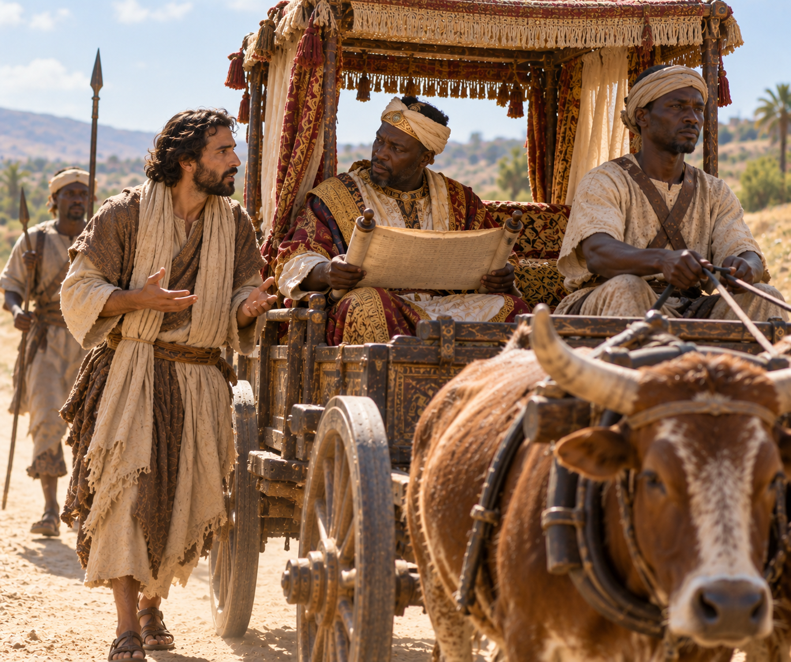
Q: 5c. How was this person’s conversion significant to the progress of the gospel? (see Psalm 68:31; Isaiah 56:3–5; Ephesians 2:11–18)
13
Notes:
We have already touched on this encounter, but it deserves a closer look. Let’s read the suggested scripture. [Read Psalm 68:31] [Read Isaiah 56:3–5] [Read Ephesians 2:11–18] Why is this significant?
[Sources]
Lesson 8 edited Bible Study Planning Document, Current Lesson/Output. Study Guide screenshots dated September 16, 2026. Scripture references use NIV. Notes and answers are paraphrases unless marked otherwise.
Acts 8:26–40; Psalm 68:31; Isaiah 56:3–5; Ephesians 2:11–18. Study Guide Question 5c: the significance of the Ethiopian official’s conversion for the progress of the gospel.
Nonspoken reference: full original wording and context
5c. How was this person’s conversion significant to the progress of the gospel (see Psalm 68:31; Isaiah 56:3–5; Ephesians 2:11–18)?
These passages connect the Ethiopian official’s conversion with the gospel’s spread across national and social boundaries and God’s welcome of outsiders. Acts does not report a later national conversion of Ethiopia.

Slide 14
Q: 5c. How was this person’s conversion significant to the progress of the gospel? (see Psalm 68:31; Isaiah 56:3–5; Ephesians 2:11–18)
Answer:
As an Ethiopian and a eunuch, he represents someone who might have been viewed as an outsider, yet he hears about Jesus and is baptized.
14
Notes:
The Ethiopian official’s conversion shows that the gospel reaches across national, ethnic, and social barriers.
[Sources]
Lesson 8 edited Bible Study Planning Document, Current Lesson/Output. Study Guide screenshots dated September 16, 2026. Scripture references use NIV. Notes and answers are paraphrases unless marked otherwise.
Acts 8:26–40; Psalm 68:31; Isaiah 56:3–5; Ephesians 2:11–18. Study Guide Question 5c: the significance of the Ethiopian official’s conversion for the progress of the gospel.
Nonspoken reference: full original wording and context
5c. How was this person’s conversion significant to the progress of the gospel (see Psalm 68:31; Isaiah 56:3–5; Ephesians 2:11–18)?
These passages connect the Ethiopian official’s conversion with the gospel’s spread across national and social boundaries and God’s welcome of outsiders. Acts does not report a later national conversion of Ethiopia.

Slide 15
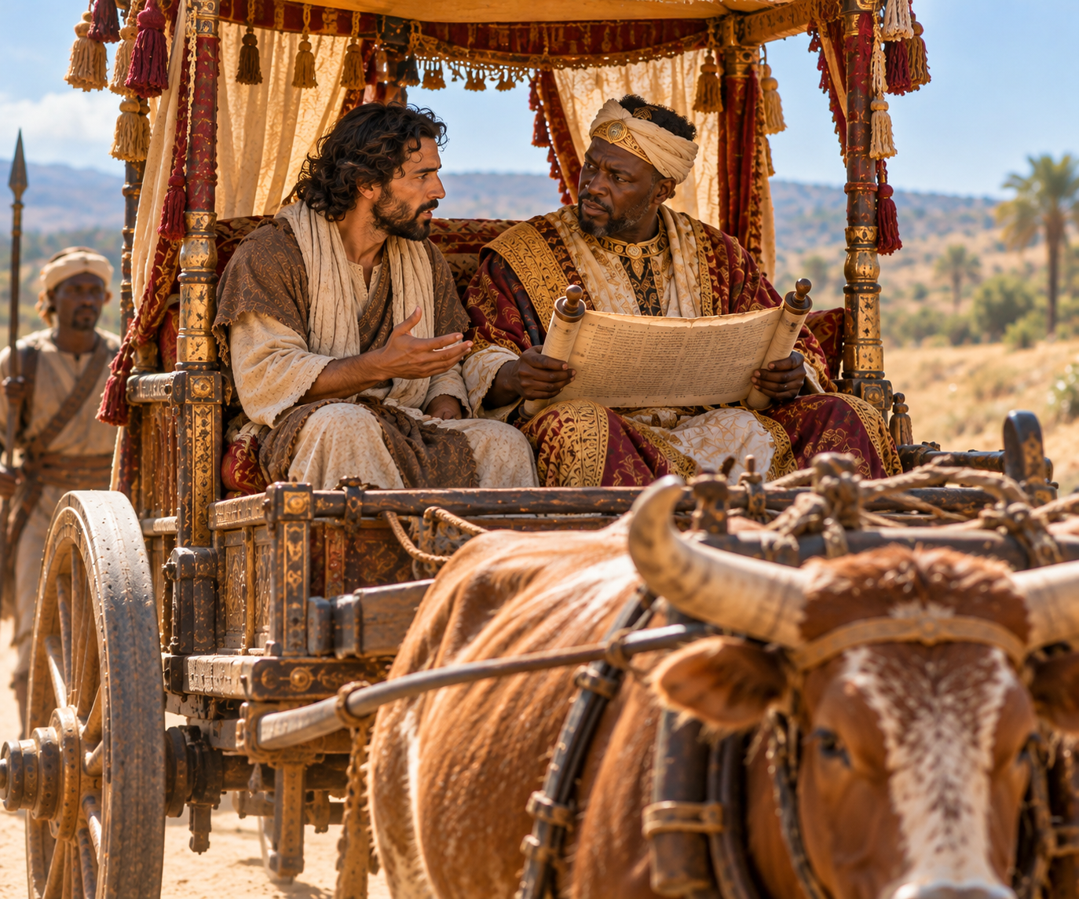
Q: 5.1. Did the eunuch need the laying on of hands to receive the Spirit? What evidence does Acts 8:36–39 give?
Answer:
Luke reports baptism and joy. He does not report
laying on of hands or the reception of the Spirit.
Q: What does this mean for us?
15
Notes:
Luke records the eunuch’s baptism but does not mention the laying on of hands or explicitly describe his reception of the Holy Spirit. This cautions us against requiring the Samaritan sequence in every case. Furthermore, what does this say about the many methods of conversion and baptism?
[Sources]
Lesson 8 edited Bible Study Planning Document, Current Lesson/Output. Study Guide screenshots dated September 16, 2026. Scripture references use NIV. Notes and answers are paraphrases unless marked otherwise.
Acts 8:36–39; 10:44–48; Romans 8:9. Study Guide For Thought and Discussion after Question 5 and Study Skill Patterns of Practice in Acts, footnote [3].
Nonspoken reference: full original wording and context
For Thought and Discussion: Did the eunuch need the laying on of hands to receive the Spirit? What evidence do we have (see 8:36–39)?
Do not identify the Spirit taking Philip away as a direct statement that the eunuch received the Spirit at that moment.

Slide 16
Rabbit Hole: Why is Acts 8:37 missing from my NIV Bible?
Acts 8:37 (KJV)
And Philip said, If thou believest with all thine heart, thou mayest. And he answered and said, I believe that Jesus Christ is the Son of God.
This verse is absent from the earliest surviving Greek manuscripts containing this passage. Many translators therefore conclude that it was not part of Luke’s original account.
Q: Why might a copyist have added this confession of faith before the baptism?
16
Notes:
Why is Acts 8:37 missing from some Bible translations? Flynt asked AI, wait a minute, rather I should say, Flynt asked me why this was so… After extensive research on my part (about 21 seconds), I found that the ancient handwritten copies of Acts differ here. The earliest surviving Greek manuscripts containing this passage do not include that verse. Many translators therefore conclude that it was added as the text was copied, rather than written by Luke originally. Why do you think it was added and what are the implications of it being or not being included?

Slide 17
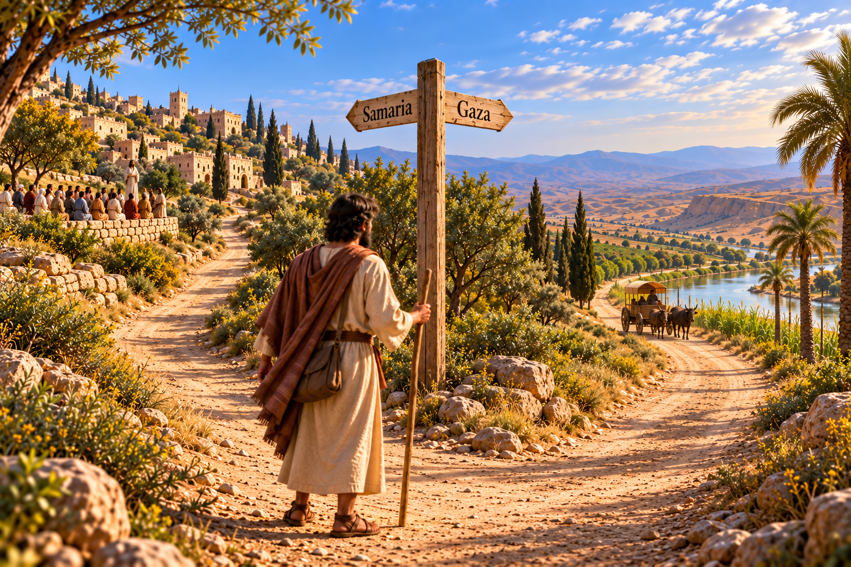
The message of Acts 8
Q: 6. Summarize what 8:4–40 contributes to the overall message of Acts.
17
Notes:
Let’s step back from the individual encounters. What does Acts 8 add to the story Luke has been telling? [Pause for discussion.]
[Sources]
Lesson 8 edited Bible Study Planning Document, Current Lesson/Output. Study Guide screenshots dated September 16, 2026. Scripture references use NIV. Notes and answers are paraphrases unless marked otherwise.
Acts 1:8; 8:4–40. Prior lesson context: Acts_Lesson_1.jsonl, acts-overview-0002 and acts-overview-0003, purpose and geographical expansion. Bible note 8:1–4 (IMG_3197.jpeg).
Nonspoken reference: full original wording and context
6. Summarize what 8:4–40 contributes to the overall message of Acts.

Slide 18
Q: 6. Summarize what Acts 8:4–40 contributes to the overall message of Acts.
Answer: Opposition cannot stop the risen Jesus’ mission. God uses scattered believers to spread the gospel beyond Jerusalem, crossing ethnic, religious, and social barriers. The gospel reaches Samaritans and an Ethiopian official.
This advances the mission announced by Jesus in Acts 1:8.
18
Notes:
Acts 8 shows the gospel crossing boundaries and reaching an ever-widening circle of people. Opposition has scattered believers, yet the message keeps spreading. A divided community hears about Jesus, and a traveler hears the same good news far from a crowd. The mission as defined by Jesus in Acts 1:8 is being fulfilled. As a reminder, here are his words: [Read Acts 1:7–9]
[Sources]
Lesson 8 edited Bible Study Planning Document, Current Lesson/Output. Study Guide screenshots dated September 16, 2026. Scripture references use NIV. Notes and answers are paraphrases unless marked otherwise.
Acts 1:8; 8:4–40. Prior lesson context: Acts_Lesson_1.jsonl, acts-overview-0002 and acts-overview-0003, purpose and geographical expansion. Bible note 8:1–4 (IMG_3197.jpeg).
Nonspoken reference: full original wording and context
6. Summarize what 8:4–40 contributes to the overall message of Acts.

Slide 19
As the Gospel Spreads…
Samaria experiences great joy.
Acts 8:8
The Ethiopian continues his journey rejoicing.
Acts 8:39
Go forth with joy.
19
Notes:
As we close, keep in mind the joy in these encounters. In Samaria, a whole city rejoices as people hear the good news and experience God’s work among them. On a quiet road, one Ethiopian traveler hears about Jesus, is baptized, and continues his journey rejoicing.
As we go into this week, may we be ready to listen, willing to share the good news about Jesus, and attentive to the people God places in our path. May the joy of knowing Christ go with us.
Go forth with joy.
[Sources]
Acts 8:1–8, 26–40.

