Slide 1
AST326Y1 Group H
Lab 1 - Basic Photon Statistics
Week 2 Mini-Report
By: Ömer, Luna, Cooper, Guillaume
All slides made by their respective presenters

Slide 2
Plan
4.1: Data distributions
4.2: Discovering the CMOS! (4.2.1-4.2.3)
4.2.4: Read Noise
  Recording Data
  Data Processing
The +
The -
Further Investigations for 4.2.5
What do we have to say for other groups?

Slide 3
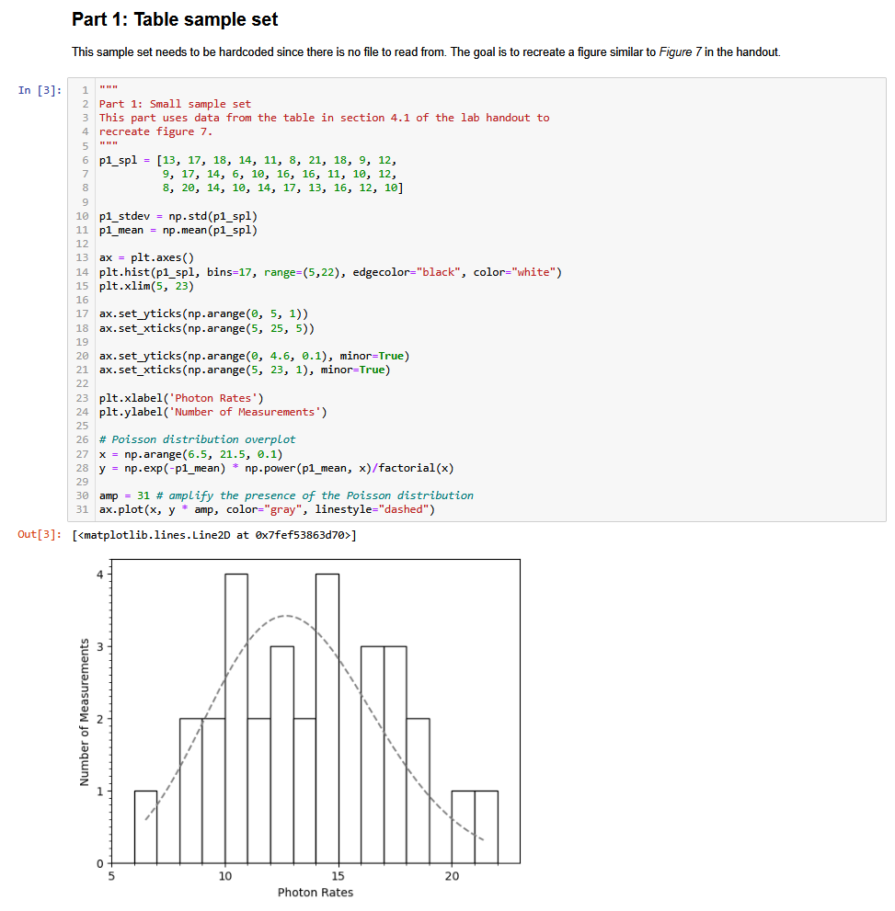
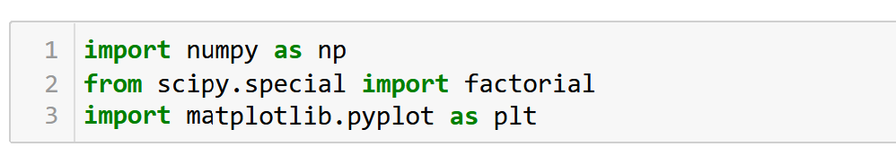
4.1: Data Distributions
Recreating the Poisson distribution histogram (figure 7)
Hardcoded data list
Poisson pmf amplified to be visible
Using pyplot.Axes for greater range of plot modifications (ticks etc.)

Slide 4
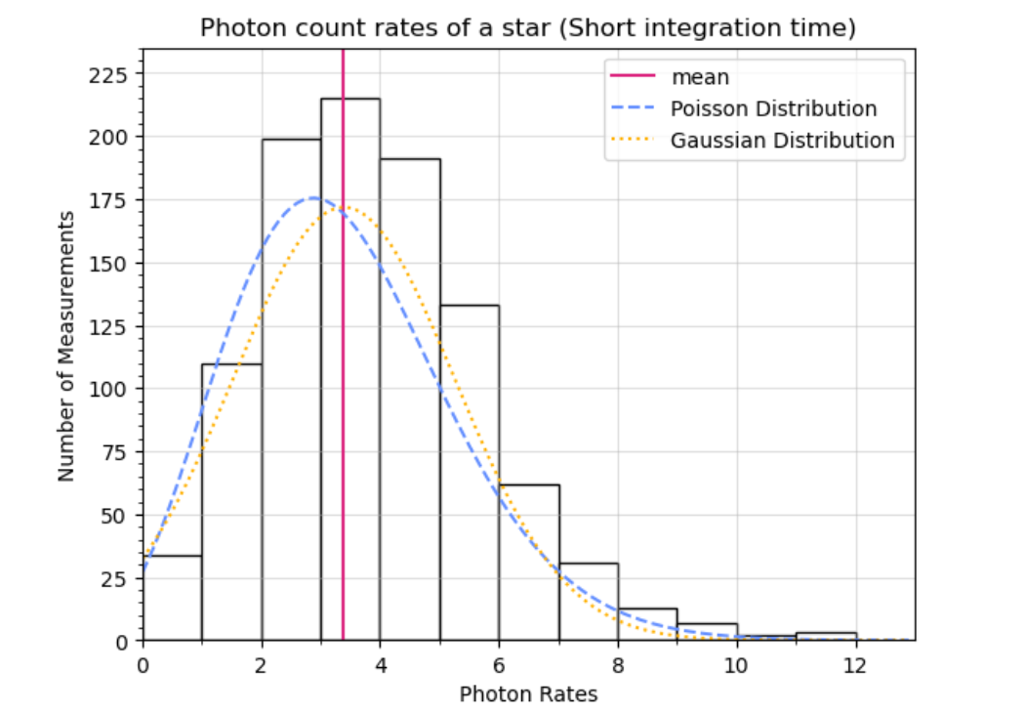
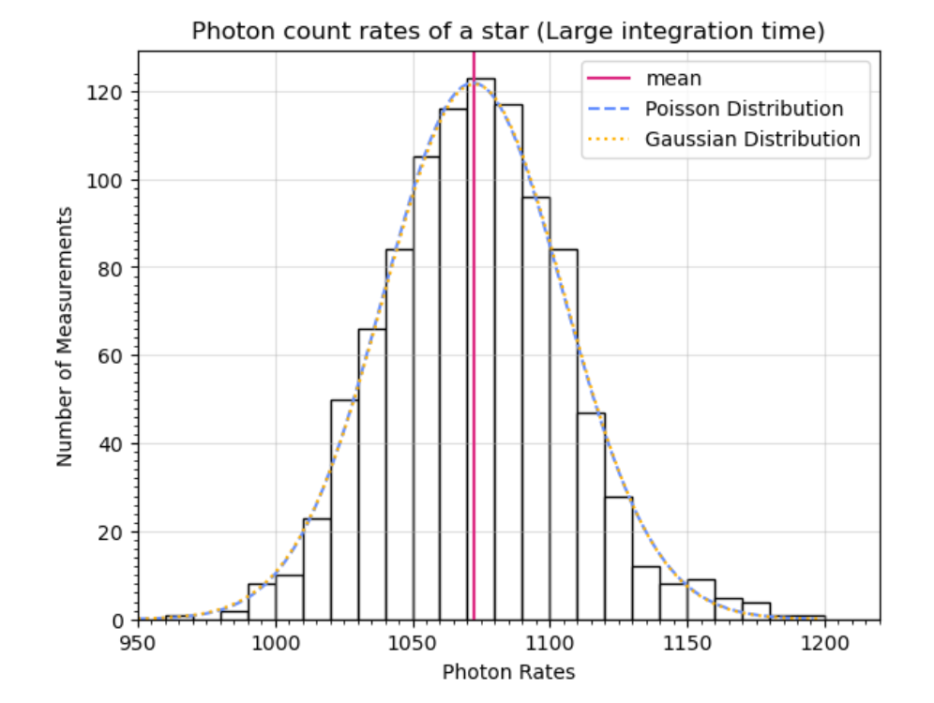
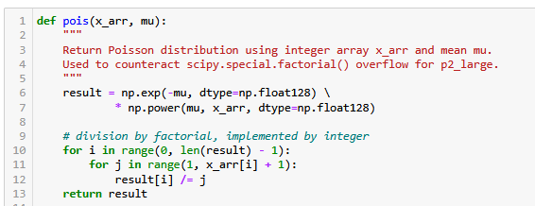
4.1: Data Distributions
small.txt photon count rates
Small ~ Poisson
(μ ≈ σ²)
Small.txt, Large.txt
Reading from files using np.readtxt(), σ and μ computed with NumPy methods
Issue: factorial overflows in Poisson pmf → loop division
large.txt photon count rates
Large ~ Normal(?)
Poisson → Normal
with μ → ∞

Slide 5
4.2: Discovering the CMOS! (4.2.1-4.2.3)
We had the monochrome CMOS FMVU-03MTM
First practical
  No stand
  Problem with the focus
  No photos taken
Second practical
  We had a stand
  Clear focused image
  Photos taken
4.2.1
lowest shutter - mean 53.9 (sd 7.7), one peak
increase shutter = brighter values, more spread out, multiple peaks.
  Some pixels get saturated at high (0.02s) shutter speed pointed at blend of desk and chair
max value for an 8-bit camera = 255

Slide 6
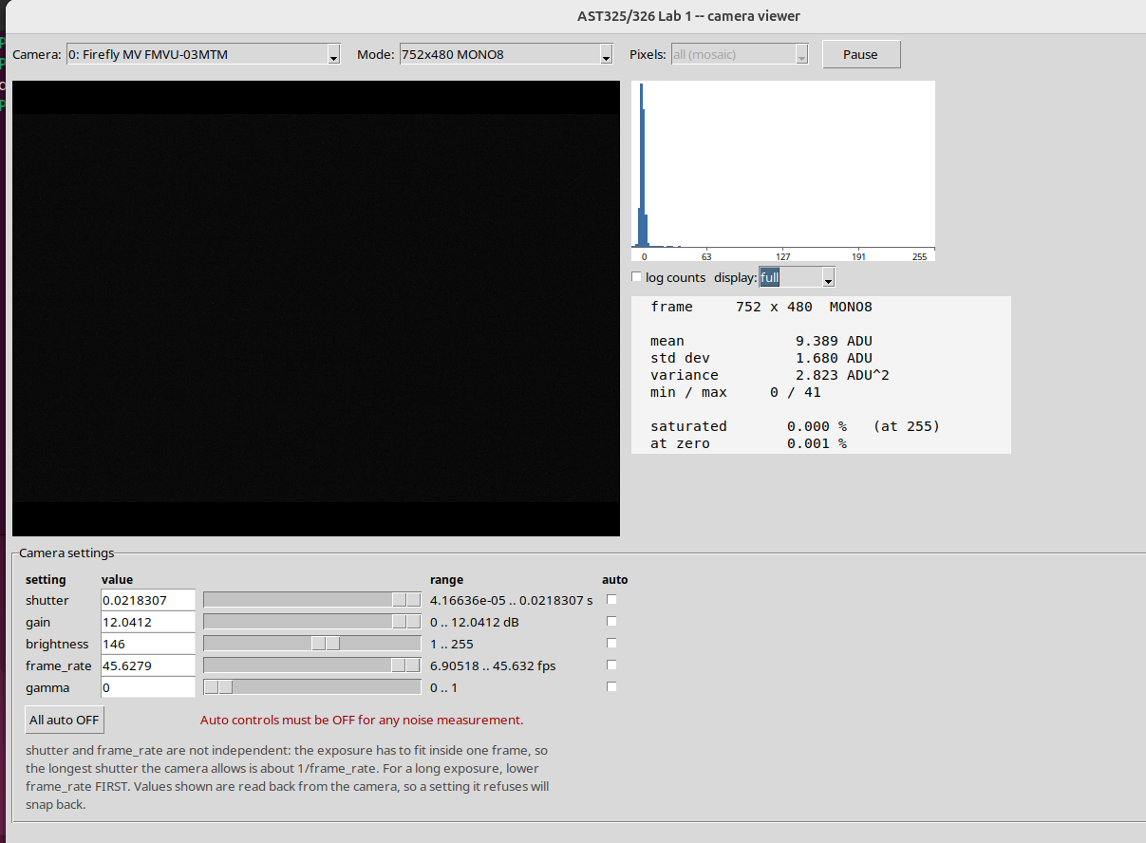
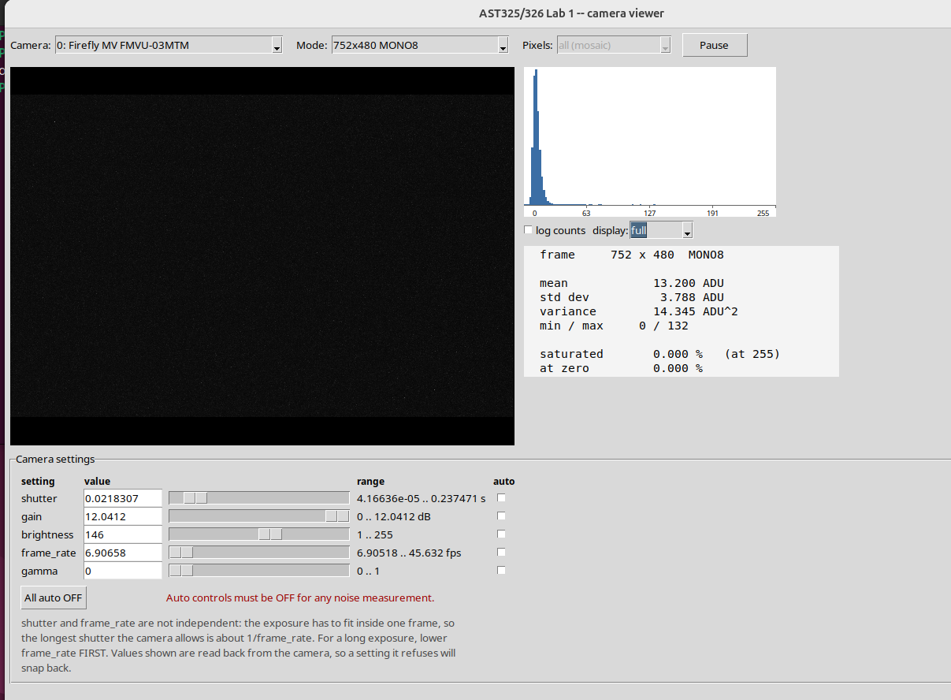
4.2: Discovering the CMOS! (4.2.1-4.2.3)
4.2.2 - In the Dark!
Lowest Frame rate -> Longest exposure
  min frame 6.90518 - couple brighter bins but still really low - max shutter 0.27
  A couple of individually bright pixels
Dark and uniform but not static!
  Exposure time increase
  increasing rate makes it darker
  the individually dark pixels darkened/disappeared
  max 45.632 - max shutter 0.02

Slide 7
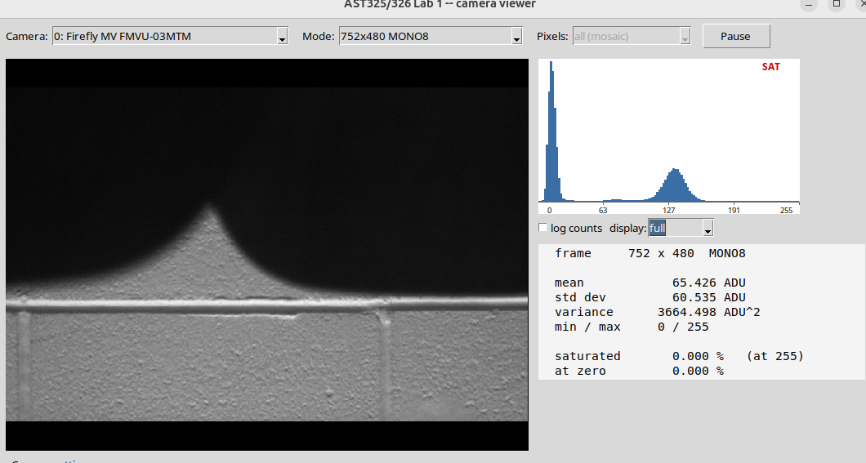
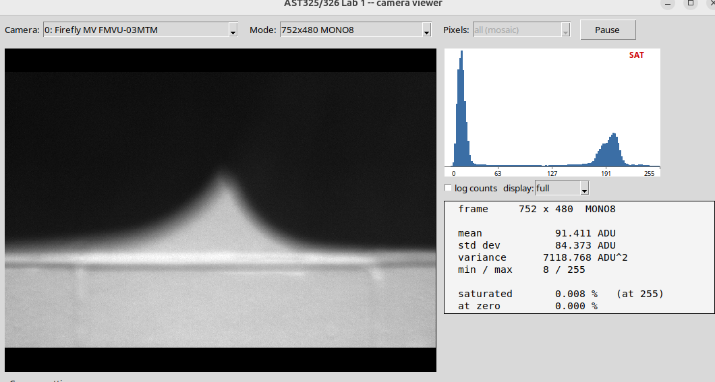
4.2.3 - Uniform vs Non-uniform
Used the back of a chair
Set max gain, aperture F/1.4, mean ADU set 180-220
  In focus we saw stark peaks, while out of focus smoothed out the histogram
  We also saw an increase in saturation - counterintuitive because less lens area should give us less light.
  Once fully closed, it was dark (obviously)
(data from first week)
F/1.4: mean 221
STD: 24.4
F/C: mean 54.5
STD: 8.1
Lowering
Aperture
—>

Slide 8
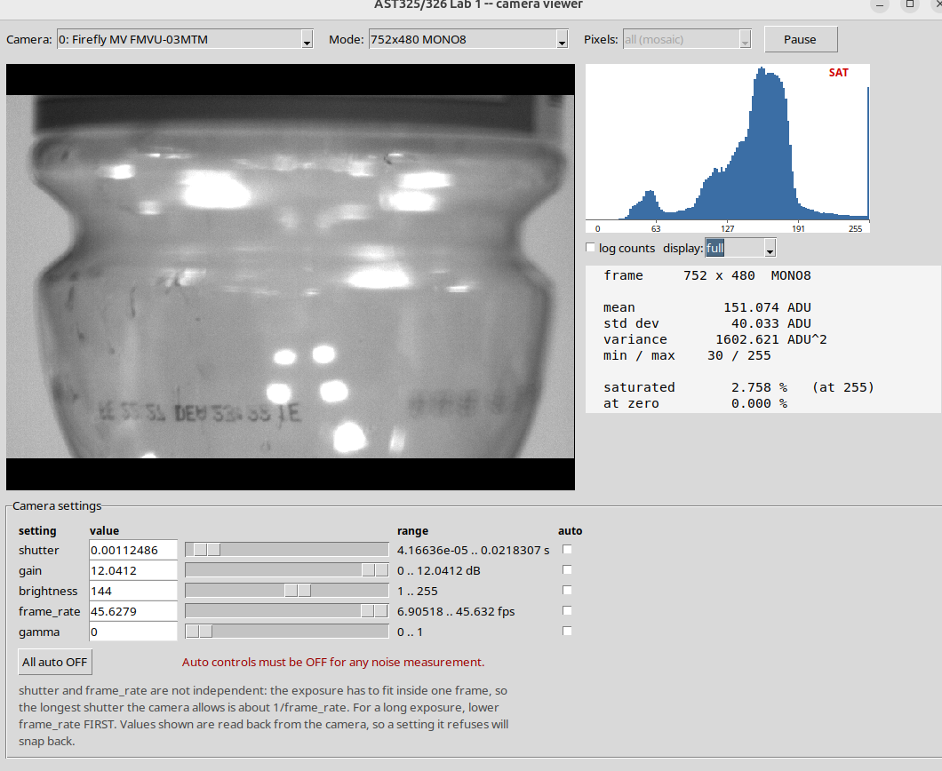
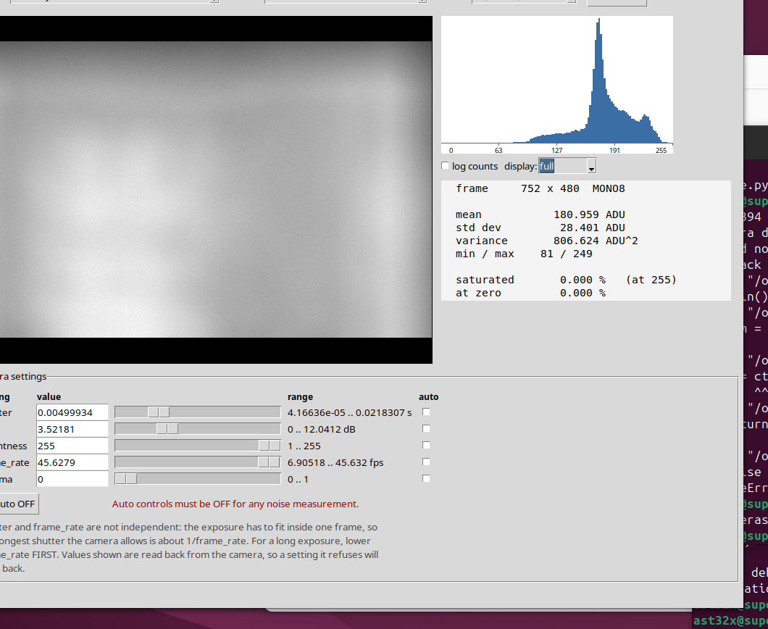
4.2.4: Read Noise
We started with a water bottle, for a non-uniform object, but it became a problem with how reflective it was, our histogram was changing too much. Anyone moving in the room changed the reflection!
Switched to a stable, less reflective object for more consistent captures.
We also blurred the camera so we got closer to a gradient
We then were able to take light and dark captures to use in the following coding sections
Reflective object (not blurred)
Improved non-reflective object (blurred)

Slide 9
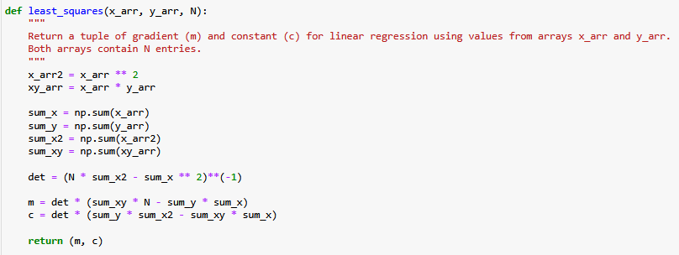
4.2.4: Read Noise
1,000 random samples from 360,960 pixels.
In-house least-squares method

Slide 10
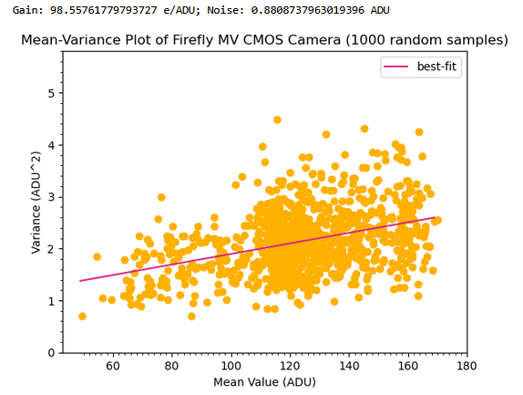
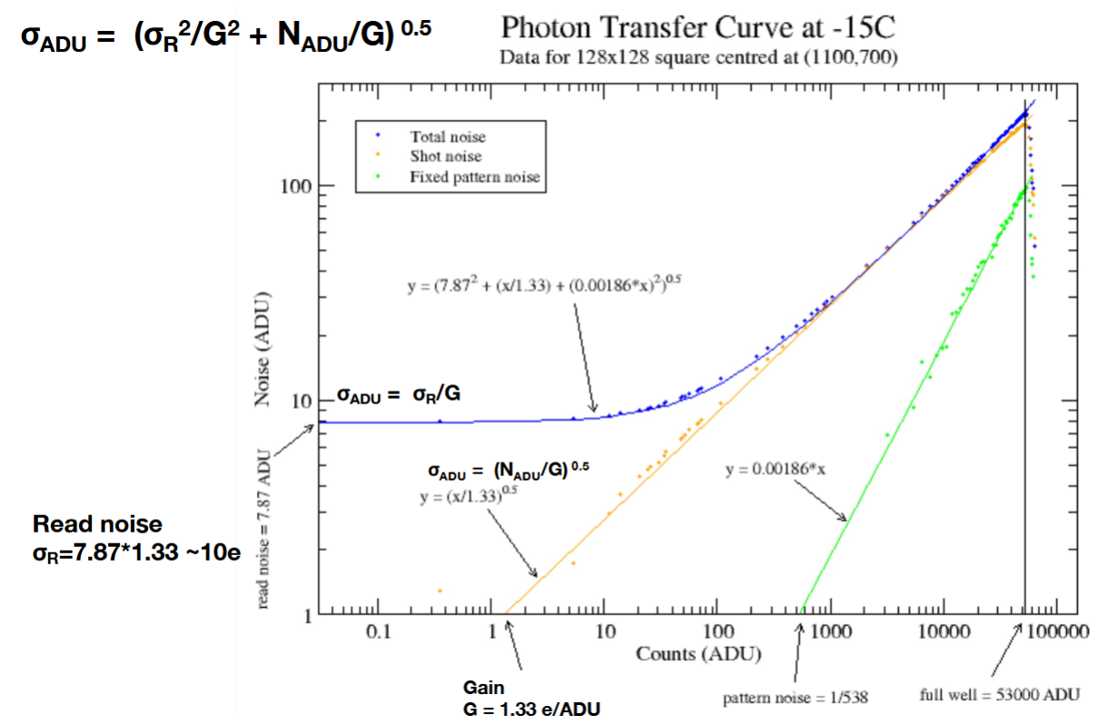
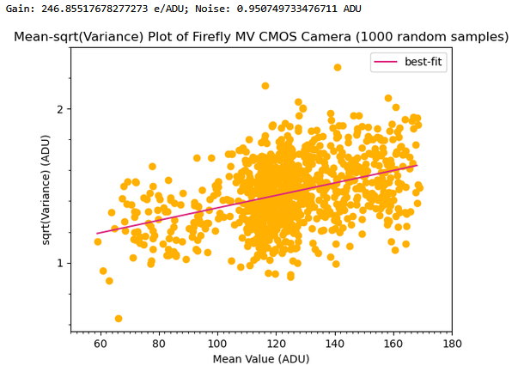
4.2.4: Read Noise
Questions/Concerns:
Axis powers? Which value on which axis?
  Tried to take reference on lecture slides:
  Gain is reciprocal of slope, units e⁻/ADU
  (Logarithmic axes?)

Slide 11
4.2.4: Read Noise
In hindsight, dimensional analysis would have been a good way to find out
Piazza post response! (28/09/2026)
Plot σ² against μ, no changes in power.
→ Top plot was the correct one!
Gain: 98.6 e⁻/ADU
Read Noise: 0.881 ADU
(86.8 e⁻)
Thank you Bruno!

Slide 12
The +
The second week, we knew what to do hence:
  Smoother Workflow
    We were more efficient and productive
    We obtained better results
  Better teamwork
    We understood each other’s strength better
  Result matches Theory
    Small data set approached a Poisson distribution as expected
    Large data set approached a Normal distribution as expected
  We were more confident about our results
We set up a GitHub repo (thank you Group D!)

Slide 13
The -
First time with the camera resulted in inconclusive results (due to it not being able to be focused)
We did not take any pictures from the 1st hour - quickly went back to what we did in the 2nd hour to take screenshots
  Both caused lots of wasted time, but was made up in our efficiency in the second hour
At first we couldn’t figure out the capturing process
Choosing a good object for the camera was a challenge, originally using one with lots of reflections was a mistake.
Linux terminal was hard to get used to

Slide 14
Further Investigations (4.2.5) Measuring Dark Current
The slope of the best-fit line will output ADU/(seconds*pixels). To convert it to electrons per second per pixel we have to use the formula:
D(electrons per pixel per second)=D(ADU)*CF*(electrons per ADU)
where CF is the gain we measured at 4.2.4 which we will use to convert dark current into electrons per second per pixel.
Normally there is a linear relation between electrons = dark current rate * time. But as exposure time increases and image comes closer to saturation each pixel’s potential well gets piled up with electrons. Also gets limited by ADU’s max values which is 2^n -1, 255 (for our camera), therefore reported value of pixels mean plateaus which leaves the linear regime. Due to these upper bounds for ADU we will be setting the exposure time in milliseconds and up to 30ms max to keep electrons = dark current rate * time linear.

Slide 15
What do we have to say for other groups?
If in doubt: Turn off and on
  If in more doubt, ask a TA/CI/T not A
Take lots of pictures and notes
Make a GitHub repo! It’s a learning curve but very worth it.
Take more frames than you think you need. More data makes the distributions much cleaner, especially for checking Poisson against Normal.

Slide 16
QUESTIONS / COMMENTS ‽

