Slide 1
Ψ
QUANTUM MECHANICS — MODULE I.1 — HILBERT SPACE & OPERATORS
L01
The Hilbert Space of Quantum States
Geometric & Algebraic Foundations — Module I.1, Lecture 1
HS
BegUG
AdvUG
MSc
PhD
Full expanded deck · 5 tiers · Worked examples · Complete problem sets
QM: Module I.1 — L01
L01

Slide 2
L01 — Lecture Overview
L01
The Hilbert Space of Quantum States
90-MIN PACING
CORE LEARNING OUTCOMES
0–20 min: Motivation — why Euclidean space is insufficient
20–45 min: Definition of a Hilbert space H: inner product, norm, completeness
45–70 min: Bounded vs. unbounded operators; operator norm; adjoint Â†
70–90 min: Anti-Hermitian operators; [Â†]† = Â; worked examples
State the definition of a Hilbert space and verify L²(ℝ) is one
Distinguish bounded from unbounded operators with physical examples
Define the adjoint Â† and compute it for 2×2 matrices
Classify Hermitian (Â = Â†) and anti-Hermitian (Â = −Â†) operators
HS
BegUG
AdvUG
MSc
PhD
Inner product as overlap; norm as length; ℝ² and ℂ² as tangible examples
Verify axioms in ℂⁿ; compute Â† for explicit matrices
Prove adjoint is unique; show (ÂB̂)† = B̂†Â†
L² space rigorously; operator norm; boundedness ↔ continuity equivalence
Spectrum of unbounded operators; domain issues; Hellinger–Toeplitz theorem
ASSESSMENT BUNDLE
Set A — verify Hilbert space axioms for ℂⁿ; compute adjoints of given 3×3 matrices
Set B — prove (Â†)† = Â; show bounded ⇒ continuous
Projects: norm visualiser for L² functions (simple); unbounded operator counterexample (complex)
QM: Module I.1 — L01
L01 · Overview

Slide 3
L01 — Dual-Track Content
L01
Two parallel perspectives: Geometric/Physical ↔ Algebraic/Axiomatic
GEOMETRIC TRACK — Infinite-Dimensional Generalisation of ℝⁿ
ALGEBRAIC/AXIOMATIC TRACK — Formal Axioms and Operator Theory
HILBERT SPACE AS GEOMETRY
HILBERT SPACE AXIOMS
H is the right infinite-dimensional generalisation of ℝⁿ. The inner product ⟨·|·⟩ gives angles between states; completeness means no 'missing limits' in sequences of states.
H is a complex vector space with inner product ⟨·|·⟩ satisfying: (1) conjugate symmetry ⟨φ|ψ⟩ = ⟨ψ|φ⟩*; (2) linearity in second argument; (3) positive definiteness ⟨ψ|ψ⟩ ≥ 0, = 0 iff |ψ⟩ = 0; (4) completeness.
INNER PRODUCT AND ANGLES
ADJOINT OPERATOR Â†
⟨φ|ψ⟩ measures the overlap (angle) between two quantum states. Real part gives correlation; imaginary part encodes phase. Orthogonality ⟨φ|ψ⟩ = 0 means perfectly distinguishable states.
The adjoint is defined by ⟨φ|Âψ⟩ = ⟨Â†φ|ψ⟩ for all |φ⟩, |ψ⟩ ∈ H. For matrices: (Â†)ᵢⱼ = (Â)ⱼᵢ* (conjugate transpose). Properties: (Â†)† = Â, (ÂB̂)† = B̂†Â†.
COMPLETENESS — NO MISSING LIMITS
BOUNDED vs. UNBOUNDED OPERATORS
Every Cauchy sequence {|ψₙ⟩} with ‖|ψₙ⟩ − |ψₘ⟩‖ → 0 must converge to a state already in H. This is essential for time-evolution, Fourier expansions, and perturbation theory.
Â is bounded if ‖Â‖ := sup{‖Â|ψ⟩‖ : ‖|ψ⟩‖ = 1} < ∞. Physical examples — bounded: spin operators Ŝᵢ; unbounded: position x̂ and momentum p̂ on L²(ℝ).
NORM FROM INNER PRODUCT
HERMITIAN AND ANTI-HERMITIAN
‖|ψ⟩‖ = √⟨ψ|ψ⟩. This defines the 'length' of a state. Normalisation ⟨ψ|ψ⟩ = 1 ensures probabilities sum to unity.
Hermitian: Â = Â† — real eigenvalues, observable. Anti-Hermitian: Â = −Â† — purely imaginary eigenvalues. Every operator decomposes: Â = (Â + Â†)/2 + (Â − Â†)/2.
QM: Module I.1 — L01
L01 · Dual Track

Slide 4
L01 — L01.1: Motivation: Why Hilbert Space?
L01
Failures of Euclidean space and the need for infinite dimensions
INADEQUACY OF ℝⁿ FOR QUANTUM MECHANICS
KEY FORMULA
Quantum states require superposition over continuous variables (position, momentum). A particle's wavefunction ψ(x) ∈ L²(ℝ) cannot be represented in any finite-dimensional space. The correct arena is an infinite-dimensional Hilbert space.
Inner product: ⟨φ|ψ⟩ ∈ ℂ
Norm: ‖|ψ⟩‖ = √⟨ψ|ψ⟩
Cauchy: ‖|ψₙ⟩ − |ψₘ⟩‖ → 0
Completeness: limit ∈ H
PHYSICAL NECESSITY OF COMPLEX NUMBERS
Interference phenomena (double-slit experiment) require complex amplitudes. Real vector spaces cannot produce the interference cross-terms |A₁ + A₂|² = |A₁|² + |A₂|² + 2 Re(A₁*A₂) with the correct sign.
WORKED EXAMPLE
L²(ℝ) as a Hilbert space:
States: ψ(x) with ∫|ψ|²dx < ∞
Inner product: ⟨φ|ψ⟩ = ∫φ*(x)ψ(x)dx
Norm: ‖ψ‖² = ∫|ψ(x)|²dx
Completeness: Riesz–Fischer theorem
─ Gaussian ψ = N·exp(−x²/2σ²) ∈ L²(ℝ) ✓
COMPLETENESS AS PHYSICAL REQUIREMENT
Time evolution U(t)|ψ⟩ and Fourier-mode expansions require limits to exist within H. A non-complete space would have quantum states 'escaping' to outside the mathematical framework.
HISTORICAL CONTEXT
von Neumann (1932) placed QM on rigorous mathematical footing using Hilbert spaces. Dirac's bra-ket notation (1930) provided the physical language that maps naturally onto this framework.
QM: Module I.1 — L01
L01 · L01.1

Slide 5
L01 — L01.2: Hilbert Space Definition and Axioms
L01
Formal structure: inner product, norm, and completeness
DEFINITION OF HILBERT SPACE
KEY FORMULA
A Hilbert space H is a complete inner product space over ℂ. The inner product ⟨·|·⟩: H × H → ℂ satisfies four axioms: (1) conjugate symmetry, (2) linearity in second slot, (3) positive definiteness, (4) non-degeneracy.
⟨φ|ψ⟩* = ⟨ψ|φ⟩
|⟨φ|ψ⟩|² ≤ ‖φ‖²‖ψ‖²
‖|ψ⟩‖ = ⟨ψ|ψ⟩^(1/2)
In ℂⁿ: ⟨φ|ψ⟩ = Σᵢ φᵢ*ψᵢ
THE FOUR INNER PRODUCT AXIOMS
(IP1) ⟨φ|ψ⟩ = ⟨ψ|φ⟩* [conjugate symmetry]
(IP2) ⟨φ|αψ + βχ⟩ = α⟨φ|ψ⟩ + β⟨φ|χ⟩ [linearity]
(IP3) ⟨ψ|ψ⟩ ≥ 0 [positive semidefinite]
(IP4) ⟨ψ|ψ⟩ = 0 ⟺ |ψ⟩ = 0 [non-degeneracy]
WORKED EXAMPLE
Verify ℂ² is a Hilbert space:
Let |φ⟩ = (φ₁,φ₂)ᵀ, |ψ⟩ = (ψ₁,ψ₂)ᵀ
⟨φ|ψ⟩ = φ₁*ψ₁ + φ₂*ψ₂
Conjugate symmetry: ✓ by inspection
Linearity: ✓ distributivity of ℂ
⟨ψ|ψ⟩ = |ψ₁|² + |ψ₂|² ≥ 0 ✓
Completeness: ℂⁿ is complete ✓
CAUCHY-SCHWARZ AND TRIANGLE INEQUALITIES
|⟨φ|ψ⟩|² ≤ ⟨φ|φ⟩·⟨ψ|ψ⟩ [Cauchy–Schwarz]
‖|φ⟩ + |ψ⟩‖ ≤ ‖|φ⟩‖ + ‖|ψ⟩‖ [Triangle inequality]
EXAMPLES AND NON-EXAMPLES
Examples: ℂⁿ (finite dim.), L²(ℝ), L²([0,1]), ℓ²(ℤ). Non-Hilbert spaces: C([0,1]) with L²-norm (not complete); L²ₗₒc without the square-integrability constraint.
QM: Module I.1 — L01
L01 · L01.2

Slide 6
L01 — L01.3: Bounded and Unbounded Operators
L01
Operator norm, domain, and physical examples
BOUNDED OPERATORS
KEY FORMULA
An operator Â: H → H is bounded if ‖Â‖ := sup{‖Â|ψ⟩‖/‖|ψ⟩‖ : |ψ⟩ ≠ 0} < ∞. Equivalently, Â is bounded iff it is continuous. All operators on finite-dimensional spaces are bounded.
‖Â‖ = sup‖Â|ψ⟩‖/‖|ψ⟩‖
⟨φ|Âψ⟩ = ⟨Â†φ|ψ⟩
(Â†)ᵢⱼ = (Â)ⱼᵢ*
(ÂB̂)† = B̂†Â†
(Â†)† = Â
UNBOUNDED OPERATORS AND DOMAIN
Unbounded operators Â: D(Â) → H are only defined on a dense subset D(Â) ⊂ H. Key examples: x̂ (position) and p̂ = −iℏ∂/∂x (momentum) on L²(ℝ). These are unbounded because x̂|ψₙ⟩ can have ‖x̂|ψₙ⟩‖ → ∞ for normalised |ψₙ⟩.
WORKED EXAMPLE
Compute Â† for spin-1/2 operator:
Â = σ₊ = [[0,1],[0,0]] (raising operator)
Â† = (Â*)ᵀ = [[0,0],[1,0]] = σ₋
Check: ⟨φ|σ₊ψ⟩ = ⟨σ₋φ|ψ⟩ ✓
─
Anti-Hermitian example: iσᵧ = [[0,1],[-1,0]]
(iσᵧ)† = −iσᵧ = −(iσᵧ) ✓ anti-Hermitian
THE ADJOINT OPERATOR Â†
Defined via ⟨φ|Âψ⟩ = ⟨Â†φ|ψ⟩ for all |φ⟩ ∈ D(Â†) and |ψ⟩ ∈ D(Â). For matrices: (Â†)ᵢⱼ = Âⱼᵢ* (conjugate transpose). Key property: (Â†)† = Â when Â is bounded.
OPERATOR CLASSIFICATIONS
• Hermitian (self-adjoint): Â = Â† → real eigenvalues (observables)
• Anti-Hermitian: Â = −Â† → imaginary eigenvalues
• Unitary: ÂÂ† = Â†Â = 1̂ → norm-preserving
• Normal: ÂÂ† = Â†Â → diagonalisable
QM: Module I.1 — L01
L01 · L01.3

Slide 7
L01 — L01.4: Hermitian and Anti-Hermitian Operators
L01
Classification, properties, and the decomposition theorem
HERMITIAN OPERATORS: Â = Â†
KEY FORMULA
A Hermitian operator satisfies ⟨φ|Âψ⟩ = ⟨Âφ|ψ⟩ for all |φ⟩, |ψ⟩. Key properties: (1) all eigenvalues are real, (2) eigenvectors for distinct eigenvalues are orthogonal, (3) eigenvectors form a complete basis (spectral theorem).
Hermitian: Â = Â†
Anti-Hermitian: Â = −Â†
(Â†)† = Â [involution]
Â_H = (Â + Â†)/2
Â_AH = (Â − Â†)/2
ANTI-HERMITIAN OPERATORS: Â = −Â†
An anti-Hermitian operator satisfies Â† = −Â. Properties: (1) all eigenvalues are purely imaginary (λ = iμ, μ ∈ ℝ), (2) iÂ is Hermitian. Physical role: generators of unitary transformations are anti-Hermitian; observables = i × generators.
WORKED EXAMPLE
PROOF: (Â†)† = Â
Decompose Â = [[1+i, 2],[3, 4−i]]:
Â† = [[1−i, 3],[2, 4+i]]
Â_H = [[1, 5/2],[5/2, 4]] (Hermitian part)
Â_AH = [[i, −1/2],[1/2, −i]] (anti-Hermitian)
─ Verify: Â_H = Â_H† ✓
─ Verify: Â_AH† = −Â_AH ✓
─ Check: Â_H + Â_AH = Â ✓
By definition of adjoint: ⟨φ|(Â†)†ψ⟩ = ⟨(Â†)φ|ψ⟩ for all |φ⟩, |ψ⟩.
But ⟨(Â†)φ|ψ⟩ = ⟨ψ|(Â†)φ⟩* = ⟨Â†ψ|φ⟩* ... Applying the adjoint definition twice recovers the original operator. Therefore (Â†)† = Â. □
DECOMPOSITION THEOREM
Every operator decomposes uniquely into Hermitian and anti-Hermitian parts:
Â = (Â + Â†)/2 + (Â − Â†)/2
= Â_H + Â_AH
where Â_H is Hermitian and Â_AH is anti-Hermitian.
QM: Module I.1 — L01
L01 · L01.4

Slide 8
HS
L01 — High School Track
L01
The Hilbert Space of Quantum States
LEARNING OBJECTIVES
PROBLEM SET
Understand inner product as 'overlap' between states
Interpret norm as 'length' of a quantum state
Use ℝ² and ℂ² as concrete finite-dimensional examples
Identify Hermitian vs. non-Hermitian 2×2 matrices by inspection
P1: Compute ⟨φ|ψ⟩ for |φ⟩=(1,i)/√2, |ψ⟩=(i,1)/√2
P2: Verify σ_x is Hermitian; verify iσ_x is anti-Hermitian
P3: Find ‖α|+⟩ + β|−⟩‖ in terms of |α|, |β|
WORKED EXAMPLE
EXTENSIONS & DEPTH
ℂ² example: |+⟩ = (1,0), |−⟩ = (0,1)
⟨+|−⟩ = 1·0 + 0·1 = 0 (orthogonal)
‖|+⟩‖ = √(1²+0²) = 1 (normalised)
σ_z = [[1,0],[0,−1]]: σ_z† = σ_z ✓ Hermitian
Connect to arrow addition in 2D
Phase factors e^(iθ) as unit complex numbers
Superposition = vector addition in ℂ²
QM: Module I.1 — L01
L01 · HS

Slide 9
BegUG
L01 — Beg. UG Track
L01
The Hilbert Space of Quantum States
LEARNING OBJECTIVES
PROBLEM SET
Verify all four Hilbert space axioms for ℂⁿ
Compute Â† for explicit 2×2 and 3×3 matrices
State definition of bounded operator and operator norm
Apply Cauchy–Schwarz: |⟨φ|ψ⟩|² ≤ ‖φ‖²‖ψ‖²
P1: Compute adjoint of a general 2×2 complex matrix
P2: Verify axiom (IP2) for L²([0,1]) explicitly
P3: Show the operator norm satisfies ‖Â‖ ≥ 0
P4: Is σ_z + iσ_y Hermitian, anti-Hermitian, or neither?
WORKED EXAMPLE
EXTENSIONS & DEPTH
Compute Â† for Â = [[1+i, 2−i],[3i, 4]]:
Step 1: Transpose → [[1+i, 3i],[2−i, 4]]
Step 2: Complex conjugate → [[1−i, −3i],[2+i, 4]]
So Â† = [[1−i, −3i],[2+i, 4]]
Proof that ‖Â‖ = ‖Â†‖ for bounded operators
Connection to Frobenius norm ‖Â‖_F = √Tr(Â†Â)
QM: Module I.1 — L01
L01 · BegUG

Slide 10
AdvUG
L01 — Adv. UG Track
L01
The Hilbert Space of Quantum States
LEARNING OBJECTIVES
PROBLEM SET
Prove adjoint is unique given inner product structure
Derive (ÂB̂)† = B̂†Â† from the adjoint definition
Construct explicit examples of unbounded operators
Show that bounded ⟺ continuous for linear operators
P1: Prove adjoint is unique (use non-degeneracy of IP)
P2: Show p̂ = −iℏd/dx is Hermitian on S(ℝ) ⊂ L²(ℝ)
P3: Prove bounded ⟺ continuous for linear operators on H
P4: Find ‖σ_x‖ using the operator norm definition
WORKED EXAMPLE
EXTENSIONS & DEPTH
Prove (ÂB̂)† = B̂†Â†:
⟨φ|(ÂB̂)ψ⟩ = ⟨Â†φ|B̂ψ⟩ = ⟨B̂†Â†φ|ψ⟩
By uniqueness of adjoint: (ÂB̂)† = B̂†Â† □
─ Key: adjoint reverses operator order
Closed graph theorem
Hellinger–Toeplitz: everywhere-defined Hermitian ⟹ bounded
QM: Module I.1 — L01
L01 · AdvUG

Slide 11
MSc
L01 — MSc Track
L01
The Hilbert Space of Quantum States
LEARNING OBJECTIVES
PROBLEM SET
Define L²(ℝ) rigorously via Lebesgue integration
Compute operator norm and relate to spectral radius
State and apply the Hellinger–Toeplitz theorem
Connect bounded ↔ continuous and domain considerations
P1: Use Riesz–Fischer to prove L²(ℝ) is complete
P2: Prove operator norm ‖Â‖ = sup of spectrum |σ(Â)|
P3: State Hellinger–Toeplitz theorem; give counterexample
WORKED EXAMPLE
EXTENSIONS & DEPTH
Compute ‖x̂‖ on L²([-N,N]):
For ψₙ = χ_[n,n+1]/√1, ‖x̂ψₙ‖ ≈ n → ∞
So x̂ is unbounded on L²(ℝ) ✓
But ‖x̂‖ on L²([-N,N]) = N (finite, bounded) ✓
Spectral radius formula: r(Â) = lim ‖Âⁿ‖^(1/n)
Relation to spectral theorem for bounded self-adjoint operators
QM: Module I.1 — L01
L01 · MSc

Slide 12
PhD
L01 — PhD Track
L01
The Hilbert Space of Quantum States
LEARNING OBJECTIVES
PROBLEM SET
Analyse spectrum of unbounded operators rigorously
Distinguish domain issues for Hermitian vs. self-adjoint operators
State the Hellinger–Toeplitz theorem with proof sketch
Classify operators by their deficiency indices
P1: Prove Hellinger–Toeplitz: dom(Â) = H, Hermitian ⟹ bounded
P2: Compute deficiency indices (n₊,n₋) for p̂ on L²([0,1])
WORKED EXAMPLE
EXTENSIONS & DEPTH
Domain distinction for p̂ on L²([0,1]):
D(p̂_min) = H¹₀(0,1): p̂ is Hermitian, not self-adjoint
D(p̂_θ) = {ψ: ψ(1) = e^(iθ)ψ(0)}: self-adjoint extension
Each θ ∈ [0,2π) gives distinct self-adjoint extension!
Closed operators and closed extensions
Von Neumann deficiency index theorem
Spectral theory: resolvent set, point/continuous/residual spectrum
QM: Module I.1 — L01
L01 · PhD

Slide 13
L01 — Common Pitfalls & Misconceptions
L01
Consolidated pitfalls across all tiers
⚠ PITFALLS (A)
⚠ PITFALLS (B)
Confusing 'Hermitian' with 'self-adjoint' — they differ for unbounded operators on domains D(Â) ⊊ H
Forgetting complex conjugation in adjoint: (Â†)ᵢⱼ = Â*ⱼᵢ not Âⱼᵢ
Assuming all operators on H are bounded — x̂ and p̂ are not
Treating ⟨φ|ψ⟩ as symmetric — it is conjugate-symmetric: ⟨φ|ψ⟩ = ⟨ψ|φ⟩*
Confusing operator norm ‖Â‖ with Frobenius norm ‖Â‖_F
Forgetting that anti-Hermitian operators have imaginary (not real) eigenvalues
HISTORICAL ANCHORS
FORMULA QUICK REFERENCE
Hilbert (1900s): spectral theory of integral operators
von Neumann (1932): Mathematical Foundations of QM — axiomatic Hilbert space
Hellinger & Toeplitz (1910): unbounded symmetric operators
Stone (1930s): self-adjoint extensions and domains
Inner product: ⟨φ|ψ⟩ = Σᵢφᵢ*ψᵢ (ℂⁿ)
Adjoint: (Â†)ᵢⱼ = Â*ⱼᵢ
Norm: ‖|ψ⟩‖ = √⟨ψ|ψ⟩
Classification: Â = Â† (Hermitian), Â = −Â† (anti-Herm.)
FORWARD CONNECTIONS
→ L02: Unitary operators Û with ÛÛ† = 1̂ built from Hermitian generators
→ L03: Spectral theorem requires self-adjoint operators; real eigenvalues
→ L04: Matrix exponential e^(iÂ) uses adjoint structure extensively
QM: Module I.1 — L01
L01 · Pitfalls

Slide 14
L01 — Assessment & Homework Summary
L01
Assessment artifact bundle — all tiers
HS
BegUG
AdvUG
MSc
PhD
Problems: 3 simple + 2 advanced
Project (simple, ~1h): Inner Product Visualiser in ℂ²
Project (adv, ~2-3h): Norm of L² Functions
Research: Explain why complex amplitudes are necessary for quantum interference
Problems: 5 simple + 2 advanced
Project (simple, ~2h): Adjoint Calculator with Verification
Project (adv, ~4h): Operator Norms for 3×3 Matrices
Research: Prove Cauchy–Schwarz inequality from the axioms
Problems: 3 simple + 3 advanced
Project (simple, ~2h): Bounded vs. Unbounded Operator Explorer
Project (adv, ~6h): Domain of p̂ on L²([0,1])
Research: Prove bounded ⟺ continuous for linear maps on H
Problems: 2 simple + 3 advanced
Project (simple, ~3h): L² Completeness via Cauchy Sequences
Project (adv, ~8h): Operator norm vs. Frobenius norm study
Research: Hellinger–Toeplitz theorem — statement, proof, implications
Problems: 2 simple + 3 advanced
Project (simple, ~3h): Rigour Checklist for Hilbert Space Axioms
Project (adv, ~15h): Self-Adjoint Extensions of p̂ on [0,1]
Research: Von Neumann's deficiency index theory
HOMEWORK ASSIGNMENT
REQUIRED (all students): Problems from your track's Set A
HONOURS (optional): Set B problems from your track
PROJECT: Choose simple OR advanced track from your tier
RESEARCH: At least one well-defined question; open questions for MSc/PhD
QM: Module I.1 — L01
L01 · Assessment

Slide 15
L01 — References & Bibliography
L01
Historical, educational, and research-level reading
PRIMARY TEXTBOOKS
EDUCATIONAL REFERENCES
HISTORICAL & RESEARCH
Sakurai & Napolitano
Modern Quantum Mechanics, 3rd ed.
Ch. 1: Fundamental Concepts
─
Dirac, P.A.M.
Principles of Quantum Mechanics, 4th ed.
Ch. 1–2: Notation & Hilbert Space
─
Nielsen & Chuang
Quantum Computation & Quantum Information
Ch. 2: Linear Algebra Primer
Reed & Simon
Methods of Modern Mathematical Physics, Vol. 1
Ch. 2: Hilbert Spaces
─
Galindo & Pascual
Quantum Mechanics I
Ch. 1: Mathematical Framework
─
Thirring
Quantum Mathematical Physics
Ch. 1: Hilbert Space Theory
von Neumann (1932)
Mathematical Foundations of Quantum Mechanics
↳ Foundational axiomatic treatment
─
Hilbert (1912)
Grundzüge einer allgemeinen Theorie der linearen Integralgleichungen
↳ Origin of Hilbert space concept
─
Hellinger & Toeplitz (1910)
Grundsätzliches über Sturm-Liouville'sche Theorie
↳ First treatment of unbounded operators
QM: Module I.1 — L01
L01 · References

Slide 16
SECTION A
Tier-Differentiated Concept Slides
L01: The Hilbert Space of Quantum States
20 slides — 5 tiers × 4 learning objectives — each with diagram
HS
BegUG
AdvUG
MSc
PhD

Slide 17
LO1
Learning Objective 1: Hilbert Space Definition
5 slides — one per tier (HS / BegUG / AdvUG / MSc / PhD)

Slide 18
HS
L01 — LO1: Hilbert Space Definition | High School Track
L01
The Hilbert Space of Quantum States
CONCEPT EXPLANATION
Inner Product = Overlap
The inner product ⟨φ|ψ⟩ measures the 'overlap' between two quantum states.
If ⟨φ|ψ⟩ = 0, the states are orthogonal — perfectly distinguishable.
The norm ‖|ψ⟩‖ = √⟨ψ|ψ⟩ gives the 'length' of a state.
Normalisation ⟨ψ|ψ⟩ = 1 ensures probabilities add to 1.
Think: the Hilbert space is like ℝ² or ℂ², but possibly infinite-dimensional.
|ψ⟩
|φ⟩
θ
⟨φ|ψ⟩ ∈ ℂ (complex number)
‖|ψ⟩‖ = √⟨ψ|ψ⟩ (real ≥ 0)
⟨ψ|ψ⟩ = 1 (normalised state)
WORKED EXAMPLE / SUMMARY
Concrete: use ℂ² spin states. |+⟩=(1,0)ᵀ, |−⟩=(0,1)ᵀ, ⟨+|−⟩ = 0 (orthogonal), ‖|+⟩‖ = 1.
⟨φ|ψ⟩ = ||φ|| ||ψ|| cos θ ∈ ℂ
QM: Module I.1 — L01
L01 · LO1 · HS

Slide 19
BegUG
L01 — LO1: Hilbert Space Definition | Beg. Undergraduate Track
L01
The Hilbert Space of Quantum States
CONCEPT EXPLANATION
The 4 Inner Product Axioms
A Hilbert space ℋ is a complete complex inner product space.
(IP1) Conjugate symmetry: ⟨φ|ψ⟩ = ⟨ψ|φ⟩*
(IP2) Linearity in second slot: ⟨φ|αψ + βχ⟩ = α⟨φ|ψ⟩ + β⟨φ|χ⟩
(IP3) Positive semidefinite: ⟨ψ|ψ⟩ ≥ 0
(IP4) Non-degenerate: ⟨ψ|ψ⟩ = 0 iff |ψ⟩ = 0
Completeness: every Cauchy sequence converges within ℋ.
IP1
IP2
Conjugate
Symmetry
⟨φ|ψ⟩=⟨ψ|φ⟩*
Linearity
in 2nd slot
α|ψ⟩+β|χ⟩
IP3
IP4
Positive
Semidefinite
⟨ψ|ψ⟩ ≥ 0
Non-
Degenerate
⟨ψ|ψ⟩=0⟺0
In ℂⁿ: ⟨φ|ψ⟩ = Σᵢ φᵢ* ψᵢ
Cauchy: ‖|ψₙ⟩ − |ψₘ⟩‖ → 0
Complete: limit ∈ ℋ
WORKED EXAMPLE / SUMMARY
Exercise: Verify all 4 axioms for ⟨φ|ψ⟩ = Σᵢ φᵢ* ψᵢ on ℂⁿ.
QM: Module I.1 — L01
+ COMPLETENESS ⟹ Hilbert Space
L01 · LO1 · BegUG

Slide 20
AdvUG
L01 — LO1: Hilbert Space Definition | Adv. Undergraduate Track
L01
The Hilbert Space of Quantum States
CONCEPT EXPLANATION
Completeness: No Missing Limits
A Hilbert space ℋ over ℂ satisfies all four inner product axioms (IP1–IP4) and is complete.
Completeness means: if ‖|ψₙ⟩ − |ψₘ⟩‖ → 0, then ∃ |ψ⟩ ∈ ℋ with ‖|ψₙ⟩ − |ψ⟩‖ → 0.
Examples: ℂⁿ (finite), L²(ℝ) (infinite). Non-example: C([0,1]) with L²-norm.
Cauchy–Schwarz: |⟨φ|ψ⟩|² ≤ ⟨φ|φ⟩⟨ψ|ψ⟩ — prove using ‖|ψ⟩ − λ|φ⟩‖² ≥ 0.
limit ∈ ℋ ✓
Complete: ℋ
‖|ψₙ⟩ − |ψₘ⟩‖ → 0 ⟹ limit ∈ ℋ
limit ∉ space ✗
Incomplete: C([0,1]) with L² norm
Sequence of polynomials → non-polynomial (not in space!)
‖|ψ⟩ − |ψₙ⟩‖ → 0 (convergence)
|⟨φ|ψ⟩|² ≤ ‖φ‖²‖ψ‖² (C-S)
ℂⁿ, L²(ℝ), ℓ²(ℤ) are Hilbert
WORKED EXAMPLE / SUMMARY
Proof task: Show C([0,1]) with ‖f‖₂ = (∫|f|²dx)^½ is NOT complete.
QM: Module I.1 — L01
L01 · LO1 · AdvUG

Slide 21
MSc
L01 — LO1: Hilbert Space Definition | Master's Track
L01
The Hilbert Space of Quantum States
CONCEPT EXPLANATION
L²(ℝ) as a Hilbert Space
L²(ℝ) is the canonical infinite-dimensional separable Hilbert space.
Formally: equivalence classes [f] where f ~ g iff ∫|f−g|²dμ = 0 (a.e. equal).
The Riesz–Fischer theorem (1907) proves L²(ℝ) is complete.
Separability: L²(ℝ) has a countable orthonormal basis {eₙ} (e.g., Hermite functions).
Sobolev spaces H^s(ℝ) ⊂ L²(ℝ) for s > 0 carry additional regularity.
ψ(x)
∫|ψ(x)|²dx
x
‖f‖² = ∫_{ℝ} |f(x)|² dμ(x)
⟨f|g⟩ = ∫ f*(x) g(x) dμ(x)
Riesz–Fischer: L² is complete
• ψ ∈ L²(ℝ): square-integrable
WORKED EXAMPLE / SUMMARY
• ⟨φ|ψ⟩ = ∫φ*(x)ψ(x)dx
Theorem (Riesz–Fischer): Every L²-Cauchy sequence has a subsequence converging pointwise a.e. to its L²-limit.
• ‖ψ‖² = ∫|ψ(x)|²dx < ∞
• Complete: Riesz–Fischer theorem
QM: Module I.1 — L01
L01 · LO1 · MSc

Slide 22
PhD
L01 — LO1: Hilbert Space Definition | PhD Track
L01
The Hilbert Space of Quantum States
CONCEPT EXPLANATION
Mathematical Hierarchy of Spaces
Separable Hilbert spaces: all infinite-dimensional separable Hilbert spaces are isomorphic to ℓ²(ℤ).
Non-separable: L∞ and certain von Neumann algebra Hilbert spaces.
Completion theorem: every inner product space has a unique Hilbert space completion.
Domain theory: operators like x̂, p̂ are defined on dense domains D(Â) ⊊ L²(ℝ).
Gel'fand triple: S(ℝ) ⊂ L²(ℝ) ⊂ S*(ℝ) — rigged Hilbert space for continuous spectrum.
Metric
Space
Normed
Space
Hilbert
Space
ℓ²(ℤ) ≅ L²(ℝ) (separable ∞-dim)
Ī = closure of inner product space
S ⊂ L² ⊂ S* (Gel'fand triple)
Banach
Space
WORKED EXAMPLE / SUMMARY
Key: all separable infinite-dimensional Hilbert spaces are unitarily isomorphic — there is essentially ONE such space.
each ⊂ previous + extra structure
+ complete inner product ⟨·|·⟩
QM: Module I.1 — L01
L01 · LO1 · PhD

Slide 23
LO2
Learning Objective 2: Bounded vs Unbounded Ops
5 slides — one per tier (HS / BegUG / AdvUG / MSc / PhD)

Slide 24
HS
L01 — LO2: Bounded vs Unbounded Ops | High School Track
L01
The Hilbert Space of Quantum States
CONCEPT EXPLANATION
Bounded vs. Unbounded
A BOUNDED operator Â has a finite 'stretching factor': ‖Â|ψ⟩‖ ≤ M‖|ψ⟩‖ for all states.
An UNBOUNDED operator can stretch states by arbitrarily large amounts.
Bounded: spin operators Ŝₓ, Ŝᵧ, Ŝᵤ (eigenvalues ±ℏ/2 — always finite).
Unbounded: position x̂ (eigenvalues any real x ∈ ℝ) and momentum p̂.
Physicists use both: bounded for two-level systems, unbounded for continuous degrees of freedom.
BOUNDED
UNBOUNDED
Â
Bounded: ∃M < ∞, ‖Â|ψ⟩‖ ≤ M‖|ψ⟩‖
Unbounded: sup ‖Â|ψ⟩‖/‖|ψ⟩‖ = ∞
WORKED EXAMPLE / SUMMARY
Rule of thumb: finite matrix → bounded. Differential operator → unbounded.
‖Â‖ < ∞
x̂, p̂ on L²(ℝ)
QM: Module I.1 — L01
L01 · LO2 · HS

Slide 25
BegUG
L01 — LO2: Bounded vs Unbounded Ops | Beg. Undergraduate Track
L01
The Hilbert Space of Quantum States
CONCEPT EXPLANATION
The Operator Norm ‖Â‖
Definition: Â is bounded if ‖Â‖ := sup{‖Â|ψ⟩‖/‖|ψ⟩‖ : |ψ⟩ ≠ 0} < ∞.
Equivalent: Â is bounded iff Â is continuous (linear maps).
Operator norm submultiplicativity: ‖ÂB̂‖ ≤ ‖Â‖‖B̂‖.
Spin operators on ℂ²: ‖σₓ‖ = ‖σᵧ‖ = ‖σᵤ‖ = 1.
Position x̂ on L²([−N,N]): ‖x̂‖ = N → ∞ as N → ∞.
Image
Â(unit ball)
‖Â‖ = max
stretching
Unit ball
{|ψ⟩: ‖|ψ⟩‖=1}
Â
‖Â‖ = sup{ ‖Â|ψ⟩‖ : ‖|ψ⟩‖ = 1 }
‖σₙ‖ = 1 (bounded)
‖x̂‖ on L²([-N,N]) = N
WORKED EXAMPLE / SUMMARY
Compute ‖σ₃‖ using the definition. Eigenvectors |+⟩, |−⟩: σ₃|±⟩ = ±|±⟩, so ‖σ₃‖ = 1.
‖Â‖ := sup{ ‖Â|ψ⟩‖ : ‖|ψ⟩‖ = 1 }
QM: Module I.1 — L01
L01 · LO2 · BegUG

Slide 26
AdvUG
L01 — LO2: Bounded vs Unbounded Ops | Adv. Undergraduate Track
L01
The Hilbert Space of Quantum States
CONCEPT EXPLANATION
Bounded ⟺ Continuous
Theorem: A linear map Â: ℋ → ℋ is bounded iff it is continuous.
Proof (→): If ‖Â‖ ≤ M, then ‖Â|ψ⟩ − Â|φ⟩‖ = ‖Â(|ψ⟩−|φ⟩)‖ ≤ M‖|ψ⟩−|φ⟩‖ → 0.
Proof (←): By contradiction — assume ‖Â|ψₙ⟩‖ ≥ n‖|ψₙ⟩‖. Normalise to get a contradiction with continuity.
Hellinger–Toeplitz: if Â is everywhere defined and Hermitian, then Â is bounded.
Consequence: x̂ and p̂ (unbounded) CANNOT be defined on all of L²(ℝ).
BOUNDED
‖Â|ψ⟩‖ ≤ M‖|ψ⟩‖
for all |ψ⟩ ∈ ℋ
CONTINUOUS
|ψₙ⟩→|ψ⟩ ⟹
Â|ψₙ⟩→Â|ψ⟩
⟺
Bounded ⟺ continuous
Proof via ε-δ argument
Hellinger–Toeplitz theorem
⟹ proof:
ε-δ argument
‖Â(|ψ⟩-|φ⟩)‖≤M‖|ψ⟩-|φ⟩‖
⟸ proof:
Contradiction via
unbounded sequence
WORKED EXAMPLE / SUMMARY
The Hellinger–Toeplitz theorem shows that genuine physical observables (x̂, p̂, Ĥ) must have restricted domains.
QM: Module I.1 — L01
L01 · LO2 · AdvUG

Slide 27
MSc
L01 — LO2: Bounded vs Unbounded Ops | Master's Track
L01
The Hilbert Space of Quantum States
CONCEPT EXPLANATION
‖x̂‖ on L²([−N,N]) = N
The operator norm ‖Â‖ = sup{‖Â|ψ⟩‖ : ‖|ψ⟩‖=1} makes B(ℋ) into a Banach algebra.
Spectral radius formula: r(Â) = lim_{n→∞} ‖Âⁿ‖^{1/n} = sup{|λ| : λ ∈ σ(Â)}.
For self-adjoint Â: ‖Â‖ = r(Â) = sup{|λ| : λ ∈ σ(Â)} (norm = spectral radius).
Compact operators: a special class — limits of finite-rank operators; spectrum is discrete (except 0).
Hilbert–Schmidt operators: ‖Â‖_HS = (Tr Â†Â)^½ < ∞; a subset of compact operators.
‖x̂‖
4
→ ∞ as N→∞
(unbounded on L²(ℝ)!)
3
2
r(Â) = lim ‖Âⁿ‖^{1/n}
Self-adjoint: ‖Â‖ = r(Â)
‖Â‖_HS = √Tr(Â†Â)
1
WORKED EXAMPLE / SUMMARY
For Hermitian Â: the operator norm equals the spectral radius, which equals the largest |eigenvalue|.
N
1
2
3
4
Key: finite interval → bounded; ℝ → unbounded
QM: Module I.1 — L01
L01 · LO2 · MSc

Slide 28
PhD
L01 — LO2: Bounded vs Unbounded Ops | PhD Track
L01
The Hilbert Space of Quantum States
CONCEPT EXPLANATION
Spectrum of Unbounded Operators
Unbounded operators require careful domain specification. Key example: p̂ = −iℏd/dx on L²([0,1]).
Deficiency indices (n₊, n₋): count dimensions of ker(Â* ∓ i).
Self-adjoint extensions exist iff n₊ = n₋.
For p̂ on L²([0,1]): n₊ = n₋ = 1 → one-parameter family of s.a. extensions p̂_θ with boundary conditions ψ(1) = e^{iθ}ψ(0).
Different θ give different physics (different spectra)!
Im
Re
n± = dim ker(Â*∓i)
s.a. extension iff n₊ = n₋
p̂_θ: ψ(1) = e^{iθ}ψ(0)
WORKED EXAMPLE / SUMMARY
σₚ(A): point spectrum (eigenvalues)
Von Neumann deficiency index theorem: the space of s.a. extensions is parametrised by U(n₊) when n₊ = n₋ = n.
σ_c(A): continuous spectrum (x̂, p̂)
QM: Module I.1 — L01
σ_r(A): residual spectrum (rare)
L01 · LO2 · PhD

Slide 29
LO3
Learning Objective 3: The Adjoint Operator Â†
5 slides — one per tier (HS / BegUG / AdvUG / MSc / PhD)

Slide 30
HS
L01 — LO3: The Adjoint Operator Â† | High School Track
L01
The Hilbert Space of Quantum States
CONCEPT EXPLANATION
Computing the Adjoint A†
The adjoint A† is the 'mirror image' of A in the inner product.
For matrices: A† = conjugate transpose = take transpose, then complex conjugate each entry.
Rule: (A†)ᵢⱼ = (A)ⱼᵢ* (swap row↔col, take complex conjugate).
Example: σ₊ = [[0,1],[0,0]] raises spin. σ₊† = σ₋ = [[0,0],[1,0]] lowers spin.
The adjoint reverses the action: where A raises, A† lowers.
a b
c d
① Transpose
(swap rows↔cols)
a c
b d
A =
② Complex Conjugate (z → z*)
A† =
a* c*
b* d*
(A†)ᵢⱼ = (A)ⱼᵢ*
(conjugate transpose)
(A†)ᵢⱼ = (A)ⱼᵢ*
(A†)† = A (involution)
σ₊† = σ₋
WORKED EXAMPLE / SUMMARY
Quick check: compute [[1+i, 2],[3, 4−i]]†. Answer: [[1−i, 3],[2, 4+i]].
QM: Module I.1 — L01
L01 · LO3 · HS

Slide 31
BegUG
L01 — LO3: The Adjoint Operator Â† | Beg. Undergraduate Track
L01
The Hilbert Space of Quantum States
CONCEPT EXPLANATION
Adjoint via Inner Product
Definition: A† is the unique operator satisfying ⟨φ|Aψ⟩ = ⟨A†φ|ψ⟩ for all |φ⟩, |ψ⟩.
For n×n matrices: (A†)ᵢⱼ = (A)ⱼᵢ* (conjugate transpose).
Key properties: (i) (A†)† = A; (ii) (AB)† = B†A† (reversal!); (iii) (αA)† = α*A†.
Hermitian: A = A† (real eigenvalues — observables). Anti-Hermitian: A = −A†.
Pauli matrices σₓ, σᵧ, σᵤ are all Hermitian: σᵢ† = σᵢ.
⟨φ | Â | ψ⟩
⟨Â†φ | ψ⟩
=
Â acts on |ψ⟩
(right side)
Â† acts on ⟨φ|
(left side)
⟨φ|Aψ⟩ = ⟨A†φ|ψ⟩ (definition)
(AB)† = B†A† (reversal)
σᵢ† = σᵢ (Hermitian)
Example: A = σ₊ = [[0,1],[0,0]]
WORKED EXAMPLE / SUMMARY
A† = [[0,0],[1,0]] = σ₋ (lowering operator)
Prove (AB)† = B†A†: ⟨φ|(AB)ψ⟩ = ⟨A†φ|Bψ⟩ = ⟨B†A†φ|ψ⟩ by applying adjoint definition twice.
Check: ⟨φ|σ₊ψ⟩ = ⟨σ₋φ|ψ⟩ ✓
∴ (σ₊)† = σ₋
QM: Module I.1 — L01
L01 · LO3 · BegUG

Slide 32
AdvUG
L01 — LO3: The Adjoint Operator Â† | Adv. Undergraduate Track
L01
The Hilbert Space of Quantum States
CONCEPT EXPLANATION
Key Adjoint Properties
Uniqueness of adjoint: if A† and Ã both satisfy ⟨φ|Aψ⟩ = ⟨A†φ|ψ⟩ = ⟨Ãφ|ψ⟩, then ⟨(A†−Ã)φ|ψ⟩ = 0 for all |ψ⟩, so A† = Ã.
Proof of (A†)† = A: ⟨φ|(A†)†ψ⟩ = ⟨(A†)φ|ψ⟩* by anti-linearity ... (show details).
Decomposition: A = (A+A†)/2 + (A−A†)/2 = A_H + A_AH (unique, A_H Hermitian, A_AH anti-Hermitian).
If A = A†, all eigenvalues real and eigenvectors orthogonal (proved in L03).
(A†)† = A
Apply definition twice:
⟨φ|(A†)†ψ⟩ = ⟨A†φ|ψ⟩* ... = ⟨Aφ|ψ⟩
⟹ (A†)† = A □
(AB)† = B†A†
⟨φ|(AB)ψ⟩ = ⟨A†φ|Bψ⟩ = ⟨B†A†φ|ψ⟩
Order reverses! □
Uniqueness: ⟨(A†−Ã)φ|ψ⟩=0 ⟹ A†=Ã
A = A_H + A_AH (unique decomp.)
A_H = (A+A†)/2
‖A‖ = ‖A†‖
Follows from ‖A‖² = ‖A†A‖
and ‖A†A‖ = ‖AA†‖ for bounded A
WORKED EXAMPLE / SUMMARY
Decompose A = [[1+i, 2],[3, 4−i]] into A_H and A_AH. Verify A_H = A_H†, A_AH = −A_AH†.
QM: Module I.1 — L01
L01 · LO3 · AdvUG

Slide 33
MSc
L01 — LO3: The Adjoint Operator Â† | Master's Track
L01
The Hilbert Space of Quantum States
CONCEPT EXPLANATION
Riesz Representation and the Adjoint
For bounded operators: Â† is the Hilbert space adjoint, related to the Banach adjoint by the Riesz map.
Riesz representation: every f ∈ ℋ* is of the form f = ⟨φ|·⟩ for a unique |φ⟩ ∈ ℋ.
Banach adjoint A*: Y* → X* defined by (A*g)(x) = g(Ax). Coincides with Hilbert adjoint via Riesz map.
For unbounded operators: domain of A† may differ from domain of A (subtle distinction between symmetric and self-adjoint).
Criterion: Â is self-adjoint iff A = A† AND D(Â) = D(A†).
ℋ (ket space)
|φ⟩, |ψ⟩ ∈ ℋ
Riesz: |φ⟩ ↔ ⟨φ|
ℋ* (bra space)
⟨φ|, ⟨ψ| ∈ ℋ*
Â: ℋ → ℋ
|ψ⟩ ↦ Â|ψ⟩
adjoint
Â†: ℋ → ℋ
⟨φ| ↦ ⟨φ|Â
Riesz Theorem: For every f ∈ ℋ*, ∃! |φ⟩ ∈ ℋ
such that f(|ψ⟩) = ⟨φ|ψ⟩ for all |ψ⟩
This makes ℋ ≅ ℋ* (self-dual)
Riesz: ℋ ≅ ℋ* (anti-linear iso)
Banach: (A*g)(x) = g(Ax)
D(Â) = D(A†) for self-adjoint
WORKED EXAMPLE / SUMMARY
Theorem: For bounded Â on ℋ, the Hilbert adjoint Â† exists uniquely and ‖Â†‖ = ‖Â‖.
QM: Module I.1 — L01
L01 · LO3 · MSc

Slide 34
PhD
L01 — LO3: The Adjoint Operator Â† | PhD Track
L01
The Hilbert Space of Quantum States
CONCEPT EXPLANATION
Domain Issues for Unbounded Adjoints
Self-adjoint vs. Hermitian: for unbounded Â, 'Hermitian' (symmetric on dense domain) ≠ 'self-adjoint' (Â = Â† with D(Â) = D(A†)).
Von Neumann theory: self-adjoint extensions of symmetric operators classified by deficiency spaces N± = ker(Â* ∓ i).
For p̂ = −iℏd/dx on L²([0,1]) with domain C∞_c(0,1): symmetric but not s.a. — n₊ = n₋ = 1.
Self-adjoint extensions p̂_θ: ψ(1) = e^{iθ}ψ(0), θ ∈ [0,2π).
Physical: different θ = different boundary conditions = different quantum mechanics!
D(Â) ⊊ ℋ
dense subset
compare
domains
D(Â†) ⊇ D(Â) ?
Not always!
Symmetric:
D(Â) ⊂ D(Â†) and Â†|_{D(A)} = Â
(but Â† ≠ Â — domains differ!)
Self-adjoint:
D(Â†) = D(Â) and Â† = Â
(observables require this!)
Essentially self-adj.:
Â has a unique s.a. extension = Â̄†
Symmetric: D(Â)⊂D(Â†), Â†|_{D}=Â
Self-adjoint: D(Â)=D(Â†)
n± = dim ker(Â*∓i)
WORKED EXAMPLE / SUMMARY
Hellinger–Toeplitz: a symmetric operator with D(Â) = ℋ is automatically bounded. So all unbounded symmetric ops have proper domain.
QM: Module I.1 — L01
L01 · LO3 · PhD

Slide 35
LO4
Learning Objective 4: Operator Classification
5 slides — one per tier (HS / BegUG / AdvUG / MSc / PhD)

Slide 36
HS
L01 — LO4: Operator Classification | High School Track
L01
The Hilbert Space of Quantum States
CONCEPT EXPLANATION
Where Do Eigenvalues Live?
HERMITIAN operators (A = A†) always have REAL eigenvalues — perfect for measurement outcomes!
ANTI-HERMITIAN operators (A = −A†) have PURELY IMAGINARY eigenvalues.
UNITARY operators (AA† = 1̂) have eigenvalues ON THE UNIT CIRCLE |λ| = 1.
Examples: σ₃ (Hermitian, λ = ±1); iσ₃ (anti-Hermitian, λ = ±i); e^{iθ} (unitary, |e^{iθ}|=1).
The type of eigenvalue tells you the physical role of the operator.
Im(λ)
Anti-Hermitian
A = −A†
eigenvalues ∈ iℝ
Unitary |λ|=1
Re(λ)
Hermitian
A = A†
eigenvalues ∈ ℝ
Hermitian: λ ∈ ℝ (observable)
Anti-Hermitian: λ ∈ iℝ (generator)
Unitary: |λ| = 1 (symmetry)
WORKED EXAMPLE / SUMMARY
Quick classification: compute Aσ₂A† for A arbitrary. Does σ₂ = σ₂†? Eigenvalues: ±1 ∈ ℝ → Hermitian ✓.
QM: Module I.1 — L01
L01 · LO4 · HS

Slide 37
BegUG
L01 — LO4: Operator Classification | Beg. Undergraduate Track
L01
The Hilbert Space of Quantum States
CONCEPT EXPLANATION
Classification Decision Tree
Classification of 2×2 operators: given A, compute A† = (A*)ᵀ, then check:
(i) A = A†? → HERMITIAN. Real eigenvalues, orthogonal eigenvectors.
(ii) A = −A†? → ANTI-HERMITIAN. Imaginary eigenvalues. i×(anti-Hermitian) = Hermitian.
(iii) AA† = A†A = 1̂? → UNITARY. Eigenvalues on unit circle, preserves inner products.
(iv) None of the above? → general complex operator.
Every operator decomposes: A = (A+A†)/2 + (A−A†)/2 (Hermitian + anti-Hermitian).
Compute A†.
Does A = A†?
YES
NO →
Does A = −A†?
HERMITIAN
A = A†
real eigenvalues
observable ✓
YES
NO
ANTI-HERMITIAN
A = −A†
imaginary eigenvalues
generator ✓
GENERAL
Complex eigenvalues
not observable
A = A† → eigenvalues ∈ ℝ
A = −A† → eigenvalues ∈ iℝ
AA† = 1̂ → |eigenvalues| = 1
WORKED EXAMPLE / SUMMARY
Classify: σ₁ (Hermitian), iσ₁ (anti-Hermitian), e^{iθσ₁} (unitary). Verify each classification.
QM: Module I.1 — L01
L01 · LO4 · BegUG

Slide 38
AdvUG
L01 — LO4: Operator Classification | Adv. Undergraduate Track
L01
The Hilbert Space of Quantum States
CONCEPT EXPLANATION
Hermitian Decomposition of Any Operator
For finite-dimensional operators, classification by spectrum and adjoint relation:
Hermitian A = A†: all λₙ ∈ ℝ, orthonormal eigenbasis, spectral theorem applies.
Normal operators AA† = A†A: same as Hermitian but eigenvalues can be complex; still diagonalisable.
Unitaries form a group U(n) under composition; Hermitians form a real vector space.
Commutator: if A = A†, B = B†, then i[A,B] is Hermitian (key for quantum mechanics!).
Â (any operator)
Â_H
(Hermitian part)
(Â + Â†) / 2
Â_AH
(Anti-Hermitian)
(Â − Â†) / 2
+
Â_H = Â_H†
→ real eigenvalues
Â_AH = −Â_AH†
→ imaginary eigenvalues
iÂ_AH is Hermitian
→ generators of unitaries
Normal: AA† = A†A (diag'able)
i[A,B] Hermitian if A,B Hermitian
U(n) group, Herm = Lie algebra u(n)
unique decomposition
→ for all bounded Â
WORKED EXAMPLE / SUMMARY
Prove: if A = A†, B = B†, then i[A,B] = i(AB−BA) is Hermitian. [Check: (i[A,B])† = −i[A,B]† = i[A,B] ✓]
QM: Module I.1 — L01
L01 · LO4 · AdvUG

Slide 39
MSc
L01 — LO4: Operator Classification | Master's Track
L01
The Hilbert Space of Quantum States
CONCEPT EXPLANATION
Spectra of Operator Classes
Spectral theorem for bounded self-adjoint operators: A = ∫λ dP(λ) where P is a projection-valued measure.
For normal operators: same but λ ∈ ℂ. Unitary operators: spectrum on S¹.
Fuglede's theorem: if AN = NA* for normal N, then AN* = N*A.
Borel functional calculus: f(A) = ∫f(λ)dP(λ) for any bounded Borel f: σ(A) → ℂ.
Von Neumann algebras: closed under weak limits; generated by spectral projections of self-adjoint operators.
Hermitian
A = A†
Anti-Hermitian
A = −A†
Unitary
AA† = 1̂
Normal
AA† = A†A
σ(A) ⊆ ℝ
σ(A) ⊆ iℝ
σ(A) ⊆ S¹
σ(A) ⊆ ℂ
A = ∫λ dP(λ) (spectral meas.)
f(A) = ∫f(λ) dP(λ) (func. calc.)
σ(A) ⊂ ℝ iff A = A†
WORKED EXAMPLE / SUMMARY
The Borel functional calculus extends the spectral theorem: any bounded Borel function of a self-adjoint operator is a well-defined bounded operator.
self-adjoint ⟹ normal; unitary ⟹ normal; normal ⟺ diagonalisable (spectral theorem)
QM: Module I.1 — L01
L01 · LO4 · MSc

Slide 40
PhD
L01 — LO4: Operator Classification | PhD Track
L01
The Hilbert Space of Quantum States
CONCEPT EXPLANATION
C*-Algebra Classification & GNS
C*-algebra perspective: B(ℋ) is a C*-algebra with involution A ↦ A†, satisfying ‖A†A‖ = ‖A‖².
Gelfand–Naimark: every C*-algebra is ∗-isomorphic to a closed subalgebra of B(ℋ).
GNS construction: from a state ω on a C*-algebra, construct a Hilbert space ℋ_ω and representation.
Tomita–Takesaki: for von Neumann algebras, the modular operator Δ and modular conjugation J classify the algebra.
Physical: KMS states, thermal equilibrium, and quantum statistical mechanics emerge from Tomita–Takesaki.
Banach algebra
‖AB‖ ≤ ‖A‖‖B‖
C*-algebra
‖A*A‖ = ‖A‖² (C*-identity)
von Neumann algebra
closed in weak operator topology
C*: ‖A*A‖ = ‖A‖² (identity)
GNS: ω → (ℋ_ω, π_ω, |Ω⟩)
Tomita: JMJ = M' (commutant)
B(ℋ) bounded operators
universal: every C*-algebra ↪ B(ℋ)
WORKED EXAMPLE / SUMMARY
Every abstract quantum theory (C*-algebra + state) can be concretely realised as operators on a Hilbert space via the GNS construction.
Gelfand–Naimark–Segal: every C*-algebra is ∗-isomorphic to a subalgebra of B(ℋ)
QM: Module I.1 — L01
L01 · LO4 · PhD

Slide 41
SECTION B
Special Topic Slides
L01: Advanced Mathematical Foundations — each with diagram
Lebesgue Integration · Banach Spaces · Banach Duality

Slide 42
L01 — Lebesgue Integration and L²(ℝ)
L01
From step functions to square-integrable wavefunctions — the measure-theoretic foundation
WHY LEBESGUE, NOT RIEMANN?
Lebesgue vs. Riemann Integration
The Riemann integral fails for: pointwise limits of sequences, functions with many discontinuities, infinite-dimensional completeness.
─
Lebesgue's key insight: measure the domain first. For f: ℝ → ℝ, partition the RANGE [a,b] into strips of height ε, then measure the set {x : a ≤ f(x) < a+ε}.
─
This allows integration of far more functions than Riemann, and crucially makes L²(ℝ) complete (Riesz–Fischer theorem).
Riemann
Lebesgue
f
f
L²(ℝ) FORMALLY
L²(ℝ) = { f: ℝ→ℂ measurable | ∫|f(x)|²dμ < ∞ }
─
Inner product: ⟨f|g⟩ = ∫f*(x)g(x)dμ(x)
Norm: ‖f‖² = ∫|f(x)|²dμ(x)
─
Key: identify f ~ g when ∫|f−g|²dμ = 0
(equal almost everywhere — measure zero sets ignored)
─
Riesz–Fischer: every Cauchy sequence in L²
converges to a function in L² → COMPLETE.
x
x
partition x-axis
→ vertical strips
partition f-range
→ horizontal slabs
fₙ → f in L²: ‖fₙ − f‖² = ∫|fₙ(x) − f(x)|²dx → 0
L01 · Lebesgue Integration
Riesz–Fischer: every Cauchy sequence converges in L²
Pointwise a.e. limit ≠ L² limit in general
PHYSICAL SIGNIFICANCE
but: dominated convergence → L² convergence
Wavefunctions ψ(x) ∈ L²(ℝ): normalisable quantum states
Riemann integral would exclude physically reasonable ψ (e.g., limits of wave packets)
Lebesgue theory makes ‖ψ(t)‖ = const rigorous for all t
Dirac delta δ(x) lives in L²-dual, not L² itself
Convergence in L²(ℝ)
QM: Module I.1 — L01

Slide 43
L01 — Banach Spaces
L01
Complete normed vector spaces: the broader family containing Hilbert spaces
DEFINITION: BANACH SPACE
Space Hierarchy & Examples
A Banach space is a complete normed vector space (X, ‖·‖) over ℝ or ℂ.
─
Norm axioms: (N1) ‖x‖ ≥ 0, = 0 iff x = 0; (N2) ‖αx‖ = |α|‖x‖; (N3) ‖x+y‖ ≤ ‖x‖ + ‖y‖.
─
Complete: every Cauchy sequence {xₙ} with ‖xₙ−xₘ‖→0 converges to a limit in X.
─
Key difference from Hilbert: a Banach space has a NORM but no INNER PRODUCT in general.
Vector Space
any linear space
addition + scalar mult.
⊂
Normed Space
polynomials P[0,1]
‖·‖ satisfies N1–N3
⊂
HILBERT VS. BANACH
Banach Space
Lᵖ(ℝ), C(K), ℓᵖ
Hilbert space ℋ: inner product ⟨·|·⟩ → norm ‖ψ‖ = √⟨ψ|ψ⟩. Every Hilbert space is Banach.
─
Banach space: norm ‖·‖ only. NOT every norm comes from an inner product.
─
Test (Parallelogram law): a normed space is Hilbert iff
‖x+y‖² + ‖x−y‖² = 2(‖x‖² + ‖y‖²) for all x, y.
─
Lᵖ(ℝ) for p ≠ 2 is Banach but NOT Hilbert: the parallelogram law fails.
+ completeness
⊂
Inner Product Space
pre-Hilbert space
⟨·|·⟩ → norm
⊂
QM: Module I.1 — L01
Hilbert Space ℋ
L²(ℝ), ℂⁿ, ℓ²
QUANTUM MECHANICS CONNECTION
+ complete inner product
QM state space is specifically a Hilbert space (needs inner product for Born rule and probabilities)
Observable algebras (C*-algebras) are Banach *-algebras with the C*-identity ‖A*A‖ = ‖A‖²
Sobolev spaces (domains of differential operators) are Banach, often not Hilbert
Parallelogram Law (Hilbert iff...)
‖x+y‖² + ‖x−y‖² = 2(‖x‖² + ‖y‖²)
Fails for ‖·‖₁ and ‖·‖∞: not Hilbert!
L01 · Banach Spaces

Slide 44
L01 — Banach Duality: Operators and Distributions
L01
The dual pairing between function spaces and their duals — from bras to Schwartz distributions
BANACH DUAL SPACE X*
Banach Duality Diagrams
For a Banach space X, the dual X* = B(X, ℂ) is the space of all continuous linear functionals f: X → ℂ.
─
Norm on X*: ‖f‖_* = sup{ |f(x)| : ‖x‖ ≤ 1 }.
─
The dual pairing ⟨f, x⟩ = f(x) is bilinear in (f, x) and bounded: |⟨f,x⟩| ≤ ‖f‖_* ‖x‖.
─
Riesz representation: For Hilbert ℋ, the map |φ⟩ ↦ ⟨φ|·⟩ is an ANTILINEAR isometric isomorphism ℋ → ℋ*. Hence ℋ ≅ ℋ* (self-dual).
Gel'fand Triple (Rigged Hilbert Space)
S(ℝ)
L²(ℝ)
S*(ℝ)
Schwartz
test functions
⊂
square-integrable
wavefunctions
⊂
distributions
|x⟩, |p⟩, δ(x)
ADJOINT OPERATORS AND DUAL MAPS
dense embeddings
Given A: X → Y (bounded operator), the adjoint (Banach sense) A*: Y* → X* is defined by:
─
(A*g)(x) = g(Ax) for g ∈ Y*, x ∈ X
─
This is the BANACH adjoint (also called transpose). For Hilbert spaces, it coincides with the Hilbert adjoint A†.
─
Key: ‖A*‖ = ‖A‖ (norm is preserved under dualisation).
Operator Adjoint = Dual Map
X
A
Y
dualise
X*
A*
Y*
DISTRIBUTIONS: L²-DUAL AND SOBOLEV
Schwartz space S(ℝ) ⊂ L²(ℝ) ⊂ S*(ℝ) — the Gel'fand triple (rigged Hilbert space).
─
S*(ℝ) = tempered distributions: |δ(x)⟩ (Dirac delta) ∈ S*, not in L².
─
⟨δ, ψ⟩ = ψ(0): a functional on S(ℝ). This is Banach duality in action.
─
Sobolev Hˢ(ℝ): dual is H⁻ˢ(ℝ). The pair (Hˢ, H⁻ˢ) is a Banach dual pair relevant to PDE and QM.
A* reverses arrows!
(A*)ᵀ = contravariant functor
Example: δ ∈ S*(ℝ) ⟺ ⟨δ, ψ⟩ = ψ(0)
x̂*δ = −δ' (adjoint in distribution sense)
Every ⟨x|ψ⟩ = ψ(x) is a dual pairing
QM: Module I.1 — L01
L01 · Banach Duality

Slide 45
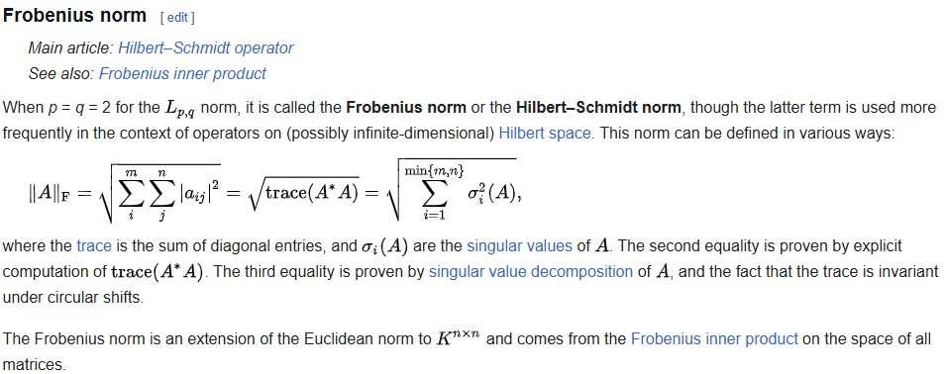
L01 — Frobenius norm
L01

Slide 46
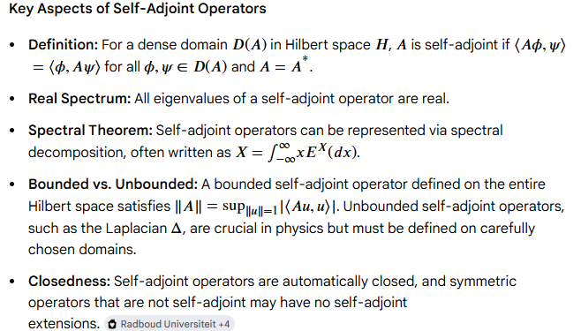
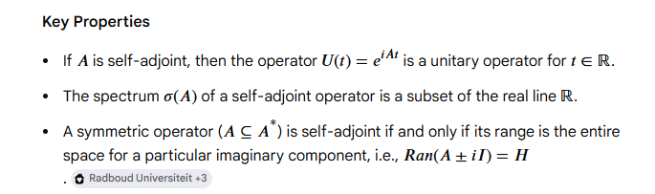
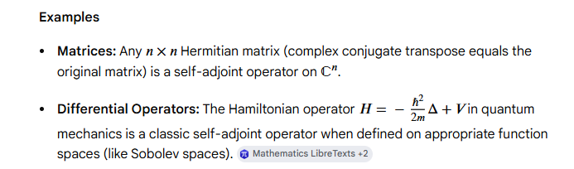
L01 — Self Adjoint operators
L01

Slide 47
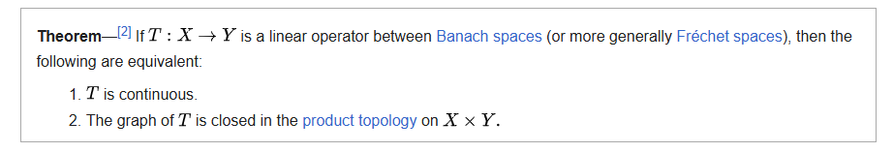
L01 — Closed Graph theorem
L01

Slide 48
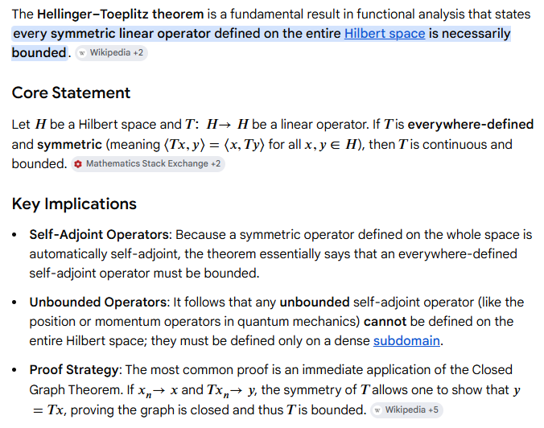
L01 — Hellinger Toeplitz theorem
L01

Slide 49
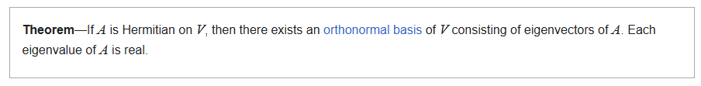
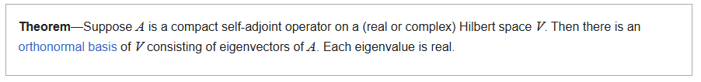
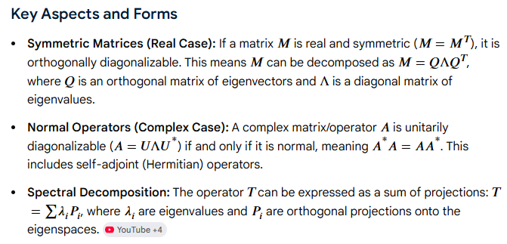
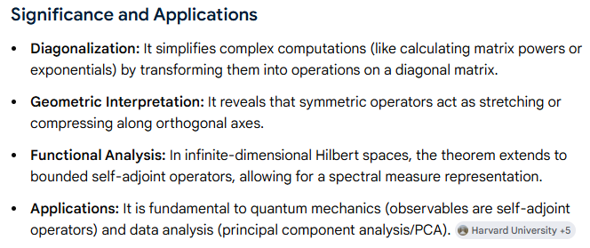
L01 — Spectral Theorem
L01

Slide 50
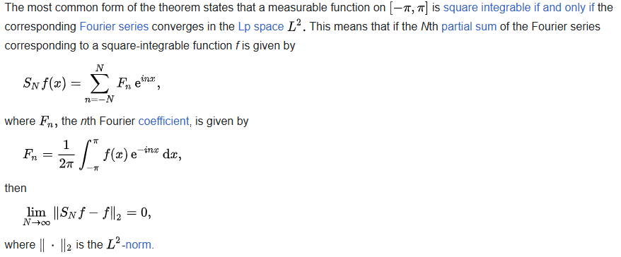
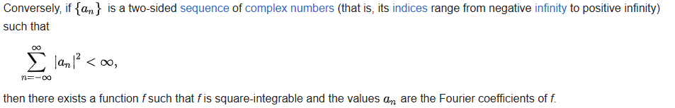
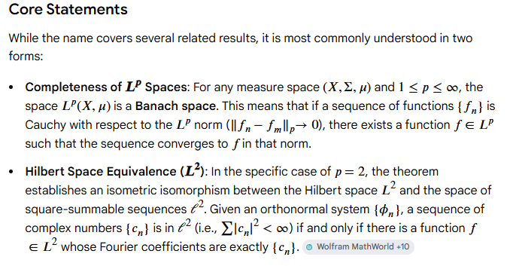
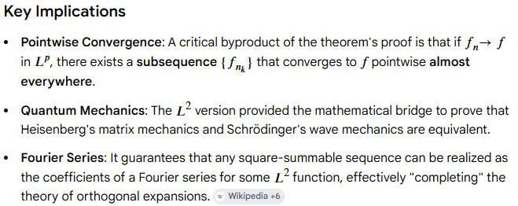
L01 — Riesz Fischer theorem
L01

Slide 51
L01 — Hahn-Banach theorem
L01
L01 — Spectral Radius
L01 — Riesz Fischer representation theorem
L01 — C* algebra
L01 — GNS

