Slide 1
Ψ
QUANTUM MECHANICS — BRA–KET NOTATION
L01
Why Dirac Notation? States as Rays & Superposition
Sakurai ↔ Dirac Dual-Track — Lecture 1
HS
BegUG
AdvUG
MSc
PhD
Full expanded deck · 5 tiers · Worked examples · Complete problem sets
QM: Bra–Ket Notation — L01
L01

Slide 2
L01 — Lecture Overview
L01
Why Dirac Notation? States as Rays & Superposition
90-MIN PACING
CORE LEARNING OUTCOMES
0--15 min: Motivation --- representations vs abstract states
15--45 min: Kets as vectors, rays, normalization, global phase
45--70 min: Bras (informal), amplitudes, Born rule
70--90 min: Notation dictionary: ket $\leftrightarrow$ column vector $\leftrightarrow$ wavefunction
• Understand state as equivalence class $|\psi\rangle \sim e^{i\theta}|\psi\rangle$
• Interpret amplitudes and Born-rule probabilities $P(a_i)=|\langle a_i|\psi\rangle|^2$
• Learn the discrete-basis dictionary $c_n = \langle n|\psi\rangle$
• Connect Sakurai (operational) and Dirac (axiomatic) perspectives
• Derive completeness, normalization, and global-phase invariance
HS
BegUG
AdvUG
MSc
PhD
Complex numbers; $|z|^2$ as probability; vector addition and interference.
Normalization $\langle\psi|\psi\rangle=1$; orthogonality; components $c_n=\langle n|\psi\rangle…
Cauchy--Schwarz; triangle inequality; metric viewpoint on state space.
Rays and projective Hilbert space $\mathbb{P}(\mathcal{H})$; Wigner theorem preview.
Precise Hilbert space axioms; separability; rays as 1D subspaces; domain caveats.
ASSESSMENT BUNDLE
Set A:
Set B:
QM: L01
L01 · Overview

Slide 3

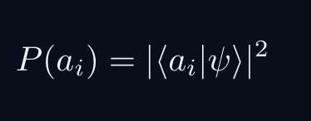
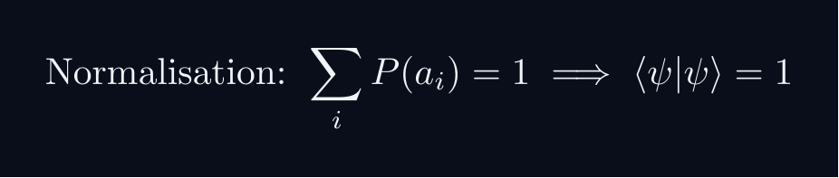
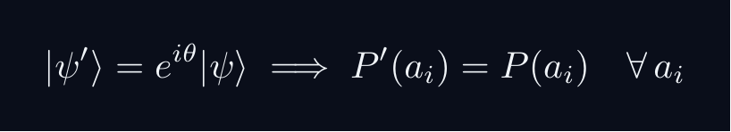
L01 — Sakurai Track
L01
Measurement-first, operational approach
SAKURAI: PREPARATION → STATISTICS → AMPLITUDES
BRIDGE TO DIRAC
SAKURAI: PREPARATION TO STATISTICS TO AMPLITUDES
• Preparation procedure ↔ ket |ψ⟩ (ray in ℋ)
• Measurement outcome aᵢ ↔ basis ket |aᵢ⟩
• Transition amplitude ↔ inner product ⟨aᵢ|ψ⟩
• Probability rule ↔ |⟨aᵢ|ψ⟩|²
• Total prob. = 1 ↔ ⟨ψ|ψ⟩ = 1
• Interference ↔ complex phase structure
STEP 1 — PREPARATION
A preparation is a reproducible laboratory protocol.
The same procedure always yields the same statistical predictions.
STEP 2 — MEASUREMENT OUTCOMES
A measurement device returns outcomes a_i with stable frequencies.
The state encodes probabilities, not definite property values.
STEP 3 — WHY AMPLITUDES?
Interference demands combining paths BEFORE squaring:
The cross-term is interference — real and measurable.
Only complex amplitudes can produce this cross-term.
STEP 4 — OPERATIONAL BORN RULE
GLOBAL PHASE IS UNOBSERVABLE
Physical states are RAYS not vectors.
QM: L01
L01 · Sakurai Track

Slide 4
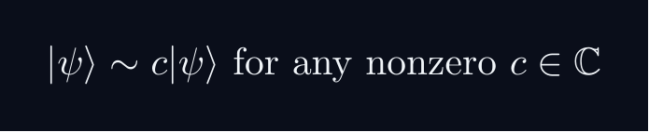
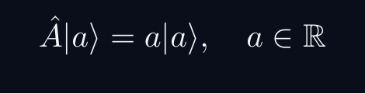
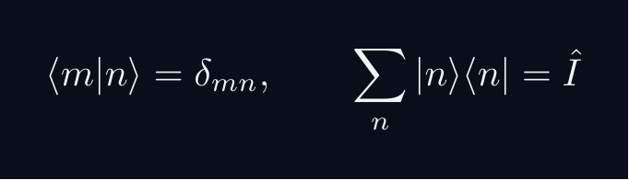
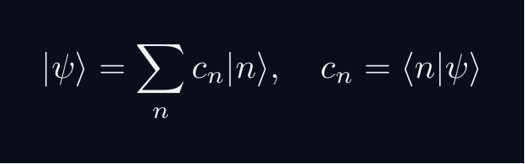


L01 — Dirac Track
L01
Abstract, representation-independent axioms
DIRAC: FIVE POSTULATES
DIRAC: FIVE POSTULATES OF QUANTUM MECHANICS
POSTULATE 1 — STATE SPACE
Every physical state is a ray in a complex Hilbert space H.
POSTULATE 2 — OBSERVABLES
Every observable A corresponds to a Hermitian operator A = A^†.
POSTULATE 3 — COMPLETENESS
POSTULATE 4 — BORN RULE
Post-measurement state (ideal projective): |ψ⟩ → |a⟩
POSTULATE 5 — DYNAMICS
QM: L01
L01 · Dirac Track

Slide 5
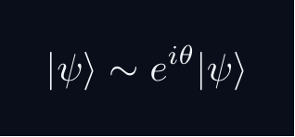
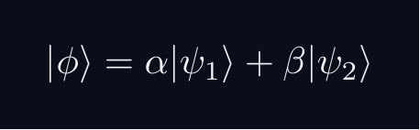
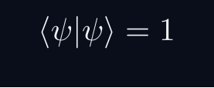
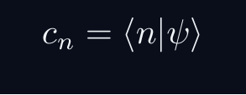
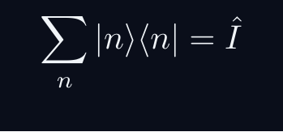
L01 — Key Formulas 1/2
L01
LaTeX-rendered formula reference
ray equiv
born rule
superposition
normalization
component
completeness
QM: L01
L01 · Formulas

Slide 6
L01 — Key Formulas 2/2
L01
LaTeX-rendered formula reference
interference
QM: L01
L01 · Formulas

Slide 7
L01 — HS: High School
L01
Tier introduction and learning context
WHAT THIS TIER COVERS
PREREQUISITES
At the high-school level the goal is to build the single most important intuition: a quantum amplitude is a complex number (an arrow in the plane), and probability is its squared length. Superposition is simply arrow addition, which immediately explains interference. No Hilbert-space vocabulary is needed.
Starting point: pre-university mathematics
Required: basic algebra and complex arithmetic
WHAT THIS TIER UNLOCKS
KEY MESSAGE FOR THIS TIER
Unlocks access to: Beginning Undergraduate
This tier equips you for:
Normalization $\langle\psi|\psi\rangle=1$; orthogonality; components $c_n=\langle n|\psi\rangle$.
Complex numbers; $|z|^2$ as probability; vector addition and interference.
QM: L01 · HS
L01 · HS · Intro

Slide 8
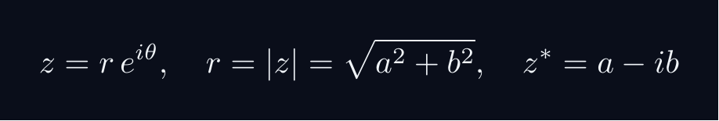
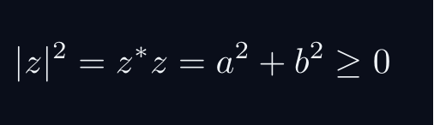
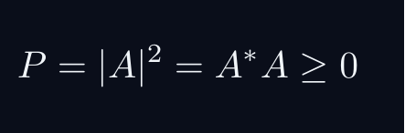
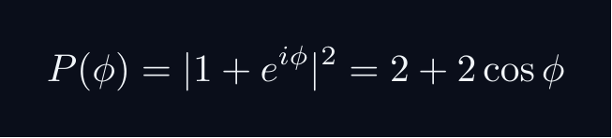
L01 — HS: Core Concepts
L01
Main ideas, key equations, and their meaning
CORE CONCEPTS & KEY RESULTS
COMPLEX NUMBERS AS ARROWS
A complex number z = a + ib lives in a 2D plane.
AMPLITUDE TO PROBABILITY (BORN RULE)
A quantum amplitude A is a complex number for a process.
Why squaring? Gives a real, non-negative number. Phase alone does not.
SUPERPOSITION = ARROW ADDITION = INTERFERENCE
Two paths: amplitudes A_1 and A_2. Total: A = A_1 + A_2.
Interference term can be positive (constructive) or negative (destructive).
WORKED FORMULA: PHASE DEPENDENCE
Let A_1 = 1, A_2 = e^{iφ} (unit magnitude, phase φ).
Maximum P=4 at φ=0 (constructive). Minimum P=0 at φ=pi (destructive).
QM: L01 · HS
L01 · HS · Concepts

Slide 9
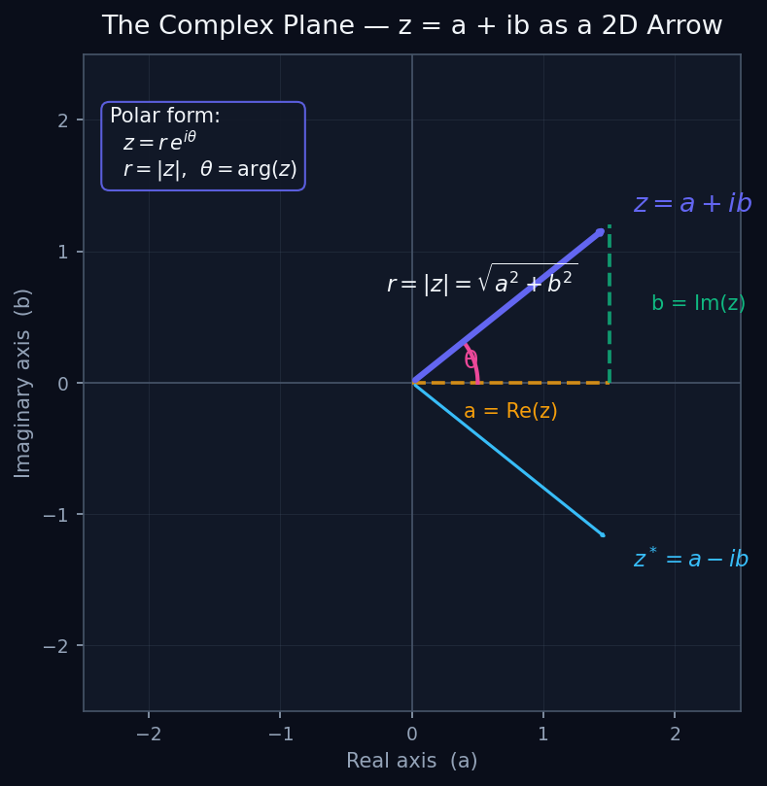
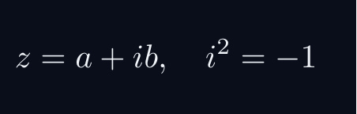
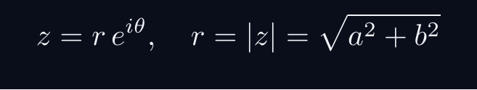

L01 — HS: Complex Numbers as Arrows
L01
The complex plane — z = a+ib as a 2D vector
COMPLEX NUMBERS AS ARROWS
WHAT IS A COMPLEX NUMBER?
A complex number z = a + ib is a 2D vector in a plane.
The plane has two axes: real (a) and imaginary (b).
POLAR FORM
r is the length (magnitude). θ is the angle (phase).
KEY IDENTITY
The squared magnitude is always real and non-negative.
WHY THIS MATTERS FOR QM
Quantum amplitudes ARE complex numbers. The probability is their squared magnitude.
QM: L01 — HS · Complex Numbers as Arrows
L01 · HS

Slide 10
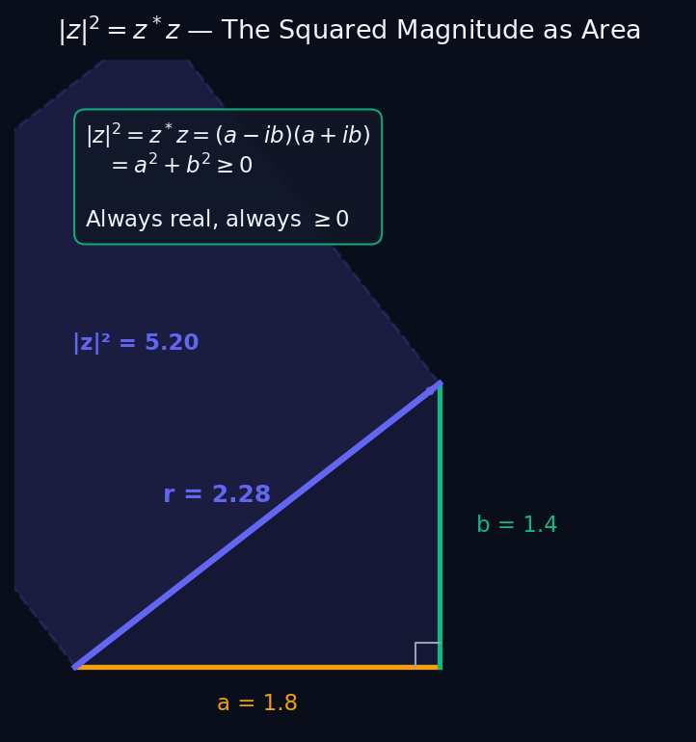
L01 — HS: Magnitude Squared as Probability
L01
P = |A|² — squaring gives a valid probability
MAGNITUDE SQUARED AS PROBABILITY
THE BORN RULE (HIGH SCHOOL VERSION)
A quantum amplitude A is a complex number describing a process.
Why must we SQUARE? Two reasons:
REASON 1 — POSITIVITY
Probabilities must be ≥ 0. Complex numbers can be negative or imaginary. Squaring always gives a non-negative real number.
REASON 2 — INTERFERENCE
If we used |A| instead of |A|², the interference term would look different. Only |A|² gives the correct two-slit experiment result.
GEOMETRIC PICTURE
The diagram shows: |z|² = (squared length) = the area of the square on the hypotenuse. It is always the sum of the squares of the sides.
QM: L01 — HS · Magnitude Squared as Probability
L01 · HS

Slide 11
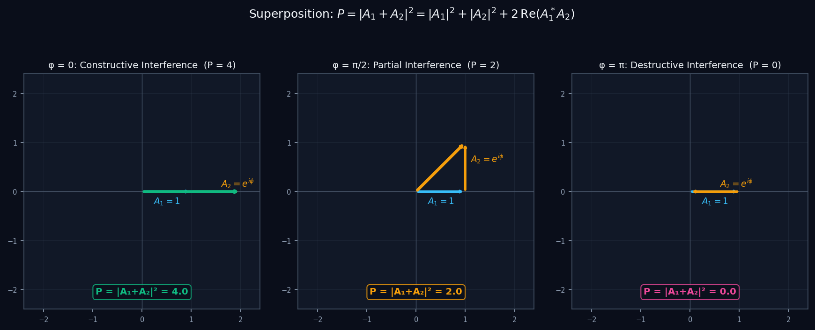

L01 — HS: Superposition and Interference
L01
Adding amplitude arrows — constructive vs destructive
SUPERPOSITION AND INTERFERENCE
SUPERPOSITION = ARROW ADDITION
When two processes can both contribute to an outcome, we ADD their amplitudes (not their probabilities).
THE INTERFERENCE TERM
The extra term 2Re(A₁*A₂) is interference. It can be positive (constructive) or negative (destructive).
PHASE CONTROLS THE SIGN
φ = 0: arrows align → P = 4 (maximum, constructive).
φ = π: arrows cancel → P = 0 (minimum, destructive).
φ = π/2: perpendicular → P = 2 (no interference).
QM: L01 — HS · Superposition and Interference
L01 · HS

Slide 12
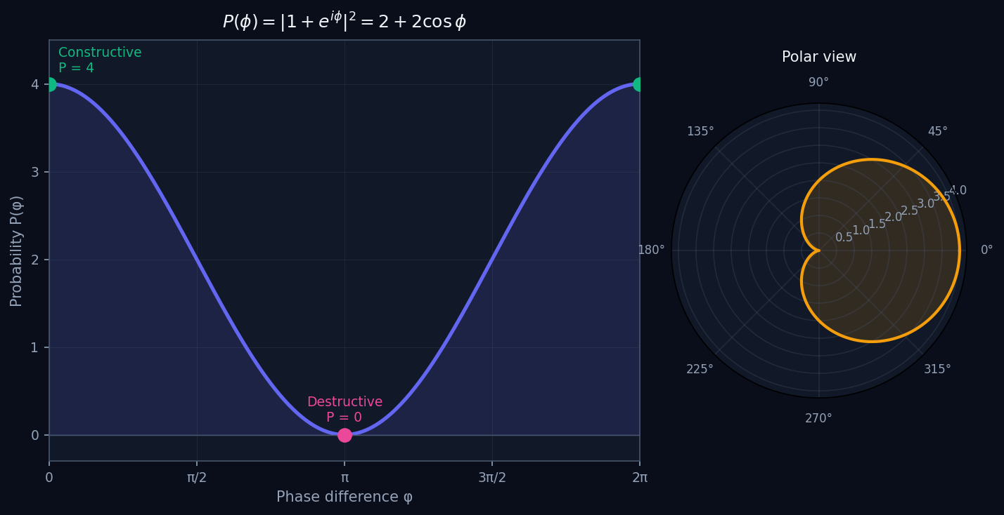
L01 — HS: Phase Dependence of Probability
L01
P(φ) = 2 + 2cosφ — the interference pattern
PHASE DEPENDENCE OF PROBABILITY
A COMPLETE INTERFERENCE PATTERN
Let A₁ = 1 and A₂ = e^{iφ}. As we vary the relative phase φ:
READING THE GRAPH
Maximum P = 4 at φ = 0, 2π (constructive). Minimum P = 0 at φ = π (destructive). The oscillation between 0 and 4 is a hallmark of wave-like behaviour.
KEY INSIGHT
If we had used probabilities directly (not amplitudes), we would get P = P₁ + P₂ = 2, always. NO interference. The interference pattern PROVES we must add amplitudes first.
TWO-SLIT ANALOGY
This is exactly the pattern seen in the double-slit experiment — bright and dark bands as the phase difference varies across the screen.
QM: L01 — HS · Phase Dependence of Probability
L01 · HS

Slide 13
L01 — HS: Worked Example 1
L01
Step-by-step solved example with commentary
EXAMPLE 1: HS-A1
WORKED SOLUTION
Compute |3+4i|^2.
FULL SOLUTION
HINTS
|3+4i|^2 = 3^2+4^2 = 9+16 = 25.
* Recall |a+ib|^2 = a^2 + b^2.
* Identify real and imaginary parts.
ADVANCED HINTS
* Equivalently compute (3+4i)^*(3+4i)=(3-4i)(3+4i).
QM: L01 · HS
L01 · HS · Example 1

Slide 14
L01 — HS: Worked Example 2
L01
Second example — deeper or alternative approach
EXAMPLE 2: HS-A2
WORKED SOLUTION
Let A_1=1 and A_2=i. Compute |A_1+A_2|^2 and compare with |A_1|^2+|A_2|^2.
FULL SOLUTION
HINTS
|1+i|^2 = 1^2+1^2 = 2. Meanwhile |A_1|^2+|A_2|^2 = 1+1 = 2. Here the interference term 2Re(1cdot(-i))=2Re(-i)=0, so there is no interference when amplitudes are perpendicular in the complex plane.
* Add the complex numbers first: 1+i.
* Compute the squared magnitude.
ADVANCED HINTS
* The difference |A_1+A_2|^2 - |A_1|^2 - |A_2|^2 = 2Re(A_1^* A_2) is the interference term.
QM: L01 · HS
L01 · HS · Example 2

Slide 15
L01 — HS: Concept Questions
L01
Think before computing — conceptual understanding checks
CONCEPT QUESTIONS
MORE QUESTIONS + GUIDANCE
1. Why can a probability never be negative?
2. Why do we square the length of an amplitude rather than take the length directly?
3. How can adding two arrows (amplitudes) make the result shorter than either arrow alone?
1. If you double every arrow in a superposition, what happens to the probabilities?
2. What is the difference between an amplitude and a probability?
─────
These questions have no calculation — think about what probability MEANS.
Key insight: squaring is the minimal operation that gives a non-negative re…
QM: L01 · HS
L01 · HS · Concept Qs

Slide 16
L01 — HS: Problem Sets
L01
Simple problems (Set A) and advanced problems (Set B)
PROBLEM SET A — SIMPLE (3 problems)
PROBLEM SET B — ADVANCED (2 problems)
[HS-A1] Compute $|3+4i|^2$.
Hint: Recall $|a+ib|^2 = a^2 + b^2$.
[HS-A2] Let $A_1=1$ and $A_2=i$. Compute $|A_1+A_2|^2$ and compare with $|A_1|^2+|A_2|^2$.
Hint: Add the complex numbers first: $1+i$.
[HS-A3] Let $A_2 = e^{i\pi} = -1$. Compute $|1+A_2|^2$. What does this correspond to physically?
Hint: $e^{i\pi} = \cos\pi + i\sin\pi = -1$.
[HS-B1] Show that $|1+e^{i\phi}|^2 = 2+2\cos\phi$. Find the value(s) of $\phi\in[0,2\pi)$ that maximise and minimise this expression.
Hint: Write $e^{i\phi}=\cos\phi+i\sin\phi$ and expand.
Key idea: Alternatively: $|1+e^{i\phi}|^2=(1+e^{i\phi})(1+e^{-i\phi})=2+2\cos\phi$.
[HS-B2] Two amplitudes $A_1$ and $A_2$ have $|A_1|=|A_2|=r$. Show that $|A_1+A_2|^2$ ranges between $0$ and $4r^2$ depending on their relative phase…
Hint: Write $A_1=r$, $A_2=re^{i\delta}$ and compute.
Key idea: Observe that $|A_1+A_2|^2=2r^2(1+\cos\delta)$.
QM: L01 · HS
L01 · HS · Problems

Slide 17
L01 — HS: References & Bibliography
L01
Historical, educational, and research-level reading
HISTORICAL (2)
EDUCATIONAL (2)
RESEARCH (1)
[1926] Born, M.
"Zur Quantenmechanik der Stossvorgange"
Zeitschrift fur Physik 37, 863--867
↳ The paper that introduced the probability interpretation: $|\psi|^2$ as probability density. Read as a historical anchor; do not …
[1965] Feynman, R. P.
"The Feynman Lectures on Physics, Vol.~III, Ch.~1"
Addison-Wesley
↳ The clearest introduction to quantum amplitude addition for a general audience. The two-slit discussion is ideal for HS motivatio…
Susskind, L. and Friedman, A. (2014)
"Quantum Mechanics: The Theoretical Minimum"
Basic Books
↳ An accessible first exposure to bra-ket ideas requiring only basic algebra and complex numbers. Chapters 1--3 are suita…
Zettili, N. (2009)
"Quantum Mechanics: Concepts and Applications, 2nd ed., Ch.~1"
Wiley
↳ Good review of complex numbers and vectors as preparation for quantum formalism.
Hardy, L. (2001)
"Quantum Theory From Five Reasonable Axioms"
arXiv:quant-ph/0101012
↳ Accessible reconstruction of quantum mechanics from operational axioms. Shows why complex numbers and the Born rule are…
QM: L01 · HS
L01 · HS · References

Slide 18
L01 — BegUG: Beginning Undergraduate
L01
Tier introduction and learning context
WHAT THIS TIER COVERS
PREREQUISITES
The beginning undergraduate student learns to work fluently with the bra-ket formalism in a discrete basis: normalization, orthogonality, the key identity $c_n=\langle n|\psi\rangle$, and the Born rule. The emphasis is on computational fluency and physical interpretation.
Builds on: High School
Required background:
Complex numbers; $|z|^2$ as probability; vector addition and interference.
WHAT THIS TIER UNLOCKS
KEY MESSAGE FOR THIS TIER
Unlocks access to: Advanced Undergraduate
This tier equips you for:
Cauchy--Schwarz; triangle inequality; metric viewpoint on state space.
Normalization $\langle\psi|\psi\rangle=1$; orthogonality; components $c_n=\langle n|\psi\rangle$.
QM: L01 · BegUG
L01 · BegUG · Intro

Slide 19
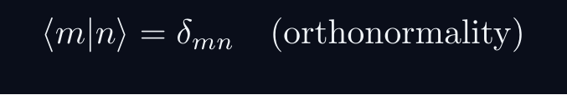
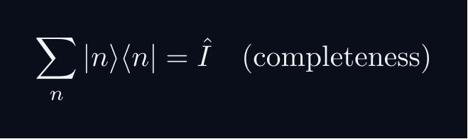
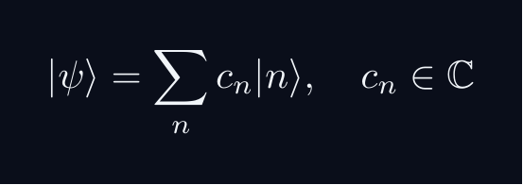
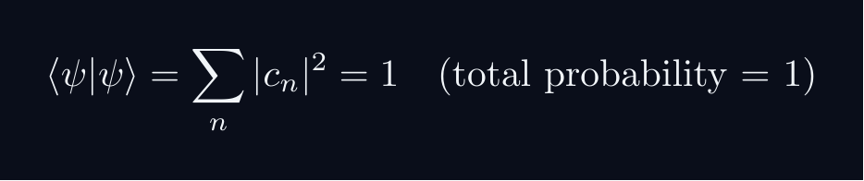


L01 — BegUG: Core Concepts
L01
Main ideas, key equations, and their meaning
CORE CONCEPTS & KEY RESULTS
HILBERT SPACE FORMALISM — DISCRETE BASIS
State vector |ψ⟩ in complex Hilbert space H.
EXPANSION AND COMPONENTS
Proof: ⟨ m|ψ⟩ = sum_n c_n ⟨ m|n⟩ = sum_n c_ndelta_{mn} = c_m
NORMALISATION AND PROBABILITIES
GLOBAL PHASE INVARIANCE
QM: L01 · BegUG
L01 · BegUG · Concepts

Slide 20
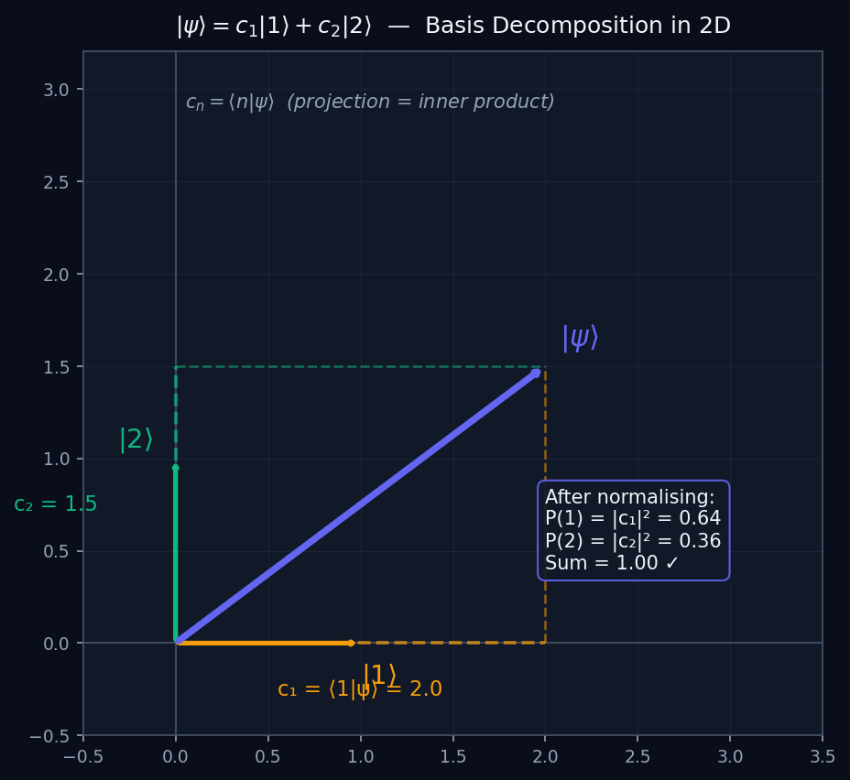
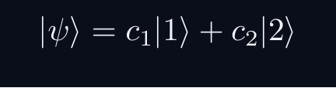
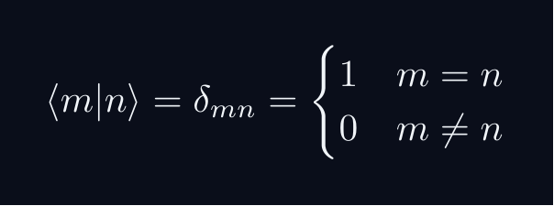
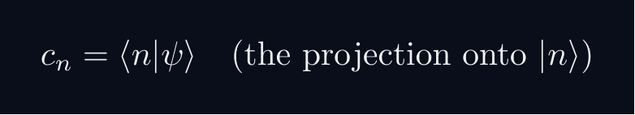
L01 — BegUG: Basis Vectors and State Decomposition
L01
|ψ⟩ = c₁|1⟩ + c₂|2⟩ — expanding in a basis
BASIS VECTORS AND STATE DECOMPOSITION
THE HILBERT SPACE AS A VECTOR SPACE
A quantum state |ψ⟩ lives in a vector space, just like a 2D or 3D arrow.
ORTHONORMAL BASIS
The basis vectors |1⟩ and |2⟩ play the role of x̂ and ŷ in 2D space:
COMPONENTS ARE INNER PRODUCTS
This is the key identity. Just like a 2D dot product gives the component along each axis.
DIAGRAM
The diagram shows |ψ⟩ decomposed along |1⟩ (x-axis) and |2⟩ (y-axis) with dashed projection lines, exactly as in 2D vector geometry.
QM: L01 — BegUG · Basis Vectors and State Decomposition
L01 · BegUG

Slide 21
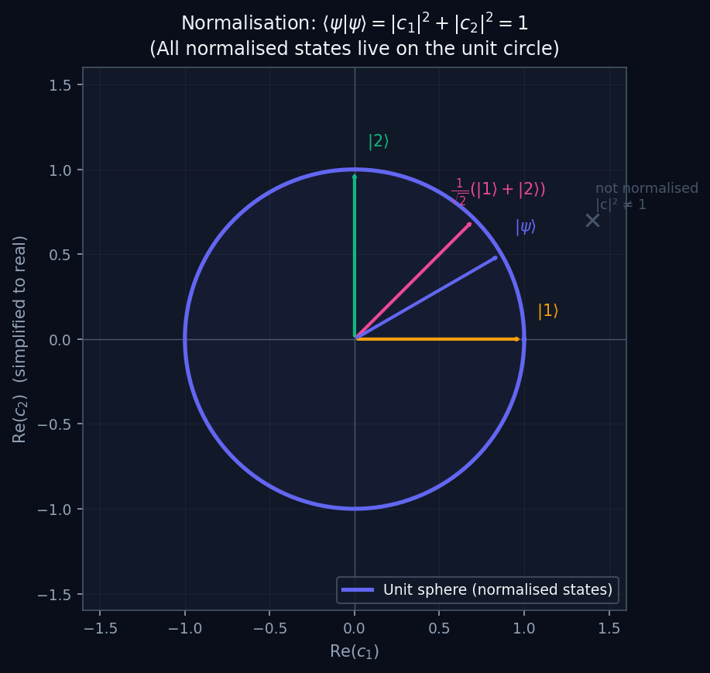
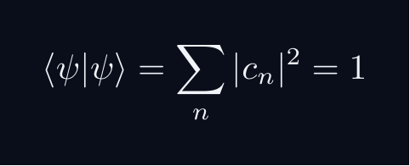
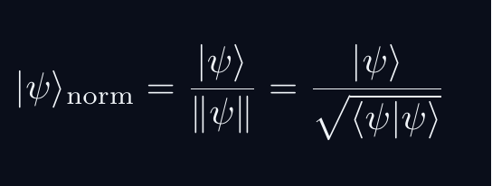
L01 — BegUG: Normalisation and the Unit Sphere
L01
⟨ψ|ψ⟩ = 1 — all states live on the unit sphere
NORMALISATION AND THE UNIT SPHERE
WHY NORMALISATION?
Total probability must equal 1. This forces:
GEOMETRIC MEANING
In 2D (real amplitudes): normalised states lie exactly on the unit circle. In 2D complex (a qubit): they lie on the Bloch sphere.
HOW TO NORMALISE
Given any |ψ⟩ ≠ 0, divide by its norm:
DIAGRAM
All normalised states sit on the circle. Non-normalised states sit outside. Physical states must be on the circle — normalisation is a physical constraint, not just a convention.
QM: L01 — BegUG · Normalisation and the Unit Sphere
L01 · BegUG

Slide 22
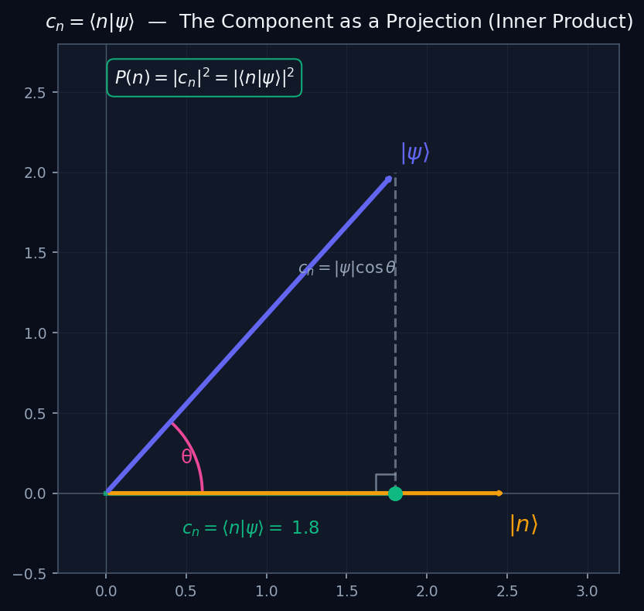
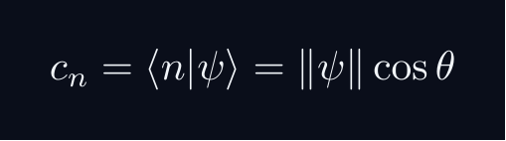
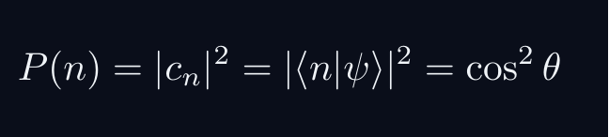
L01 — BegUG: The Inner Product as Projection
L01
c_n = ⟨n|ψ⟩ — the component IS the projection
THE INNER PRODUCT AS PROJECTION
INNER PRODUCT = OVERLAP
The inner product ⟨φ|ψ⟩ measures how much |ψ⟩ overlaps with |φ⟩. Geometrically: it is the projection (shadow) of |ψ⟩ onto the direction of |φ⟩.
THE COMPONENT FORMULA
where θ is the angle between |ψ⟩ and the basis vector |n⟩.
BORN RULE FROM PROJECTION
(for normalised states). The probability is the SQUARED projection — the squared shadow length.
KEY INSIGHT
The diagram shows the projection construction. This is identical to decomposing a 2D vector along a coordinate axis. The only new feature in QM: the components are complex numbers.
QM: L01 — BegUG · The Inner Product as Projection
L01 · BegUG

Slide 23
L01 — BegUG: Worked Example 1
L01
Step-by-step solved example with commentary
EXAMPLE 1: BegUG-A1
WORKED SOLUTION
Let {|1⟩,|2⟩} be orthonormal. Normalize |ψ⟩ = |1⟩ + i|2⟩.
FULL SOLUTION
HINTS
⟨ψ|ψ⟩ = (⟨ 1|-i⟨ 2|)(|1⟩+i|2⟩)=1+0+0+1=2. Normalized: |ψ⟩_{rm norm}=frac{1}{sqrt{2}}(|1⟩+i|2⟩).
* Compute ⟨ψ|ψ⟩.
* Divide by sqrt{⟨ψ|ψ⟩}.
ADVANCED HINTS
* Use ⟨ψ| = ⟨ 1| - i⟨ 2| (conjugate coefficients).
QM: L01 · BegUG
L01 · BegUG · Example 1

Slide 24
L01 — BegUG: Worked Example 2
L01
Second example — deeper or alternative approach
EXAMPLE 2: BegUG-A2
WORKED SOLUTION
For |ψ⟩=frac{1}{sqrt{5}}(|1⟩+2i|2⟩), compute c_1, c_2, P(1), and P(2).
FULL SOLUTION
HINTS
c_1=1/sqrt{5}, c_2=2i/sqrt{5}. P(1)=1/5, P(2)=4/5. Sum: 1. Correct.
* c_n = ⟨ n|ψ⟩.
* P(n)=|c_n|^2.
ADVANCED HINTS
* Check: P(1)+P(2) should equal 1.
QM: L01 · BegUG
L01 · BegUG · Example 2

Slide 25
L01 — BegUG: Concept Questions
L01
Think before computing — conceptual understanding checks
CONCEPT QUESTIONS
MORE QUESTIONS + GUIDANCE
1. Why do we impose $\langle\psi|\psi\rangle=1$? What would happen if we allowed $\langle\psi|\psi\rangle=2$?
2. What does orthogonality $\langle m|n\rangle=0$ mean in terms of measurement outcomes?
3. Why does a basis choice correspond to a measurement choice?
1. If $c_n = \langle n|\psi\rangle$, what happens to $c_n$ if you multiply $|\psi\rangle$ by $e^{i\theta}$?
2. Can two different states give the same set of probabilities $\{P(n)\}$ in some basis?
─────
Work from the definition: write out the expansion, act with ⟨m| on the left, use δₘₙ.
For normalization: total probability must equal 1 — that is the…
QM: L01 · BegUG
L01 · BegUG · Concept Qs

Slide 26
L01 — BegUG: Problem Sets
L01
Simple problems (Set A) and advanced problems (Set B)
PROBLEM SET A — SIMPLE (5 problems)
PROBLEM SET B — ADVANCED (2 problems)
[BegUG-A1] Let $\{|1\rangle,|2\rangle\}$ be orthonormal. Normalize $|\psi\rangle = |1\rangle + i|2\rangle$.
Hint: Compute $\langle\psi|\psi\rangle$.
[BegUG-A2] For $|\psi\rangle=\frac{1}{\sqrt{5}}(|1\rangle+2i|2\rangle)$, compute $c_1$, $c_2$, $P(1)$, and $P(2)$.
Hint: $c_n = \langle n|\psi\rangle$.
[BegUG-A3] Show, starting from the expansion $|\psi\rangle=\sum_n c_n|n\rangle$, that $c_m = \langle m|\psi\rangle$.
Hint: Multiply on the left by $\langle m|$.
[BegUG-A4] Show that global phase invariance holds: $|\langle n|e^{i\theta}\psi\rangle|^2=|\langle n|\psi\rangle|^2$.
Hint: Pull $e^{i\theta}$ out using linearity of the inner product.
[BegUG-A5] Using completeness $\sum_n |n\rangle\langle n|=\hat{I}$, prove $\langle\psi|\psi\rangle=\sum_n|\langle n|\psi\rangle|^2$.
Hint: Insert the identity between $\langle\psi|$ and $|\psi\rangle$.
[BegUG-B1] Insert the identity to prove: $\langle\phi|\psi\rangle=\sum_n \phi_n^*\psi_n$ where $\phi_n=\langle n|\phi\rangle$ and $\psi_n=\langle n|\ps…
Hint: Insert $\sum_n|n\rangle\langle n|$ between $\langle\phi|$ and $|\psi\rangle$.
Key idea: Note $\langle\phi|n\rangle=(\langle n|\phi\rangle)^*=\phi_n^*$.
[BegUG-B2] Let $|\psi'\rangle=\alpha|1\rangle+\beta|2\rangle$ with $|\alpha|^2+|\beta|^2=1$. Show that no matter which orthonormal basis $\{|n\rangle\}…
Hint: Use the result of BegUG-A5.
Key idea: The key is that normalization $\langle\psi|\psi\rangle=1$ is basis-independent.
QM: L01 · BegUG
L01 · BegUG · Problems

Slide 27
L01 — BegUG: References & Bibliography
L01
Historical, educational, and research-level reading
HISTORICAL (2)
EDUCATIONAL (3)
RESEARCH (1)
[1926] Born, M.
"Quantenmechanik der Stossvorgange"
Zeitschrift fur Physik 38, 803--827
↳ Assign guided reading excerpts or a structured summary. Students identify the probability postulate and compare to the modern Born…
[1927] Dirac, P. A. M.
"The Physical Interpretation of the Quantum Dynamics"
Proceedings of the Royal Society A 113, 621--641
↳ Dirac's earliest systematic use of transformation theory and probability amplitudes. Use a guided secondary summary; the notation…
Sakurai, J. J. and Napolitano, J. (2021)
"Modern Quantum Mechanics, 3rd ed., Ch.~1"
Cambridge University Press
↳ The primary text for this track. Chapter 1 develops the bra-ket formalism through the Stern-Gerlach experiment --- exact…
Griffiths, D. J. and Schroeter, D. F. (2018)
"Introduction to Quantum Mechanics, 3rd ed., Ch.~3"
Cambridge University Press
↳ Accessible treatment of Hilbert-space formalism for beginners. Use alongside Sakurai for complementary perspectives.
Shankar, R. (1994)
"Principles of Quantum Mechanics, 2nd ed., Ch.~1"
Springer
↳ Particularly clear on the mathematical prerequisites (linear algebra review in Chapter 1).
Gleason, A. M. (1957)
"Measures on the Closed Subspaces of a Hilbert Space"
Journal of Mathematics and Mechanics 6, 885--893
↳ Gleason's theorem: any probability measure on the closed subspaces of a Hilbert space (dim $\geq 3$) must be of the Born…
QM: L01 · BegUG
L01 · BegUG · References

Slide 28
L01 — AdvUG: Advanced Undergraduate
L01
Tier introduction and learning context
WHAT THIS TIER COVERS
PREREQUISITES
Advanced undergraduates transition from computation to proof. The Cauchy--Schwarz and triangle inequalities establish that the Hilbert space has a genuine geometry: overlaps measure 'angles', norms measure 'lengths', and probabilities are geometrically bounded. The subtlety of the physically correct notion of distance (phase-invariant) motivates the projective Hilbert space perspective at the Ma…
Builds on: Beginning Undergraduate
Required background:
Normalization $\langle\psi|\psi\rangle=1$; orthogonality; components $c_n=\langle n|\psi\rangle$.
WHAT THIS TIER UNLOCKS
KEY MESSAGE FOR THIS TIER
Unlocks access to: Master's Level
This tier equips you for:
Rays and projective Hilbert space $\mathbb{P}(\mathcal{H})$; Wigner theorem preview.
Cauchy--Schwarz; triangle inequality; metric viewpoint on state space.
QM: L01 · AdvUG
L01 · AdvUG · Intro

Slide 29
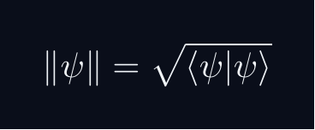
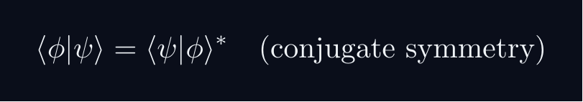


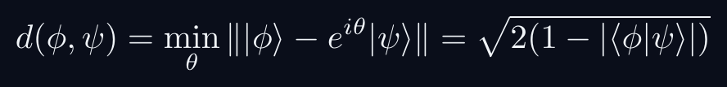
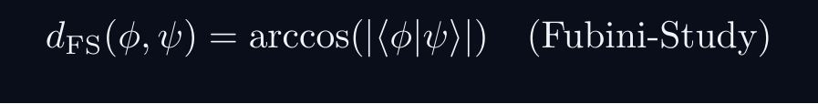
L01 — AdvUG: Core Concepts
L01
Main ideas, key equations, and their meaning
CORE CONCEPTS & KEY RESULTS
INNER PRODUCT SPACE GEOMETRY
CAUCHY-SCHWARZ INEQUALITY
Proof: set f(lambda) = | |φ⟩ - lambda|ψ⟩ |^2 ≥ 0.
Choose lambda = ⟨ψ|φ⟩ / |ψ|^2 to minimise.
TRIANGLE INEQUALITY
Proof: square both sides; apply C-S to the cross term.
PHASE-INVARIANT DISTANCE
UNITARY MAPS PRESERVE GEOMETRY
QM: L01 · AdvUG
L01 · AdvUG · Concepts

Slide 30
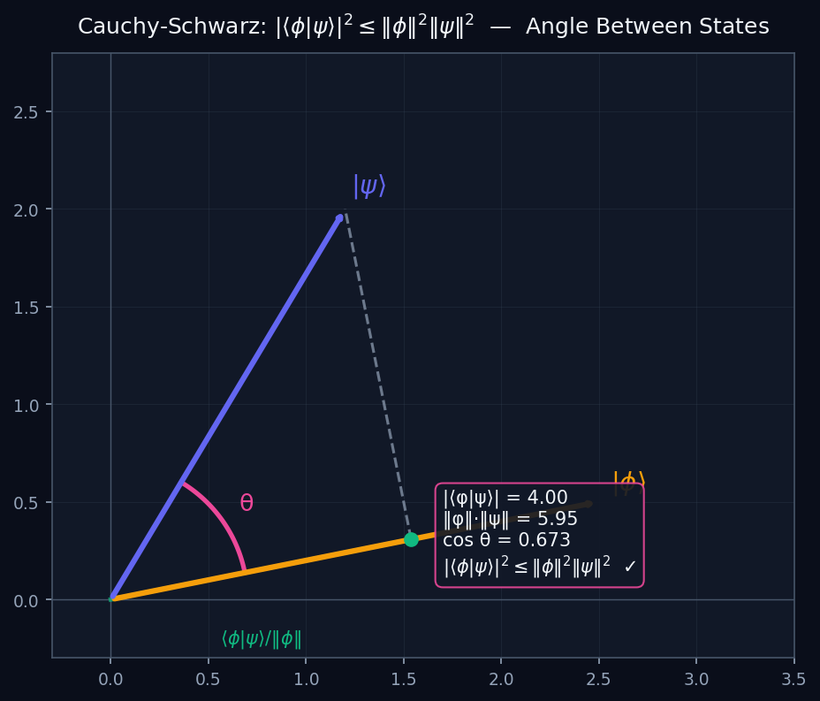

L01 — AdvUG: Cauchy-Schwarz and the Geometry of Overlap
L01
|⟨φ|ψ⟩|² ≤ ‖φ‖²‖ψ‖² — why probabilities are bounded
CAUCHY-SCHWARZ AND THE GEOMETRY OF OVERLAP
THE CAUCHY-SCHWARZ INEQUALITY
For normalised states this gives |⟨φ|ψ⟩|² ≤ 1 — transition probabilities are always bounded by 1.
PROOF IDEA (MINIMISATION)
For any complex λ, define f(λ) = ‖|φ⟩ − λ|ψ⟩‖² ≥ 0.
Choose λ = ⟨ψ|φ⟩/‖ψ‖² to minimise f → the inequality falls out.
GEOMETRIC MEANING
The diagram shows two vectors. |⟨φ|ψ⟩| = ‖φ‖‖ψ‖|cosθ| ≤ ‖φ‖‖ψ‖ because |cosθ| ≤ 1. C-S is just the statement that the absolute cosine of an angle is ≤ 1.
QM: L01 — AdvUG · Cauchy-Schwarz and the Geometry of Overlap
L01 · AdvUG

Slide 31
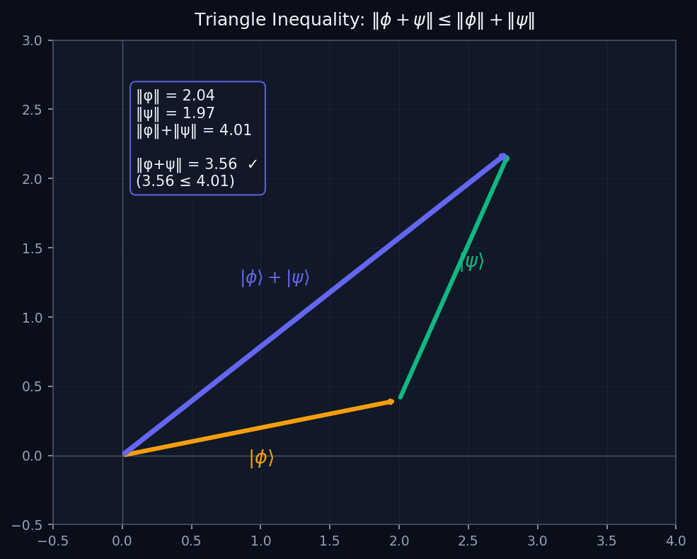

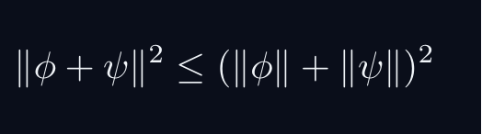
L01 — AdvUG: Triangle Inequality
L01
‖φ+ψ‖ ≤ ‖φ‖+‖ψ‖ — the norm behaves like geometric length
TRIANGLE INEQUALITY
THE TRIANGLE INEQUALITY
The length of the sum is at most the sum of the lengths. This is exactly the triangle inequality from Euclidean geometry.
PROOF
Square both sides (both sides ≥ 0):
Use Re⟨φ|ψ⟩ ≤ |⟨φ|ψ⟩| ≤ ‖φ‖‖ψ‖ (by C-S):
Taking square roots gives the result.
WHY IT MATTERS
The triangle inequality makes ‖·‖ a proper norm, and (ℋ, ‖·‖) a metric space. Limits, continuity, and convergence all rely on this.
QM: L01 — AdvUG · Triangle Inequality
L01 · AdvUG

Slide 32
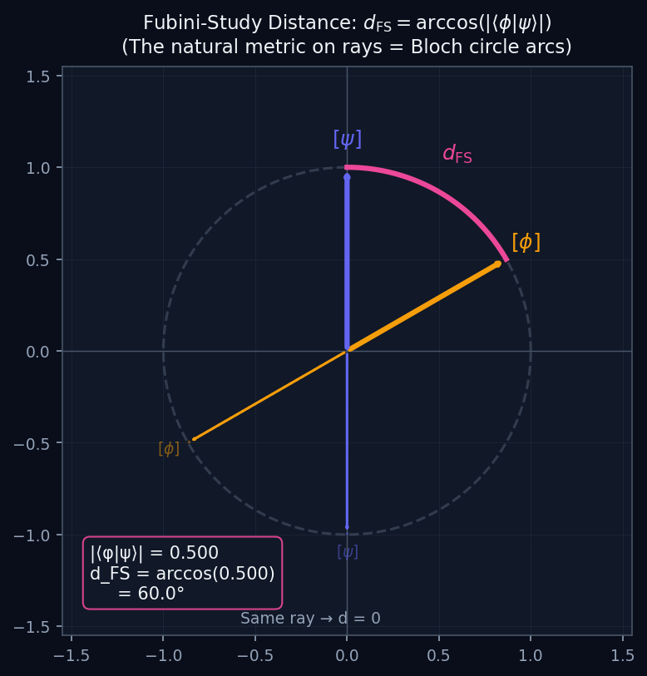
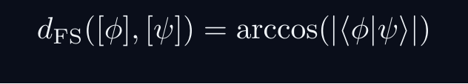
L01 — AdvUG: The Fubini-Study Metric on Rays
L01
d_FS = arccos|⟨φ|ψ⟩| — the physical distance between states
THE FUBINI-STUDY METRIC ON RAYS
WHY ‖φ−ψ‖ IS NOT THE RIGHT DISTANCE
Physical states are rays — |ψ⟩ and e^{iθ}|ψ⟩ are the same state. But ‖|ψ⟩ − e^{iθ}|ψ⟩‖ depends on θ. So ‖φ−ψ‖ is NOT phase-invariant.
THE CORRECT DISTANCE
FUBINI-STUDY METRIC
This is the angle between rays — invariant under global phase. On the Bloch circle (diagram), it is the arc length between two points.
SPECIAL VALUES
d_FS = 0 iff same ray (same physical state). d_FS = π/2 iff orthogonal states (mutually exclusive outcomes). d_FS = π/2 is the maximum distinguishability.
QM: L01 — AdvUG · The Fubini-Study Metric on Rays
L01 · AdvUG

Slide 33
L01 — AdvUG: Worked Example 1
L01
Step-by-step solved example with commentary
EXAMPLE 1: AdvUG-A1
WORKED SOLUTION
Prove the Cauchy--Schwarz inequality: |⟨φ|ψ⟩|^2 le ⟨φ|φ⟩,⟨ψ|ψ⟩.
FULL SOLUTION
Define f(lambda)=⟨φ-lambdaψ|φ-lambdaψ⟩=|φ|^2 - lambda⟨φ|ψ⟩ - barlambda⟨ψ|φ⟩+|lambda|^2|ψ|^2 ge 0. Set lambda=⟨ψ|φ⟩/|ψ|^2: f=|φ|^2-|⟨φ|ψ⟩|^2/|ψ|^2ge 0, giving |⟨φ|ψ⟩|^2le|φ|^2|ψ|^2. square
HINTS
* Consider f(lambda)=||φ⟩-lambda|ψ⟩|^2ge 0 for any complex lambda.
* Expand f(lambda) and choose lambda to minimise it.
ADVANCED HINTS
* Choose lambda=⟨ψ|φ⟩/⟨ψ|ψ⟩.
* Identify the resulting inequality as the Cauchy--Schwarz bound.
QM: L01 · AdvUG
L01 · AdvUG · Example 1

Slide 34
L01 — AdvUG: Worked Example 2
L01
Second example — deeper or alternative approach
EXAMPLE 2: AdvUG-A2
WORKED SOLUTION
Prove the triangle inequality |φ+ψ|le|φ|+|ψ|.
FULL SOLUTION
HINTS
|φ+ψ|^2=|φ|^2+2Re⟨φ|ψ⟩+|ψ|^2le |φ|^2+2|⟨φ|ψ⟩|+|ψ|^2le |φ|^2+2|φ||ψ|+|ψ|^2=(|φ|+|ψ|)^2. Take square roots (both sides non-negative). square
* Square both sides.
* Expand |φ+ψ|^2 and apply Re z le |z|.
ADVANCED HINTS
* Use Cauchy--Schwarz on the cross term 2Re⟨φ|ψ⟩.
QM: L01 · AdvUG
L01 · AdvUG · Example 2

Slide 35
L01 — AdvUG: Concept Questions
L01
Think before computing — conceptual understanding checks
CONCEPT QUESTIONS
MORE QUESTIONS + GUIDANCE
1. Why must $|\langle\phi|\psi\rangle|\le 1$ for normalized states? What would happen if it could exceed 1?
2. In what sense is probability a 'geometry' on the space of states?
3. Why is $d(\phi,\psi)=\|\phi-\psi\|$ not a physically meaningful distance on quantum states?
1. What is the role of completeness of $\mathcal{H}$ (convergence of Cauchy sequences)?
2. Is $\|\psi\|$ a norm in the mathematical sense? Verify all three norm axioms.
─────
For C–S: the proof idea is to consider ‖|φ⟩ - λ|ψ⟩‖² ≥ 0 and choose the minimising λ.
For the geometry questions: draw a unit circle in ℂ²; overlap |…
QM: L01 · AdvUG
L01 · AdvUG · Concept Qs

Slide 36
L01 — AdvUG: Problem Sets
L01
Simple problems (Set A) and advanced problems (Set B)
PROBLEM SET A — SIMPLE (3 problems)
PROBLEM SET B — ADVANCED (2 problems)
[AdvUG-A1] Prove the Cauchy--Schwarz inequality: $|\langle\phi|\psi\rangle|^2 \le \langle\phi|\phi\rangle\,\langle\psi|\psi\rangle$.
Hint: Consider $f(\lambda)=\||\phi\rangle-\lambda|\psi\rangle\|^2\ge 0$ for any complex $\lambda…
[AdvUG-A2] Prove the triangle inequality $\|\phi+\psi\|\le\|\phi\|+\|\psi\|$.
Hint: Square both sides.
[AdvUG-A3] Show that $\|\psi\|=0$ implies $|\psi\rangle=0$.
Hint: Use positive-definiteness of the inner product: $\langle\psi|\psi\rangle\ge 0$ with equali…
[AdvUG-B1] Define the phase-invariant distance on normalised states: $d(\phi,\psi)=\min_{\theta\in[0,2\pi)}\||\phi\rangle-e^{i\theta}|\psi\rangle\|$. S…
Hint: Expand $\||\phi\rangle-e^{i\theta}|\psi\rangle\|^2$ and use normalisation.
Key idea: Write $\langle\phi|\psi\rangle=|\langle\phi|\psi\rangle|e^{i\alpha}$ and choose …
[AdvUG-B2] Let $\hat U$ be unitary ($\hat U^\dagger \hat U=\hat I$). Show that $\langle\hat U\phi|\hat U\psi\rangle=\langle\phi|\psi\rangle$ for all $|…
Hint: Use $\langle\hat U\phi|=\langle\phi|\hat U^\dagger$.
Key idea: Conclude: unitary maps preserve the entire geometry of the Hilbert space.
QM: L01 · AdvUG
L01 · AdvUG · Problems

Slide 37
L01 — AdvUG: References & Bibliography
L01
Historical, educational, and research-level reading
HISTORICAL (2)
EDUCATIONAL (3)
RESEARCH (1)
[1932] von Neumann, J.
"Mathematische Grundlagen der Quantenmechanik"
Springer, Berlin (English trans. Princeton UP, 1955)
↳ The foundational text establishing quantum mechanics on a rigorous Hilbert-space basis. Assign selected sections on inner-product…
[1885] Schwarz, H. A.
"\"Uber ein die Fl\"achen kleinsten Fl\"acheninhalts betreffendes Probl…"
Acta Societatis Scientiarum Fennicae 15, 315--362
↳ Historical origin of the Cauchy--Schwarz inequality in the continuous (integral) setting. Use as a historical note --- the inequa…
Dirac, P. A. M. (1958)
"The Principles of Quantum Mechanics, 4th ed."
Oxford University Press
↳ Read Chapter 1 for the formalist perspective. Dirac introduces bras and kets axiomatically with extraordinary economy of…
Axler, S. (2015)
"Linear Algebra Done Right, 3rd ed., Ch.~6"
Springer
↳ Best undergraduate proof-based treatment of inner products, norms, and the Cauchy--Schwarz inequality.
Cohen-Tannoudji, C., Diu, B., and Lalo\"e, F. (1977)
"Quantum Mechanics, Vol.~1, Ch.~II"
Wiley
↳ Comprehensive mathematical complement sections (II-A through II-D) covering inner products, orthonormal bases, and the D…
Wigner, E. P. (1959)
"Group Theory and Its Application to the Quantum Mechanics of Atomic Sp…"
Academic Press
↳ Contains the original proof of Wigner's theorem on symmetry transformations. Assign as preview reading for the Master's…
QM: L01 · AdvUG
L01 · AdvUG · References

Slide 38
L01 — MSc: Master's Level
L01
Tier introduction and learning context
WHAT THIS TIER COVERS
PREREQUISITES
Master's students focus on what is physically real vs representational. States are rays in projective Hilbert space $\mathbb{P}(\mathcal{H})$; the Fubini--Study metric is the natural distance on this space. Wigner's theorem reveals that any transformation preserving transition probabilities must be unitary or antiunitary --- a profound structural result connecting measurement statistics directly t…
Builds on: Advanced Undergraduate
Required background:
Cauchy--Schwarz; triangle inequality; metric viewpoint on state space.
WHAT THIS TIER UNLOCKS
KEY MESSAGE FOR THIS TIER
Unlocks access to: PhD Level
This tier equips you for:
Precise Hilbert space axioms; separability; rays as 1D subspaces; domain caveats.
Rays and projective Hilbert space $\mathbb{P}(\mathcal{H})$; Wigner theorem preview.
QM: L01 · MSc
L01 · MSc · Intro

Slide 39
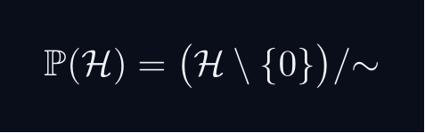
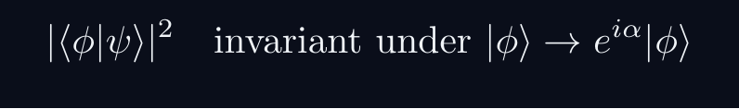
L01 — MSc: Core Concepts
L01
Main ideas, key equations, and their meaning
CORE CONCEPTS & KEY RESULTS
PROJECTIVE HILBERT SPACE
Physical state space is P(H), not H itself.
A ray [ψ] is a one-dimensional complex subspace of H.
Example: P(C^2) cong S^2 — the Bloch sphere.
PHYSICALLY INVARIANT QUANTITIES
WIGNER'S THEOREM
Any bijection T:P(H)→P(H) preserving |⟨φ|ψ⟩|^2
is implemented by a UNITARY or ANTIUNITARY operator U on H.
Consequence: all quantum symmetries are (anti)unitary.
CONSEQUENCES
Symmetry group G acting on states gives projective representation of G.
Forces spin SO(3)→ SU(2), superselection rules, CPT symmetry.
QM: L01 · MSc
L01 · MSc · Concepts

Slide 40
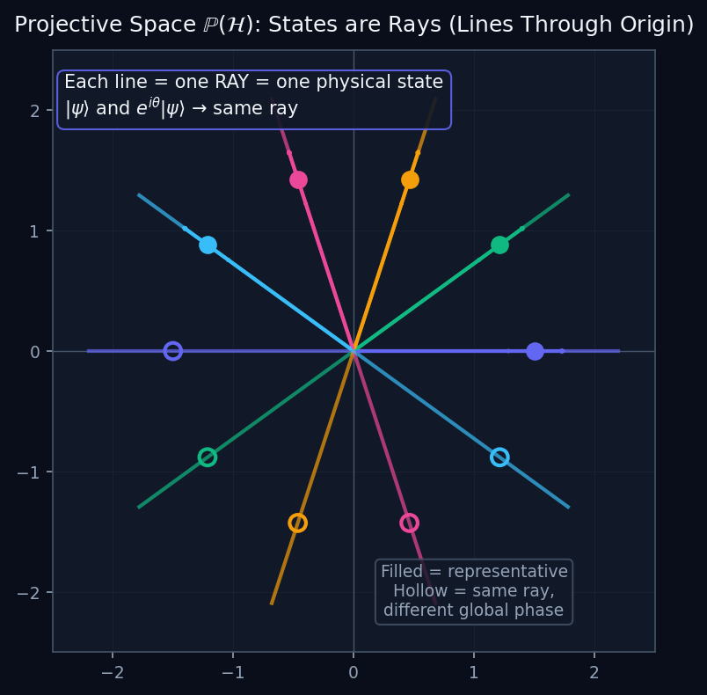
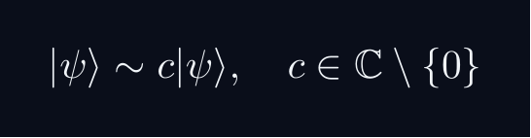
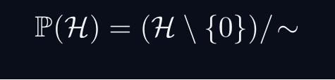

L01 — MSc: Projective Hilbert Space
L01
ℙ(ℋ) — states as lines through the origin
PROJECTIVE HILBERT SPACE
RAYS = EQUIVALENCE CLASSES
Two vectors represent the same physical state if they differ by a non-zero complex scalar:
A ray [ψ] is the equivalence class — a one-dimensional complex subspace.
PROJECTIVE HILBERT SPACE
Each point of ℙ(ℋ) is a ray — a physical pure state.
DIAGRAM
The diagram shows ℝ² (or ℂ²). Each line through the origin is one ray — one physical state. Points on the same line (same colour) differ only by phase or scale.
DIMENSION
For a qubit (n=2): dim = 2 real dimensions → the Bloch sphere S².
QM: L01 — MSc · Projective Hilbert Space
L01 · MSc

Slide 41



L01 — MSc: The Bloch Sphere
L01
ℙ(ℂ²) ≅ S² — every qubit state is a point on a 3-sphere
THE BLOCH SPHERE
QUBIT STATES AS SPHERE POINTS
Any normalised qubit state can be written:
Two real parameters (θ,φ) label a point on S² — the Bloch sphere.
KEY STATES
|0⟩ and |1⟩ are the North and South poles.
Superpositions (|0⟩+|1⟩)/√2 live on the equator.
ANTIPODAL POINTS = ORTHOGONAL STATES
FUBINI-STUDY ON THE SPHERE
The Fubini-Study metric on ℙ(ℂ²) is exactly the round metric on S² (up to a factor). The geodesics are great circle arcs.
QM: L01 — MSc · The Bloch Sphere
L01 · MSc

Slide 42
L01 — MSc: Worked Example 1
L01
Step-by-step solved example with commentary
EXAMPLE 1: MSc-A1
WORKED SOLUTION
Show that |⟨φ|ψ⟩|^2 is invariant under independent global phase changes: |φ⟩→ e^{ialpha}|φ⟩ and |ψ⟩→ e^{ibeta}|ψ⟩.
FULL SOLUTION
|⟨ e^{ialpha}φ|e^{ibeta}ψ⟩|^2=|e^{-ialpha}e^{ibeta}⟨φ|ψ⟩|^2=|⟨φ|ψ⟩|^2. square
HINTS
* Substitute and use |e^{ialpha}|=1.
QM: L01 · MSc
L01 · MSc · Example 1

Slide 43
L01 — MSc: Worked Example 2
L01
Second example — deeper or alternative approach
EXAMPLE 2: MSc-A2
WORKED SOLUTION
Show that the Fubini--Study distance d_{FS}(φ,ψ)=arccos(|⟨φ|ψ⟩|) satisfies d_{FS}=0 if and only if |φ⟩ and |ψ⟩ represent the same ray.
FULL SOLUTION
d_{FS}=0⟺|⟨φ|ψ⟩|=1. By C-S equality, this holds iff |φ⟩=lambda|ψ⟩ for some lambda∈C, i.e., they represent the same ray. square
HINTS
* arccos(x)=0 iff x=1.
* |⟨φ|ψ⟩|=1 iff |φ⟩=e^{itheta}|ψ⟩ for normalised states.
ADVANCED HINTS
* Use the equality condition of Cauchy--Schwarz.
QM: L01 · MSc
L01 · MSc · Example 2

Slide 44
L01 — MSc: Concept Questions
L01
Think before computing — conceptual understanding checks
CONCEPT QUESTIONS
MORE QUESTIONS + GUIDANCE
1. Why is the physical state space $\mathbb{P}(\mathcal{H})$ and not $\mathcal{H}$ itself?
2. What precisely does 'global phase is gauge redundancy' mean?
3. Why is $|\langle\phi|\psi\rangle|^2$ the physically invariant object, not $\langle\phi|\psi\rangle$ itself?
1. State Wigner's theorem precisely. What does 'antiunitary' mean?
2. How does the Fubini--Study distance reduce to the ordinary angle between unit vectors when $\mathcal{H}=\mathbb{R}^n$?
─────
For projective space: think of it as points on a sphere (for 2D), or more generally a complex manifold.
For Wigner: the key word is 'preserves transi…
QM: L01 · MSc
L01 · MSc · Concept Qs

Slide 45
L01 — MSc: Problem Sets
L01
Simple problems (Set A) and advanced problems (Set B)
PROBLEM SET A — SIMPLE (2 problems)
PROBLEM SET B — ADVANCED (2 problems)
[MSc-A1] Show that $|\langle\phi|\psi\rangle|^2$ is invariant under independent global phase changes: $|\phi\rangle\to e^{i\alpha}|\phi\rangle$ and $…
Hint: Substitute and use $|e^{i\alpha}|=1$.
[MSc-A2] Show that the Fubini--Study distance $d_{FS}(\phi,\psi)=\arccos(|\langle\phi|\psi\rangle|)$ satisfies $d_{FS}=0$ if and only if $|\phi\rangl…
Hint: $\arccos(x)=0$ iff $x=1$.
[MSc-B1] Outline the proof of Wigner's theorem: any bijection $T:\mathbb{P}(\mathcal{H})\to\mathbb{P}(\mathcal{H})$ preserving $|\langle\phi|\psi\ran…
Hint: Start from an orthonormal basis and show $T$ must map it to an orthonormal set.
Key idea: Bargmann (1964) gives the cleanest proof.
[MSc-B2] Show that a unitary change of basis $|n\rangle\to\hat{U}|n\rangle$ is a representation change, not a physical transformation. Concretely: al…
Hint: Define $|m'\rangle=\hat{U}|m\rangle$ and compute $|\langle m'|\psi\rangle|^2$.
Key idea: Compare with $|\langle m|\hat{U}^\dagger\psi\rangle|^2$ to see both descriptions…
QM: L01 · MSc
L01 · MSc · Problems

Slide 46
L01 — MSc: References & Bibliography
L01
Historical, educational, and research-level reading
HISTORICAL (2)
EDUCATIONAL (2)
RESEARCH (1)
[1931] Wigner, E. P.
"Gruppentheorie und ihre Anwendung auf die Quantenmechanik der Atomspek…"
Vieweg, Braunschweig
↳ Original source of Wigner's theorem. Use Bargmann's 1964 proof (below) for a rigorous modern version.
[1964] Bargmann, V.
"Note on Wigner's Theorem on Symmetry Operations"
Journal of Mathematical Physics 5, 862--868
↳ The clearest and most rigorous proof of Wigner's theorem. Assign as the primary reference for the theorem at MSc level.
Weinberg, S. (2015)
"Lectures on Quantum Mechanics, 2nd ed., Ch.~1"
Cambridge University Press
↳ Contains a clear discussion of state vectors as rays and a derivation of the Wigner theorem at a level appropriate for M…
Isham, C. J. (1995)
"Lectures on Quantum Theory: Mathematical and Structural Foundations"
Imperial College Press
↳ Rigorous treatment of the projective Hilbert space and the geometric formulation of quantum mechanics.
Braunstein, S. L. and Caves, C. M. (1994)
"Statistical Distance and the Geometry of Quantum States"
Physical Review Letters 72, 3439--3443
↳ Derives the quantum Fisher information metric as the operationally natural geometry on quantum state space. Advanced rea…
QM: L01 · MSc
L01 · MSc · References

Slide 47
L01 — PhD: PhD Level
L01
Tier introduction and learning context
WHAT THIS TIER COVERS
PREREQUISITES
At the PhD level, all handwaving is removed. A Hilbert space is precisely a complete complex inner-product space. Separability (countable ONB) is verified for all standard QM systems. The physical state space is $\mathbb{P}(\mathcal{H})$ --- the space of one-dimensional complex subspaces (rays). The critical domain subtlety: Hermitian on a dense domain does not imply self-adjoint. This distinctio…
Builds on: Master's Level
Required background:
Rays and projective Hilbert space $\mathbb{P}(\mathcal{H})$; Wigner theorem preview.
WHAT THIS TIER UNLOCKS
KEY MESSAGE FOR THIS TIER
Frontier level: connects to active research
This tier equips you for:
Primary literature and open problems
Precise Hilbert space axioms; separability; rays as 1D subspaces; domain caveats.
QM: L01 · PhD
L01 · PhD · Intro

Slide 48



L01 — PhD: Core Concepts
L01
Main ideas, key equations, and their meaning
CORE CONCEPTS & KEY RESULTS
HILBERT SPACE — PRECISE AXIOMS
Definition: a complex vector space H with ⟨cdot|cdot⟩ that is COMPLETE.
Completeness: every Cauchy sequence {ψ_n} converges in H.
Essential for: spectral theory, Fourier expansions, Stone's theorem.
SEPARABILITY
H separable ⟺ countable dense subset ⟺ countable ONB {e_n}.
All standard NRQM spaces: L^2(R^n), C^n, ell^2(N).
RAYS AS ONE-DIMENSIONAL SUBSPACES
P(H) is a Kahler manifold with Fubini-Study metric.
UNBOUNDED OPERATORS — DOMAIN SUBTLETY
Self-adjoint ≠ Hermitian for unbounded operators (x̂, p̂).
Spectral theorem and Stone's theorem REQUIRE self-adjointness.
QM: L01 · PhD
L01 · PhD · Concepts

Slide 49


L01 — PhD: Completeness and Cauchy Sequences
L01
Why ℋ must be complete — limits must stay in the space
COMPLETENESS AND CAUCHY SEQUENCES
THE COMPLETENESS AXIOM
A Hilbert space ℋ must be COMPLETE: every Cauchy sequence converges in ℋ.
WHY PHYSICISTS NEED THIS
In QM we constantly take limits: Fourier series, perturbation theory, time evolution, spectral expansions. If ℋ were not complete, these limits might not exist in the space.
THE DIAGRAM
The diagram shows partial Fourier sums approximating √x in L²([0,1]). Each partial sum is in L², and their L²-norm distance shrinks (Cauchy sequence). The limit f(x) = √x is also in L² because L² is complete.
CONTRAST: NON-COMPLETE SPACE
The rationals ℚ are NOT complete: the sequence 1, 1.4, 1.41, 1.414, … is Cauchy in ℚ but converges to √2 ∉ ℚ. Physics needs ℝ or ℂ, not ℚ.
QM: L01 — PhD · Completeness and Cauchy Sequences
L01 · PhD

Slide 50

L01 — PhD: Hermitian vs Self-Adjoint Operators
L01
Domain subtlety — why this distinction is physical
HERMITIAN VS SELF-ADJOINT OPERATORS
THE DISTINCTION
For bounded operators on a finite-dimensional space, Hermitian = self-adjoint. For UNBOUNDED operators (p̂, x̂), these are different:
PHYSICAL CONSEQUENCE
The spectral theorem (real eigenvalues, complete eigenbasis) REQUIRES self-adjointness, not just Hermitian symmetry. Physical observables must be self-adjoint.
EXAMPLE: p̂ on [0,1]
p̂ = -iℏd/dx on C^∞_c(0,1) is Hermitian but NOT self-adjoint. Each boundary condition ψ(1) = e^{iθ}ψ(0) gives a different self-adjoint extension, with a different spectrum.
DIAGRAM
The domain diagram shows 𝒟(Â) ⊊ 𝒟(Â†). The self-adjoint case (green) has equal domains.
QM: L01 — PhD · Hermitian vs Self-Adjoint Operators
L01 · PhD

Slide 51
L01 — PhD: Worked Example 1
L01
Step-by-step solved example with commentary
EXAMPLE 1: PhD-A1
WORKED SOLUTION
Show that any separable Hilbert space has a countable orthonormal basis (i.e., that the two definitions of 'separable' are equivalent for Hilbert spaces).
FULL SOLUTION
Let D={d_k} be a countable dense subset. Apply Gram--Schmidt to D (discarding linearly dependent elements) to obtain a countable ONB {e_n}. For any |ψ⟩∈H and varepsilon>0, there exists d_k with ||ψ⟩-|d_k⟩|<varepsilon, hence the ONB expansion converges. square
HINTS
* Use Gram--Schmidt on a countable dense subset.
ADVANCED HINTS
* Density ensures the resulting ONB spans H.
QM: L01 · PhD
L01 · PhD · Example 1

Slide 52
L01 — PhD: Worked Example 2
L01
Second example — deeper or alternative approach
EXAMPLE 2: PhD-A2
WORKED SOLUTION
Prove rigorously that any two representatives of the same ray in P(H) yield the same transition probabilities.
FULL SOLUTION
Let |φ'⟩=e^{ialpha}|φ⟩ and |ψ'⟩=e^{ibeta}|ψ⟩. |⟨φ'|ψ'⟩|^2=|e^{-ialpha}e^{ibeta}⟨φ|ψ⟩|^2=|⟨φ|ψ⟩|^2. square
HINTS
* Two representatives of the same ray satisfy |φ'⟩=c|φ⟩ for some c≠ 0.
ADVANCED HINTS
* Normalisation reduces to c=e^{itheta}.
QM: L01 · PhD
L01 · PhD · Example 2

Slide 53
L01 — PhD: Concept Questions
L01
Think before computing — conceptual understanding checks
CONCEPT QUESTIONS
MORE QUESTIONS + GUIDANCE
1. What precisely does 'completeness' of a Hilbert space mean? Why does it matter for physics?
2. Why is separability (countable ONB) typically assumed in non-relativistic QM?
3. Give an example where 'Hermitian' and 'self-adjoint' differ. What are the consequences?
1. Why is $|x\rangle\notin\mathcal{H}$? What space does it belong to?
2. State precisely what $\mathbb{P}(\mathcal{H})$ is as a topological space.
─────
For completeness: construct Cauchy sequences that don't converge to a square-integrable function in a non-complete space.
For separability: construct…
QM: L01 · PhD
L01 · PhD · Concept Qs

Slide 54
L01 — PhD: Problem Sets
L01
Simple problems (Set A) and advanced problems (Set B)
PROBLEM SET A — SIMPLE (2 problems)
PROBLEM SET B — ADVANCED (2 problems)
[PhD-A1] Show that any separable Hilbert space has a countable orthonormal basis (i.e., that the two definitions of 'separable' are equivalent for Hi…
Hint: Use Gram--Schmidt on a countable dense subset.
[PhD-A2] Prove rigorously that any two representatives of the same ray in $\mathbb{P}(\mathcal{H})$ yield the same transition probabilities.
Hint: Two representatives of the same ray satisfy $|\phi'\rangle=c|\phi\rangle$ for some $c\neq …
[PhD-B1] Provide a precise example of an operator that is Hermitian on a dense domain but is not self-adjoint. What is the physical consequence of t…
Hint: Consider $\hat{p}=-i\hbar\frac{d}{dx}$ on $L^2([0,1])$ with domain $C^\infty_0((…
Key idea: Check deficiency indices $(n_+,n_-)$. Self-adjoint extensions correspond to dis…
[PhD-B2] Motivate the rigged Hilbert space construction $\Phi\subset\mathcal{H}\subset\Phi'$. Explain why $|x\rangle$ lives in $\Phi'$ and not in $\m…
Hint: Note that $\langle x|x\rangle=\delta(0)$ is not a finite number.
Key idea: Nuclear spectral theorem: if $\hat{A}$ is self-adjoint on $\mathcal{H}$ and $\Ph…
QM: L01 · PhD
L01 · PhD · Problems

Slide 55
L01 — PhD: References & Bibliography
L01
Historical, educational, and research-level reading
HISTORICAL (2)
EDUCATIONAL (3)
RESEARCH (2)
[1929] von Neumann, J.
"Allgemeine Eigenwerttheorie Hermitescher Funktionaloperatoren"
Mathematische Annalen 102, 49--131
↳ Von Neumann's foundational paper developing spectral theory for Hermitian operators on Hilbert space. Read selected sections on t…
[1932] Stone, M. H.
"On One-Parameter Unitary Groups in Hilbert Space"
Annals of Mathematics 33, 643--648
↳ Stone's theorem: every strongly continuous one-parameter unitary group has a self-adjoint generator. This underpins all of time ev…
Reed, M. and Simon, B. (1972)
"Methods of Modern Mathematical Physics, Vol.~1: Functional Analysis"
Academic Press
↳ The standard rigorous reference. Chapter 2 (Hilbert spaces) and Chapter 8 (unbounded operators) are essential for PhD-le…
Galindo, A. and Pascual, P. (1990)
"Quantum Mechanics I, Ch.~1"
Springer
↳ Provides a careful mathematical treatment of Hilbert spaces, separability, and the domain question at a physics-oriented…
Thirring, W. (2002)
"Quantum Mathematical Physics, 2nd ed."
Springer
↳ Rigorous treatment of quantum mechanics using $C^*$-algebra and functional analysis. Chapters 1--2 are relevant.
Gel'fand, I. M. and Vilenkin, N. Ya. (1964)
"Generalized Functions, Vol.~4: Applications of Harmonic Analysis"
Academic Press
↳ Introduces the rigged Hilbert space (Gel'fand triple) $\Phi\subset\mathcal{H}\subset\Phi'$. The mathematical foundation…
Bohm, A. and Gadella, M. (1989)
"Dirac Kets, Gamow Vectors and Gel'fand Triplets"
Springer Lecture Notes in Physics 348
↳ Physics-oriented treatment of rigged Hilbert spaces. Shows how $|x\rangle$ and $|p\rangle$ are elements of $\Phi'$, not …
QM: L01 · PhD
L01 · PhD · References

Slide 56
L01 — Common Pitfalls & Misconceptions
L01
Consolidated pitfalls across all tiers
⚠ PITFALLS (A)
⚠ PITFALLS (B)
• Confusing $|\psi\rangle$ (abstract ket) with a column vector (representation-dependent).
• Forgetting complex conjugation: if $|\psi\rangle=\sum c_n|n\rangle$ then $\langle\psi|=\sum c_n^*\langle n|$.
• Treating global phase as physically meaningful --- only relative phases affect probabilities.
• Assuming normalization is automatic --- always verify $\langle\psi|\psi\rangle=1$.
HISTORICAL ANCHORS
FORMULA QUICK REFERENCE
• Born (1926) --- probability interpretation of the wave function.
• Dirac (1927--1930) --- transformation theory and bra-ket formalism.
• von Neumann (1932) --- Hilbert-space axiomatic foundations.
• Wigner --- symmetry principles and transition probabilities (preview).
Key formulas in this lecture:
ray_equiv · born_rule · superposition · normalization · component · completeness
See formula slides for full LaTeX-rendered versions.
QM: L01
L01 · Pitfalls

Slide 57
L01 — Homework & Project Summary
L01
Assessment overview across all tiers
HS
BegUG
AdvUG
MSc
PhD
Problems: 3 simple + 2 advanced
Project (simple, ~1h): Interference as Arrow Addition
Project (advanced, ~2-3h): Interference Pattern Plotter
Research (defined): Explain, using only arrow addition in the complex plane, how the two-slit experi…
Research (open): Could we build a consistent theory of probability using real-valued amplitudes (…
Problems: 5 simple + 2 advanced
Project (simple, ~2h): Basis-Expansion Calculator
Project (advanced, ~4-6h): Representations of the Same State
Research (defined): Explain in a 2-page note why the choice of measurement basis is equivalent to th…
Research (open): What is the minimum set of axioms from which $c_n=\langle n|\psi\rangle$ and the…
Problems: 3 simple + 2 advanced
Project (simple, ~2h): Numerical Verification of Cauchy--Schwarz
Project (advanced, ~6-8h): Geometry of State Distinguishability
Research (defined): Write a 3-page proof-based note showing that the Cauchy--Schwarz inequality guar…
Research (open): Are there physically motivated geometries on the space of quantum states other t…
Problems: 2 simple + 2 advanced
Project (simple, ~3h): Fubini--Study Distance on the Bloch Sphere
Project (advanced, ~8-10h): Symmetries, Unitaries, and Conservation Laws
Research (defined): Write a structured 5-page reading report on Wigner's theorem: state the theorem …
Research (open): Which operational assumptions uniquely single out complex Hilbert spaces (versus…
Problems: 2 simple + 2 advanced
Project (simple, ~2-3h): Rigor Checklist for Dirac Notation
Project (advanced, ~15-20h): Projective Hilbert Space in Quantum Information
Research (defined): Write a 10-page note on separability assumptions in quantum mechanics: which phy…
Research (open): Operational reconstructions of quantum mechanics: what is the minimal set of axi…
HOMEWORK ASSIGNMENT
REQUIRED (all students): Problems from your track's Set A
HONOURS (optional): Set B problems from your track
PROJECT: Choose simple OR advanced track from your tier
RESEARCH: At least one well-defined question; open questions for MSc/PhD
QM: L01
L01 · Homework

