Slide 1
L02
Deep Concept Slides
Bras, Dual Space & Inner Product Structure
One slide per core concept · Full explanation · Geometric diagram
HS
BegUG
AdvUG
MSc
PhD
5 concept slides
QM: Bra-Ket — L02 Concepts
L02

Slide 2
HS
High School
1. Bras as Row Vectors
QM: L02 — High School
L02

Slide 3
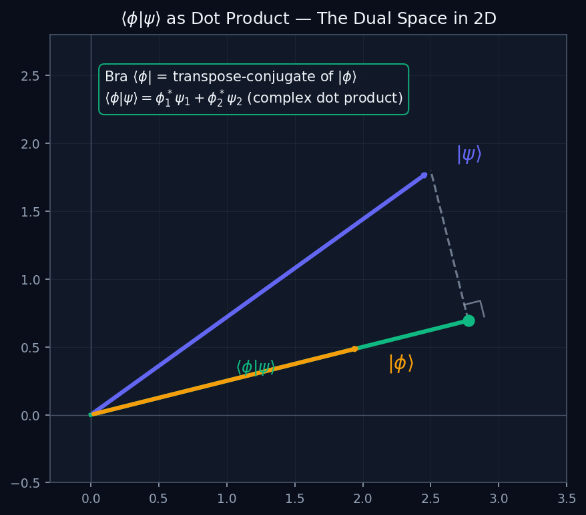
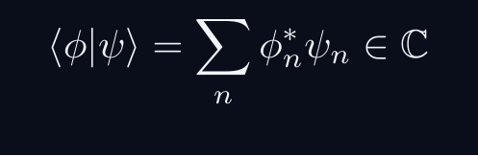

L02 — HS: Bras as Row Vectors
L02
⟨φ| is the transpose-conjugate of |φ⟩
BRAS AS ROW VECTORS
THE BRA IS A DUAL VECTOR
Every ket |ψ⟩ has a corresponding bra ⟨ψ|. In a finite basis, the bra is the conjugate-transpose (row vector) of the ket (column vector).
|psi angle o (c1,c2)T, quad langlepsi| = (c1*, c2*)
GEOMETRIC MEANING
The inner product ⟨φ|ψ⟩ is the complex dot product — the projection of |ψ⟩ onto |φ⟩.
QM: L02 — HS · Bras as Row Vectors
L02 · HS

Slide 4
BegUG
Beginning Undergraduate
1. Gram-Schmidt Process
QM: L02 — Beginning Undergraduate
L02

Slide 5
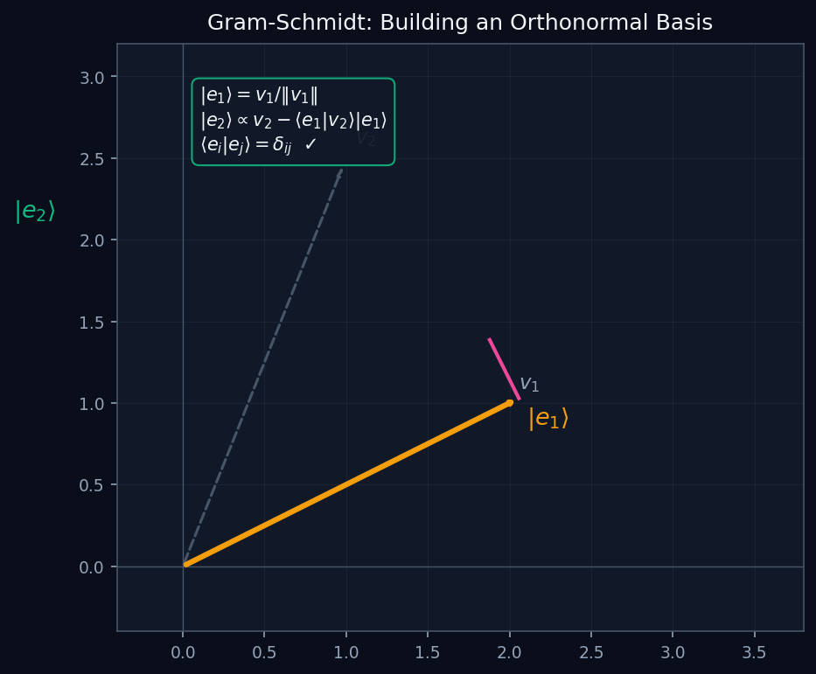
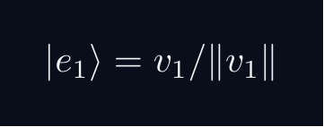
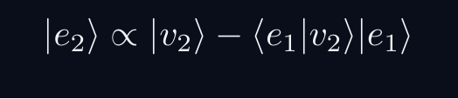
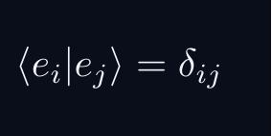
L02 — BegUG: Gram-Schmidt Process
L02
Building an orthonormal basis from any linearly independent set
GRAM-SCHMIDT PROCESS
GRAM-SCHMIDT ORTHOGONALISATION
Given any set of linearly independent vectors, Gram-Schmidt builds an orthonormal basis step by step:
WHY THIS MATTERS
Any Hilbert space has an orthonormal basis. Gram-Schmidt proves it constructively — it converts any independent set into one with ⟨eᵢ|eⱼ⟩ = δᵢⱼ.
QM: L02 — BegUG · Gram-Schmidt Process
L02 · BegUG

Slide 6
AdvUG
Advanced Undergraduate
1. Riesz Representation Theorem
QM: L02 — Advanced Undergraduate
L02

Slide 7
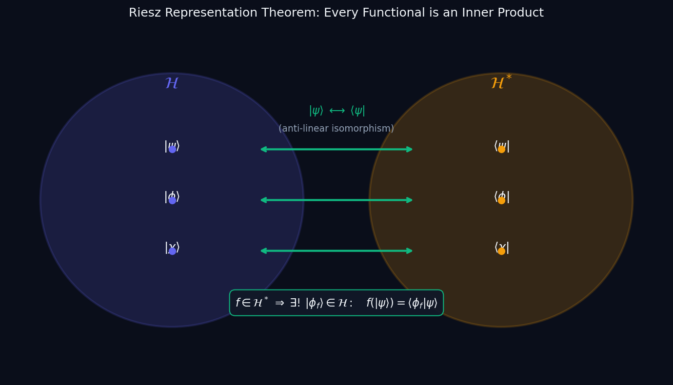


L02 — AdvUG: Riesz Representation Theorem
L02
Every bounded linear functional on ℋ is an inner product
RIESZ REPRESENTATION THEOREM
RIESZ REPRESENTATION THEOREM
Let f: ℋ → ℂ be a bounded linear functional. Then there exists a unique |φ_f⟩ ∈ ℋ such that:
CONSEQUENCE: H ≅ H*
The map |φ⟩ ↦ ⟨φ| is an anti-linear isomorphism between ℋ and its dual ℋ*. This is WHY bra-ket notation works — every bra is a ket in disguise.
Anti-linear: ⟨cφ| = c*⟨φ| (note the conjugate). This reflects the sesquilinear nature of the inner product.
QM: L02 — AdvUG · Riesz Representation Theorem
L02 · AdvUG

Slide 8
MSc
Master's Level
1. Dual Space as Functionals
QM: L02 — Master's Level
L02

Slide 9
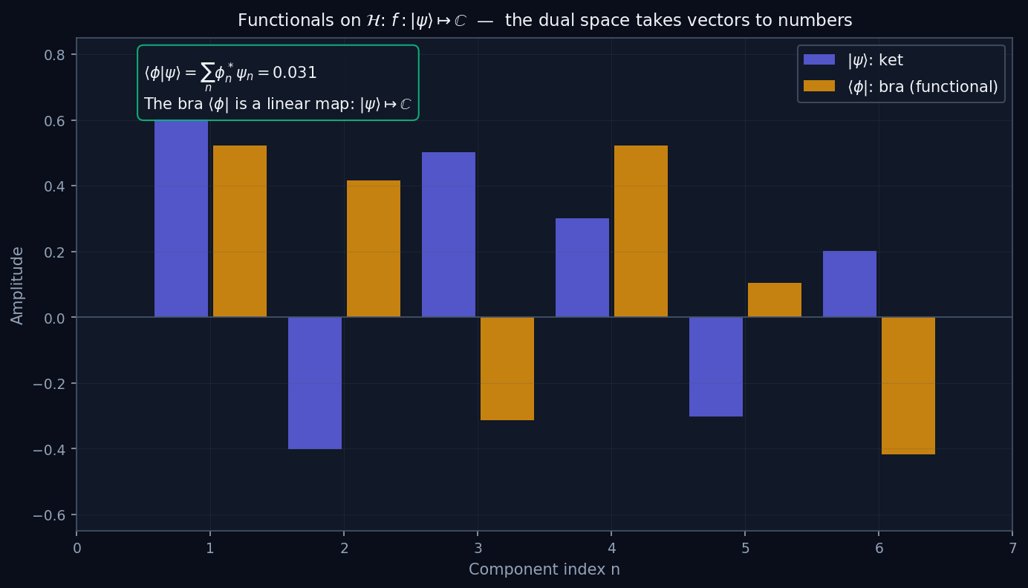

L02 — MSc: Dual Space as Functionals
L02
ℋ* = {bounded linear maps ℋ → ℂ}
DUAL SPACE AS FUNCTIONALS
THE DUAL SPACE ℋ*
The dual space ℋ* consists of all bounded linear functionals f: ℋ → ℂ. Each bra ⟨φ| is such a functional:
langlephi|: |psirangle longmapsto langlephi|psirangle in mathbbC
NORM ON ℋ*
By Riesz, ‖⟨φ|‖ = ‖|φ⟩‖ — the dual norm equals the original norm. ℋ and ℋ* are isometrically anti-isomorphic.
WHY BOUNDED?
Unbounded functionals exist on infinite-dimensional spaces but are not continuous. Physics requires continuous operations — hence we restrict to bounded (= continuous) functionals.
QM: L02 — MSc · Dual Space as Functionals
L02 · MSc

Slide 10
PhD
PhD Level
1. Reflexivity and Bidual
QM: L02 — PhD Level
L02

Slide 11


L02 — PhD: Reflexivity and Bidual
L02
ℋ ≅ ℋ** — Hilbert spaces are reflexive
REFLEXIVITY AND BIDUAL
REFLEXIVITY OF HILBERT SPACES
For a Hilbert space ℋ, the bidual ℋ** = (ℋ*)* is naturally isometric to ℋ itself. This is reflexivity.
IMPLICATION
Every element of ℋ** is evaluation at some point of ℋ. In physics: there are no 'exotic' second-order duals — the double bra ⟨⟨φ|| is just |φ⟩ back.
COMPARISON: BANACH SPACES
General Banach spaces need not be reflexive (example: L¹ is not). Reflexivity of Hilbert spaces is a deep consequence of the parallelogram law and completeness.
QM: L02 — PhD · Reflexivity and Bidual
L02 · PhD

