Slide 1
Ψ
QUANTUM MECHANICS — BRA–KET NOTATION
L02
Bras, Dual Space & Inner Product Structure
Duality, conjugate linearity, Riesz representation
HS
BegUG
AdvUG
MSc
PhD
Full expanded deck · 5 tiers · Worked examples · Complete problem sets
QM: Bra–Ket Notation — L02
L02

Slide 2
L02 — Lecture Overview
L02
Bras, Dual Space & Inner Product Structure
90-MIN PACING
CORE LEARNING OUTCOMES
0–20 min: Define bras as linear functionals on H
20–50 min: Conjugate linearity; inner product axioms
50–70 min: Probability amplitude ⟨φ|ψ⟩ and Born rule
70–90 min: Orthonormal basis; Gram–Schmidt sketch
• Define bra ⟨ψ| as element of dual space H*
• Master conjugate linearity: (a⟨φ₁|+b⟨φ₂|)|ψ⟩ = a*⟨φ₁|ψ⟩ + b*⟨φ₂|ψ⟩
• Derive Born-rule probability from inner product structure
• State Riesz representation theorem (intuition)
HS
BegUG
AdvUG
MSc
PhD
Conjugation rules; dot-product analogy for real vectors
Orthonormal bases; Gram–Schmidt procedure
Riesz representation theorem intuition; proofs
Anti-linear maps; adjoint rigorously defined; continuity
Bounded vs unbounded functionals; Banach space context
ASSESSMENT BUNDLE
Set A: Compute ⟨φ|ψ⟩ for |φ⟩ = (1/√2)(|1⟩-i|2⟩), |ψ⟩ = (1/√5)(|1⟩+2i|2⟩) · Verify conjugate symmetry for the above pair
Set B: Prove that inner product positive-definiteness implies norm > 0 for |ψ⟩ ≠ 0 · Prove Gram–Schmidt produces orthonormal vectors
QM: L02
L02 · Overview

Slide 3

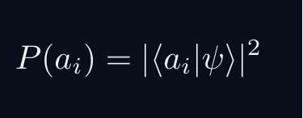


L02 — Sakurai Track
L02
Measurement-first, operational approach
SAKURAI: PREPARATION → STATISTICS → AMPLITUDES
BRIDGE TO DIRAC
SAKURAI: PREPARATION TO STATISTICS TO AMPLITUDES
• Preparation procedure ↔ ket |ψ⟩ (ray in ℋ)
• Measurement outcome aᵢ ↔ basis ket |aᵢ⟩
• Transition amplitude ↔ inner product ⟨aᵢ|ψ⟩
• Probability rule ↔ |⟨aᵢ|ψ⟩|²
• Total prob. = 1 ↔ ⟨ψ|ψ⟩ = 1
• Interference ↔ complex phase structure
STEP 1 — PREPARATION
A preparation is a reproducible laboratory protocol.
The same procedure always yields the same statistical predictions.
STEP 2 — MEASUREMENT OUTCOMES
A measurement device returns outcomes a_i with stable frequencies.
The state encodes probabilities, not definite property values.
STEP 3 — WHY AMPLITUDES?
Interference demands combining paths BEFORE squaring:
The cross-term is interference — real and measurable.
Only complex amplitudes can produce this cross-term.
STEP 4 — OPERATIONAL BORN RULE
GLOBAL PHASE IS UNOBSERVABLE
Physical states are RAYS not vectors.
QM: L02
L02 · Sakurai Track

Slide 4


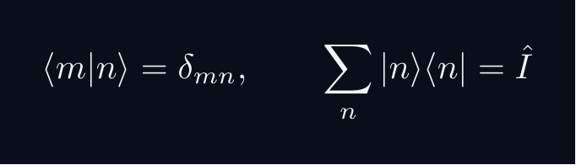
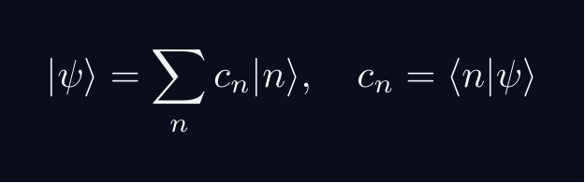


L02 — Dirac Track
L02
Abstract, representation-independent axioms
DIRAC: FIVE POSTULATES
DIRAC: FIVE POSTULATES OF QUANTUM MECHANICS
POSTULATE 1 — STATE SPACE
Every physical state is a ray in a complex Hilbert space H.
POSTULATE 2 — OBSERVABLES
Every observable A corresponds to a Hermitian operator A = A^†.
POSTULATE 3 — COMPLETENESS
POSTULATE 4 — BORN RULE
Post-measurement state (ideal projective): |ψ⟩ → |a⟩
POSTULATE 5 — DYNAMICS
QM: L02
L02 · Dirac Track

Slide 5



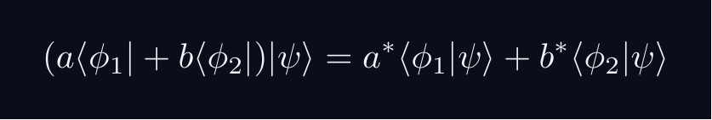
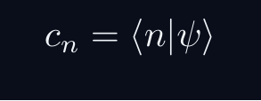
L02 — Key Formulas
L02
LaTeX-rendered formula reference
inner product
conj symmetry
linearity ket
conj lin bra
component via ip
QM: L02
L02 · Formulas

Slide 6
L02 — HS: High School
L02
Tier introduction and learning context
WHAT THIS TIER COVERS
PREREQUISITES
This lecture covers Bras, Dual Space & Inner Product Structure at the HS level.
Starting point: pre-university mathematics
Required: basic algebra and complex arithmetic
WHAT THIS TIER UNLOCKS
KEY MESSAGE FOR THIS TIER
Unlocks access to: Beginning Undergraduate
This tier equips you for:
Orthonormal bases; Gram–Schmidt procedure
Conjugation rules; dot-product analogy for real vectors
QM: L02 · HS
L02 · HS · Intro

Slide 7
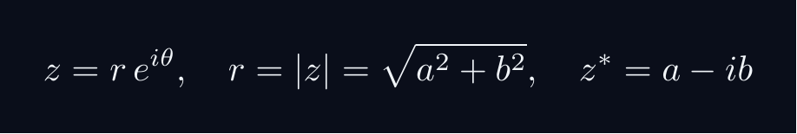
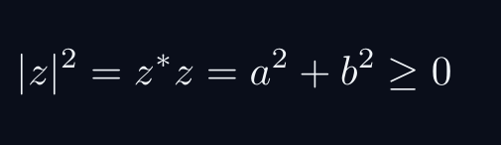
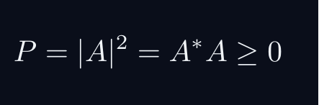

L02 — HS: Core Concepts
L02
Main ideas, key equations, and their meaning
CORE CONCEPTS & KEY RESULTS
This lecture covers Bras, Dual Space & Inner Product Structure at the HS level.
COMPLEX NUMBERS AS ARROWS
A complex number z = a + ib lives in a 2D plane.
AMPLITUDE TO PROBABILITY (BORN RULE)
A quantum amplitude A is a complex number for a process.
Why squaring? Gives a real, non-negative number. Phase alone does not.
SUPERPOSITION = ARROW ADDITION = INTERFERENCE
Two paths: amplitudes A_1 and A_2. Total: A = A_1 + A_2.
Interference term can be positive (constructive) or negative (destructive).
WORKED FORMULA: PHASE DEPENDENCE
Let A_1 = 1, A_2 = e^{iφ} (unit magnitude, phase φ).
Maximum P=4 at φ=0 (constructive). Minimum P=0 at φ=pi (destructive).
QM: L02 · HS
L02 · HS · Concepts

Slide 8
L02 — HS: Worked Example 1
L02
Step-by-step solved example with commentary
EXAMPLE 1: HS-A1
WORKED SOLUTION
Core problem for L02 (HS). Conjugation rules; dot-product analogy for real vectors
FULL SOLUTION
HINTS
Apply the relevant formula.
* Apply the definition
ADVANCED HINTS
* Verify basis-independence
QM: L02 · HS
L02 · HS · Example 1

Slide 9
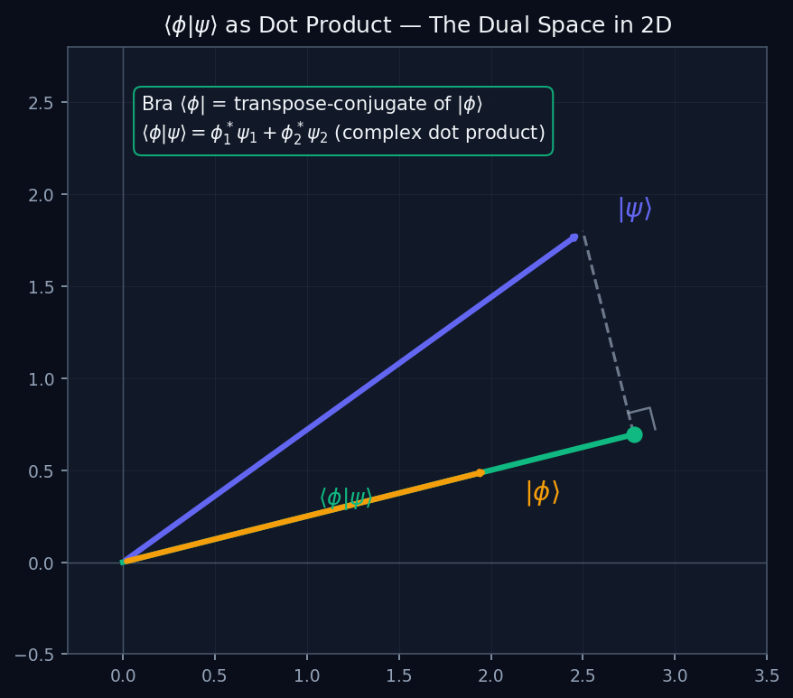
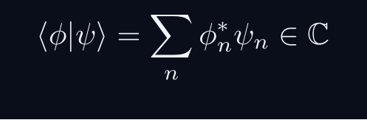

L02 — HS: Bras as Row Vectors
L02
⟨φ| is the transpose-conjugate of |φ⟩
BRAS AS ROW VECTORS
THE BRA IS A DUAL VECTOR
Every ket |ψ⟩ has a corresponding bra ⟨ψ|. In a finite basis, the bra is the conjugate-transpose (row vector) of the ket (column vector).
|psi angle o (c1,c2)T, quad langlepsi| = (c1*, c2*)
GEOMETRIC MEANING
The inner product ⟨φ|ψ⟩ is the complex dot product — the projection of |ψ⟩ onto |φ⟩.
QM: L02 — HS · Bras as Row Vectors
L02 · HS

Slide 10
L02 — HS: Worked Example 2
L02
Second example — deeper or alternative approach
EXAMPLE 2: HS-A2
WORKED SOLUTION
Verification exercise for L02 (HS).
FULL SOLUTION
HINTS
Follow the derivation step by step.
* Use orthonormality
ADVANCED HINTS
* Check normalisation
QM: L02 · HS
L02 · HS · Example 2

Slide 11
L02 — HS: Concept Questions
L02
Think before computing — conceptual understanding checks
CONCEPT QUESTIONS
MORE QUESTIONS + GUIDANCE
1. Q1: HS question for L02.
2. Q2: HS question for L02.
3. Q3: HS question for L02.
1. Q4: HS question for L02.
2. Q5: HS question for L02.
─────
These questions have no calculation — think about what probability MEANS.
Key insight: squaring is the minimal operation that gives a non-negative re…
QM: L02 · HS
L02 · HS · Concept Qs

Slide 12
L02 — HS: Problem Sets
L02
Simple problems (Set A) and advanced problems (Set B)
PROBLEM SET A — SIMPLE (2 problems)
PROBLEM SET B — ADVANCED (1 problems)
[HS-A1] Core problem for L02 (HS). Conjugation rules; dot-product analogy for real vectors
Hint: Apply the definition
[HS-A2] Verification exercise for L02 (HS).
Hint: Use orthonormality
[HS-B1] Proof exercise for L02 (HS).
Hint: Start from definition
Key idea: Check edge cases
QM: L02 · HS
L02 · HS · Problems

Slide 13
L02 — HS: References & Bibliography
L02
Historical, educational, and research-level reading
HISTORICAL (1)
EDUCATIONAL (2)
RESEARCH (1)
[1930] Dirac
"Principles of QM"
Oxford UP
↳ Source for L02.
Sakurai (2021)
"Modern QM"
Cambridge UP
↳ Main text.
Cohen-Tannoudji (1977)
"QM Vol. 1"
Wiley
↳ Complements.
von Neumann (1932)
"Math. Grundlagen"
Springer
↳ Rigorous foundations.
QM: L02 · HS
L02 · HS · References

Slide 14
L02 — BegUG: Beginning Undergraduate
L02
Tier introduction and learning context
WHAT THIS TIER COVERS
PREREQUISITES
This lecture covers Bras, Dual Space & Inner Product Structure at the BegUG level.
Builds on: High School
Required background:
Conjugation rules; dot-product analogy for real vectors
WHAT THIS TIER UNLOCKS
KEY MESSAGE FOR THIS TIER
Unlocks access to: Advanced Undergraduate
This tier equips you for:
Riesz representation theorem intuition; proofs
Orthonormal bases; Gram–Schmidt procedure
QM: L02 · BegUG
L02 · BegUG · Intro

Slide 15

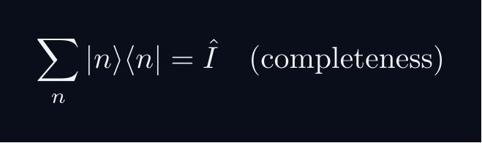
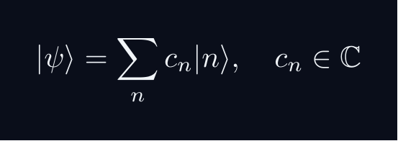
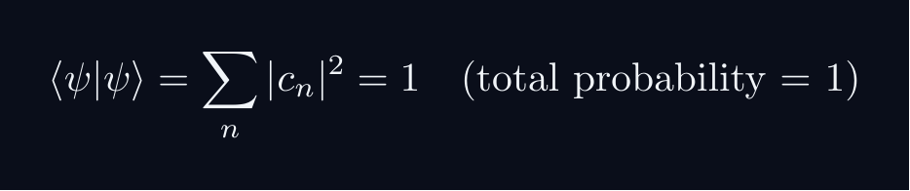


L02 — BegUG: Core Concepts
L02
Main ideas, key equations, and their meaning
CORE CONCEPTS & KEY RESULTS
This lecture covers Bras, Dual Space & Inner Product Structure at the BegUG level.
HILBERT SPACE FORMALISM — DISCRETE BASIS
State vector |ψ⟩ in complex Hilbert space H.
EXPANSION AND COMPONENTS
Proof: ⟨ m|ψ⟩ = sum_n c_n ⟨ m|n⟩ = sum_n c_ndelta_{mn} = c_m
NORMALISATION AND PROBABILITIES
GLOBAL PHASE INVARIANCE
QM: L02 · BegUG
L02 · BegUG · Concepts

Slide 16
L02 — BegUG: Worked Example 1
L02
Step-by-step solved example with commentary
EXAMPLE 1: BegUG-A1
WORKED SOLUTION
Core problem for L02 (BegUG). Orthonormal bases; Gram–Schmidt procedure
FULL SOLUTION
HINTS
Apply the relevant formula.
* Apply the definition
ADVANCED HINTS
* Verify basis-independence
QM: L02 · BegUG
L02 · BegUG · Example 1

Slide 17
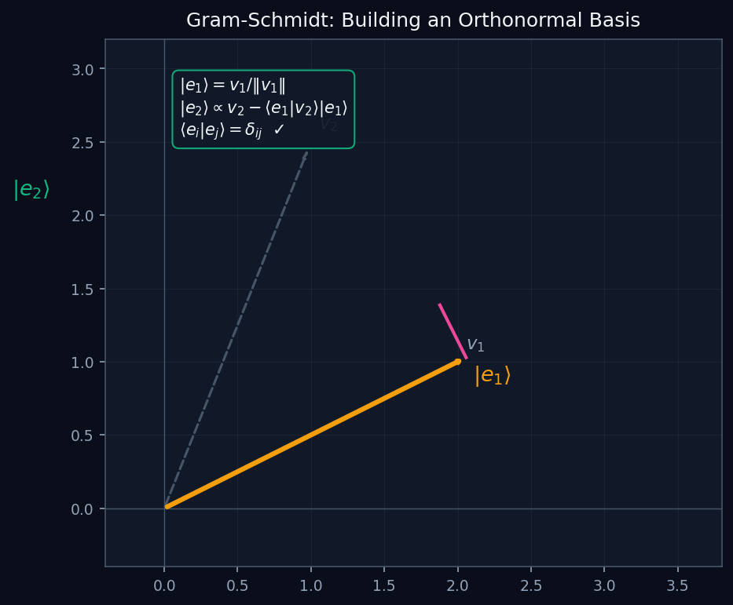
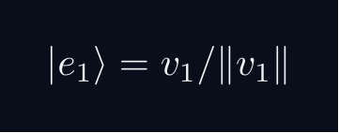
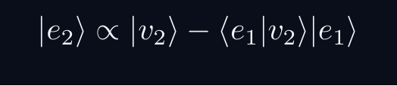

L02 — BegUG: Gram-Schmidt Process
L02
Building an orthonormal basis from any linearly independent set
GRAM-SCHMIDT PROCESS
GRAM-SCHMIDT ORTHOGONALISATION
Given any set of linearly independent vectors, Gram-Schmidt builds an orthonormal basis step by step:
WHY THIS MATTERS
Any Hilbert space has an orthonormal basis. Gram-Schmidt proves it constructively — it converts any independent set into one with ⟨eᵢ|eⱼ⟩ = δᵢⱼ.
QM: L02 — BegUG · Gram-Schmidt Process
L02 · BegUG

Slide 18
L02 — BegUG: Worked Example 2
L02
Second example — deeper or alternative approach
EXAMPLE 2: BegUG-A2
WORKED SOLUTION
Verification exercise for L02 (BegUG).
FULL SOLUTION
HINTS
Follow the derivation step by step.
* Use orthonormality
ADVANCED HINTS
* Check normalisation
QM: L02 · BegUG
L02 · BegUG · Example 2

Slide 19
L02 — BegUG: Concept Questions
L02
Think before computing — conceptual understanding checks
CONCEPT QUESTIONS
MORE QUESTIONS + GUIDANCE
1. Q1: BegUG question for L02.
2. Q2: BegUG question for L02.
3. Q3: BegUG question for L02.
1. Q4: BegUG question for L02.
2. Q5: BegUG question for L02.
─────
Work from the definition: write out the expansion, act with ⟨m| on the left, use δₘₙ.
For normalization: total probability must equal 1 — that is the…
QM: L02 · BegUG
L02 · BegUG · Concept Qs

Slide 20
L02 — BegUG: Problem Sets
L02
Simple problems (Set A) and advanced problems (Set B)
PROBLEM SET A — SIMPLE (2 problems)
PROBLEM SET B — ADVANCED (1 problems)
[BegUG-A1] Core problem for L02 (BegUG). Orthonormal bases; Gram–Schmidt procedure
Hint: Apply the definition
[BegUG-A2] Verification exercise for L02 (BegUG).
Hint: Use orthonormality
[BegUG-B1] Proof exercise for L02 (BegUG).
Hint: Start from definition
Key idea: Check edge cases
QM: L02 · BegUG
L02 · BegUG · Problems

Slide 21
L02 — BegUG: References & Bibliography
L02
Historical, educational, and research-level reading
HISTORICAL (1)
EDUCATIONAL (2)
RESEARCH (1)
[1930] Dirac
"Principles of QM"
Oxford UP
↳ Source for L02.
Sakurai (2021)
"Modern QM"
Cambridge UP
↳ Main text.
Cohen-Tannoudji (1977)
"QM Vol. 1"
Wiley
↳ Complements.
von Neumann (1932)
"Math. Grundlagen"
Springer
↳ Rigorous foundations.
QM: L02 · BegUG
L02 · BegUG · References

Slide 22
L02 — AdvUG: Advanced Undergraduate
L02
Tier introduction and learning context
WHAT THIS TIER COVERS
PREREQUISITES
This lecture covers Bras, Dual Space & Inner Product Structure at the AdvUG level.
Builds on: Beginning Undergraduate
Required background:
Orthonormal bases; Gram–Schmidt procedure
WHAT THIS TIER UNLOCKS
KEY MESSAGE FOR THIS TIER
Unlocks access to: Master's Level
This tier equips you for:
Anti-linear maps; adjoint rigorously defined; continuity
Riesz representation theorem intuition; proofs
QM: L02 · AdvUG
L02 · AdvUG · Intro

Slide 23
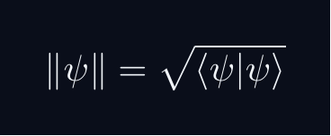



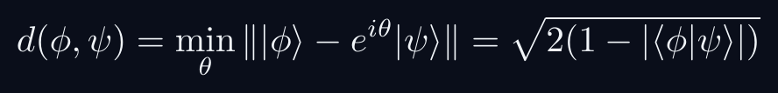

L02 — AdvUG: Core Concepts
L02
Main ideas, key equations, and their meaning
CORE CONCEPTS & KEY RESULTS
This lecture covers Bras, Dual Space & Inner Product Structure at the AdvUG level.
INNER PRODUCT SPACE GEOMETRY
CAUCHY-SCHWARZ INEQUALITY
Proof: set f(lambda) = | |φ⟩ - lambda|ψ⟩ |^2 ≥ 0.
Choose lambda = ⟨ψ|φ⟩ / |ψ|^2 to minimise.
TRIANGLE INEQUALITY
Proof: square both sides; apply C-S to the cross term.
PHASE-INVARIANT DISTANCE
QM: L02 · AdvUG
L02 · AdvUG · Concepts

Slide 24
L02 — AdvUG: Worked Example 1
L02
Step-by-step solved example with commentary
EXAMPLE 1: AdvUG-A1
WORKED SOLUTION
Core problem for L02 (AdvUG). Riesz representation theorem intuition; proofs
FULL SOLUTION
HINTS
Apply the relevant formula.
* Apply the definition
ADVANCED HINTS
* Verify basis-independence
QM: L02 · AdvUG
L02 · AdvUG · Example 1

Slide 25
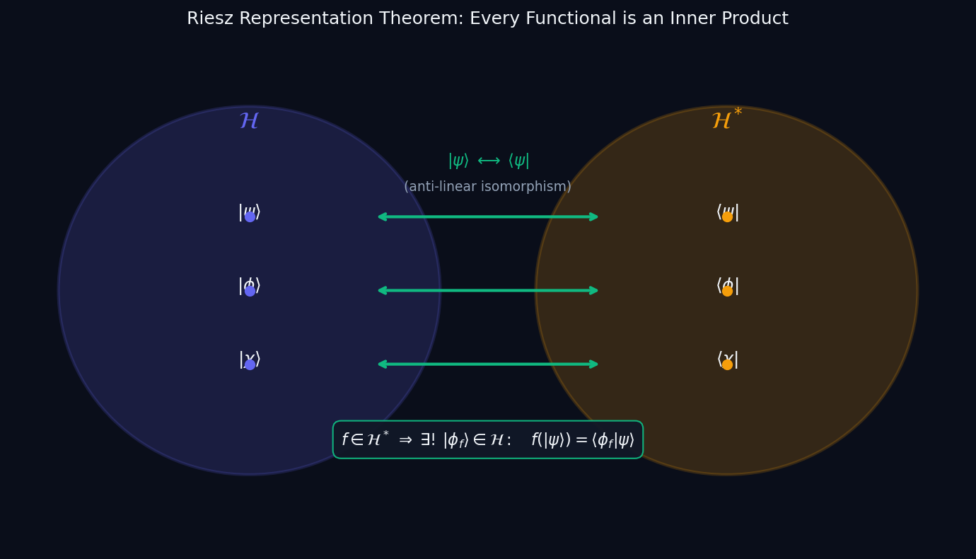


L02 — AdvUG: Riesz Representation Theorem
L02
Every bounded linear functional on ℋ is an inner product
RIESZ REPRESENTATION THEOREM
RIESZ REPRESENTATION THEOREM
Let f: ℋ → ℂ be a bounded linear functional. Then there exists a unique |φ_f⟩ ∈ ℋ such that:
CONSEQUENCE: H ≅ H*
The map |φ⟩ ↦ ⟨φ| is an anti-linear isomorphism between ℋ and its dual ℋ*. This is WHY bra-ket notation works — every bra is a ket in disguise.
Anti-linear: ⟨cφ| = c*⟨φ| (note the conjugate). This reflects the sesquilinear nature of the inner product.
QM: L02 — AdvUG · Riesz Representation Theorem
L02 · AdvUG

Slide 26
L02 — AdvUG: Worked Example 2
L02
Second example — deeper or alternative approach
EXAMPLE 2: AdvUG-A2
WORKED SOLUTION
Verification exercise for L02 (AdvUG).
FULL SOLUTION
HINTS
Follow the derivation step by step.
* Use orthonormality
ADVANCED HINTS
* Check normalisation
QM: L02 · AdvUG
L02 · AdvUG · Example 2

Slide 27
L02 — AdvUG: Concept Questions
L02
Think before computing — conceptual understanding checks
CONCEPT QUESTIONS
MORE QUESTIONS + GUIDANCE
1. Q1: AdvUG question for L02.
2. Q2: AdvUG question for L02.
3. Q3: AdvUG question for L02.
1. Q4: AdvUG question for L02.
2. Q5: AdvUG question for L02.
─────
For C–S: the proof idea is to consider ‖|φ⟩ - λ|ψ⟩‖² ≥ 0 and choose the minimising λ.
For the geometry questions: draw a unit circle in ℂ²; overlap |…
QM: L02 · AdvUG
L02 · AdvUG · Concept Qs

Slide 28
L02 — AdvUG: Problem Sets
L02
Simple problems (Set A) and advanced problems (Set B)
PROBLEM SET A — SIMPLE (2 problems)
PROBLEM SET B — ADVANCED (1 problems)
[AdvUG-A1] Core problem for L02 (AdvUG). Riesz representation theorem intuition; proofs
Hint: Apply the definition
[AdvUG-A2] Verification exercise for L02 (AdvUG).
Hint: Use orthonormality
[AdvUG-B1] Proof exercise for L02 (AdvUG).
Hint: Start from definition
Key idea: Check edge cases
QM: L02 · AdvUG
L02 · AdvUG · Problems

Slide 29
L02 — AdvUG: References & Bibliography
L02
Historical, educational, and research-level reading
HISTORICAL (1)
EDUCATIONAL (2)
RESEARCH (1)
[1930] Dirac
"Principles of QM"
Oxford UP
↳ Source for L02.
Sakurai (2021)
"Modern QM"
Cambridge UP
↳ Main text.
Cohen-Tannoudji (1977)
"QM Vol. 1"
Wiley
↳ Complements.
von Neumann (1932)
"Math. Grundlagen"
Springer
↳ Rigorous foundations.
QM: L02 · AdvUG
L02 · AdvUG · References

Slide 30
L02 — MSc: Master's Level
L02
Tier introduction and learning context
WHAT THIS TIER COVERS
PREREQUISITES
This lecture covers Bras, Dual Space & Inner Product Structure at the MSc level.
Builds on: Advanced Undergraduate
Required background:
Riesz representation theorem intuition; proofs
WHAT THIS TIER UNLOCKS
KEY MESSAGE FOR THIS TIER
Unlocks access to: PhD Level
This tier equips you for:
Bounded vs unbounded functionals; Banach space context
Anti-linear maps; adjoint rigorously defined; continuity
QM: L02 · MSc
L02 · MSc · Intro

Slide 31
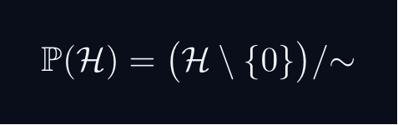
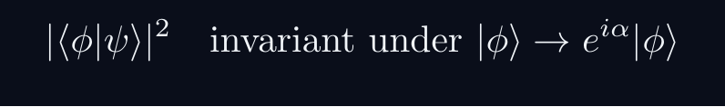

L02 — MSc: Core Concepts
L02
Main ideas, key equations, and their meaning
CORE CONCEPTS & KEY RESULTS
This lecture covers Bras, Dual Space & Inner Product Structure at the MSc level.
PROJECTIVE HILBERT SPACE
Physical state space is P(H), not H itself.
A ray [ψ] is a one-dimensional complex subspace of H.
Example: P(C^2) cong S^2 — the Bloch sphere.
PHYSICALLY INVARIANT QUANTITIES
WIGNER'S THEOREM
Any bijection T:P(H)→P(H) preserving |⟨φ|ψ⟩|^2
is implemented by a UNITARY or ANTIUNITARY operator U on H.
Consequence: all quantum symmetries are (anti)unitary.
CONSEQUENCES
Symmetry group G acting on states gives projective representation of G.
Forces spin SO(3)→ SU(2), superselection rules, CPT symmetry.
QM: L02 · MSc
L02 · MSc · Concepts

Slide 32
L02 — MSc: Worked Example 1
L02
Step-by-step solved example with commentary
EXAMPLE 1: MSc-A1
WORKED SOLUTION
Core problem for L02 (MSc). Anti-linear maps; adjoint rigorously defined; continuity
FULL SOLUTION
HINTS
Apply the relevant formula.
* Apply the definition
ADVANCED HINTS
* Verify basis-independence
QM: L02 · MSc
L02 · MSc · Example 1

Slide 33
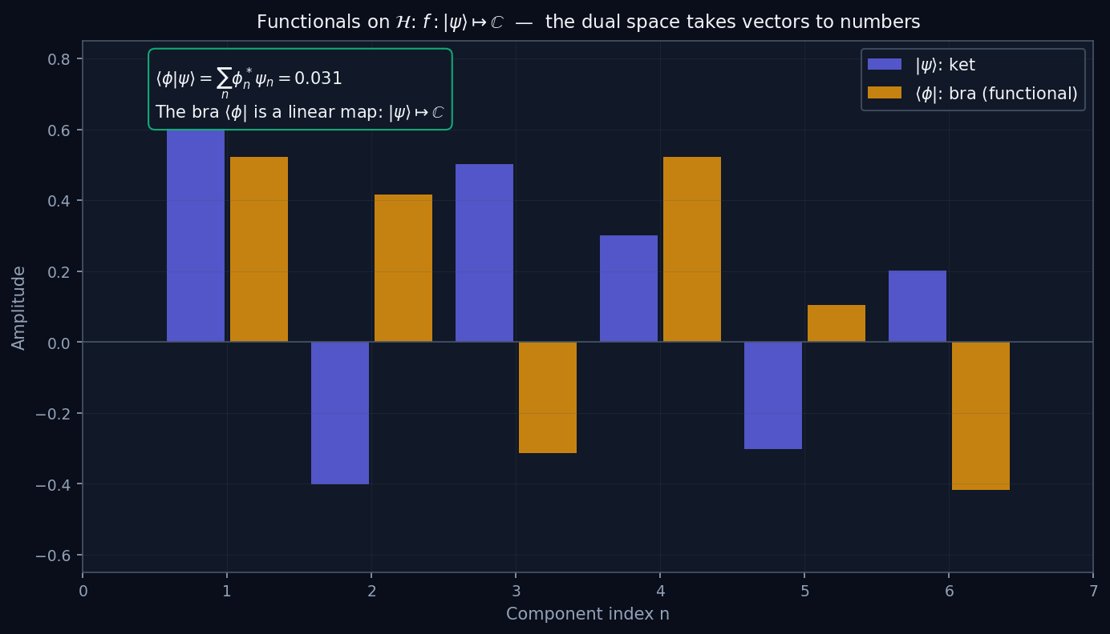

L02 — MSc: Dual Space as Functionals
L02
ℋ* = {bounded linear maps ℋ → ℂ}
DUAL SPACE AS FUNCTIONALS
THE DUAL SPACE ℋ*
The dual space ℋ* consists of all bounded linear functionals f: ℋ → ℂ. Each bra ⟨φ| is such a functional:
langlephi|: |psirangle longmapsto langlephi|psirangle in mathbbC
NORM ON ℋ*
By Riesz, ‖⟨φ|‖ = ‖|φ⟩‖ — the dual norm equals the original norm. ℋ and ℋ* are isometrically anti-isomorphic.
WHY BOUNDED?
Unbounded functionals exist on infinite-dimensional spaces but are not continuous. Physics requires continuous operations — hence we restrict to bounded (= continuous) functionals.
QM: L02 — MSc · Dual Space as Functionals
L02 · MSc

Slide 34
L02 — MSc: Worked Example 2
L02
Second example — deeper or alternative approach
EXAMPLE 2: MSc-A2
WORKED SOLUTION
Verification exercise for L02 (MSc).
FULL SOLUTION
HINTS
Follow the derivation step by step.
* Use orthonormality
ADVANCED HINTS
* Check normalisation
QM: L02 · MSc
L02 · MSc · Example 2

Slide 35
L02 — MSc: Concept Questions
L02
Think before computing — conceptual understanding checks
CONCEPT QUESTIONS
MORE QUESTIONS + GUIDANCE
1. Q1: MSc question for L02.
2. Q2: MSc question for L02.
3. Q3: MSc question for L02.
1. Q4: MSc question for L02.
2. Q5: MSc question for L02.
─────
For projective space: think of it as points on a sphere (for 2D), or more generally a complex manifold.
For Wigner: the key word is 'preserves transi…
QM: L02 · MSc
L02 · MSc · Concept Qs

Slide 36
L02 — MSc: Problem Sets
L02
Simple problems (Set A) and advanced problems (Set B)
PROBLEM SET A — SIMPLE (2 problems)
PROBLEM SET B — ADVANCED (1 problems)
[MSc-A1] Core problem for L02 (MSc). Anti-linear maps; adjoint rigorously defined; continuity
Hint: Apply the definition
[MSc-A2] Verification exercise for L02 (MSc).
Hint: Use orthonormality
[MSc-B1] Proof exercise for L02 (MSc).
Hint: Start from definition
Key idea: Check edge cases
QM: L02 · MSc
L02 · MSc · Problems

Slide 37
L02 — MSc: References & Bibliography
L02
Historical, educational, and research-level reading
HISTORICAL (1)
EDUCATIONAL (2)
RESEARCH (1)
[1930] Dirac
"Principles of QM"
Oxford UP
↳ Source for L02.
Sakurai (2021)
"Modern QM"
Cambridge UP
↳ Main text.
Cohen-Tannoudji (1977)
"QM Vol. 1"
Wiley
↳ Complements.
von Neumann (1932)
"Math. Grundlagen"
Springer
↳ Rigorous foundations.
QM: L02 · MSc
L02 · MSc · References

Slide 38
L02 — PhD: PhD Level
L02
Tier introduction and learning context
WHAT THIS TIER COVERS
PREREQUISITES
This lecture covers Bras, Dual Space & Inner Product Structure at the PhD level.
Builds on: Master's Level
Required background:
Anti-linear maps; adjoint rigorously defined; continuity
WHAT THIS TIER UNLOCKS
KEY MESSAGE FOR THIS TIER
Frontier level: connects to active research
This tier equips you for:
Primary literature and open problems
Bounded vs unbounded functionals; Banach space context
QM: L02 · PhD
L02 · PhD · Intro

Slide 39



L02 — PhD: Core Concepts
L02
Main ideas, key equations, and their meaning
CORE CONCEPTS & KEY RESULTS
This lecture covers Bras, Dual Space & Inner Product Structure at the PhD level.
HILBERT SPACE — PRECISE AXIOMS
Definition: a complex vector space H with ⟨cdot|cdot⟩ that is COMPLETE.
Completeness: every Cauchy sequence {ψ_n} converges in H.
Essential for: spectral theory, Fourier expansions, Stone's theorem.
SEPARABILITY
H separable ⟺ countable dense subset ⟺ countable ONB {e_n}.
All standard NRQM spaces: L^2(R^n), C^n, ell^2(N).
RAYS AS ONE-DIMENSIONAL SUBSPACES
P(H) is a Kahler manifold with Fubini-Study metric.
UNBOUNDED OPERATORS — DOMAIN SUBTLETY
Self-adjoint ≠ Hermitian for unbounded operators (x̂, p̂).
Spectral theorem and Stone's theorem REQUIRE self-adjointness.
QM: L02 · PhD
L02 · PhD · Concepts

Slide 40
L02 — PhD: Worked Example 1
L02
Step-by-step solved example with commentary
EXAMPLE 1: PhD-A1
WORKED SOLUTION
Core problem for L02 (PhD). Bounded vs unbounded functionals; Banach space context
FULL SOLUTION
HINTS
Apply the relevant formula.
* Apply the definition
ADVANCED HINTS
* Verify basis-independence
QM: L02 · PhD
L02 · PhD · Example 1

Slide 41


L02 — PhD: Reflexivity and Bidual
L02
ℋ ≅ ℋ** — Hilbert spaces are reflexive
REFLEXIVITY AND BIDUAL
REFLEXIVITY OF HILBERT SPACES
For a Hilbert space ℋ, the bidual ℋ** = (ℋ*)* is naturally isometric to ℋ itself. This is reflexivity.
IMPLICATION
Every element of ℋ** is evaluation at some point of ℋ. In physics: there are no 'exotic' second-order duals — the double bra ⟨⟨φ|| is just |φ⟩ back.
COMPARISON: BANACH SPACES
General Banach spaces need not be reflexive (example: L¹ is not). Reflexivity of Hilbert spaces is a deep consequence of the parallelogram law and completeness.
QM: L02 — PhD · Reflexivity and Bidual
L02 · PhD

Slide 42
L02 — PhD: Worked Example 2
L02
Second example — deeper or alternative approach
EXAMPLE 2: PhD-A2
WORKED SOLUTION
Verification exercise for L02 (PhD).
FULL SOLUTION
HINTS
Follow the derivation step by step.
* Use orthonormality
ADVANCED HINTS
* Check normalisation
QM: L02 · PhD
L02 · PhD · Example 2

Slide 43
L02 — PhD: Concept Questions
L02
Think before computing — conceptual understanding checks
CONCEPT QUESTIONS
MORE QUESTIONS + GUIDANCE
1. Q1: PhD question for L02.
2. Q2: PhD question for L02.
3. Q3: PhD question for L02.
1. Q4: PhD question for L02.
2. Q5: PhD question for L02.
─────
For completeness: construct Cauchy sequences that don't converge to a square-integrable function in a non-complete space.
For separability: construct…
QM: L02 · PhD
L02 · PhD · Concept Qs

Slide 44
L02 — PhD: Problem Sets
L02
Simple problems (Set A) and advanced problems (Set B)
PROBLEM SET A — SIMPLE (2 problems)
PROBLEM SET B — ADVANCED (1 problems)
[PhD-A1] Core problem for L02 (PhD). Bounded vs unbounded functionals; Banach space context
Hint: Apply the definition
[PhD-A2] Verification exercise for L02 (PhD).
Hint: Use orthonormality
[PhD-B1] Proof exercise for L02 (PhD).
Hint: Start from definition
Key idea: Check edge cases
QM: L02 · PhD
L02 · PhD · Problems

Slide 45
L02 — PhD: References & Bibliography
L02
Historical, educational, and research-level reading
HISTORICAL (1)
EDUCATIONAL (2)
RESEARCH (1)
[1930] Dirac
"Principles of QM"
Oxford UP
↳ Source for L02.
Sakurai (2021)
"Modern QM"
Cambridge UP
↳ Main text.
Cohen-Tannoudji (1977)
"QM Vol. 1"
Wiley
↳ Complements.
von Neumann (1932)
"Math. Grundlagen"
Springer
↳ Rigorous foundations.
QM: L02 · PhD
L02 · PhD · References

Slide 46
L02 — Common Pitfalls & Misconceptions
L02
Consolidated pitfalls across all tiers
⚠ PITFALLS (A)
⚠ PITFALLS (B)
• Forgetting that bra is antilinear: bra of (a|ψ⟩) is a*⟨ψ|
• Treating ⟨φ|ψ⟩ as symmetric — it is conjugate symmetric
• Confusing row vector (bra in a basis) with abstract dual vector
HISTORICAL ANCHORS
FORMULA QUICK REFERENCE
• Hilbert (1900s) — inner product spaces formalized
• Riesz (1907) — representation theorem for bounded functionals
• Dirac (1930) — bra as dual vector, bracket notation
Key formulas in this lecture:
inner_product · conj_symmetry · linearity_ket · conj_lin_bra · component_via_ip
See formula slides for full LaTeX-rendered versions.
QM: L02
L02 · Pitfalls

Slide 47
L02 — Homework & Project Summary
L02
Assessment overview across all tiers
HS
BegUG
AdvUG
MSc
PhD
Problems: 2 simple + 1 advanced
Project (simple, ~2-3h): HS Project
Project (advanced, ~8-10h): HS Advanced
Research (defined): Explain key result of L02 (HS).
Research (open): Open question for L02 (HS).
Problems: 2 simple + 1 advanced
Project (simple, ~2-3h): BegUG Project
Project (advanced, ~8-10h): BegUG Advanced
Research (defined): Explain key result of L02 (BegUG).
Research (open): Open question for L02 (BegUG).
Problems: 2 simple + 1 advanced
Project (simple, ~2-3h): AdvUG Project
Project (advanced, ~8-10h): AdvUG Advanced
Research (defined): Explain key result of L02 (AdvUG).
Research (open): Open question for L02 (AdvUG).
Problems: 2 simple + 1 advanced
Project (simple, ~2-3h): MSc Project
Project (advanced, ~8-10h): MSc Advanced
Research (defined): Explain key result of L02 (MSc).
Research (open): Open question for L02 (MSc).
Problems: 2 simple + 1 advanced
Project (simple, ~2-3h): PhD Project
Project (advanced, ~8-10h): PhD Advanced
Research (defined): Explain key result of L02 (PhD).
Research (open): Open question for L02 (PhD).
HOMEWORK ASSIGNMENT
REQUIRED (all students): Problems from your track's Set A
HONOURS (optional): Set B problems from your track
PROJECT: Choose simple OR advanced track from your tier
RESEARCH: At least one well-defined question; open questions for MSc/PhD
QM: L02
L02 · Homework

