Slide 1
L03
Deep Concept Slides
Linear Operators: Adjoint, Hermitian & Unitary
One slide per core concept · Full explanation · Geometric diagram
HS
BegUG
AdvUG
MSc
PhD
5 concept slides
QM: Bra-Ket — L03 Concepts
L03

Slide 2
HS
High School
1. Operators as Transformations
QM: L03 — High School
L03

Slide 3
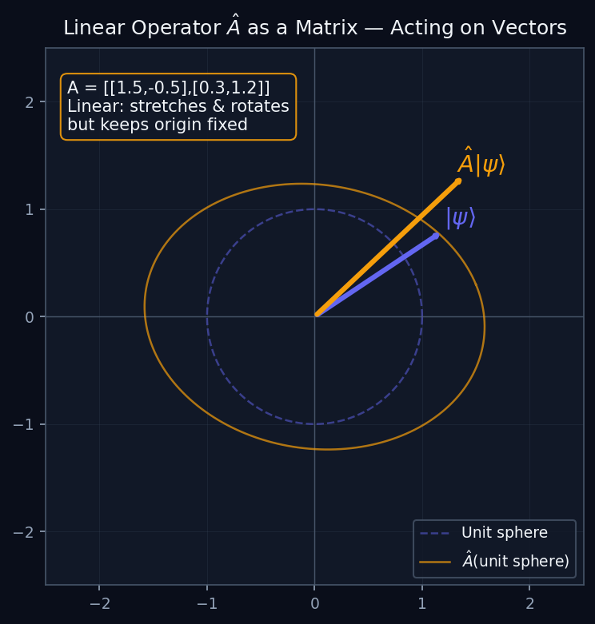
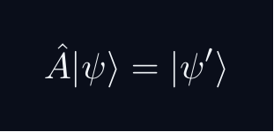
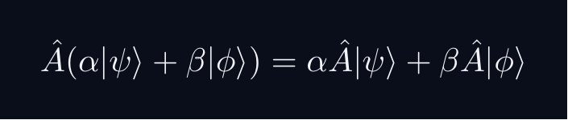
L03 — HS: Operators as Transformations
L03
Â|ψ⟩ maps one vector to another
OPERATORS AS TRANSFORMATIONS
WHAT IS A QUANTUM OPERATOR?
An operator Â takes a state |ψ⟩ and produces a new state Â|ψ⟩. In 2D it is exactly a matrix acting on a column vector.
The diagram shows the unit circle (all normalised states) being mapped to an ellipse by the operator — stretching some directions and squeezing others.
LINEARITY IS THE KEY
Linearity means superposition is preserved. This is why quantum mechanics is a linear theory.
QM: L03 — HS · Operators as Transformations
L03 · HS

Slide 4
BegUG
Beginning Undergraduate
1. Hermitian Operators
QM: L03 — Beginning Undergraduate
L03

Slide 5
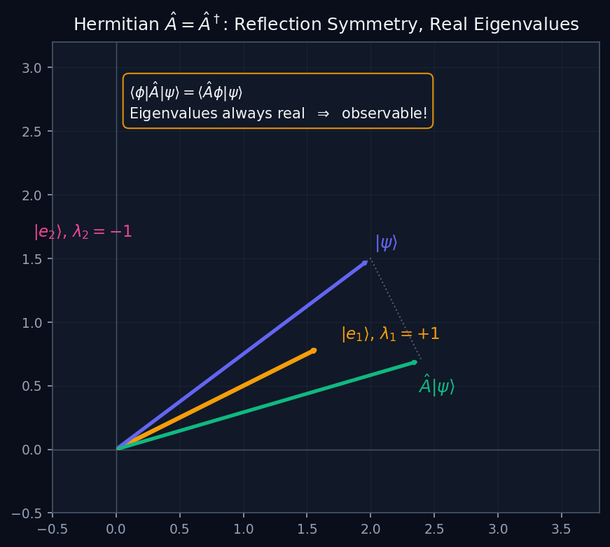
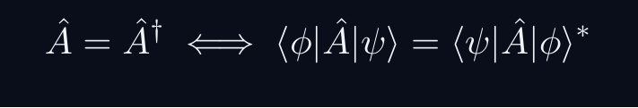
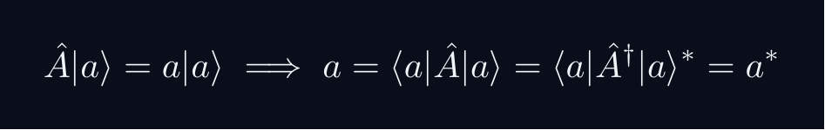
L03 — BegUG: Hermitian Operators
L03
Â = Â† — real eigenvalues, observable quantities
HERMITIAN OPERATORS
THE HERMITIAN CONDITION
Hermitian operators are the QM analogue of real symmetric matrices in 2D. The diagram shows a reflection — eigenvalues ±1 are real.
WHY HERMITIAN = OBSERVABLE
Measurement outcomes must be real numbers. The eigenvalues of a Hermitian operator are always real:
So a = a* — the eigenvalue is real. This is why Hermitian operators represent physical observables.
QM: L03 — BegUG · Hermitian Operators
L03 · BegUG

Slide 6
AdvUG
Advanced Undergraduate
1. Unitary Operators
QM: L03 — Advanced Undergraduate
L03

Slide 7
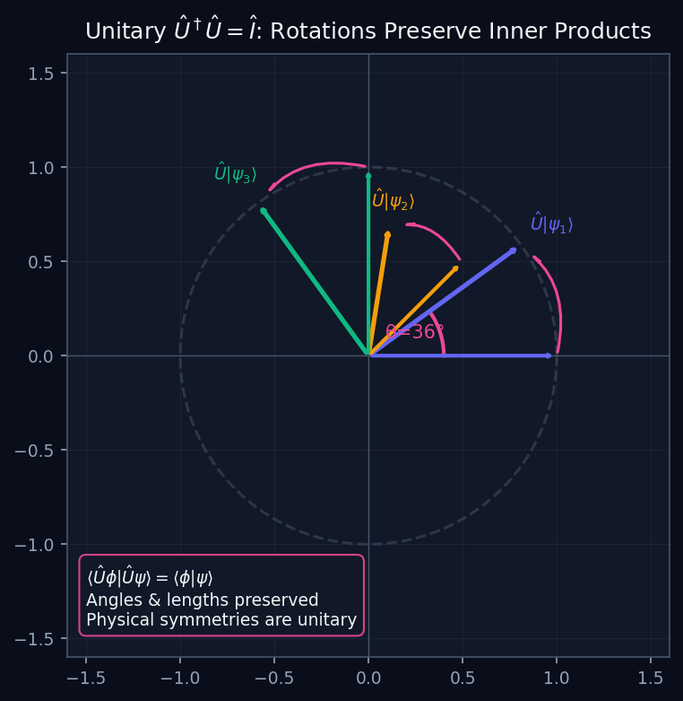
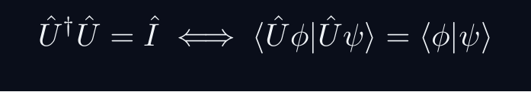
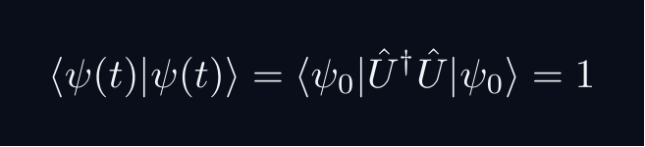
L03 — AdvUG: Unitary Operators
L03
Û†Û = Î — preserve all geometry
UNITARY OPERATORS
THE UNITARY CONDITION
Unitary operators preserve all inner products — all angles, lengths, and probabilities. They are the quantum analogue of rigid rotations in 2D.
PHYSICAL IMPORTANCE
Time evolution is unitary (Û = e^{-iĤt/ℏ}). This guarantees probability conservation: if ⟨ψ|ψ⟩=1 at t=0, it stays 1 for all t.
Wigner's theorem: all quantum symmetries are implemented by unitary (or antiunitary) operators.
QM: L03 — AdvUG · Unitary Operators
L03 · AdvUG

Slide 8
MSc
Master's Level
1. Eigenvalue Geometry
QM: L03 — Master's Level
L03

Slide 9
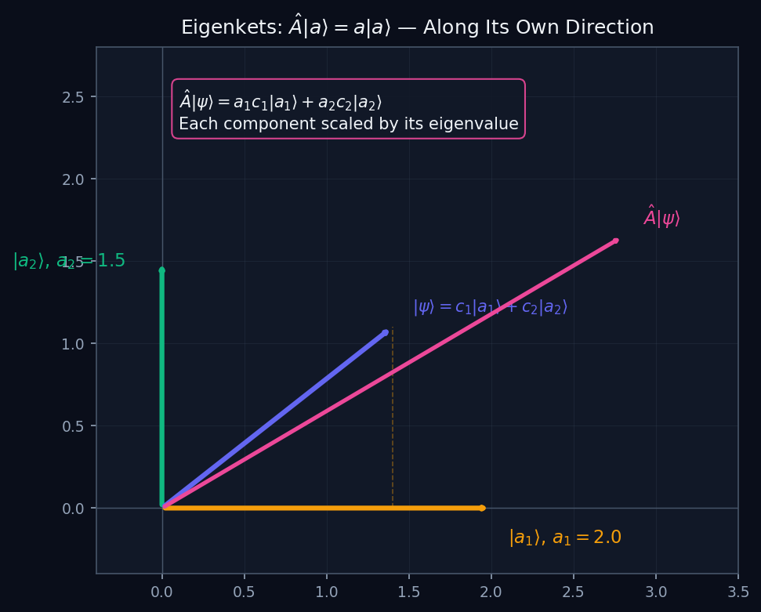
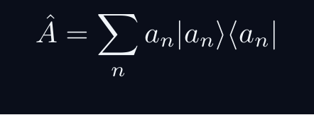
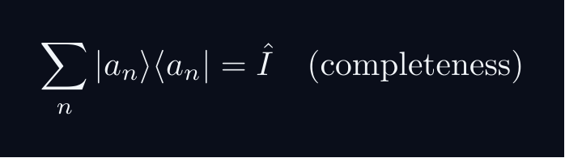
L03 — MSc: Eigenvalue Geometry
L03
Â|a⟩ = a|a⟩ — eigenvectors as special directions
EIGENVALUE GEOMETRY
SPECTRAL DECOMPOSITION
For a Hermitian operator Â with orthonormal eigenbasis {|aₙ⟩}:
Each eigenvector is a special direction that Â only scales, not rotates. The eigenvalue aₙ is the scale factor.
SPECTRAL THEOREM
Every Hermitian operator on a finite-dimensional Hilbert space (or bounded self-adjoint operator on infinite-dimensional ℋ) has a complete orthonormal eigenbasis.
For unbounded operators (x̂, p̂): need the spectral theorem for self-adjoint operators — eigenvectors live in the rigged Hilbert space Φ'.
QM: L03 — MSc · Eigenvalue Geometry
L03 · MSc

Slide 10
PhD
PhD Level
1. Functional Calculus
QM: L03 — PhD Level
L03

Slide 11
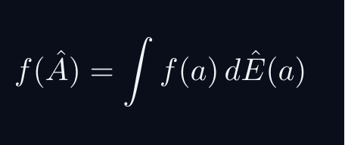
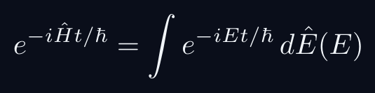
L03 — PhD: Functional Calculus
L03
f(Â) — applying functions to operators
FUNCTIONAL CALCULUS
FUNCTIONAL CALCULUS
Given f: ℝ → ℂ and a self-adjoint Â = ∫a dÊ(a), define:
On the eigenbasis: f(Â)|aₙ⟩ = f(aₙ)|aₙ⟩. The function f is applied to the eigenvalues.
KEY EXAMPLES
This gives time evolution. The spectral measure dÊ(E) is the resolution of identity for Ĥ.
DOMAIN ISSUES
For unbounded Â, f(Â) may only be defined on a dense domain. The domain requires careful specification — f must be integrable with respect to the spectral measure.
QM: L03 — PhD · Functional Calculus
L03 · PhD

