Slide 1
Ψ
QUANTUM MECHANICS — BRA–KET NOTATION
L03
Linear Operators: Adjoint, Hermitian & Unitary
Operator algebra, observables and symmetries
HS
BegUG
AdvUG
MSc
PhD
Full expanded deck · 5 tiers · Worked examples · Complete problem sets
QM: Bra–Ket Notation — L03
L03

Slide 2
L03 — Lecture Overview
L03
Linear Operators: Adjoint, Hermitian & Unitary
90-MIN PACING
CORE LEARNING OUTCOMES
0–20 min: Operators as maps H→H; matrix elements ⟨φ|Â|ψ⟩
20–50 min: Adjoint Â†; Hermitian observables; unitary symmetries
50–70 min: Expectation values; operator algebra
70–90 min: Commutators preview; spectral theorem motivation
• Compute matrix elements ⟨φ|Â|ψ⟩ in any basis
• Define adjoint via ⟨φ|Â|ψ⟩ = ⟨Â†φ|ψ⟩
• Characterize Hermitian (Â=Â†) and unitary (Û†Û=Î) operators
• Prove expectation value of Hermitian operator is real
HS
BegUG
AdvUG
MSc
PhD
Matrices as machines on vectors; 2×2 examples
Eigenvalues basics; expectation value ⟨Â⟩ = ⟨ψ|Â|ψ⟩
Hermitian ⇒ real expectation; unitary preserves inner product
Spectral theorem preview; commutators; normal operators
Domains of unbounded operators; self-adjoint vs merely Hermitian
ASSESSMENT BUNDLE
Set A: Find Â† if Â = [[1+i, 2], [3, 4-i]] in matrix representation · Verify Hermiticity of σₓ, σᵧ, σᵤ (Pauli matrices)
Set B: Prove: if Â = Â† then ⟨ψ|Â|ψ⟩ ∈ ℝ for all |ψ⟩ · Prove: if Û is unitary then ⟨Ûφ|Ûψ⟩ = ⟨φ|ψ⟩
QM: L03
L03 · Overview

Slide 3

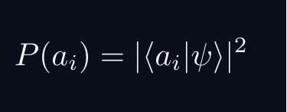


L03 — Sakurai Track
L03
Measurement-first, operational approach
SAKURAI: PREPARATION → STATISTICS → AMPLITUDES
BRIDGE TO DIRAC
SAKURAI: PREPARATION TO STATISTICS TO AMPLITUDES
• Preparation procedure ↔ ket |ψ⟩ (ray in ℋ)
• Measurement outcome aᵢ ↔ basis ket |aᵢ⟩
• Transition amplitude ↔ inner product ⟨aᵢ|ψ⟩
• Probability rule ↔ |⟨aᵢ|ψ⟩|²
• Total prob. = 1 ↔ ⟨ψ|ψ⟩ = 1
• Interference ↔ complex phase structure
STEP 1 — PREPARATION
A preparation is a reproducible laboratory protocol.
The same procedure always yields the same statistical predictions.
STEP 2 — MEASUREMENT OUTCOMES
A measurement device returns outcomes a_i with stable frequencies.
The state encodes probabilities, not definite property values.
STEP 3 — WHY AMPLITUDES?
Interference demands combining paths BEFORE squaring:
The cross-term is interference — real and measurable.
Only complex amplitudes can produce this cross-term.
STEP 4 — OPERATIONAL BORN RULE
GLOBAL PHASE IS UNOBSERVABLE
Physical states are RAYS not vectors.
QM: L03
L03 · Sakurai Track

Slide 4


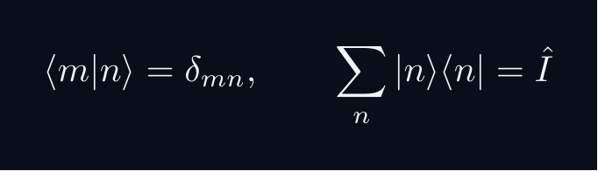
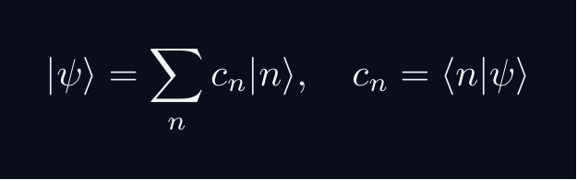


L03 — Dirac Track
L03
Abstract, representation-independent axioms
DIRAC: FIVE POSTULATES
DIRAC: FIVE POSTULATES OF QUANTUM MECHANICS
POSTULATE 1 — STATE SPACE
Every physical state is a ray in a complex Hilbert space H.
POSTULATE 2 — OBSERVABLES
Every observable A corresponds to a Hermitian operator A = A^†.
POSTULATE 3 — COMPLETENESS
POSTULATE 4 — BORN RULE
Post-measurement state (ideal projective): |ψ⟩ → |a⟩
POSTULATE 5 — DYNAMICS
QM: L03
L03 · Dirac Track

Slide 5
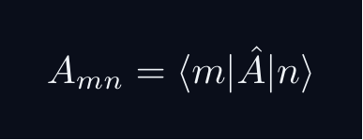
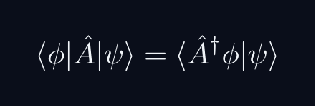


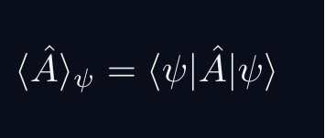
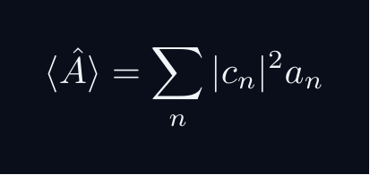
L03 — Key Formulas
L03
LaTeX-rendered formula reference
matrix element
adjoint def
hermitian
unitary
expectation
exp eigenbasis
QM: L03
L03 · Formulas

Slide 6
L03 — HS: High School
L03
Tier introduction and learning context
WHAT THIS TIER COVERS
PREREQUISITES
This lecture covers Linear Operators: Adjoint, Hermitian & Unitary at the HS level.
Starting point: pre-university mathematics
Required: basic algebra and complex arithmetic
WHAT THIS TIER UNLOCKS
KEY MESSAGE FOR THIS TIER
Unlocks access to: Beginning Undergraduate
This tier equips you for:
Eigenvalues basics; expectation value ⟨Â⟩ = ⟨ψ|Â|ψ⟩
Matrices as machines on vectors; 2×2 examples
QM: L03 · HS
L03 · HS · Intro

Slide 7
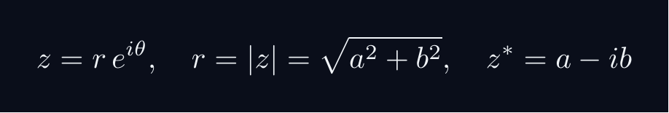
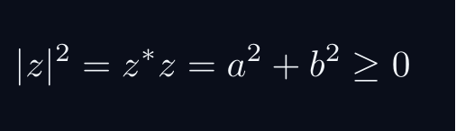
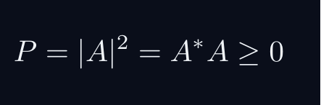

L03 — HS: Core Concepts
L03
Main ideas, key equations, and their meaning
CORE CONCEPTS & KEY RESULTS
This lecture covers Linear Operators: Adjoint, Hermitian & Unitary at the HS level.
COMPLEX NUMBERS AS ARROWS
A complex number z = a + ib lives in a 2D plane.
AMPLITUDE TO PROBABILITY (BORN RULE)
A quantum amplitude A is a complex number for a process.
Why squaring? Gives a real, non-negative number. Phase alone does not.
SUPERPOSITION = ARROW ADDITION = INTERFERENCE
Two paths: amplitudes A_1 and A_2. Total: A = A_1 + A_2.
Interference term can be positive (constructive) or negative (destructive).
WORKED FORMULA: PHASE DEPENDENCE
Let A_1 = 1, A_2 = e^{iφ} (unit magnitude, phase φ).
Maximum P=4 at φ=0 (constructive). Minimum P=0 at φ=pi (destructive).
QM: L03 · HS
L03 · HS · Concepts

Slide 8
L03 — HS: Worked Example 1
L03
Step-by-step solved example with commentary
EXAMPLE 1: HS-A1
WORKED SOLUTION
Core problem for L03 (HS). Matrices as machines on vectors; 2×2 examples
FULL SOLUTION
HINTS
Apply the relevant formula.
* Apply the definition
ADVANCED HINTS
* Verify basis-independence
QM: L03 · HS
L03 · HS · Example 1

Slide 9
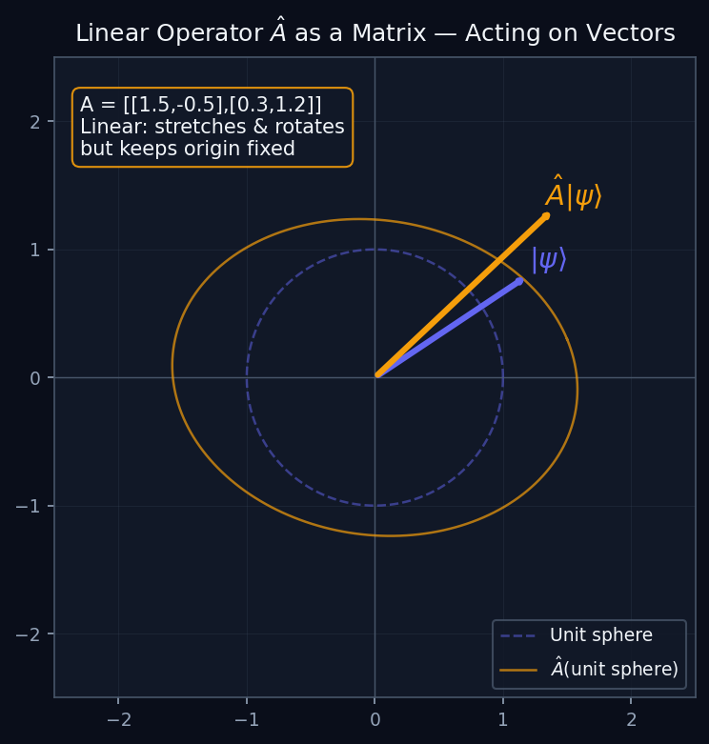
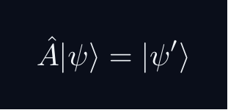
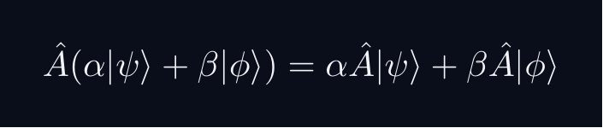
L03 — HS: Operators as Transformations
L03
Â|ψ⟩ maps one vector to another
OPERATORS AS TRANSFORMATIONS
WHAT IS A QUANTUM OPERATOR?
An operator Â takes a state |ψ⟩ and produces a new state Â|ψ⟩. In 2D it is exactly a matrix acting on a column vector.
The diagram shows the unit circle (all normalised states) being mapped to an ellipse by the operator — stretching some directions and squeezing others.
LINEARITY IS THE KEY
Linearity means superposition is preserved. This is why quantum mechanics is a linear theory.
QM: L03 — HS · Operators as Transformations
L03 · HS

Slide 10
L03 — HS: Worked Example 2
L03
Second example — deeper or alternative approach
EXAMPLE 2: HS-A2
WORKED SOLUTION
Verification exercise for L03 (HS).
FULL SOLUTION
HINTS
Follow the derivation step by step.
* Use orthonormality
ADVANCED HINTS
* Check normalisation
QM: L03 · HS
L03 · HS · Example 2

Slide 11
L03 — HS: Concept Questions
L03
Think before computing — conceptual understanding checks
CONCEPT QUESTIONS
MORE QUESTIONS + GUIDANCE
1. Q1: HS question for L03.
2. Q2: HS question for L03.
3. Q3: HS question for L03.
1. Q4: HS question for L03.
2. Q5: HS question for L03.
─────
These questions have no calculation — think about what probability MEANS.
Key insight: squaring is the minimal operation that gives a non-negative re…
QM: L03 · HS
L03 · HS · Concept Qs

Slide 12
L03 — HS: Problem Sets
L03
Simple problems (Set A) and advanced problems (Set B)
PROBLEM SET A — SIMPLE (2 problems)
PROBLEM SET B — ADVANCED (1 problems)
[HS-A1] Core problem for L03 (HS). Matrices as machines on vectors; 2×2 examples
Hint: Apply the definition
[HS-A2] Verification exercise for L03 (HS).
Hint: Use orthonormality
[HS-B1] Proof exercise for L03 (HS).
Hint: Start from definition
Key idea: Check edge cases
QM: L03 · HS
L03 · HS · Problems

Slide 13
L03 — HS: References & Bibliography
L03
Historical, educational, and research-level reading
HISTORICAL (1)
EDUCATIONAL (2)
RESEARCH (1)
[1930] Dirac
"Principles of QM"
Oxford UP
↳ Source for L03.
Sakurai (2021)
"Modern QM"
Cambridge UP
↳ Main text.
Cohen-Tannoudji (1977)
"QM Vol. 1"
Wiley
↳ Complements.
von Neumann (1932)
"Math. Grundlagen"
Springer
↳ Rigorous foundations.
QM: L03 · HS
L03 · HS · References

Slide 14
L03 — BegUG: Beginning Undergraduate
L03
Tier introduction and learning context
WHAT THIS TIER COVERS
PREREQUISITES
This lecture covers Linear Operators: Adjoint, Hermitian & Unitary at the BegUG level.
Builds on: High School
Required background:
Matrices as machines on vectors; 2×2 examples
WHAT THIS TIER UNLOCKS
KEY MESSAGE FOR THIS TIER
Unlocks access to: Advanced Undergraduate
This tier equips you for:
Hermitian ⇒ real expectation; unitary preserves inner product
Eigenvalues basics; expectation value ⟨Â⟩ = ⟨ψ|Â|ψ⟩
QM: L03 · BegUG
L03 · BegUG · Intro

Slide 15

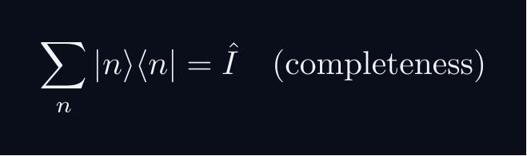
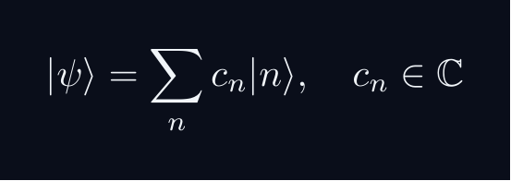
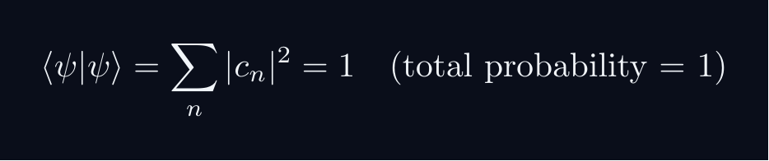


L03 — BegUG: Core Concepts
L03
Main ideas, key equations, and their meaning
CORE CONCEPTS & KEY RESULTS
This lecture covers Linear Operators: Adjoint, Hermitian & Unitary at the BegUG level.
HILBERT SPACE FORMALISM — DISCRETE BASIS
State vector |ψ⟩ in complex Hilbert space H.
EXPANSION AND COMPONENTS
Proof: ⟨ m|ψ⟩ = sum_n c_n ⟨ m|n⟩ = sum_n c_ndelta_{mn} = c_m
NORMALISATION AND PROBABILITIES
GLOBAL PHASE INVARIANCE
QM: L03 · BegUG
L03 · BegUG · Concepts

Slide 16
L03 — BegUG: Worked Example 1
L03
Step-by-step solved example with commentary
EXAMPLE 1: BegUG-A1
WORKED SOLUTION
Core problem for L03 (BegUG). Eigenvalues basics; expectation value ⟨Â⟩ = ⟨ψ|Â|ψ⟩
FULL SOLUTION
HINTS
Apply the relevant formula.
* Apply the definition
ADVANCED HINTS
* Verify basis-independence
QM: L03 · BegUG
L03 · BegUG · Example 1

Slide 17
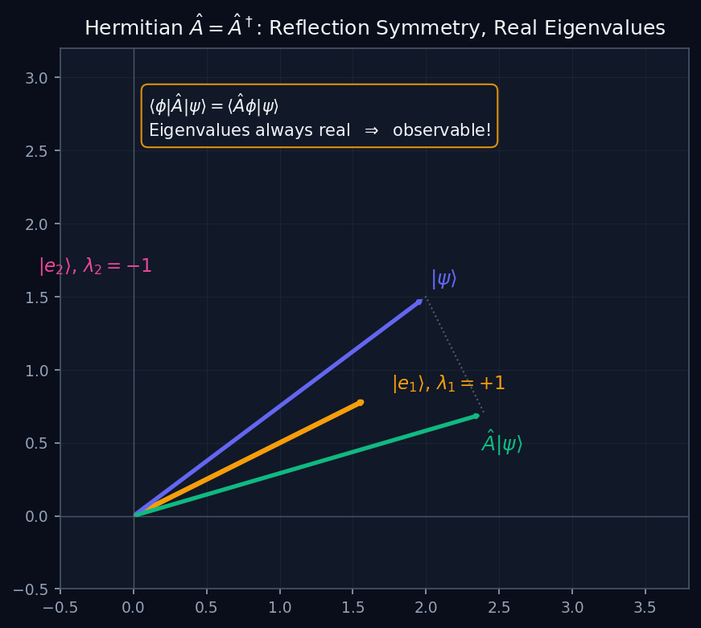

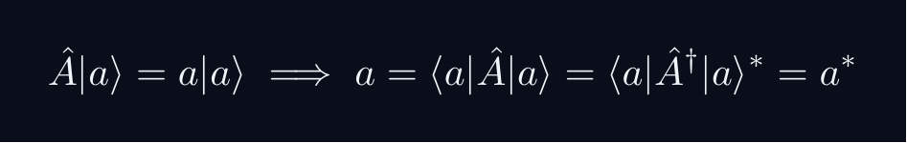
L03 — BegUG: Hermitian Operators
L03
Â = Â† — real eigenvalues, observable quantities
HERMITIAN OPERATORS
THE HERMITIAN CONDITION
Hermitian operators are the QM analogue of real symmetric matrices in 2D. The diagram shows a reflection — eigenvalues ±1 are real.
WHY HERMITIAN = OBSERVABLE
Measurement outcomes must be real numbers. The eigenvalues of a Hermitian operator are always real:
So a = a* — the eigenvalue is real. This is why Hermitian operators represent physical observables.
QM: L03 — BegUG · Hermitian Operators
L03 · BegUG

Slide 18
L03 — BegUG: Worked Example 2
L03
Second example — deeper or alternative approach
EXAMPLE 2: BegUG-A2
WORKED SOLUTION
Verification exercise for L03 (BegUG).
FULL SOLUTION
HINTS
Follow the derivation step by step.
* Use orthonormality
ADVANCED HINTS
* Check normalisation
QM: L03 · BegUG
L03 · BegUG · Example 2

Slide 19
L03 — BegUG: Concept Questions
L03
Think before computing — conceptual understanding checks
CONCEPT QUESTIONS
MORE QUESTIONS + GUIDANCE
1. Q1: BegUG question for L03.
2. Q2: BegUG question for L03.
3. Q3: BegUG question for L03.
1. Q4: BegUG question for L03.
2. Q5: BegUG question for L03.
─────
Work from the definition: write out the expansion, act with ⟨m| on the left, use δₘₙ.
For normalization: total probability must equal 1 — that is the…
QM: L03 · BegUG
L03 · BegUG · Concept Qs

Slide 20
L03 — BegUG: Problem Sets
L03
Simple problems (Set A) and advanced problems (Set B)
PROBLEM SET A — SIMPLE (2 problems)
PROBLEM SET B — ADVANCED (1 problems)
[BegUG-A1] Core problem for L03 (BegUG). Eigenvalues basics; expectation value ⟨Â⟩ = ⟨ψ|Â|ψ⟩
Hint: Apply the definition
[BegUG-A2] Verification exercise for L03 (BegUG).
Hint: Use orthonormality
[BegUG-B1] Proof exercise for L03 (BegUG).
Hint: Start from definition
Key idea: Check edge cases
QM: L03 · BegUG
L03 · BegUG · Problems

Slide 21
L03 — BegUG: References & Bibliography
L03
Historical, educational, and research-level reading
HISTORICAL (1)
EDUCATIONAL (2)
RESEARCH (1)
[1930] Dirac
"Principles of QM"
Oxford UP
↳ Source for L03.
Sakurai (2021)
"Modern QM"
Cambridge UP
↳ Main text.
Cohen-Tannoudji (1977)
"QM Vol. 1"
Wiley
↳ Complements.
von Neumann (1932)
"Math. Grundlagen"
Springer
↳ Rigorous foundations.
QM: L03 · BegUG
L03 · BegUG · References

Slide 22
L03 — AdvUG: Advanced Undergraduate
L03
Tier introduction and learning context
WHAT THIS TIER COVERS
PREREQUISITES
This lecture covers Linear Operators: Adjoint, Hermitian & Unitary at the AdvUG level.
Builds on: Beginning Undergraduate
Required background:
Eigenvalues basics; expectation value ⟨Â⟩ = ⟨ψ|Â|ψ⟩
WHAT THIS TIER UNLOCKS
KEY MESSAGE FOR THIS TIER
Unlocks access to: Master's Level
This tier equips you for:
Spectral theorem preview; commutators; normal operators
Hermitian ⇒ real expectation; unitary preserves inner product
QM: L03 · AdvUG
L03 · AdvUG · Intro

Slide 23
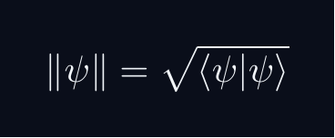
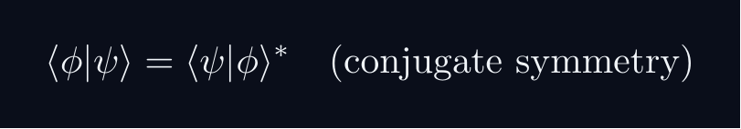


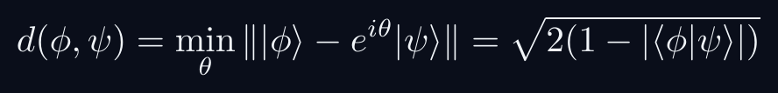

L03 — AdvUG: Core Concepts
L03
Main ideas, key equations, and their meaning
CORE CONCEPTS & KEY RESULTS
This lecture covers Linear Operators: Adjoint, Hermitian & Unitary at the AdvUG level.
INNER PRODUCT SPACE GEOMETRY
CAUCHY-SCHWARZ INEQUALITY
Proof: set f(lambda) = | |φ⟩ - lambda|ψ⟩ |^2 ≥ 0.
Choose lambda = ⟨ψ|φ⟩ / |ψ|^2 to minimise.
TRIANGLE INEQUALITY
Proof: square both sides; apply C-S to the cross term.
PHASE-INVARIANT DISTANCE
QM: L03 · AdvUG
L03 · AdvUG · Concepts

Slide 24
L03 — AdvUG: Worked Example 1
L03
Step-by-step solved example with commentary
EXAMPLE 1: AdvUG-A1
WORKED SOLUTION
Core problem for L03 (AdvUG). Hermitian ⇒ real expectation; unitary preserves inner product
FULL SOLUTION
HINTS
Apply the relevant formula.
* Apply the definition
ADVANCED HINTS
* Verify basis-independence
QM: L03 · AdvUG
L03 · AdvUG · Example 1

Slide 25
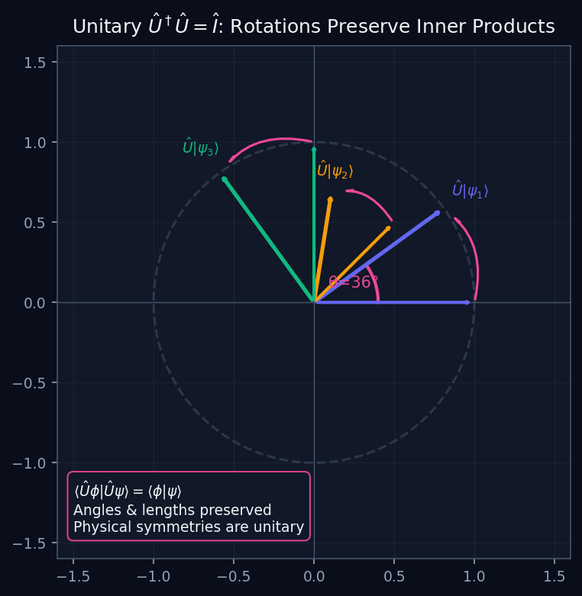

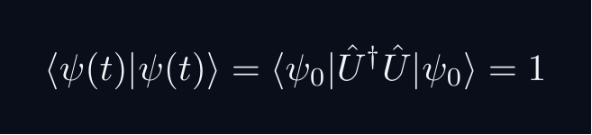
L03 — AdvUG: Unitary Operators
L03
Û†Û = Î — preserve all geometry
UNITARY OPERATORS
THE UNITARY CONDITION
Unitary operators preserve all inner products — all angles, lengths, and probabilities. They are the quantum analogue of rigid rotations in 2D.
PHYSICAL IMPORTANCE
Time evolution is unitary (Û = e^{-iĤt/ℏ}). This guarantees probability conservation: if ⟨ψ|ψ⟩=1 at t=0, it stays 1 for all t.
Wigner's theorem: all quantum symmetries are implemented by unitary (or antiunitary) operators.
QM: L03 — AdvUG · Unitary Operators
L03 · AdvUG

Slide 26
L03 — AdvUG: Worked Example 2
L03
Second example — deeper or alternative approach
EXAMPLE 2: AdvUG-A2
WORKED SOLUTION
Verification exercise for L03 (AdvUG).
FULL SOLUTION
HINTS
Follow the derivation step by step.
* Use orthonormality
ADVANCED HINTS
* Check normalisation
QM: L03 · AdvUG
L03 · AdvUG · Example 2

Slide 27
L03 — AdvUG: Concept Questions
L03
Think before computing — conceptual understanding checks
CONCEPT QUESTIONS
MORE QUESTIONS + GUIDANCE
1. Q1: AdvUG question for L03.
2. Q2: AdvUG question for L03.
3. Q3: AdvUG question for L03.
1. Q4: AdvUG question for L03.
2. Q5: AdvUG question for L03.
─────
For C–S: the proof idea is to consider ‖|φ⟩ - λ|ψ⟩‖² ≥ 0 and choose the minimising λ.
For the geometry questions: draw a unit circle in ℂ²; overlap |…
QM: L03 · AdvUG
L03 · AdvUG · Concept Qs

Slide 28
L03 — AdvUG: Problem Sets
L03
Simple problems (Set A) and advanced problems (Set B)
PROBLEM SET A — SIMPLE (2 problems)
PROBLEM SET B — ADVANCED (1 problems)
[AdvUG-A1] Core problem for L03 (AdvUG). Hermitian ⇒ real expectation; unitary preserves inner product
Hint: Apply the definition
[AdvUG-A2] Verification exercise for L03 (AdvUG).
Hint: Use orthonormality
[AdvUG-B1] Proof exercise for L03 (AdvUG).
Hint: Start from definition
Key idea: Check edge cases
QM: L03 · AdvUG
L03 · AdvUG · Problems

Slide 29
L03 — AdvUG: References & Bibliography
L03
Historical, educational, and research-level reading
HISTORICAL (1)
EDUCATIONAL (2)
RESEARCH (1)
[1930] Dirac
"Principles of QM"
Oxford UP
↳ Source for L03.
Sakurai (2021)
"Modern QM"
Cambridge UP
↳ Main text.
Cohen-Tannoudji (1977)
"QM Vol. 1"
Wiley
↳ Complements.
von Neumann (1932)
"Math. Grundlagen"
Springer
↳ Rigorous foundations.
QM: L03 · AdvUG
L03 · AdvUG · References

Slide 30
L03 — MSc: Master's Level
L03
Tier introduction and learning context
WHAT THIS TIER COVERS
PREREQUISITES
This lecture covers Linear Operators: Adjoint, Hermitian & Unitary at the MSc level.
Builds on: Advanced Undergraduate
Required background:
Hermitian ⇒ real expectation; unitary preserves inner product
WHAT THIS TIER UNLOCKS
KEY MESSAGE FOR THIS TIER
Unlocks access to: PhD Level
This tier equips you for:
Domains of unbounded operators; self-adjoint vs merely Hermitian
Spectral theorem preview; commutators; normal operators
QM: L03 · MSc
L03 · MSc · Intro

Slide 31
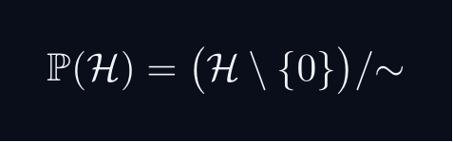
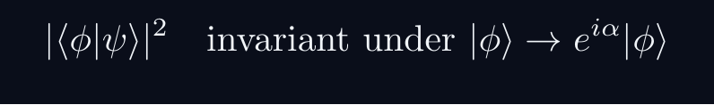

L03 — MSc: Core Concepts
L03
Main ideas, key equations, and their meaning
CORE CONCEPTS & KEY RESULTS
This lecture covers Linear Operators: Adjoint, Hermitian & Unitary at the MSc level.
PROJECTIVE HILBERT SPACE
Physical state space is P(H), not H itself.
A ray [ψ] is a one-dimensional complex subspace of H.
Example: P(C^2) cong S^2 — the Bloch sphere.
PHYSICALLY INVARIANT QUANTITIES
WIGNER'S THEOREM
Any bijection T:P(H)→P(H) preserving |⟨φ|ψ⟩|^2
is implemented by a UNITARY or ANTIUNITARY operator U on H.
Consequence: all quantum symmetries are (anti)unitary.
CONSEQUENCES
Symmetry group G acting on states gives projective representation of G.
Forces spin SO(3)→ SU(2), superselection rules, CPT symmetry.
QM: L03 · MSc
L03 · MSc · Concepts

Slide 32
L03 — MSc: Worked Example 1
L03
Step-by-step solved example with commentary
EXAMPLE 1: MSc-A1
WORKED SOLUTION
Core problem for L03 (MSc). Spectral theorem preview; commutators; normal operators
FULL SOLUTION
HINTS
Apply the relevant formula.
* Apply the definition
ADVANCED HINTS
* Verify basis-independence
QM: L03 · MSc
L03 · MSc · Example 1

Slide 33
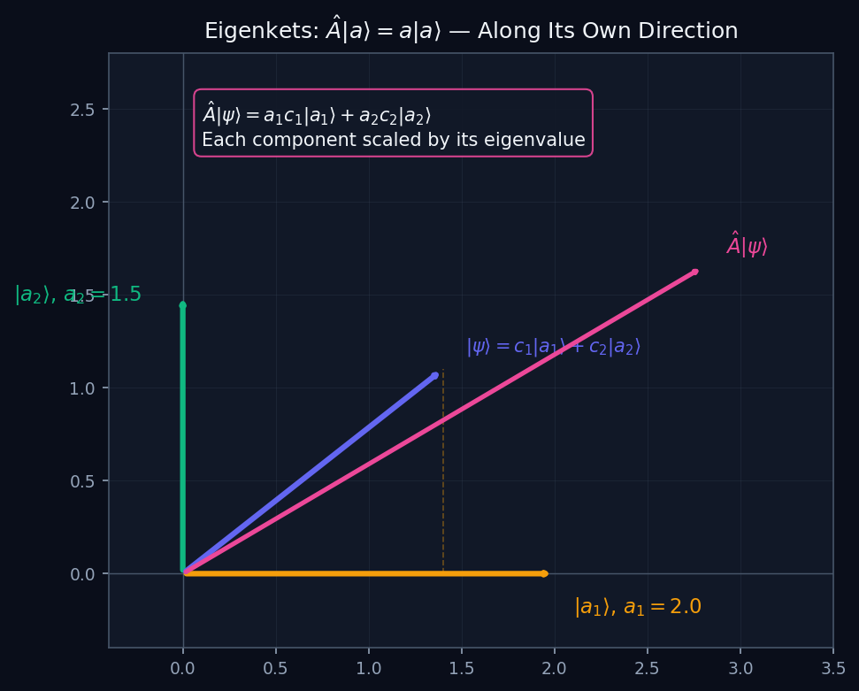
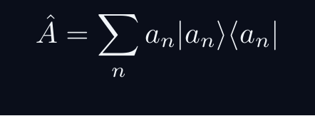
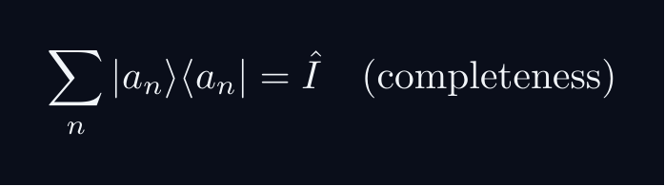
L03 — MSc: Eigenvalue Geometry
L03
Â|a⟩ = a|a⟩ — eigenvectors as special directions
EIGENVALUE GEOMETRY
SPECTRAL DECOMPOSITION
For a Hermitian operator Â with orthonormal eigenbasis {|aₙ⟩}:
Each eigenvector is a special direction that Â only scales, not rotates. The eigenvalue aₙ is the scale factor.
SPECTRAL THEOREM
Every Hermitian operator on a finite-dimensional Hilbert space (or bounded self-adjoint operator on infinite-dimensional ℋ) has a complete orthonormal eigenbasis.
For unbounded operators (x̂, p̂): need the spectral theorem for self-adjoint operators — eigenvectors live in the rigged Hilbert space Φ'.
QM: L03 — MSc · Eigenvalue Geometry
L03 · MSc

Slide 34
L03 — MSc: Worked Example 2
L03
Second example — deeper or alternative approach
EXAMPLE 2: MSc-A2
WORKED SOLUTION
Verification exercise for L03 (MSc).
FULL SOLUTION
HINTS
Follow the derivation step by step.
* Use orthonormality
ADVANCED HINTS
* Check normalisation
QM: L03 · MSc
L03 · MSc · Example 2

Slide 35
L03 — MSc: Concept Questions
L03
Think before computing — conceptual understanding checks
CONCEPT QUESTIONS
MORE QUESTIONS + GUIDANCE
1. Q1: MSc question for L03.
2. Q2: MSc question for L03.
3. Q3: MSc question for L03.
1. Q4: MSc question for L03.
2. Q5: MSc question for L03.
─────
For projective space: think of it as points on a sphere (for 2D), or more generally a complex manifold.
For Wigner: the key word is 'preserves transi…
QM: L03 · MSc
L03 · MSc · Concept Qs

Slide 36
L03 — MSc: Problem Sets
L03
Simple problems (Set A) and advanced problems (Set B)
PROBLEM SET A — SIMPLE (2 problems)
PROBLEM SET B — ADVANCED (1 problems)
[MSc-A1] Core problem for L03 (MSc). Spectral theorem preview; commutators; normal operators
Hint: Apply the definition
[MSc-A2] Verification exercise for L03 (MSc).
Hint: Use orthonormality
[MSc-B1] Proof exercise for L03 (MSc).
Hint: Start from definition
Key idea: Check edge cases
QM: L03 · MSc
L03 · MSc · Problems

Slide 37
L03 — MSc: References & Bibliography
L03
Historical, educational, and research-level reading
HISTORICAL (1)
EDUCATIONAL (2)
RESEARCH (1)
[1930] Dirac
"Principles of QM"
Oxford UP
↳ Source for L03.
Sakurai (2021)
"Modern QM"
Cambridge UP
↳ Main text.
Cohen-Tannoudji (1977)
"QM Vol. 1"
Wiley
↳ Complements.
von Neumann (1932)
"Math. Grundlagen"
Springer
↳ Rigorous foundations.
QM: L03 · MSc
L03 · MSc · References

Slide 38
L03 — PhD: PhD Level
L03
Tier introduction and learning context
WHAT THIS TIER COVERS
PREREQUISITES
This lecture covers Linear Operators: Adjoint, Hermitian & Unitary at the PhD level.
Builds on: Master's Level
Required background:
Spectral theorem preview; commutators; normal operators
WHAT THIS TIER UNLOCKS
KEY MESSAGE FOR THIS TIER
Frontier level: connects to active research
This tier equips you for:
Primary literature and open problems
Domains of unbounded operators; self-adjoint vs merely Hermitian
QM: L03 · PhD
L03 · PhD · Intro

Slide 39



L03 — PhD: Core Concepts
L03
Main ideas, key equations, and their meaning
CORE CONCEPTS & KEY RESULTS
This lecture covers Linear Operators: Adjoint, Hermitian & Unitary at the PhD level.
HILBERT SPACE — PRECISE AXIOMS
Definition: a complex vector space H with ⟨cdot|cdot⟩ that is COMPLETE.
Completeness: every Cauchy sequence {ψ_n} converges in H.
Essential for: spectral theory, Fourier expansions, Stone's theorem.
SEPARABILITY
H separable ⟺ countable dense subset ⟺ countable ONB {e_n}.
All standard NRQM spaces: L^2(R^n), C^n, ell^2(N).
RAYS AS ONE-DIMENSIONAL SUBSPACES
P(H) is a Kahler manifold with Fubini-Study metric.
UNBOUNDED OPERATORS — DOMAIN SUBTLETY
Self-adjoint ≠ Hermitian for unbounded operators (x̂, p̂).
Spectral theorem and Stone's theorem REQUIRE self-adjointness.
QM: L03 · PhD
L03 · PhD · Concepts

Slide 40
L03 — PhD: Worked Example 1
L03
Step-by-step solved example with commentary
EXAMPLE 1: PhD-A1
WORKED SOLUTION
Core problem for L03 (PhD). Domains of unbounded operators; self-adjoint vs merely Hermitian
FULL SOLUTION
HINTS
Apply the relevant formula.
* Apply the definition
ADVANCED HINTS
* Verify basis-independence
QM: L03 · PhD
L03 · PhD · Example 1

Slide 41
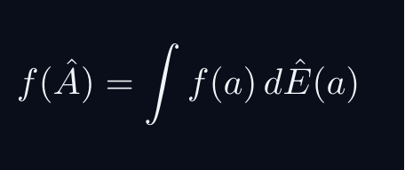
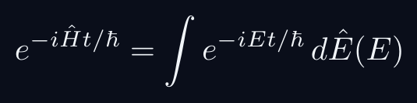
L03 — PhD: Functional Calculus
L03
f(Â) — applying functions to operators
FUNCTIONAL CALCULUS
FUNCTIONAL CALCULUS
Given f: ℝ → ℂ and a self-adjoint Â = ∫a dÊ(a), define:
On the eigenbasis: f(Â)|aₙ⟩ = f(aₙ)|aₙ⟩. The function f is applied to the eigenvalues.
KEY EXAMPLES
This gives time evolution. The spectral measure dÊ(E) is the resolution of identity for Ĥ.
DOMAIN ISSUES
For unbounded Â, f(Â) may only be defined on a dense domain. The domain requires careful specification — f must be integrable with respect to the spectral measure.
QM: L03 — PhD · Functional Calculus
L03 · PhD

Slide 42
L03 — PhD: Worked Example 2
L03
Second example — deeper or alternative approach
EXAMPLE 2: PhD-A2
WORKED SOLUTION
Verification exercise for L03 (PhD).
FULL SOLUTION
HINTS
Follow the derivation step by step.
* Use orthonormality
ADVANCED HINTS
* Check normalisation
QM: L03 · PhD
L03 · PhD · Example 2

Slide 43
L03 — PhD: Concept Questions
L03
Think before computing — conceptual understanding checks
CONCEPT QUESTIONS
MORE QUESTIONS + GUIDANCE
1. Q1: PhD question for L03.
2. Q2: PhD question for L03.
3. Q3: PhD question for L03.
1. Q4: PhD question for L03.
2. Q5: PhD question for L03.
─────
For completeness: construct Cauchy sequences that don't converge to a square-integrable function in a non-complete space.
For separability: construct…
QM: L03 · PhD
L03 · PhD · Concept Qs

Slide 44
L03 — PhD: Problem Sets
L03
Simple problems (Set A) and advanced problems (Set B)
PROBLEM SET A — SIMPLE (2 problems)
PROBLEM SET B — ADVANCED (1 problems)
[PhD-A1] Core problem for L03 (PhD). Domains of unbounded operators; self-adjoint vs merely Hermitian
Hint: Apply the definition
[PhD-A2] Verification exercise for L03 (PhD).
Hint: Use orthonormality
[PhD-B1] Proof exercise for L03 (PhD).
Hint: Start from definition
Key idea: Check edge cases
QM: L03 · PhD
L03 · PhD · Problems

Slide 45
L03 — PhD: References & Bibliography
L03
Historical, educational, and research-level reading
HISTORICAL (1)
EDUCATIONAL (2)
RESEARCH (1)
[1930] Dirac
"Principles of QM"
Oxford UP
↳ Source for L03.
Sakurai (2021)
"Modern QM"
Cambridge UP
↳ Main text.
Cohen-Tannoudji (1977)
"QM Vol. 1"
Wiley
↳ Complements.
von Neumann (1932)
"Math. Grundlagen"
Springer
↳ Rigorous foundations.
QM: L03 · PhD
L03 · PhD · References

Slide 46
L03 — Common Pitfalls & Misconceptions
L03
Consolidated pitfalls across all tiers
⚠ PITFALLS (A)
⚠ PITFALLS (B)
• Confusing adjoint with transpose — must take complex conjugate too
• Assuming Hermitian implies bounded — position/momentum are unbounded
• Using Û† = Û⁻¹ blindly without checking domain
HISTORICAL ANCHORS
FORMULA QUICK REFERENCE
• Heisenberg (1925) — matrix mechanics; operators as physical quantities
• Born & Jordan (1925) — canonical commutation relations
• von Neumann (1927) — operator algebra on Hilbert space
Key formulas in this lecture:
matrix_element · adjoint_def · hermitian · unitary · expectation · exp_eigenbasis
See formula slides for full LaTeX-rendered versions.
QM: L03
L03 · Pitfalls

Slide 47
L03 — Homework & Project Summary
L03
Assessment overview across all tiers
HS
BegUG
AdvUG
MSc
PhD
Problems: 2 simple + 1 advanced
Project (simple, ~2-3h): HS Project
Project (advanced, ~8-10h): HS Advanced
Research (defined): Explain key result of L03 (HS).
Research (open): Open question for L03 (HS).
Problems: 2 simple + 1 advanced
Project (simple, ~2-3h): BegUG Project
Project (advanced, ~8-10h): BegUG Advanced
Research (defined): Explain key result of L03 (BegUG).
Research (open): Open question for L03 (BegUG).
Problems: 2 simple + 1 advanced
Project (simple, ~2-3h): AdvUG Project
Project (advanced, ~8-10h): AdvUG Advanced
Research (defined): Explain key result of L03 (AdvUG).
Research (open): Open question for L03 (AdvUG).
Problems: 2 simple + 1 advanced
Project (simple, ~2-3h): MSc Project
Project (advanced, ~8-10h): MSc Advanced
Research (defined): Explain key result of L03 (MSc).
Research (open): Open question for L03 (MSc).
Problems: 2 simple + 1 advanced
Project (simple, ~2-3h): PhD Project
Project (advanced, ~8-10h): PhD Advanced
Research (defined): Explain key result of L03 (PhD).
Research (open): Open question for L03 (PhD).
HOMEWORK ASSIGNMENT
REQUIRED (all students): Problems from your track's Set A
HONOURS (optional): Set B problems from your track
PROJECT: Choose simple OR advanced track from your tier
RESEARCH: At least one well-defined question; open questions for MSc/PhD
QM: L03
L03 · Homework

