Slide 1
L04
Deep Concept Slides
Eigenkets, Projectors & Spectral Decomposition
One slide per core concept · Full explanation · Geometric diagram
HS
BegUG
AdvUG
MSc
PhD
4 concept slides
QM: Bra-Ket — L04 Concepts
L04

Slide 2
HS
High School
1. Stern Gerlach Filter
QM: L04 — High School
L04

Slide 3
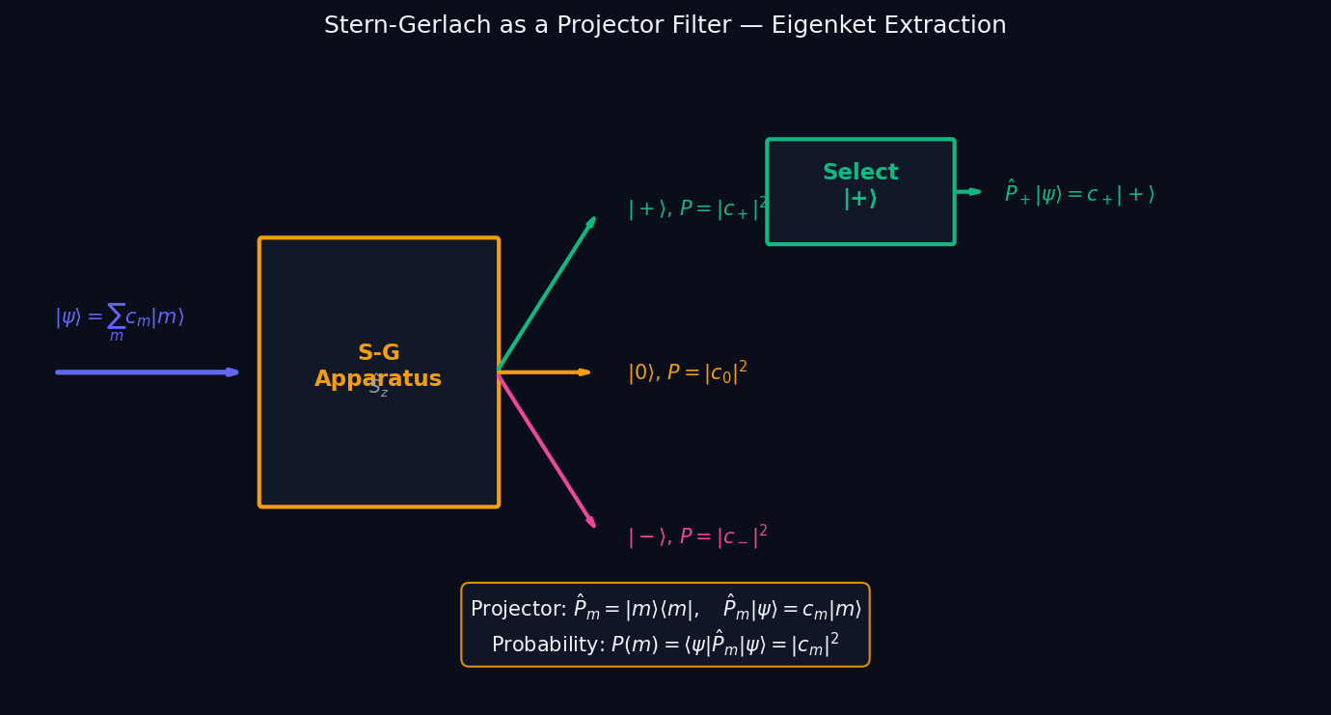
L04 — HS: Stern Gerlach Filter
L04
High School — Eigenkets, Projectors & Spectral Decomposition
STERN GERLACH FILTER
HS — STERN GERLACH FILTER
This lecture covers Eigenkets, Projectors & Spectral Decomposition at the HS level.
GEOMETRIC INTERPRETATION
The diagram on the right shows the 2D/3D geometric analogy for this concept. Use it to build physical intuition before working through the formalism.
• Q1: HS question for L04.
• Q2: HS question for L04.
QM: L04 — HS · Stern Gerlach Filter
L04 · HS

Slide 4
BegUG
Beginning Undergraduate
1. Projector Geometry
QM: L04 — Beginning Undergraduate
L04

Slide 5
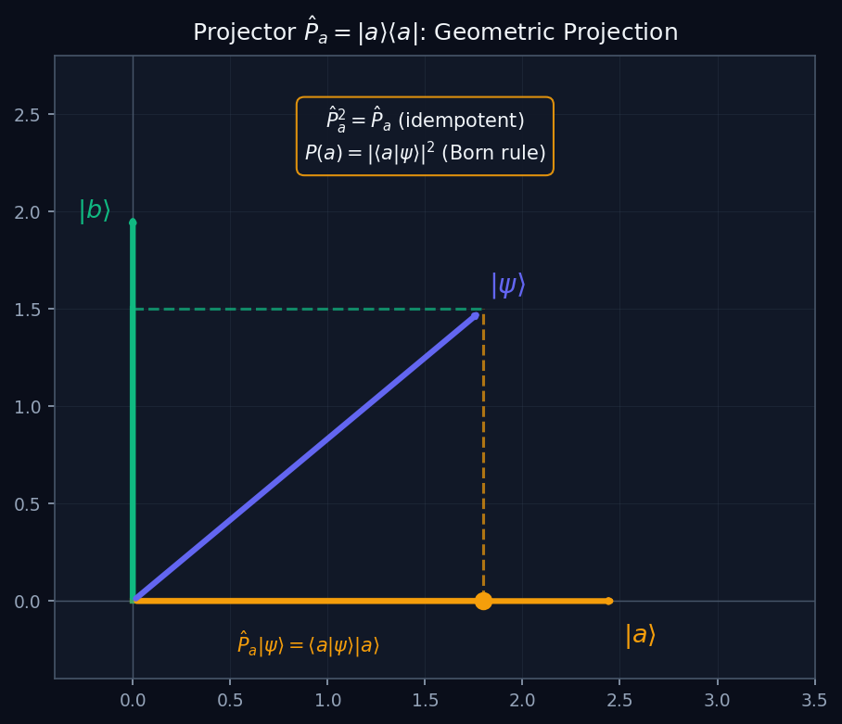
L04 — BegUG: Projector Geometry
L04
Beginning Undergraduate — Eigenkets, Projectors & Spectral Decomposition
PROJECTOR GEOMETRY
BegUG — PROJECTOR GEOMETRY
This lecture covers Eigenkets, Projectors & Spectral Decomposition at the BegUG level.
GEOMETRIC INTERPRETATION
The diagram on the right shows the 2D/3D geometric analogy for this concept. Use it to build physical intuition before working through the formalism.
• Q1: BegUG question for L04.
• Q2: BegUG question for L04.
QM: L04 — BegUG · Projector Geometry
L04 · BegUG

Slide 6
AdvUG
Advanced Undergraduate
1. Spectral Decomp
QM: L04 — Advanced Undergraduate
L04

Slide 7
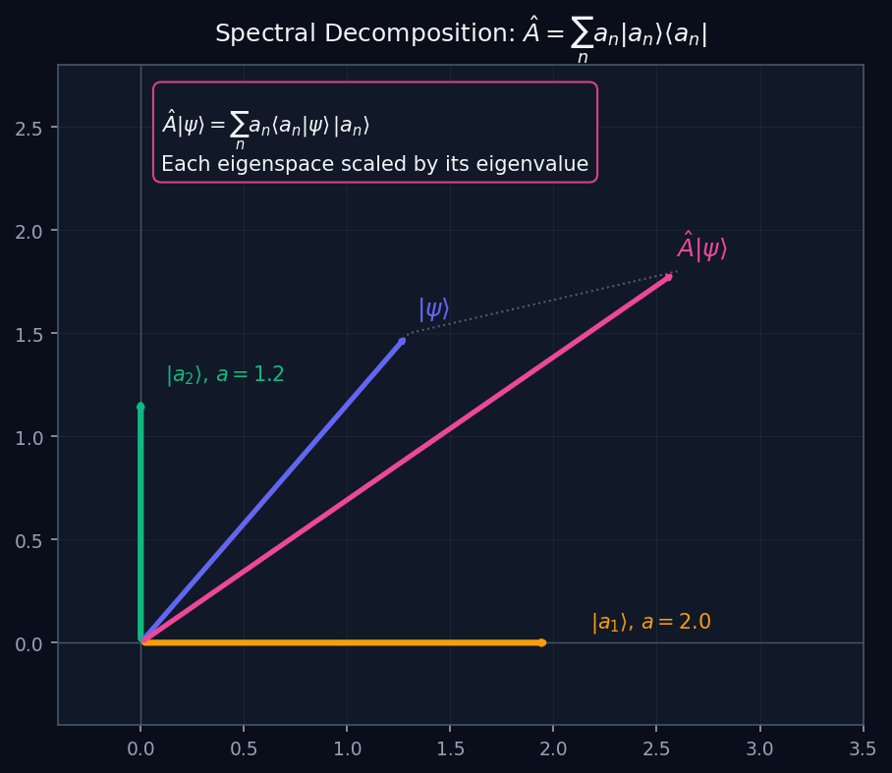
L04 — AdvUG: Spectral Decomp
L04
Advanced Undergraduate — Eigenkets, Projectors & Spectral Decomposition
SPECTRAL DECOMP
AdvUG — SPECTRAL DECOMP
This lecture covers Eigenkets, Projectors & Spectral Decomposition at the AdvUG level.
GEOMETRIC INTERPRETATION
The diagram on the right shows the 2D/3D geometric analogy for this concept. Use it to build physical intuition before working through the formalism.
• Q1: AdvUG question for L04.
• Q2: AdvUG question for L04.
QM: L04 — AdvUG · Spectral Decomp
L04 · AdvUG

Slide 8
MSc
Master's Level
1. Resolution Identity
QM: L04 — Master's Level
L04

Slide 9
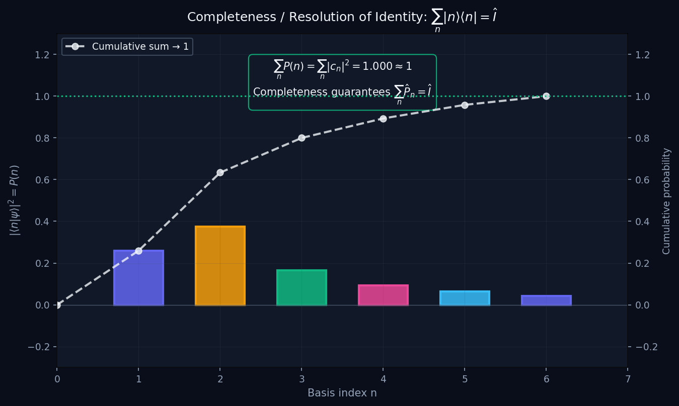
L04 — MSc: Resolution Identity
L04
Master's Level — Eigenkets, Projectors & Spectral Decomposition
RESOLUTION IDENTITY
MSc — RESOLUTION IDENTITY
This lecture covers Eigenkets, Projectors & Spectral Decomposition at the MSc level.
GEOMETRIC INTERPRETATION
The diagram on the right shows the 2D/3D geometric analogy for this concept. Use it to build physical intuition before working through the formalism.
• Q1: MSc question for L04.
• Q2: MSc question for L04.
QM: L04 — MSc · Resolution Identity
L04 · MSc

