Slide 1
L05
Deep Concept Slides
Completeness, Change of Basis & Matrix Mechanics
One slide per core concept · Full explanation · Geometric diagram
HS
BegUG
AdvUG
MSc
PhD
4 concept slides
QM: Bra-Ket — L05 Concepts
L05

Slide 2
HS
High School
1. Basis Rotation 2d
QM: L05 — High School
L05

Slide 3
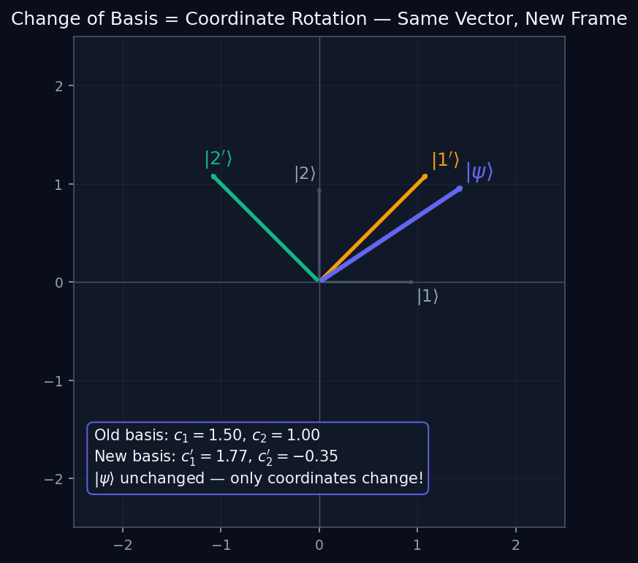
L05 — HS: Basis Rotation 2d
L05
High School — Completeness, Change of Basis & Matrix Mechanics
BASIS ROTATION 2D
HS — BASIS ROTATION 2D
This lecture covers Completeness, Change of Basis & Matrix Mechanics at the HS level.
GEOMETRIC INTERPRETATION
The diagram on the right shows the 2D/3D geometric analogy for this concept. Use it to build physical intuition before working through the formalism.
• Q1: HS question for L05.
• Q2: HS question for L05.
QM: L05 — HS · Basis Rotation 2d
L05 · HS

Slide 4
BegUG
Beginning Undergraduate
1. Matrix Representation
QM: L05 — Beginning Undergraduate
L05

Slide 5
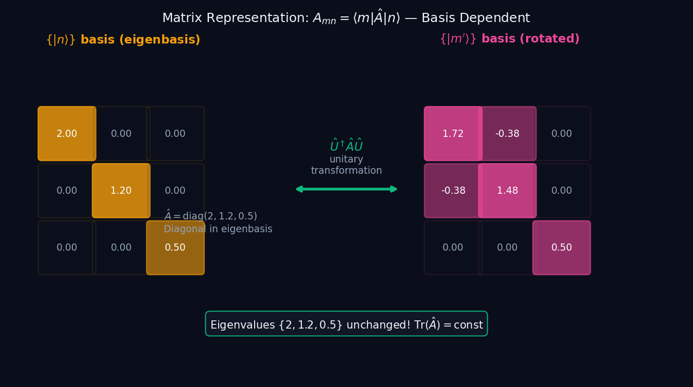
L05 — BegUG: Matrix Representation
L05
Beginning Undergraduate — Completeness, Change of Basis & Matrix Mechanics
MATRIX REPRESENTATION
BegUG — MATRIX REPRESENTATION
This lecture covers Completeness, Change of Basis & Matrix Mechanics at the BegUG level.
GEOMETRIC INTERPRETATION
The diagram on the right shows the 2D/3D geometric analogy for this concept. Use it to build physical intuition before working through the formalism.
• Q1: BegUG question for L05.
• Q2: BegUG question for L05.
QM: L05 — BegUG · Matrix Representation
L05 · BegUG

Slide 6
AdvUG
Advanced Undergraduate
1. Trace Invariant
QM: L05 — Advanced Undergraduate
L05

Slide 7
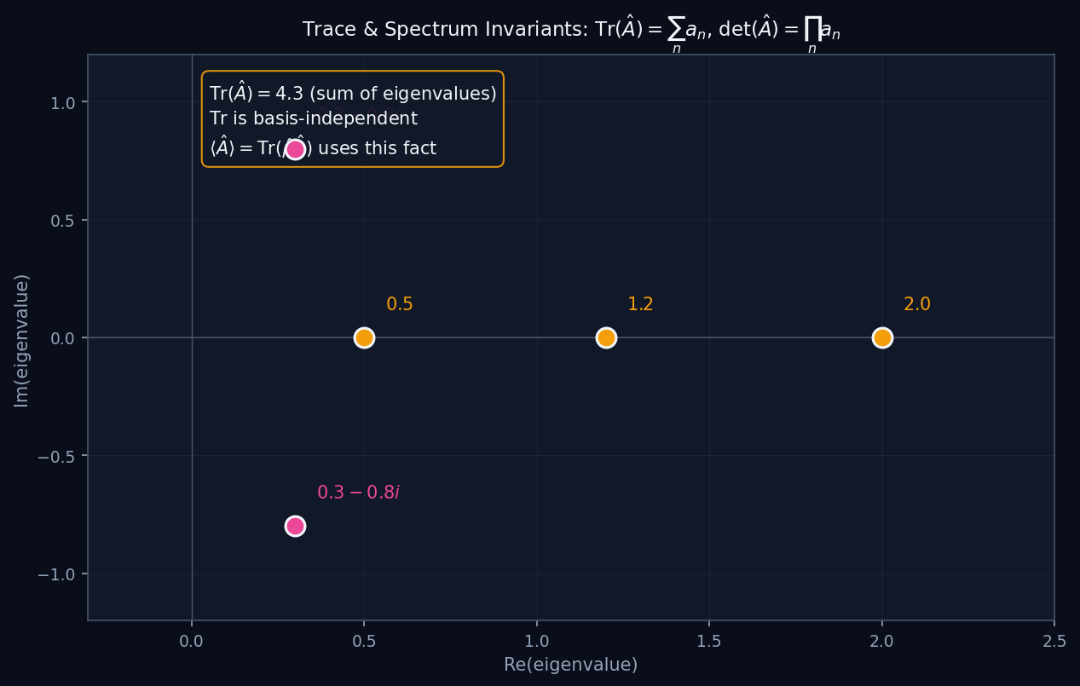
L05 — AdvUG: Trace Invariant
L05
Advanced Undergraduate — Completeness, Change of Basis & Matrix Mechanics
TRACE INVARIANT
AdvUG — TRACE INVARIANT
This lecture covers Completeness, Change of Basis & Matrix Mechanics at the AdvUG level.
GEOMETRIC INTERPRETATION
The diagram on the right shows the 2D/3D geometric analogy for this concept. Use it to build physical intuition before working through the formalism.
• Q1: AdvUG question for L05.
• Q2: AdvUG question for L05.
QM: L05 — AdvUG · Trace Invariant
L05 · AdvUG

Slide 8
MSc
Master's Level
1. Similarity Transform
QM: L05 — Master's Level
L05

Slide 9
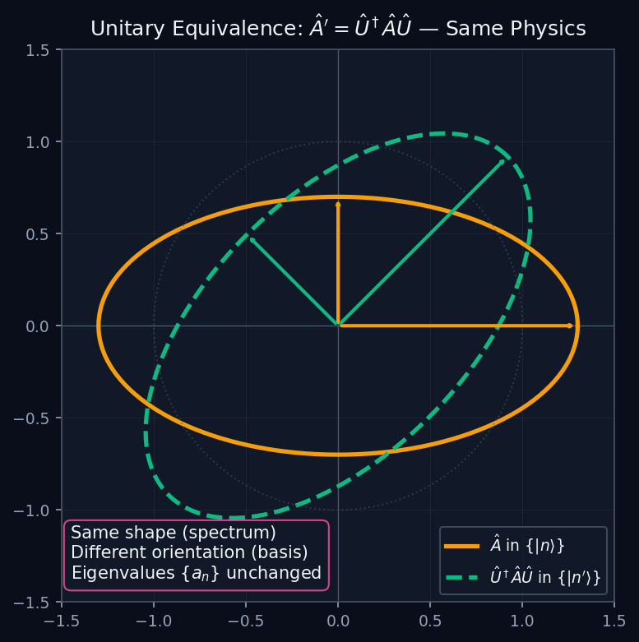
L05 — MSc: Similarity Transform
L05
Master's Level — Completeness, Change of Basis & Matrix Mechanics
SIMILARITY TRANSFORM
MSc — SIMILARITY TRANSFORM
This lecture covers Completeness, Change of Basis & Matrix Mechanics at the MSc level.
GEOMETRIC INTERPRETATION
The diagram on the right shows the 2D/3D geometric analogy for this concept. Use it to build physical intuition before working through the formalism.
• Q1: MSc question for L05.
• Q2: MSc question for L05.
QM: L05 — MSc · Similarity Transform
L05 · MSc

