Slide 1
L06
Deep Concept Slides
Continuous Bases: |x⟩, |p⟩ & Delta Functions
One slide per core concept · Full explanation · Geometric diagram
HS
BegUG
AdvUG
MSc
PhD
4 concept slides
QM: Bra-Ket — L06 Concepts
L06

Slide 2
HS
High School
1. Continuum Limit
QM: L06 — High School
L06

Slide 3
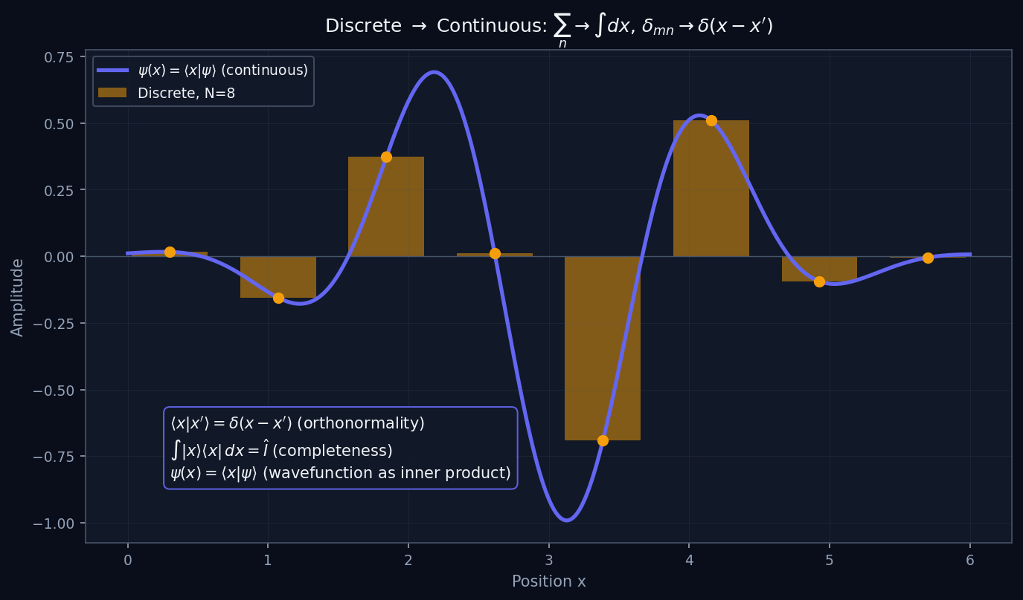
L06 — HS: Continuum Limit
L06
High School — Continuous Bases: |x⟩, |p⟩ & Delta Functions
CONTINUUM LIMIT
HS — CONTINUUM LIMIT
This lecture covers Continuous Bases: |x⟩, |p⟩ & Delta Functions at the HS level.
GEOMETRIC INTERPRETATION
The diagram on the right shows the 2D/3D geometric analogy for this concept. Use it to build physical intuition before working through the formalism.
• Q1: HS question for L06.
• Q2: HS question for L06.
QM: L06 — HS · Continuum Limit
L06 · HS

Slide 4
BegUG
Beginning Undergraduate
1. Delta Function
QM: L06 — Beginning Undergraduate
L06

Slide 5
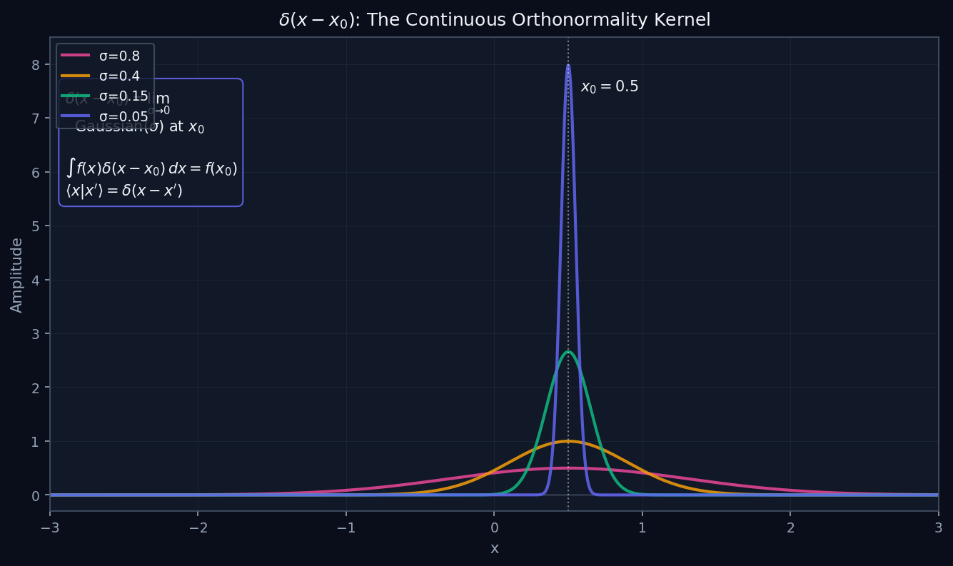
L06 — BegUG: Delta Function
L06
Beginning Undergraduate — Continuous Bases: |x⟩, |p⟩ & Delta Functions
DELTA FUNCTION
BegUG — DELTA FUNCTION
This lecture covers Continuous Bases: |x⟩, |p⟩ & Delta Functions at the BegUG level.
GEOMETRIC INTERPRETATION
The diagram on the right shows the 2D/3D geometric analogy for this concept. Use it to build physical intuition before working through the formalism.
• Q1: BegUG question for L06.
• Q2: BegUG question for L06.
QM: L06 — BegUG · Delta Function
L06 · BegUG

Slide 6
AdvUG
Advanced Undergraduate
1. Position Momentum
QM: L06 — Advanced Undergraduate
L06

Slide 7
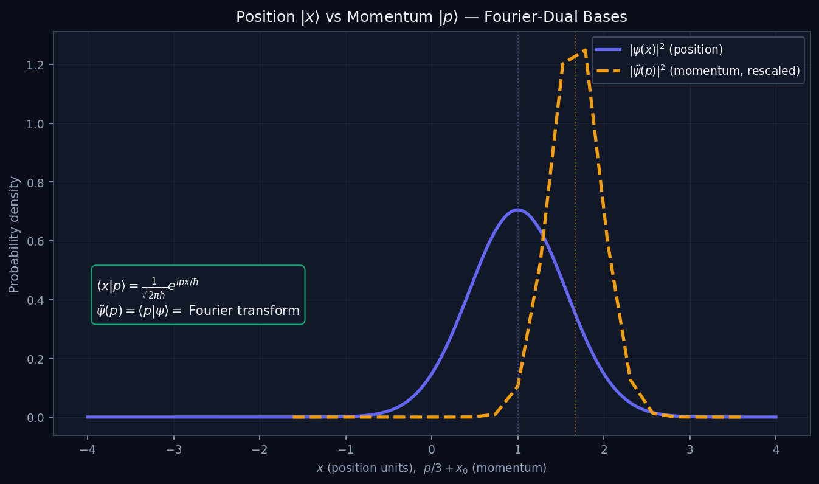
L06 — AdvUG: Position Momentum
L06
Advanced Undergraduate — Continuous Bases: |x⟩, |p⟩ & Delta Functions
POSITION MOMENTUM
AdvUG — POSITION MOMENTUM
This lecture covers Continuous Bases: |x⟩, |p⟩ & Delta Functions at the AdvUG level.
GEOMETRIC INTERPRETATION
The diagram on the right shows the 2D/3D geometric analogy for this concept. Use it to build physical intuition before working through the formalism.
• Q1: AdvUG question for L06.
• Q2: AdvUG question for L06.
QM: L06 — AdvUG · Position Momentum
L06 · AdvUG

Slide 8
MSc
Master's Level
1. Fourier Duality
QM: L06 — Master's Level
L06

Slide 9
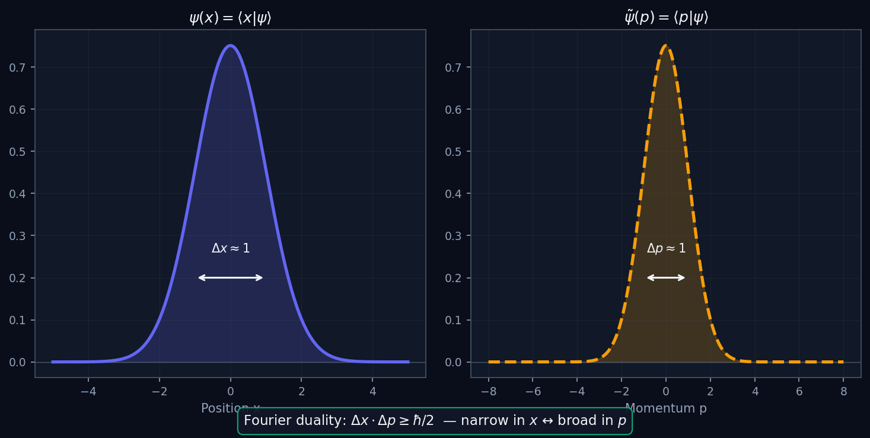
L06 — MSc: Fourier Duality
L06
Master's Level — Continuous Bases: |x⟩, |p⟩ & Delta Functions
FOURIER DUALITY
MSc — FOURIER DUALITY
This lecture covers Continuous Bases: |x⟩, |p⟩ & Delta Functions at the MSc level.
GEOMETRIC INTERPRETATION
The diagram on the right shows the 2D/3D geometric analogy for this concept. Use it to build physical intuition before working through the formalism.
• Q1: MSc question for L06.
• Q2: MSc question for L06.
QM: L06 — MSc · Fourier Duality
L06 · MSc

