Slide 1
Ψ
QUANTUM MECHANICS — BRA–KET NOTATION
L06
Continuous Bases: |x⟩, |p⟩ & Delta Functions
Position/momentum bases, wavefunctions, Fourier connection
HS
BegUG
AdvUG
MSc
PhD
Full expanded deck · 5 tiers · Worked examples · Complete problem sets
QM: Bra–Ket Notation — L06
L06

Slide 2
L06 — Lecture Overview
L06
Continuous Bases: |x⟩, |p⟩ & Delta Functions
90-MIN PACING
CORE LEARNING OUTCOMES
0–20 min: Continuous completeness ∫|x⟩⟨x|dx = Î
20–50 min: Wavefunction as ψ(x) = ⟨x|ψ⟩
50–75 min: Momentum basis; ⟨x|p⟩ = e^{ipx/ℏ}/√(2πℏ)
75–90 min: Fourier connection; delta function identities
• Understand ⟨x|x'⟩ = δ(x−x') as continuous orthonormality
• Derive wavefunction ψ(x) as projection onto position basis
• Connect Fourier transform to ⟨x|p⟩ inner product
• Handle Dirac delta distributions carefully
HS
BegUG
AdvUG
MSc
PhD
What a continuum of outcomes means physically
Basic integrals; qualitative delta function properties
Careful delta manipulations; normalization conventions
Distribution theory viewpoint; generalized eigenvectors
Rigged Hilbert spaces motivation; Gel'fand triple preview
ASSESSMENT BUNDLE
Set A: Show ∫|x⟩⟨x|dx=Î implies ⟨φ|ψ⟩ = ∫φ*(x)ψ(x)dx · Verify ψ̃(p) = ⟨p|ψ⟩ is the Fourier transform of ψ(x)
Set B: Derive ψ(x) as Fourier transform of φ(p) from ⟨x|p⟩ kernel · Prove Parseval–Plancherel: ∫|ψ|² dx = ∫|φ|² dp from completeness
QM: L06
L06 · Overview

Slide 3

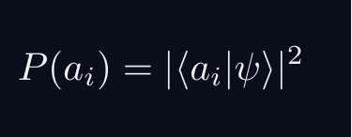
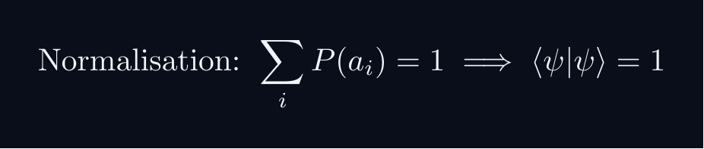
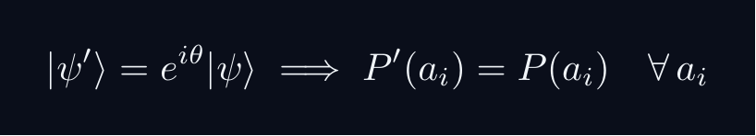
L06 — Sakurai Track
L06
Measurement-first, operational approach
SAKURAI: PREPARATION → STATISTICS → AMPLITUDES
BRIDGE TO DIRAC
SAKURAI: PREPARATION TO STATISTICS TO AMPLITUDES
• Preparation procedure ↔ ket |ψ⟩ (ray in ℋ)
• Measurement outcome aᵢ ↔ basis ket |aᵢ⟩
• Transition amplitude ↔ inner product ⟨aᵢ|ψ⟩
• Probability rule ↔ |⟨aᵢ|ψ⟩|²
• Total prob. = 1 ↔ ⟨ψ|ψ⟩ = 1
• Interference ↔ complex phase structure
STEP 1 — PREPARATION
A preparation is a reproducible laboratory protocol.
The same procedure always yields the same statistical predictions.
STEP 2 — MEASUREMENT OUTCOMES
A measurement device returns outcomes a_i with stable frequencies.
The state encodes probabilities, not definite property values.
STEP 3 — WHY AMPLITUDES?
Interference demands combining paths BEFORE squaring:
The cross-term is interference — real and measurable.
Only complex amplitudes can produce this cross-term.
STEP 4 — OPERATIONAL BORN RULE
GLOBAL PHASE IS UNOBSERVABLE
Physical states are RAYS not vectors.
QM: L06
L06 · Sakurai Track

Slide 4


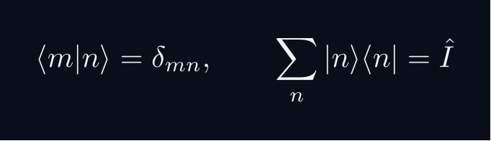
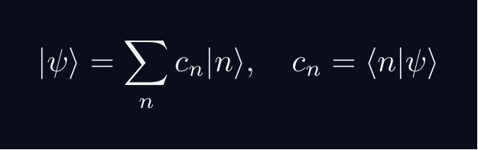


L06 — Dirac Track
L06
Abstract, representation-independent axioms
DIRAC: FIVE POSTULATES
DIRAC: FIVE POSTULATES OF QUANTUM MECHANICS
POSTULATE 1 — STATE SPACE
Every physical state is a ray in a complex Hilbert space H.
POSTULATE 2 — OBSERVABLES
Every observable A corresponds to a Hermitian operator A = A^†.
POSTULATE 3 — COMPLETENESS
POSTULATE 4 — BORN RULE
Post-measurement state (ideal projective): |ψ⟩ → |a⟩
POSTULATE 5 — DYNAMICS
QM: L06
L06 · Dirac Track

Slide 5
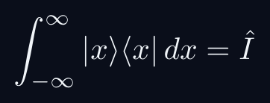
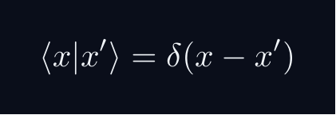
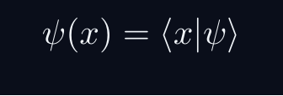
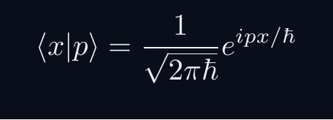
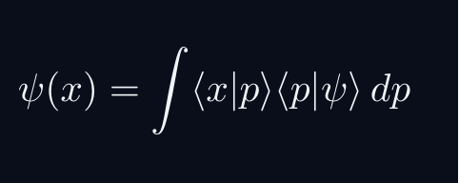
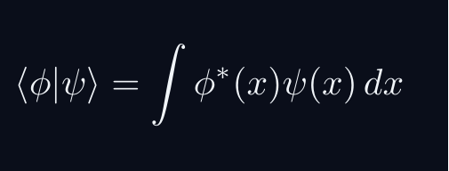
L06 — Key Formulas
L06
LaTeX-rendered formula reference
cont completeness
position ortho
wavefunction
momentum kernel
fourier via bk
ip as integral
QM: L06
L06 · Formulas

Slide 6
L06 — HS: High School
L06
Tier introduction and learning context
WHAT THIS TIER COVERS
PREREQUISITES
This lecture covers Continuous Bases: |x⟩, |p⟩ & Delta Functions at the HS level.
Starting point: pre-university mathematics
Required: basic algebra and complex arithmetic
WHAT THIS TIER UNLOCKS
KEY MESSAGE FOR THIS TIER
Unlocks access to: Beginning Undergraduate
This tier equips you for:
Basic integrals; qualitative delta function properties
What a continuum of outcomes means physically
QM: L06 · HS
L06 · HS · Intro

Slide 7
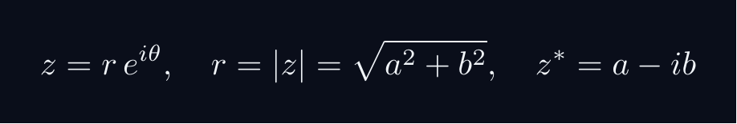
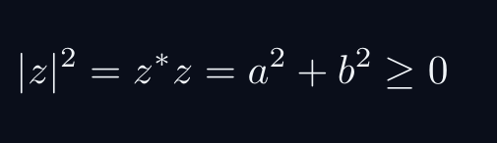
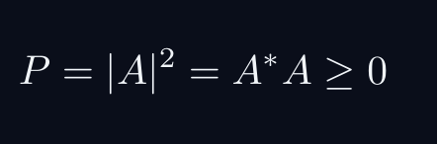
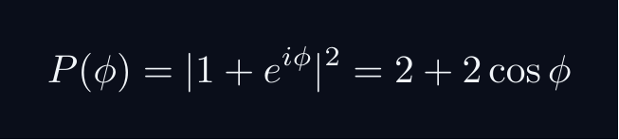
L06 — HS: Core Concepts
L06
Main ideas, key equations, and their meaning
CORE CONCEPTS & KEY RESULTS
This lecture covers Continuous Bases: |x⟩, |p⟩ & Delta Functions at the HS level.
COMPLEX NUMBERS AS ARROWS
A complex number z = a + ib lives in a 2D plane.
AMPLITUDE TO PROBABILITY (BORN RULE)
A quantum amplitude A is a complex number for a process.
Why squaring? Gives a real, non-negative number. Phase alone does not.
SUPERPOSITION = ARROW ADDITION = INTERFERENCE
Two paths: amplitudes A_1 and A_2. Total: A = A_1 + A_2.
Interference term can be positive (constructive) or negative (destructive).
WORKED FORMULA: PHASE DEPENDENCE
Let A_1 = 1, A_2 = e^{iφ} (unit magnitude, phase φ).
Maximum P=4 at φ=0 (constructive). Minimum P=0 at φ=pi (destructive).
QM: L06 · HS
L06 · HS · Concepts

Slide 8
L06 — HS: Worked Example 1
L06
Step-by-step solved example with commentary
EXAMPLE 1: HS-A1
WORKED SOLUTION
Core problem for L06 (HS). What a continuum of outcomes means physically
FULL SOLUTION
HINTS
Apply the formula.
* Apply the definition
ADVANCED HINTS
* Verify result
QM: L06 · HS
L06 · HS · Example 1

Slide 9
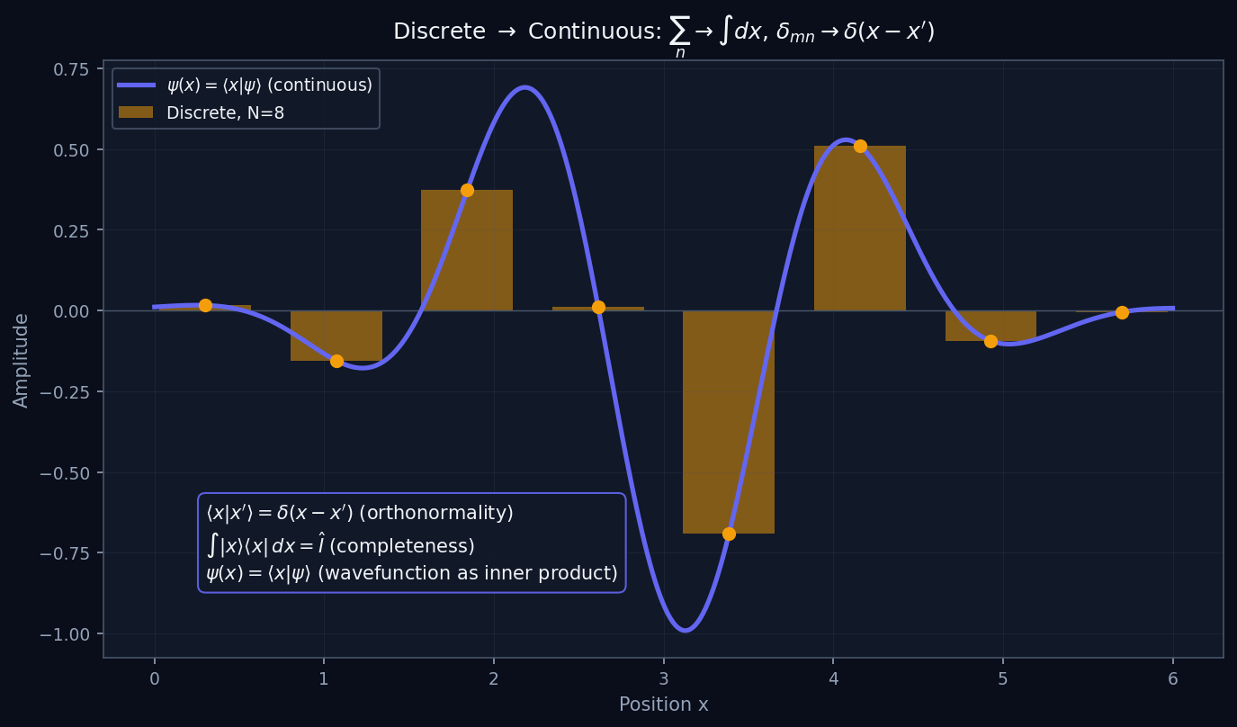
L06 — HS: Continuum Limit
L06
High School — Continuous Bases: |x⟩, |p⟩ & Delta Functions
CONTINUUM LIMIT
HS — CONTINUUM LIMIT
This lecture covers Continuous Bases: |x⟩, |p⟩ & Delta Functions at the HS level.
GEOMETRIC INTERPRETATION
The diagram on the right shows the 2D/3D geometric analogy for this concept. Use it to build physical intuition before working through the formalism.
• Q1: HS question for L06.
• Q2: HS question for L06.
QM: L06 — HS · Continuum Limit
L06 · HS

Slide 10
L06 — HS: Worked Example 2
L06
Second example — deeper or alternative approach
EXAMPLE 2: HS-A2
WORKED SOLUTION
Verification for L06 (HS).
FULL SOLUTION
HINTS
Follow the derivation.
* Use orthonormality
ADVANCED HINTS
* Check normalisation
QM: L06 · HS
L06 · HS · Example 2

Slide 11
L06 — HS: Concept Questions
L06
Think before computing — conceptual understanding checks
CONCEPT QUESTIONS
MORE QUESTIONS + GUIDANCE
1. Q1: HS question for L06.
2. Q2: HS question for L06.
3. Q3: HS question for L06.
1. Q4: HS question for L06.
2. Q5: HS question for L06.
─────
These questions have no calculation — think about what probability MEANS.
Key insight: squaring is the minimal operation that gives a non-negative re…
QM: L06 · HS
L06 · HS · Concept Qs

Slide 12
L06 — HS: Problem Sets
L06
Simple problems (Set A) and advanced problems (Set B)
PROBLEM SET A — SIMPLE (2 problems)
PROBLEM SET B — ADVANCED (1 problems)
[HS-A1] Core problem for L06 (HS). What a continuum of outcomes means physically
Hint: Apply the definition
[HS-A2] Verification for L06 (HS).
Hint: Use orthonormality
[HS-B1] Proof exercise for L06 (HS).
Hint: Start from definition
Key idea: Check edge cases
QM: L06 · HS
L06 · HS · Problems

Slide 13
L06 — HS: References & Bibliography
L06
Historical, educational, and research-level reading
HISTORICAL (1)
EDUCATIONAL (2)
RESEARCH (1)
[1930] Dirac
"Principles of QM"
Oxford UP
↳ Primary source.
Sakurai (2021)
"Modern QM"
Cambridge UP
↳ Main text.
Cohen-Tannoudji (1977)
"QM Vol. 1"
Wiley
↳ Complements.
von Neumann (1932)
"Math. Grundlagen"
Springer
↳ Rigorous foundations.
QM: L06 · HS
L06 · HS · References

Slide 14
L06 — BegUG: Beginning Undergraduate
L06
Tier introduction and learning context
WHAT THIS TIER COVERS
PREREQUISITES
This lecture covers Continuous Bases: |x⟩, |p⟩ & Delta Functions at the BegUG level.
Builds on: High School
Required background:
What a continuum of outcomes means physically
WHAT THIS TIER UNLOCKS
KEY MESSAGE FOR THIS TIER
Unlocks access to: Advanced Undergraduate
This tier equips you for:
Careful delta manipulations; normalization conventions
Basic integrals; qualitative delta function properties
QM: L06 · BegUG
L06 · BegUG · Intro

Slide 15
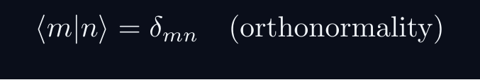
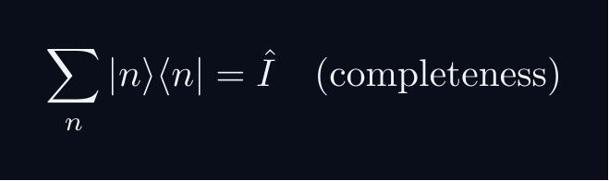
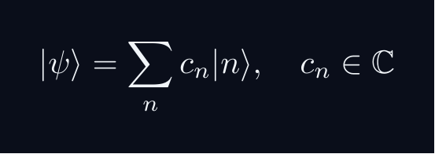
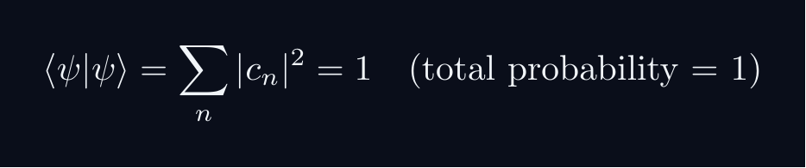


L06 — BegUG: Core Concepts
L06
Main ideas, key equations, and their meaning
CORE CONCEPTS & KEY RESULTS
This lecture covers Continuous Bases: |x⟩, |p⟩ & Delta Functions at the BegUG level.
HILBERT SPACE FORMALISM — DISCRETE BASIS
State vector |ψ⟩ in complex Hilbert space H.
EXPANSION AND COMPONENTS
Proof: ⟨ m|ψ⟩ = sum_n c_n ⟨ m|n⟩ = sum_n c_ndelta_{mn} = c_m
NORMALISATION AND PROBABILITIES
GLOBAL PHASE INVARIANCE
QM: L06 · BegUG
L06 · BegUG · Concepts

Slide 16
L06 — BegUG: Worked Example 1
L06
Step-by-step solved example with commentary
EXAMPLE 1: BegUG-A1
WORKED SOLUTION
Core problem for L06 (BegUG). Basic integrals; qualitative delta function properties
FULL SOLUTION
HINTS
Apply the formula.
* Apply the definition
ADVANCED HINTS
* Verify result
QM: L06 · BegUG
L06 · BegUG · Example 1

Slide 17
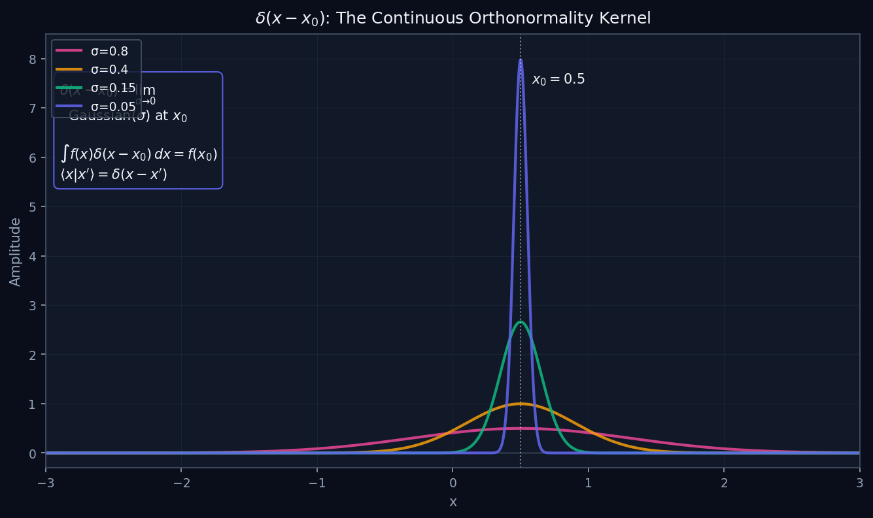
L06 — BegUG: Delta Function
L06
Beginning Undergraduate — Continuous Bases: |x⟩, |p⟩ & Delta Functions
DELTA FUNCTION
BegUG — DELTA FUNCTION
This lecture covers Continuous Bases: |x⟩, |p⟩ & Delta Functions at the BegUG level.
GEOMETRIC INTERPRETATION
The diagram on the right shows the 2D/3D geometric analogy for this concept. Use it to build physical intuition before working through the formalism.
• Q1: BegUG question for L06.
• Q2: BegUG question for L06.
QM: L06 — BegUG · Delta Function
L06 · BegUG

Slide 18
L06 — BegUG: Worked Example 2
L06
Second example — deeper or alternative approach
EXAMPLE 2: BegUG-A2
WORKED SOLUTION
Verification for L06 (BegUG).
FULL SOLUTION
HINTS
Follow the derivation.
* Use orthonormality
ADVANCED HINTS
* Check normalisation
QM: L06 · BegUG
L06 · BegUG · Example 2

Slide 19
L06 — BegUG: Concept Questions
L06
Think before computing — conceptual understanding checks
CONCEPT QUESTIONS
MORE QUESTIONS + GUIDANCE
1. Q1: BegUG question for L06.
2. Q2: BegUG question for L06.
3. Q3: BegUG question for L06.
1. Q4: BegUG question for L06.
2. Q5: BegUG question for L06.
─────
Work from the definition: write out the expansion, act with ⟨m| on the left, use δₘₙ.
For normalization: total probability must equal 1 — that is the…
QM: L06 · BegUG
L06 · BegUG · Concept Qs

Slide 20
L06 — BegUG: Problem Sets
L06
Simple problems (Set A) and advanced problems (Set B)
PROBLEM SET A — SIMPLE (2 problems)
PROBLEM SET B — ADVANCED (1 problems)
[BegUG-A1] Core problem for L06 (BegUG). Basic integrals; qualitative delta function properties
Hint: Apply the definition
[BegUG-A2] Verification for L06 (BegUG).
Hint: Use orthonormality
[BegUG-B1] Proof exercise for L06 (BegUG).
Hint: Start from definition
Key idea: Check edge cases
QM: L06 · BegUG
L06 · BegUG · Problems

Slide 21
L06 — BegUG: References & Bibliography
L06
Historical, educational, and research-level reading
HISTORICAL (1)
EDUCATIONAL (2)
RESEARCH (1)
[1930] Dirac
"Principles of QM"
Oxford UP
↳ Primary source.
Sakurai (2021)
"Modern QM"
Cambridge UP
↳ Main text.
Cohen-Tannoudji (1977)
"QM Vol. 1"
Wiley
↳ Complements.
von Neumann (1932)
"Math. Grundlagen"
Springer
↳ Rigorous foundations.
QM: L06 · BegUG
L06 · BegUG · References

Slide 22
L06 — AdvUG: Advanced Undergraduate
L06
Tier introduction and learning context
WHAT THIS TIER COVERS
PREREQUISITES
This lecture covers Continuous Bases: |x⟩, |p⟩ & Delta Functions at the AdvUG level.
Builds on: Beginning Undergraduate
Required background:
Basic integrals; qualitative delta function properties
WHAT THIS TIER UNLOCKS
KEY MESSAGE FOR THIS TIER
Unlocks access to: Master's Level
This tier equips you for:
Distribution theory viewpoint; generalized eigenvectors
Careful delta manipulations; normalization conventions
QM: L06 · AdvUG
L06 · AdvUG · Intro

Slide 23
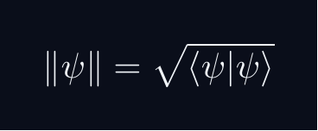
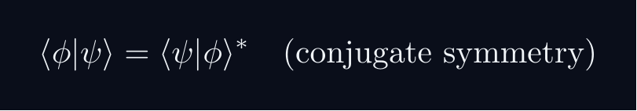


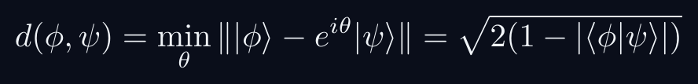
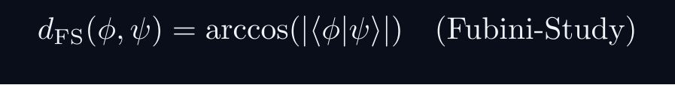
L06 — AdvUG: Core Concepts
L06
Main ideas, key equations, and their meaning
CORE CONCEPTS & KEY RESULTS
This lecture covers Continuous Bases: |x⟩, |p⟩ & Delta Functions at the AdvUG level.
INNER PRODUCT SPACE GEOMETRY
CAUCHY-SCHWARZ INEQUALITY
Proof: set f(lambda) = | |φ⟩ - lambda|ψ⟩ |^2 ≥ 0.
Choose lambda = ⟨ψ|φ⟩ / |ψ|^2 to minimise.
TRIANGLE INEQUALITY
Proof: square both sides; apply C-S to the cross term.
PHASE-INVARIANT DISTANCE
QM: L06 · AdvUG
L06 · AdvUG · Concepts

Slide 24
L06 — AdvUG: Worked Example 1
L06
Step-by-step solved example with commentary
EXAMPLE 1: AdvUG-A1
WORKED SOLUTION
Core problem for L06 (AdvUG). Careful delta manipulations; normalization conventions
FULL SOLUTION
HINTS
Apply the formula.
* Apply the definition
ADVANCED HINTS
* Verify result
QM: L06 · AdvUG
L06 · AdvUG · Example 1

Slide 25
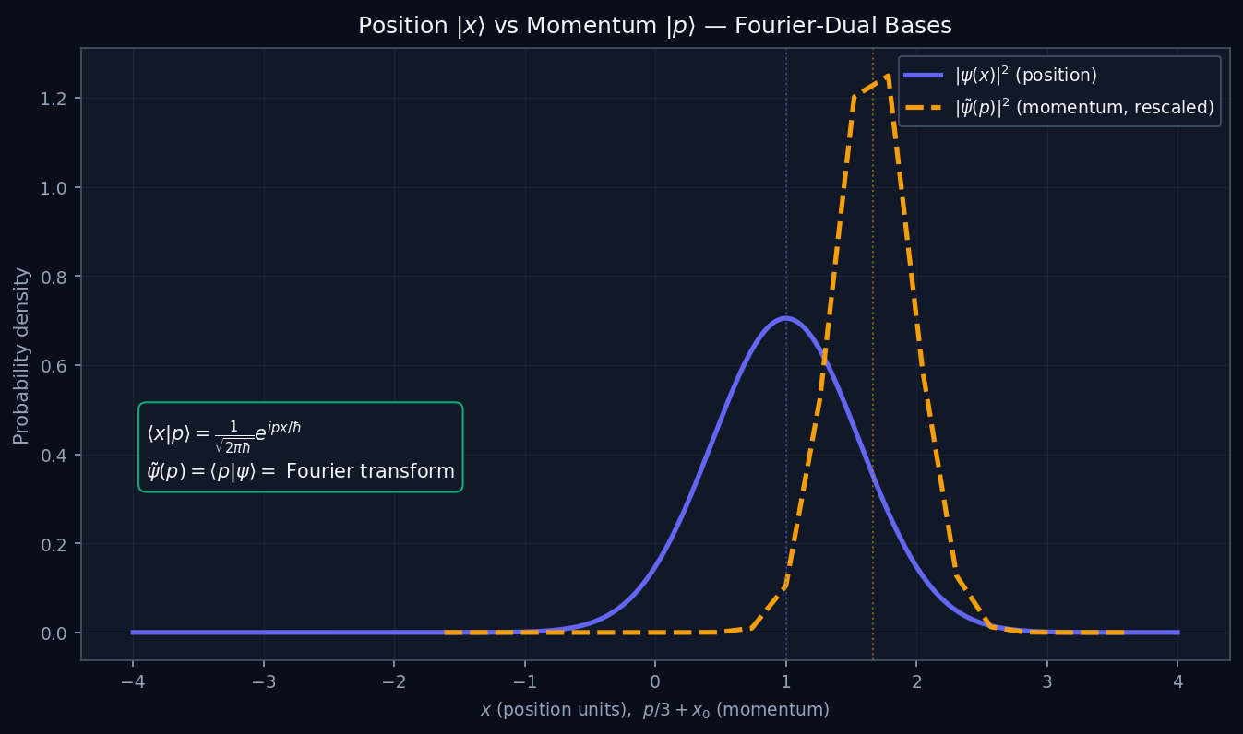
L06 — AdvUG: Position Momentum
L06
Advanced Undergraduate — Continuous Bases: |x⟩, |p⟩ & Delta Functions
POSITION MOMENTUM
AdvUG — POSITION MOMENTUM
This lecture covers Continuous Bases: |x⟩, |p⟩ & Delta Functions at the AdvUG level.
GEOMETRIC INTERPRETATION
The diagram on the right shows the 2D/3D geometric analogy for this concept. Use it to build physical intuition before working through the formalism.
• Q1: AdvUG question for L06.
• Q2: AdvUG question for L06.
QM: L06 — AdvUG · Position Momentum
L06 · AdvUG

Slide 26
L06 — AdvUG: Worked Example 2
L06
Second example — deeper or alternative approach
EXAMPLE 2: AdvUG-A2
WORKED SOLUTION
Verification for L06 (AdvUG).
FULL SOLUTION
HINTS
Follow the derivation.
* Use orthonormality
ADVANCED HINTS
* Check normalisation
QM: L06 · AdvUG
L06 · AdvUG · Example 2

Slide 27
L06 — AdvUG: Concept Questions
L06
Think before computing — conceptual understanding checks
CONCEPT QUESTIONS
MORE QUESTIONS + GUIDANCE
1. Q1: AdvUG question for L06.
2. Q2: AdvUG question for L06.
3. Q3: AdvUG question for L06.
1. Q4: AdvUG question for L06.
2. Q5: AdvUG question for L06.
─────
For C–S: the proof idea is to consider ‖|φ⟩ - λ|ψ⟩‖² ≥ 0 and choose the minimising λ.
For the geometry questions: draw a unit circle in ℂ²; overlap |…
QM: L06 · AdvUG
L06 · AdvUG · Concept Qs

Slide 28
L06 — AdvUG: Problem Sets
L06
Simple problems (Set A) and advanced problems (Set B)
PROBLEM SET A — SIMPLE (2 problems)
PROBLEM SET B — ADVANCED (1 problems)
[AdvUG-A1] Core problem for L06 (AdvUG). Careful delta manipulations; normalization conventions
Hint: Apply the definition
[AdvUG-A2] Verification for L06 (AdvUG).
Hint: Use orthonormality
[AdvUG-B1] Proof exercise for L06 (AdvUG).
Hint: Start from definition
Key idea: Check edge cases
QM: L06 · AdvUG
L06 · AdvUG · Problems

Slide 29
L06 — AdvUG: References & Bibliography
L06
Historical, educational, and research-level reading
HISTORICAL (1)
EDUCATIONAL (2)
RESEARCH (1)
[1930] Dirac
"Principles of QM"
Oxford UP
↳ Primary source.
Sakurai (2021)
"Modern QM"
Cambridge UP
↳ Main text.
Cohen-Tannoudji (1977)
"QM Vol. 1"
Wiley
↳ Complements.
von Neumann (1932)
"Math. Grundlagen"
Springer
↳ Rigorous foundations.
QM: L06 · AdvUG
L06 · AdvUG · References

Slide 30
L06 — MSc: Master's Level
L06
Tier introduction and learning context
WHAT THIS TIER COVERS
PREREQUISITES
This lecture covers Continuous Bases: |x⟩, |p⟩ & Delta Functions at the MSc level.
Builds on: Advanced Undergraduate
Required background:
Careful delta manipulations; normalization conventions
WHAT THIS TIER UNLOCKS
KEY MESSAGE FOR THIS TIER
Unlocks access to: PhD Level
This tier equips you for:
Rigged Hilbert spaces motivation; Gel'fand triple preview
Distribution theory viewpoint; generalized eigenvectors
QM: L06 · MSc
L06 · MSc · Intro

Slide 31
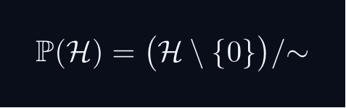
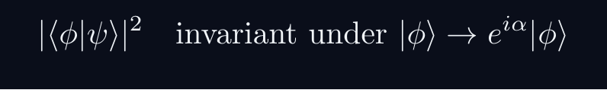

L06 — MSc: Core Concepts
L06
Main ideas, key equations, and their meaning
CORE CONCEPTS & KEY RESULTS
This lecture covers Continuous Bases: |x⟩, |p⟩ & Delta Functions at the MSc level.
PROJECTIVE HILBERT SPACE
Physical state space is P(H), not H itself.
A ray [ψ] is a one-dimensional complex subspace of H.
Example: P(C^2) cong S^2 — the Bloch sphere.
PHYSICALLY INVARIANT QUANTITIES
WIGNER'S THEOREM
Any bijection T:P(H)→P(H) preserving |⟨φ|ψ⟩|^2
is implemented by a UNITARY or ANTIUNITARY operator U on H.
Consequence: all quantum symmetries are (anti)unitary.
CONSEQUENCES
Symmetry group G acting on states gives projective representation of G.
Forces spin SO(3)→ SU(2), superselection rules, CPT symmetry.
QM: L06 · MSc
L06 · MSc · Concepts

Slide 32
L06 — MSc: Worked Example 1
L06
Step-by-step solved example with commentary
EXAMPLE 1: MSc-A1
WORKED SOLUTION
Core problem for L06 (MSc). Distribution theory viewpoint; generalized eigenvectors
FULL SOLUTION
HINTS
Apply the formula.
* Apply the definition
ADVANCED HINTS
* Verify result
QM: L06 · MSc
L06 · MSc · Example 1

Slide 33
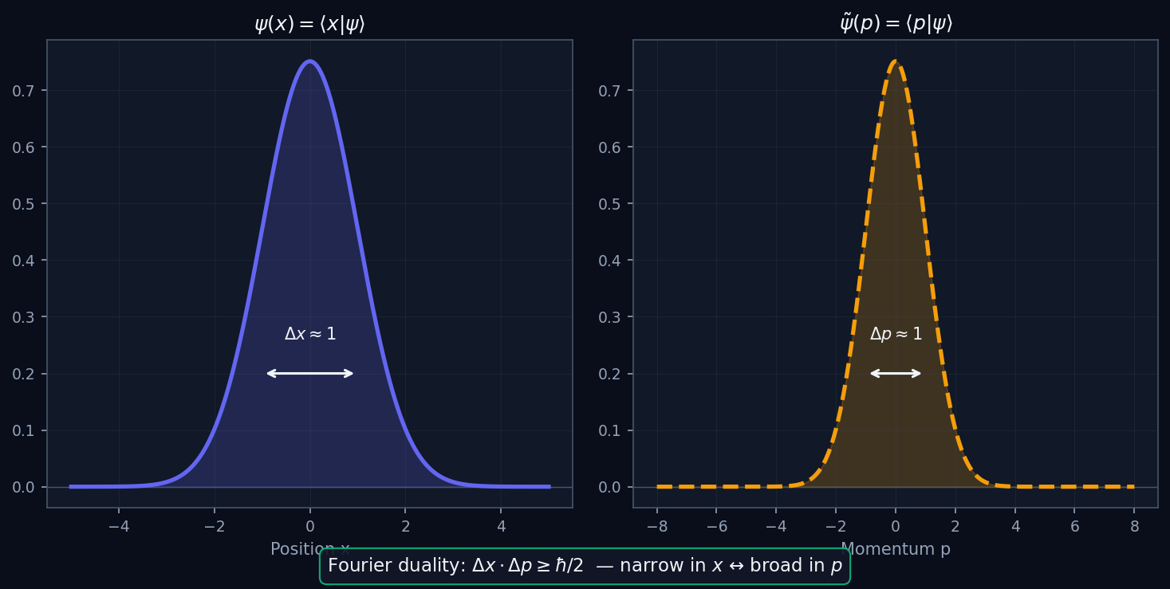
L06 — MSc: Fourier Duality
L06
Master's Level — Continuous Bases: |x⟩, |p⟩ & Delta Functions
FOURIER DUALITY
MSc — FOURIER DUALITY
This lecture covers Continuous Bases: |x⟩, |p⟩ & Delta Functions at the MSc level.
GEOMETRIC INTERPRETATION
The diagram on the right shows the 2D/3D geometric analogy for this concept. Use it to build physical intuition before working through the formalism.
• Q1: MSc question for L06.
• Q2: MSc question for L06.
QM: L06 — MSc · Fourier Duality
L06 · MSc

Slide 34
L06 — MSc: Worked Example 2
L06
Second example — deeper or alternative approach
EXAMPLE 2: MSc-A2
WORKED SOLUTION
Verification for L06 (MSc).
FULL SOLUTION
HINTS
Follow the derivation.
* Use orthonormality
ADVANCED HINTS
* Check normalisation
QM: L06 · MSc
L06 · MSc · Example 2

Slide 35
L06 — MSc: Concept Questions
L06
Think before computing — conceptual understanding checks
CONCEPT QUESTIONS
MORE QUESTIONS + GUIDANCE
1. Q1: MSc question for L06.
2. Q2: MSc question for L06.
3. Q3: MSc question for L06.
1. Q4: MSc question for L06.
2. Q5: MSc question for L06.
─────
For projective space: think of it as points on a sphere (for 2D), or more generally a complex manifold.
For Wigner: the key word is 'preserves transi…
QM: L06 · MSc
L06 · MSc · Concept Qs

Slide 36
L06 — MSc: Problem Sets
L06
Simple problems (Set A) and advanced problems (Set B)
PROBLEM SET A — SIMPLE (2 problems)
PROBLEM SET B — ADVANCED (1 problems)
[MSc-A1] Core problem for L06 (MSc). Distribution theory viewpoint; generalized eigenvectors
Hint: Apply the definition
[MSc-A2] Verification for L06 (MSc).
Hint: Use orthonormality
[MSc-B1] Proof exercise for L06 (MSc).
Hint: Start from definition
Key idea: Check edge cases
QM: L06 · MSc
L06 · MSc · Problems

Slide 37
L06 — MSc: References & Bibliography
L06
Historical, educational, and research-level reading
HISTORICAL (1)
EDUCATIONAL (2)
RESEARCH (1)
[1930] Dirac
"Principles of QM"
Oxford UP
↳ Primary source.
Sakurai (2021)
"Modern QM"
Cambridge UP
↳ Main text.
Cohen-Tannoudji (1977)
"QM Vol. 1"
Wiley
↳ Complements.
von Neumann (1932)
"Math. Grundlagen"
Springer
↳ Rigorous foundations.
QM: L06 · MSc
L06 · MSc · References

Slide 38
L06 — PhD: PhD Level
L06
Tier introduction and learning context
WHAT THIS TIER COVERS
PREREQUISITES
This lecture covers Continuous Bases: |x⟩, |p⟩ & Delta Functions at the PhD level.
Builds on: Master's Level
Required background:
Distribution theory viewpoint; generalized eigenvectors
WHAT THIS TIER UNLOCKS
KEY MESSAGE FOR THIS TIER
Frontier level: connects to active research
This tier equips you for:
Primary literature and open problems
Rigged Hilbert spaces motivation; Gel'fand triple preview
QM: L06 · PhD
L06 · PhD · Intro

Slide 39

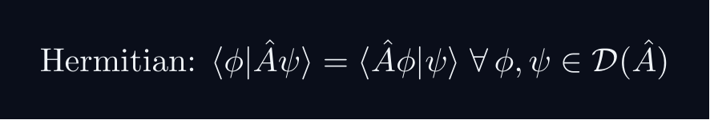
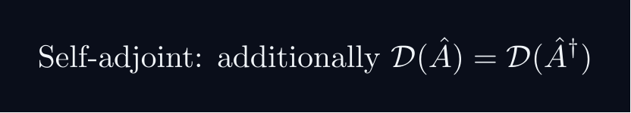
L06 — PhD: Core Concepts
L06
Main ideas, key equations, and their meaning
CORE CONCEPTS & KEY RESULTS
This lecture covers Continuous Bases: |x⟩, |p⟩ & Delta Functions at the PhD level.
HILBERT SPACE — PRECISE AXIOMS
Definition: a complex vector space H with ⟨cdot|cdot⟩ that is COMPLETE.
Completeness: every Cauchy sequence {ψ_n} converges in H.
Essential for: spectral theory, Fourier expansions, Stone's theorem.
SEPARABILITY
H separable ⟺ countable dense subset ⟺ countable ONB {e_n}.
All standard NRQM spaces: L^2(R^n), C^n, ell^2(N).
RAYS AS ONE-DIMENSIONAL SUBSPACES
P(H) is a Kahler manifold with Fubini-Study metric.
UNBOUNDED OPERATORS — DOMAIN SUBTLETY
Self-adjoint ≠ Hermitian for unbounded operators (x̂, p̂).
Spectral theorem and Stone's theorem REQUIRE self-adjointness.
QM: L06 · PhD
L06 · PhD · Concepts

Slide 40
L06 — PhD: Worked Example 1
L06
Step-by-step solved example with commentary
EXAMPLE 1: PhD-A1
WORKED SOLUTION
Core problem for L06 (PhD). Rigged Hilbert spaces motivation; Gel'fand triple preview
FULL SOLUTION
HINTS
Apply the formula.
* Apply the definition
ADVANCED HINTS
* Verify result
QM: L06 · PhD
L06 · PhD · Example 1

Slide 41
L06 — PhD: Worked Example 2
L06
Second example — deeper or alternative approach
EXAMPLE 2: PhD-A2
WORKED SOLUTION
Verification for L06 (PhD).
FULL SOLUTION
HINTS
Follow the derivation.
* Use orthonormality
ADVANCED HINTS
* Check normalisation
QM: L06 · PhD
L06 · PhD · Example 2

Slide 42
L06 — PhD: Concept Questions
L06
Think before computing — conceptual understanding checks
CONCEPT QUESTIONS
MORE QUESTIONS + GUIDANCE
1. Q1: PhD question for L06.
2. Q2: PhD question for L06.
3. Q3: PhD question for L06.
1. Q4: PhD question for L06.
2. Q5: PhD question for L06.
─────
For completeness: construct Cauchy sequences that don't converge to a square-integrable function in a non-complete space.
For separability: construct…
QM: L06 · PhD
L06 · PhD · Concept Qs

Slide 43
L06 — PhD: Problem Sets
L06
Simple problems (Set A) and advanced problems (Set B)
PROBLEM SET A — SIMPLE (2 problems)
PROBLEM SET B — ADVANCED (1 problems)
[PhD-A1] Core problem for L06 (PhD). Rigged Hilbert spaces motivation; Gel'fand triple preview
Hint: Apply the definition
[PhD-A2] Verification for L06 (PhD).
Hint: Use orthonormality
[PhD-B1] Proof exercise for L06 (PhD).
Hint: Start from definition
Key idea: Check edge cases
QM: L06 · PhD
L06 · PhD · Problems

Slide 44
L06 — PhD: References & Bibliography
L06
Historical, educational, and research-level reading
HISTORICAL (1)
EDUCATIONAL (2)
RESEARCH (1)
[1930] Dirac
"Principles of QM"
Oxford UP
↳ Primary source.
Sakurai (2021)
"Modern QM"
Cambridge UP
↳ Main text.
Cohen-Tannoudji (1977)
"QM Vol. 1"
Wiley
↳ Complements.
von Neumann (1932)
"Math. Grundlagen"
Springer
↳ Rigorous foundations.
QM: L06 · PhD
L06 · PhD · References

Slide 45
L06 — Common Pitfalls & Misconceptions
L06
Consolidated pitfalls across all tiers
⚠ PITFALLS (A)
⚠ PITFALLS (B)
• Treating δ(x−x') as a regular function — it is a distribution
• Wrong normalization: ⟨x|x'⟩ uses δ not Kronecker δ
• Confusing momentum eigenstate normalization conventions (ℏ vs 1)
HISTORICAL ANCHORS
FORMULA QUICK REFERENCE
• Schrödinger (1926) — wave mechanics and ψ(x)
• Dirac (1927) — δ-function introduced (informally)
• Schwartz (1950s) — distribution theory: rigorous foundation for δ
Key formulas in this lecture:
cont_completeness · position_ortho · wavefunction · momentum_kernel · fourier_via_bk · ip_as_integral
See formula slides for full LaTeX-rendered versions.
QM: L06
L06 · Pitfalls

Slide 46
L06 — Homework & Project Summary
L06
Assessment overview across all tiers
HS
BegUG
AdvUG
MSc
PhD
Problems: 2 simple + 1 advanced
Project (simple, ~2-3h): HS Project
Project (advanced, ~8-10h): HS Advanced
Research (defined): Explain key result (HS).
Research (open): Open question (HS).
Problems: 2 simple + 1 advanced
Project (simple, ~2-3h): BegUG Project
Project (advanced, ~8-10h): BegUG Advanced
Research (defined): Explain key result (BegUG).
Research (open): Open question (BegUG).
Problems: 2 simple + 1 advanced
Project (simple, ~2-3h): AdvUG Project
Project (advanced, ~8-10h): AdvUG Advanced
Research (defined): Explain key result (AdvUG).
Research (open): Open question (AdvUG).
Problems: 2 simple + 1 advanced
Project (simple, ~2-3h): MSc Project
Project (advanced, ~8-10h): MSc Advanced
Research (defined): Explain key result (MSc).
Research (open): Open question (MSc).
Problems: 2 simple + 1 advanced
Project (simple, ~2-3h): PhD Project
Project (advanced, ~8-10h): PhD Advanced
Research (defined): Explain key result (PhD).
Research (open): Open question (PhD).
HOMEWORK ASSIGNMENT
REQUIRED (all students): Problems from your track's Set A
HONOURS (optional): Set B problems from your track
PROJECT: Choose simple OR advanced track from your tier
RESEARCH: At least one well-defined question; open questions for MSc/PhD
QM: L06
L06 · Homework

