Slide 1
L07
Deep Concept Slides
Measurement Theory: Postulates, Compatibility & Uncertainty
One slide per core concept · Full explanation · Geometric diagram
HS
BegUG
AdvUG
MSc
PhD
4 concept slides
QM: Bra-Ket — L07 Concepts
L07

Slide 2
HS
High School
1. Uncertainty Spread
QM: L07 — High School
L07

Slide 3
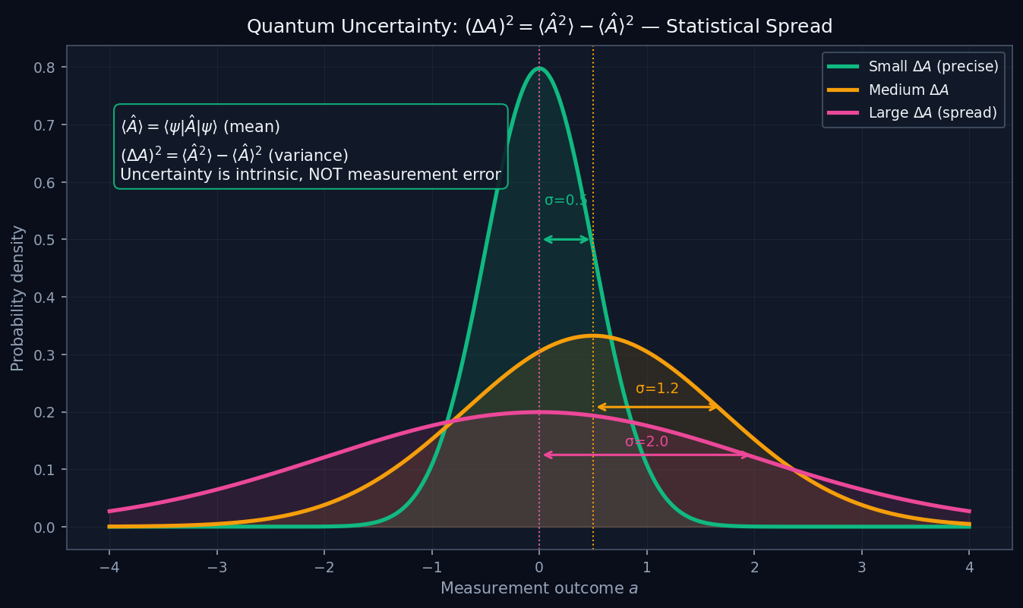
L07 — HS: Uncertainty Spread
L07
High School — Measurement Theory: Postulates, Compatibility & Uncertainty
UNCERTAINTY SPREAD
HS — UNCERTAINTY SPREAD
This lecture covers Measurement Theory: Postulates, Compatibility & Uncertainty at the HS level.
GEOMETRIC INTERPRETATION
The diagram on the right shows the 2D/3D geometric analogy for this concept. Use it to build physical intuition before working through the formalism.
• Q1: HS question for L07.
• Q2: HS question for L07.
QM: L07 — HS · Uncertainty Spread
L07 · HS

Slide 4
BegUG
Beginning Undergraduate
1. Commutator Geometry
QM: L07 — Beginning Undergraduate
L07

Slide 5
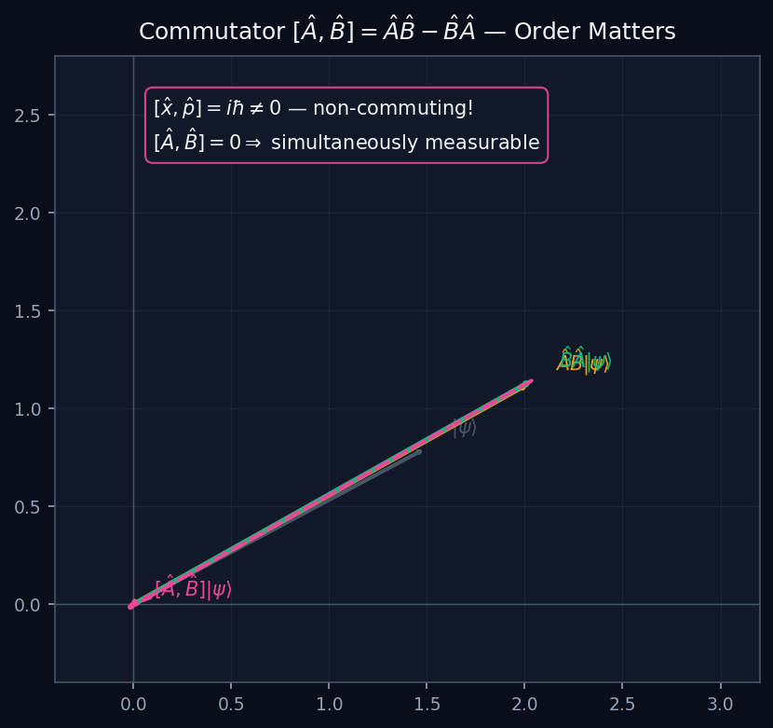
L07 — BegUG: Commutator Geometry
L07
Beginning Undergraduate — Measurement Theory: Postulates, Compatibility & Uncertainty
COMMUTATOR GEOMETRY
BegUG — COMMUTATOR GEOMETRY
This lecture covers Measurement Theory: Postulates, Compatibility & Uncertainty at the BegUG level.
GEOMETRIC INTERPRETATION
The diagram on the right shows the 2D/3D geometric analogy for this concept. Use it to build physical intuition before working through the formalism.
• Q1: BegUG question for L07.
• Q2: BegUG question for L07.
QM: L07 — BegUG · Commutator Geometry
L07 · BegUG

Slide 6
AdvUG
Advanced Undergraduate
1. Robertson Diagram
QM: L07 — Advanced Undergraduate
L07

Slide 7
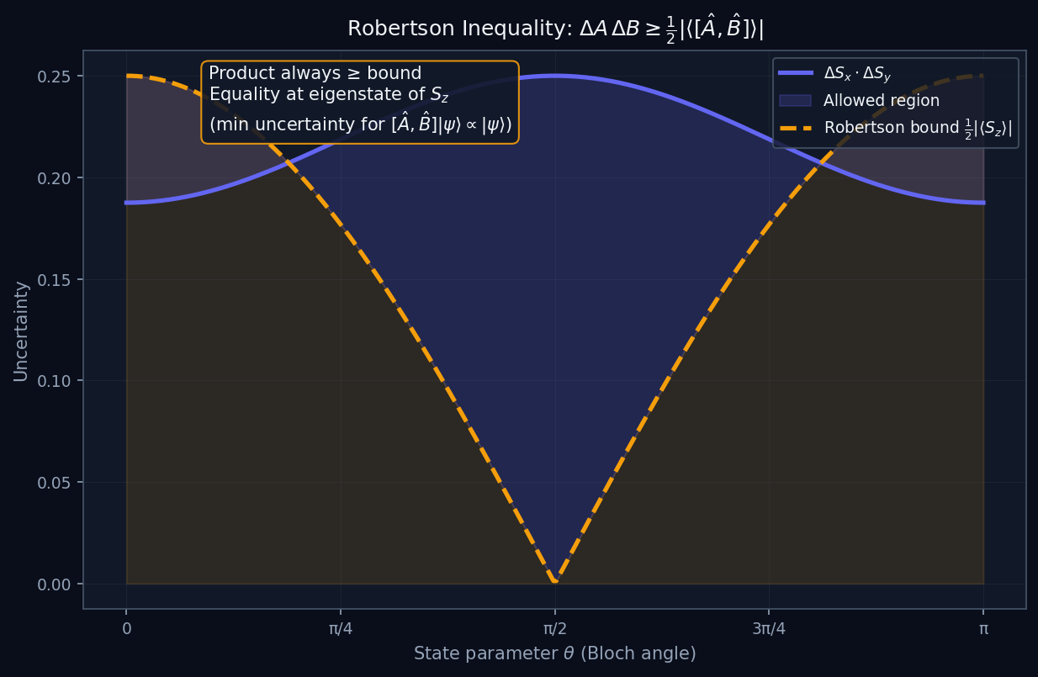
L07 — AdvUG: Robertson Diagram
L07
Advanced Undergraduate — Measurement Theory: Postulates, Compatibility & Uncertainty
ROBERTSON DIAGRAM
AdvUG — ROBERTSON DIAGRAM
This lecture covers Measurement Theory: Postulates, Compatibility & Uncertainty at the AdvUG level.
GEOMETRIC INTERPRETATION
The diagram on the right shows the 2D/3D geometric analogy for this concept. Use it to build physical intuition before working through the formalism.
• Q1: AdvUG question for L07.
• Q2: AdvUG question for L07.
QM: L07 — AdvUG · Robertson Diagram
L07 · AdvUG

Slide 8
MSc
Master's Level
1. Compatible Observables
QM: L07 — Master's Level
L07

Slide 9
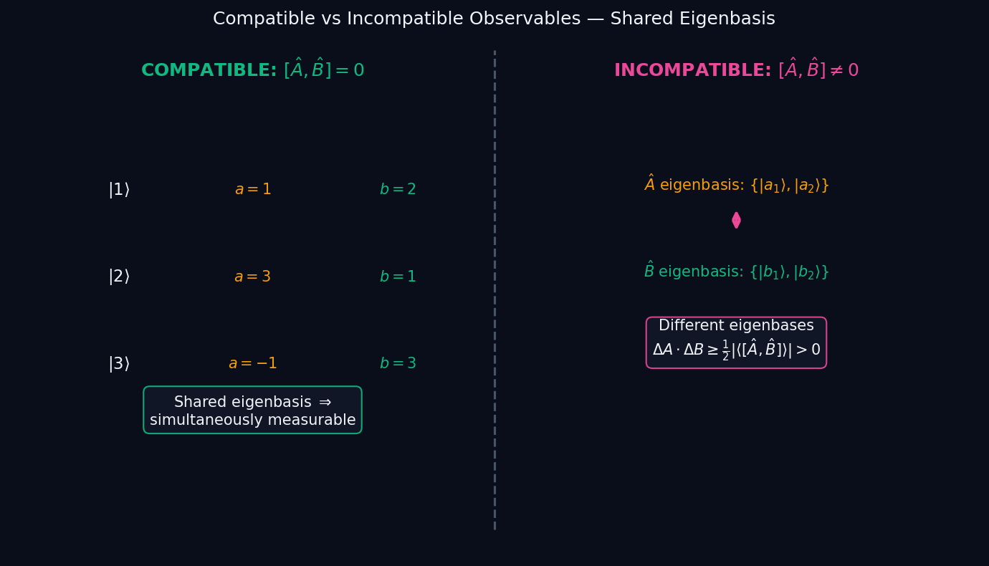
L07 — MSc: Compatible Observables
L07
Master's Level — Measurement Theory: Postulates, Compatibility & Uncertainty
COMPATIBLE OBSERVABLES
MSc — COMPATIBLE OBSERVABLES
This lecture covers Measurement Theory: Postulates, Compatibility & Uncertainty at the MSc level.
GEOMETRIC INTERPRETATION
The diagram on the right shows the 2D/3D geometric analogy for this concept. Use it to build physical intuition before working through the formalism.
• Q1: MSc question for L07.
• Q2: MSc question for L07.
QM: L07 — MSc · Compatible Observables
L07 · MSc

