Slide 1
L08
Deep Concept Slides
Time Evolution & Pictures of Quantum Mechanics
One slide per core concept · Full explanation · Geometric diagram
HS
BegUG
AdvUG
MSc
PhD
4 concept slides
QM: Bra-Ket — L08 Concepts
L08

Slide 2
HS
High School
1. Unitary Flow
QM: L08 — High School
L08

Slide 3
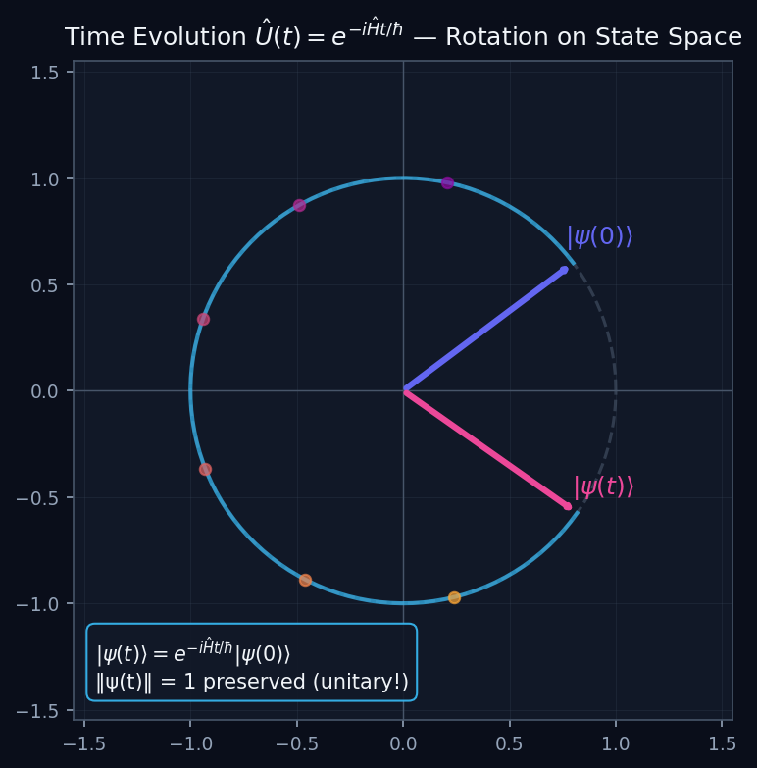
L08 — HS: Unitary Flow
L08
High School — Time Evolution & Pictures of Quantum Mechanics
UNITARY FLOW
HS — UNITARY FLOW
This lecture covers Time Evolution & Pictures of Quantum Mechanics at the HS level.
GEOMETRIC INTERPRETATION
The diagram on the right shows the 2D/3D geometric analogy for this concept. Use it to build physical intuition before working through the formalism.
• Q1: HS question for L08.
• Q2: HS question for L08.
QM: L08 — HS · Unitary Flow
L08 · HS

Slide 4
BegUG
Beginning Undergraduate
1. Heisenberg Schrodinger
QM: L08 — Beginning Undergraduate
L08

Slide 5
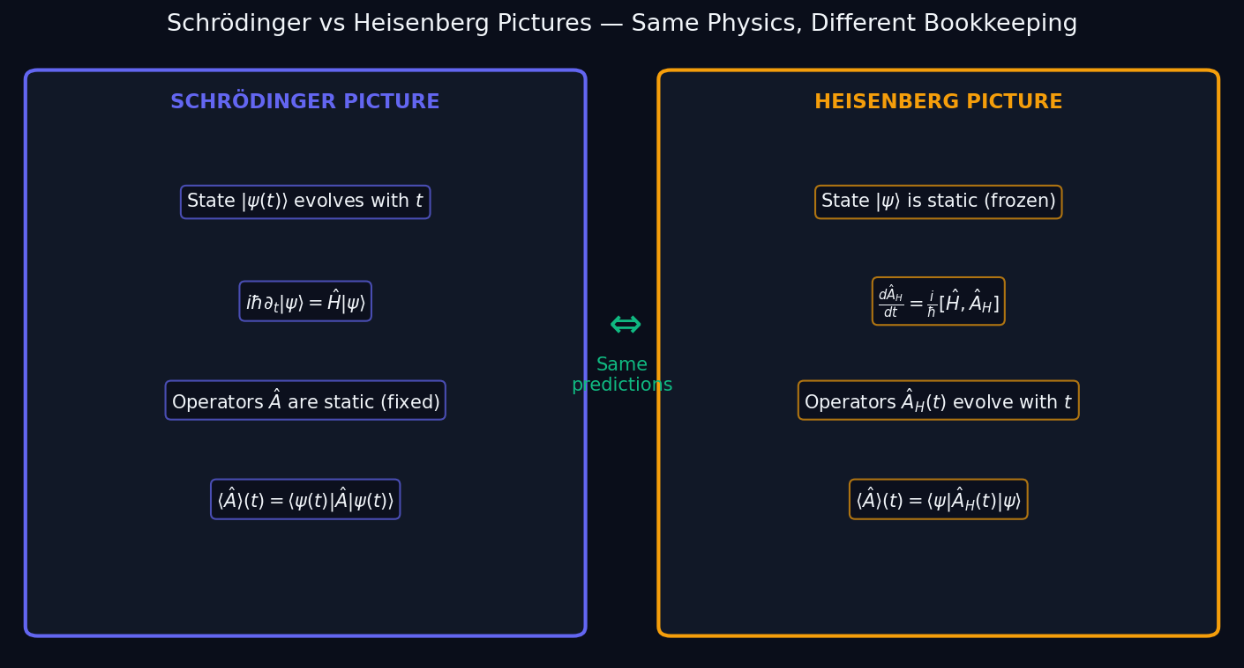
L08 — BegUG: Heisenberg Schrodinger
L08
Beginning Undergraduate — Time Evolution & Pictures of Quantum Mechanics
HEISENBERG SCHRODINGER
BegUG — HEISENBERG SCHRODINGER
This lecture covers Time Evolution & Pictures of Quantum Mechanics at the BegUG level.
GEOMETRIC INTERPRETATION
The diagram on the right shows the 2D/3D geometric analogy for this concept. Use it to build physical intuition before working through the formalism.
• Q1: BegUG question for L08.
• Q2: BegUG question for L08.
QM: L08 — BegUG · Heisenberg Schrodinger
L08 · BegUG

Slide 6
AdvUG
Advanced Undergraduate
1. Ehrenfest
QM: L08 — Advanced Undergraduate
L08

Slide 7
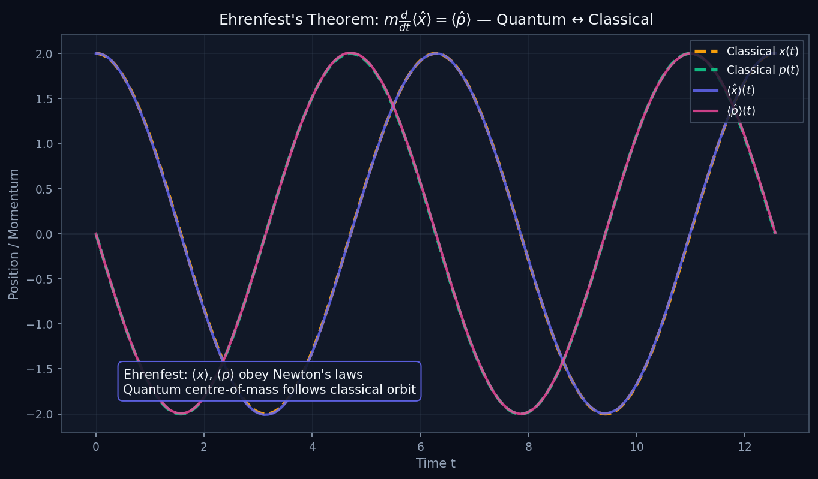
L08 — AdvUG: Ehrenfest
L08
Advanced Undergraduate — Time Evolution & Pictures of Quantum Mechanics
EHRENFEST
AdvUG — EHRENFEST
This lecture covers Time Evolution & Pictures of Quantum Mechanics at the AdvUG level.
GEOMETRIC INTERPRETATION
The diagram on the right shows the 2D/3D geometric analogy for this concept. Use it to build physical intuition before working through the formalism.
• Q1: AdvUG question for L08.
• Q2: AdvUG question for L08.
QM: L08 — AdvUG · Ehrenfest
L08 · AdvUG

Slide 8
MSc
Master's Level
1. Exponential Steps
QM: L08 — Master's Level
L08

Slide 9
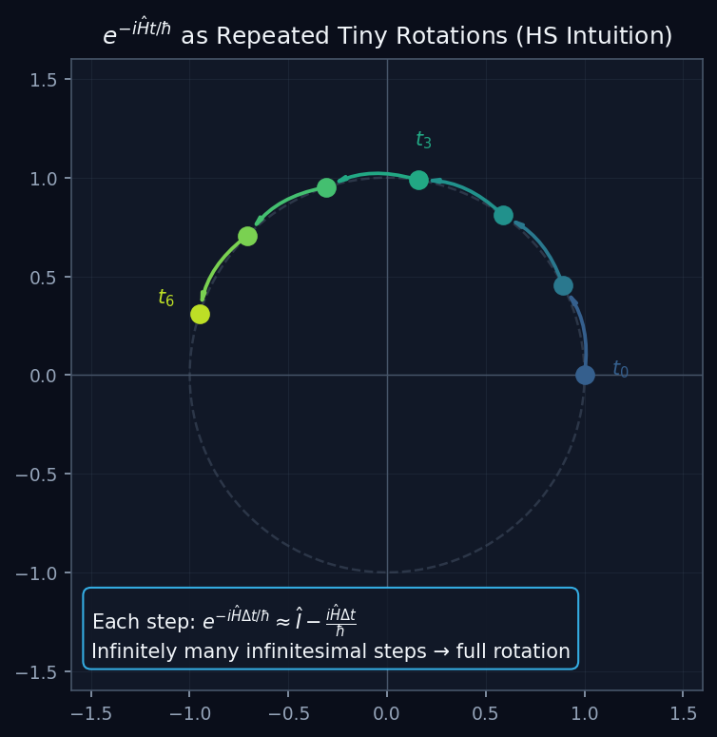
L08 — MSc: Exponential Steps
L08
Master's Level — Time Evolution & Pictures of Quantum Mechanics
EXPONENTIAL STEPS
MSc — EXPONENTIAL STEPS
This lecture covers Time Evolution & Pictures of Quantum Mechanics at the MSc level.
GEOMETRIC INTERPRETATION
The diagram on the right shows the 2D/3D geometric analogy for this concept. Use it to build physical intuition before working through the formalism.
• Q1: MSc question for L08.
• Q2: MSc question for L08.
QM: L08 — MSc · Exponential Steps
L08 · MSc

