Slide 1
Ψ
QUANTUM MECHANICS — BRA–KET NOTATION
L08
Time Evolution & Pictures of Quantum Mechanics
Unitary evolution, Schrödinger/Heisenberg pictures, constants of motion
HS
BegUG
AdvUG
MSc
PhD
Full expanded deck · 5 tiers · Worked examples · Complete problem sets
QM: Bra–Ket Notation — L08
L08

Slide 2
L08 — Lecture Overview
L08
Time Evolution & Pictures of Quantum Mechanics
90-MIN PACING
CORE LEARNING OUTCOMES
0–20 min: Unitary evolution Û(t) = e^{−iĤt/ℏ}
20–45 min: Schrödinger picture: states evolve, operators fixed
45–70 min: Heisenberg picture: operators evolve
70–90 min: Constants of motion; [Â,Ĥ]=0 ⟺ conserved
• Derive Û(t) from unitarity and time-translation invariance
• Work fluently in both Schrödinger and Heisenberg pictures
• Derive Heisenberg equation of motion dÂ_H/dt
• Identify constants of motion via [Â,Ĥ]=0
HS
BegUG
AdvUG
MSc
PhD
Exponential as repeated tiny evolution steps
Differentiate ⟨Â⟩ with time; simple Hamiltonians
Heisenberg EOM; Ehrenfest's theorem
Time-ordering; interaction picture preview
Stone's theorem; one-parameter unitary groups; domain issues
ASSESSMENT BUNDLE
Set A: Show Û†Û = Î if Ĥ is Hermitian · Prove d/dt ⟨ψ(t)|ψ(t)⟩ = 0 under unitary evolution
Set B: Derive Heisenberg EOM from d/dt⟨Â⟩ = d/dt⟨ψ|Â|ψ⟩ · Prove Ehrenfest: d⟨x̂⟩/dt = ⟨p̂⟩/m from Ĥ = p̂²/2m + V(x̂)
QM: L08
L08 · Overview

Slide 3

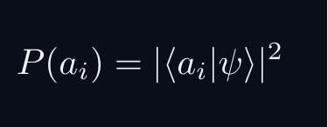
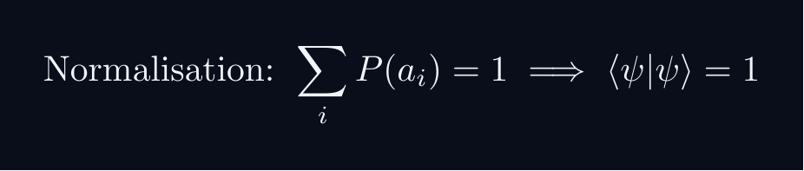
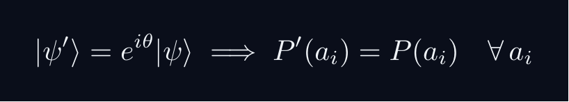
L08 — Sakurai Track
L08
Measurement-first, operational approach
SAKURAI: PREPARATION → STATISTICS → AMPLITUDES
BRIDGE TO DIRAC
SAKURAI: PREPARATION TO STATISTICS TO AMPLITUDES
• Preparation procedure ↔ ket |ψ⟩ (ray in ℋ)
• Measurement outcome aᵢ ↔ basis ket |aᵢ⟩
• Transition amplitude ↔ inner product ⟨aᵢ|ψ⟩
• Probability rule ↔ |⟨aᵢ|ψ⟩|²
• Total prob. = 1 ↔ ⟨ψ|ψ⟩ = 1
• Interference ↔ complex phase structure
STEP 1 — PREPARATION
A preparation is a reproducible laboratory protocol.
The same procedure always yields the same statistical predictions.
STEP 2 — MEASUREMENT OUTCOMES
A measurement device returns outcomes a_i with stable frequencies.
The state encodes probabilities, not definite property values.
STEP 3 — WHY AMPLITUDES?
Interference demands combining paths BEFORE squaring:
The cross-term is interference — real and measurable.
Only complex amplitudes can produce this cross-term.
STEP 4 — OPERATIONAL BORN RULE
GLOBAL PHASE IS UNOBSERVABLE
Physical states are RAYS not vectors.
QM: L08
L08 · Sakurai Track

Slide 4

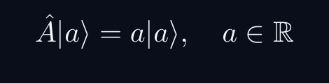
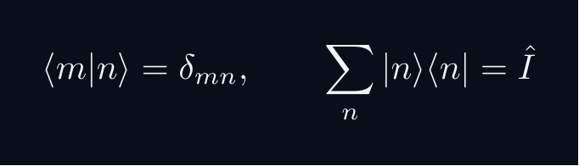
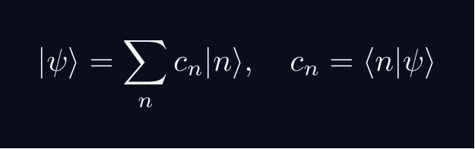


L08 — Dirac Track
L08
Abstract, representation-independent axioms
DIRAC: FIVE POSTULATES
DIRAC: FIVE POSTULATES OF QUANTUM MECHANICS
POSTULATE 1 — STATE SPACE
Every physical state is a ray in a complex Hilbert space H.
POSTULATE 2 — OBSERVABLES
Every observable A corresponds to a Hermitian operator A = A^†.
POSTULATE 3 — COMPLETENESS
POSTULATE 4 — BORN RULE
Post-measurement state (ideal projective): |ψ⟩ → |a⟩
POSTULATE 5 — DYNAMICS
QM: L08
L08 · Dirac Track

Slide 5
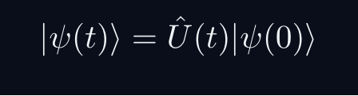

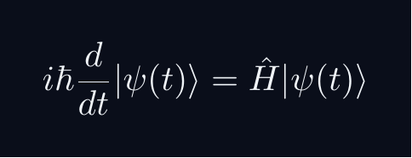
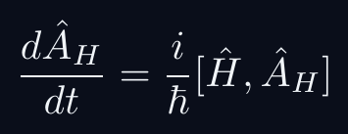
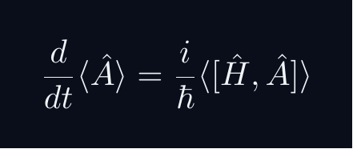
L08 — Key Formulas
L08
LaTeX-rendered formula reference
time evolution
unitary exp
schrodinger eq
heisenberg eom
ehrenfest
QM: L08
L08 · Formulas

Slide 6
L08 — HS: High School
L08
Tier introduction and learning context
WHAT THIS TIER COVERS
PREREQUISITES
This lecture covers Time Evolution & Pictures of Quantum Mechanics at the HS level.
Starting point: pre-university mathematics
Required: basic algebra and complex arithmetic
WHAT THIS TIER UNLOCKS
KEY MESSAGE FOR THIS TIER
Unlocks access to: Beginning Undergraduate
This tier equips you for:
Differentiate ⟨Â⟩ with time; simple Hamiltonians
Exponential as repeated tiny evolution steps
QM: L08 · HS
L08 · HS · Intro

Slide 7
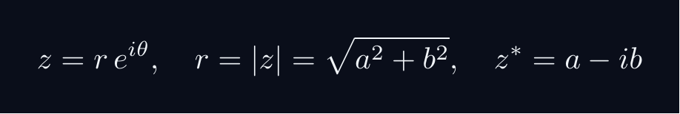
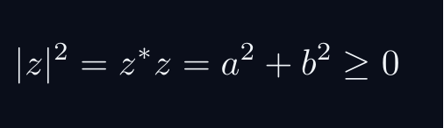
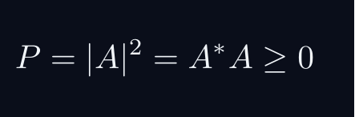
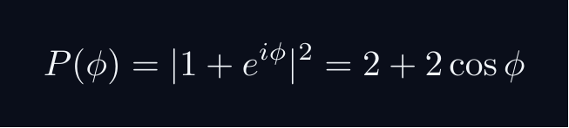
L08 — HS: Core Concepts
L08
Main ideas, key equations, and their meaning
CORE CONCEPTS & KEY RESULTS
This lecture covers Time Evolution & Pictures of Quantum Mechanics at the HS level.
COMPLEX NUMBERS AS ARROWS
A complex number z = a + ib lives in a 2D plane.
AMPLITUDE TO PROBABILITY (BORN RULE)
A quantum amplitude A is a complex number for a process.
Why squaring? Gives a real, non-negative number. Phase alone does not.
SUPERPOSITION = ARROW ADDITION = INTERFERENCE
Two paths: amplitudes A_1 and A_2. Total: A = A_1 + A_2.
Interference term can be positive (constructive) or negative (destructive).
WORKED FORMULA: PHASE DEPENDENCE
Let A_1 = 1, A_2 = e^{iφ} (unit magnitude, phase φ).
Maximum P=4 at φ=0 (constructive). Minimum P=0 at φ=pi (destructive).
QM: L08 · HS
L08 · HS · Concepts

Slide 8
L08 — HS: Worked Example 1
L08
Step-by-step solved example with commentary
EXAMPLE 1: HS-A1
WORKED SOLUTION
Core problem for L08 (HS). Exponential as repeated tiny evolution steps
FULL SOLUTION
HINTS
Apply the formula.
* Apply the definition
ADVANCED HINTS
* Verify result
QM: L08 · HS
L08 · HS · Example 1

Slide 9
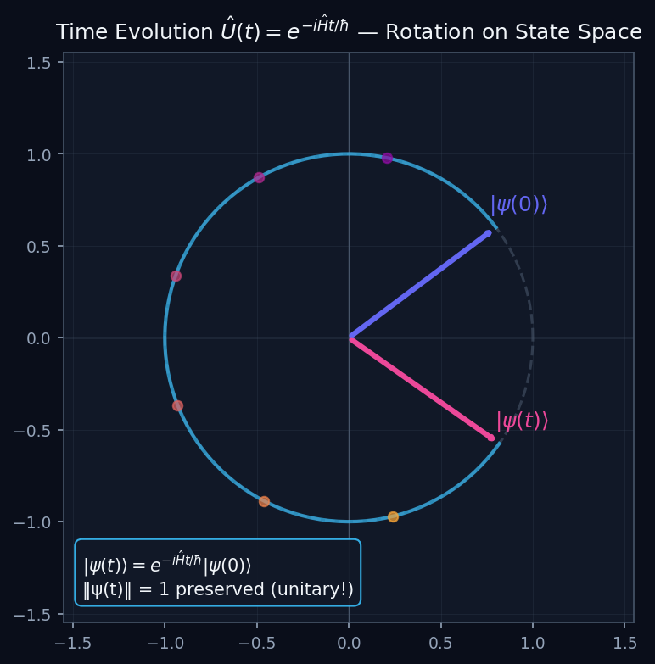
L08 — HS: Unitary Flow
L08
High School — Time Evolution & Pictures of Quantum Mechanics
UNITARY FLOW
HS — UNITARY FLOW
This lecture covers Time Evolution & Pictures of Quantum Mechanics at the HS level.
GEOMETRIC INTERPRETATION
The diagram on the right shows the 2D/3D geometric analogy for this concept. Use it to build physical intuition before working through the formalism.
• Q1: HS question for L08.
• Q2: HS question for L08.
QM: L08 — HS · Unitary Flow
L08 · HS

Slide 10
L08 — HS: Worked Example 2
L08
Second example — deeper or alternative approach
EXAMPLE 2: HS-A2
WORKED SOLUTION
Verification for L08 (HS).
FULL SOLUTION
HINTS
Follow the derivation.
* Use orthonormality
ADVANCED HINTS
* Check normalisation
QM: L08 · HS
L08 · HS · Example 2

Slide 11
L08 — HS: Concept Questions
L08
Think before computing — conceptual understanding checks
CONCEPT QUESTIONS
MORE QUESTIONS + GUIDANCE
1. Q1: HS question for L08.
2. Q2: HS question for L08.
3. Q3: HS question for L08.
1. Q4: HS question for L08.
2. Q5: HS question for L08.
─────
These questions have no calculation — think about what probability MEANS.
Key insight: squaring is the minimal operation that gives a non-negative re…
QM: L08 · HS
L08 · HS · Concept Qs

Slide 12
L08 — HS: Problem Sets
L08
Simple problems (Set A) and advanced problems (Set B)
PROBLEM SET A — SIMPLE (2 problems)
PROBLEM SET B — ADVANCED (1 problems)
[HS-A1] Core problem for L08 (HS). Exponential as repeated tiny evolution steps
Hint: Apply the definition
[HS-A2] Verification for L08 (HS).
Hint: Use orthonormality
[HS-B1] Proof exercise for L08 (HS).
Hint: Start from definition
Key idea: Check edge cases
QM: L08 · HS
L08 · HS · Problems

Slide 13
L08 — HS: References & Bibliography
L08
Historical, educational, and research-level reading
HISTORICAL (1)
EDUCATIONAL (2)
RESEARCH (1)
[1930] Dirac
"Principles of QM"
Oxford UP
↳ Primary source.
Sakurai (2021)
"Modern QM"
Cambridge UP
↳ Main text.
Cohen-Tannoudji (1977)
"QM Vol. 1"
Wiley
↳ Complements.
von Neumann (1932)
"Math. Grundlagen"
Springer
↳ Rigorous foundations.
QM: L08 · HS
L08 · HS · References

Slide 14
L08 — BegUG: Beginning Undergraduate
L08
Tier introduction and learning context
WHAT THIS TIER COVERS
PREREQUISITES
This lecture covers Time Evolution & Pictures of Quantum Mechanics at the BegUG level.
Builds on: High School
Required background:
Exponential as repeated tiny evolution steps
WHAT THIS TIER UNLOCKS
KEY MESSAGE FOR THIS TIER
Unlocks access to: Advanced Undergraduate
This tier equips you for:
Heisenberg EOM; Ehrenfest's theorem
Differentiate ⟨Â⟩ with time; simple Hamiltonians
QM: L08 · BegUG
L08 · BegUG · Intro

Slide 15
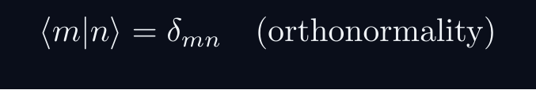
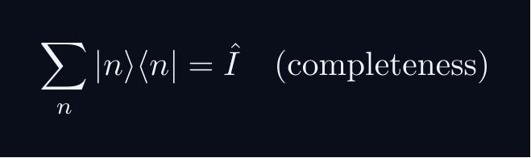
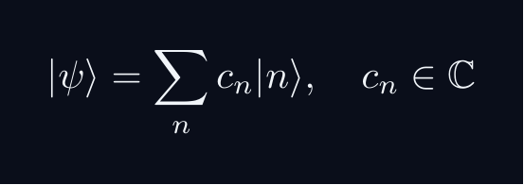
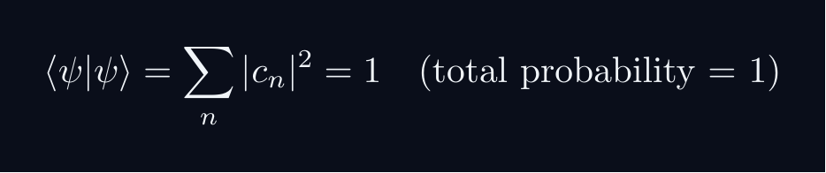


L08 — BegUG: Core Concepts
L08
Main ideas, key equations, and their meaning
CORE CONCEPTS & KEY RESULTS
This lecture covers Time Evolution & Pictures of Quantum Mechanics at the BegUG level.
HILBERT SPACE FORMALISM — DISCRETE BASIS
State vector |ψ⟩ in complex Hilbert space H.
EXPANSION AND COMPONENTS
Proof: ⟨ m|ψ⟩ = sum_n c_n ⟨ m|n⟩ = sum_n c_ndelta_{mn} = c_m
NORMALISATION AND PROBABILITIES
GLOBAL PHASE INVARIANCE
QM: L08 · BegUG
L08 · BegUG · Concepts

Slide 16
L08 — BegUG: Worked Example 1
L08
Step-by-step solved example with commentary
EXAMPLE 1: BegUG-A1
WORKED SOLUTION
Core problem for L08 (BegUG). Differentiate ⟨Â⟩ with time; simple Hamiltonians
FULL SOLUTION
HINTS
Apply the formula.
* Apply the definition
ADVANCED HINTS
* Verify result
QM: L08 · BegUG
L08 · BegUG · Example 1

Slide 17
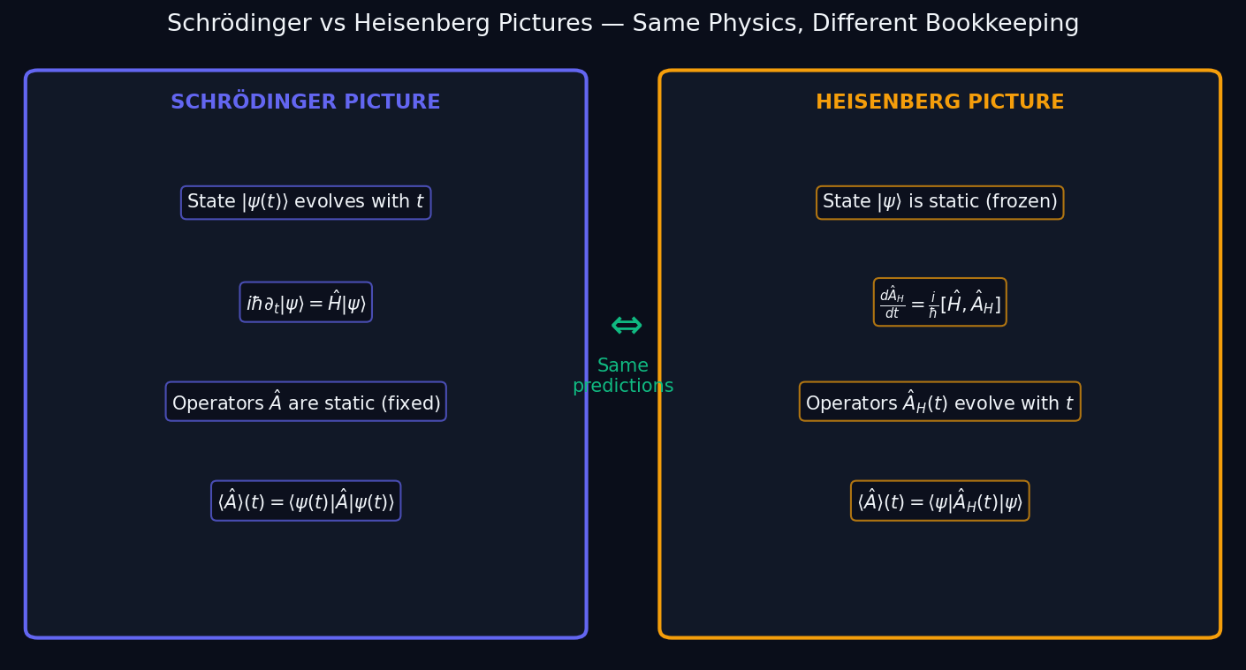
L08 — BegUG: Heisenberg Schrodinger
L08
Beginning Undergraduate — Time Evolution & Pictures of Quantum Mechanics
HEISENBERG SCHRODINGER
BegUG — HEISENBERG SCHRODINGER
This lecture covers Time Evolution & Pictures of Quantum Mechanics at the BegUG level.
GEOMETRIC INTERPRETATION
The diagram on the right shows the 2D/3D geometric analogy for this concept. Use it to build physical intuition before working through the formalism.
• Q1: BegUG question for L08.
• Q2: BegUG question for L08.
QM: L08 — BegUG · Heisenberg Schrodinger
L08 · BegUG

Slide 18
L08 — BegUG: Worked Example 2
L08
Second example — deeper or alternative approach
EXAMPLE 2: BegUG-A2
WORKED SOLUTION
Verification for L08 (BegUG).
FULL SOLUTION
HINTS
Follow the derivation.
* Use orthonormality
ADVANCED HINTS
* Check normalisation
QM: L08 · BegUG
L08 · BegUG · Example 2

Slide 19
L08 — BegUG: Concept Questions
L08
Think before computing — conceptual understanding checks
CONCEPT QUESTIONS
MORE QUESTIONS + GUIDANCE
1. Q1: BegUG question for L08.
2. Q2: BegUG question for L08.
3. Q3: BegUG question for L08.
1. Q4: BegUG question for L08.
2. Q5: BegUG question for L08.
─────
Work from the definition: write out the expansion, act with ⟨m| on the left, use δₘₙ.
For normalization: total probability must equal 1 — that is the…
QM: L08 · BegUG
L08 · BegUG · Concept Qs

Slide 20
L08 — BegUG: Problem Sets
L08
Simple problems (Set A) and advanced problems (Set B)
PROBLEM SET A — SIMPLE (2 problems)
PROBLEM SET B — ADVANCED (1 problems)
[BegUG-A1] Core problem for L08 (BegUG). Differentiate ⟨Â⟩ with time; simple Hamiltonians
Hint: Apply the definition
[BegUG-A2] Verification for L08 (BegUG).
Hint: Use orthonormality
[BegUG-B1] Proof exercise for L08 (BegUG).
Hint: Start from definition
Key idea: Check edge cases
QM: L08 · BegUG
L08 · BegUG · Problems

Slide 21
L08 — BegUG: References & Bibliography
L08
Historical, educational, and research-level reading
HISTORICAL (1)
EDUCATIONAL (2)
RESEARCH (1)
[1930] Dirac
"Principles of QM"
Oxford UP
↳ Primary source.
Sakurai (2021)
"Modern QM"
Cambridge UP
↳ Main text.
Cohen-Tannoudji (1977)
"QM Vol. 1"
Wiley
↳ Complements.
von Neumann (1932)
"Math. Grundlagen"
Springer
↳ Rigorous foundations.
QM: L08 · BegUG
L08 · BegUG · References

Slide 22
L08 — AdvUG: Advanced Undergraduate
L08
Tier introduction and learning context
WHAT THIS TIER COVERS
PREREQUISITES
This lecture covers Time Evolution & Pictures of Quantum Mechanics at the AdvUG level.
Builds on: Beginning Undergraduate
Required background:
Differentiate ⟨Â⟩ with time; simple Hamiltonians
WHAT THIS TIER UNLOCKS
KEY MESSAGE FOR THIS TIER
Unlocks access to: Master's Level
This tier equips you for:
Time-ordering; interaction picture preview
Heisenberg EOM; Ehrenfest's theorem
QM: L08 · AdvUG
L08 · AdvUG · Intro

Slide 23
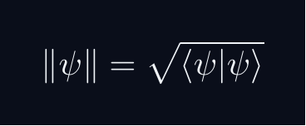
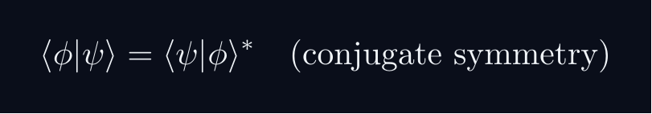


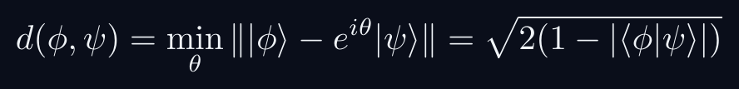
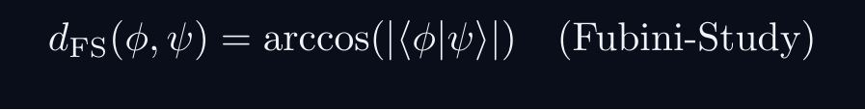
L08 — AdvUG: Core Concepts
L08
Main ideas, key equations, and their meaning
CORE CONCEPTS & KEY RESULTS
This lecture covers Time Evolution & Pictures of Quantum Mechanics at the AdvUG level.
INNER PRODUCT SPACE GEOMETRY
CAUCHY-SCHWARZ INEQUALITY
Proof: set f(lambda) = | |φ⟩ - lambda|ψ⟩ |^2 ≥ 0.
Choose lambda = ⟨ψ|φ⟩ / |ψ|^2 to minimise.
TRIANGLE INEQUALITY
Proof: square both sides; apply C-S to the cross term.
PHASE-INVARIANT DISTANCE
QM: L08 · AdvUG
L08 · AdvUG · Concepts

Slide 24
L08 — AdvUG: Worked Example 1
L08
Step-by-step solved example with commentary
EXAMPLE 1: AdvUG-A1
WORKED SOLUTION
Core problem for L08 (AdvUG). Heisenberg EOM; Ehrenfest's theorem
FULL SOLUTION
HINTS
Apply the formula.
* Apply the definition
ADVANCED HINTS
* Verify result
QM: L08 · AdvUG
L08 · AdvUG · Example 1

Slide 25
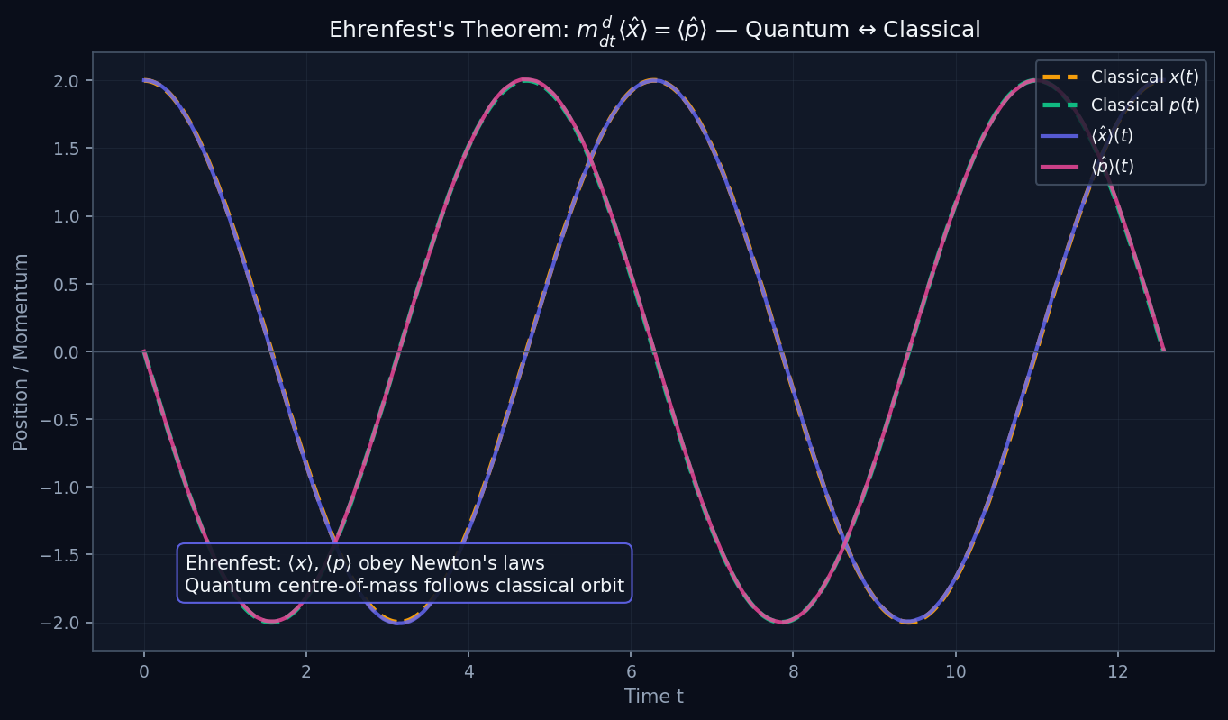
L08 — AdvUG: Ehrenfest
L08
Advanced Undergraduate — Time Evolution & Pictures of Quantum Mechanics
EHRENFEST
AdvUG — EHRENFEST
This lecture covers Time Evolution & Pictures of Quantum Mechanics at the AdvUG level.
GEOMETRIC INTERPRETATION
The diagram on the right shows the 2D/3D geometric analogy for this concept. Use it to build physical intuition before working through the formalism.
• Q1: AdvUG question for L08.
• Q2: AdvUG question for L08.
QM: L08 — AdvUG · Ehrenfest
L08 · AdvUG

Slide 26
L08 — AdvUG: Worked Example 2
L08
Second example — deeper or alternative approach
EXAMPLE 2: AdvUG-A2
WORKED SOLUTION
Verification for L08 (AdvUG).
FULL SOLUTION
HINTS
Follow the derivation.
* Use orthonormality
ADVANCED HINTS
* Check normalisation
QM: L08 · AdvUG
L08 · AdvUG · Example 2

Slide 27
L08 — AdvUG: Concept Questions
L08
Think before computing — conceptual understanding checks
CONCEPT QUESTIONS
MORE QUESTIONS + GUIDANCE
1. Q1: AdvUG question for L08.
2. Q2: AdvUG question for L08.
3. Q3: AdvUG question for L08.
1. Q4: AdvUG question for L08.
2. Q5: AdvUG question for L08.
─────
For C–S: the proof idea is to consider ‖|φ⟩ - λ|ψ⟩‖² ≥ 0 and choose the minimising λ.
For the geometry questions: draw a unit circle in ℂ²; overlap |…
QM: L08 · AdvUG
L08 · AdvUG · Concept Qs

Slide 28
L08 — AdvUG: Problem Sets
L08
Simple problems (Set A) and advanced problems (Set B)
PROBLEM SET A — SIMPLE (2 problems)
PROBLEM SET B — ADVANCED (1 problems)
[AdvUG-A1] Core problem for L08 (AdvUG). Heisenberg EOM; Ehrenfest's theorem
Hint: Apply the definition
[AdvUG-A2] Verification for L08 (AdvUG).
Hint: Use orthonormality
[AdvUG-B1] Proof exercise for L08 (AdvUG).
Hint: Start from definition
Key idea: Check edge cases
QM: L08 · AdvUG
L08 · AdvUG · Problems

Slide 29
L08 — AdvUG: References & Bibliography
L08
Historical, educational, and research-level reading
HISTORICAL (1)
EDUCATIONAL (2)
RESEARCH (1)
[1930] Dirac
"Principles of QM"
Oxford UP
↳ Primary source.
Sakurai (2021)
"Modern QM"
Cambridge UP
↳ Main text.
Cohen-Tannoudji (1977)
"QM Vol. 1"
Wiley
↳ Complements.
von Neumann (1932)
"Math. Grundlagen"
Springer
↳ Rigorous foundations.
QM: L08 · AdvUG
L08 · AdvUG · References

Slide 30
L08 — MSc: Master's Level
L08
Tier introduction and learning context
WHAT THIS TIER COVERS
PREREQUISITES
This lecture covers Time Evolution & Pictures of Quantum Mechanics at the MSc level.
Builds on: Advanced Undergraduate
Required background:
Heisenberg EOM; Ehrenfest's theorem
WHAT THIS TIER UNLOCKS
KEY MESSAGE FOR THIS TIER
Unlocks access to: PhD Level
This tier equips you for:
Stone's theorem; one-parameter unitary groups; domain issues
Time-ordering; interaction picture preview
QM: L08 · MSc
L08 · MSc · Intro

Slide 31
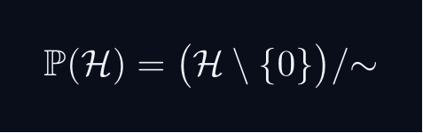
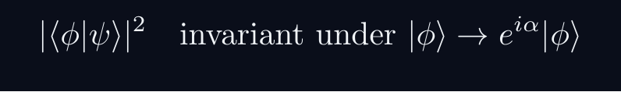

L08 — MSc: Core Concepts
L08
Main ideas, key equations, and their meaning
CORE CONCEPTS & KEY RESULTS
This lecture covers Time Evolution & Pictures of Quantum Mechanics at the MSc level.
PROJECTIVE HILBERT SPACE
Physical state space is P(H), not H itself.
A ray [ψ] is a one-dimensional complex subspace of H.
Example: P(C^2) cong S^2 — the Bloch sphere.
PHYSICALLY INVARIANT QUANTITIES
WIGNER'S THEOREM
Any bijection T:P(H)→P(H) preserving |⟨φ|ψ⟩|^2
is implemented by a UNITARY or ANTIUNITARY operator U on H.
Consequence: all quantum symmetries are (anti)unitary.
CONSEQUENCES
Symmetry group G acting on states gives projective representation of G.
Forces spin SO(3)→ SU(2), superselection rules, CPT symmetry.
QM: L08 · MSc
L08 · MSc · Concepts

Slide 32
L08 — MSc: Worked Example 1
L08
Step-by-step solved example with commentary
EXAMPLE 1: MSc-A1
WORKED SOLUTION
Core problem for L08 (MSc). Time-ordering; interaction picture preview
FULL SOLUTION
HINTS
Apply the formula.
* Apply the definition
ADVANCED HINTS
* Verify result
QM: L08 · MSc
L08 · MSc · Example 1

Slide 33
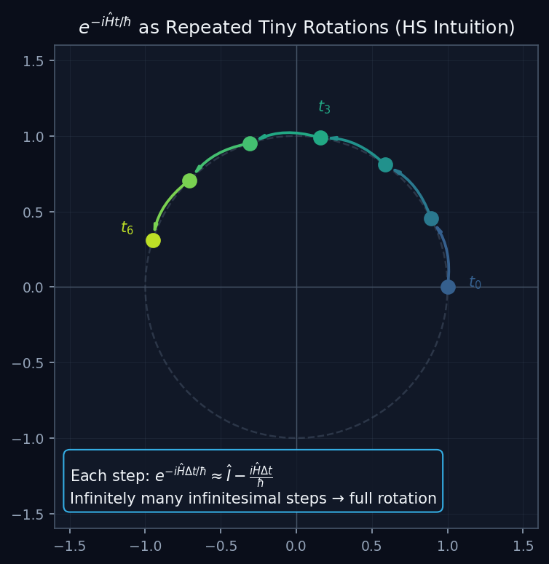
L08 — MSc: Exponential Steps
L08
Master's Level — Time Evolution & Pictures of Quantum Mechanics
EXPONENTIAL STEPS
MSc — EXPONENTIAL STEPS
This lecture covers Time Evolution & Pictures of Quantum Mechanics at the MSc level.
GEOMETRIC INTERPRETATION
The diagram on the right shows the 2D/3D geometric analogy for this concept. Use it to build physical intuition before working through the formalism.
• Q1: MSc question for L08.
• Q2: MSc question for L08.
QM: L08 — MSc · Exponential Steps
L08 · MSc

Slide 34
L08 — MSc: Worked Example 2
L08
Second example — deeper or alternative approach
EXAMPLE 2: MSc-A2
WORKED SOLUTION
Verification for L08 (MSc).
FULL SOLUTION
HINTS
Follow the derivation.
* Use orthonormality
ADVANCED HINTS
* Check normalisation
QM: L08 · MSc
L08 · MSc · Example 2

Slide 35
L08 — MSc: Concept Questions
L08
Think before computing — conceptual understanding checks
CONCEPT QUESTIONS
MORE QUESTIONS + GUIDANCE
1. Q1: MSc question for L08.
2. Q2: MSc question for L08.
3. Q3: MSc question for L08.
1. Q4: MSc question for L08.
2. Q5: MSc question for L08.
─────
For projective space: think of it as points on a sphere (for 2D), or more generally a complex manifold.
For Wigner: the key word is 'preserves transi…
QM: L08 · MSc
L08 · MSc · Concept Qs

Slide 36
L08 — MSc: Problem Sets
L08
Simple problems (Set A) and advanced problems (Set B)
PROBLEM SET A — SIMPLE (2 problems)
PROBLEM SET B — ADVANCED (1 problems)
[MSc-A1] Core problem for L08 (MSc). Time-ordering; interaction picture preview
Hint: Apply the definition
[MSc-A2] Verification for L08 (MSc).
Hint: Use orthonormality
[MSc-B1] Proof exercise for L08 (MSc).
Hint: Start from definition
Key idea: Check edge cases
QM: L08 · MSc
L08 · MSc · Problems

Slide 37
L08 — MSc: References & Bibliography
L08
Historical, educational, and research-level reading
HISTORICAL (1)
EDUCATIONAL (2)
RESEARCH (1)
[1930] Dirac
"Principles of QM"
Oxford UP
↳ Primary source.
Sakurai (2021)
"Modern QM"
Cambridge UP
↳ Main text.
Cohen-Tannoudji (1977)
"QM Vol. 1"
Wiley
↳ Complements.
von Neumann (1932)
"Math. Grundlagen"
Springer
↳ Rigorous foundations.
QM: L08 · MSc
L08 · MSc · References

Slide 38
L08 — PhD: PhD Level
L08
Tier introduction and learning context
WHAT THIS TIER COVERS
PREREQUISITES
This lecture covers Time Evolution & Pictures of Quantum Mechanics at the PhD level.
Builds on: Master's Level
Required background:
Time-ordering; interaction picture preview
WHAT THIS TIER UNLOCKS
KEY MESSAGE FOR THIS TIER
Frontier level: connects to active research
This tier equips you for:
Primary literature and open problems
Stone's theorem; one-parameter unitary groups; domain issues
QM: L08 · PhD
L08 · PhD · Intro

Slide 39

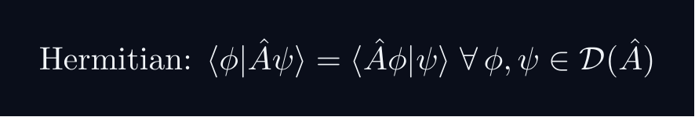
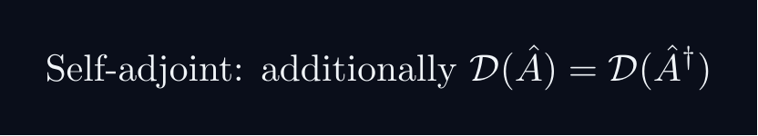
L08 — PhD: Core Concepts
L08
Main ideas, key equations, and their meaning
CORE CONCEPTS & KEY RESULTS
This lecture covers Time Evolution & Pictures of Quantum Mechanics at the PhD level.
HILBERT SPACE — PRECISE AXIOMS
Definition: a complex vector space H with ⟨cdot|cdot⟩ that is COMPLETE.
Completeness: every Cauchy sequence {ψ_n} converges in H.
Essential for: spectral theory, Fourier expansions, Stone's theorem.
SEPARABILITY
H separable ⟺ countable dense subset ⟺ countable ONB {e_n}.
All standard NRQM spaces: L^2(R^n), C^n, ell^2(N).
RAYS AS ONE-DIMENSIONAL SUBSPACES
P(H) is a Kahler manifold with Fubini-Study metric.
UNBOUNDED OPERATORS — DOMAIN SUBTLETY
Self-adjoint ≠ Hermitian for unbounded operators (x̂, p̂).
Spectral theorem and Stone's theorem REQUIRE self-adjointness.
QM: L08 · PhD
L08 · PhD · Concepts

Slide 40
L08 — PhD: Worked Example 1
L08
Step-by-step solved example with commentary
EXAMPLE 1: PhD-A1
WORKED SOLUTION
Core problem for L08 (PhD). Stone's theorem; one-parameter unitary groups; domain issues
FULL SOLUTION
HINTS
Apply the formula.
* Apply the definition
ADVANCED HINTS
* Verify result
QM: L08 · PhD
L08 · PhD · Example 1

Slide 41
L08 — PhD: Worked Example 2
L08
Second example — deeper or alternative approach
EXAMPLE 2: PhD-A2
WORKED SOLUTION
Verification for L08 (PhD).
FULL SOLUTION
HINTS
Follow the derivation.
* Use orthonormality
ADVANCED HINTS
* Check normalisation
QM: L08 · PhD
L08 · PhD · Example 2

Slide 42
L08 — PhD: Concept Questions
L08
Think before computing — conceptual understanding checks
CONCEPT QUESTIONS
MORE QUESTIONS + GUIDANCE
1. Q1: PhD question for L08.
2. Q2: PhD question for L08.
3. Q3: PhD question for L08.
1. Q4: PhD question for L08.
2. Q5: PhD question for L08.
─────
For completeness: construct Cauchy sequences that don't converge to a square-integrable function in a non-complete space.
For separability: construct…
QM: L08 · PhD
L08 · PhD · Concept Qs

Slide 43
L08 — PhD: Problem Sets
L08
Simple problems (Set A) and advanced problems (Set B)
PROBLEM SET A — SIMPLE (2 problems)
PROBLEM SET B — ADVANCED (1 problems)
[PhD-A1] Core problem for L08 (PhD). Stone's theorem; one-parameter unitary groups; domain issues
Hint: Apply the definition
[PhD-A2] Verification for L08 (PhD).
Hint: Use orthonormality
[PhD-B1] Proof exercise for L08 (PhD).
Hint: Start from definition
Key idea: Check edge cases
QM: L08 · PhD
L08 · PhD · Problems

Slide 44
L08 — PhD: References & Bibliography
L08
Historical, educational, and research-level reading
HISTORICAL (1)
EDUCATIONAL (2)
RESEARCH (1)
[1930] Dirac
"Principles of QM"
Oxford UP
↳ Primary source.
Sakurai (2021)
"Modern QM"
Cambridge UP
↳ Main text.
Cohen-Tannoudji (1977)
"QM Vol. 1"
Wiley
↳ Complements.
von Neumann (1932)
"Math. Grundlagen"
Springer
↳ Rigorous foundations.
QM: L08 · PhD
L08 · PhD · References

Slide 45
L08 — Common Pitfalls & Misconceptions
L08
Consolidated pitfalls across all tiers
⚠ PITFALLS (A)
⚠ PITFALLS (B)
• Forgetting sign: dÂ_H/dt = (i/ℏ)[Ĥ,Â_H], not [Â_H,Ĥ]
• Mixing Schrödinger and Heisenberg pictures in same equation
• Assuming e^{Â+B̂} = e^Â·e^{B̂} — only true if [Â,B̂]=0
HISTORICAL ANCHORS
FORMULA QUICK REFERENCE
• Schrödinger (1926) — wave equation, Schrödinger picture
• Heisenberg (1925) — matrix mechanics, Heisenberg picture
• Dirac (1927) — interaction picture; both pictures equivalent
Key formulas in this lecture:
time_evolution · unitary_exp · schrodinger_eq · heisenberg_eom · ehrenfest
See formula slides for full LaTeX-rendered versions.
QM: L08
L08 · Pitfalls

Slide 46
L08 — Homework & Project Summary
L08
Assessment overview across all tiers
HS
BegUG
AdvUG
MSc
PhD
Problems: 2 simple + 1 advanced
Project (simple, ~2-3h): HS Project
Project (advanced, ~8-10h): HS Advanced
Research (defined): Explain key result (HS).
Research (open): Open question (HS).
Problems: 2 simple + 1 advanced
Project (simple, ~2-3h): BegUG Project
Project (advanced, ~8-10h): BegUG Advanced
Research (defined): Explain key result (BegUG).
Research (open): Open question (BegUG).
Problems: 2 simple + 1 advanced
Project (simple, ~2-3h): AdvUG Project
Project (advanced, ~8-10h): AdvUG Advanced
Research (defined): Explain key result (AdvUG).
Research (open): Open question (AdvUG).
Problems: 2 simple + 1 advanced
Project (simple, ~2-3h): MSc Project
Project (advanced, ~8-10h): MSc Advanced
Research (defined): Explain key result (MSc).
Research (open): Open question (MSc).
Problems: 2 simple + 1 advanced
Project (simple, ~2-3h): PhD Project
Project (advanced, ~8-10h): PhD Advanced
Research (defined): Explain key result (PhD).
Research (open): Open question (PhD).
HOMEWORK ASSIGNMENT
REQUIRED (all students): Problems from your track's Set A
HONOURS (optional): Set B problems from your track
PROJECT: Choose simple OR advanced track from your tier
RESEARCH: At least one well-defined question; open questions for MSc/PhD
QM: L08
L08 · Homework

