Slide 1
L09
Deep Concept Slides
Tensor Products: Composite Systems & Entanglement
One slide per core concept · Full explanation · Geometric diagram
HS
BegUG
AdvUG
MSc
PhD
4 concept slides
QM: Bra-Ket — L09 Concepts
L09

Slide 2
HS
High School
1. Product Space Grid
QM: L09 — High School
L09

Slide 3
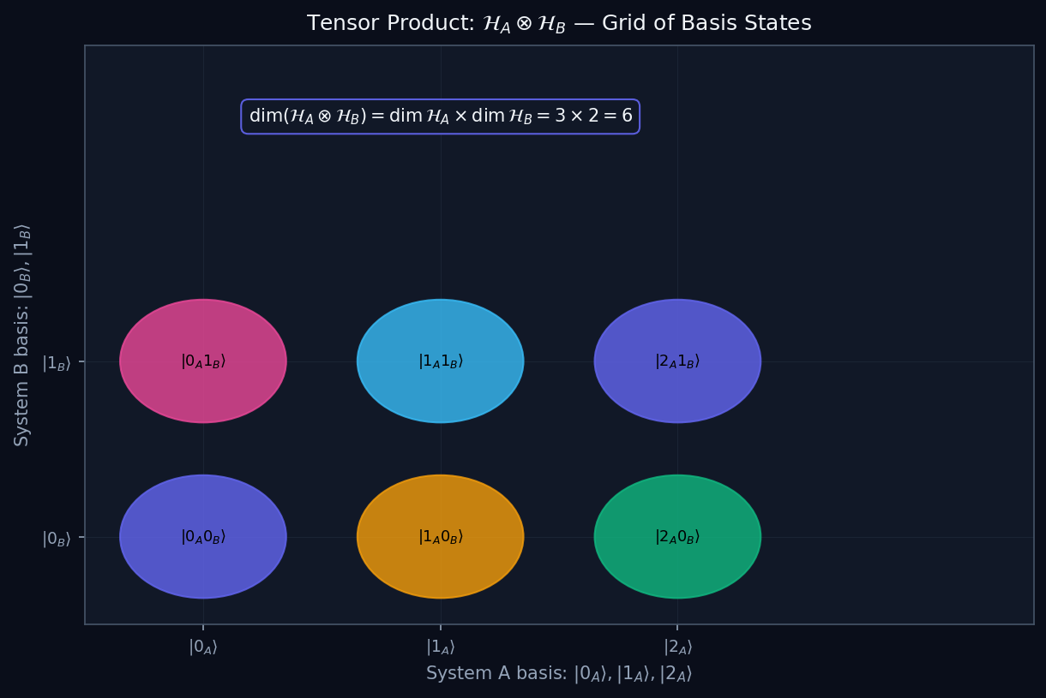
L09 — HS: Product Space Grid
L09
High School — Tensor Products: Composite Systems & Entanglement
PRODUCT SPACE GRID
HS — PRODUCT SPACE GRID
This lecture covers Tensor Products: Composite Systems & Entanglement at the HS level.
GEOMETRIC INTERPRETATION
The diagram on the right shows the 2D/3D geometric analogy for this concept. Use it to build physical intuition before working through the formalism.
• Q1: HS question for L09.
• Q2: HS question for L09.
QM: L09 — HS · Product Space Grid
L09 · HS

Slide 4
BegUG
Beginning Undergraduate
1. Entangled Vs Product
QM: L09 — Beginning Undergraduate
L09

Slide 5
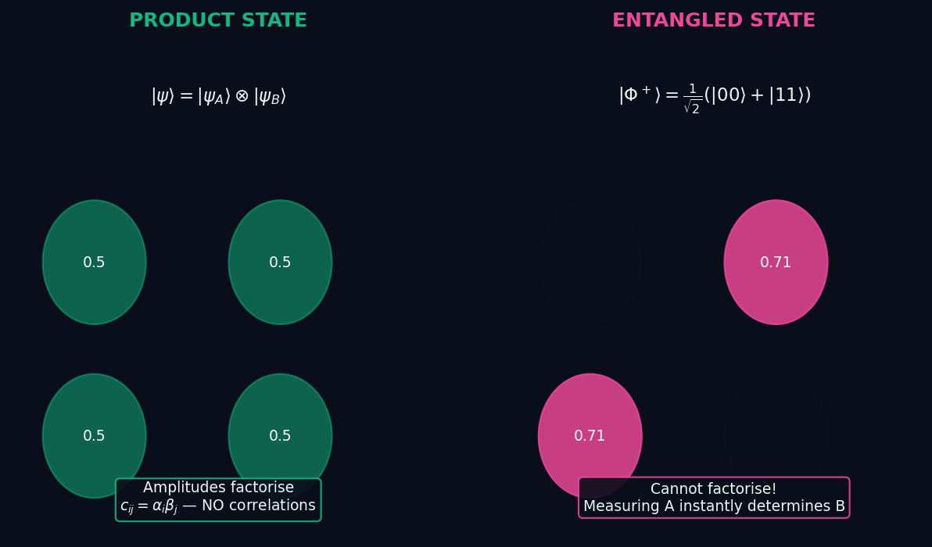
L09 — BegUG: Entangled Vs Product
L09
Beginning Undergraduate — Tensor Products: Composite Systems & Entanglement
ENTANGLED VS PRODUCT
BegUG — ENTANGLED VS PRODUCT
This lecture covers Tensor Products: Composite Systems & Entanglement at the BegUG level.
GEOMETRIC INTERPRETATION
The diagram on the right shows the 2D/3D geometric analogy for this concept. Use it to build physical intuition before working through the formalism.
• Q1: BegUG question for L09.
• Q2: BegUG question for L09.
QM: L09 — BegUG · Entangled Vs Product
L09 · BegUG

Slide 6
AdvUG
Advanced Undergraduate
1. Schmidt Decomp
QM: L09 — Advanced Undergraduate
L09

Slide 7
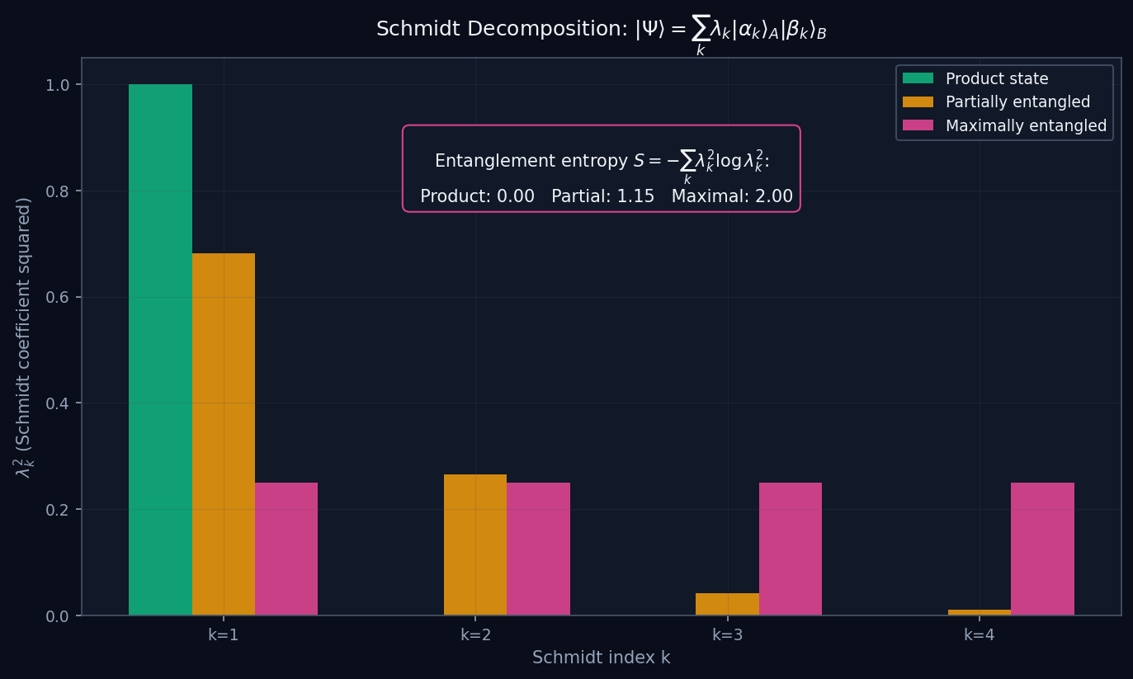
L09 — AdvUG: Schmidt Decomp
L09
Advanced Undergraduate — Tensor Products: Composite Systems & Entanglement
SCHMIDT DECOMP
AdvUG — SCHMIDT DECOMP
This lecture covers Tensor Products: Composite Systems & Entanglement at the AdvUG level.
GEOMETRIC INTERPRETATION
The diagram on the right shows the 2D/3D geometric analogy for this concept. Use it to build physical intuition before working through the formalism.
• Q1: AdvUG question for L09.
• Q2: AdvUG question for L09.
QM: L09 — AdvUG · Schmidt Decomp
L09 · AdvUG

Slide 8
MSc
Master's Level
1. Partial Trace
QM: L09 — Master's Level
L09

Slide 9
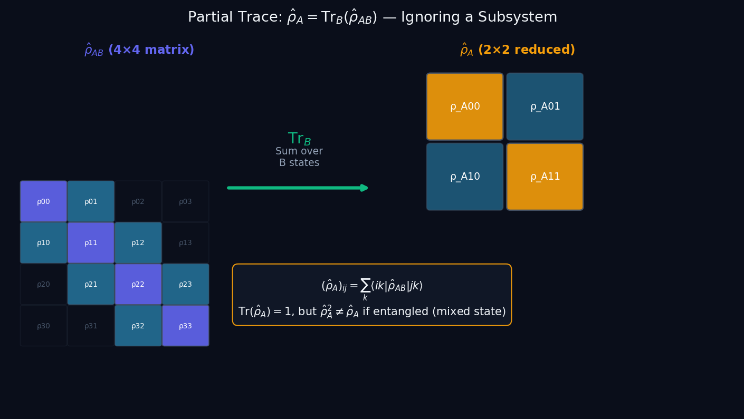
L09 — MSc: Partial Trace
L09
Master's Level — Tensor Products: Composite Systems & Entanglement
PARTIAL TRACE
MSc — PARTIAL TRACE
This lecture covers Tensor Products: Composite Systems & Entanglement at the MSc level.
GEOMETRIC INTERPRETATION
The diagram on the right shows the 2D/3D geometric analogy for this concept. Use it to build physical intuition before working through the formalism.
• Q1: MSc question for L09.
• Q2: MSc question for L09.
QM: L09 — MSc · Partial Trace
L09 · MSc

