Slide 1
Ψ
QUANTUM MECHANICS — BRA–KET NOTATION
L09
Tensor Products: Composite Systems & Entanglement
Product vs entangled states, Schmidt decomposition
HS
BegUG
AdvUG
MSc
PhD
Full expanded deck · 5 tiers · Worked examples · Complete problem sets
QM: Bra–Ket Notation — L09
L09

Slide 2
L09 — Lecture Overview
L09
Tensor Products: Composite Systems & Entanglement
90-MIN PACING
CORE LEARNING OUTCOMES
0–20 min: Tensor product space H_A ⊗ H_B
20–50 min: Product vs entangled states; operator action
50–75 min: Entanglement criterion; Schmidt decomposition
75–90 min: Partial measurement; reduced state preview
• Construct product states |i⟩_A ⊗ |j⟩_B and general bipartite states
• Identify entanglement by failure of coefficient factorization
• Apply Schmidt decomposition to find Schmidt rank
• Preview partial trace as reduced description of a subsystem
HS
BegUG
AdvUG
MSc
PhD
Two systems = bigger space — classical analogy & beyond
Compute product basis components; ⊗ of matrices
Schmidt decomposition (intro); maximally entangled states
Partial trace lightly; entanglement entropy preview
Entanglement measures, operational tasks, reading prompts
ASSESSMENT BUNDLE
Set A: Construct the 4-dim basis for two spin-1/2 particles · Show |Φ+⟩ = (1/√2)(|00⟩+|11⟩) is entangled
Set B: Find Schmidt decomposition of |Ψ⟩ = (|00⟩+|01⟩+|10⟩-|11⟩)/2 · Prove (⟨φ|⊗⟨χ|)(|ψ⟩⊗|η⟩) = ⟨φ|ψ⟩⟨χ|η⟩ from bilinearity
QM: L09
L09 · Overview

Slide 3

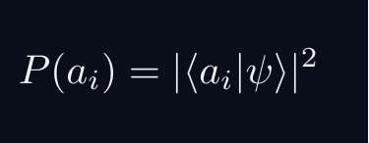


L09 — Sakurai Track
L09
Measurement-first, operational approach
SAKURAI: PREPARATION → STATISTICS → AMPLITUDES
BRIDGE TO DIRAC
SAKURAI: PREPARATION TO STATISTICS TO AMPLITUDES
• Preparation procedure ↔ ket |ψ⟩ (ray in ℋ)
• Measurement outcome aᵢ ↔ basis ket |aᵢ⟩
• Transition amplitude ↔ inner product ⟨aᵢ|ψ⟩
• Probability rule ↔ |⟨aᵢ|ψ⟩|²
• Total prob. = 1 ↔ ⟨ψ|ψ⟩ = 1
• Interference ↔ complex phase structure
STEP 1 — PREPARATION
A preparation is a reproducible laboratory protocol.
The same procedure always yields the same statistical predictions.
STEP 2 — MEASUREMENT OUTCOMES
A measurement device returns outcomes a_i with stable frequencies.
The state encodes probabilities, not definite property values.
STEP 3 — WHY AMPLITUDES?
Interference demands combining paths BEFORE squaring:
The cross-term is interference — real and measurable.
Only complex amplitudes can produce this cross-term.
STEP 4 — OPERATIONAL BORN RULE
GLOBAL PHASE IS UNOBSERVABLE
Physical states are RAYS not vectors.
QM: L09
L09 · Sakurai Track

Slide 4


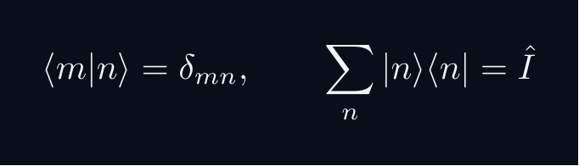
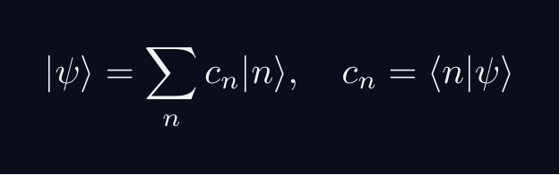


L09 — Dirac Track
L09
Abstract, representation-independent axioms
DIRAC: FIVE POSTULATES
DIRAC: FIVE POSTULATES OF QUANTUM MECHANICS
POSTULATE 1 — STATE SPACE
Every physical state is a ray in a complex Hilbert space H.
POSTULATE 2 — OBSERVABLES
Every observable A corresponds to a Hermitian operator A = A^†.
POSTULATE 3 — COMPLETENESS
POSTULATE 4 — BORN RULE
Post-measurement state (ideal projective): |ψ⟩ → |a⟩
POSTULATE 5 — DYNAMICS
QM: L09
L09 · Dirac Track

Slide 5
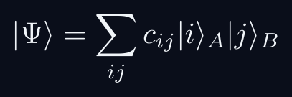

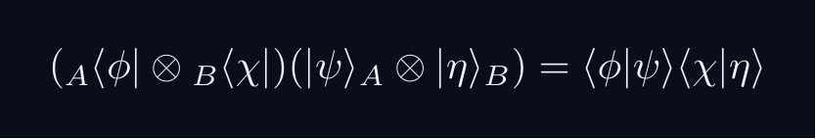
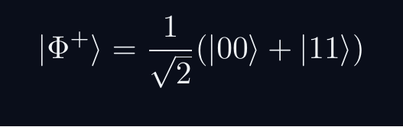
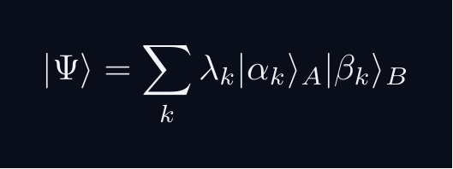
L09 — Key Formulas
L09
LaTeX-rendered formula reference
tensor product
product state
ip factorizes
bell state
schmidt
QM: L09
L09 · Formulas

Slide 6
L09 — HS: High School
L09
Tier introduction and learning context
WHAT THIS TIER COVERS
PREREQUISITES
This lecture covers Tensor Products: Composite Systems & Entanglement at the HS level.
Starting point: pre-university mathematics
Required: basic algebra and complex arithmetic
WHAT THIS TIER UNLOCKS
KEY MESSAGE FOR THIS TIER
Unlocks access to: Beginning Undergraduate
This tier equips you for:
Compute product basis components; ⊗ of matrices
Two systems = bigger space — classical analogy & beyond
QM: L09 · HS
L09 · HS · Intro

Slide 7
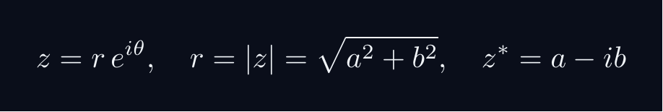
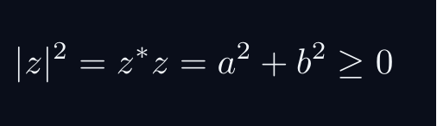
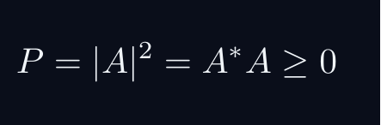

L09 — HS: Core Concepts
L09
Main ideas, key equations, and their meaning
CORE CONCEPTS & KEY RESULTS
This lecture covers Tensor Products: Composite Systems & Entanglement at the HS level.
COMPLEX NUMBERS AS ARROWS
A complex number z = a + ib lives in a 2D plane.
AMPLITUDE TO PROBABILITY (BORN RULE)
A quantum amplitude A is a complex number for a process.
Why squaring? Gives a real, non-negative number. Phase alone does not.
SUPERPOSITION = ARROW ADDITION = INTERFERENCE
Two paths: amplitudes A_1 and A_2. Total: A = A_1 + A_2.
Interference term can be positive (constructive) or negative (destructive).
WORKED FORMULA: PHASE DEPENDENCE
Let A_1 = 1, A_2 = e^{iφ} (unit magnitude, phase φ).
Maximum P=4 at φ=0 (constructive). Minimum P=0 at φ=pi (destructive).
QM: L09 · HS
L09 · HS · Concepts

Slide 8
L09 — HS: Worked Example 1
L09
Step-by-step solved example with commentary
EXAMPLE 1: HS-A1
WORKED SOLUTION
Core problem for L09 (HS). Two systems = bigger space — classical analogy & beyond
FULL SOLUTION
HINTS
Apply the formula.
* Apply the definition
ADVANCED HINTS
* Verify result
QM: L09 · HS
L09 · HS · Example 1

Slide 9
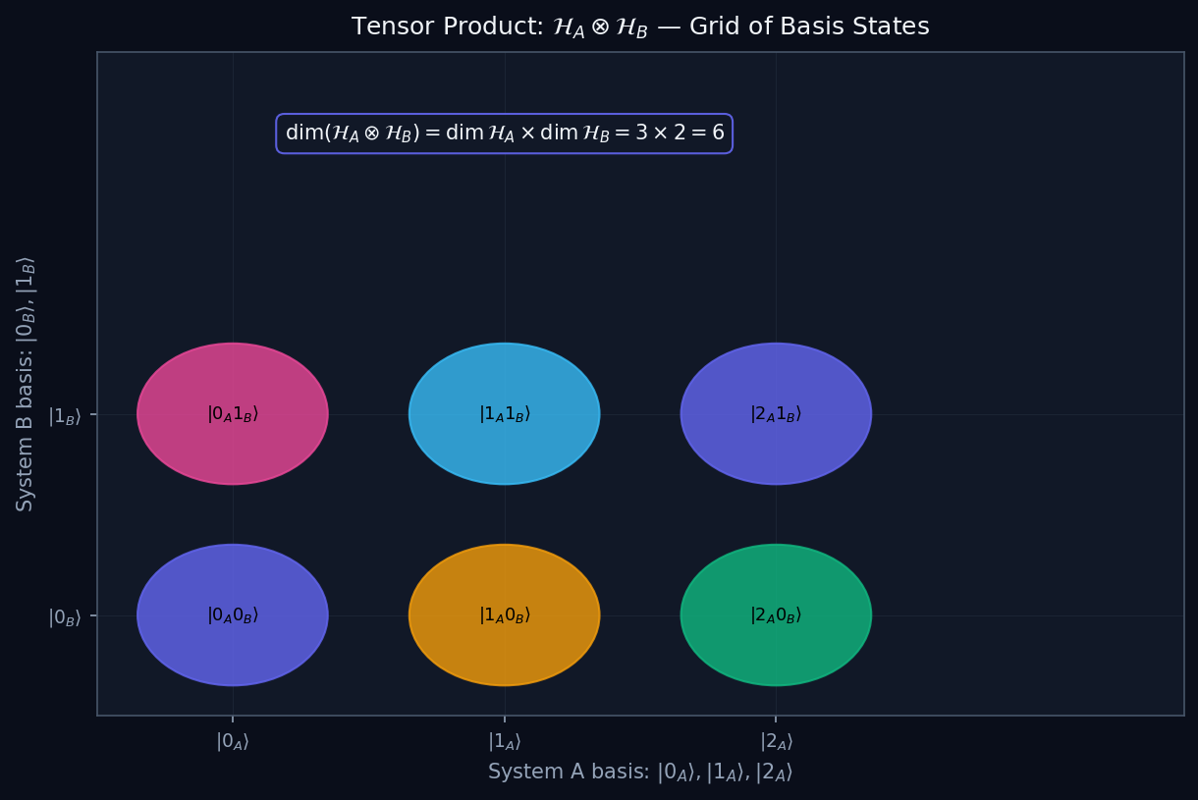
L09 — HS: Product Space Grid
L09
High School — Tensor Products: Composite Systems & Entanglement
PRODUCT SPACE GRID
HS — PRODUCT SPACE GRID
This lecture covers Tensor Products: Composite Systems & Entanglement at the HS level.
GEOMETRIC INTERPRETATION
The diagram on the right shows the 2D/3D geometric analogy for this concept. Use it to build physical intuition before working through the formalism.
• Q1: HS question for L09.
• Q2: HS question for L09.
QM: L09 — HS · Product Space Grid
L09 · HS

Slide 10
L09 — HS: Worked Example 2
L09
Second example — deeper or alternative approach
EXAMPLE 2: HS-A2
WORKED SOLUTION
Verification for L09 (HS).
FULL SOLUTION
HINTS
Follow the derivation.
* Use orthonormality
ADVANCED HINTS
* Check normalisation
QM: L09 · HS
L09 · HS · Example 2

Slide 11
L09 — HS: Concept Questions
L09
Think before computing — conceptual understanding checks
CONCEPT QUESTIONS
MORE QUESTIONS + GUIDANCE
1. Q1: HS question for L09.
2. Q2: HS question for L09.
3. Q3: HS question for L09.
1. Q4: HS question for L09.
2. Q5: HS question for L09.
─────
These questions have no calculation — think about what probability MEANS.
Key insight: squaring is the minimal operation that gives a non-negative re…
QM: L09 · HS
L09 · HS · Concept Qs

Slide 12
L09 — HS: Problem Sets
L09
Simple problems (Set A) and advanced problems (Set B)
PROBLEM SET A — SIMPLE (2 problems)
PROBLEM SET B — ADVANCED (1 problems)
[HS-A1] Core problem for L09 (HS). Two systems = bigger space — classical analogy & beyond
Hint: Apply the definition
[HS-A2] Verification for L09 (HS).
Hint: Use orthonormality
[HS-B1] Proof exercise for L09 (HS).
Hint: Start from definition
Key idea: Check edge cases
QM: L09 · HS
L09 · HS · Problems

Slide 13
L09 — HS: References & Bibliography
L09
Historical, educational, and research-level reading
HISTORICAL (1)
EDUCATIONAL (2)
RESEARCH (1)
[1930] Dirac
"Principles of QM"
Oxford UP
↳ Primary source.
Sakurai (2021)
"Modern QM"
Cambridge UP
↳ Main text.
Cohen-Tannoudji (1977)
"QM Vol. 1"
Wiley
↳ Complements.
von Neumann (1932)
"Math. Grundlagen"
Springer
↳ Rigorous foundations.
QM: L09 · HS
L09 · HS · References

Slide 14
L09 — BegUG: Beginning Undergraduate
L09
Tier introduction and learning context
WHAT THIS TIER COVERS
PREREQUISITES
This lecture covers Tensor Products: Composite Systems & Entanglement at the BegUG level.
Builds on: High School
Required background:
Two systems = bigger space — classical analogy & beyond
WHAT THIS TIER UNLOCKS
KEY MESSAGE FOR THIS TIER
Unlocks access to: Advanced Undergraduate
This tier equips you for:
Schmidt decomposition (intro); maximally entangled states
Compute product basis components; ⊗ of matrices
QM: L09 · BegUG
L09 · BegUG · Intro

Slide 15

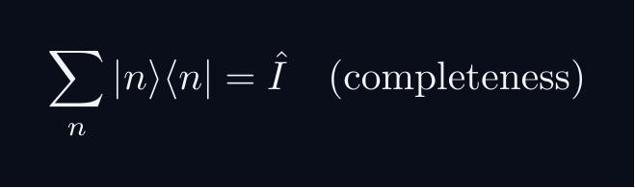
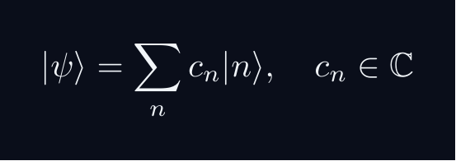
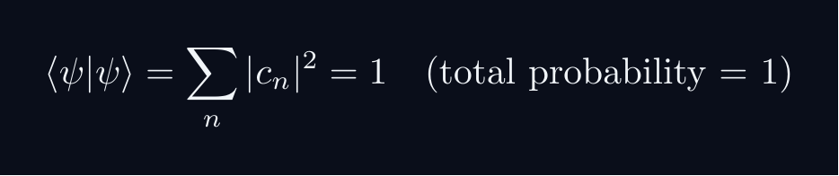


L09 — BegUG: Core Concepts
L09
Main ideas, key equations, and their meaning
CORE CONCEPTS & KEY RESULTS
This lecture covers Tensor Products: Composite Systems & Entanglement at the BegUG level.
HILBERT SPACE FORMALISM — DISCRETE BASIS
State vector |ψ⟩ in complex Hilbert space H.
EXPANSION AND COMPONENTS
Proof: ⟨ m|ψ⟩ = sum_n c_n ⟨ m|n⟩ = sum_n c_ndelta_{mn} = c_m
NORMALISATION AND PROBABILITIES
GLOBAL PHASE INVARIANCE
QM: L09 · BegUG
L09 · BegUG · Concepts

Slide 16
L09 — BegUG: Worked Example 1
L09
Step-by-step solved example with commentary
EXAMPLE 1: BegUG-A1
WORKED SOLUTION
Core problem for L09 (BegUG). Compute product basis components; ⊗ of matrices
FULL SOLUTION
HINTS
Apply the formula.
* Apply the definition
ADVANCED HINTS
* Verify result
QM: L09 · BegUG
L09 · BegUG · Example 1

Slide 17
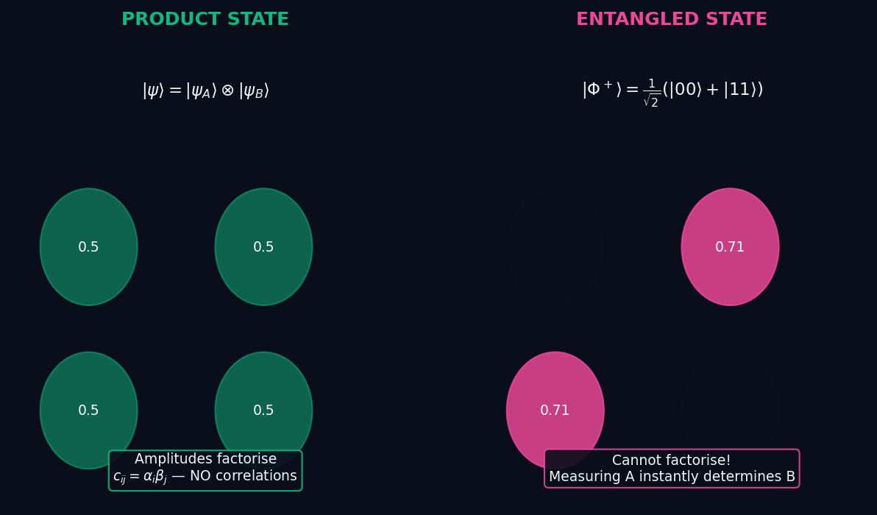
L09 — BegUG: Entangled Vs Product
L09
Beginning Undergraduate — Tensor Products: Composite Systems & Entanglement
ENTANGLED VS PRODUCT
BegUG — ENTANGLED VS PRODUCT
This lecture covers Tensor Products: Composite Systems & Entanglement at the BegUG level.
GEOMETRIC INTERPRETATION
The diagram on the right shows the 2D/3D geometric analogy for this concept. Use it to build physical intuition before working through the formalism.
• Q1: BegUG question for L09.
• Q2: BegUG question for L09.
QM: L09 — BegUG · Entangled Vs Product
L09 · BegUG

Slide 18
L09 — BegUG: Worked Example 2
L09
Second example — deeper or alternative approach
EXAMPLE 2: BegUG-A2
WORKED SOLUTION
Verification for L09 (BegUG).
FULL SOLUTION
HINTS
Follow the derivation.
* Use orthonormality
ADVANCED HINTS
* Check normalisation
QM: L09 · BegUG
L09 · BegUG · Example 2

Slide 19
L09 — BegUG: Concept Questions
L09
Think before computing — conceptual understanding checks
CONCEPT QUESTIONS
MORE QUESTIONS + GUIDANCE
1. Q1: BegUG question for L09.
2. Q2: BegUG question for L09.
3. Q3: BegUG question for L09.
1. Q4: BegUG question for L09.
2. Q5: BegUG question for L09.
─────
Work from the definition: write out the expansion, act with ⟨m| on the left, use δₘₙ.
For normalization: total probability must equal 1 — that is the…
QM: L09 · BegUG
L09 · BegUG · Concept Qs

Slide 20
L09 — BegUG: Problem Sets
L09
Simple problems (Set A) and advanced problems (Set B)
PROBLEM SET A — SIMPLE (2 problems)
PROBLEM SET B — ADVANCED (1 problems)
[BegUG-A1] Core problem for L09 (BegUG). Compute product basis components; ⊗ of matrices
Hint: Apply the definition
[BegUG-A2] Verification for L09 (BegUG).
Hint: Use orthonormality
[BegUG-B1] Proof exercise for L09 (BegUG).
Hint: Start from definition
Key idea: Check edge cases
QM: L09 · BegUG
L09 · BegUG · Problems

Slide 21
L09 — BegUG: References & Bibliography
L09
Historical, educational, and research-level reading
HISTORICAL (1)
EDUCATIONAL (2)
RESEARCH (1)
[1930] Dirac
"Principles of QM"
Oxford UP
↳ Primary source.
Sakurai (2021)
"Modern QM"
Cambridge UP
↳ Main text.
Cohen-Tannoudji (1977)
"QM Vol. 1"
Wiley
↳ Complements.
von Neumann (1932)
"Math. Grundlagen"
Springer
↳ Rigorous foundations.
QM: L09 · BegUG
L09 · BegUG · References

Slide 22
L09 — AdvUG: Advanced Undergraduate
L09
Tier introduction and learning context
WHAT THIS TIER COVERS
PREREQUISITES
This lecture covers Tensor Products: Composite Systems & Entanglement at the AdvUG level.
Builds on: Beginning Undergraduate
Required background:
Compute product basis components; ⊗ of matrices
WHAT THIS TIER UNLOCKS
KEY MESSAGE FOR THIS TIER
Unlocks access to: Master's Level
This tier equips you for:
Partial trace lightly; entanglement entropy preview
Schmidt decomposition (intro); maximally entangled states
QM: L09 · AdvUG
L09 · AdvUG · Intro

Slide 23
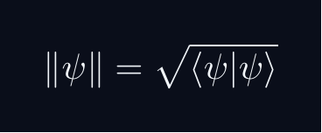
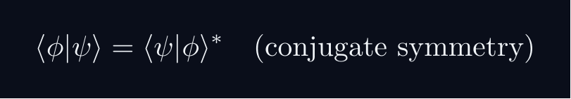


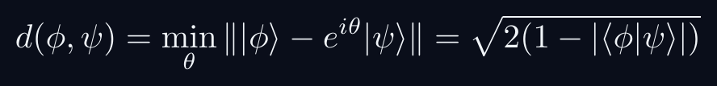
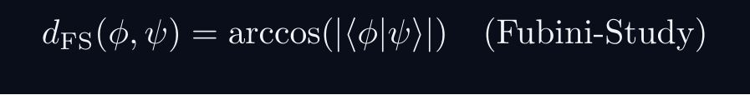
L09 — AdvUG: Core Concepts
L09
Main ideas, key equations, and their meaning
CORE CONCEPTS & KEY RESULTS
This lecture covers Tensor Products: Composite Systems & Entanglement at the AdvUG level.
INNER PRODUCT SPACE GEOMETRY
CAUCHY-SCHWARZ INEQUALITY
Proof: set f(lambda) = | |φ⟩ - lambda|ψ⟩ |^2 ≥ 0.
Choose lambda = ⟨ψ|φ⟩ / |ψ|^2 to minimise.
TRIANGLE INEQUALITY
Proof: square both sides; apply C-S to the cross term.
PHASE-INVARIANT DISTANCE
QM: L09 · AdvUG
L09 · AdvUG · Concepts

Slide 24
L09 — AdvUG: Worked Example 1
L09
Step-by-step solved example with commentary
EXAMPLE 1: AdvUG-A1
WORKED SOLUTION
Core problem for L09 (AdvUG). Schmidt decomposition (intro); maximally entangled states
FULL SOLUTION
HINTS
Apply the formula.
* Apply the definition
ADVANCED HINTS
* Verify result
QM: L09 · AdvUG
L09 · AdvUG · Example 1

Slide 25
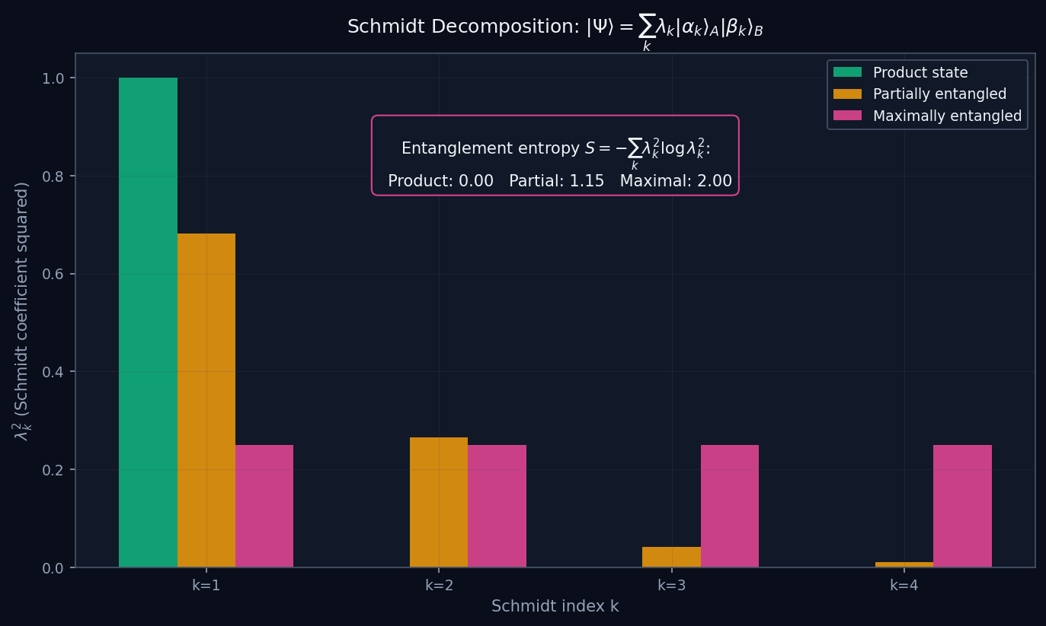
L09 — AdvUG: Schmidt Decomp
L09
Advanced Undergraduate — Tensor Products: Composite Systems & Entanglement
SCHMIDT DECOMP
AdvUG — SCHMIDT DECOMP
This lecture covers Tensor Products: Composite Systems & Entanglement at the AdvUG level.
GEOMETRIC INTERPRETATION
The diagram on the right shows the 2D/3D geometric analogy for this concept. Use it to build physical intuition before working through the formalism.
• Q1: AdvUG question for L09.
• Q2: AdvUG question for L09.
QM: L09 — AdvUG · Schmidt Decomp
L09 · AdvUG

Slide 26
L09 — AdvUG: Worked Example 2
L09
Second example — deeper or alternative approach
EXAMPLE 2: AdvUG-A2
WORKED SOLUTION
Verification for L09 (AdvUG).
FULL SOLUTION
HINTS
Follow the derivation.
* Use orthonormality
ADVANCED HINTS
* Check normalisation
QM: L09 · AdvUG
L09 · AdvUG · Example 2

Slide 27
L09 — AdvUG: Concept Questions
L09
Think before computing — conceptual understanding checks
CONCEPT QUESTIONS
MORE QUESTIONS + GUIDANCE
1. Q1: AdvUG question for L09.
2. Q2: AdvUG question for L09.
3. Q3: AdvUG question for L09.
1. Q4: AdvUG question for L09.
2. Q5: AdvUG question for L09.
─────
For C–S: the proof idea is to consider ‖|φ⟩ - λ|ψ⟩‖² ≥ 0 and choose the minimising λ.
For the geometry questions: draw a unit circle in ℂ²; overlap |…
QM: L09 · AdvUG
L09 · AdvUG · Concept Qs

Slide 28
L09 — AdvUG: Problem Sets
L09
Simple problems (Set A) and advanced problems (Set B)
PROBLEM SET A — SIMPLE (2 problems)
PROBLEM SET B — ADVANCED (1 problems)
[AdvUG-A1] Core problem for L09 (AdvUG). Schmidt decomposition (intro); maximally entangled states
Hint: Apply the definition
[AdvUG-A2] Verification for L09 (AdvUG).
Hint: Use orthonormality
[AdvUG-B1] Proof exercise for L09 (AdvUG).
Hint: Start from definition
Key idea: Check edge cases
QM: L09 · AdvUG
L09 · AdvUG · Problems

Slide 29
L09 — AdvUG: References & Bibliography
L09
Historical, educational, and research-level reading
HISTORICAL (1)
EDUCATIONAL (2)
RESEARCH (1)
[1930] Dirac
"Principles of QM"
Oxford UP
↳ Primary source.
Sakurai (2021)
"Modern QM"
Cambridge UP
↳ Main text.
Cohen-Tannoudji (1977)
"QM Vol. 1"
Wiley
↳ Complements.
von Neumann (1932)
"Math. Grundlagen"
Springer
↳ Rigorous foundations.
QM: L09 · AdvUG
L09 · AdvUG · References

Slide 30
L09 — MSc: Master's Level
L09
Tier introduction and learning context
WHAT THIS TIER COVERS
PREREQUISITES
This lecture covers Tensor Products: Composite Systems & Entanglement at the MSc level.
Builds on: Advanced Undergraduate
Required background:
Schmidt decomposition (intro); maximally entangled states
WHAT THIS TIER UNLOCKS
KEY MESSAGE FOR THIS TIER
Unlocks access to: PhD Level
This tier equips you for:
Entanglement measures, operational tasks, reading prompts
Partial trace lightly; entanglement entropy preview
QM: L09 · MSc
L09 · MSc · Intro

Slide 31

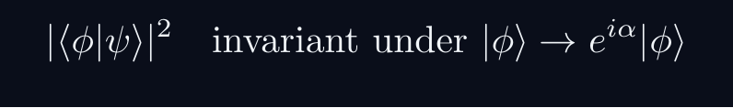

L09 — MSc: Core Concepts
L09
Main ideas, key equations, and their meaning
CORE CONCEPTS & KEY RESULTS
This lecture covers Tensor Products: Composite Systems & Entanglement at the MSc level.
PROJECTIVE HILBERT SPACE
Physical state space is P(H), not H itself.
A ray [ψ] is a one-dimensional complex subspace of H.
Example: P(C^2) cong S^2 — the Bloch sphere.
PHYSICALLY INVARIANT QUANTITIES
WIGNER'S THEOREM
Any bijection T:P(H)→P(H) preserving |⟨φ|ψ⟩|^2
is implemented by a UNITARY or ANTIUNITARY operator U on H.
Consequence: all quantum symmetries are (anti)unitary.
CONSEQUENCES
Symmetry group G acting on states gives projective representation of G.
Forces spin SO(3)→ SU(2), superselection rules, CPT symmetry.
QM: L09 · MSc
L09 · MSc · Concepts

Slide 32
L09 — MSc: Worked Example 1
L09
Step-by-step solved example with commentary
EXAMPLE 1: MSc-A1
WORKED SOLUTION
Core problem for L09 (MSc). Partial trace lightly; entanglement entropy preview
FULL SOLUTION
HINTS
Apply the formula.
* Apply the definition
ADVANCED HINTS
* Verify result
QM: L09 · MSc
L09 · MSc · Example 1

Slide 33
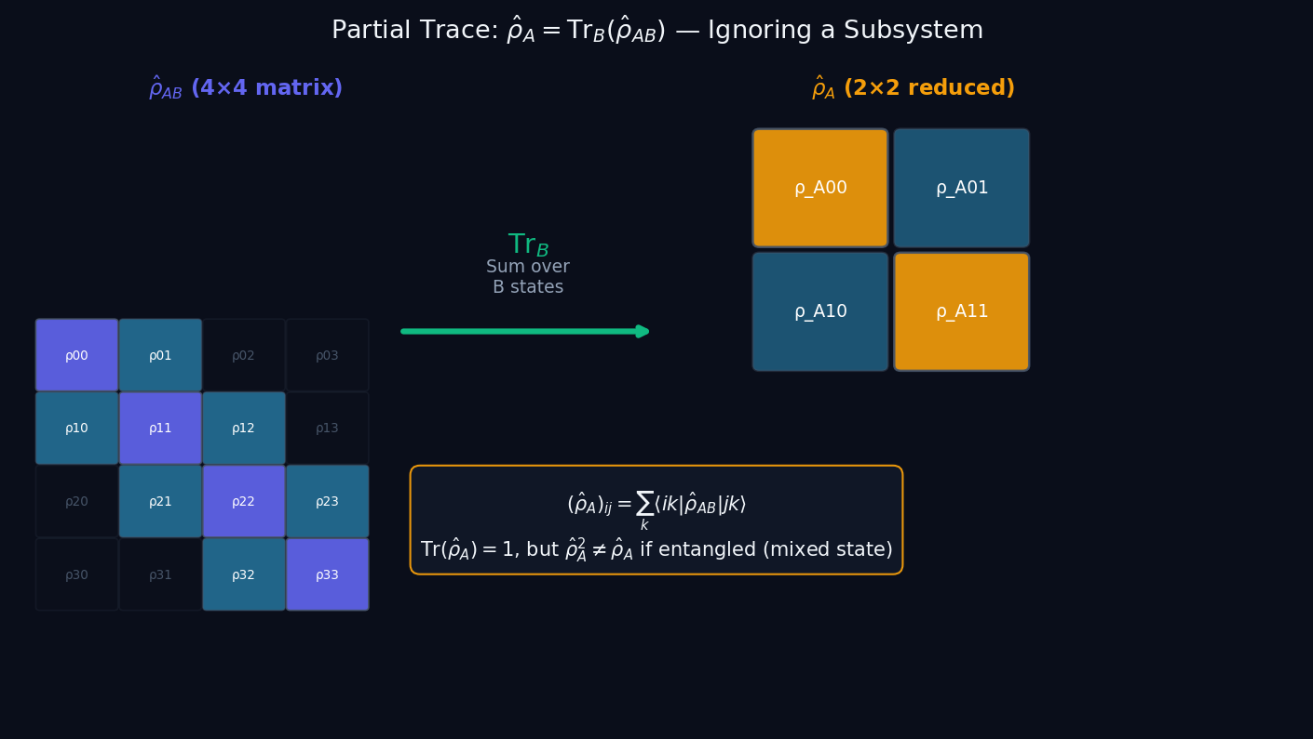
L09 — MSc: Partial Trace
L09
Master's Level — Tensor Products: Composite Systems & Entanglement
PARTIAL TRACE
MSc — PARTIAL TRACE
This lecture covers Tensor Products: Composite Systems & Entanglement at the MSc level.
GEOMETRIC INTERPRETATION
The diagram on the right shows the 2D/3D geometric analogy for this concept. Use it to build physical intuition before working through the formalism.
• Q1: MSc question for L09.
• Q2: MSc question for L09.
QM: L09 — MSc · Partial Trace
L09 · MSc

Slide 34
L09 — MSc: Worked Example 2
L09
Second example — deeper or alternative approach
EXAMPLE 2: MSc-A2
WORKED SOLUTION
Verification for L09 (MSc).
FULL SOLUTION
HINTS
Follow the derivation.
* Use orthonormality
ADVANCED HINTS
* Check normalisation
QM: L09 · MSc
L09 · MSc · Example 2

Slide 35
L09 — MSc: Concept Questions
L09
Think before computing — conceptual understanding checks
CONCEPT QUESTIONS
MORE QUESTIONS + GUIDANCE
1. Q1: MSc question for L09.
2. Q2: MSc question for L09.
3. Q3: MSc question for L09.
1. Q4: MSc question for L09.
2. Q5: MSc question for L09.
─────
For projective space: think of it as points on a sphere (for 2D), or more generally a complex manifold.
For Wigner: the key word is 'preserves transi…
QM: L09 · MSc
L09 · MSc · Concept Qs

Slide 36
L09 — MSc: Problem Sets
L09
Simple problems (Set A) and advanced problems (Set B)
PROBLEM SET A — SIMPLE (2 problems)
PROBLEM SET B — ADVANCED (1 problems)
[MSc-A1] Core problem for L09 (MSc). Partial trace lightly; entanglement entropy preview
Hint: Apply the definition
[MSc-A2] Verification for L09 (MSc).
Hint: Use orthonormality
[MSc-B1] Proof exercise for L09 (MSc).
Hint: Start from definition
Key idea: Check edge cases
QM: L09 · MSc
L09 · MSc · Problems

Slide 37
L09 — MSc: References & Bibliography
L09
Historical, educational, and research-level reading
HISTORICAL (1)
EDUCATIONAL (2)
RESEARCH (1)
[1930] Dirac
"Principles of QM"
Oxford UP
↳ Primary source.
Sakurai (2021)
"Modern QM"
Cambridge UP
↳ Main text.
Cohen-Tannoudji (1977)
"QM Vol. 1"
Wiley
↳ Complements.
von Neumann (1932)
"Math. Grundlagen"
Springer
↳ Rigorous foundations.
QM: L09 · MSc
L09 · MSc · References

Slide 38
L09 — PhD: PhD Level
L09
Tier introduction and learning context
WHAT THIS TIER COVERS
PREREQUISITES
This lecture covers Tensor Products: Composite Systems & Entanglement at the PhD level.
Builds on: Master's Level
Required background:
Partial trace lightly; entanglement entropy preview
WHAT THIS TIER UNLOCKS
KEY MESSAGE FOR THIS TIER
Frontier level: connects to active research
This tier equips you for:
Primary literature and open problems
Entanglement measures, operational tasks, reading prompts
QM: L09 · PhD
L09 · PhD · Intro

Slide 39



L09 — PhD: Core Concepts
L09
Main ideas, key equations, and their meaning
CORE CONCEPTS & KEY RESULTS
This lecture covers Tensor Products: Composite Systems & Entanglement at the PhD level.
HILBERT SPACE — PRECISE AXIOMS
Definition: a complex vector space H with ⟨cdot|cdot⟩ that is COMPLETE.
Completeness: every Cauchy sequence {ψ_n} converges in H.
Essential for: spectral theory, Fourier expansions, Stone's theorem.
SEPARABILITY
H separable ⟺ countable dense subset ⟺ countable ONB {e_n}.
All standard NRQM spaces: L^2(R^n), C^n, ell^2(N).
RAYS AS ONE-DIMENSIONAL SUBSPACES
P(H) is a Kahler manifold with Fubini-Study metric.
UNBOUNDED OPERATORS — DOMAIN SUBTLETY
Self-adjoint ≠ Hermitian for unbounded operators (x̂, p̂).
Spectral theorem and Stone's theorem REQUIRE self-adjointness.
QM: L09 · PhD
L09 · PhD · Concepts

Slide 40
L09 — PhD: Worked Example 1
L09
Step-by-step solved example with commentary
EXAMPLE 1: PhD-A1
WORKED SOLUTION
Core problem for L09 (PhD). Entanglement measures, operational tasks, reading prompts
FULL SOLUTION
HINTS
Apply the formula.
* Apply the definition
ADVANCED HINTS
* Verify result
QM: L09 · PhD
L09 · PhD · Example 1

Slide 41
L09 — PhD: Worked Example 2
L09
Second example — deeper or alternative approach
EXAMPLE 2: PhD-A2
WORKED SOLUTION
Verification for L09 (PhD).
FULL SOLUTION
HINTS
Follow the derivation.
* Use orthonormality
ADVANCED HINTS
* Check normalisation
QM: L09 · PhD
L09 · PhD · Example 2

Slide 42
L09 — PhD: Concept Questions
L09
Think before computing — conceptual understanding checks
CONCEPT QUESTIONS
MORE QUESTIONS + GUIDANCE
1. Q1: PhD question for L09.
2. Q2: PhD question for L09.
3. Q3: PhD question for L09.
1. Q4: PhD question for L09.
2. Q5: PhD question for L09.
─────
For completeness: construct Cauchy sequences that don't converge to a square-integrable function in a non-complete space.
For separability: construct…
QM: L09 · PhD
L09 · PhD · Concept Qs

Slide 43
L09 — PhD: Problem Sets
L09
Simple problems (Set A) and advanced problems (Set B)
PROBLEM SET A — SIMPLE (2 problems)
PROBLEM SET B — ADVANCED (1 problems)
[PhD-A1] Core problem for L09 (PhD). Entanglement measures, operational tasks, reading prompts
Hint: Apply the definition
[PhD-A2] Verification for L09 (PhD).
Hint: Use orthonormality
[PhD-B1] Proof exercise for L09 (PhD).
Hint: Start from definition
Key idea: Check edge cases
QM: L09 · PhD
L09 · PhD · Problems

Slide 44
L09 — PhD: References & Bibliography
L09
Historical, educational, and research-level reading
HISTORICAL (1)
EDUCATIONAL (2)
RESEARCH (1)
[1930] Dirac
"Principles of QM"
Oxford UP
↳ Primary source.
Sakurai (2021)
"Modern QM"
Cambridge UP
↳ Main text.
Cohen-Tannoudji (1977)
"QM Vol. 1"
Wiley
↳ Complements.
von Neumann (1932)
"Math. Grundlagen"
Springer
↳ Rigorous foundations.
QM: L09 · PhD
L09 · PhD · References

Slide 45
L09 — Common Pitfalls & Misconceptions
L09
Consolidated pitfalls across all tiers
⚠ PITFALLS (A)
⚠ PITFALLS (B)
• Assuming all bipartite states are product states
• Forgetting that dim(H_A ⊗ H_B) = dim(H_A) × dim(H_B)
• Confusing Schmidt rank 1 (separable) with full Schmidt decomposition
HISTORICAL ANCHORS
FORMULA QUICK REFERENCE
• Schrödinger (1935) — 'entanglement' (Verschränkung) coined
• Einstein, Podolsky, Rosen (1935) — EPR paradox
• Bell (1964) — Bell inequalities; experimental tests
Key formulas in this lecture:
tensor_product · product_state · ip_factorizes · bell_state · schmidt
See formula slides for full LaTeX-rendered versions.
QM: L09
L09 · Pitfalls

Slide 46
L09 — Homework & Project Summary
L09
Assessment overview across all tiers
HS
BegUG
AdvUG
MSc
PhD
Problems: 2 simple + 1 advanced
Project (simple, ~2-3h): HS Project
Project (advanced, ~8-10h): HS Advanced
Research (defined): Explain key result (HS).
Research (open): Open question (HS).
Problems: 2 simple + 1 advanced
Project (simple, ~2-3h): BegUG Project
Project (advanced, ~8-10h): BegUG Advanced
Research (defined): Explain key result (BegUG).
Research (open): Open question (BegUG).
Problems: 2 simple + 1 advanced
Project (simple, ~2-3h): AdvUG Project
Project (advanced, ~8-10h): AdvUG Advanced
Research (defined): Explain key result (AdvUG).
Research (open): Open question (AdvUG).
Problems: 2 simple + 1 advanced
Project (simple, ~2-3h): MSc Project
Project (advanced, ~8-10h): MSc Advanced
Research (defined): Explain key result (MSc).
Research (open): Open question (MSc).
Problems: 2 simple + 1 advanced
Project (simple, ~2-3h): PhD Project
Project (advanced, ~8-10h): PhD Advanced
Research (defined): Explain key result (PhD).
Research (open): Open question (PhD).
HOMEWORK ASSIGNMENT
REQUIRED (all students): Problems from your track's Set A
HONOURS (optional): Set B problems from your track
PROJECT: Choose simple OR advanced track from your tier
RESEARCH: At least one well-defined question; open questions for MSc/PhD
QM: L09
L09 · Homework

