Slide 1
L10
Deep Concept Slides
Spin & Finite-Dimensional Hilbert Spaces (SU(2))
One slide per core concept · Full explanation · Geometric diagram
HS
BegUG
AdvUG
MSc
PhD
4 concept slides
QM: Bra-Ket — L10 Concepts
L10

Slide 2
HS
High School
1. Bloch Sphere Spin
QM: L10 — High School
L10

Slide 3
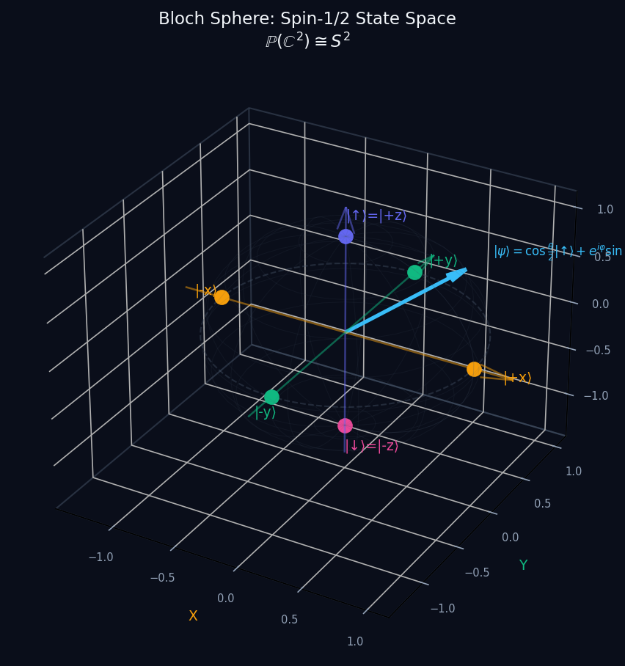
L10 — HS: Bloch Sphere Spin
L10
High School — Spin & Finite-Dimensional Hilbert Spaces (SU(2))
BLOCH SPHERE SPIN
HS — BLOCH SPHERE SPIN
This lecture covers Spin & Finite-Dimensional Hilbert Spaces (SU(2)) at the HS level.
GEOMETRIC INTERPRETATION
The diagram on the right shows the 2D/3D geometric analogy for this concept. Use it to build physical intuition before working through the formalism.
• Q1: HS question for L10.
• Q2: HS question for L10.
QM: L10 — HS · Bloch Sphere Spin
L10 · HS

Slide 4
BegUG
Beginning Undergraduate
1. Pauli Matrices
QM: L10 — Beginning Undergraduate
L10

Slide 5
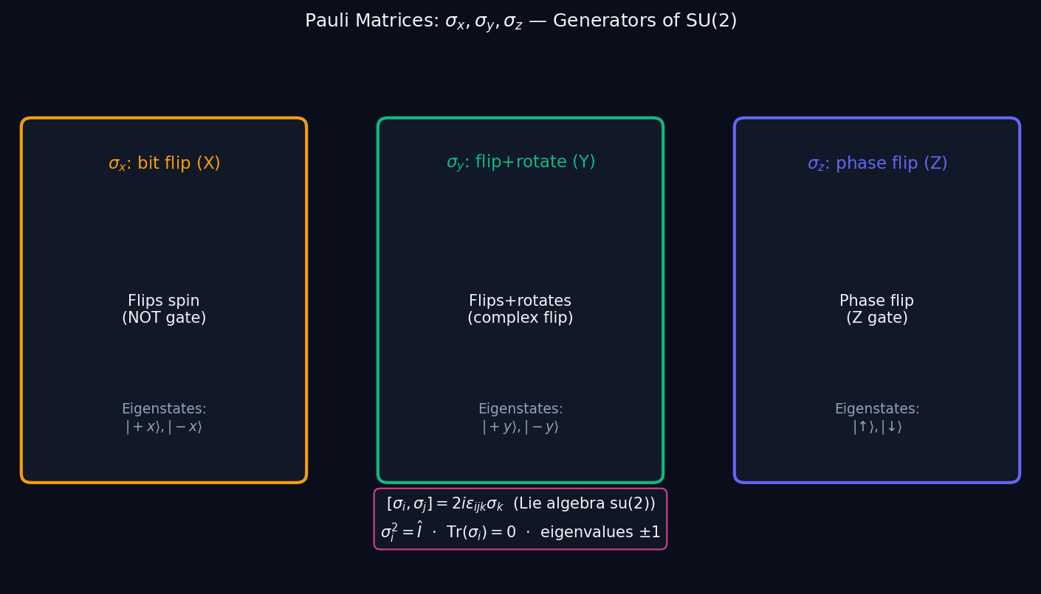
L10 — BegUG: Pauli Matrices
L10
Beginning Undergraduate — Spin & Finite-Dimensional Hilbert Spaces (SU(2))
PAULI MATRICES
BegUG — PAULI MATRICES
This lecture covers Spin & Finite-Dimensional Hilbert Spaces (SU(2)) at the BegUG level.
GEOMETRIC INTERPRETATION
The diagram on the right shows the 2D/3D geometric analogy for this concept. Use it to build physical intuition before working through the formalism.
• Q1: BegUG question for L10.
• Q2: BegUG question for L10.
QM: L10 — BegUG · Pauli Matrices
L10 · BegUG

Slide 6
AdvUG
Advanced Undergraduate
1. Su2 Rotation
QM: L10 — Advanced Undergraduate
L10

Slide 7
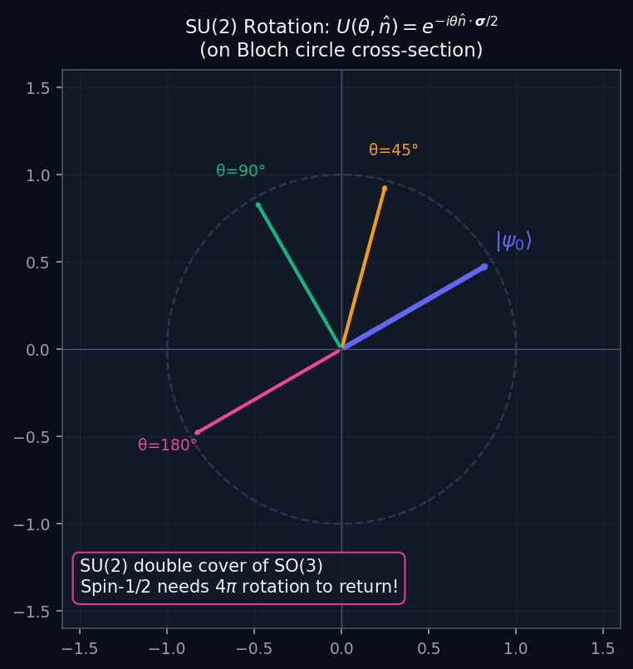
L10 — AdvUG: Su2 Rotation
L10
Advanced Undergraduate — Spin & Finite-Dimensional Hilbert Spaces (SU(2))
SU2 ROTATION
AdvUG — SU2 ROTATION
This lecture covers Spin & Finite-Dimensional Hilbert Spaces (SU(2)) at the AdvUG level.
GEOMETRIC INTERPRETATION
The diagram on the right shows the 2D/3D geometric analogy for this concept. Use it to build physical intuition before working through the formalism.
• Q1: AdvUG question for L10.
• Q2: AdvUG question for L10.
QM: L10 — AdvUG · Su2 Rotation
L10 · AdvUG

Slide 8
MSc
Master's Level
1. Angular Momentum Ladder
QM: L10 — Master's Level
L10

Slide 9
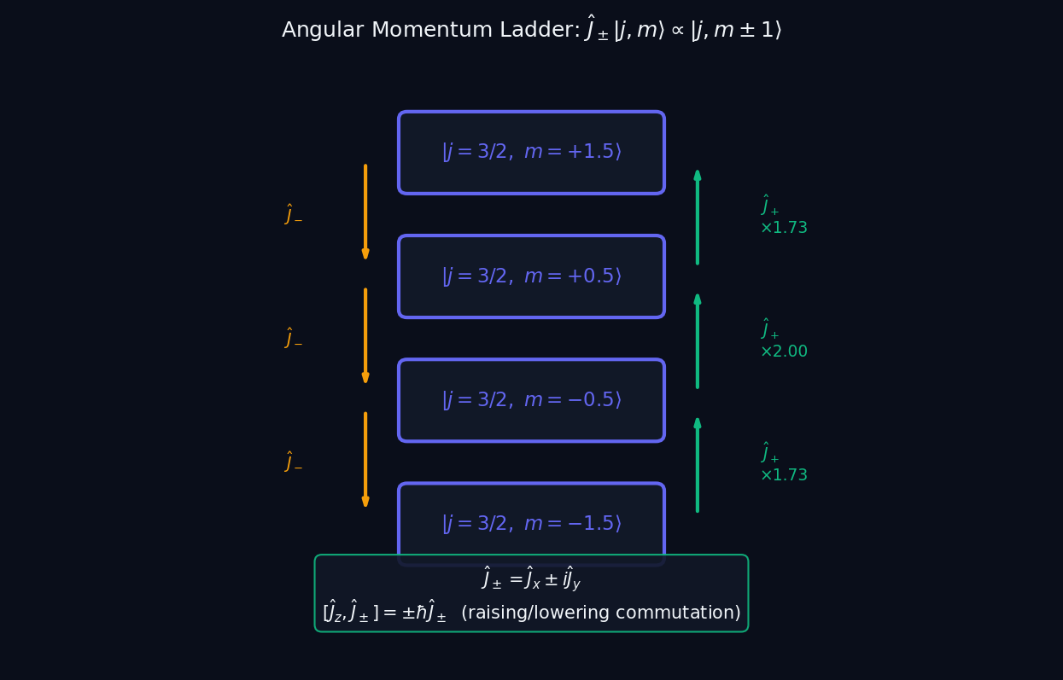
L10 — MSc: Angular Momentum Ladder
L10
Master's Level — Spin & Finite-Dimensional Hilbert Spaces (SU(2))
ANGULAR MOMENTUM LADDER
MSc — ANGULAR MOMENTUM LADDER
This lecture covers Spin & Finite-Dimensional Hilbert Spaces (SU(2)) at the MSc level.
GEOMETRIC INTERPRETATION
The diagram on the right shows the 2D/3D geometric analogy for this concept. Use it to build physical intuition before working through the formalism.
• Q1: MSc question for L10.
• Q2: MSc question for L10.
QM: L10 — MSc · Angular Momentum Ladder
L10 · MSc

