Slide 1
Ψ
QUANTUM MECHANICS — BRA–KET NOTATION
L10
Spin & Finite-Dimensional Hilbert Spaces (SU(2))
Spin-1/2, Pauli matrices, rotation operators, Bloch sphere
HS
BegUG
AdvUG
MSc
PhD
Full expanded deck · 5 tiers · Worked examples · Complete problem sets
QM: Bra–Ket Notation — L10
L10

Slide 2
L10 — Lecture Overview
L10
Spin & Finite-Dimensional Hilbert Spaces (SU(2))
90-MIN PACING
CORE LEARNING OUTCOMES
0–20 min: Spin-1/2 as 2D Hilbert space; |+⟩, |−⟩ basis
20–50 min: Pauli matrices; spin operators Sₓ, Sᵧ, Sᵤ
50–75 min: Rotation operators U(θ,n̂) = e^{−iθσ·n̂/2}
75–90 min: Angular momentum algebra; SU(2)/SO(3) link
• Work with spin-1/2 as prototype finite-dimensional QM
• Compute eigenkets and probabilities for all spin components
• Apply rotation operators U(θ,n̂) = e^{−iθσ·n̂/2}
• Connect SU(2) group to physical rotations SO(3)
HS
BegUG
AdvUG
MSc
PhD
Two-state systems as qubits — conceptual motivation
Compute spin measurement probabilities; Stern–Gerlach
Rotation operators; verify [σᵢ,σⱼ] = 2iεᵢⱼₖσₖ
Representation theory; angular momentum J+, J−
SU(2) vs SO(3), projective representations, Wigner theorem
ASSESSMENT BUNDLE
Set A: Find eigenkets of σₓ in terms of |+z⟩ and |−z⟩ · Compute P(+x) for state |+z⟩
Set B: Prove [σᵢ,σⱼ] = 2iεᵢⱼₖσₖ for all pairs · Derive U(θ,ẑ) = e^{−iθσᵤ/2} explicitly
QM: L10
L10 · Overview

Slide 3

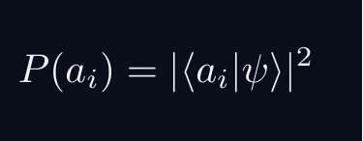
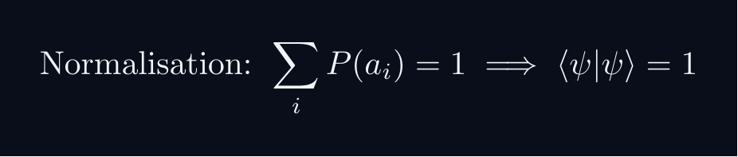
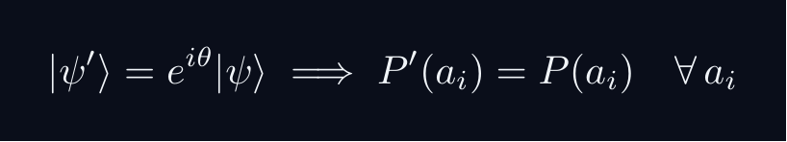
L10 — Sakurai Track
L10
Measurement-first, operational approach
SAKURAI: PREPARATION → STATISTICS → AMPLITUDES
BRIDGE TO DIRAC
SAKURAI: PREPARATION TO STATISTICS TO AMPLITUDES
• Preparation procedure ↔ ket |ψ⟩ (ray in ℋ)
• Measurement outcome aᵢ ↔ basis ket |aᵢ⟩
• Transition amplitude ↔ inner product ⟨aᵢ|ψ⟩
• Probability rule ↔ |⟨aᵢ|ψ⟩|²
• Total prob. = 1 ↔ ⟨ψ|ψ⟩ = 1
• Interference ↔ complex phase structure
STEP 1 — PREPARATION
A preparation is a reproducible laboratory protocol.
The same procedure always yields the same statistical predictions.
STEP 2 — MEASUREMENT OUTCOMES
A measurement device returns outcomes a_i with stable frequencies.
The state encodes probabilities, not definite property values.
STEP 3 — WHY AMPLITUDES?
Interference demands combining paths BEFORE squaring:
The cross-term is interference — real and measurable.
Only complex amplitudes can produce this cross-term.
STEP 4 — OPERATIONAL BORN RULE
GLOBAL PHASE IS UNOBSERVABLE
Physical states are RAYS not vectors.
QM: L10
L10 · Sakurai Track

Slide 4
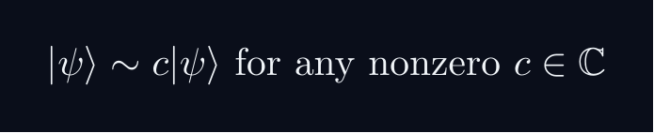
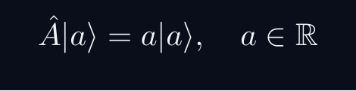
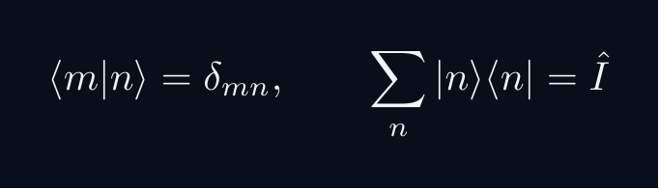
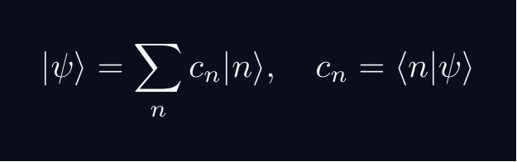


L10 — Dirac Track
L10
Abstract, representation-independent axioms
DIRAC: FIVE POSTULATES
DIRAC: FIVE POSTULATES OF QUANTUM MECHANICS
POSTULATE 1 — STATE SPACE
Every physical state is a ray in a complex Hilbert space H.
POSTULATE 2 — OBSERVABLES
Every observable A corresponds to a Hermitian operator A = A^†.
POSTULATE 3 — COMPLETENESS
POSTULATE 4 — BORN RULE
Post-measurement state (ideal projective): |ψ⟩ → |a⟩
POSTULATE 5 — DYNAMICS
QM: L10
L10 · Dirac Track

Slide 5
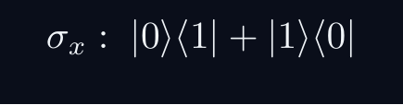
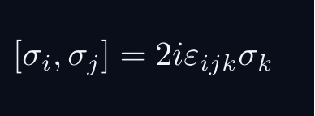
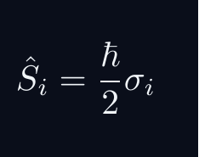
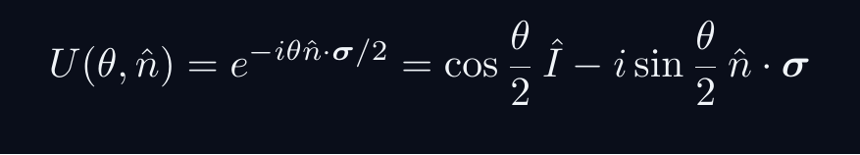
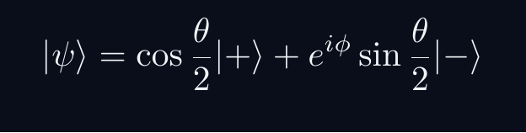
L10 — Key Formulas
L10
LaTeX-rendered formula reference
pauli x
pauli commutator
spin op
rotation op
bloch state
QM: L10
L10 · Formulas

Slide 6
L10 — HS: High School
L10
Tier introduction and learning context
WHAT THIS TIER COVERS
PREREQUISITES
This lecture covers Spin & Finite-Dimensional Hilbert Spaces (SU(2)) at the HS level.
Starting point: pre-university mathematics
Required: basic algebra and complex arithmetic
WHAT THIS TIER UNLOCKS
KEY MESSAGE FOR THIS TIER
Unlocks access to: Beginning Undergraduate
This tier equips you for:
Compute spin measurement probabilities; Stern–Gerlach
Two-state systems as qubits — conceptual motivation
QM: L10 · HS
L10 · HS · Intro

Slide 7
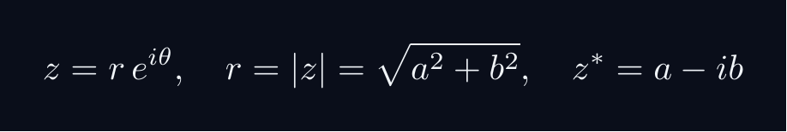
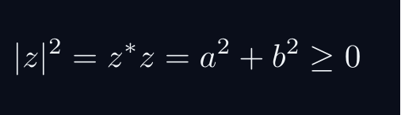
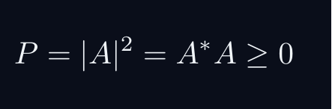
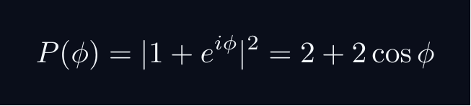
L10 — HS: Core Concepts
L10
Main ideas, key equations, and their meaning
CORE CONCEPTS & KEY RESULTS
This lecture covers Spin & Finite-Dimensional Hilbert Spaces (SU(2)) at the HS level.
COMPLEX NUMBERS AS ARROWS
A complex number z = a + ib lives in a 2D plane.
AMPLITUDE TO PROBABILITY (BORN RULE)
A quantum amplitude A is a complex number for a process.
Why squaring? Gives a real, non-negative number. Phase alone does not.
SUPERPOSITION = ARROW ADDITION = INTERFERENCE
Two paths: amplitudes A_1 and A_2. Total: A = A_1 + A_2.
Interference term can be positive (constructive) or negative (destructive).
WORKED FORMULA: PHASE DEPENDENCE
Let A_1 = 1, A_2 = e^{iφ} (unit magnitude, phase φ).
Maximum P=4 at φ=0 (constructive). Minimum P=0 at φ=pi (destructive).
QM: L10 · HS
L10 · HS · Concepts

Slide 8
L10 — HS: Worked Example 1
L10
Step-by-step solved example with commentary
EXAMPLE 1: HS-A1
WORKED SOLUTION
Core problem for L10 (HS). Two-state systems as qubits — conceptual motivation
FULL SOLUTION
HINTS
Apply the formula.
* Apply the definition
ADVANCED HINTS
* Verify result
QM: L10 · HS
L10 · HS · Example 1

Slide 9
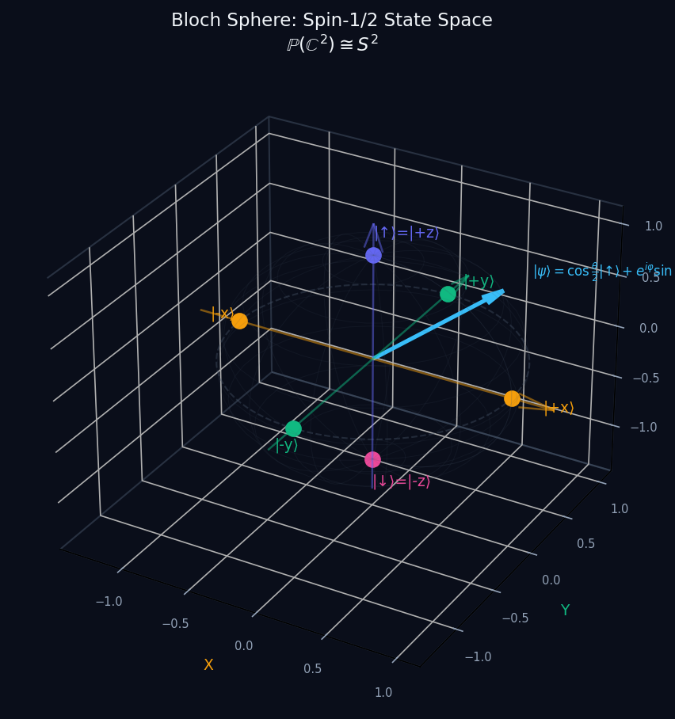
L10 — HS: Bloch Sphere Spin
L10
High School — Spin & Finite-Dimensional Hilbert Spaces (SU(2))
BLOCH SPHERE SPIN
HS — BLOCH SPHERE SPIN
This lecture covers Spin & Finite-Dimensional Hilbert Spaces (SU(2)) at the HS level.
GEOMETRIC INTERPRETATION
The diagram on the right shows the 2D/3D geometric analogy for this concept. Use it to build physical intuition before working through the formalism.
• Q1: HS question for L10.
• Q2: HS question for L10.
QM: L10 — HS · Bloch Sphere Spin
L10 · HS

Slide 10
L10 — HS: Worked Example 2
L10
Second example — deeper or alternative approach
EXAMPLE 2: HS-A2
WORKED SOLUTION
Verification for L10 (HS).
FULL SOLUTION
HINTS
Follow the derivation.
* Use orthonormality
ADVANCED HINTS
* Check normalisation
QM: L10 · HS
L10 · HS · Example 2

Slide 11
L10 — HS: Concept Questions
L10
Think before computing — conceptual understanding checks
CONCEPT QUESTIONS
MORE QUESTIONS + GUIDANCE
1. Q1: HS question for L10.
2. Q2: HS question for L10.
3. Q3: HS question for L10.
1. Q4: HS question for L10.
2. Q5: HS question for L10.
─────
These questions have no calculation — think about what probability MEANS.
Key insight: squaring is the minimal operation that gives a non-negative re…
QM: L10 · HS
L10 · HS · Concept Qs

Slide 12
L10 — HS: Problem Sets
L10
Simple problems (Set A) and advanced problems (Set B)
PROBLEM SET A — SIMPLE (2 problems)
PROBLEM SET B — ADVANCED (1 problems)
[HS-A1] Core problem for L10 (HS). Two-state systems as qubits — conceptual motivation
Hint: Apply the definition
[HS-A2] Verification for L10 (HS).
Hint: Use orthonormality
[HS-B1] Proof exercise for L10 (HS).
Hint: Start from definition
Key idea: Check edge cases
QM: L10 · HS
L10 · HS · Problems

Slide 13
L10 — HS: References & Bibliography
L10
Historical, educational, and research-level reading
HISTORICAL (1)
EDUCATIONAL (2)
RESEARCH (1)
[1930] Dirac
"Principles of QM"
Oxford UP
↳ Primary source.
Sakurai (2021)
"Modern QM"
Cambridge UP
↳ Main text.
Cohen-Tannoudji (1977)
"QM Vol. 1"
Wiley
↳ Complements.
von Neumann (1932)
"Math. Grundlagen"
Springer
↳ Rigorous foundations.
QM: L10 · HS
L10 · HS · References

Slide 14
L10 — BegUG: Beginning Undergraduate
L10
Tier introduction and learning context
WHAT THIS TIER COVERS
PREREQUISITES
This lecture covers Spin & Finite-Dimensional Hilbert Spaces (SU(2)) at the BegUG level.
Builds on: High School
Required background:
Two-state systems as qubits — conceptual motivation
WHAT THIS TIER UNLOCKS
KEY MESSAGE FOR THIS TIER
Unlocks access to: Advanced Undergraduate
This tier equips you for:
Rotation operators; verify [σᵢ,σⱼ] = 2iεᵢⱼₖσₖ
Compute spin measurement probabilities; Stern–Gerlach
QM: L10 · BegUG
L10 · BegUG · Intro

Slide 15
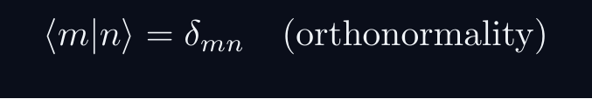
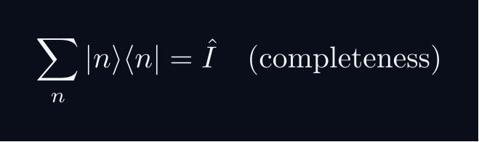
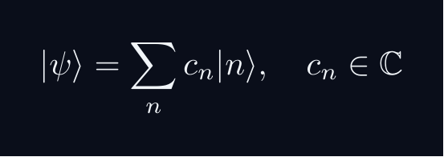
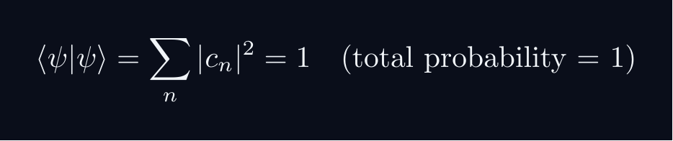

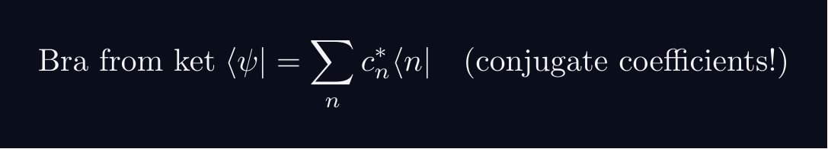
L10 — BegUG: Core Concepts
L10
Main ideas, key equations, and their meaning
CORE CONCEPTS & KEY RESULTS
This lecture covers Spin & Finite-Dimensional Hilbert Spaces (SU(2)) at the BegUG level.
HILBERT SPACE FORMALISM — DISCRETE BASIS
State vector |ψ⟩ in complex Hilbert space H.
EXPANSION AND COMPONENTS
Proof: ⟨ m|ψ⟩ = sum_n c_n ⟨ m|n⟩ = sum_n c_ndelta_{mn} = c_m
NORMALISATION AND PROBABILITIES
GLOBAL PHASE INVARIANCE
QM: L10 · BegUG
L10 · BegUG · Concepts

Slide 16
L10 — BegUG: Worked Example 1
L10
Step-by-step solved example with commentary
EXAMPLE 1: BegUG-A1
WORKED SOLUTION
Core problem for L10 (BegUG). Compute spin measurement probabilities; Stern–Gerlach
FULL SOLUTION
HINTS
Apply the formula.
* Apply the definition
ADVANCED HINTS
* Verify result
QM: L10 · BegUG
L10 · BegUG · Example 1

Slide 17
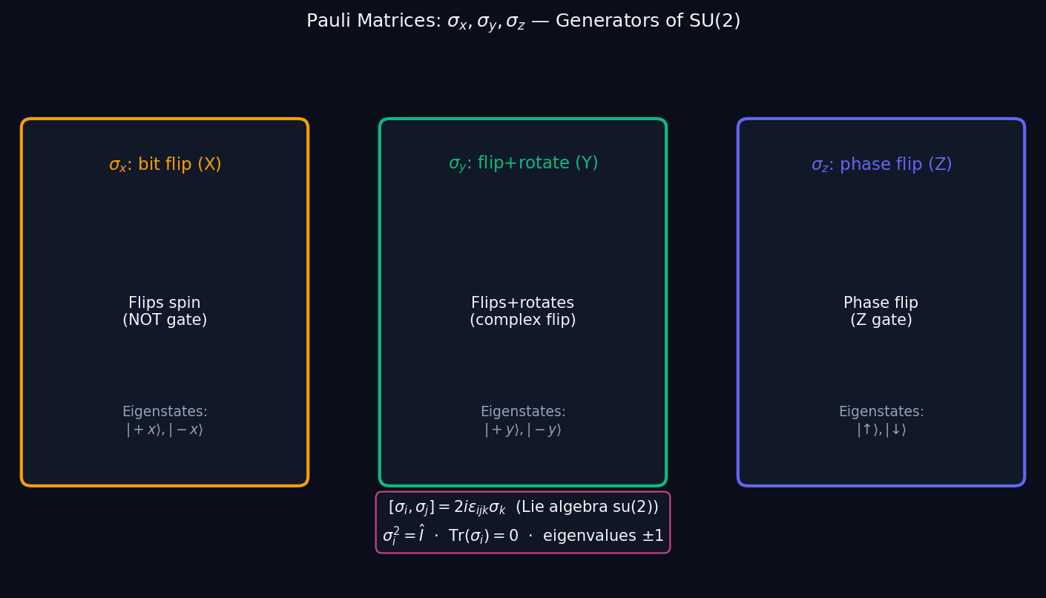
L10 — BegUG: Pauli Matrices
L10
Beginning Undergraduate — Spin & Finite-Dimensional Hilbert Spaces (SU(2))
PAULI MATRICES
BegUG — PAULI MATRICES
This lecture covers Spin & Finite-Dimensional Hilbert Spaces (SU(2)) at the BegUG level.
GEOMETRIC INTERPRETATION
The diagram on the right shows the 2D/3D geometric analogy for this concept. Use it to build physical intuition before working through the formalism.
• Q1: BegUG question for L10.
• Q2: BegUG question for L10.
QM: L10 — BegUG · Pauli Matrices
L10 · BegUG

Slide 18
L10 — BegUG: Worked Example 2
L10
Second example — deeper or alternative approach
EXAMPLE 2: BegUG-A2
WORKED SOLUTION
Verification for L10 (BegUG).
FULL SOLUTION
HINTS
Follow the derivation.
* Use orthonormality
ADVANCED HINTS
* Check normalisation
QM: L10 · BegUG
L10 · BegUG · Example 2

Slide 19
L10 — BegUG: Concept Questions
L10
Think before computing — conceptual understanding checks
CONCEPT QUESTIONS
MORE QUESTIONS + GUIDANCE
1. Q1: BegUG question for L10.
2. Q2: BegUG question for L10.
3. Q3: BegUG question for L10.
1. Q4: BegUG question for L10.
2. Q5: BegUG question for L10.
─────
Work from the definition: write out the expansion, act with ⟨m| on the left, use δₘₙ.
For normalization: total probability must equal 1 — that is the…
QM: L10 · BegUG
L10 · BegUG · Concept Qs

Slide 20
L10 — BegUG: Problem Sets
L10
Simple problems (Set A) and advanced problems (Set B)
PROBLEM SET A — SIMPLE (2 problems)
PROBLEM SET B — ADVANCED (1 problems)
[BegUG-A1] Core problem for L10 (BegUG). Compute spin measurement probabilities; Stern–Gerlach
Hint: Apply the definition
[BegUG-A2] Verification for L10 (BegUG).
Hint: Use orthonormality
[BegUG-B1] Proof exercise for L10 (BegUG).
Hint: Start from definition
Key idea: Check edge cases
QM: L10 · BegUG
L10 · BegUG · Problems

Slide 21
L10 — BegUG: References & Bibliography
L10
Historical, educational, and research-level reading
HISTORICAL (1)
EDUCATIONAL (2)
RESEARCH (1)
[1930] Dirac
"Principles of QM"
Oxford UP
↳ Primary source.
Sakurai (2021)
"Modern QM"
Cambridge UP
↳ Main text.
Cohen-Tannoudji (1977)
"QM Vol. 1"
Wiley
↳ Complements.
von Neumann (1932)
"Math. Grundlagen"
Springer
↳ Rigorous foundations.
QM: L10 · BegUG
L10 · BegUG · References

Slide 22
L10 — AdvUG: Advanced Undergraduate
L10
Tier introduction and learning context
WHAT THIS TIER COVERS
PREREQUISITES
This lecture covers Spin & Finite-Dimensional Hilbert Spaces (SU(2)) at the AdvUG level.
Builds on: Beginning Undergraduate
Required background:
Compute spin measurement probabilities; Stern–Gerlach
WHAT THIS TIER UNLOCKS
KEY MESSAGE FOR THIS TIER
Unlocks access to: Master's Level
This tier equips you for:
Representation theory; angular momentum J+, J−
Rotation operators; verify [σᵢ,σⱼ] = 2iεᵢⱼₖσₖ
QM: L10 · AdvUG
L10 · AdvUG · Intro

Slide 23
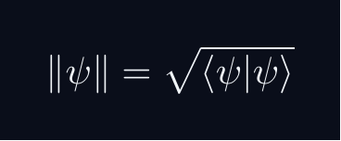
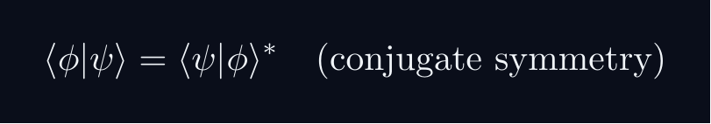


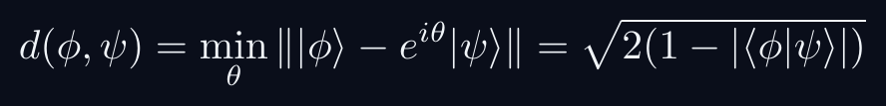
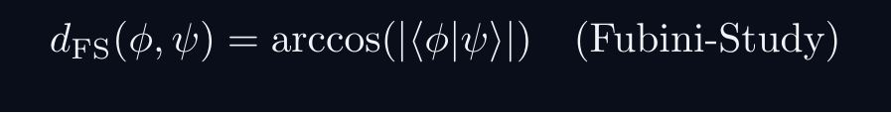
L10 — AdvUG: Core Concepts
L10
Main ideas, key equations, and their meaning
CORE CONCEPTS & KEY RESULTS
This lecture covers Spin & Finite-Dimensional Hilbert Spaces (SU(2)) at the AdvUG level.
INNER PRODUCT SPACE GEOMETRY
CAUCHY-SCHWARZ INEQUALITY
Proof: set f(lambda) = | |φ⟩ - lambda|ψ⟩ |^2 ≥ 0.
Choose lambda = ⟨ψ|φ⟩ / |ψ|^2 to minimise.
TRIANGLE INEQUALITY
Proof: square both sides; apply C-S to the cross term.
PHASE-INVARIANT DISTANCE
QM: L10 · AdvUG
L10 · AdvUG · Concepts

Slide 24
L10 — AdvUG: Worked Example 1
L10
Step-by-step solved example with commentary
EXAMPLE 1: AdvUG-A1
WORKED SOLUTION
Core problem for L10 (AdvUG). Rotation operators; verify [σᵢ,σⱼ] = 2iεᵢⱼₖσₖ
FULL SOLUTION
HINTS
Apply the formula.
* Apply the definition
ADVANCED HINTS
* Verify result
QM: L10 · AdvUG
L10 · AdvUG · Example 1

Slide 25
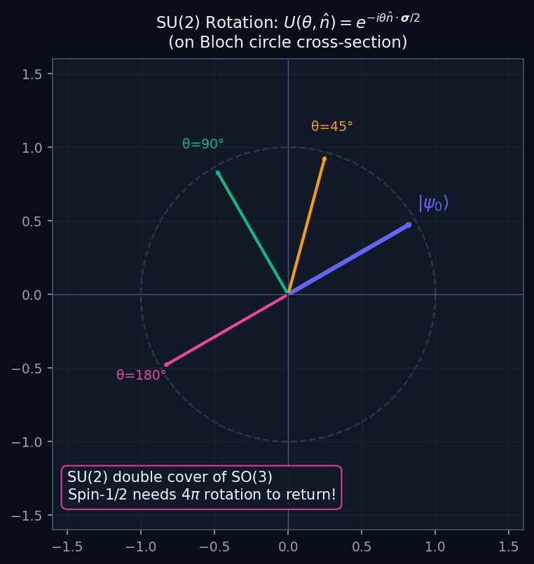
L10 — AdvUG: Su2 Rotation
L10
Advanced Undergraduate — Spin & Finite-Dimensional Hilbert Spaces (SU(2))
SU2 ROTATION
AdvUG — SU2 ROTATION
This lecture covers Spin & Finite-Dimensional Hilbert Spaces (SU(2)) at the AdvUG level.
GEOMETRIC INTERPRETATION
The diagram on the right shows the 2D/3D geometric analogy for this concept. Use it to build physical intuition before working through the formalism.
• Q1: AdvUG question for L10.
• Q2: AdvUG question for L10.
QM: L10 — AdvUG · Su2 Rotation
L10 · AdvUG

Slide 26
L10 — AdvUG: Worked Example 2
L10
Second example — deeper or alternative approach
EXAMPLE 2: AdvUG-A2
WORKED SOLUTION
Verification for L10 (AdvUG).
FULL SOLUTION
HINTS
Follow the derivation.
* Use orthonormality
ADVANCED HINTS
* Check normalisation
QM: L10 · AdvUG
L10 · AdvUG · Example 2

Slide 27
L10 — AdvUG: Concept Questions
L10
Think before computing — conceptual understanding checks
CONCEPT QUESTIONS
MORE QUESTIONS + GUIDANCE
1. Q1: AdvUG question for L10.
2. Q2: AdvUG question for L10.
3. Q3: AdvUG question for L10.
1. Q4: AdvUG question for L10.
2. Q5: AdvUG question for L10.
─────
For C–S: the proof idea is to consider ‖|φ⟩ - λ|ψ⟩‖² ≥ 0 and choose the minimising λ.
For the geometry questions: draw a unit circle in ℂ²; overlap |…
QM: L10 · AdvUG
L10 · AdvUG · Concept Qs

Slide 28
L10 — AdvUG: Problem Sets
L10
Simple problems (Set A) and advanced problems (Set B)
PROBLEM SET A — SIMPLE (2 problems)
PROBLEM SET B — ADVANCED (1 problems)
[AdvUG-A1] Core problem for L10 (AdvUG). Rotation operators; verify [σᵢ,σⱼ] = 2iεᵢⱼₖσₖ
Hint: Apply the definition
[AdvUG-A2] Verification for L10 (AdvUG).
Hint: Use orthonormality
[AdvUG-B1] Proof exercise for L10 (AdvUG).
Hint: Start from definition
Key idea: Check edge cases
QM: L10 · AdvUG
L10 · AdvUG · Problems

Slide 29
L10 — AdvUG: References & Bibliography
L10
Historical, educational, and research-level reading
HISTORICAL (1)
EDUCATIONAL (2)
RESEARCH (1)
[1930] Dirac
"Principles of QM"
Oxford UP
↳ Primary source.
Sakurai (2021)
"Modern QM"
Cambridge UP
↳ Main text.
Cohen-Tannoudji (1977)
"QM Vol. 1"
Wiley
↳ Complements.
von Neumann (1932)
"Math. Grundlagen"
Springer
↳ Rigorous foundations.
QM: L10 · AdvUG
L10 · AdvUG · References

Slide 30
L10 — MSc: Master's Level
L10
Tier introduction and learning context
WHAT THIS TIER COVERS
PREREQUISITES
This lecture covers Spin & Finite-Dimensional Hilbert Spaces (SU(2)) at the MSc level.
Builds on: Advanced Undergraduate
Required background:
Rotation operators; verify [σᵢ,σⱼ] = 2iεᵢⱼₖσₖ
WHAT THIS TIER UNLOCKS
KEY MESSAGE FOR THIS TIER
Unlocks access to: PhD Level
This tier equips you for:
SU(2) vs SO(3), projective representations, Wigner theorem
Representation theory; angular momentum J+, J−
QM: L10 · MSc
L10 · MSc · Intro

Slide 31
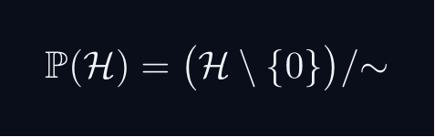
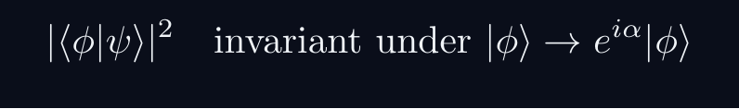
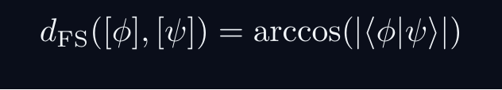
L10 — MSc: Core Concepts
L10
Main ideas, key equations, and their meaning
CORE CONCEPTS & KEY RESULTS
This lecture covers Spin & Finite-Dimensional Hilbert Spaces (SU(2)) at the MSc level.
PROJECTIVE HILBERT SPACE
Physical state space is P(H), not H itself.
A ray [ψ] is a one-dimensional complex subspace of H.
Example: P(C^2) cong S^2 — the Bloch sphere.
PHYSICALLY INVARIANT QUANTITIES
WIGNER'S THEOREM
Any bijection T:P(H)→P(H) preserving |⟨φ|ψ⟩|^2
is implemented by a UNITARY or ANTIUNITARY operator U on H.
Consequence: all quantum symmetries are (anti)unitary.
CONSEQUENCES
Symmetry group G acting on states gives projective representation of G.
Forces spin SO(3)→ SU(2), superselection rules, CPT symmetry.
QM: L10 · MSc
L10 · MSc · Concepts

Slide 32
L10 — MSc: Worked Example 1
L10
Step-by-step solved example with commentary
EXAMPLE 1: MSc-A1
WORKED SOLUTION
Core problem for L10 (MSc). Representation theory; angular momentum J+, J−
FULL SOLUTION
HINTS
Apply the formula.
* Apply the definition
ADVANCED HINTS
* Verify result
QM: L10 · MSc
L10 · MSc · Example 1

Slide 33
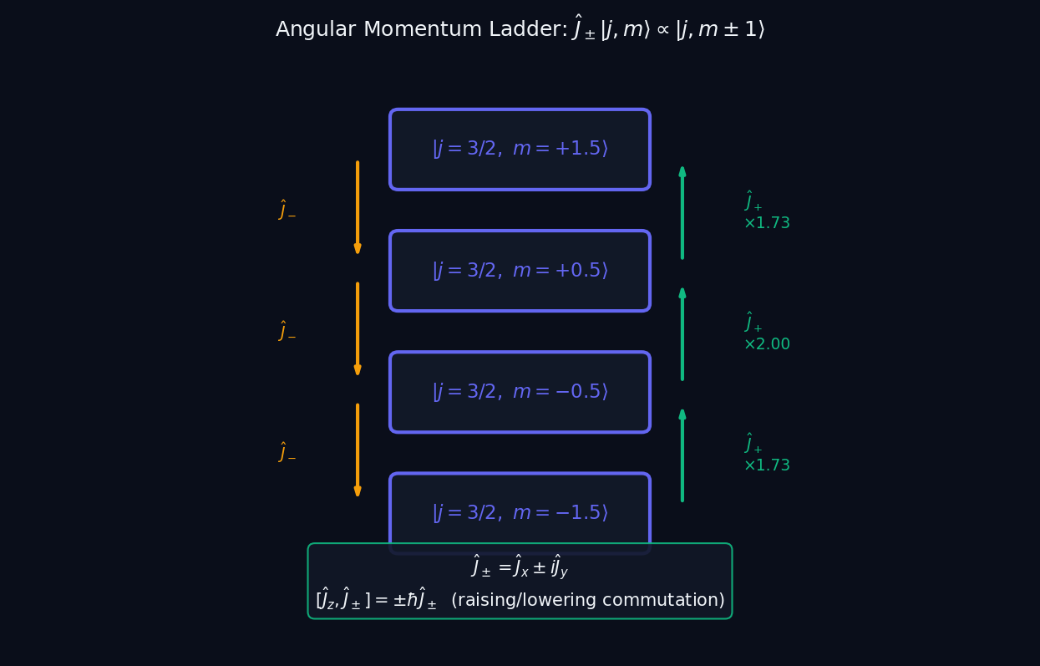
L10 — MSc: Angular Momentum Ladder
L10
Master's Level — Spin & Finite-Dimensional Hilbert Spaces (SU(2))
ANGULAR MOMENTUM LADDER
MSc — ANGULAR MOMENTUM LADDER
This lecture covers Spin & Finite-Dimensional Hilbert Spaces (SU(2)) at the MSc level.
GEOMETRIC INTERPRETATION
The diagram on the right shows the 2D/3D geometric analogy for this concept. Use it to build physical intuition before working through the formalism.
• Q1: MSc question for L10.
• Q2: MSc question for L10.
QM: L10 — MSc · Angular Momentum Ladder
L10 · MSc

Slide 34
L10 — MSc: Worked Example 2
L10
Second example — deeper or alternative approach
EXAMPLE 2: MSc-A2
WORKED SOLUTION
Verification for L10 (MSc).
FULL SOLUTION
HINTS
Follow the derivation.
* Use orthonormality
ADVANCED HINTS
* Check normalisation
QM: L10 · MSc
L10 · MSc · Example 2

Slide 35
L10 — MSc: Concept Questions
L10
Think before computing — conceptual understanding checks
CONCEPT QUESTIONS
MORE QUESTIONS + GUIDANCE
1. Q1: MSc question for L10.
2. Q2: MSc question for L10.
3. Q3: MSc question for L10.
1. Q4: MSc question for L10.
2. Q5: MSc question for L10.
─────
For projective space: think of it as points on a sphere (for 2D), or more generally a complex manifold.
For Wigner: the key word is 'preserves transi…
QM: L10 · MSc
L10 · MSc · Concept Qs

Slide 36
L10 — MSc: Problem Sets
L10
Simple problems (Set A) and advanced problems (Set B)
PROBLEM SET A — SIMPLE (2 problems)
PROBLEM SET B — ADVANCED (1 problems)
[MSc-A1] Core problem for L10 (MSc). Representation theory; angular momentum J+, J−
Hint: Apply the definition
[MSc-A2] Verification for L10 (MSc).
Hint: Use orthonormality
[MSc-B1] Proof exercise for L10 (MSc).
Hint: Start from definition
Key idea: Check edge cases
QM: L10 · MSc
L10 · MSc · Problems

Slide 37
L10 — MSc: References & Bibliography
L10
Historical, educational, and research-level reading
HISTORICAL (1)
EDUCATIONAL (2)
RESEARCH (1)
[1930] Dirac
"Principles of QM"
Oxford UP
↳ Primary source.
Sakurai (2021)
"Modern QM"
Cambridge UP
↳ Main text.
Cohen-Tannoudji (1977)
"QM Vol. 1"
Wiley
↳ Complements.
von Neumann (1932)
"Math. Grundlagen"
Springer
↳ Rigorous foundations.
QM: L10 · MSc
L10 · MSc · References

Slide 38
L10 — PhD: PhD Level
L10
Tier introduction and learning context
WHAT THIS TIER COVERS
PREREQUISITES
This lecture covers Spin & Finite-Dimensional Hilbert Spaces (SU(2)) at the PhD level.
Builds on: Master's Level
Required background:
Representation theory; angular momentum J+, J−
WHAT THIS TIER UNLOCKS
KEY MESSAGE FOR THIS TIER
Frontier level: connects to active research
This tier equips you for:
Primary literature and open problems
SU(2) vs SO(3), projective representations, Wigner theorem
QM: L10 · PhD
L10 · PhD · Intro

Slide 39
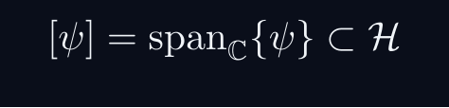
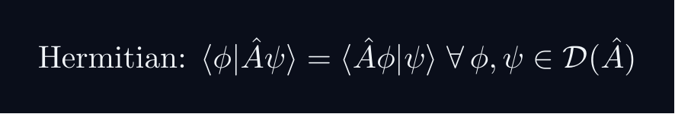
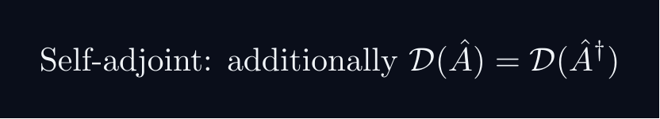
L10 — PhD: Core Concepts
L10
Main ideas, key equations, and their meaning
CORE CONCEPTS & KEY RESULTS
This lecture covers Spin & Finite-Dimensional Hilbert Spaces (SU(2)) at the PhD level.
HILBERT SPACE — PRECISE AXIOMS
Definition: a complex vector space H with ⟨cdot|cdot⟩ that is COMPLETE.
Completeness: every Cauchy sequence {ψ_n} converges in H.
Essential for: spectral theory, Fourier expansions, Stone's theorem.
SEPARABILITY
H separable ⟺ countable dense subset ⟺ countable ONB {e_n}.
All standard NRQM spaces: L^2(R^n), C^n, ell^2(N).
RAYS AS ONE-DIMENSIONAL SUBSPACES
P(H) is a Kahler manifold with Fubini-Study metric.
UNBOUNDED OPERATORS — DOMAIN SUBTLETY
Self-adjoint ≠ Hermitian for unbounded operators (x̂, p̂).
Spectral theorem and Stone's theorem REQUIRE self-adjointness.
QM: L10 · PhD
L10 · PhD · Concepts

Slide 40
L10 — PhD: Worked Example 1
L10
Step-by-step solved example with commentary
EXAMPLE 1: PhD-A1
WORKED SOLUTION
Core problem for L10 (PhD). SU(2) vs SO(3), projective representations, Wigner theorem
FULL SOLUTION
HINTS
Apply the formula.
* Apply the definition
ADVANCED HINTS
* Verify result
QM: L10 · PhD
L10 · PhD · Example 1

Slide 41
L10 — PhD: Worked Example 2
L10
Second example — deeper or alternative approach
EXAMPLE 2: PhD-A2
WORKED SOLUTION
Verification for L10 (PhD).
FULL SOLUTION
HINTS
Follow the derivation.
* Use orthonormality
ADVANCED HINTS
* Check normalisation
QM: L10 · PhD
L10 · PhD · Example 2

Slide 42
L10 — PhD: Concept Questions
L10
Think before computing — conceptual understanding checks
CONCEPT QUESTIONS
MORE QUESTIONS + GUIDANCE
1. Q1: PhD question for L10.
2. Q2: PhD question for L10.
3. Q3: PhD question for L10.
1. Q4: PhD question for L10.
2. Q5: PhD question for L10.
─────
For completeness: construct Cauchy sequences that don't converge to a square-integrable function in a non-complete space.
For separability: construct…
QM: L10 · PhD
L10 · PhD · Concept Qs

Slide 43
L10 — PhD: Problem Sets
L10
Simple problems (Set A) and advanced problems (Set B)
PROBLEM SET A — SIMPLE (2 problems)
PROBLEM SET B — ADVANCED (1 problems)
[PhD-A1] Core problem for L10 (PhD). SU(2) vs SO(3), projective representations, Wigner theorem
Hint: Apply the definition
[PhD-A2] Verification for L10 (PhD).
Hint: Use orthonormality
[PhD-B1] Proof exercise for L10 (PhD).
Hint: Start from definition
Key idea: Check edge cases
QM: L10 · PhD
L10 · PhD · Problems

Slide 44
L10 — PhD: References & Bibliography
L10
Historical, educational, and research-level reading
HISTORICAL (1)
EDUCATIONAL (2)
RESEARCH (1)
[1930] Dirac
"Principles of QM"
Oxford UP
↳ Primary source.
Sakurai (2021)
"Modern QM"
Cambridge UP
↳ Main text.
Cohen-Tannoudji (1977)
"QM Vol. 1"
Wiley
↳ Complements.
von Neumann (1932)
"Math. Grundlagen"
Springer
↳ Rigorous foundations.
QM: L10 · PhD
L10 · PhD · References

Slide 45
L10 — Common Pitfalls & Misconceptions
L10
Consolidated pitfalls across all tiers
⚠ PITFALLS (A)
⚠ PITFALLS (B)
• Off-by-2 in rotation: SU(2) element for 2π rotation is −Î, not +Î
• Confusing σᵢ (dimensionless) with Sᵢ = ℏσᵢ/2
• Bloch sphere θ is polar angle (0 to π), not azimuthal
HISTORICAL ANCHORS
FORMULA QUICK REFERENCE
• Goudsmit & Uhlenbeck (1925) — spin hypothesis
• Pauli (1927) — Pauli matrices; spin-1/2 formalism
• Cartan (1913) / Weyl (1925) — SU(2) representation theory
Key formulas in this lecture:
pauli_x · pauli_commutator · spin_op · rotation_op · bloch_state
See formula slides for full LaTeX-rendered versions.
QM: L10
L10 · Pitfalls

Slide 46
L10 — Homework & Project Summary
L10
Assessment overview across all tiers
HS
BegUG
AdvUG
MSc
PhD
Problems: 2 simple + 1 advanced
Project (simple, ~2-3h): HS Project
Project (advanced, ~8-10h): HS Advanced
Research (defined): Explain key result (HS).
Research (open): Open question (HS).
Problems: 2 simple + 1 advanced
Project (simple, ~2-3h): BegUG Project
Project (advanced, ~8-10h): BegUG Advanced
Research (defined): Explain key result (BegUG).
Research (open): Open question (BegUG).
Problems: 2 simple + 1 advanced
Project (simple, ~2-3h): AdvUG Project
Project (advanced, ~8-10h): AdvUG Advanced
Research (defined): Explain key result (AdvUG).
Research (open): Open question (AdvUG).
Problems: 2 simple + 1 advanced
Project (simple, ~2-3h): MSc Project
Project (advanced, ~8-10h): MSc Advanced
Research (defined): Explain key result (MSc).
Research (open): Open question (MSc).
Problems: 2 simple + 1 advanced
Project (simple, ~2-3h): PhD Project
Project (advanced, ~8-10h): PhD Advanced
Research (defined): Explain key result (PhD).
Research (open): Open question (PhD).
HOMEWORK ASSIGNMENT
REQUIRED (all students): Problems from your track's Set A
HONOURS (optional): Set B problems from your track
PROJECT: Choose simple OR advanced track from your tier
RESEARCH: At least one well-defined question; open questions for MSc/PhD
QM: L10
L10 · Homework

