Slide 1
L11
Deep Concept Slides
Density Operators, Mixed States & Partial Trace
One slide per core concept · Full explanation · Geometric diagram
HS
BegUG
AdvUG
MSc
PhD
4 concept slides
QM: Bra-Ket — L11 Concepts
L11

Slide 2
HS
High School
1. Density Bloch
QM: L11 — High School
L11

Slide 3
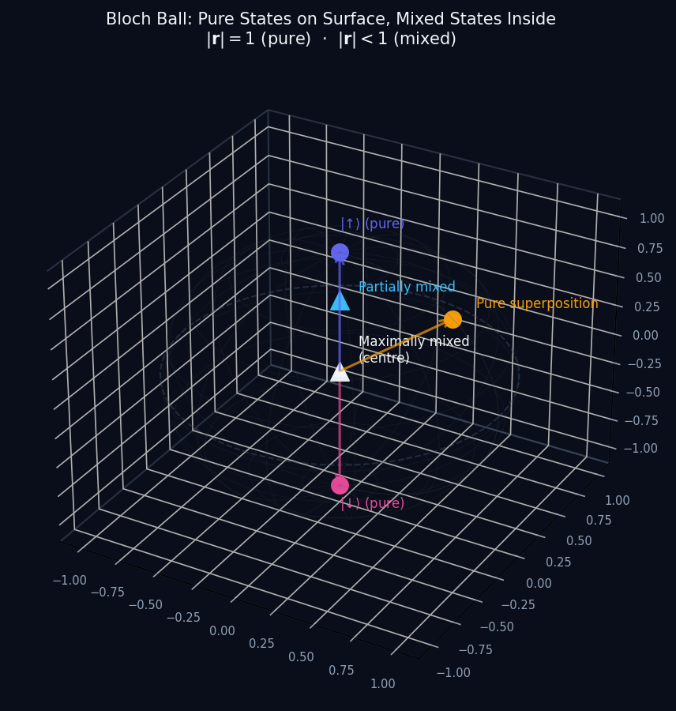
L11 — HS: Density Bloch
L11
High School — Density Operators, Mixed States & Partial Trace
DENSITY BLOCH
HS — DENSITY BLOCH
This lecture covers Density Operators, Mixed States & Partial Trace at the HS level.
GEOMETRIC INTERPRETATION
The diagram on the right shows the 2D/3D geometric analogy for this concept. Use it to build physical intuition before working through the formalism.
• Q1: HS question for L11.
• Q2: HS question for L11.
QM: L11 — HS · Density Bloch
L11 · HS

Slide 4
BegUG
Beginning Undergraduate
1. Pure Vs Mixed
QM: L11 — Beginning Undergraduate
L11

Slide 5
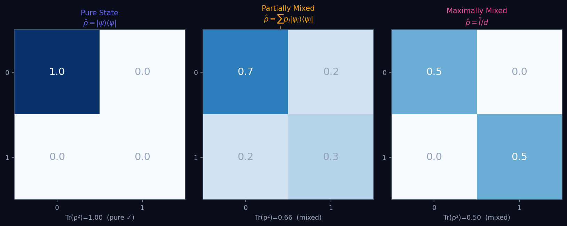
L11 — BegUG: Pure Vs Mixed
L11
Beginning Undergraduate — Density Operators, Mixed States & Partial Trace
PURE VS MIXED
BegUG — PURE VS MIXED
This lecture covers Density Operators, Mixed States & Partial Trace at the BegUG level.
GEOMETRIC INTERPRETATION
The diagram on the right shows the 2D/3D geometric analogy for this concept. Use it to build physical intuition before working through the formalism.
• Q1: BegUG question for L11.
• Q2: BegUG question for L11.
QM: L11 — BegUG · Pure Vs Mixed
L11 · BegUG

Slide 6
AdvUG
Advanced Undergraduate
1. Kraus Channel
QM: L11 — Advanced Undergraduate
L11

Slide 7
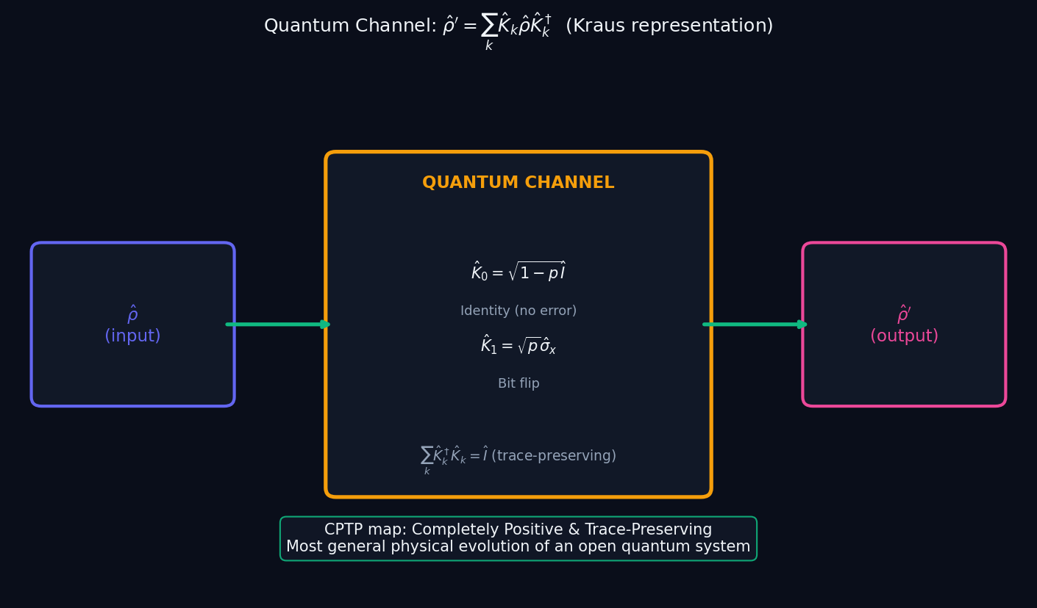
L11 — AdvUG: Kraus Channel
L11
Advanced Undergraduate — Density Operators, Mixed States & Partial Trace
KRAUS CHANNEL
AdvUG — KRAUS CHANNEL
This lecture covers Density Operators, Mixed States & Partial Trace at the AdvUG level.
GEOMETRIC INTERPRETATION
The diagram on the right shows the 2D/3D geometric analogy for this concept. Use it to build physical intuition before working through the formalism.
• Q1: AdvUG question for L11.
• Q2: AdvUG question for L11.
QM: L11 — AdvUG · Kraus Channel
L11 · AdvUG

Slide 8
MSc
Master's Level
1. Decoherence
QM: L11 — Master's Level
L11

Slide 9
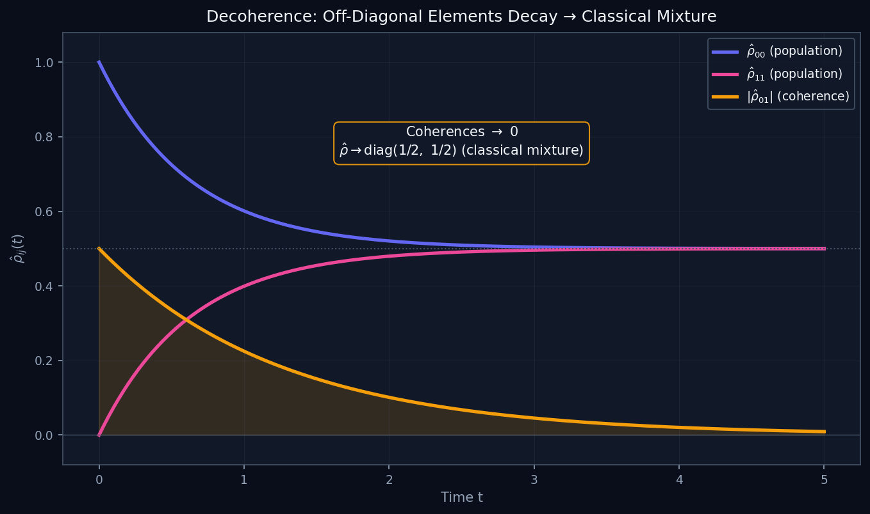
L11 — MSc: Decoherence
L11
Master's Level — Density Operators, Mixed States & Partial Trace
DECOHERENCE
MSc — DECOHERENCE
This lecture covers Density Operators, Mixed States & Partial Trace at the MSc level.
GEOMETRIC INTERPRETATION
The diagram on the right shows the 2D/3D geometric analogy for this concept. Use it to build physical intuition before working through the formalism.
• Q1: MSc question for L11.
• Q2: MSc question for L11.
QM: L11 — MSc · Decoherence
L11 · MSc

