Slide 1
L12
Deep Concept Slides
Rigged Hilbert Spaces & Mathematical Foundations
One slide per core concept · Full explanation · Geometric diagram
HS
BegUG
AdvUG
MSc
PhD
4 concept slides
QM: Bra-Ket — L12 Concepts
L12

Slide 2
HS
High School
1. Gelfand Triple
QM: L12 — High School
L12

Slide 3
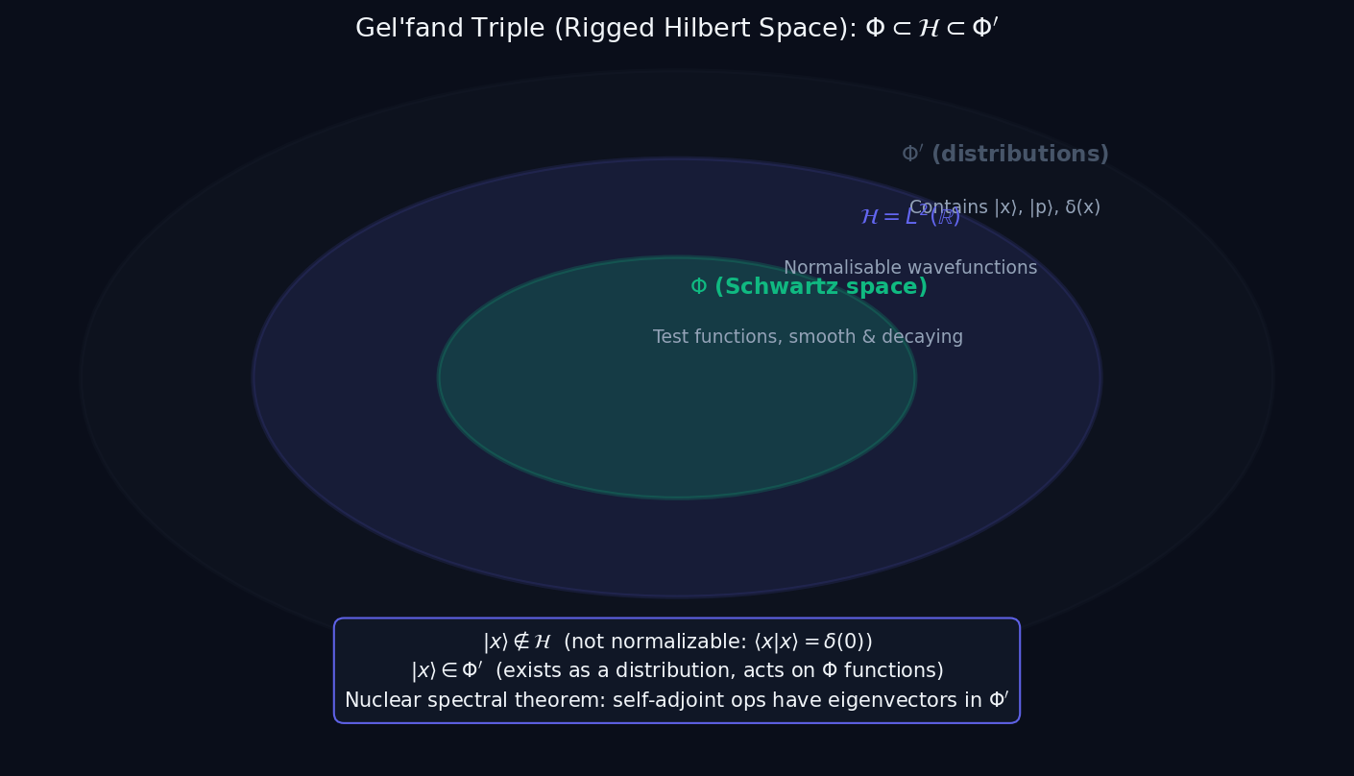
L12 — HS: Gelfand Triple
L12
High School — Rigged Hilbert Spaces & Mathematical Foundations
GELFAND TRIPLE
HS — GELFAND TRIPLE
This lecture covers Rigged Hilbert Spaces & Mathematical Foundations at the HS level.
GEOMETRIC INTERPRETATION
The diagram on the right shows the 2D/3D geometric analogy for this concept. Use it to build physical intuition before working through the formalism.
• Q1: HS question for L12.
• Q2: HS question for L12.
QM: L12 — HS · Gelfand Triple
L12 · HS

Slide 4
BegUG
Beginning Undergraduate
1. Distributional Delta
QM: L12 — Beginning Undergraduate
L12

Slide 5
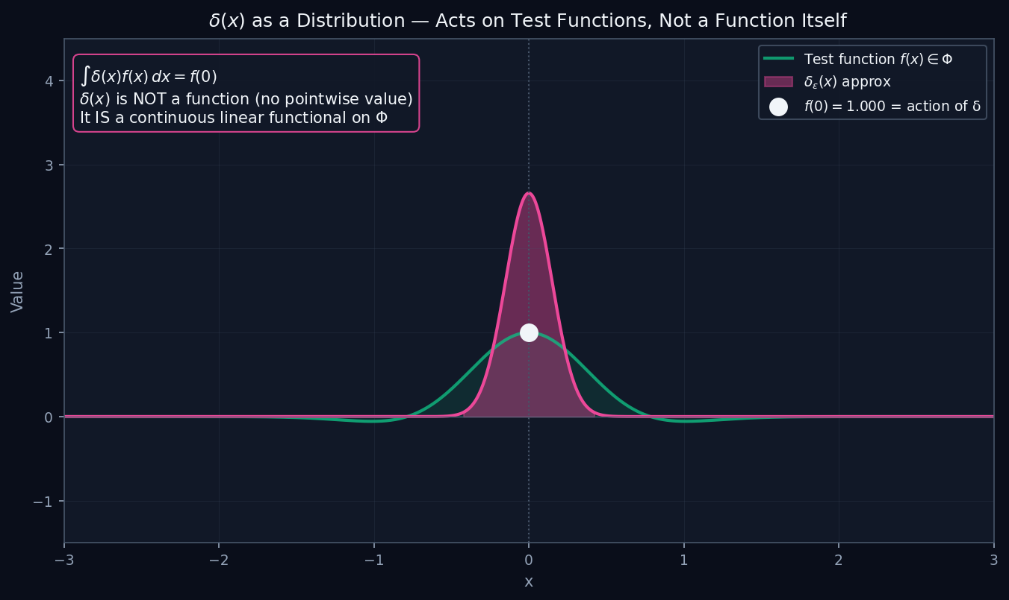
L12 — BegUG: Distributional Delta
L12
Beginning Undergraduate — Rigged Hilbert Spaces & Mathematical Foundations
DISTRIBUTIONAL DELTA
BegUG — DISTRIBUTIONAL DELTA
This lecture covers Rigged Hilbert Spaces & Mathematical Foundations at the BegUG level.
GEOMETRIC INTERPRETATION
The diagram on the right shows the 2D/3D geometric analogy for this concept. Use it to build physical intuition before working through the formalism.
• Q1: BegUG question for L12.
• Q2: BegUG question for L12.
QM: L12 — BegUG · Distributional Delta
L12 · BegUG

Slide 6
AdvUG
Advanced Undergraduate
1. Spectral Measure
QM: L12 — Advanced Undergraduate
L12

Slide 7
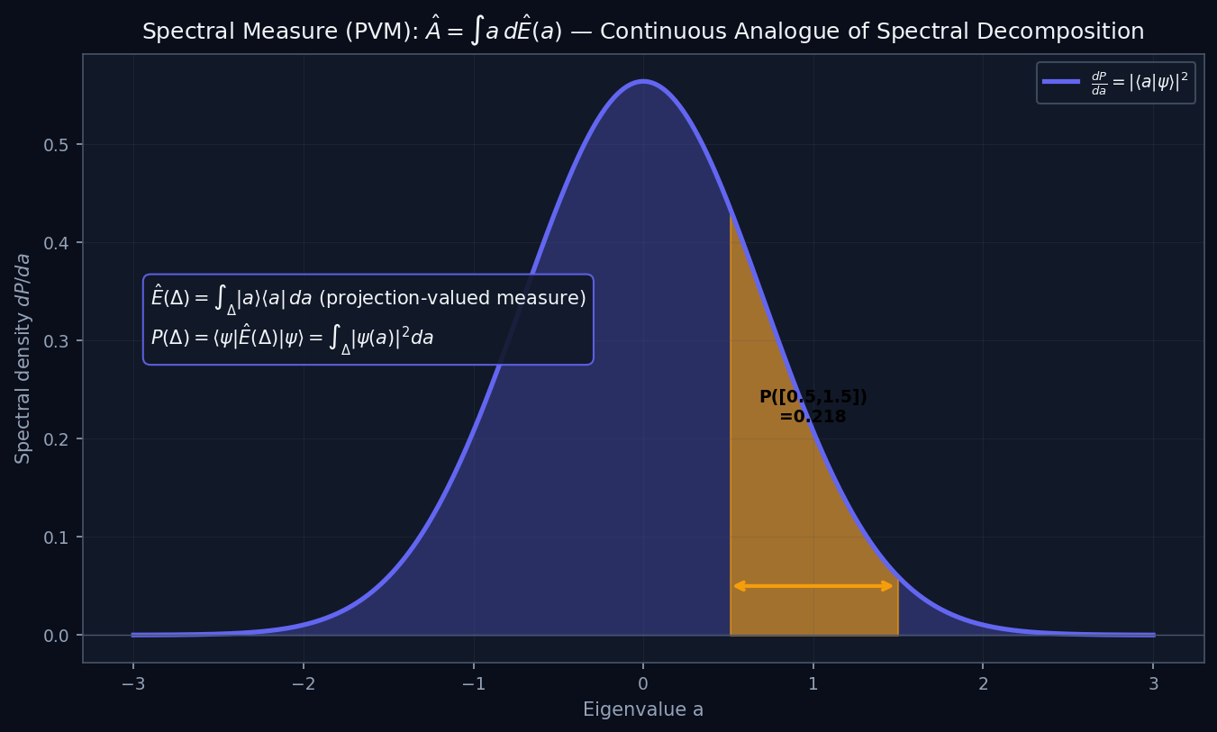
L12 — AdvUG: Spectral Measure
L12
Advanced Undergraduate — Rigged Hilbert Spaces & Mathematical Foundations
SPECTRAL MEASURE
AdvUG — SPECTRAL MEASURE
This lecture covers Rigged Hilbert Spaces & Mathematical Foundations at the AdvUG level.
GEOMETRIC INTERPRETATION
The diagram on the right shows the 2D/3D geometric analogy for this concept. Use it to build physical intuition before working through the formalism.
• Q1: AdvUG question for L12.
• Q2: AdvUG question for L12.
QM: L12 — AdvUG · Spectral Measure
L12 · AdvUG

Slide 8
MSc
Master's Level
1. Deficiency Indices
QM: L12 — Master's Level
L12

Slide 9
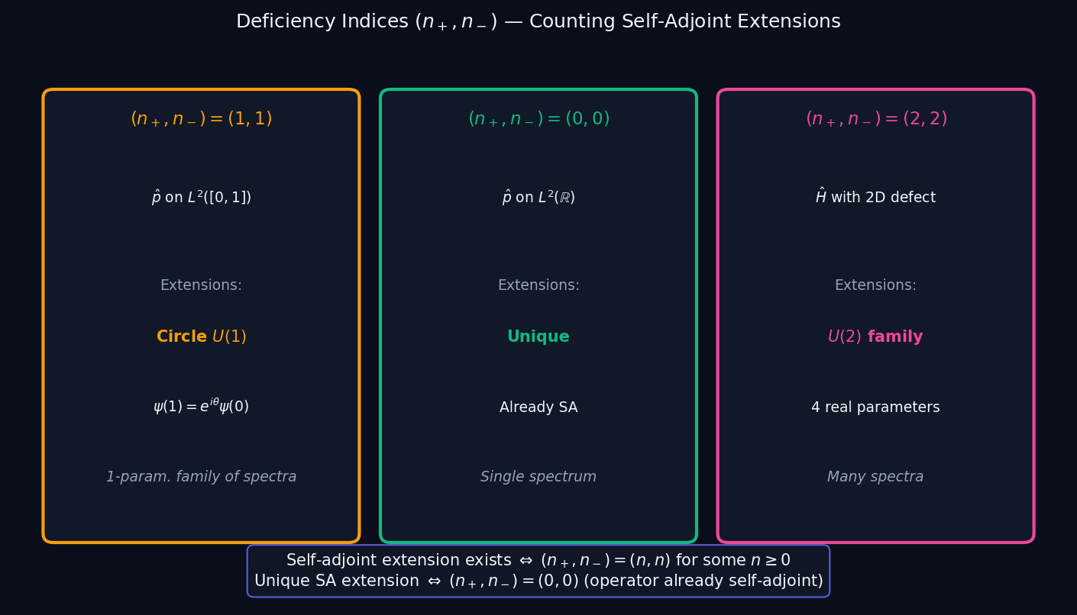
L12 — MSc: Deficiency Indices
L12
Master's Level — Rigged Hilbert Spaces & Mathematical Foundations
DEFICIENCY INDICES
MSc — DEFICIENCY INDICES
This lecture covers Rigged Hilbert Spaces & Mathematical Foundations at the MSc level.
GEOMETRIC INTERPRETATION
The diagram on the right shows the 2D/3D geometric analogy for this concept. Use it to build physical intuition before working through the formalism.
• Q1: MSc question for L12.
• Q2: MSc question for L12.
QM: L12 — MSc · Deficiency Indices
L12 · MSc

