Slide 1
LECTURE 00
Prerequisites for Senior High Schoolers
Light, Refraction, Snell's Law, Matrices — Everything You Need Before the Course
Linear Optics Course · All formulas typeset with LaTeX

Slide 2
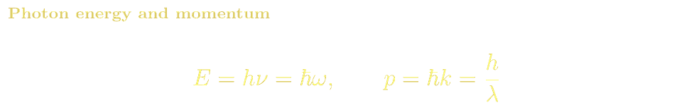
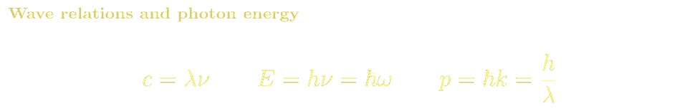
PREREQUISITES
What Is Light? Waves, Rays & Photons
Wave Picture
The Ray Model & Photons
Electromagnetic wave — oscillating E and B fields
Speed c = 1/√(ε₀μ₀) ≈ 3×10⁸ m/s in vacuum
Wavelength λ: crest-to-crest distance (visible: 380–740 nm)
Frequency ν: oscillations per second. Relation: c = λν
Polarization: direction of the E-field oscillation
Colour is determined by wavelength: red ~700 nm, blue ~450 nm
Light travels in straight lines (rays) when λ ≪ objects
Ray optics is the basis of lenses, mirrors, telescopes
Light is quantized into photons: energy E = hν
Wave-particle duality: single photons produce interference
Linear optics: photon number unchanged, only paths & phases altered

Slide 3
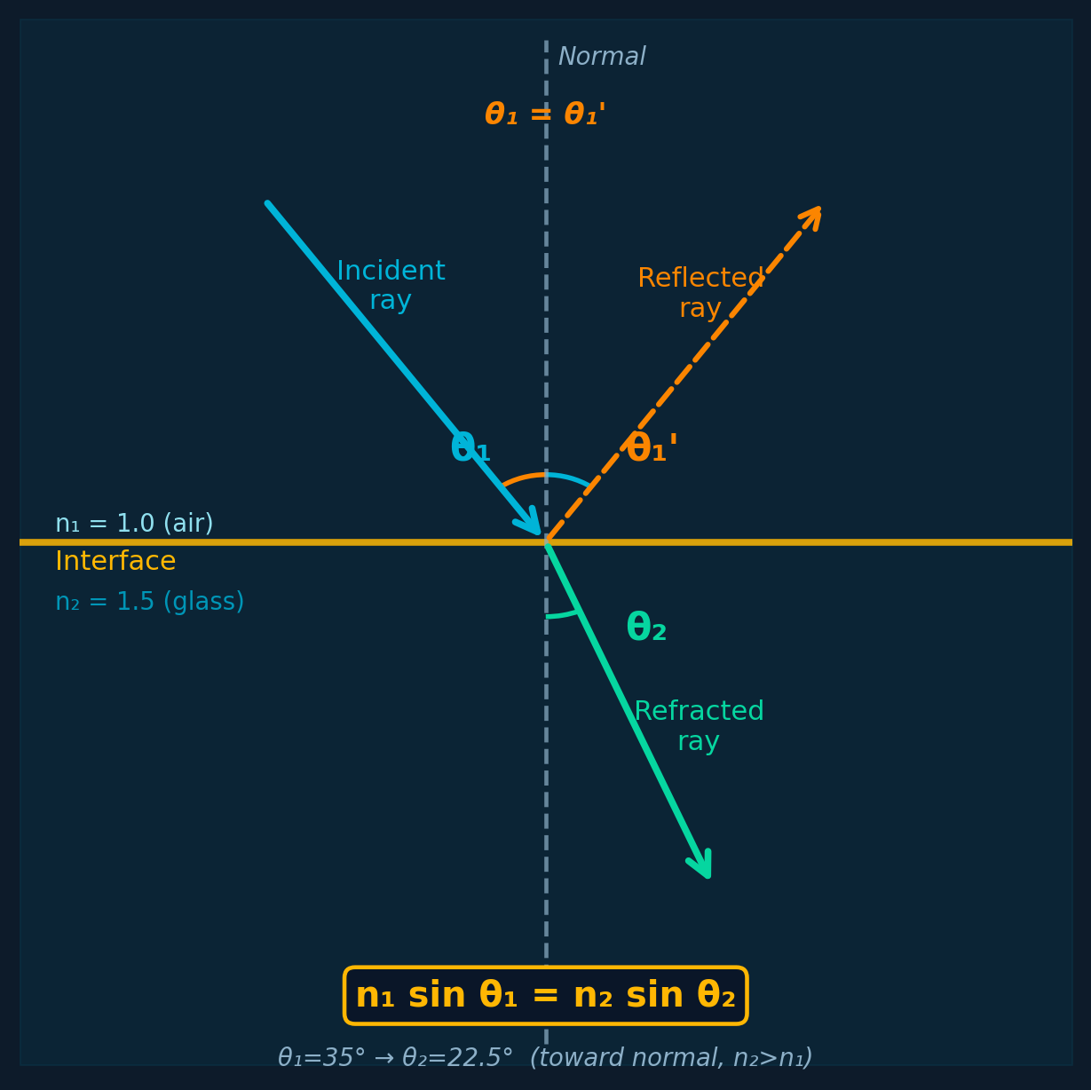

PREREQUISITES
Snell's Law: Refraction & Reflection — Detailed Diagram
Law of Reflection
Angle of incidence θᵢ = angle of reflection θᵣ (from normal)
Incident ray, reflected ray, and normal are coplanar
θᵢ = θᵣ for all smooth (specular) surfaces
Snell's Law of Refraction
Light bends when crossing a boundary between two media
n₂ > n₁: beam bends toward normal (e.g. air → glass)
n₂ < n₁: beam bends away (e.g. glass → air)
θ₁ > θc = arcsin(n₂/n₁): Total Internal Reflection (TIR)

Slide 4
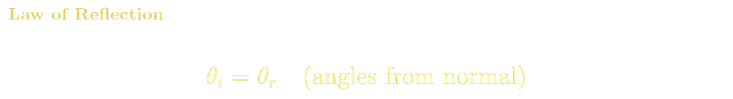
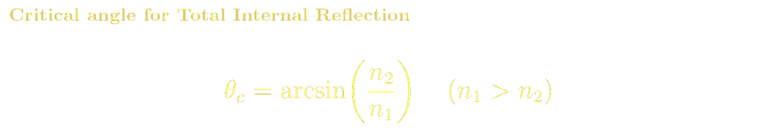
PREREQUISITES
Snell's Law: Numerical Example & Total Internal Reflection
TIR — Fibre Optic Principle
Glass core n₁=1.46, cladding n₂=1.44
θc = arcsin(1.44/1.46) = 80.5°
Light launched within acceptance cone totally internally reflects
Propagates km with <0.2 dB/km loss (single-mode fibre)
Basis of global internet infrastructure
Step-by-step: air → glass (n₁=1.0, n₂=1.5, θ₁=30°)
1. Write Snell's law: n₁ sinθ₁ = n₂ sinθ₂
2. Substitute: (1.0)×sin(30°) = (1.5)×sinθ₂
3. sin(30°)=0.5, so sinθ₂ = 0.5/1.5 = 0.333
4. θ₂ = arcsin(0.333) ≈ 19.5° — beam bends toward normal ✓
Total Internal Reflection (TIR)
When n₁ > n₂ there is a critical angle θc = arcsin(n₂/n₁). For θ₁ > θc, NO refracted ray exists — all light reflects. This is the basis of optical fibers.

Slide 5
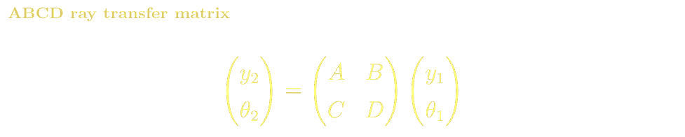
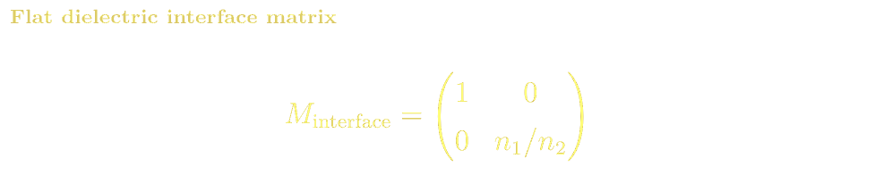
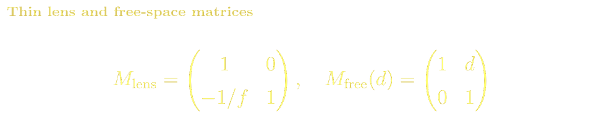
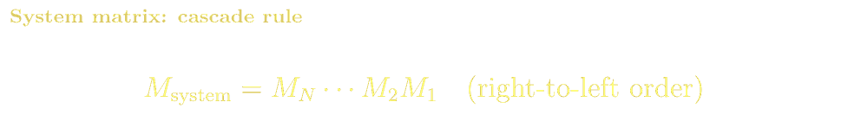
PREREQUISITES
Introduction to Matrices: From Linear Equations to ABCD
A matrix is a rectangular array of numbers. Multiplying a 2×2 matrix by a 2-vector transforms one vector into another — exactly what an optical element does to a ray.
Worked Example: Air → Glass
n₁=1.0, n₂=1.5, ray: y₁=2mm, θ₁=0.1 rad
Step-by-step rule for 2×2 × 2-vector
y₂ = 1·2.0 + 0·0.1 = 2.0 mm (height unchanged)
θ₂ = 0·2.0 + 0.667·0.1 = 0.0667 rad
Bends toward normal ✓ (0.1 → 0.067 rad)
Check: sin(0.1)≈0.1, ×(1.0/1.5) = 0.067 ✓
Top output: y₂ = A·y₁ + B·θ₁ (top row dotted with input vector)
Bottom output: θ₂ = C·y₁ + D·θ₁ (bottom row dotted with input)
Each output is a weighted sum — this is a linear map
System of N elements: multiply matrices right-to-left

Slide 6
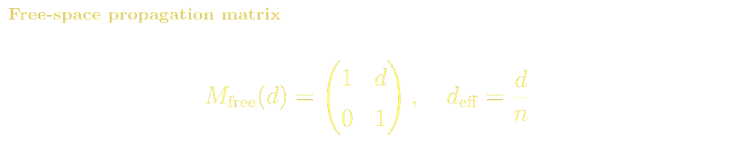
PREREQUISITES
Matrix Multiplication & Cascading Two Elements
Why matrices are powerful
Each optical element → one 2×2 matrix
Any number of elements → one matrix product
Trace a ray through a telescope with one multiply
This is the ABCD (Ray Transfer Matrix) method
Covered in full depth in Lecture 2
Thin lens example: f=100mm, y₁=5mm, θ₁=0 rad
Lens matrix: M = [1,0; -1/f, 1] = [1,0; -0.01, 1]
Top: y₂ = 1×5 + 0×0 = 5.0 mm (height unchanged)
Bottom: θ₂ = -0.01×5 + 1×0 = -0.05 rad (tilted toward axis)
After 100mm free space: y = 5 + (-0.05)×100 = 0 → focused! ✓
Cascading: 50mm free space then lens f=100mm
M = M_lens × M_free = [1,0;-0.01,1] × [1,50;0,1] = [1,50;-0.01,0.5] ← one matrix replaces both elements

Slide 7
PREREQUISITES
High School Reading List & Resources
Feynman Lectures on Physics, Vol. I — Ch. 26–36
Optics, reflection, refraction, diffraction, interference. Free at feynmanlectures.caltech.edu
Hecht, Optics (5th ed.) — Chapters 1–4
Nature of light, reflection, refraction, basic wave optics. The standard BSc optics text with excellent diagrams.
Jenkins & White, Fundamentals of Optics — Ch. 1–3
Classic clear introduction to ray optics and laws of reflection/refraction.
Halliday, Resnick & Walker, Physics — Ch. 33–36
EM waves, reflection, refraction, interference, diffraction. Standard pre-university text.
Online: PhET 'Bending Light' & 'Wave Interference' (phet.colorado.edu) · Khan Academy: Geometric Optics unit

