Slide 1
LECTURE 00b
Projective Geometry & Metric Tensors
Scalar Products · Homogeneous Coordinates · Transformations · Distances on Curved Spaces
Linear Optics Course · All formulas typeset with LaTeX

Slide 2
PART A — HIGH SCHOOL PREREQUISITES
The Scalar (Dot) Product
From geometric projection to Euclidean distance — the common thread running through all of this lecture
Geometric meaning
The dot product a·b = |a||b|cosθ measures how much of a lies along b — it is a projection.
Coordinate formula
a·b = a₁b₁ + a₂b₂ + a₃b₃ — sum of products of components; no angles needed.
Distance via dot product
The Euclidean distance is d(a,b) = √((a−b)·(a−b)) — derived entirely from the dot product.
Generalisation
Replacing the identity matrix I with any symmetric positive-definite matrix g changes which distances are measured — this is the metric tensor.

Slide 3


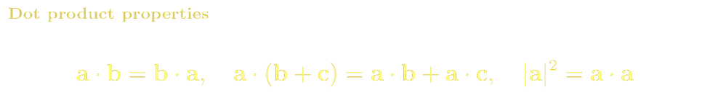
PREREQUISITES · SCALAR PRODUCT
The Scalar Product as a Geometric Projection
The scalar (dot) product has a precise geometric meaning: it measures the signed length of the projection of one vector onto another. This is the foundation of everything that follows.
Projection diagram
Worked example: a=(3,1), b=(4,0)
a
a·b = 3×4 + 1×0 = 12
|a| = √(9+1) = √10 ≈ 3.16, |b| = 4
cosθ = 12/(3.16×4) = 0.949 → θ ≈ 18.4°
proj_b(a) = (a·b/|b|²)b = (12/16)(4,0) = (3,0)
Component: a·b/|b| = 12/4 = 3.0 ✓
θ
b
proj

Slide 4
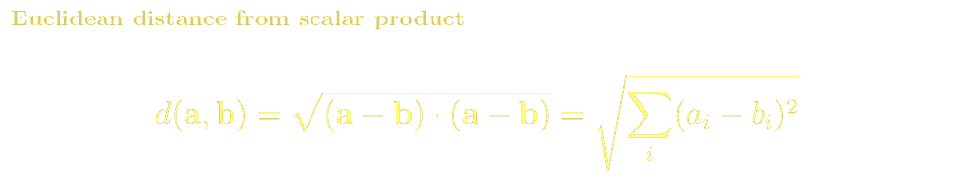
PREREQUISITES · SCALAR PRODUCT
From Scalar Product to Euclidean Distance
The Euclidean distance between two points is completely determined by the scalar product. This connection will generalise: changing the scalar product changes which distances are measured.
Derivation in 2D
Matrix form (key insight)
Let a=(a₁,a₂), b=(b₁,b₂). Difference vector: d = a−b = (a₁−b₁, a₂−b₂).
d·d = (a₁−b₁)²+(a₂−b₂)²
d(a,b) = √(d·d) = √((a₁−b₁)²+(a₂−b₂)²) (Pythagoras ✓)
d(a,b)² = (a−b)ᵀ I (a−b) where I = identity matrix
The matrix I defines which scalar product we use.
Replace I with any matrix g → different geometry!
This is the metric tensor (Section C of this lecture).
Why this matters for the rest of the lecture
The scalar product ℓ·x = 0 (a point lies on a line) is the central concept in projective geometry
Euclidean geometry: g = I₃ (identity) gives the familiar flat distances
Minkowski spacetime: g = diag(1,−1,−1,−1) gives relativistic intervals
Sphere: g_ij(θ,φ) encodes curved distances on the surface of a globe

Slide 5
PART B — PROJECTIVE GEOMETRY
From Ordinary Planes to the Projective Plane
Parallel lines meet · Points at infinity · Duality between points and lines
Axioms
Two points determine a unique line. Two lines determine a unique point. No exceptions — no 'parallel' lines.
Homogeneous coordinates
Points and lines both become 3-vectors. The scalar product between them has an exact meaning: incidence (lying on).
Duality
Every theorem about points and lines has a dual theorem — swap the words and it still holds.
Transformations
3×3 invertible matrices (homographies H) act on points and lines while preserving incidence.

Slide 6
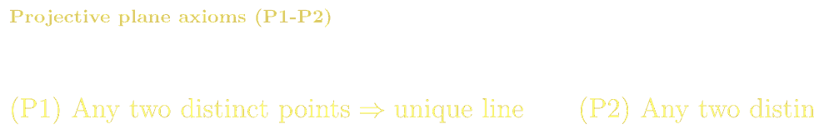
PROJECTIVE GEOMETRY · AXIOMS
Axioms of Projective Geometry
Ordinary (Euclidean) geometry has an awkward exception: parallel lines never meet. Projective geometry removes this exception by adding 'points at infinity'. The result is a cleaner, more symmetric theory.
The three axioms
The Duality Principle
P1: Any two distinct points lie on a unique line
P2: Any two distinct lines meet in a unique point
P3: There exist four points, no three of which are collinear (non-degenerate quadrilateral — prevents trivial models)
Swap the words 'point' and 'line' in any true theorem → get another true theorem.
P1 dual: Any two distinct lines lie on a unique point (= P2).
Every configuration has a dual configuration. Every proof has a dual proof.
Parallel lines in the projective plane
Classical theorems
Parallel lines in ℝ² (same direction d) both pass through the point at infinity (d₁:d₂:0)
Distinct parallel families → distinct points at infinity
All points at infinity lie on the line at infinity: (0:0:1) row vector
So the Euclidean plane ℝ² ⊂ ℙ² as the complement of the line at infinity
Pappus' theorem: six points on two lines → three intersection points are collinear
Desargues' theorem: two triangles perspective from a point ↔ perspective from a line
Cross-ratio: the one projective invariant of four collinear points
These all follow cleanly from the axioms — no coordinates needed!

Slide 7
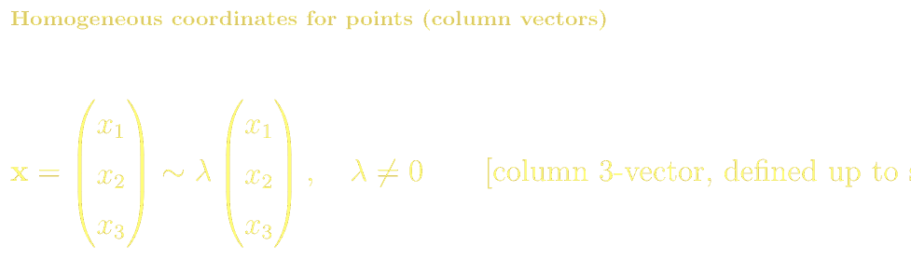
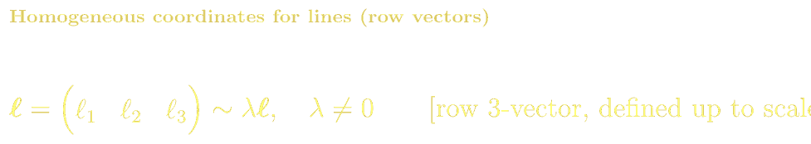
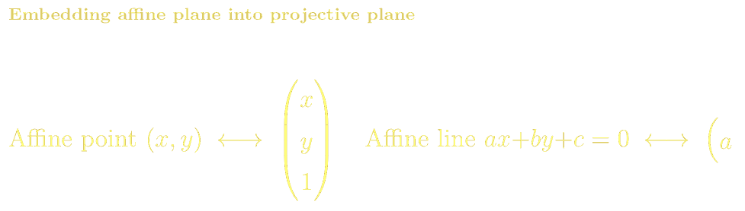
PROJECTIVE GEOMETRY · COORDINATES
Homogeneous Coordinates: Points and Lines as 3-Vectors
To compute with projective geometry we use homogeneous coordinates. Points become column 3-vectors; lines become row 3-vectors. Both are defined only up to a non-zero scalar multiple.
Reading homogeneous coordinates
Examples
(x₁:x₂:x₃) with x₃≠0 corresponds to affine point (x₁/x₃, x₂/x₃) ∈ ℝ²
(x₁:x₂:0) is a point at infinity in direction (x₁,x₂)
Scale doesn't matter: (2:4:2) and (1:2:1) are the same point (1,2)
Affine line ax+by+c=0 ↔ row vector (a : b : c) in projective coordinates
Line at infinity: (0 : 0 : 1) — contains all points (d₁:d₂:0)
Point (3,2) ↔ column (3:2:1)ᵀ
Point at infinity 'rightward' ↔ (1:0:0)ᵀ
Horizontal line y=5 (i.e. 0·x+1·y−5=0) ↔ row (0:1:−5)
Line at infinity ↔ row (0:0:1)
Check: (0:1:−5)·(3:5:1)ᵀ = 0+5−5 = 0 ✓ (point (3,5) lies on y=5)
Check: (0:0:1)·(d₁:d₂:0)ᵀ = 0 ✓ (all points at infinity lie on line at infinity)

Slide 8

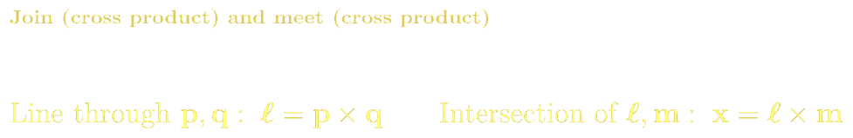
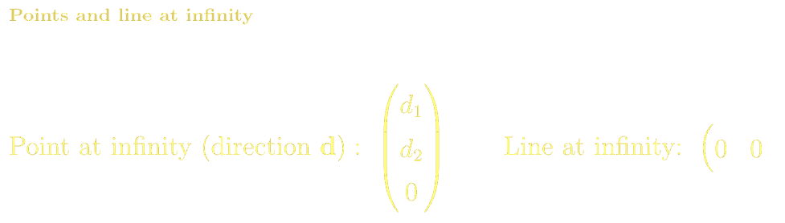
PROJECTIVE GEOMETRY · INCIDENCE
Incidence as a Scalar Product: ℓ · x = 0
The central operation in projective geometry is the scalar product between a line (row vector) and a point (column vector). It is zero if and only if the point lies on the line — this is the incidence condition.
Join and meet via cross product
Worked example: where do two lines meet?
Line through p and q: ℓ = p × q (treat column vectors as 3D vectors, take cross product)
Intersection of lines ℓ and m: x = ℓ × m (same operation — duality!)
Cross product yields a 3-vector; treat result as column (point) or row (line) as needed
ℓ₁ = (1:0:−2) [line x=2] and ℓ₂ = (0:1:−3) [line y=3]
x = ℓ₁ × ℓ₂ = (0·(−3)−(−2)·1 , (−2)·0−1·(−3) , 1·1−0·0)
= (2 : 3 : 1)
Affine point: (2/1, 3/1) = (2, 3) ✓

Slide 9

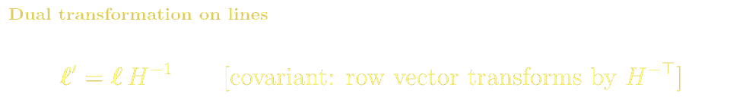

PROJECTIVE GEOMETRY · TRANSFORMATIONS
3×3 Matrix Transformations: Points, Lines and Invariance
A 3×3 invertible real matrix H (homography) transforms the entire projective plane. It acts differently on points (column vectors) and lines (row vectors) so that incidence is always preserved.
Why ℓ transforms by H⁻ᵀ
Types of homographies
We need ℓ'x' = 0 whenever ℓx = 0.
x' = Hx so ℓ' must satisfy ℓ'(Hx) = 0
⟹ (ℓ'H)x = 0 for all x on ℓ
⟹ ℓ'H = ℓ ⟹ ℓ' = ℓH⁻¹
Equivalently: ℓ'ᵀ = H⁻ᵀ ℓᵀ (column form: covariant).
Euclidean motions (rotation + translation): H = [R|t; 0ᵀ|1], preserves distances
Similarities: H = s[R|t; 0ᵀ|1], preserves angles, not distances
Affinities: H = [A|t; 0ᵀ|1], preserves parallelism
General projectivity: any 8-dof H, preserves collinearity and cross-ratio only
Each subgroup has its own invariants — projective is the most general

Slide 10
PROJECTIVE GEOMETRY · SUMMARY
Summary: The Projective Plane at a Glance
POINT x
LINE ℓ
Column 3-vector:
x = (x₁, x₂, x₃)ᵀ
defined up to scale
Affine: (x₁/x₃, x₂/x₃)
At ∞: x₃ = 0
ℓ · x = 0
Row 3-vector:
ℓ = (ℓ₁ ℓ₂ ℓ₃)
defined up to scale
Affine: ℓ₁x+ℓ₂y+ℓ₃=0
At ∞: (0 0 1)
point lies on line
x' = H x
Join & Meet
ℓ' = ℓ H⁻¹
H ∈ GL(3,ℝ)
3×3 invertible matrix
8 degrees of freedom
Line p∨q: ℓ = p × q
Point ℓ∧m: x = ℓ × m
(same operation — duality!)
Dual transform
preserves incidence:
ℓ'x' = ℓx always
Key invariant: ℓ'x' = (ℓH⁻¹)(Hx) = ℓx — incidence is invariant under all projective transformations

Slide 11
PART C — DISTANCES VIA SCALAR PRODUCTS
Euclidean, Minkowski & Metric Tensors
Changing the matrix in the scalar product changes which distances are measured
Euclidean distance
g = I (identity). Gives the familiar flat-space Pythagoras theorem. Preserved by rotations and reflections.
Minkowski distance
g = diag(1,−1,−1,−1). Gives spacetime interval. Preserved by Lorentz boosts. Can be negative!
Metric tensor
g_ij(u) varying with position. Gives distances on curved 2D surfaces embedded in 3D space.

Slide 12

METRIC TENSORS · EUCLIDEAN
Euclidean Distance: Scalar Product with Identity Matrix
The familiar Euclidean distance is just a scalar product in disguise. The identity matrix I acts as the 'metric' — it tells us how to compute distances in flat space.
The scalar product with g = I
Symmetries preserved by g = I
⟨u,v⟩_I = uᵀ I v = u₁v₁ + u₂v₂ + u₃v₃
|u|² = uᵀ I u = u₁² + u₂² + u₃²
d(a,b)² = (a−b)ᵀ I (a−b) = Pythagoras ✓
Rotations: R ᵀ I R = I — all rotations preserve the distance
Reflections: same property
The group of symmetries is O(3) — the orthogonal group
Translations also preserve d, giving the Euclidean group E(3)
Key insight: the matrix g IS the geometry
Any real symmetric positive-definite matrix g defines a valid inner product and distance. Changing g changes the geometry. The Euclidean case g=I is just the simplest choice. The same scalar product structure xᵀg y applies to all the geometries below.

Slide 13
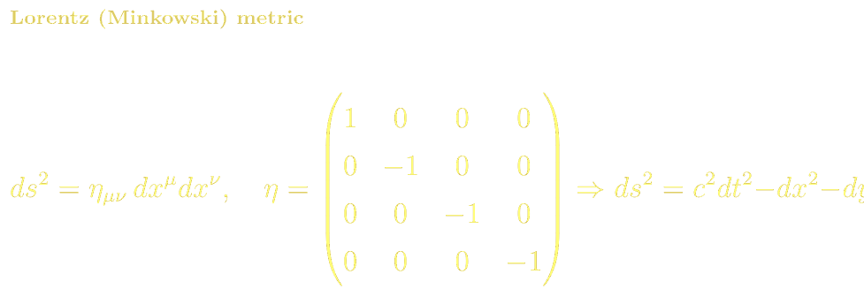
METRIC TENSORS · LORENTZ
Lorentz (Minkowski) Distance: Spacetime Intervals
Replace I with η = diag(1,−1,−1,−1). The resulting 'distance' is the spacetime interval of special relativity — it can be positive, zero (light-like), or negative.
Three types of spacetime interval
Same scalar-product structure
ds² > 0 (time-like): causally connected events. A massive particle can travel between them. |ds| = proper time elapsed on the particle's clock.
ds² = 0 (light-like / null): events connected by a light ray. Photons travel on these paths. No proper time elapses.
ds² < 0 (space-like): events that cannot influence each other. No physical signal can connect them. |ds| = proper length in rest frame.
Lorentz inner product:
⟨u,v⟩_η = uᵀ η v
= u⁰v⁰ − u¹v¹ − u²v² − u³v³
This looks identical to the projective incidence
scalar product ℓ·x — just a bilinear form with
a specific matrix. The geometry is different but
the algebraic machinery is the same.
Lorentz boosts Λ satisfy: Λᵀ η Λ = η
(analogous to Rᵀ I R = I for rotations).

Slide 14
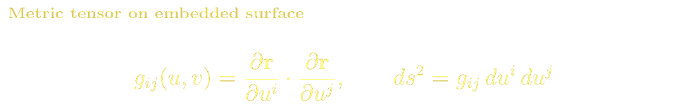
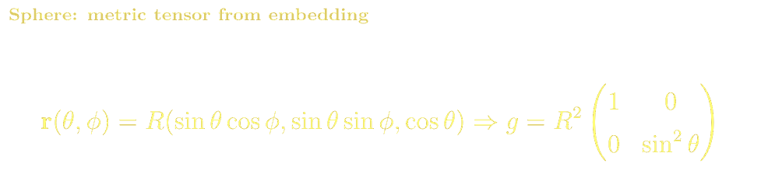
METRIC TENSORS · SURFACE
Metric Tensor on a Curved 2D Surface Embedded in 3D
A 2D surface embedded in 3D inherits a metric from the ambient Euclidean space. The metric tensor g_ij(u,v) encodes how distances in the surface relate to the coordinate changes (du, dv).
Sphere — coordinates (θ,φ)
Computing g from the embedding
g = R²[1 0 ; 0 sin²θ]
ds² = R²(dθ² + sin²θ dφ²)
At equator (θ=π/2): ds² = R²(dθ²+dφ²)
At pole (θ→0): dφ becomes irrelevant
Given r(θ,φ) = R(sinθcosφ, sinθsinφ, cosθ) ∈ ℝ³:
∂r/∂θ = R(cosθcosφ, cosθsinφ, −sinθ)
∂r/∂φ = R(−sinθsinφ, sinθcosφ, 0)
g_θθ = (∂r/∂θ)·(∂r/∂θ) = R²
g_φφ = (∂r/∂φ)·(∂r/∂φ) = R²sin²θ
g_θφ = (∂r/∂θ)·(∂r/∂φ) = 0
→ g = R²diag(1, sin²θ) ✓
θ
φ
R

Slide 15

METRIC TENSORS · INNER PRODUCT
General Inner Product, Lengths and Angles via g
Once we have the metric tensor g, we can define all of geometry: inner products, lengths, angles, and distances — all via the same scalar-product formula with g replacing I.
Length of a vector
Angle between vectors
On the sphere with g=R²diag(1,sin²θ):
|dθ ê_θ| = R dθ (a step in latitude)
|dφ ê_φ| = R sinθ dφ (shorter near poles!)
cosα = ⟨u,v⟩_g / (|u|_g |v|_g)
On sphere: coordinate lines θ=const and φ=const are orthogonal (g_θφ=0) → g is diagonal ✓
Geodesic (shortest path)
Gaussian curvature
Minimise ∫ds = ∫√(g_ij u'ⁱ u'ʲ) dt
On sphere: great circles. On flat plane: straight lines. The metric determines 'straight'.
K = −(1/√g) ∂/∂u[√g Γ] — derived from g
Sphere: K = 1/R². Flat plane: K = 0. g encodes everything about intrinsic geometry.

Slide 16
METRIC TENSORS · UNIFICATION
The Unifying Picture: Scalar Products Everywhere
The scalar product — a bilinear form defined by a matrix g — appears identically in projective geometry (incidence), in Euclidean geometry, in special relativity, and on curved surfaces. Only the matrix changes.
Geometry
Matrix g
Scalar product
What it measures
Symmetry group
Projective ℙ²
any g
ℓᵀg x = 0
Incidence (point on line)
GL(3,ℝ) homographies
Euclidean ℝⁿ
I (identity)
uᵀI v = Σ uᵢvᵢ
Flat distance, angle
O(n) rotations + translations
Minkowski ℝ³ˡ¹
diag(1,−1,−1,−1)
uᵀη v = u⁰v⁰−Σ uⁱvⁱ
Spacetime interval
SO(3,1) Lorentz group
Sphere S²(R)
R²diag(1,sin²θ)
g_ij uⁱ vʲ
Arc length on sphere
SO(3) rotations
General surface
g_ij(u,v) from ∂r/∂uⁱ
g_ij uⁱ vʲ
Curved-surface distance
Diffeomorphisms preserving g

Slide 17
PROJECTIVE GEOMETRY · REFERENCES
References, Exercises & Problem Sets
BSc References & Reading
MSc / Advanced References
Semple & Kneebone, Algebraic Projective Geometry (1952) — Oxford. The classical rigorous introduction.
Coxeter, The Real Projective Plane, 3rd ed. (1993) — Springer. Elegant synthetic treatment.
Hartley & Zisserman, Multiple View Geometry in Computer Vision, 2nd ed. (2004) — Cambridge. Ch. 1–4: homogeneous coords and homographies.
Needham, Visual Complex Analysis — Ch. 3: Möbius transformations as projective maps of ℙ¹.
Strang, Linear Algebra and its Applications — dot products, projections, symmetric matrices.
Misner, Thorne & Wheeler, Gravitation (1973) — Freeman. Box 2.1–2.4: metric tensors, line elements.
Carroll, Spacetime and Geometry (2004) — Pearson. Ch. 1–2: special relativity, metric, Lorentz group.
do Carmo, Differential Geometry of Curves and Surfaces (1976) — Prentice Hall. Ch. 1–2: first fundamental form = metric tensor.
Faugeras, Three-Dimensional Computer Vision (1993) — MIT Press. Ch. 3: projective geometry applied to cameras.
Penrose & Rindler, Spinors and Space-Time Vol. 1 — Cambridge. Abstract index notation and metric geometry.
Problem Sets & Projects
[HS] Show that (1:2:1), (3:4:1) lie on the line (2:−1:0). Verify ℓ·x=0.
[HS] Find the projective intersection of y=2x+1 and y=−x+4. Express both lines as row vectors and compute the cross product.
[BSc] Prove the dual of Pappus' theorem by swapping 'point' and 'line' in the statement and the proof.
[BSc] Show that for a homography H ∈ GL(3,ℝ), the cross-ratio (ABCD) = (A'B'C'D') is preserved.
[BSc] Compute the metric tensor for the cylinder r(θ,z)=(cosθ, sinθ, z). Show that ds² = dθ²+dz² (flat!).
[MSc] Derive the geodesic equations on the sphere from the metric g=R²diag(1,sin²θ). Show that great circles are solutions.
[MSc] Show that the Lorentz boost Λ(β) with velocity β satisfies Λᵀ η Λ = η. What is the geometric meaning?
[MSc Project] Implement a projective homography estimator in Python using the DLT algorithm. Unwarp a photographed planar surface using 4-point correspondences.

