Slide 1
LECTURE 02
ABCD Ray Transfer Matrices
Paraxial Optics · Component Matrices · System Design · Telescope Examples
Linear Optics Course · All formulas typeset with LaTeX

Slide 2
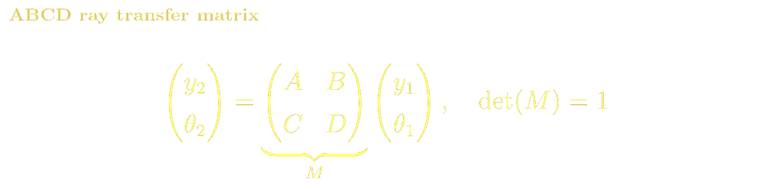
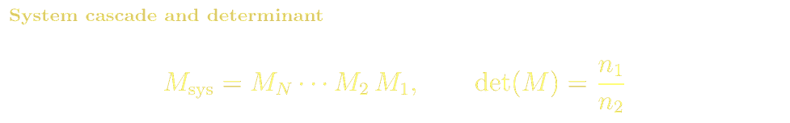
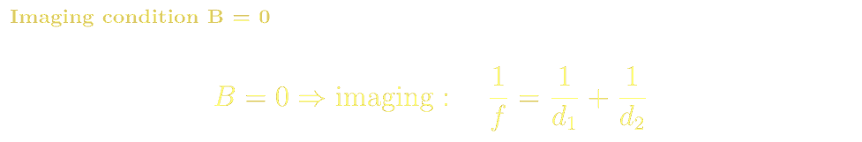
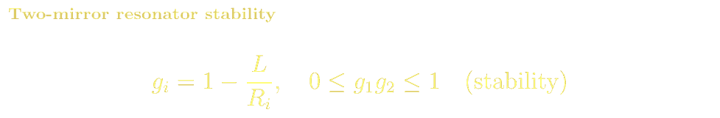
ABCD MATRICES
The Paraxial Approximation & ABCD Formalism
The paraxial (small-angle) approximation sinθ ≈ θ linearises ray propagation, enabling every optical element to be a 2×2 real matrix:
ABCD Element Meanings
A = y₂/y₁ at θ₁=0 (transverse magnification)
B = y₂/θ₁ at y₁=0 (units of length)
C = θ₂/y₁ at θ₁=0 (optical power = −C)
D = θ₂/θ₁ at y₁=0 (angular magnification)
det(M) = 1 (homogeneous medium)
B = 0: imaging condition
C = 0: afocal (telescope)

Slide 3
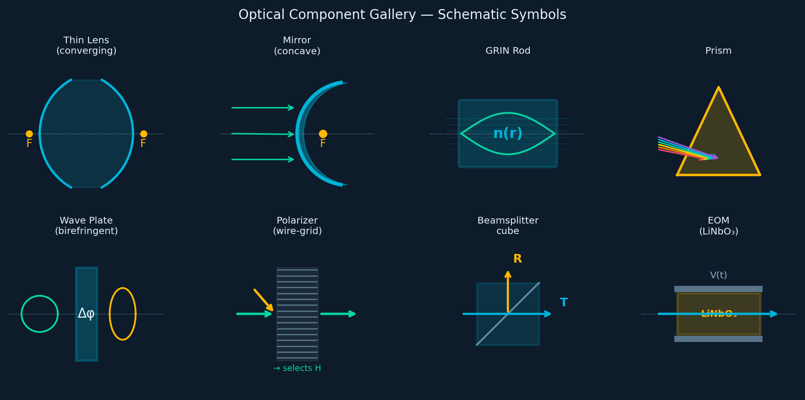
ABCD MATRICES · COMPONENTS
Optical Component Schematic Symbols
Every optical element has a standard schematic symbol used in ray diagrams and system layouts:
Biconvex lens · Concave mirror · GRIN rod · Dispersing prism · Wave plate (Δφ) · Wire-grid polarizer · BS cube · EOM (LiNbO₃ crystal with electrodes)

Slide 4
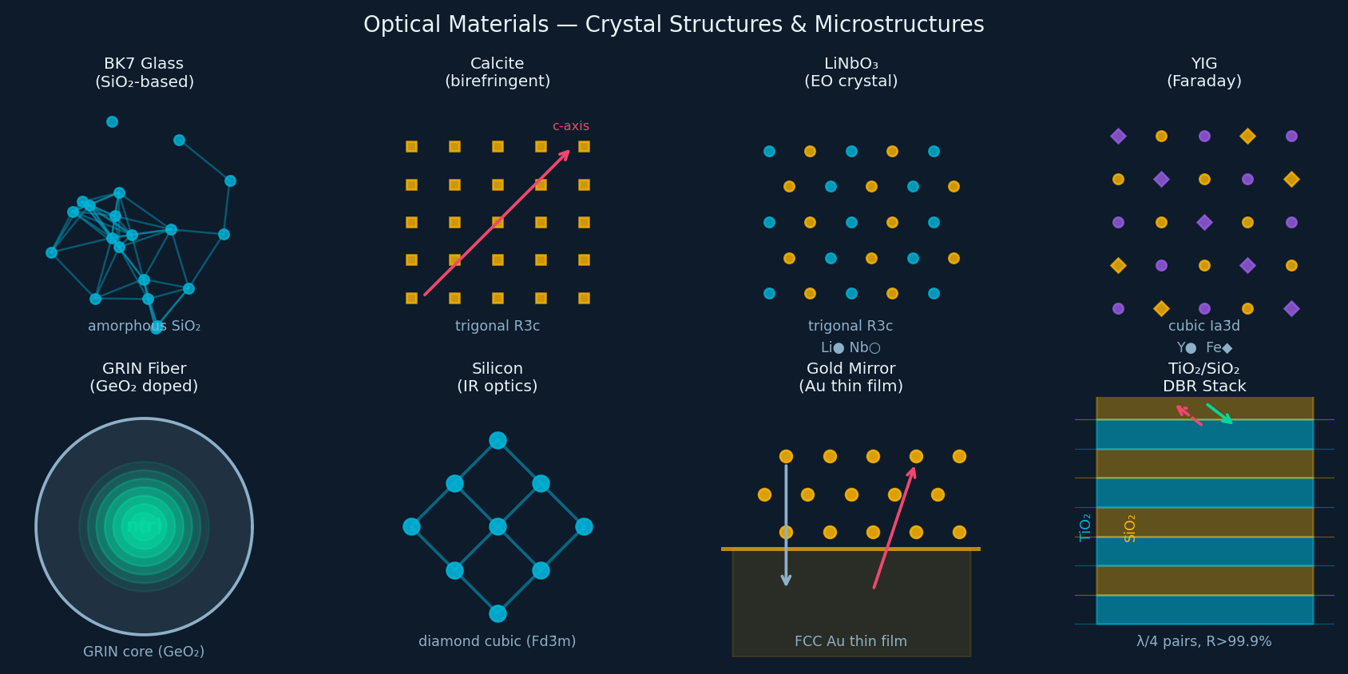
ABCD MATRICES · MATERIALS
Optical Materials: Crystal Structures & Microstructures
The macroscopic optical properties arise from the microscopic crystal structure. Here is the structural origin of key materials:
BK7 amorphous SiO₂ · Calcite trigonal R3̄c · LiNbO₃ trigonal R3c · YIG cubic Ia3̄d · GRIN fibre graded GeO₂ core · Si diamond cubic Fd3̄m · Au FCC thin film · TiO₂/SiO₂ DBR multilayer

Slide 5
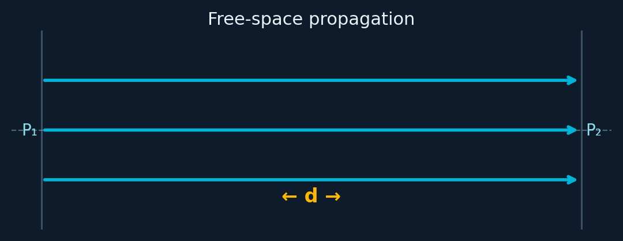
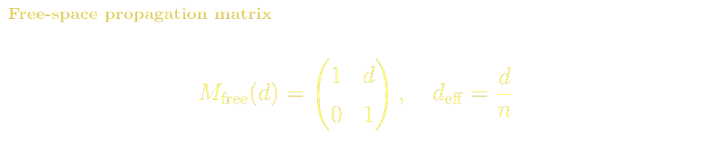
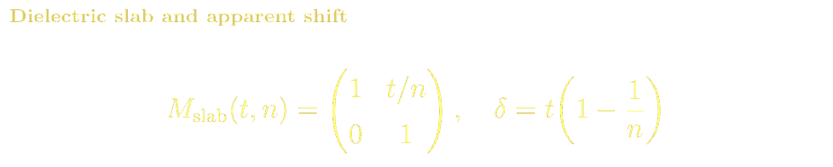
ABCD MATRICES
ABCD: Free-Space Propagation
Microscopic Origin & Materials
In vacuum light travels at c with no interaction. In a dielectric, the macroscopic n = √εᵣ emerges from the Clausius-Mossotti relation linking atomic polarizability to εᵣ. Electrons oscillate driven by E; their re-radiated field slows propagation to c/n.
1 m of BK7 (n=1.517) → d_eff = 0.659 m for ray-matrix purposes.
1 m of Si (n=3.48) → d_eff = 0.287 m.
n (λ=589nm):
Air 1.0003 · BK7 1.517 · SiO₂ 1.458
Si 3.48 · Ge 4.0 · GaAs 3.6
Height increases with angle (y₂ = y₁ + d·θ₁). Angle unchanged. In medium n: replace d with d/n (reduced distance).

Slide 6
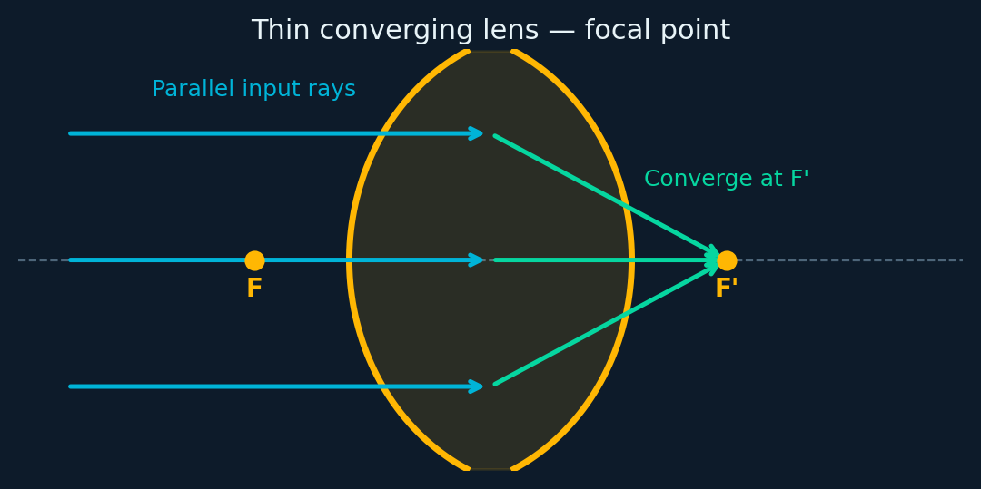
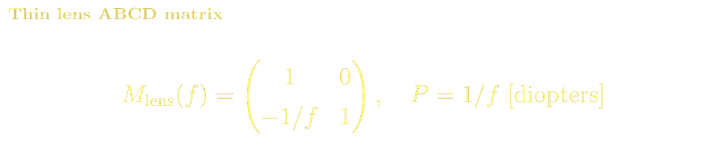
ABCD MATRICES
ABCD: Thin Lens
Microscopic Structure & Materials
Glass lenses are amorphous SiO₂ networks. Curved surfaces ground/polished to sub-λ roughness. AR coatings reduce Fresnel reflection <0.1% per surface.
Refractive index from electronic polarizability of Si-O bonds (Kramers-Kronig). Dispersion from UV electronic and mid-IR phonon resonances.
BK7: n=1.517, V=64
Fused SiO₂: n=1.458, V=68, UV grade
N-SF11: n=1.784, V=25 (dense flint)
CaF₂: n=1.434, UV & IR range
Si, Ge: mid-IR optics (3–12 μm)
Lens changes angle but not height. Cascade M_free(d₂)·M_lens·M_free(d₁), set B=0 to get 1/f = 1/d₁+1/d₂.

Slide 7
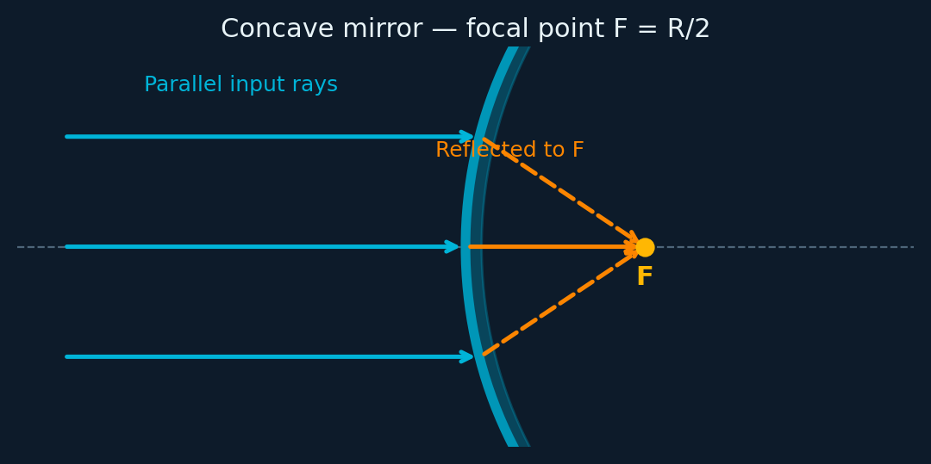
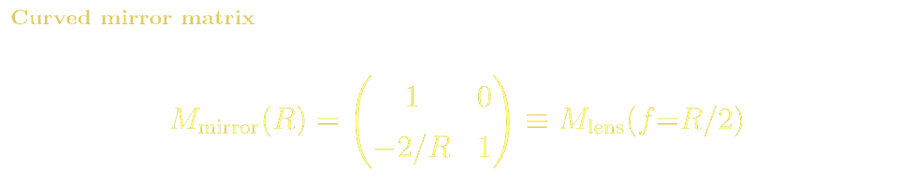
ABCD MATRICES
ABCD: Curved Mirror
Microscopic Structure & Materials
Metallic mirrors: Al, Ag, Au thin films (~100 nm) evaporated onto polished glass. Ag: R~98% VIS; Au: R~98% NIR/IR.
Dielectric mirrors: alternating λ/4 layers TiO₂ (n~2.3)/SiO₂ (n~1.45). 20–40 pairs → R>99.99%. Supermirrors for cavity QED reach R>99.9999%.
Substrate: Zerodur® or ULE® glass-ceramic for ultra-low thermal expansion.
Al: telescopes, broadband
Ag: spectroscopy, optical clocks
Au: IR/THz, λ>700nm
DBR stacks: laser cavities
Equivalent to thin lens with f = R/2. In an unfolded cavity diagram, mirrors → equivalent lenses.

Slide 8
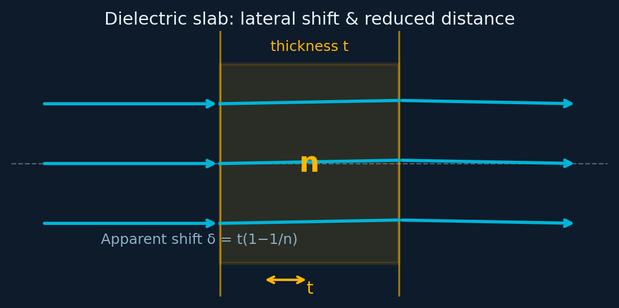
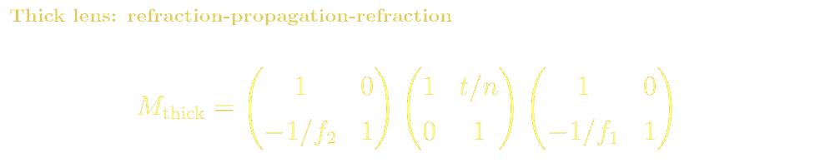
ABCD MATRICES
ABCD: Thick Lens & Dielectric Slab
Thick Lens & Apparent Shift
Principal planes H,H' shift inward from vertices for biconvex lens
EFL measured from H,H' — not from lens surfaces
Slab shifts apparent object position: δ = t(1−1/n) toward observer
Critical in microscopy: coverslip correction collar, oil immersion (n=1.515)
Example: 0.17mm coverslip, n=1.515: δ = 0.17×(1−1/1.515) ≈ 0.058 mm
Apparent thickness of a fish tank wall from outside

Slide 9
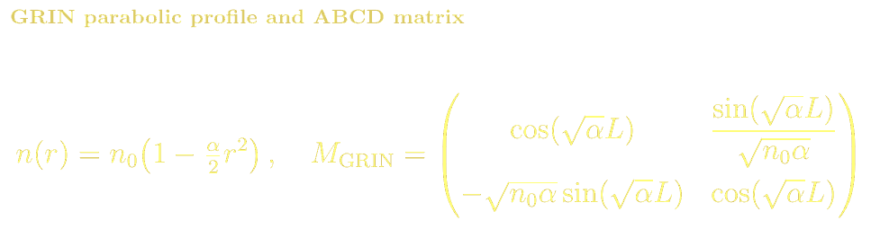
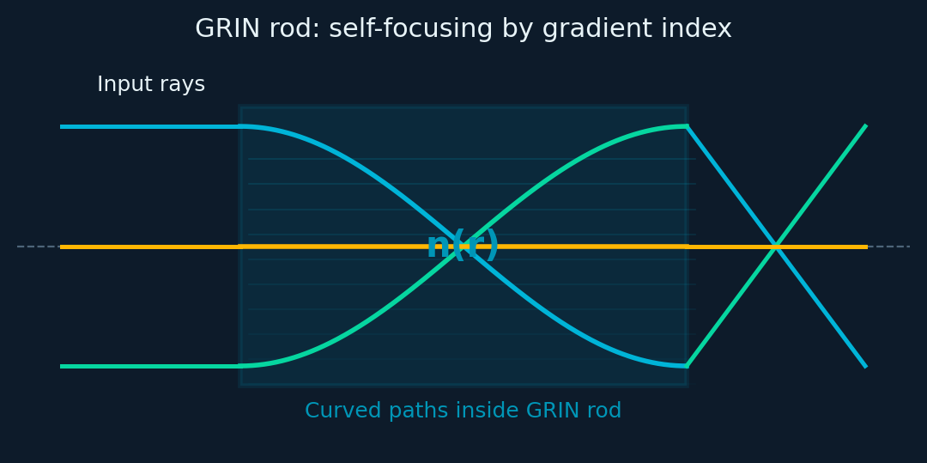
ABCD MATRICES
ABCD: Gradient-Index (GRIN) Medium
Microscopic Structure & Materials
GRIN lenses fabricated by controlled ion-exchange: immersing glass in molten salt bath (AgNO₃ or TlNO₃) replaces Na⁺ ions, creating graded dopant → parabolic n(r). Quarter-pitch rod (L=π/2√α) collimates a point source; half-pitch images input to output plane.
Fiber GRIN preforms: modified CVD (MCVD) — layer-by-layer SiO₂/GeO₂ deposition with graded Ge doping.
NSG Selfoc® GRIN rods · GRIN fiber collimators
GRIN endoscope objectives · LIDAR · OM3/OM4/OM5

Slide 10
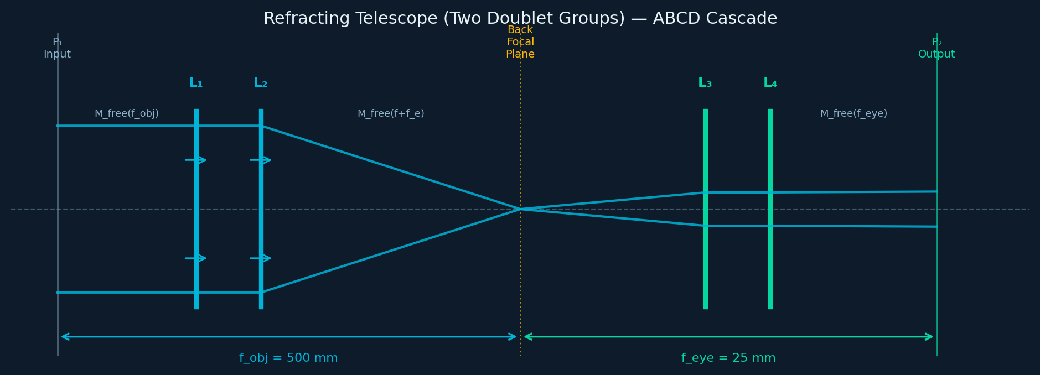
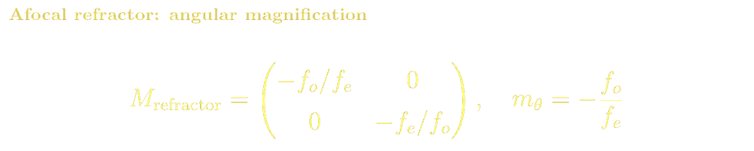
ABCD MATRICES · TELESCOPE
Extended Example: Refracting Telescope (Two Doublet Groups)
A refractor telescope is an afocal (C=0) system: objective + eyepiece separated by f_obj+f_eye. We trace a ray through all planes using the ABCD cascade:
Key Results & Interpretation
C=0 confirms afocal design: collimated input → collimated output
Angular magnification = −f_obj/f_eye = −500/25 = −20× (inverted)
Add erecting prism (M=−1) → upright image for terrestrial use
B-element gives the tube length (entrance pupil location)

Slide 11
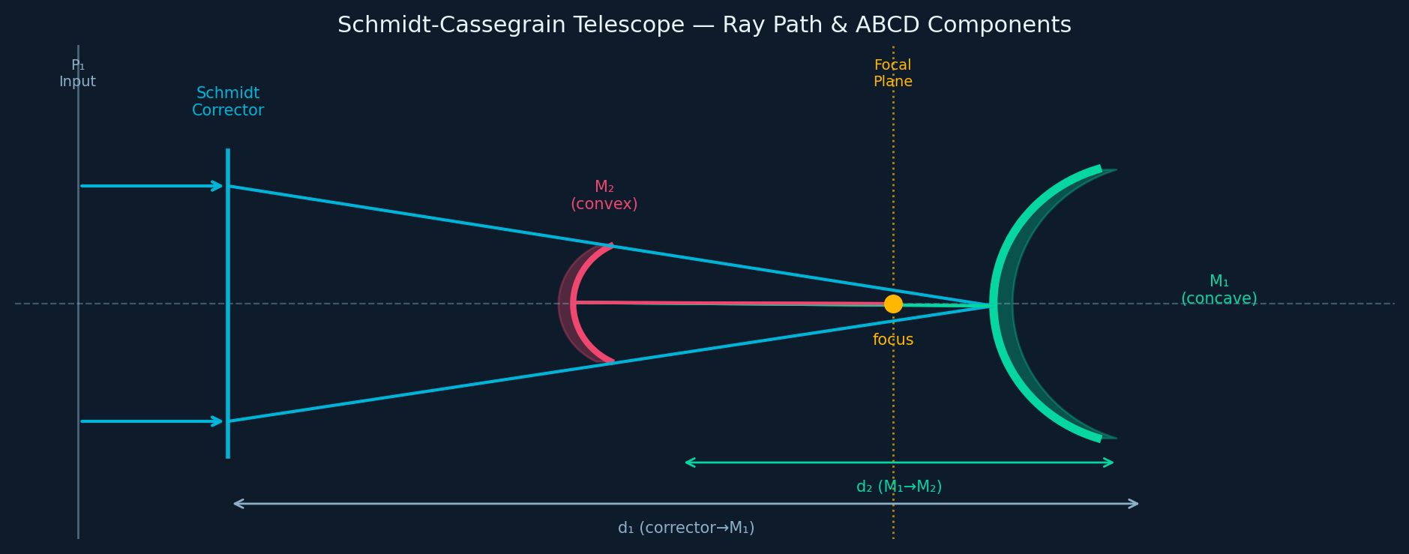
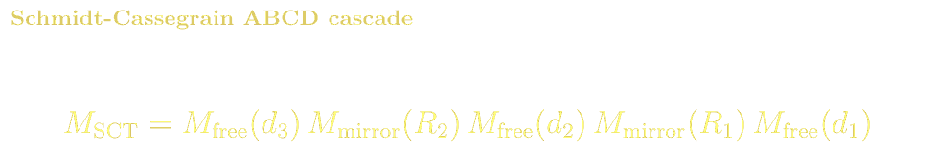
ABCD MATRICES · TELESCOPE
Extended Example: Schmidt-Cassegrain Reflector
The SCT combines a spherical primary mirror (M₁), a Schmidt corrector plate, and a convex secondary mirror (M₂). Beam folded through hole in primary (shown unfolded):
Typical 8" f/10 SCT Parameters
Key Results
R₁ = −1000 mm (primary concave), R₂ = +300 mm (secondary convex)
d₁ = 200 mm, d₂ = 300 mm
EFL ≈ 2000 mm (f/10), FOV ~0.5°
Secondary provides ~5× Cassegrain amplification of EFL
Schmidt corrector removes spherical aberration of primary
Back focal distance = B-element of system matrix
Folded path: compact and mechanically stiff
Used by Meade and Celestron for 8–16" amateur scopes

Slide 12
ABCD MATRICES · REFERENCES
ABCD Matrices: References, Problems & Projects
BSc References & Reading
MSc / Advanced References
Hecht, Optics Ch. 5–6: lenses, mirrors, instruments — ABCD introduced informally.
Saleh & Teich, Fundamentals of Photonics Ch. 1–2: ray optics and matrix methods.
Smith, Modern Optical Engineering (2000): practical lens design with matrix methods.
Pedrotti & Pedrotti, Introduction to Optics: ray-matrix chapter with exercises.
Siegman, Lasers Ch. 15: ABCD matrices and Gaussian beam propagation — definitive.
Gerrard & Burch, Introduction to Matrix Methods in Optics (1975) — Dover. Classic text.
Saleh & Teich Ch. 9: resonators and Gaussian beams via ABCD.
Yariv, Quantum Electronics Ch. 2: resonator stability, matrix approach.
Problem Sets & Projects
[BSc] Compute system matrix for a Galilean telescope (positive + negative lens). Show C=0 and find the angular magnification.
[BSc] A plano-convex BK7 lens (R=50mm, n=1.517, t=8mm) — compute the thick-lens matrix and compare EFL with thin-lens approximation.
[BSc] Derive the stability condition 0≤g₁g₂≤1 for a two-mirror cavity using ABCD matrices.
[MSc] Using ABCD matrices, design a beam expander that expands a 1mm Gaussian beam waist to 10mm with minimum overall length.
[MSc] Model the unfolded cavity of a Nd:YAG laser (R₁=∞, R₂=1m, L=0.5m). Find the intracavity Gaussian beam parameters.
[Project: MSc] Implement a Zemax-like paraxial ray-tracer in Python using ABCD matrices. Simulate a Cassegrain telescope and plot spot diagrams.

