Slide 1
LECTURE 03
Jones Calculus
Polarization Algebra · Jones Vectors · Component Matrices · Superposition
Linear Optics Course · All formulas typeset with LaTeX

Slide 2

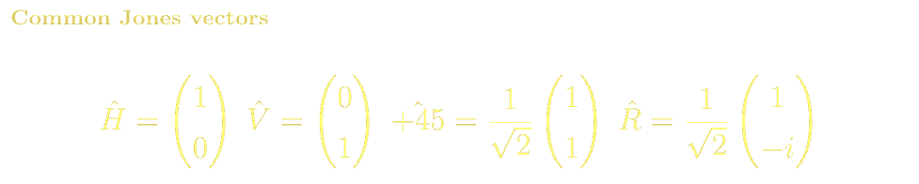
JONES CALCULUS
Jones Vectors: Representing Polarization States
H linear
V linear
+45° linear
[1, 0]ᵀ
[0, 1]ᵀ
[1, 1]ᵀ / √2
RCP
LCP
Elliptical
[1, −i]ᵀ / √2
[1, +i]ᵀ / √2
[cosχ, i sinχ]ᵀ

Slide 3
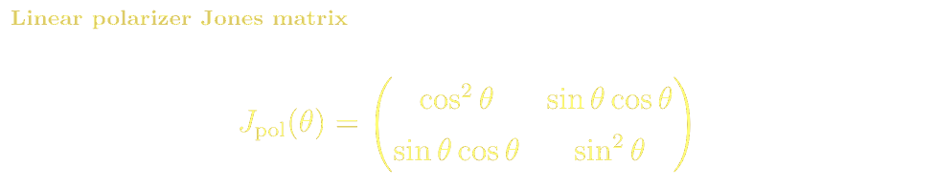
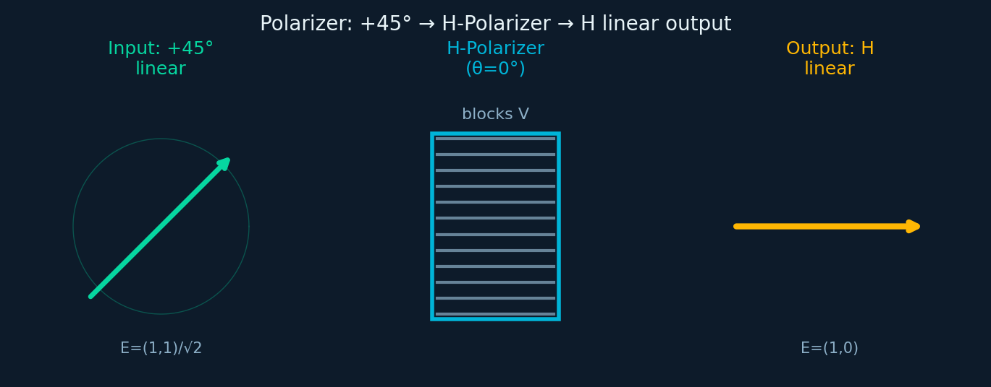

JONES CALCULUS
Jones Matrix: Linear Polarizer
Microscopic Structure & Materials
Sheet polarizers (Polaroid™): PVA film stretched to align polymer chains, doped with iodine chains that absorb the E-component parallel to the stretch direction (dichroism). ER~10³:1.
Wire-grid polarizers: sub-λ Al or Au wires on ZnSe or fused silica substrate. TM transmitted, TE reflected. Used in IR/THz.
Glan-Taylor prism: calcite birefringence (nₑ=1.658, nₒ=1.486) separates polarizations via TIR at the cemented interface. ER>10⁵:1.
Key Properties
Thorlabs LPVIS100 (sheet)
Glan-Taylor calcite (ER>10⁵:1)
IR wire-grid: ZnSe substrate
PBS cube: MacNeille coating
J_H · J_V = 0 (crossed polarizers block each other)
ER = I_max/I_min: sheet ~10³:1, Glan-Taylor >10⁵:1
Acceptance angle, wavelength range, damage threshold are key specs

Slide 4
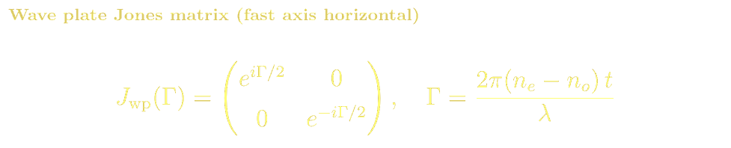
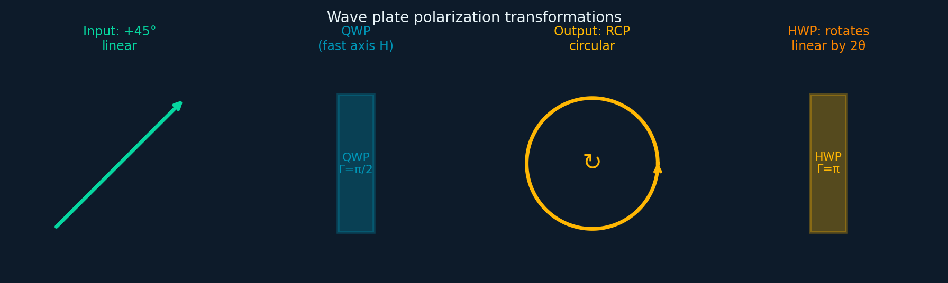

Slide 6
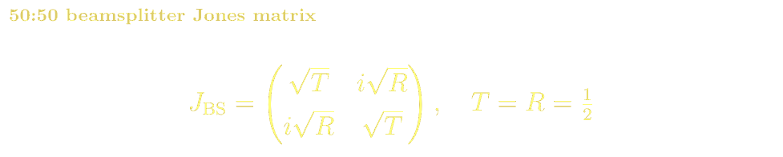
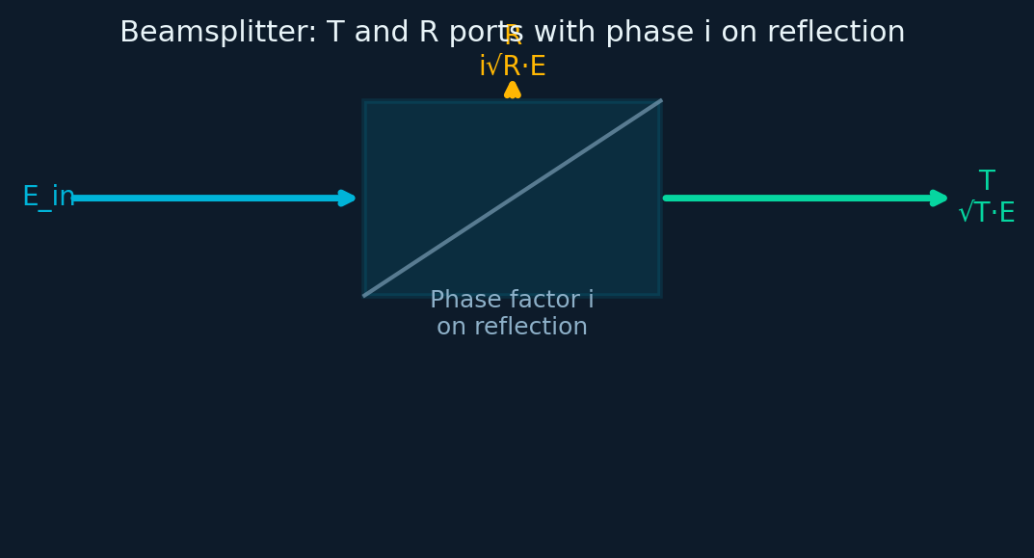
JONES CALCULUS
Jones Matrix: Beamsplitter & Polarizing Beamsplitter
Microscopic Structure & Materials
Cube BS: two right-angle prisms cemented (optical cement n~1.52) with metal-dielectric or all-dielectric coating at hypotenuse, designed for R≈T at 45°.
Plate BS: tilted glass plate — introduces walk-off astigmatism. Simpler but less achromatic.
PBS MacNeille design: multilayer coating on hypotenuse. TIR-based PBS (Glan-Thompson): very high ER.
Materials: BK7 (VIS), fused silica (UV), ZnSe (mid-IR), CaF₂ (broad IR).
PBS matrices & interference condition
J_T = [1,0;0,0] (transmits p-pol / H)
J_R = [0,0;0,1] (reflects s-pol / V)
Interference visibility = 1 only when both beams have same polarization state
50:50 cube: Thorlabs BS010
PBS cube: ER>500:1
Glan-Thompson: TIR-based, high ER
Non-polarizing cube: equal R/T

Slide 7
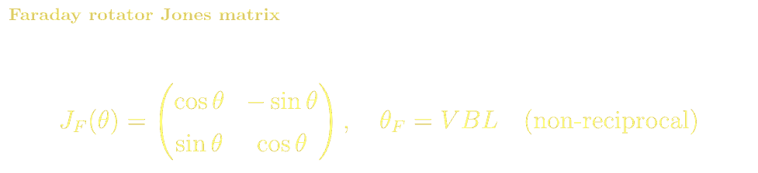
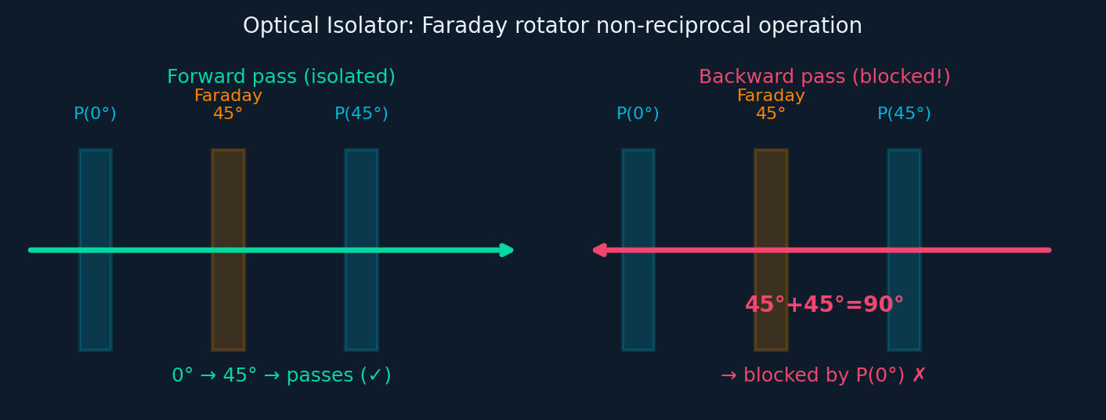
JONES CALCULUS
Jones Matrix: Faraday Rotator & Optical Isolator
Microscopic Structure & Materials
Magneto-optical effect: applied B-field lifts degeneracy of LCP/RCP modes via Zeeman splitting → n₊≠n₋ (circular birefringence). θ_F = (n₋−n₊)πL/λ.
YIG (Y₃Fe₅O₁₂): cubic garnet, Ia3̄d space group. V≈−0.12°/(Oe·cm) at 1064nm.
TGG (Tb₃Ga₅O₁₂): V≈−134 rad/(T·m) at 1064nm. Dominant for high-power lasers.
Bi:YIG thin film: very high Verdet for integrated photonics isolators.
Non-reciprocal: back-propagating light rotates by ADDITIONAL +θ_F (not −θ_F). Breaks time-reversal symmetry.
Optical Isolator (30–60 dB isolation)
P(0°) → Faraday 45° → P(45°) [forward: 0°→45°→pass]
Backward: 45°→45°+45°=90° → blocked by P(0°)
YIG: V≈−0.12°/(Oe·cm)
TGG: V≈−134 rad/(T·m)
Bi:YIG: integrated photonics
Insertion loss: <0.3 dB

Slide 8

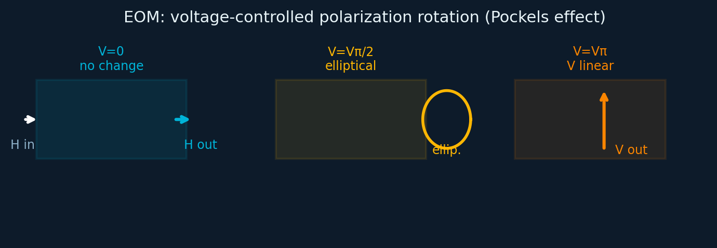
JONES CALCULUS
Jones Matrix: Electro-Optic Modulator (Pockels EOM)
Microscopic Structure & Materials
LiNbO₃: trigonal (R3c), ferroelectric at RT. r₃₃=31 pm/V, Vπ~200–400V for cm-length crystal. Telecom modulator workhorse.
KTP (KTiOPO₄): orthorhombic (Pna2₁). r₃₃=35 pm/V, lower Vπ.
BBO (β-BaB₂O₄): UV range, r₂₂=2.7 pm/V. For UV pulse pickers.
Lithium niobate on insulator (LNOI): Vπ<1V in nanophotonic waveguide, >100GHz bandwidth.
Pockels Effect Fundamentals
χ⁽²⁾ ≠ 0 required (non-centrosymmetric crystal). Applied E-field changes n via Δn = −½n³rE (linear EO / Pockels coefficient r). LiNbO₃: r₃₃≈31 pm/V. AC voltage V(t) modulates polarization state dynamically for RF modulation up to ~40 GHz.
RF EOM: GHz modulation
Q-switch, pulse picker
Mach-Zehnder modulator
LNOI: Vπ<1V, >100GHz BW

Slide 9
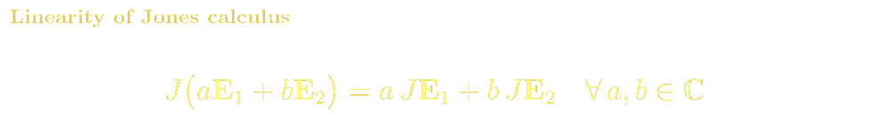
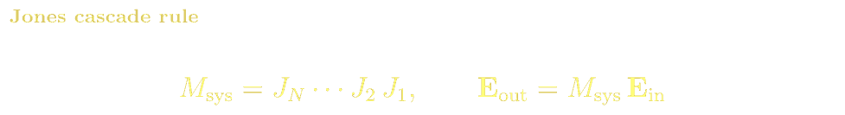
JONES CALCULUS
Linear Superposition & Cascade in Jones Calculus
Jones calculus is a direct application of linear algebra. The linearity of Maxwell's equations means both Jones vectors and matrices obey the superposition principle:
Superposition Examples
Linearity Across Multiple Components
H + V (δ=0): E=[1,1]ᵀ/√2 → +45° linear polarization
H + V (δ=π/2): E=[1,i]ᵀ/√2 → right circular polarization
Any elliptical state is a superposition of H and V basis states
RCP and LCP are a complete circular basis
System J = Jₙ·...·J₂·J₁ — product of all element matrices
J·(aE₁+bE₂) = aJ·E₁ + bJ·E₂ for any complex a,b
Holds through any number of elements: full linearity retained
Consequence: polarization state space is a complex vector space

Slide 10
JONES CALCULUS · REFERENCES
Jones Calculus: References, Problems & Projects
BSc References & Reading
MSc / Advanced References
Hecht, Optics Ch. 8: polarization — intuitive introduction with diagrams.
Pedrotti Ch. 14–16: matrix methods for polarization.
Saleh & Teich Ch. 6: polarization optics and Jones matrices.
Hecht Ch. 9: birefringence, wave plates, polarizing elements.
Yariv & Yeh, Optical Waves in Crystals (1984): definitive Jones/Mueller with crystal physics.
Chipman, Handbook of Optics Vol. II Ch. 22–27: Jones and Mueller — comprehensive.
Collett, Field Guide to Polarization (SPIE 2005): compact graduate reference.
Azzam & Bashara, Ellipsometry and Polarized Light (1977): Mueller/Stokes depth.
Problem Sets & Projects
[BSc] Compute J = J_QWP(45°)·J_HWP(22.5°). Verify it rotates horizontal → vertical polarization.
[BSc] Show a HWP with fast axis at 45° converts RCP to LCP. Use Jones matrix formalism.
[BSc] An isolator: Faraday 45° between two polarizers. Compute forward and backward transmission in dB.
[MSc] Derive the Jones matrix for a Babinet-Soleil compensator; show it generates any polarization state from horizontal input.
[MSc] Compute the Jones matrix for a Lyot filter and plot the transmission spectrum vs. wavelength.
[Project: MSc] Simulate a full Stokes polarimeter (4-state measurement); reconstruct Stokes vector from noisy intensity data.

